Slide 1
Whither Advanced Academic Networking? WITHER Advanced Academic Networking? [Whither == Interrogative: "Where shall we go now?" vs. Wither == Verb: "To lose vitality, force, or freshness..."]
Joe St Sauver, Ph.D. (joe@oregon.uoregon.edu)
Merit Networking Summit 2014
September 23rd, 2014

Slide 2
I. Introduction

Slide 3
An obligatory disclaimer: The opinions and perspective I'm going to share with you today represent my own point of view, and do not necessarily represent the opinion of any other person or organization.

Slide 4
One More Thing To Get Our Right Up Front...
I'm NOT here to bash what the community has worked really hard to build.
Everyone HAS worked really hard, and you've done a great job.
The existing network at the national level (as well as our regional and campus networks) are, collectively, tangible evidence of what the community has been able to accomplish to-date.
But having said that, we MUST talk about where we should be going NEXT.
We can't afford to just sit back and rest on our laurels and coast, and we can't afford to get distracted, either.

Slide 5
Last Year and Today
With that out of the way, let me thank Merit for the invitation to talk with you once again this year.
Last year I talked about "Networking in These Crazy Days," describing some of the security challenges we faced, and urging you to stay calm, get secure, and get involved. (If you're interested, those slides are still available online at http://www.stsauver.com/merit-networking/ )
Many of you have taken those recommendations to heart and that's great. THANK YOU!
Today, however, let's talk about the current state of advanced academic networking, and its future prospects.

Slide 6
Today's Questions
Where's advanced academic networking "at" today? Where will it "go" in the future? Where should it be going?
Is advanced academic networking thriving? Or is it searching for meaning and direction?
How did we get where we are?
What should be the role of Michigan's colleges and universities?
Before we can talk about advanced academic networking, we need to begin by talking about university research.

Slide 7
II. Higher Education and Research

Slide 8
The Classification of Colleges and Universities
There are literally thousands of American colleges and universities, each with its own unique and important role, and each striving to meet the needs of its particular community.
Today, however, we're primarily interested in two (of the many) Carnegie categories: -- The 108 "Research Universities (Very High Research Activity)" [including, in Michigan, the University of Michigan, Michigan State, and Wayne State University, and in Oregon, the University of Oregon and Oregon State University], and -- The 99 "Research Universities (High Research Activity)" [including, in Michigan, Michigan Tech and Western Michigan, and in Oregon, Portland State University]

Slide 9
Research Universities Are The Core of the U.S. Advanced Networking Community
While it goes without saying that Internet2 highly values ALL of its members (whether from higher ed or elsewhere, and whether research focused or not), Internet2 was originally founded by research universities, and research universities are, and should remain, Internet2's "core constituency:"
108 RU/VH schools (100% of the RU/VH category) are currently members of Internet2 (see http://www.internet2.edu/communities-groups/members/higher-education/level_1/all/all )
78 out of 99 RU/H schools (78% of the RU/H category) are also members of Internet2 (see http://www.internet2.edu/communities-groups/members/higher-education/level_2/all/all )

Slide 10
Association of American Universities (AAU)
Other organizations also focus on research universities.
For example, the AAU is an association of "62 leading public and private RESEARCH UNIVERSITIES in the United States and Canada." [emphasis added] In Michigan, AAU universities are the University of Michigan and Michigan State; in Oregon, there's the University of Oregon.
AAU membership is by invitation, and their policy states that "current members whose research and education profile falls significantly below that of other current members or below the criteria for admission of new members will be subject to further review and possible discontinuation of membership."

Slide 11
Common Solutions Group (stonesoup.org)
Another invitational group, CSG has just 29 members, including both the University of Michigan and Michigan State. Stone Soup also has two consortial members, Educause and Internet2.
CSG states, "Intensively networked information technology is uniformly central to the work of major research universities. [...] it is critical to the overall efficiency of research universities that they act collaboratively to influence commercial providers of information technology and, where the market fails to provide appropriate technology, work collaboratively to develop and disseminate common solutions to important IT challenges. Collaborative work of this sort requires open, sophisticated interaction within and across two groups, namely the technical staff of key research universities and the senior IT administrators responsible for strategic direction and resource allocation."

Slide 12
What Do Some Schools Themselves Say?
"With expenditures in excess of $1 billion, research is central to U-M's mission and permeates all 190 schools and colleges..." https://www.umich.edu/research/
"Research, both basic and applied, is fundamental to the mission of the University and is essential to Oregon’s economic and civic vitality." http://research.uoregon.edu/
While research is very important to higher education, research at universities has been dramatically outpaced by research conducted elsewhere...

Slide 13
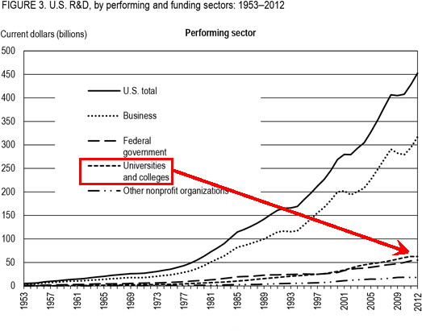
U.S. R&D Expenditures by Sector Over Time: Higher Ed--Just a 13.9% Share as of 2012!
Source: http://www.nsf.gov/statistics/infbrief/nsf14307/

Slide 14
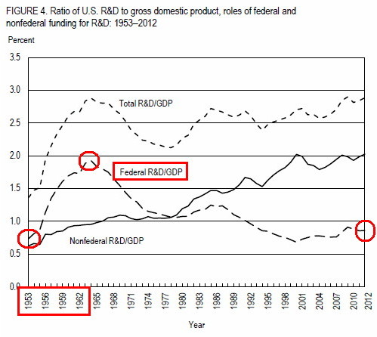
U.S. Federal Expenditures on R&D as a % of GDP: Investments Increased Dramatically From '53-'64
For context, the US spent 3.8% of its GDP in 2013 on military expenditures
Source: http://www.nsf.gov/statistics/infbrief/nsf14307/

Slide 15
Coming Back To R&D Spending...
You've just seen how Federal investments in research and development soared from 1953-1964...
That's now six decades ago.
What the heck was going on then? Answer: the "Cold War."

Slide 16
III. The Cold War "1957 – USSR launches Sputnik into space. In response, the USA creates the Advanced Research Projects Agency (ARPA) with the mission of becoming the leading force in science and new technologies. "1962 – J.C.R. Licklider of MIT proposes the concept of a “Galactic Network.” For the first time ideas about a global network of computers are introduced. J.C.R. Licklider is later chosen to head ARPA's research efforts. "1962 - Paul Baran, a member of the RAND Corporation, determines a way for the Air Force to control bombers and missiles in case of a nuclear event. His results call for a decentralized network comprised of packet switches." "A History of the Internet: Internet Timeline," http://inthistory4u.blogspot.com/2012/06/internet-timeline.html

Slide 17
A Strange Time
The 1950s were a strange time because of world events, but also because of the world's leaders during that period.
The success or failure of a nation (or any organization for that matter) is often the result of its leaders, their priorities, and their ability to execute and accomplish their missions.

Slide 18
American Presidents of the 1950's
There were just two men who lead the United States during the 1950s:
Harry S. Truman (D): Two term president, serving from April 1945 through January 1953 (Truman assumed the presidency when FDR died). Made the decision to use America's new atomic weapons against Japan, ending World War II. Supported creation of the UN, but took a hard line against Soviet expansionism (aka, the "Truman Doctrine"). Rebuilt postwar Europe. Created the DoD, Air Force, CIA and National Security Council.
Dwight D. Eisenhower (R): Two term President, serving from January 1953 through January 1961. Five Star Army General and former Army Chief of Staff under Truman. Supreme Allied Commander Europe from 1949-1952. First supreme commander of NATO. Created the Interstate and Defense Highway System. Originated the "Domino Theory." President of Columbia Univ.

Slide 19
What About The Soviet Leaders of the 1950's?
Joseph Stalin lead the Soviet Union from the mid-1920s until his death in 1953. Stalin is thought to have been responsible for 15-20 million Soviet deaths. He also started the Soviet nuclear program. Many Americans were profoundly frightened of Stalin.
He was followed by Malenkov. Few in the west know Malenkov. [It was during his tenure, in February of 1954, that Crimea was transferred from the Russian SFSR to the Ukrainian SSR]
Nikolai Bulganin became Premier in February 1955, continuing through March of 1958. During the Suez Crisis of 1956, Bulganin threated Britain, France and Israel with nuclear attack.
Nikita Khrushchev (Premier from March 1958-October 1964). Khrushchev was the Russian (after Stalin) who may truly have frightened the West the most, acting belligerently in the UN, fulminating the Berlin Crisis (1958-1961) and then causing the Cuban Missile Crisis in October 1962.

Slide 20
In 1953, Nuclear War Was Perceived As A Very Real Possibility
In 1953, after both the United States and the Soviet Union successfully tested high yield thermonuclear weapons, The Bulletin of the Atomic Scientists set its "Doomsday Clock" to two minutes to midnight, the closest to midnight (e.g., doomsday) that its ever been.
High yield (multi-megaton) thermonuclear weapons were assumed to be the cornerstone of a "total war strategy," targeting major population centers (so-called "counter-value targets").

Slide 21
Nuclear Delivery Technologies of the Early 1950s
Fortunately, early thermonuclear weapons were large and cumbersome, which meant that the only practical way to deliver them against intercontinental targets was via heavy bombers.
Bomber attacks would be slow and relatively easily detected.
This lead authorities to develop complex civil defense programs for evacuating the populations of major American target cities in the hours between the time an attack was detected, and bombs could actually be delivered.
This was also an era when nuclear-tipped surface-to-air anti-aircraft missiles were deployed across many parts of America to help defend major cities against incoming enemy bombers.

Slide 22
A Civil Defense Classic: "A Day Called X"
See also: http://www.atomictheater.com/civildefensefilms.htm

Slide 23
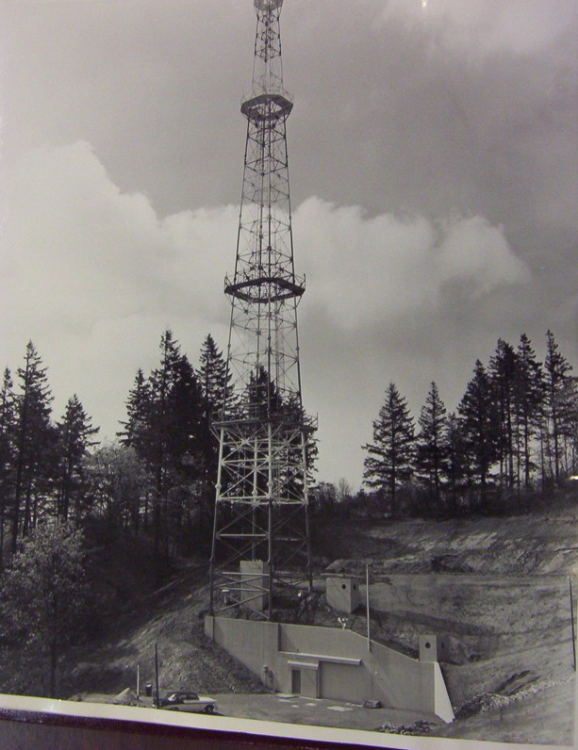
The Site From "A Day Called X", Portland (1957)
18,820 sq ft underground complex; 6.5 miles east of downtown Portland at 2960 SE 103rd Dr, Portland OR 97266
Was to house 250 people for 2 weeks for "continuity of city government"
26 inch thick reinforced concrete roof and a 230 foot reinforced radio tower
Cost $670,000 in 1956 dollars
First of its kind in the United States
Senator Wayne Morse derided these efforts as a pointless hoax.
Portland subsequently quit the Civil Defense program in 1963.
http://kellybutteunderground.blogspot.com/

Slide 24
What About Other Hardened City Government Continuity of Government Centers? As of 1959, "The number [was] small but increasing" and included Detroit, as well as Portland...
Office of Civil and Defense Mobilization, Annual Report 1959, https://training.fema.gov/EMIWeb/edu/docs/HistoricalInterest/ Office%20of%20Civil%20and%20Defense%20Mobilization%20-%2019 59%20-%20Annual%20Rep.pdf

Slide 25
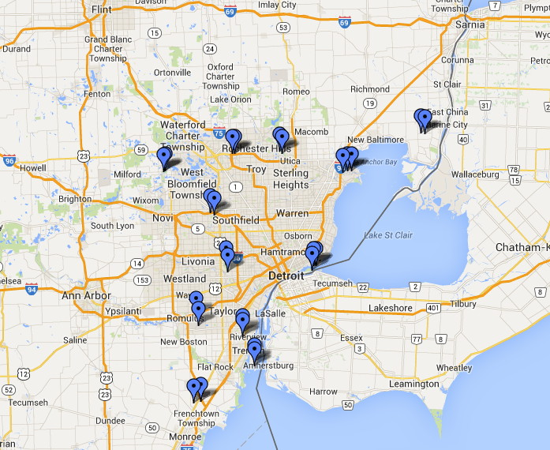
Michigan Also Had Nike Air Defense Sites Which Were to Launch Surface-to-Air 20KT Warheads...
http://en.wikipedia.org/wiki/List_of_Nike_missile_sites

Slide 26
All VERY SCARY, But Mostly VERY SLOW
As long as weapons were coming in via bombers, events moved in human time frames: the military had hours to predict aircraft courses/targets, and citizens had hours to potentially evacuate.
That would change, if/when nuclear weapons were delivered by missiles rather than bombers.
Both sides were working hard on missile technology in the cold war era, it's just that America always assumed it would be the first to demonstrate expertise in ICBM-class technology.
The USSR's Sputnik Project demonstrated that that was a false assumption.

Slide 27
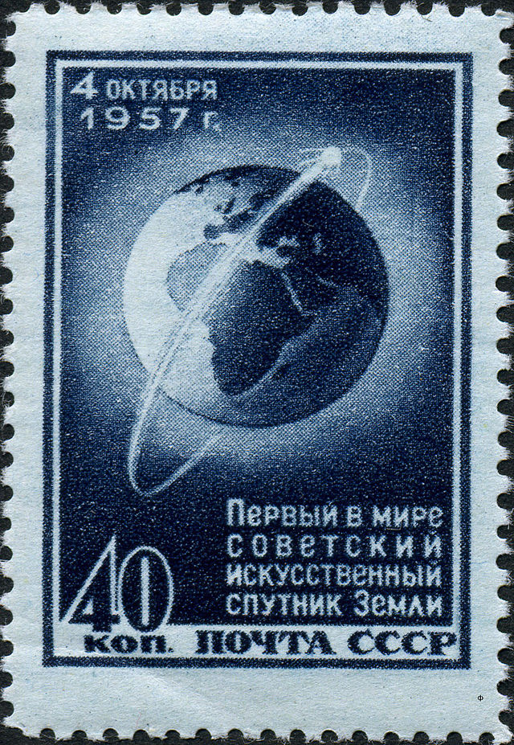
So What Was "Sputnik," Again?
57 years ago, Sputnik ("satellite" in Russian) was the first artificial Earth satellite, launched by the USSR from Baikonur Cosmodrome on Oct 4th, 1957. It orbited the earth for 92 days.
It was a 23 inches metal sphere and had two pairs of external radio antennas. It weighed 184.3 pounds (112 pounds of that weight, 60.7%, was a power supply full of batteries that would last just 22 days)
Sputnik sent a piercing fast "beeping" sound on 20.005 and 40.010 MHz. Want to hear it? You can, if you're curious: http://www.amsat.org/amsat/features/sounds/sputnk1b.wav
NBC radio, in rebroadcasting Sputnik's beeping, said, "Listen now for the sound which forever more separates the old from the new" [quoted in "Red Moon Over the U.S.," Time, Oct 14th, 1957]

Slide 28
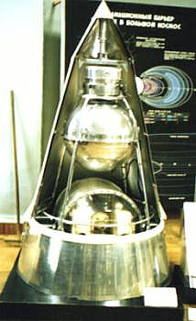
Sputnik 2
If there had only been the first Sputnik, its impact might have been limited. However, less than a month later, on Nov 3rd, 1957, the USSR launched again.
The 2nd Sputnik had a 1,121 pound payload, included a live dog. The payload weight was what was important, however: that was the weight of a nuke.
(BTW, poor Laika was doomed from the time she was launched because the USSR hadn't mastered re-entry as of Nov 1957)
Anyhow, Sputnik 2 was a very big deal.
President Eisenhower responded with a major radio and television address...
http://upload.wikimedia.org/ wikipedia/commons/a/ab/ Sputnik2_vsm.jpg

Slide 29
Eisenhower's Radio & TV Address of Nov 7th, 1957
"My subject tonight is Science in National Security."
R&D for defense was already running over $5 billion a year
Discussed the B-52 jet bomber, and nuclear subs & carriers
Mentioned that we have more and better nukes than the Soviets
Discussed creation of an early warning radar system
"According to my scientific friends [JES: remember, he was formerly president of Columbia University], one of our greatest, and most glaring, deficiencies is the failure of us in this country to give high enough priority to scientific education and to the place of science in our national life."
"They believe that a second critical need is that of giving higher priority, both public and private, to basic research."
Speech transcript linked from: www.eisenhower.archives.gov/research/online_documents/sputnik.html

Slide 30
Some Specific Outcomes, Both Good and Bad
The National Defense Education Act was created, providing scholarships for those studying math and science at universities
Funding for basic research via the NSF dramatically increased
NASA and ARPA were both created in 1958
The 'SAGE' Project was started (more expensive than the Manhattan Project that resulted in the first atomic bombs)
And speaking of nuclear weapons, US and Soviet nuclear weapon counts started ramping up dramatically during this period. If you believe "more nukes=good," I suppose that's great, but if you believe "more nukes are bad," well there you go...

Slide 31
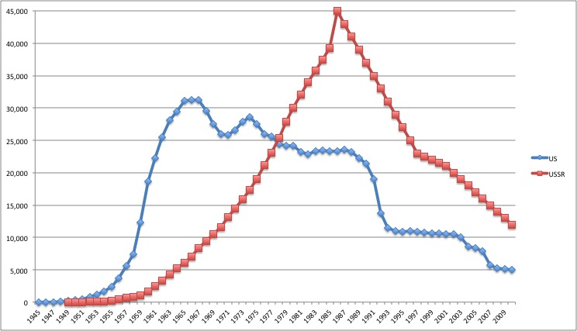
Stockpiles Ramp Up Sharply Beginning in 1957 (U.S. Finally Gets Back to 1957 Levels In 2007)
← USSR peaks in 1986 (Gorbachev and Reagan)
US finally back to 1957 levels in 2007 (Bush and Putin) →
"Global Nuclear Weapon Inventories, 1945-2010," Bulletin of the Atomic Scientists, 4/2010.

Slide 32
The Key Project Many Never Heard Of -- SAGE
"Semi-Automatic Ground Environment:" massive system for US air defense, operating from 1959 through 1979.
Total SAGE costs are unclear, but it was believed to be several times more expensive than the Manhattan Project (the Manhattan Project cost ~$2 billion (1945 dollars); SAGE cost $8-12 billion (1964 dollars), equal to $61.5-92.2 billion today
Noteworthy as one of the first wide area networks, built using Bell 101 (110 baud) modems (the first equipment to use ASCII).
24 of the largest computers ever built, IBM AN/FSQ-7's, each with 60,000 tubes, drawing 3 megawatts, and weighing 250 tons.
The work was lead by MIT Lincoln Laboratory however the University of Michigan had been a strong contender to do the R&D work (see "From Whirlwind to MITRE: The R&D Story of the SAGE Air Defense Computer" at pages 186, 216, etc.)

Slide 33
Michigan State Univ. During That Same Period
Michigan State was lead by Pres. John Hannah from 1941-1969: http://www.archives.msu.edu/collections/presidents_hannah_j.php
Quoting from that page "Hannah's government service included: [...] Assistant Secretary of Defense, 1953–1954; Chairman of the Commission on Civil Rights, 1957–1964; and, Chairman of the United States Section of the Permanent Joint Board on Defense, 1954-1964."
PJBD??? "... formed in 1940 by the Ogdensburg Declaration, to create a body that could consider, in the broad sense, the security and defense of the northern half of the Western Hemisphere." blogs.ottawa.usembassy.gov/ambassador/index.php/tag/permanent-joint-board-on-defense/

Slide 34
Bottom Line on the Cold War Era
The 1950s were a very scary time due to the threat of nuclear war, and the whole country was focused on nuclear defense (including both Michigan and Oregon).
Many massive scientific research and development programs were getting underway, often motivated by defense concerns. These programs often leveraged academic expertise in partnership with industry. This period also saw noteworthy service by key academics in government.
RAND also began research on the survivability of national command and control channels in the face of a nuclear first strike

Slide 35
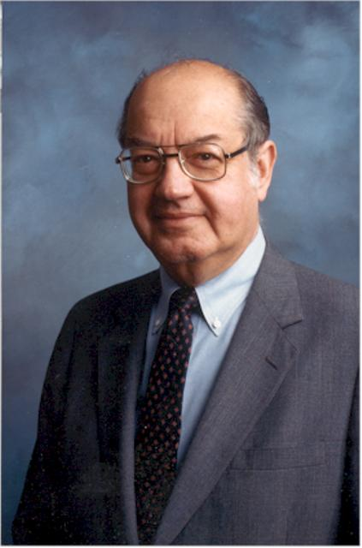
IV: Mr. Paul Baran
Born in 1926 in Grodno, Poland (now Belarus).
Baran's family moved to the US in May, 1928.
BSEE from Drexel (1949)
1949: tech at Eckert-Mauchly Computer Company, working on UNIVAC (the first commercial computer)
MSE (Computers) UCLA (1959)
At RAND from 1959 through 1968
Wrote "On Distributed Communications"
Testified before Congress on computer privacy in 1965 (first computer scientist to do so)
Recommended the divestiture of ARPANET
Founded Metricom in 1986, a wireless company that offered "Ricochet" wireless Internet service (even in Eugene, Oregon!)
Died March 2011 in Palo Alto, at age 84
www.ieeeghn.org/wiki/index.php/Paul_Baran

Slide 36
A Brilliant Cold War Era Scientist: Paul Baran
It was in this apocalyptic cold war environment that Paul Baran, a scientist at RAND, worked on assured/survivable communications.
Baran came up with many of the key concepts that were eventually incorporated into the modern Internet.
Sadly, most people, including many long time Internet engineers, have never heard of Baran, in part because he was a very modest and self-effacing guy. I mention him here in the hope he will be remembered by at least those of you in this room today.
Baran was also far ahead of his time. In particular, some of his ideas were hindered by being potentially economically disruptive.

Slide 37
"On Distributed Communications," August 1964
"This Memorandum briefly reviews the distributed communications network concept and compares it to the hierarchical or more centralized systems. The payoff in terms of survivability for a distributed configuration [...] is demonstrated. "The requirements for a future all-digital-data distributed network which provides common user service for a wide range of users having different requirements is considered. The use of a standard format message block permits building relatively simple switching mechanisms using an adaptive store-and-forward routing policy to handle all forms of digital data [...]" Paul Baran, "On Distributed Communication," Volume 1, http://web.archive.org/web/20110330091634/http://www.rand.org/content/dam/rand/pubs/research_memoranda/2006/RM3420.pdf

Slide 38
The Logic of Positive Control
In the 1950s, military command and control communications happened via AT&T Long Lines or high frequency ("skywave") radio. Both could end up disrupted in the event of nuclear war.
Cut off from national authorities, nuclear base commanders might feel compelled to use their "best judgment" about whether or not to launch a counterstrike. This was NOT viewed as desirable.
The goal for nuclear weapons has always been "positive control:" -- ALWAYS launch IF you receive a properly formatted and authenticated Emergency Action Message (EAM) from the National Command Authority, and -- Equally importantly, NEVER launch if you haven't.
Launch instructions were (and are) apparently surprisingly succinct; see the discussion at http://mt-milcom.blogspot.com/p/what-is-emergency-action-message-or-eam.html

Slide 39
Baran's First Idea: Leverage AM Radio Stations
Baran proposed a point-to-point ground wave communication network between AM broadcast stations for "Minimum Essential Communications" (e.g., nuclear launch orders).
While traditional phone switching centers might have been destroyed and HF radio rendered unusable, many AM radio stations would have continued to work, and AM radio stations were already part of a national emergency warning system. They could easily have served as a path to pass along "go" codes.
This plan was rejected by military authorities.
Given the fully authenticated false alarm of February 20, 1971 ( http://conelrad.blogspot.com/2010/09/code-word-hatefulness-great-ebs-scare.html ) this might have been a very good decision. [for a subsequent failure, see also http://www.csmonitor.com/USA/2011/1109/Did-the-national-Emergency-Alert-System-mistakenly-play-Lady-Gaga ]

Slide 40
Baran's Second Idea
Baran then decided: "As I can't figure out what essential communications [may be] needed, let's take a different tack. I'll give those guys so much damn bandwidth that they wouldn't know what in Hell to do with it all. In other words, I viewed the challenge to be the design of a secure network able send signals over a network being cut up, and yet having the signals delivered with perfectly reliability. And, with more capacity than anything built to date." See www.ieeeghn.org/wiki6/index.php/Oral-History:Paul_Baran
That's what he proceeded to design. Like a good engineer, he also worked out cost estimates. They turned out to be surprisingly low.

Slide 41
Aside: Goring A Cash Cow Is Dangerous
Baran's digital system was estimated to cost roughly $60 million in 1964 dollars.
It could have rapidly replaced the traditional AT&T long distance telecom system in use by the American military, which cost American taxpayers $2 billion/year at the time.
Excellent (but potentially financially disruptive) ideas can sometimes be smothered at birth if they rock the boat too much.
Bottom line: Baran's packet switched network didn't get built (then).

Slide 42
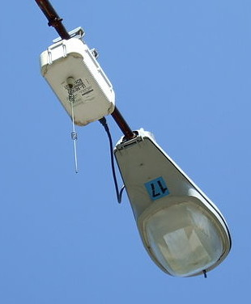
Other Key Points to Note
Military needs (assured communications to direct nuclear war fighting) were the original driver for Baran's work, as well as for early computing projects such as Project SAGE.
Abundant capacity was important (even if exact capacity requirements were unclear); "when in doubt, overbuild."
Reliability (through architectural redundancy) was key.
Business models mattered when Baran's packet switched network ideas were being evaluated (a lesson he rediscovered decades later when building out Metricom's Ricochet service, a pioneering wireless network that serviced Detroit and Eugene in the mid-1990s)

Slide 43
V. "So Can We Finally Get To The ARPANET Era Now?" No. Let's Go Backwards A Bit Further, Instead.

Slide 44
Far Before The Internet, People Still Wanted to Communicate, Share News, and Be Entertained
This was manifest in many diverse projects and technologies: -- Postal mail -- Telegraphy -- Telephony -- Teleprinter/Teletype Networks -- Broadcast Radio
All of these have helped set the stage for the Internet
All have had a mix of academic, government and commercial involvement (the government has always been interested in improving communications, particularly for national defense requirements)
Many have had ups and downs as business cycles go...

Slide 45
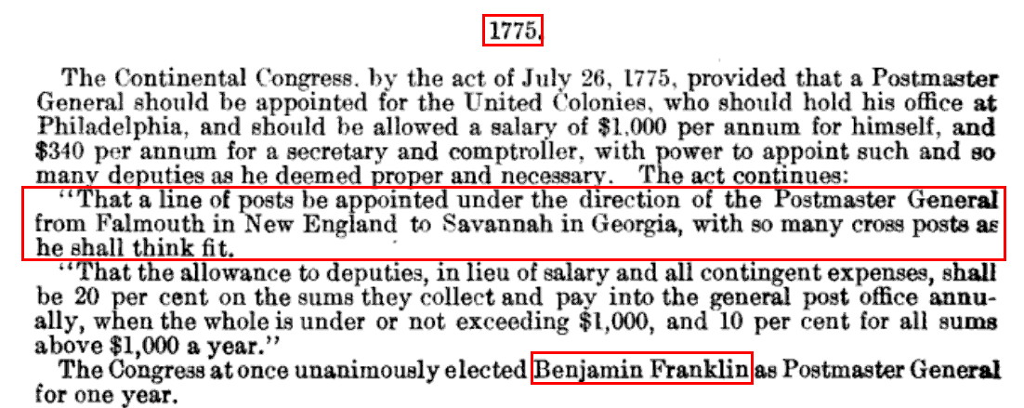
A Postal "Network," Falmouth MA to Savannah GA
Source: "Congressional Serial Set," http://books.google.com/books?id=4rMqAAAAYAAJ&lpg=PA102 (page 102)

Slide 46
A Few Notes About "The Postal Service"...
Postal service in the 1700s bore little resemblance to postal service today.
Sending a letter between two major American cities (such as New York and Philadelphia) might take weeks to go a distance of a little over a hundred miles.
Letters were quite expensive. Ordinary people (who were often illiterate) might send just a single letter a year. (c.f., http://www.postalmuseum.si.edu/letterwriting/lw02.html )
The postal system didn't even use standardized stamps until 1847.

Slide 47
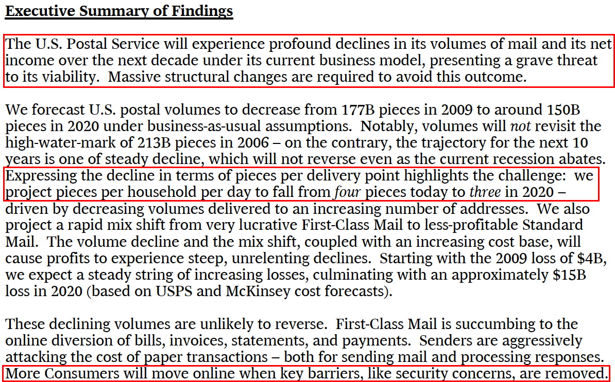
The Postal Service Today: In a Business Death Spiral?
Source: "Projecting U.S. Mail Volumes to 2020," https://about.usps.com/future-postal-service/gcg-narrative.pdf

Slide 48
Telegraphy: The Morse System, 1837-1844
The "Morse System" was patented in the United States by Samuel Morse in 1837. Information was sent as dits (dots) and dahs (dashes), also known as "Morse Code."
In 1844, a message was sent by wire from the Capitol in Washington DC to Mt. Clare Depot in Baltimore, "WHAT HATH GOD WROUGHT" A profoundly insightful rhetorical question. :-)
Morse code was sent by an operator using a key, and received messages were initially recorded via marks on paper tape (later operators found that they could transcribe messages via "ear")

Slide 49
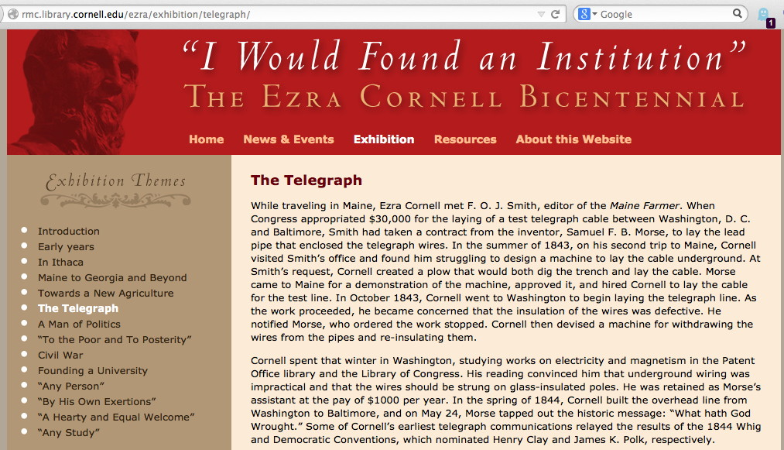
1844: Early Wireline Telegraphy Had Close Ties to Academia... and to the U.S. Federal Government (Ezra Cornell Pulled Cable From DC to Baltimore)

Slide 50
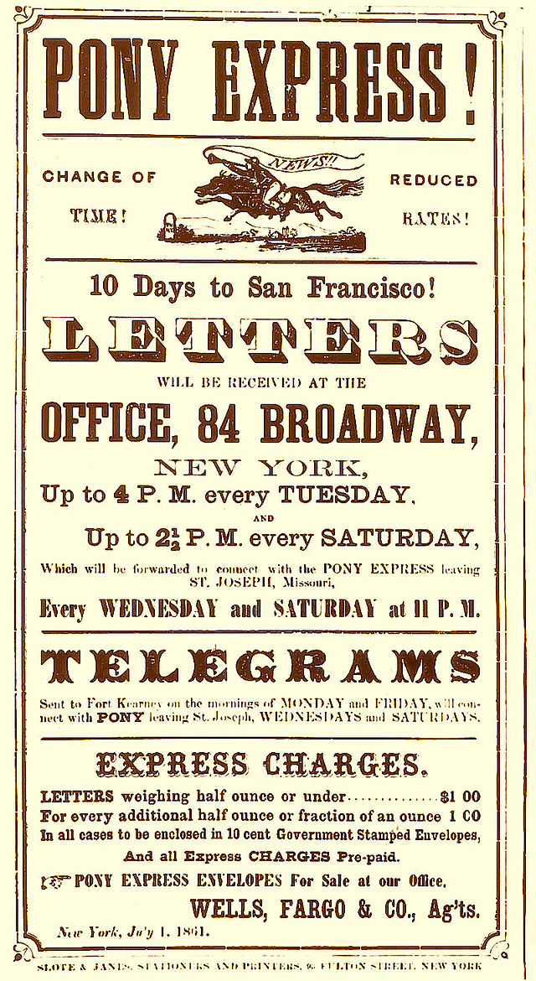
A Brief Diversion: The Pony Express
During just two years (from 1860-1861) the "Pony Express" delivered ~35,000 letters (and managed to lose $200,000)
Why did the Pony Express end in 1861? The wireline telegraph linked the coasts in 1861 The telegraph also proved its value during the American Civil War (1861-1865)

Slide 51
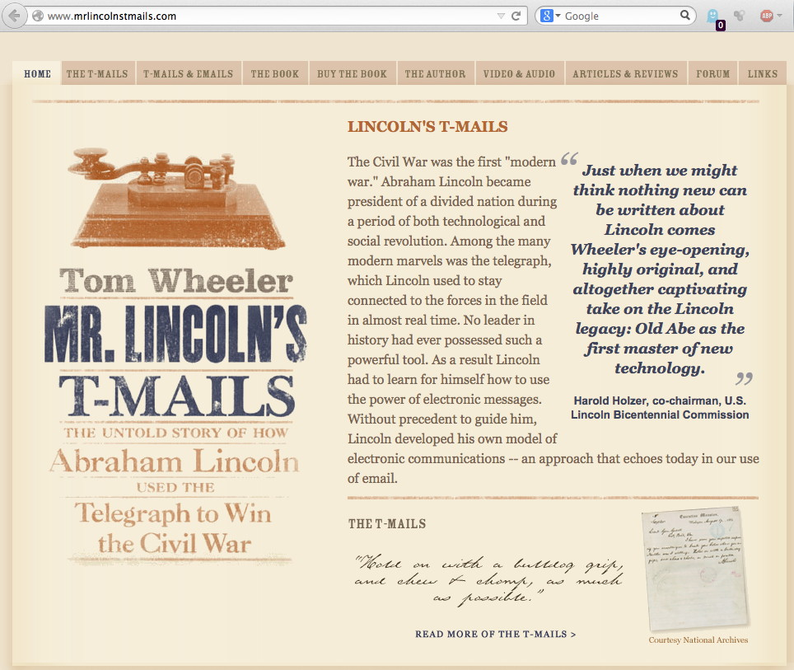
Lincoln and The Telegraph at War

Slide 52
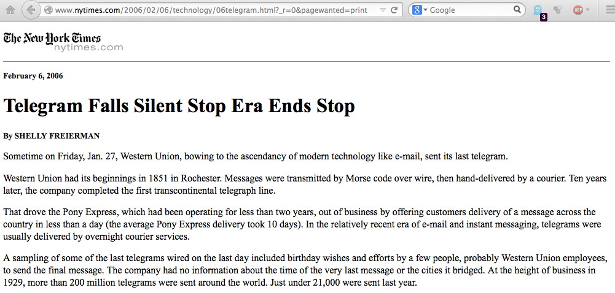
But, The Last U.S. Telegram Was Sent in 2006...

Slide 53
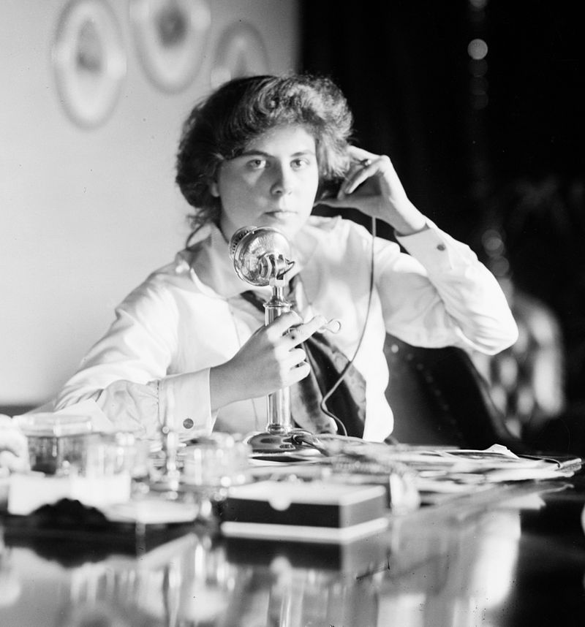
What About Telephony?
http://en.wikipedia.org/wiki/Candlestick_telephone#mediaviewer/ File:Genevieve-Clark-Bain.jpeg (circa 1915)

Slide 54
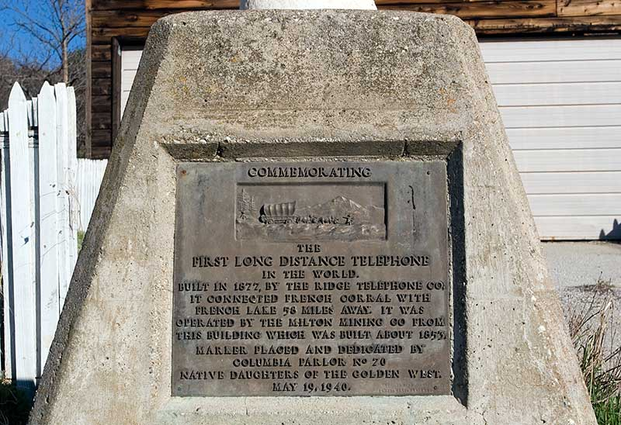
Telephony's First "Long Distance" (60 mile) Line: French Corral to French Lake, California (1877)
Source: http://www.noehill.com/nevada_county_california/images/telephone_plaque.jpg See also: http://malakoffdigginsstatepark.org/?page_id=587

Slide 55
Coast-to-Coast? Less Than A Hundred Years Ago...

Slide 56
First Transoceanic Cables? Just 58 Years Ago!

Slide 57
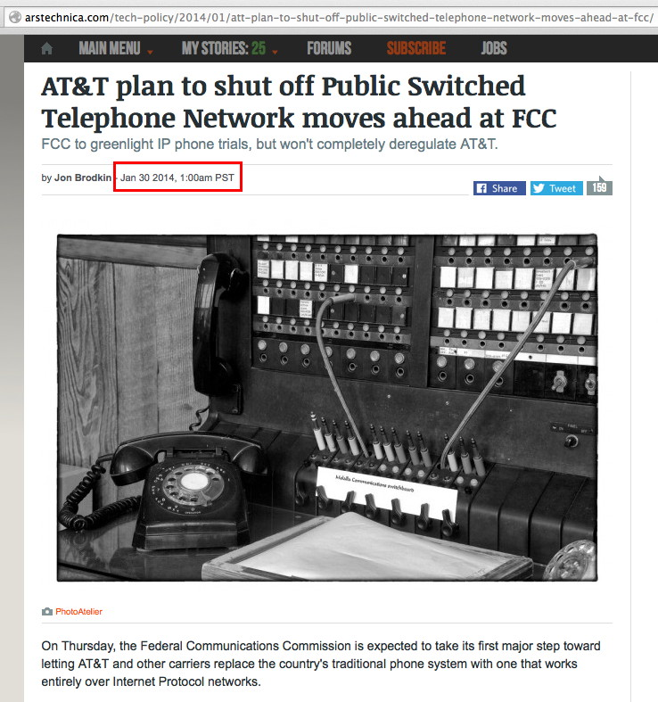
And Now Just This Year...

Slide 58
What About Teletype Networks? UPI's National News Network
Around the same time that telegraphy and telephony were becoming commercially successful, e.g., 1914, during WW I, national news syndicates began to use teletype networks to routinely transmit news around the country, see http://100years.upi.com/history_ms_1911.html
National news stories (and later, even wire photos!) began to be transmitted nationally to subscribing newspapers.
News syndicates weren't the only ones running national scale networks far before the modern Internet, either....

Slide 59
Aviation Weather Was Also Transmitted Via Teletype
"Jul 1, 1928: The Commerce Department began using teletype machines to transmit aviation weather information. Among the first airport stations to receive teletypes were those at Hadley Field, N.J., Cleveland, Ohio, Chicago, Ill., and Concord, Calif. Those units were all connected with the central office at Washington, D.C., from which data were exchanged for all locations. By Oct 1938, the teletype weather communications system had been extended to a total of 21,790 miles, covering all 48 states except Maine, New Hampshire, and South Dakota."
Source: https://www.faa.gov/about/media/b-chron.pdf

Slide 60
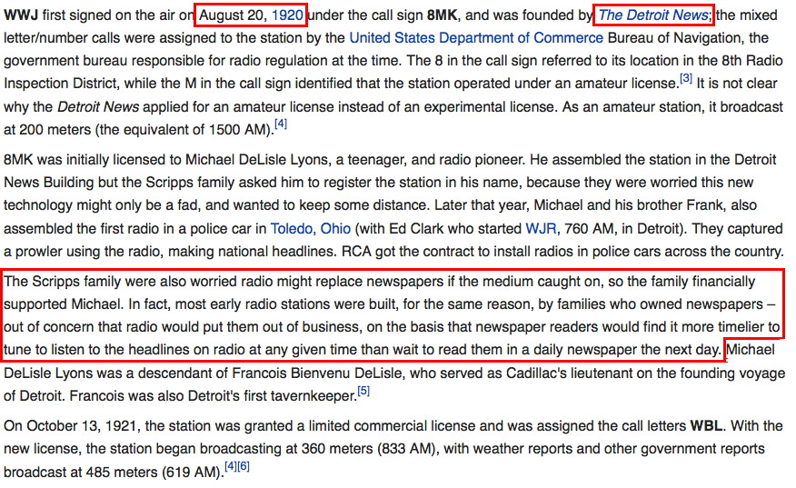
What About Wireless? Early Broadcast Radio
Source: http://en.wikipedia.org/wiki/WWJ_%28AM%29#History

Slide 61
All Of Those Technologies Exhibit Commonalities
They were all about one-to-one messaging (postal service, telegraphy, telephony), or one-to-many messaging (e.g., broadcast radio, news syndicate teletype networks, and weather teletype services, etc.)
All technologies needed to operate over substantial distances
Faster solutions rendered slower solutions obsolete
Cost was always critical
The government was almost always involved in one capacity or another, and quite often so was academia, as well as industry.

Slide 62
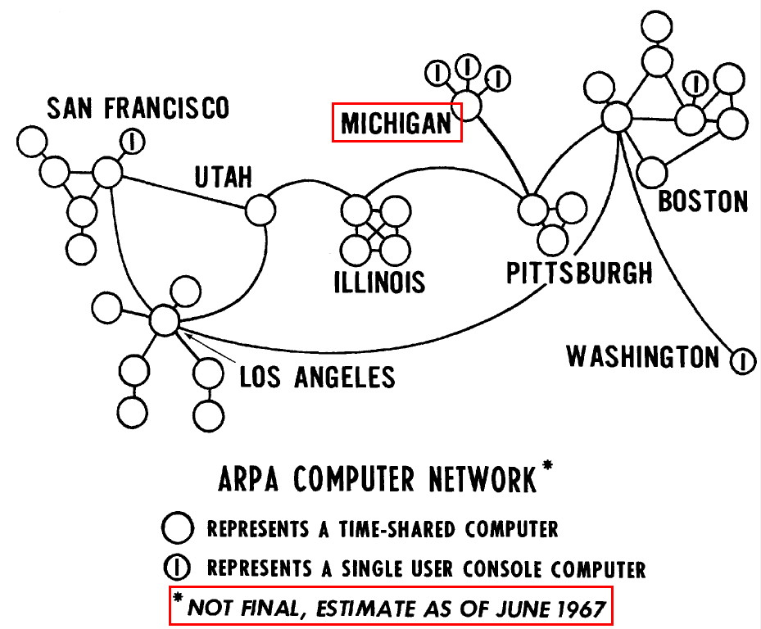
VI. Now We Come to The ARPANET
"Multiple computer networks and interconnection communications,"
Lawrence G. Roberts, http://dl.acm.org/citation.cfm?id=811680

Slide 63
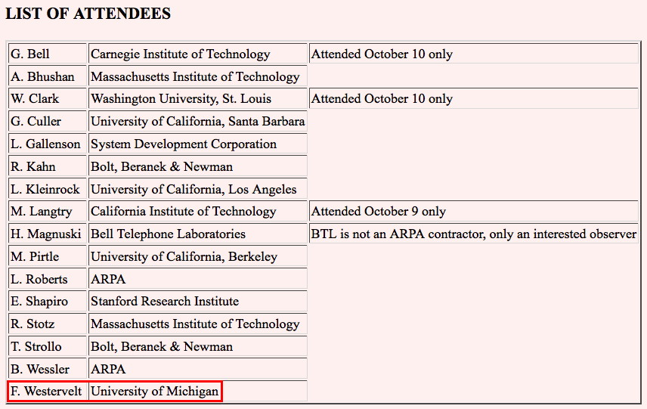
The First ARPANET Meeting at the Pentagon, Oct 9-10, 1967 and UMich Was 1 of The Original 13
http://web.stanford.edu/dept/SUL/library/extra4/sloan/mousesite/Archive/ Post68/ARPANETMeeting1167.html

Slide 64
Same Meeting: Routing and Baran's Work
"3 Routing Procedures "3a It is anticipated that extremely dynamic traffic routing procedures will be employed, implemented by programs in each IMP. In particular a version of the Baran (of RAND) hot potato method may he employed. The notion of the packet (an entity of 1000 bits maximum) was introduced, where a given message could be composed of many packets. The routing mechanism would deal with the packet, thus packets of the same message may traverse different routes from source to destination. The problem now arises of packets of common message arriving at their common destination out of time sequence." http://web.stanford.edu/dept/SUL/library/extra4/sloan/mousesite/Archive/Post68/ARPANETMeeting1167.html

Slide 65
How Was The ARPANET Supposed To Be Used?
"Load Sharing" ("... not a major consideration here")
"Message Service" ("... not an important motivation for a network of scientific computers") [emphasis added]
"Data Sharing" ("This type of use is particularly important to the military for command and control, information retrieval, logistics and war gaming applications.")
"Program Sharing"
"Remote Service" ("this will probably be the most common mode of operation until communication costs come down.")
See "Multiple computer networks and interconnection communications," Lawrence G. Roberts, http://dl.acm.org/citation.cfm?id=811680 [emphasis added]

Slide 66
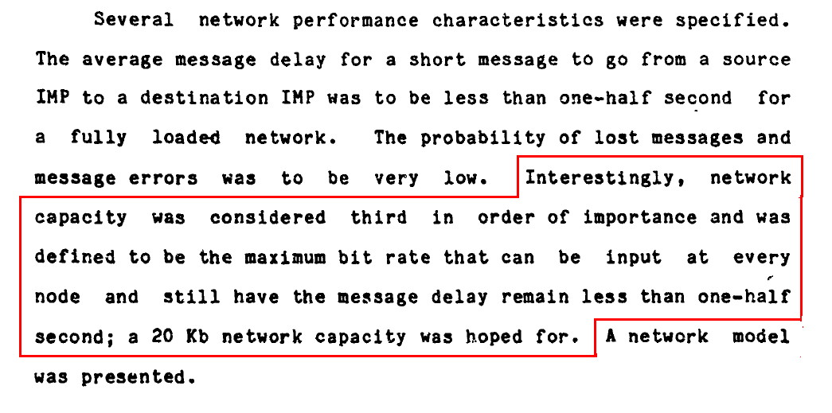
Minimal Latency, NOT BANDWIDTH, Was Thought Key To The Original ARPANET Design...
"A HIstory of the ARPANET: The First Decade," pdf page 64, describing the 1968/69 RFQ http://www.dtic.mil/get-tr-doc/pdf?Location=U2&doc=GetTRDoc.pdf&AD=ADA115440

Slide 67
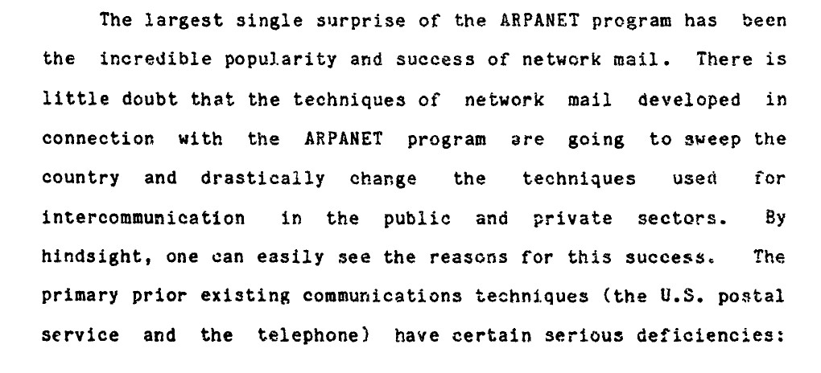
"The Largest Single Surprise of the ARPANET Program"
"A HIstory of the ARPANET: The First Decade," pdf page 152 http://www.dtic.mil/get-tr-doc/pdf?Location=U2&doc=GetTRDoc.pdf&AD=ADA115440

Slide 68
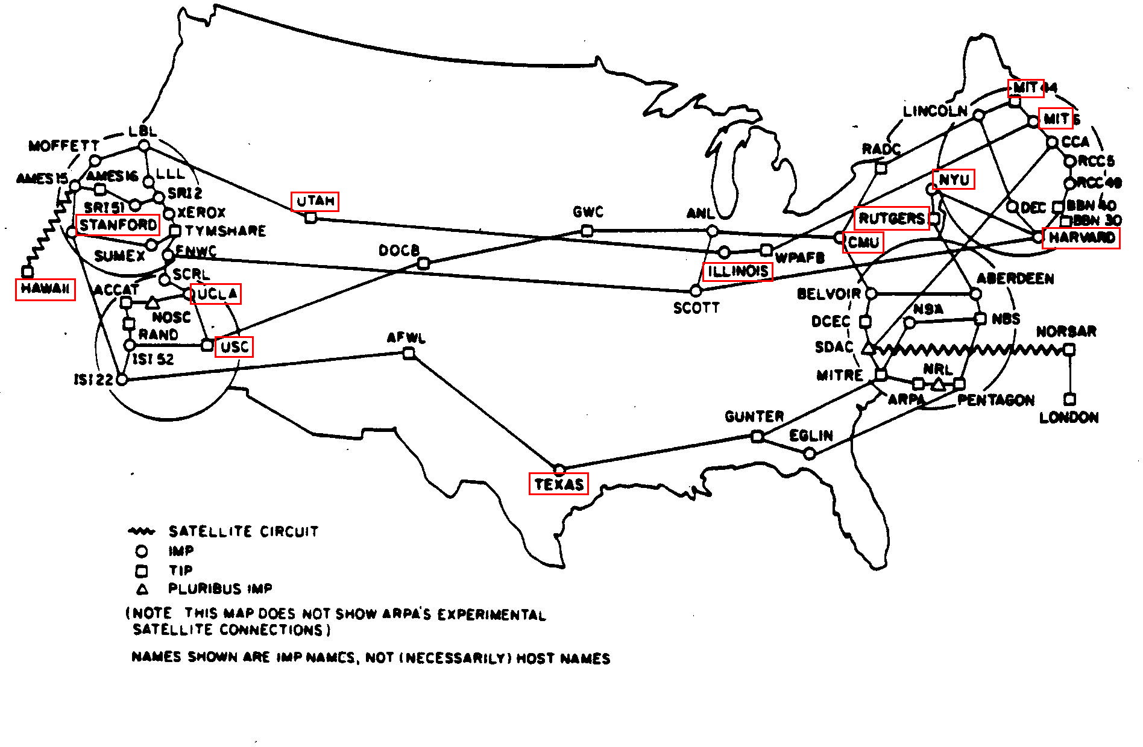
By July 1977, There Were Still Some Academic Sites But Gov/Mil Sites Were Now Numerous....
Source: http://som.csudh.edu/cis/lpress/history/arpamaps/ reportedly scanned from "ARPANET Completion Report," BBN, January 4th, 1978.

Slide 69
The Gov/Mil Guys Wanted A "Little Time Apart"
"In the mid-1980s, NSF decided the time was right to try to link its regional university networks and its supercomputer centers together. This initial effort was called NSFNET. "By 1987, participation in the new NSFNET project grew so rapidly that NSF knew it had to expand the capacity of this new network. In November of that year, it awarded a grant to a consortium of IBM, MCI, and a center at the University of Michigan called Merit to create a network or networks -- or inter-net -- capable of carrying data at speeds up to 56 kilobits a second. By July, 1987, this new system was up and running. The modern Internet was born." http://www.nsf.gov/news/special_reports/nsf-net/textonly/80s.jsp [emphasis added]

Slide 70
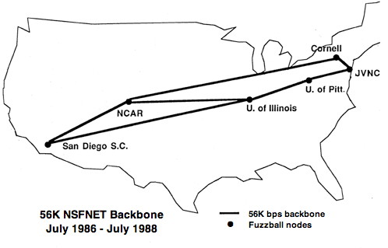
The Six Node 56Kbps NSFNet Backbone Interconnected Supercomputer Sites
Source: http://en.wikipedia.org/wiki/NSFNET#mediaviewer/File:NSFNET-backbone-56K.png

Slide 71
VII. Going Faster As the research and education network community evolved, there has been one relentless drumbeat: "Hey, go faster." Good news? I think we're currently going as fast as we need to go. Success! But if so, now what?

Slide 72
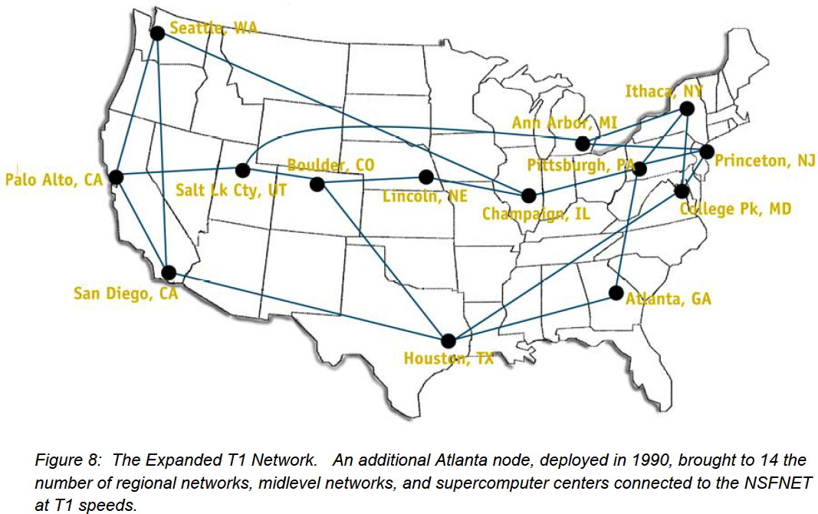
The NSFNET at T1 (1.5Mbps) Speeds (~1990)
Source: https://web.archive.org/web/20111125110726/http://www.merit.edu/networ kresearch/projecthistory/nsfnet/pdf/nsfnet_report.pdf

Slide 73
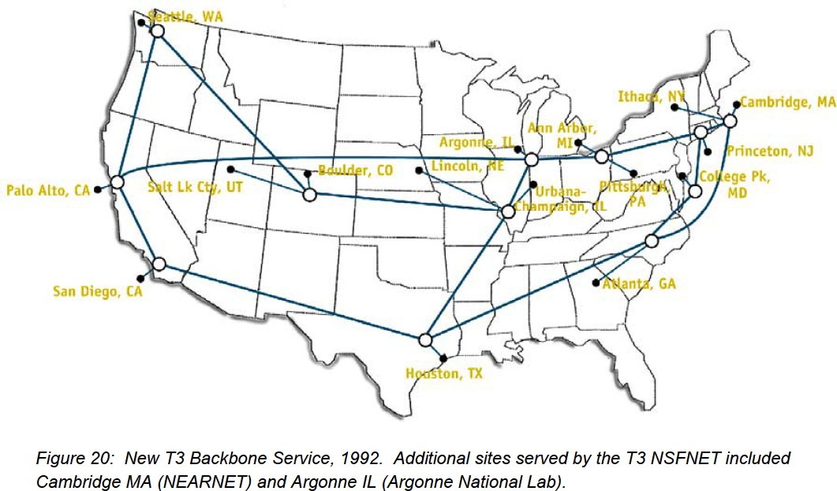
The NSFNET at T3 (45Mbps) Speeds (~1992)
Source: https://web.archive.org/web/20111125110726/http://www.merit.edu/networ kresearch/projecthistory/nsfnet/pdf/nsfnet_report.pdf

Slide 74
Remember the vBNS? May 20th, 1997 (17 Years Ago)
"Twenty-four Internet2 members were among the awardees today as Vice President Gore announced $12.3 million in grants to 35 research institutions across the United States. The National Science Foundation awards will allow them to connect to the very high speed Backbone Network Service (vBNS) and to communicate with other Internet2 members at speeds 10 to 100 times greater than is possible through today's Internet. These grants bring to 44 the number of Internet2 institutions connected to the vBNS." https://web.archive.org/web/19970607044127/ http://www.internet2.edu/html/20_may_1997_nsf_awards.html

Slide 75
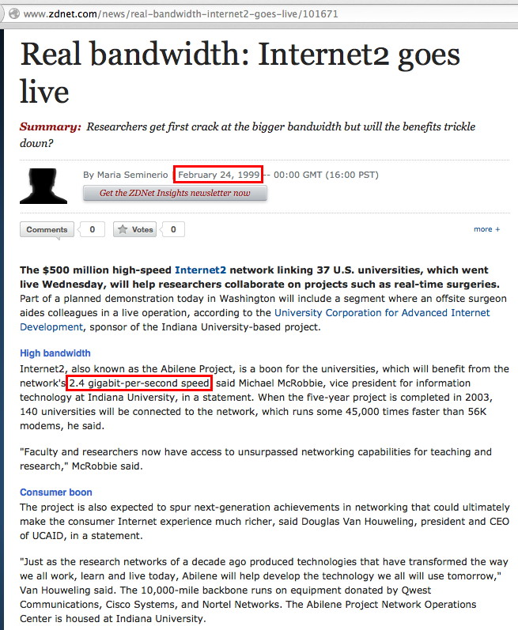
Just Two Years Later, 1999: Internet2 @ 2.4Gbps

Slide 76
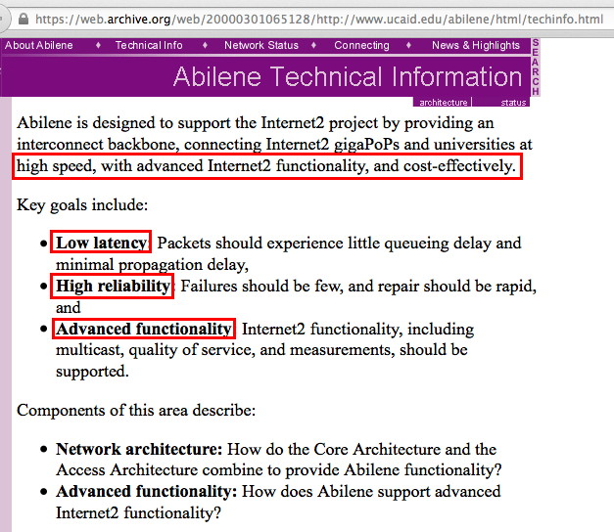
So What Was Internet2 Trying To Do, Again?

Slide 77
Thinking About Those Objectives...
Low latency: check -- just like the original ARPANET objective.
High speed: check -- just like Baran's game plan (if in doubt, give 'em lots of bandwidth)
Highly reliable: check -- another Baran objective.
Cost effective: check -- another Baran theme.

Slide 78
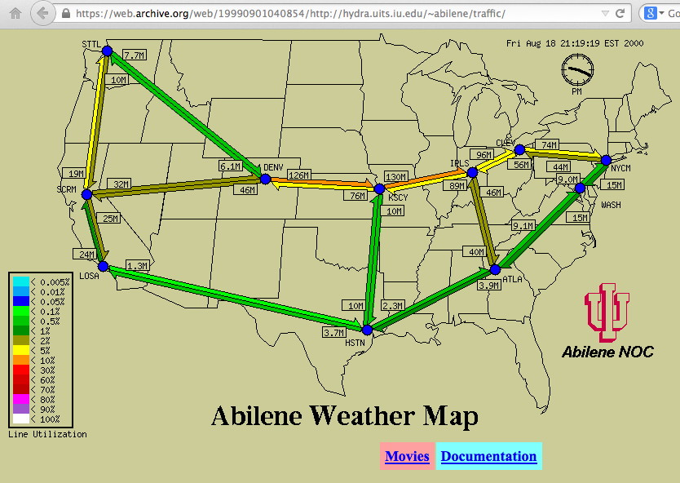
The Shape of Internet2 in August 2000

Slide 79
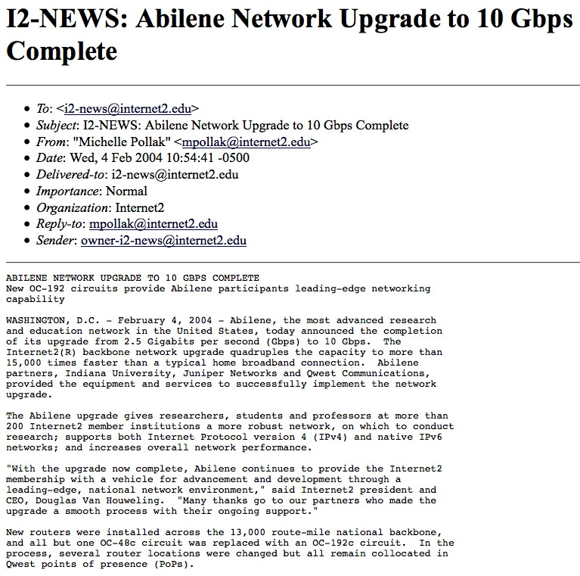
https://web.archive.org/web/20050317090529/ http://archives.internet2.edu/guest/archives/I2-NEWS/log200402/msg00001.html

Slide 80
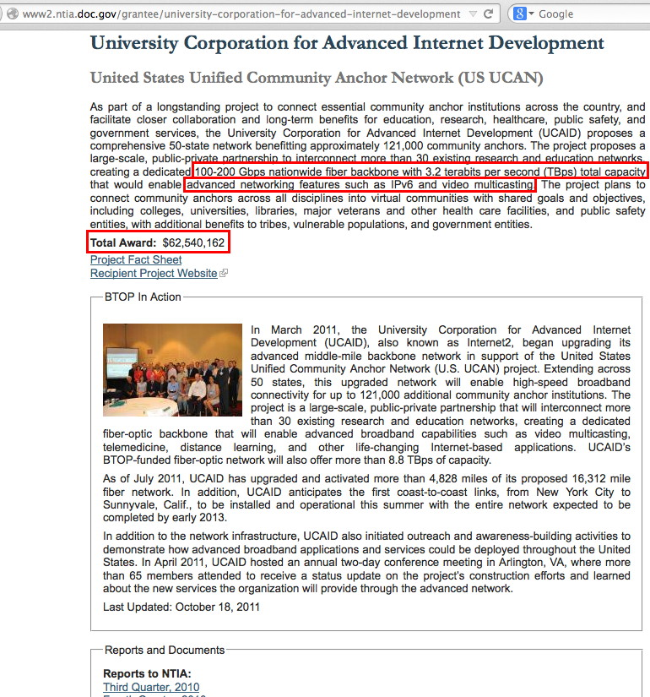

Slide 81
BTW, Nice Summary From Chris From 06/05/12

Slide 82
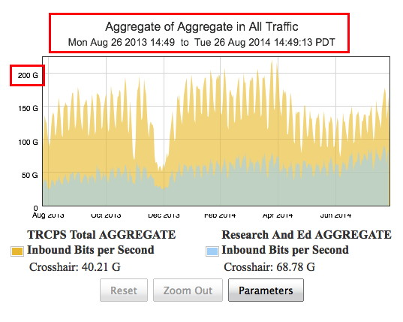
Internet2 Aggregate Traffic Over The Last Year
Source: http://noc.net.internet2.edu/

Slide 83
Thinking About The Preceding Graph A Little...
Interpreting that graph requires a little guidance. It shows the SUM of ALL traffic into to the Internet2 network. The TOTAL input traffic shown there peaked at a little over 200 Gbps. That represents the aggregate of traffic coming from ALL regional optional networks. Individual connectors and individual backbone links will NOT normally see traffic at that level. Individual 100 Gbps links will have plenty of headroom, even when striving to avoid any possibility of congestion/packet loss.
That that graph is the superposition of two datasets: research and education traffic (greyish) and Transit Rail/CPS traffic (goldish).
Commodity Internet peering traffic increasingly dominates community R&E traffic.

Slide 84
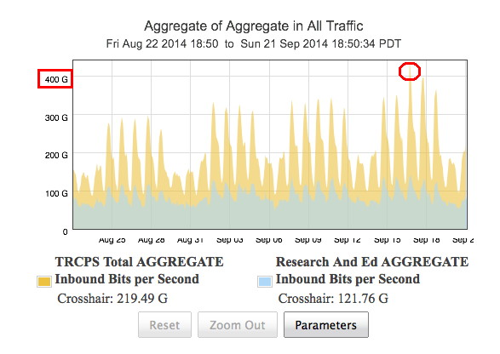
Last Month...

Slide 85
Are We Changing What We Do?
Should our goal be to meet the community's networking needs, whatever those needs may be?
If most of the community's load turns out to now be commodity peering traffic, is that our new reason for being? Are we okay with that?
And if so, is our pricing right? What does 100Gbps peering currently cost, anyhow?

Slide 86
AMS-IX As A Benchmark
If you happen to be a network engineer in Amsterdam, and you want 100Gbps peering,AMS-IX sells a 100GE peering port for EUR 5,000/month (~$6,600/month) plus VAT (see https://ams-ix.net/services-pricing/pricing ). Doing the math: -- $6,660/month*12 months=$79,200/year -- Going the other direction, $6,600/100,000Mbps= $0.066 per Mbps/month. That's pretty cheap.
For comparison, from Internet2: -- A 100GE Advanced Layer 3 port costs a higher education member $200,000/year, or $16,666.67/month (>2.5X AMS-IX) -- A 100GE Advanced Layer 2 port from Internet2 costs a higher ed member $165,000/year, or $13,750/month (>2X AMS-IX)
Is there anything cheaper still?

Slide 87
Multi-TB Drives Shipped Via FedEx?
If you're just transferring bulk data, and you don't need interactivity, "Never underestimate the bandwidth of a station wagon full of tapes hurtling down the highway," as Andrew S. Tanenbaum famously said – or now, the bandwidth of 6TB drives via an overnight shipper such as FedEx.
Any average researcher can now buy a brand new 6 terabyte USB external drive for $300 and promptly load it at up to 5Gbps via a USB 3.0 port, no special network "hoop jumping" skill required.
If they need to share that drive with a colleague on the other coast, they can get it there via FedEx Overnight for less than a hundred bucks, or if they're not pushed for time, they can get it there in two days for half that price. That's pretty cost effective.
I'm not sure I want to engage in that economic (or throughput!) "race."

Slide 88
So How's Internet2 Different From the Regular Commodity Internet, Again?
At one point, our key differentiator was speed. We were faster than what you could get from the commodity Internet. But as you can see from the AMS-IX pricing, they're doing 100GE these days, too.
Being fast, in and by itself, is just no longer enough to set us apart from the "regular Internet."
That's okay, we also strived to deliver advanced protocols.

Slide 89
IP Multicast, IPv6, QoS...
Historically the community has also put heavy emphasis on our support for advanced protocols, such as IP multicast, IPv6, or QoS.
We now know that the world has looked at IP multicast and shrugged its shoulders: IP multicast is dead, Jim. It was a technically elegant protocol, and one that many of us loved, but Netflix, Hulu and Youtube have won. It's time to stop flogging it.
IPv6 is doing somewhat better, but uptake in commercial ISPs (such as Comcast) now challenges uptake in higher education. If a person's grandparents can get IPv6 from their cable Internet provider, does that really still qualify as something "exotic" or "cool" that we can still brag about? I don't think so.
And when it comes to QoS...

Slide 90
QoS, Another Fallen Advanced Network Service
"Between May 1998 and October 2001, Internet2 worked to specify and deploy the QBone Premium Service (QPS) [QBone], an interdomain virtual leased-line IP service built on diff-serv [RFC2475] forwarding primitives and hereafter referred to simply as "Premium". Despite considerable effort and success with proof-of-concept demonstrations, this effort yielded no operational deployments and has been suspended indefinitely. [...]
"The costs of Premium are too high relative to the perceived benefits. Moreover, even if successfully deployed, Premium fundamentally changes the Internet architecture, running contrary to the end-to-end design principle, and threatening the future scalability and flexibility of the Internet." "Why Premium IP Service Has Not Deployed (and Probably Never Will)," https://web.archive.org/web/20081203141945/http://qos.internet2.edu/wg/documents-informational/20020503-premium-problems-non-architectural.txt

Slide 91
VIII. So What SHOULD We Be Working On These Days, Eh?

Slide 92
The Community Really Needs To Do Some Planning
If you're going to get where you need to go when it comes to advanced academic networking, you need a plan.
Internet2 went through a strategic planning exercise once before, in 2008, see https://wiki.internet2.edu/confluence/display/I2SP/2008+INTERNET2+STRATEGIC+PLANNING , but that plan's now woefully out of date.
Without a current plan, how will we all be able to get where we need to go?
Answer: we won't. We'll end up lost, perhaps with priorities that have subtly shifted to areas that are important to some, but which aren't consistent with a primary focus on RESEARCH.

Slide 93
We Need To Re-Engage With Academic Researchers, And With Campus Technical Networking Leaders
Of late, there has been much effort to better connect with university Chief Information Officers (CIOs), and that's great. Our CIOs lead production IT in our schools, and they write the checks that we keep our network infrastructure operating. They need to be "on-board." However, CIOs tend to worry primarily about "CIO stuff."
As a result, there's a risk of misalignment: what CIOs want or thinks their school needs may not be what faculty researchers want or need, or what technical networking leaders see as critical steps in preparation for meeting the community's network needs.
We need renewed national dialog with our research faculty members (and senior academic staff, such as our Provosts and VPs for Research), AND with our technical networking staff.

Slide 94
Let's Never Forget Why We're Here: Research!
At one time, research computing needs dominated campus network planning. Hosts connected directly to the network, rather than living behind firewalls (or other throughput-limiting and protocol-constraining middleboxes). Sensitive administrative hosts were the exception, and they were handled by putting *them* in a specially protected network enclave.
These days, things have gotten "all turned around." These days, administrative computing security requirements dictate the default network posture for everyone, including most campus researchers, and that means that most people are behind a firewall by default. It is only the rare uber-high performance research host that is allowed to be "daring," and live outside the campus firewall in a specially plumbed "Science DMZ." This is crazy – we're letting the administrative tail wag the research dog. Research needs should drive university network architectures.

Slide 95
The Rising Tide That Lifts All Boats vs. Specialized Solutions For "Unusual" Needs
Treating high performance networking as a "special case" scenario has many implications, but one of the most important ones is that the effort (and money!) that a site puts into delivering high performance network doesn't help everyone on campus -- it only helps the few researchers who may be lucky enough to have hosts living in the campus "Science DMZ."
While I know that every campus has a few research stars who have the budgets (and clout!) to get whatever they want, I guess I'm enough of a populist that I'd like to see network investments help all members of the university community, if only because I have a hard time guessing in advance who will turn out to be the NEXT research star, and building capacity accordingly.
Fix the general case, don't micro-optimize just the "exceptions."

Slide 96
Network Confidentiality with IPsec
Recent revelations about pervasive network monitoring by Edward Snowden have made it clear that we can no longer assume that international (or even domestic) network traffic will be immune from interception (if we ever could)
Moreover, trust in even application layer crypto has been severely undercut by discovery of implementation flaw-after- implementation flaw in widely deployed cryptographic libraries. (wasn't "Heartbleed" just a ton of fun?)
We need a layered cryptographic approach for redundancy, and to regain practical network confidentiality.
Specifically, we've never seen substantial deployment of IPsec (see relevant RFCs at http://en.wikipedia.org/wiki/IPsec ). The time has come for that to change. It is time for the community to work on getting IPsec broadly deployed.

Slide 97
Success in Deploying Opportunistic Encryption
As we think about deploying IPsec as a community, I want to highlight the fact that we've actually seen commercial success when it comes to deploying another type of encryption, namely opportunistic encryption of email traffic from mail server to mail server, at least here in the US. See https://www.google.com/transparencyreport/saferemail/
Is your campus mail server protecting MTA-to-MTA flows?

Slide 98
The Challenge of Traffic Analysis
Even if application traffic is fully encrypted, simply knowing that two particular parties are communicating can tell a analyst a lot. For example, if a person living under a repressive regime is seen sending an encrypted email to a human rights organization, even if there's no way to tell what's being said in that email, the mere fact that there's any communication may still send up a red flag.
Similarly, knowing WHEN someone's communicating, or how extensively they're communication, or how a sequence of communications occurred can all tell a trained analyst a lot, even if the body of the communications is totally encrypted.
This is another area where we need to work as a community -- we need to ensure that we have trustworthy solutions that will effectively resist traffic analytic approaches. This is a potentially a very difficult goal to try to satisfy.

Slide 99
Surprisingly, Paul Baran Anticipated This, Too...
"The proposed network is a universal high-secrecy system, made up of a hierarchy of less-secure sub-systems. It is proposed that the network intentionally treat all inputs as if they are classified, in order to raise the intercept price to the enemy to a value so high that interception would not be worthy his effort. Of course, that extra layer of conventional cryptography would be maintained for use in those extremely sensitive cases where the proposed approach might seem risky. "Thus, fullest advantage is taken of the mechanism within the proposed system that takes a channel or a message and chops it into small pieces (like a fruit salad), transmitting it on a series of message blocks, each using a different path. Additionally, much unclassified material is purposely transmitted cryptographically, and perhaps even a light dose of obsolete traffic is mixed in. Given a big enough bowl, it becomes very difficult to separate the garbage from the salad." [emphasis in original] "On Distributed Communications: IX. Security, Secrecy and Tamper-Free Considerations," http://web.archive.org/web/20111004164807/http://www.rand.org/content/dam/rand/pubs/research_memoranda/2006/RM3765.pdf

Slide 100
Securing Wide Area Routing
Another area that has seen woefully little progress to-date has been the area of securing BGP.
This is an area that the FCC Communications Security, Interoperability and Reliability Council has recently been concerned about, and one that we should also be concerned about -- and working to address as a community -- too.
You can read a one page outline of the issue here: http://pages.uoregon.edu/joe/csric4-wg6/bgp-routing-security-outline.pdf

Slide 101
The 10,000 Mile Problem (International Networking)
If you're fortunate enough to be a researcher in the United States or Canada, or the European Union, or one of the advanced countries in the Far East such as Japan or South Korea, you've typically got pretty good connectivity. Give thanks for your good fortune!
When it comes to much of the rest world, connectivity is still all-too-often expensive and limited.
Should we (those of us who are fortunate to have so much), voluntarily help our less fortunate colleagues with their hugely expensive transoceanic connections? The United States and the EU have already done some of that sort of thing, but pragmatically, have we done enough?

Slide 102
Why Should Developed Nations (Like the US) Pay To Improve Connectivity to Developing Nations?
Millions of new Internet users are coming online from developing nations every month. Many of those users are using insecure systems that aren't patched up-to-date, and as a result we're seeing spam and other unwanted traffic from them.
Why aren't those systems secure?
Users in some of these regions may be using older systems that run old and no-longer-supported software, or they may be using pirated software.
Most times, however, users may have poor connectivity, so it takes too long to download updates over the network.
The FCC worries about trivial levels of infected hosts in U.S. service provider networks, but that's crazy when there are countries where botnets are endemic – and those systems are targeting the United States. Focus on the low hanging/worst problems first!

Slide 103
% of Infected Internet Users, Selected Countries
#1 Cypress 15.73% #2 Dominica 6.36% #3 Gabon 6.08% #11 Iran 2.23% #12 Vietnam 2.11% #40 Russia 0.87% #63 India 0.58% #98 Brazil 0.38% #132 China 0.20% #138 US 0.16% #141 UK 0.16% #146 Japan 0.15% #154 Canada 0.12% #171 Netherlands 0.08%
cbl.abuseat.org/countrypercapita.html
So where's the REAL
problem with
insecure (botted)
systems? Is it the US? Or is it elsewhere?
Should we obsess about fixing tiny
residual issues at
home, or should we
get our priorities
straight and focus
on helping countries
overseas that are totally overrun?

Slide 104
Finally, The "Five-to-Ten Millimeter" Problem
Everyone tells me "Joe! The future is all about mobile devices."
Today's smart phones -- things like the new iPhone 6, or the Galaxy S5 -- sure are terrific, aren't they? Everybody probably loves them -- except, I guess, me. I have multiple problems with mobile devices, but let me just talk about one of them, what we might call the "five-to- ten millimeter problem."
That's the typical thickness of the human skull bone, the obvious physical barrier between mobile devices and the brain. As a result:
I still get output from smart phones via my worn-out eyes and ears, and
I still (try) to enter text by typing with my too-large fingers or by using my voice ("Siri, why are smart phones still so damn primitive?")
I don't want a 1920's interface solution for my 2014 devices!

Slide 105
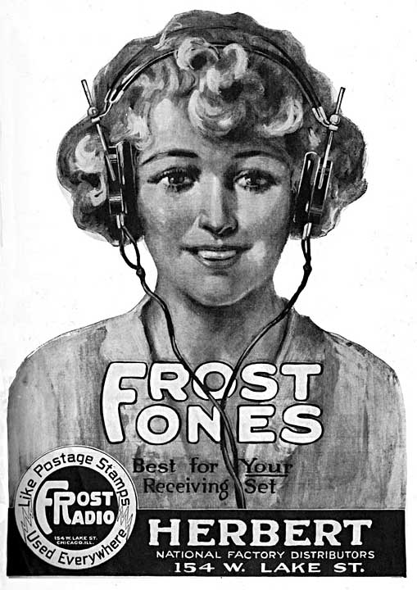
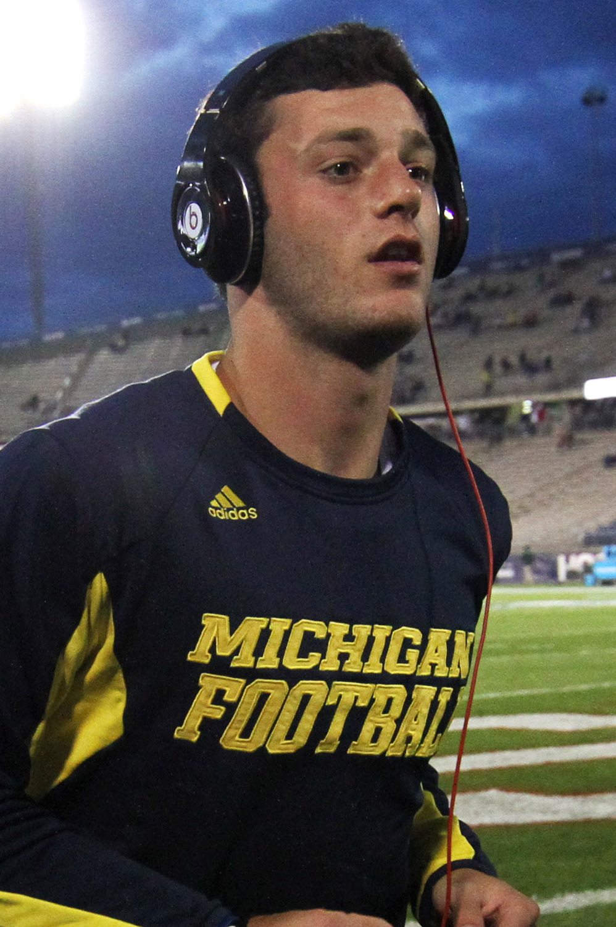
Connecting to Your Personal Communications/ Entertainment System in The 1920s... and Today
Right image source: http://upload.wikimedia.org/wikipedia/commons/e/e3/ Shane_Morris_September_2013_%28cropped%29.jpg

Slide 106
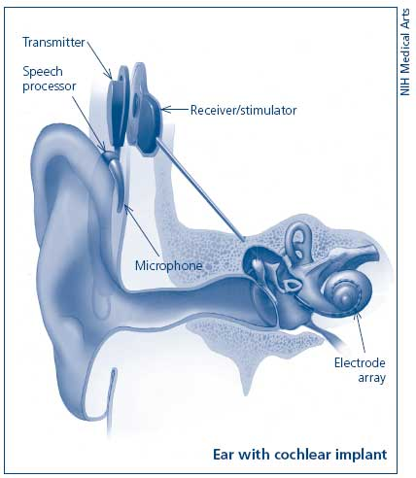
A Medical Example of Man-Machine Coupling
360 million people worldwide have disabling hearing loss (that amounts to over 5% of the world's population)
Notwithstanding the substantial cost (averaging $60,000 per ear), at least 300,000 people worldwide (0.083% of those who might be helped) now have a cochlear implant.
Even production of simple hearing aids is just at less than 10% of the level needed to meet worldwide demand. [Thus many who are deaf or hard of hearing rely on sign language, send text msgs, etc.]

Slide 107
Thinking About Man-Machine Interconnections
First of all, let me be clear that I'm not suggesting that the hearing get cochlearized! THAT's not my point. I merely raise that as one example of a current effort to directly couple users & processors.
Many issues remain, including the fact that we don't know how to do link systems and brains for all relevant senses on a routine basis. The insides of our own heads? Still largely terra incognita.
Costs are still prohibitive, and will likely continue to be so.
There are potentially profound security issues (I don't know if I want to have a direct connection into my head to get hacked).
Typical mobile device life cycles run around two years. Unless upgrades can be constrained purely to external components, I don't think you want invasive surgery on a two year schedule. :-;
And yet, shouldn't we be pushing the frontier somewhere? If not here, where?

Slide 108
One Last Historical Note...
Remember Licklider, mentioned on slide 16 of this talk? I like to think that he'd particularly like to see this topic finally getting a little of the attention it deserves, too... He wrote:
"At present, however, there are no man-computer symbioses. [...] The hope is that, in not too many years, human brains and computing machines will be coupled together very tightly, and that the resulting partnership will think as no human brain has ever thought and process data in a way not approached by the information-handling machines we know today." "Man-Computer Symbiosis," J. C. R. Licklider, March 1960 http://groups.csail.mit.edu/medg/people/psz/Licklider.html
Let's work on making his vision -- or your vision -- come true.

Slide 109
Thanks For The Chance To Talk Today
Are there any questions?

