Slide 1
SNMP Security for Campus Networks and Systems Internet2 Technology Exchange Indianapolis, IN, Wed Oct 29th, 2014 White River Ballroom D, 1:30-2:15 PM
Joe St Sauver, Ph.D. (joe@stsauver.com)
https://www.stsauver.com/joe/snmp-security/

Slide 2
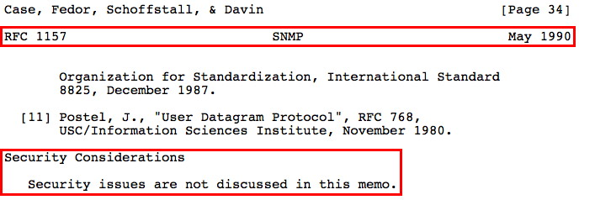
Section 1. The Legacy of "Security As An Afterthought" For A Key/Ubiquitous Protocol

Slide 3
SNMP Security Has Always Been An Afterthought
In a world where security really needs to be designed in from the beginning, SNMP has always been a protocol where security was largely overlooked or ignored.
This can be clearly seen in the excerpt from RFC 1157 quoted on the intro to this section: "Security issues are not discussed in this memo."

Slide 4
Nonetheless, SNMP *Is* Ubiquitous
Seemingly every device on the network supports SNMP.
This is, in many ways, laudable: you can centrally manage "everything."
This is, in many OTHER ways, horrific: -- least-common-denominator protocol implementations tend to lack critical features (like security and privacy) -- "on by default" rather than "on only where absolutely needed" increases your attack surface -- many unexpected side effects surface seemingly everywhere.

Slide 5
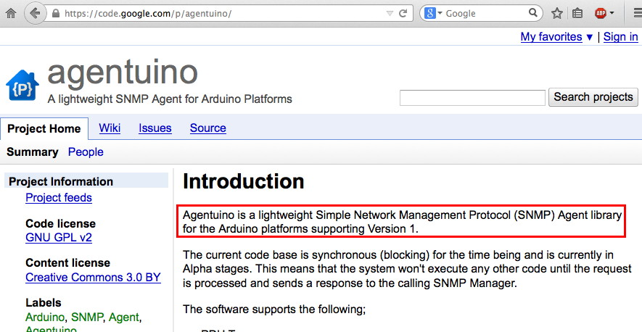
SNMP, Even on The Smallest/Simplest of Devices
If you're not familiar with the Arduino, see http://arduino.cc/

Slide 6
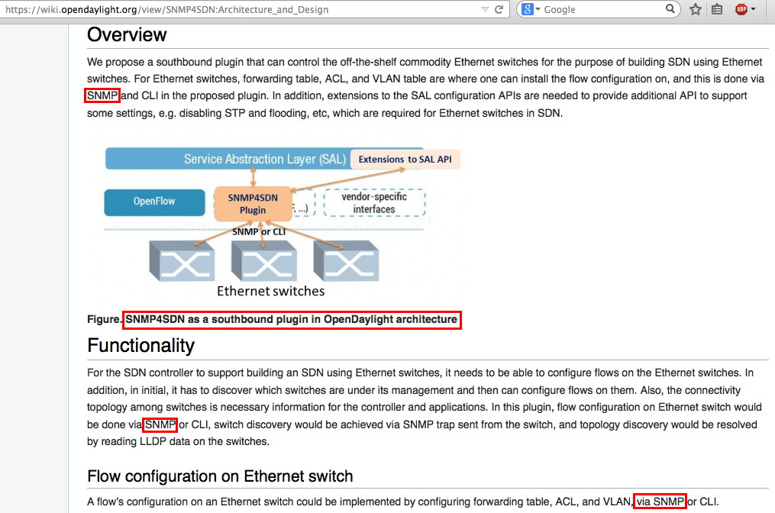
SNMP on Core Strategic Technologies (e.g., SDN)

Slide 7
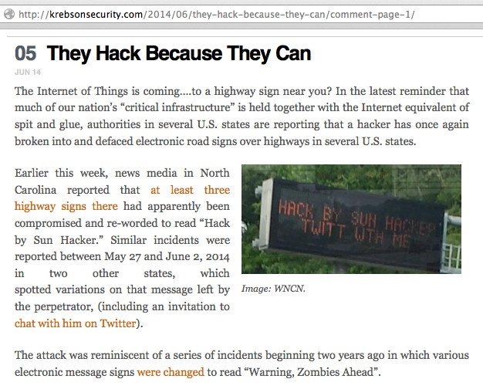
SNMP on Non-Enterprise Devices, Too

Slide 8
SNMP's Design Leverages UDP
This means it's vulnerable to spoofed traffic if everyone doesn't do BCP38/BCP84 (and many still don't)
This also means that it can act as a terrific packet cannon, potentially generating congestion-insensitive blasts of UDP packets at wire speed.
But hey, what could go wrong? :-;

Slide 9
Why Pay Attention to SNMP Security Today?
SNMP is being attacked, but it is also being used as a tool for attacking other sites (e.g., for conducting DDoS attacks).
If you run SNMP and end up hurting yourself, that's one thing. Your errors, your pain.
If your SNMP problems affect others, that's something completely different and much more serious. Your mistake, community pain and suffering. That asymmetry is a big problem for me.
SNMP reflective amplification attacks are quite similar to DNS, NTP and similar reflective amplification attacks, but with far larger potential amplification factors.

Slide 10
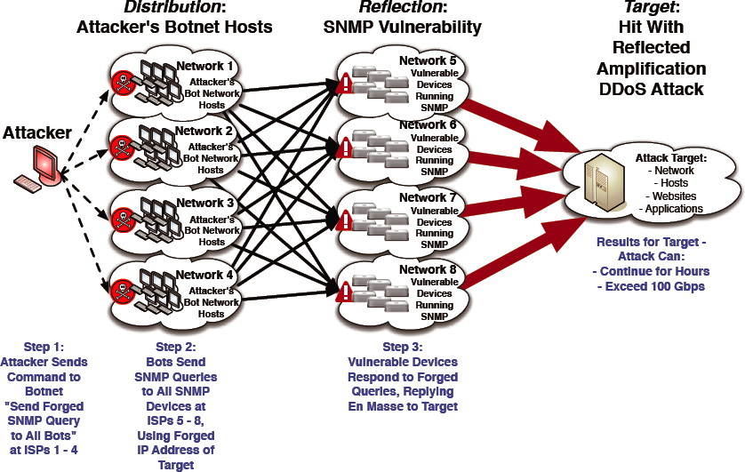
How An SNMP Reflection Attack Works
http://www.bitag.org/documents/SNMP-Reflected-Amplification-DDoS-Attack-Mitigation.pdf

Slide 11
SNMP Reflection Amplification Factor
"... the laboratory setup was able to replicate requests and payloads. The tool produced a request of 37 bytes and an amplified response of 51,722 bytes, effectively replicating the SNMP reflection attack seen in the campaigns." "Threat Advisory: SNMP Reflection Attacks," http://www.prolexic.com/kcresources/prolexic-threat-advisories/prolexic-ddos-threat-advisory-snmp-reflector/TA-SNMP-Reflection-A4-052014.pdf
Doing the math: 51,722/37=1,397.9 amplification factor!
The attack tool in question is easily found on the Internet today.

Slide 12
SNMP Also Frequently Acts As A Routine "Built in Flaw/Point of Vulnerability"
For example:
SNMP community strings brute forced (presumably) as an entry point for further attacks against the SNMP-managed device
In other cases, SNMP can be just a little two willing to spill its guts about itself
SNMP as a DoS vector against applications running on the managed device (example: Squid)
Attackers are even exploring attacks against basic device functions (such as packet forwarding) via intentional device misconfiguration via SNMP
Some specific examples of these...

Slide 13
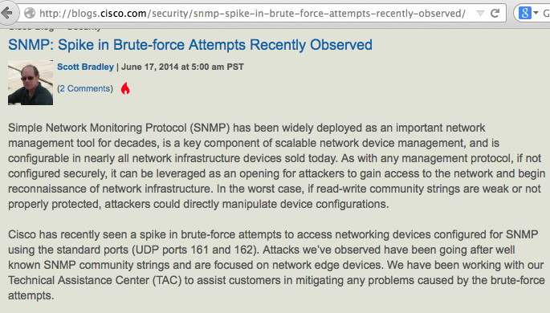
Spike In Brute Force Access Attacks

Slide 14
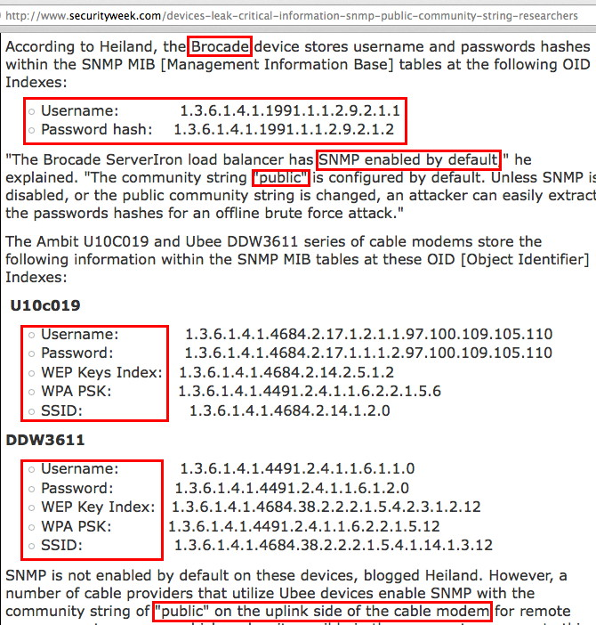

Slide 15
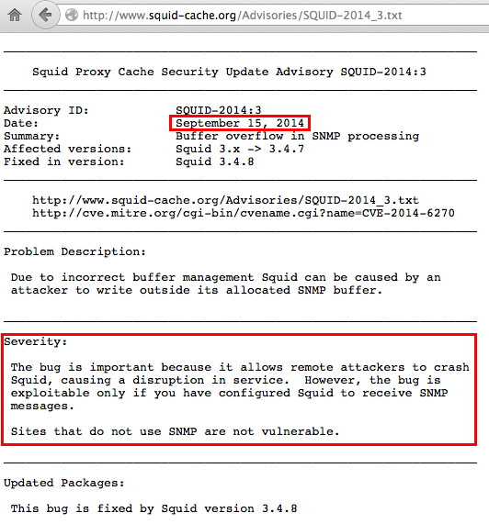
Flaws Allowing DoS Of Systems Using SNMP

Slide 16
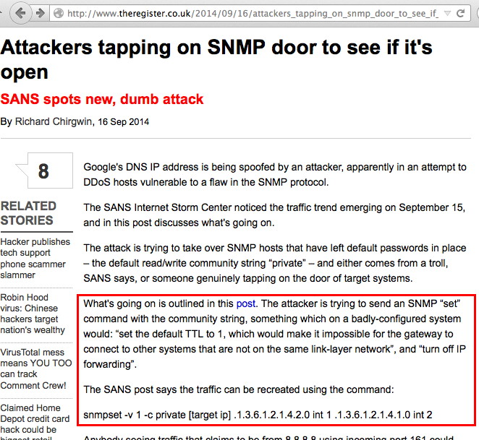
SNMP-Based Forwarding Attack Attempt: Set TTL=1 and Disable IP Forwarding

Slide 17
There Are MANY Other Problems with SNMP
A year or two ago I warned you that there were MANY problems with SSL/TLS, and I told you that people weren't correctly configuring SSL/TLS. [I'm talking more about that here tomorrow at 8:30AM] Since then, SOME of those SSL/TLS problems have surfaced in the form of things like Heartbleed, Poodle, etc.
Today I'm raising a similar red flag about SNMP. We all really need to be paying attention to this protocol. We also need to be working as a community to fix its protocol-level issues, and to clean up how it's been deployed to-date.
And yes, we need to pay attention to SNMP's crypto, too.

Slide 18
Section 2. SNMP's Crypto

Slide 19
NO Crypto Support (In Early Versions)
Because SNMP is a very old protocol, and because SNMP also needed to be usable even on very simple/low horsepower devices, it historically did not support encryption.
Unencrypted SNMP connections represent an obvious problem when you realize that SNMP authentication protocols are quite "basic", and readily vulnerable to sniffing over the wire
Things are particularly bad if SNMP protocols are routinely used for configuration management purposes, e.g., "set" (or "write") access rather than just "get" (or "read") access

Slide 20
An SNMP Encryption Support Summary
SNMP v1: NO CRYPTO, DON'T USE
SNMP v2c: NO CRYPTO, DON'T USE
SNMP v3: LIMITED CRYPTO SUPPORT
What does "LIMITED" mean?
To be blunt, SNMP crypto support lags far behind what's available for https.

Slide 21
MD-5/SHA-1/SHA-2
One example of the primitive state of SNMP crypto is easy to identify: as soon as you begin looking at SNMP, you see references to MD-5 and SHA-1 for SNMP authentication. Ugh.
Good news (since most of the world is busily phasing out SHA-1): SNMP SHA-2 protocol support is being worked on, see: "HMAC-SHA-2 Authentication Protocols in USM for SNMP draft-hmac-sha-2-usm-snmp-01," http://tools.ietf.org/html/draft-hmac-sha-2-usm-snmp-01 (Expires November 7th, 2014)

Slide 22
Symmetric Cipher Suites: More Crypto Trouble?
Implementations of SNMP v3 often do DES (see "User-based Security Model (USM) for version 3 of the Simple Network Management Protocol (SNMPv3)," https://tools.ietf.org/html/rfc3414 ).
DES is NOT cryptographically adequate (see the next slide).
Things got better with support for AES-128 per "The Advanced Encryption Standard (AES) Cipher Algorithm in the SNMP User-based Security Model," http://tools.ietf.org/html/rfc3826
In a limited number of even MORE uncommon cases, you'll even have support for AES-256, which is excellent (this is typically via vendor SNMP extensions)
Unfortunately, we need strong crypto for ALL SNMP devices, not just for rare exceptions.

Slide 23
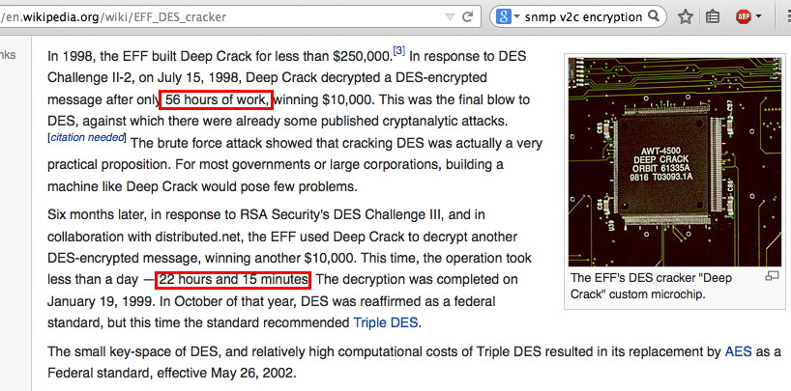
The Problem with DES As A Crypto Option...

Slide 24
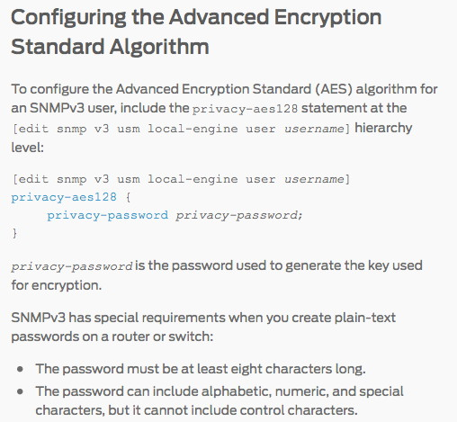
One Vendor's AES-128 Support
Source: http://www.juniper.net/techpubs/en_US/junos14.1/topics/task/ configuration/snmpv3-encrypton-type-configuring-junos-nm.html

Slide 25
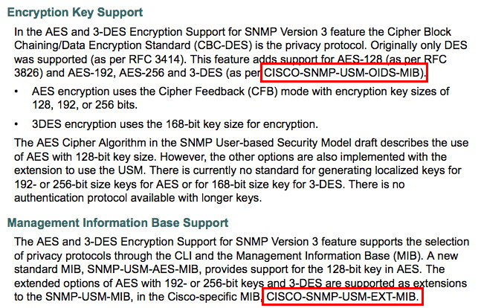
AES-256 Support From Another Vendor
See http://www.cisco.com/c/en/us/td/docs/ios/12_4t/12_4t2/snmpv3ae.html

Slide 26
AES in CFB Mode?
http://www.ietf.org/rfc/rfc3826.txt at 3.1.1.1 ("Mode of operation") says: "The NIST Special Publication 800-38A [AES-MODE] recommends five confidentiality modes of operation for use with AES: Electronic Codebook (ECB), Cipher Block Chaining (CBC), Cipher Feedback (CFB), Output Feedback (OFB), and Counter (CTR). The symmetric encryption protocol described in this memo uses AES in CFB mode with the parameter S (number of bits fed back) set to 128 according to the definition of CFB mode given in [AES-MODE]. This mode requires an Initialization Vector (IV) that is the same size as the block size of the cipher algorithm." CFB is a relatively uncommon mode.

Slide 27
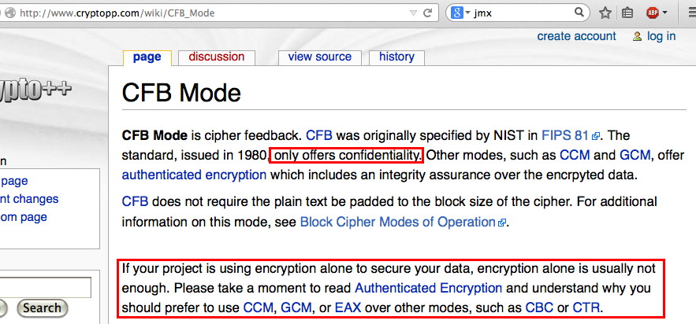
What Does the Crypto Community Say?

Slide 28
Recap: What Crypto Work Might SNMP Need?
We need to begin treating SNMP crypto as if it is JUST as critical as https crypto, if not more. We need it to be closely scrutinized, and we probably need automated tools like the Qualys SSL Tester but for SNMP crypto.
SNMP needs standardized SHA-2 support.
SNMP support for AES-256 should be ubiquitous.
Do we need a hard look at the decision to use CFB mode with AES? Are the initialization vectors (IV) appropriately?
Is there/should there be any worry about MITM risks for SNMP? That is, how do you know you're providing your credentials to the "right" SNMP-using device currently?
What about low end (low horsepower) systems that need to do SNMP? Will they be okay with moving to beefier crypto?

Slide 29
Section 3. Community Strings

Slide 30
Default Passwords Are A Well Known Threat
Pen testers (as well as less benign individuals) are well aware that default passwords often get configured "at the factory" and then are forgotten/never changed.
There are many lists of default device passwords in circulation, including (among others): -- http://www.defaultpassword.com/ -- http://www.routerpasswords.com/
SNMP has its own version of the "default password problem," namely default community strings.

Slide 31
Default Community Strings
If your device has a read community string of public or a write community string of private you're either running a honeypot or you're crazy.
If you're using one of the other common SNMP community strings listed at https://code.google.com/p/fuzzdb/source/browse/ trunk/wordlists-misc/wordlist-common-snmp-community-strings.txt you're just about equally as nuts.

Slide 32
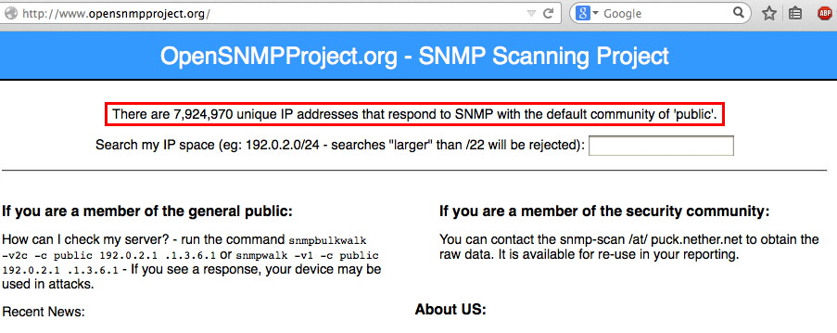
There Are A LOT of Crazy People Out There

Slide 33
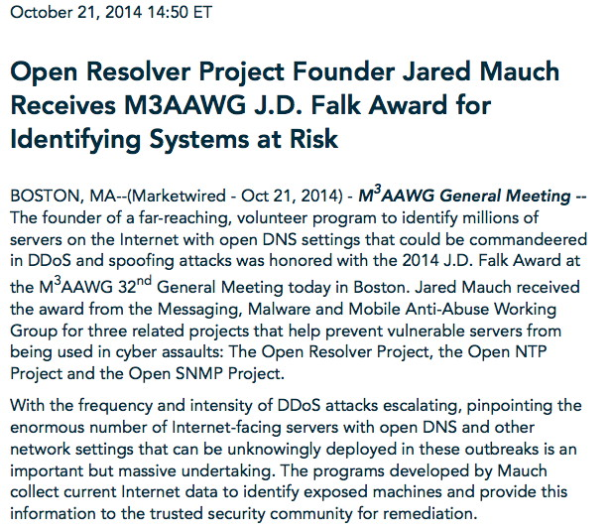
Jared Just Won The JD Falk Award For His Work

Slide 35
The SAME Community Strings on ALL Devices?
Let's assume that you're NOT crazy, and you've set a non-default / uncommon community string for read and write access.
Did you set the SAME community string for ALL managed devices on your campus? Are all those devices of equal sensitivity/importance?
Don't we routinely preach at users about the risks of using the same passwords on multiple systems?
Yes, I know that having unique per-device SNMP communities "adds complexity" or "is impractical" when teams manage large networks, but...

Slide 36
What About Brute Force Attacks on SNMP?
Are you paying attention to potential brute force attacks against your community strings? SNMP brute forcing/dictionary attack tools are widely available: -- http://nmap.org/nsedoc/scripts/snmp-brute.html -- https://www.thc.org/thc-hydra/ -- etc., etc., etc. You can probably arrange to monitor SNMP traps for failed password attempts, if you're into whack-a-moling.
Of course, random people shouldn't have access to SNMP on your managed devices in the first place, now should they?

Slide 37
When Did You Last CHANGE Your Device Community String(s)?
For example: -- If one or more staff have left, did you change any community strings that they may have known? -- If you've used the same community strings for the last year, do you think it might be time to schedule a network wide change? -- What does your school's policies say? What do your auditors expect? Have they ever asked about your community strings? Should your SNMP practices be something that they DO ask about/look at?

Slide 38
Something Better Than Plain Old Passwords?
And it sure would be nice if SNMP could also do some sort of strong authentication (should as client certificates on smartcards), at least if you're modifying meaningful systems via SNMP.

Slide 39
Section 4. Limiting Network Access To SNMP

Slide 40
"First Of All, Do I Need To Run SNMP At All?"
If you don't need to run SNMP, DON'T. (Disabling unneeded services is the best way to reduce your attack surface.)
However, disabling SNMP is a strategy that comes at the cost of substantial collateral damage. Taken to an extreme, totally blocking SNMP access might mean that you're suddenly having to try to run a large network more or less totally blind. That's going too far.
You're probably better off just heavily "fencing SNMP in."
Sadly, at least some people DON'T bother limiting access to SNMP.

Slide 41
The Basic: Block Port 161 and 162 At The Border
I'm not a huge fan of port-based blocks, but there shouldn't be ANY port 161 (SNMP) nor ANY port 162 (SNMP Trap) traffic crossing your campus border inbound OR outbound Be sure you block 161 an 162 on both IPv4 AND IPv6 (assuming your network supports both IPv4 and IPv6)
One example of a campus that currently blocks 161 and 162: http://www.net.princeton.edu/filters/internet-border.html Good job, Princeton! A+

Slide 42
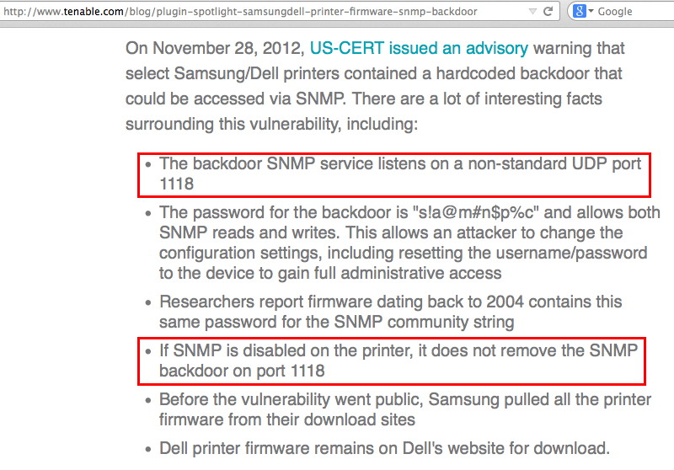
SNMP Doesn't ONLY Run Over Port 161 and 162

Slide 43
We Empirically Know Some Sites Do NOT Bother Blocking Port 161 At The Border, Anyhow
If you'd like to see the problem first hand, create a free Shodan account (http://www.shodanhq.com/), then do a query for hostname:.edu port:161
When I did this query on the 28th of October, 2014, Shodan found 30,256 matching edu hosts in the US. (NOT good)
If you get a Shodan account and run a report on that query, you can see the responsible organizations. Just four (4) US universities accounted for over half of those accessible SNMP hosts; fix those four sites and roughly 17,000 problematic hosts go away. Is YOUR campus one of those sites?

Slide 44
So What *IS* Shodan Finding and Reporting?
If you want to see those four campuses, you'll have to check for yourself.
However, reportedly the top product seen by Shodan was the "Symbol Spectrum Access Point," a wireless access point. This product was seen at a level that was more than 2X the next most common SNMP-able device in higher education.
The report also identified Linux 2.6.x (believed in this case to be showing up because of its use in things like networked printers), and Windows 7 or 8, plus Windows XP, among others. Note, of course, that Windows XP is end-of-life, and really shouldn't be getting seen on the wire AT ALL (much less doing SNMP!) Has YOUR campus phased out Windows XP? If not, why not?

Slide 45
Internally Control Network SNMP Traffic, Too
Scenario: "What if an intruder compromises a system that's inside the perimeter? They can then use that host as a stepping stone for SNMP attacks!"
One option for limiting opportunities for SNMP-related mischief on campus is to run a separate out-of-band network reserved exclusively for all SNMP traffic.
If that's not "practical," you may at least want to consider restrictions on where SNMP traffic can flow internally. That is, if all your network management work is done from one dedicated network engineering subnet, why allow SNMP traffic from the campus wireless network, or your residence hall network, etc.?

Slide 46
BCP 38/BCP 84
In addition to blocking SNMP specifically, you should ALSO be taking steps to block packets with spoofed source addresses from leaving your network. For example, at UO, where packets should be coming from 128.223.0.0/16, packets that pretend to come from some other source IP address should be dropped.
Spoofed traffic is one of the crucial elements that make reflective amplification attacks of ALL types possible. Block spoofed traffic, please!
See: -- http://tools.ietf.org/html/bcp38 and -- http://tools.ietf.org/html/bcp84

Slide 47
SNMP's Days May Be Getting Short(er)
Source: "Features Removed or Deprecated in Windows Server 2012," http://technet.microsoft.com/en-us/library/hh831568.aspx
Note carefully: "deprecated" is NOT synonymous with "removed!" SNMP may still be present and used on Windows Server 2012!
[BTW, if curious about CIM, see http://en.wikipedia.org/wiki/ Common_Information_Model_%28computing%29 ]

Slide 48
Section 5. Conclusion

Slide 49
The One Slide Summary Message
SNMP is everywhere, and it can be grossly insecure; it's on the smallest and largest hosts, and it's used in control systems, too
SNMP can hurt you, and others, if not carefully limited
Disable it if you don't need it or you're not actively using it
If you must run it, run SNMPv3 only, NOT SNMP v1 NOR v2c
Don't use stupid default community strings like "public"!
Use SHA-1 if your device supports it, NOT MD5! Push your vendors to phase in SHA-2!
Use AES-128 or AES-256 if your device supports it; if your device doesn't support it, bug your vendor. Don't trust DES!
BLOCK port 161 and 162 at your border!
Implement BCP38/BCP84 anti-spoofing filters at your border, too!

Slide 50
A Personal Note
I'll be concluding my work with Internet2 and InCommon and the University of Oregon at the end of the month to take a new position with Paul Vixie's data-driven security company Farsight Security (https://www.farsightsecurity.com/)
It's been a real honor and privilege to have had the chance to work with all of you, and I particularly appreciate your putting up with me preaching at you about security issues – especially if you're at a school that's already proactively doing the right thing.
Copies of my talks will continue to be available from my personal web site, https://www.stsauver.com/joe/ and if you ever need to reach me, joe@stsauver.com should work.

Slide 51
Thanks For The Chance To Talk Today
Are there any questions?
Don't forget, there's another session I'll be doing, too, tomorrow morning at 8:30AM ("New Crypto 101")

