Slide 1
Pretty Good Privacy (PGP) And GNU Privacy Guard (GPG): Just Enough Training to Make You Dangerous
Joe St Sauver, Ph.D. M3AAWG Senior Technical Advisor
Scientist Farsight Security, Inc.
M3AAWG 36, San Francisco, California Monday, Feb 15th, 2016, 12:30-14:30
https://www.stsauver.com/joe/pgp-tutorial-sfo/

Slide 2
0. Introduction

Slide 3
Obligatory Screen: Eligibility For Strong Encryption
This is not legal advice (for that, please contact your attorney), however please note that some people are NOT ALLOWED to use strong encryption under prevailing laws.
By continuing with this training, you certify that you are NOT: -- a citizen, national, or resident of a country barred from access to strong encryption by the U.S. or other countries, including but not limited to persons from the Crimea region of the Ukraine, Cuba, Iran, North Korea, Sudan, or Syria; -- nor are you a "Specially Designated National" (see http://www.treasury.gov/resource-center/sanctions/SDN-List/ Pages/default.aspx ), nor a person (or representative of a company) that is subject to any other US or other sanctions program or restriction.
If you are subject to any such prohibition or restriction, you must NOT participate in today's encryption training.

Slide 4
Disclaimer
While all due care was used in preparing the content of this training, we cannot ensure that you will not inadvertently make a mistake, or encounter a vulnerability while using PGP/GPG.
Given that you cannot "unring the bell once it has been rung," and given that some potential "losses of confidentiality" may have grave or even catastrophic consequences, please remember that: -- you should not use PGP/GPG for "life/safety-critical" purposes -- today's training is provided on a "best efforts," as-is, where-is basis, with all evident and/or latent faults/flaws -- should you decide to use and rely on PGP/GPG, the decision to do so is your own and at your own risk; we disclaim all responsibility for any impacts associated with the use, misuse, or abuse of PGP/GPG by anyone here today or using this talk.
If you do not agree with these terms, please do not rely on the information in this talk, and please do not stay for this training.

Slide 5
Our Goal Today: 'Basic PGP/GPG Functional Literacy'
Background -- understanding why you might need or want PGP/GPG -- understanding criticisms/limitations of PGP/GPG -- understanding (in general) how PGP/GPG works
Installing and Configuring PGP/GPG (Mac [and Linux], and MS Windows)
Creating and Managing Keys -- creating and publishing your own keypair -- getting other peoples' PGP/GPG keys
Digitally Signing/Validating Messages -- sending a signed message -- validating a signed message you've received
Encrypting/Decrypting Messages -- sending an encrypted message -- decrypting an encrypted message you've received
Signing PGP/GPG Keys
Convenience Tools: Enigmail, Mailvelope and Mailpile
Optional Key Signing Party

Slide 6
I. Why Bother Learning To Use PGP/GPG?

Slide 7
All Email Is Private, Right?
You might expect your email to be private, exchanged just between you and your intended correspondent(s). However, many people may potentially be in a position to look at it:
Network engineers/system administrators with privileged access
Supervisors/managers with administrative power to obtain access
Hardware techs with physical access when fixing hardware issues
Advertising/automatic marketing systems (at least on some free ad-sponsored email services)
Family members with access to automatically-logged in mail clients
Hacker/crackers with unauthorized access due to bugs/exploits
Civil litigants engaged in compulsory pre-trial discovery during a lawsuit
Law enforcement officers (LEOs) with a warrant or other paperwork (or exigent circumstances)
Members of the intelligence community (foreign or domestic)
Customs officers at international borders
FOIA requestors (for government officials), etc.

Slide 8
"But Joe! I've Got Nothing to Hide!"
And that's terrific. Most folks don't. But sometimes others may want to share something with you in confidence – wouldn't it be nice if they could?
Maybe you're trying to talk about spam or malware, and just need a way to avoid having your messages automatically filtered when your message contains malware samples or spam samples?
In other cases, perhaps you need to know how to use PGP/GPG simply because a group you want to work with may require you to be able to do so, whether you perceive a need for it or not.
Another possibility: maybe you'd like to digitally sign your email, so that there's no question that it came from you, and hasn't been tampered with since it was sent?
Bottom line, there are many, many legitimate reasons why people might need or want to use PGP/GPG

Slide 9
"But What About PGP/GPG and the Bad Guys???"
It's true – the bad guys are interested in PGP/GPG, too. Some really unsavory types (terrorists, pedophiles, organized crime members, etc.) would love to keep their messages away from the authorities. Those bad guys dream about the privacy that PGP/GPG provides (and they likely already use it).
Sadly, there's no way that I know of to keep the bad guys from using PGP while still allowing everyone else to use it including: -- law-abiding international businessmen -- peaceful religious or political dissidents -- investigative journalists, and -- ordinary privacy-minded men and women.
Criminal misuse can and should be punished, but lawful use by everyone else shouldn't be precluded.

Slide 10
II. PGP/GPG: "Too Hard To Learn To Use?"

Slide 11
PGP/GPG: A "Daunting" Crypto Option?
PGP/GNU PrivacyGuard has often been viewed as technically daunting, even spawning academic studies such as the famous:
"Why Johnny Can't Encrypt" (1999), http://www.eecs.berkeley.edu/~tygar/papers/Why_Johnny_Cant_Encrypt/USENIX.pdf "Our twelve test participants were generally educated and experienced at using email, yet only one third of them were able to use PGP 5.0 to correctly sign and encrypt an email message when given 90 minutes in which to do so. Furthermore, one quarter of them accidentally exposed the secret they were meant to protect in the process, by sending it in email they thought they had encrypted but had not." [emphasis added]
But hey, that was sixteen years ago, right? Surely we've perfected PGP/GPG since then? We'll see! :-)

Slide 12
Is PGP/GPG Something of A "Dead End?"
In the spirit of full disclosure, some people will tell you that learning to use PGP may be a waste of your time.
See for example: -- Matthew Green's "What's the matter with PGP?" http://blog.cryptographyengineering.com/2014/08/whats-matter-with-pgp.html (But also see the rejoinder at: https://pthree.org/2014/08/18/whats-the-matter-with-pgp/ ) -- Moxie Marlinspike's "GPG and Me" http://www.thoughtcrime.org/blog/gpg-and-me/ -- Secushare's "15 reasons to not start using PGP," http://secushare.org/PGP -- "The World’s Email Encryption Software Relies on One Guy, Who is Going Broke," http://www.propublica.org/article/the-worlds-email-encryption-software-relies-on-one-guy-who-is-going-broke [don't worry too much, he's gotten funding now]

Slide 13
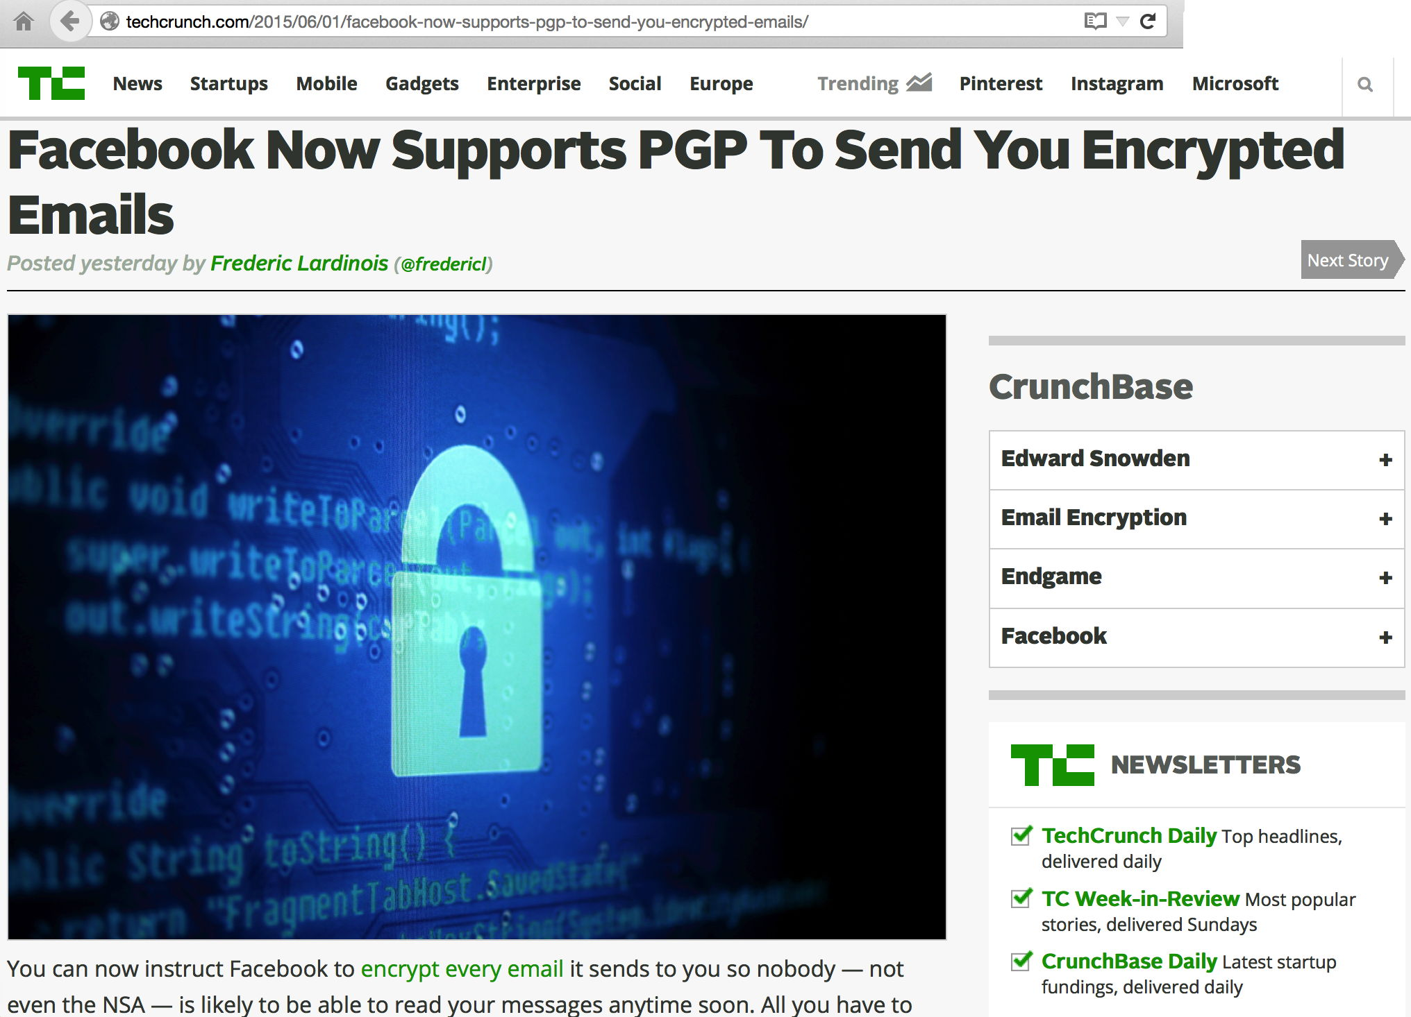
If PGP/GPG Is "Dying," No One's Told Facebook That

Slide 14
Some Genuine Limitations of PGP/GPG
PGP/GPG isn't perfect by any means. Real limitations include:
It can take some time and effort to learn to use PGP/GPG.
PGP/GPG isn't "built-in" to most messaging software; you need to manually add it.
Both you AND your correspondent need to use it if you want the protection of encryption
PGP/GPG doesn't encrypt message subject lines
It also doesn't protect you from traffic analysis attacks (an observer can still see who's sending a message, and who it's being sent to); that can be surprisingly revealing, in and of itself (but see also –hidden-recipient )
If you're careless, you can end up accidentally sending plain text when you meant to send cipher text.
If you forget your passphrase, you will lose everything encrypted with that passphrase. PGP/GPG is like a power tool or a firearm: if you fail to pay attention while using crypto/power tools/guns, you very well may get hurt. Do NOT forget your passphrase!

Slide 15
On Balance, However...
I still think it is worth while learning to use PGP/GPG, which is why I'm excited to have the chance to offer you this training today for M3AAWG attendees in SFO.
Having previously taught other people how to use PGP/GPG, I'm confident that I can teach you how to use it, too.
I don't use PGP/GPG all the time, but I do use it when it makes sense to do so. I'd encourage you to adopt a similar policy.
If it turns out you don't ever use it, that's fine too – I want the choice to be yours. Once you know how to use PGP/GPG, the choice will be yours.

Slide 16
Platforms
People have been known to run PGP/GPG on pretty much everything or anything you can name.
Today we're going to cover running PGP/GPG on: -- Mac OS/X laptops (and Linux laptops, if we have any Linux users in the audience), and -- MS Windows laptops.
Once you have the outline from those platforms, you should be able to generalize that information to other operating systems (Linux, tablet operating systems, smart phones, etc.)

Slide 17
III. How PGP/GPG Works (In General)

Slide 18
PGP/GPG vs. Alternative End-To-End Crypto Options
Before you sign up to become part of the PGP/GPG "club," you should know that there are alternatives for end-to-end email encryption, most notably S/MIME, and/or just use of a shared key.
S/MIME relies on PKI personal certs, and has its own advantages and limitations. If you're interested in S/MIME, see the M3AAWG training I previously did on it; those slides are available at: "Client Certs & S/MIME Signing and Encryption: An Introduction," https://www.stsauver.com/joe/maawg24/maawg24.pdf
You could also just encrypt a file using something like 7-Zip and a symmetric key (a key that both you and your correspondent know), and then send that encrypted file to your colleague.

Slide 19
Symmetrically Encrypting a File with 7-Zip*
7-Zip is an archiver that includes AES-256 symmetric encryption.
Assume your secret message is in sample.txt, and your shared secret password is "SecretSecretFoo" (without quotes)
Encrypt sample.txt with z7a creating sample.zip: $ 7za a -pSecretSecretFoo sample.zip sample.txt
Recipient would then extract and decrypt sample.zip with: $ 7za e sample.zip Enter password (will not be echoed) : SecretSecretFoo
* 7-Zip is available free from http://www.7-zip.org/download.html

Slide 20
But There's The Rub....
If you DON'T use something like PGP/GPG (or S/MIME), you and your correspondent both need to agree to use the same secret key (such as "SecretSecretFoo" in the preceding example). Remember, encryption that uses the same key for both encryption and decryption is called "symmetric encryption."
If you and your correspondent meet face-to-face, you can agree on a secret key that you'll use for all your future correspondence. But what if you've NEVER met a particular person face-to-face, yet you'd still like to be able to confidentially communicate with them? How do you bootstrap that initial "shared secret?"
Or what if you want to communicate with multiple people: do you share the same common key with all of them? Ugh.
Do you really want to manually set up personalized keys face-to-face with hundreds of people? I really doubt it.

Slide 21
Scaling Key Exchange: Symmetric Crypto Can't
Number of Correspondents | Symmetric crypto with a unique key for each pair of correspondents | Public key crypto, as used by PGP/GPG
2 (you and someone else) | 1 key that you both know | 2 key pairs
3 (you and two others) | (3*2)/2=3 keys, one for each pair | 3 key pairs
12 people (you & 11 others) | (12*11)/2=66 keys | 12 key pairs
100 people | (100*99)/2=4,950 keys | 100 key pairs
500 people | (500*499)/2=124,750 key | 500 key pairs
Understanding the math: consider the 100 person case. The first person needs a key for the other 99 people, ditto the 2nd person, the third person, etc. For a 100 people, that gets you to "(100*99)"
However, because we assume that the same key is used from sender A to receiver B, AND FROM sender B back to receiver A, that lets us divide the total number of unique keys required in half.

Slide 22
Why Not Just Share One Common Community-Wide Key?
If you tried to short circuit this "itsy-bitsy" scaling problem by just having one common secret key shared by all correspondents, then all it would take would be for one untrustworthy correspondent to disclose the common key, and then your entire crypto network would be insecure!
And in a network of 500 users, you're pretty safe in assuming that there's at least one person who's less than totally trustworthy (or at least somewhat careless).
Symmetric crypto just isn't the right answer.
Symmetric crypto just doesn't scale, and it doesn't have a good way to bootstrap initial secret keys for remote colleagues, either.

Slide 23
Asymmetric Cryptography
PGP/GPG works by leveraging asymmetric ("public key") cryptography: instead of using the same key to encrypt AND decrypt, you'll use a pair of related keys, one to encrypt, and a corresponding (but different) one to decrypt.
Half of your key pair is a private key that you'll never reveal to anyone. The other half is a corresponding public key that you can (and should!) share with the world.
Knowing one of those keys (e.g., the public part) does NOT allow you to derive the other corresponding one.
Every user of PGP/GPG will normally have their own key pair.

Slide 24
How Does Someone Get A PGP/GPG Key Pair?
You make yourself one – anyone with the PGP/GPG software can do so.
Creating a key pair for each of you is one of the things we'll do as part of today's session.

Slide 25
How Does Someone Get Someone Else's Public Key?
PGP/GPG public keys are often distributed via public database servers known as "key servers." That said, some people may not know about key servers, or may choose not to use them.
Those people will often put their public key on a web page, or they may simply email you their public key on request (they're free to distribute their public key any way they might like). Note that you MUST share your publicly key with others some way or another. Unless you have a compelling reason not to, I recommend using PGP/GPG key servers.
Why do some people not just use key servers? Three main reasons: they worry that spammers will harvest them to find email addresses to spam; they may find using key servers confusing; or they may be confused by the PGP/GPG "web of trust" concept.

Slide 26
Picking the RIGHT PGP/GPG Public Key
Anyone can submit a PGP/GPG public key to a key server.
Logical question, then: if anyone can submit a public key to a PGP/GPG public key server (and they can), "what keeps people from submitting bogus PGP/GPG public keys?"
The answer to that is simple: nothing. Nothing prevents people from submitting totally bogus keys to a public key server.
YOU are responsible for selecting the right/real one, assuming any of the available PGP/GPG keys are real (they might all be bad)
But how to choose the right PGP/GPG key?
There are essentially two approaches that people tend to use: you can rely on information received directly from the person who owns the key (such as a key fingerprint printed on a business card you received directly from that person), OR you can rely on the PGP/GPG "web of trust"

Slide 27
The PGP/GPG Web of Trust
Basic idea behind the web of trust: the owner of a PGP/GPG keypair asks others to digitally sign his/her public key.
Key signers sign after confirming the identity of a key holder by inspecting a government-issued ID document (driver's license, passport, etc.). After signing a key, the signed key gets sent back to its owner.
How do we know that those signing the key are who THEY claim to be? Well, their keys are in turn signed by other people... And the keys of those other people are in turn signed by other people...
This creates an interwoven "web of trust" that ultimately acts to tie an identity to an associated key pair.
The more broadly a key has been signed by other trusted signers, the more confidence you should have that the signed key belongs to the person whom it claims to represent.

Slide 28
NOTE: Signing a Key ^= "Vouching" For Someone
From time to time I've run into people who confuse the signing of a key with "vouching" for someone's "trustworthiness" or "integrity." That's NOT what signing a PGP/GPG key is about.
Signing a PGP/GPG key *IS* about asserting that there is a connection between: -- a PGP/GPG key pair, and -- an asserted identity.
The actual person associated with an identity could be "as good "as Mother Theresa" or "as evil as Hitler," you're NOT vouching for them just by signing their key! You ARE saying that you have personally made the connection between their real life identity and their keys.
Then again, because of the confusion around this point, I'd probably suggest NOT signing the keys of obviously evil people.

Slide 29
Is Signing PGP/GPG Keys "Required?"
Signing PGP/GPG keys is NOT required. There is no PGP/GPG police who will "pull you over" for having an unsigned key.
Some people NEVER bother to get their keys signed; when that's true, it is up to you to figure out an alternative way to ensure you've got the "right" key for that person.
Likewise, you are NOT required to sign anyone else's key, although if you're a nice person, it's a kind thing to do for someone. We'll show you how to do this later in this training.
In the other direction, no one else is required to sign YOUR key. If they do agree to sign it, they're doing you a favor, so be polite when asking and be gracious if someone declines to do so.

Slide 30
So Why Doesn't Everyone Use PGP/GPG?
When we think about why PGP/GPG hasn't been more broadly adopted, you now are aware of several reasons: -- Some people think they have nothing that needs protection (although they're probably wrong) -- You need to download and install PGP/GPG, it doesn't come "built in" or "preinstalled" -- It's relatively complex (not as hard as taking a class in differential equations, but not as simple as grilling a burger) -- Your correspondents may not be using PGP/GPG -- Key distribution may feel ad hoc or insecure (even though it it can be perfectly secure when properly utilized), and the web of trust may seem somehow "kludgy" or ad hoc. -- There are alternatives (such as S/MIME, or use of symmetric crypto) that may end up getting used instead of PGP/GPG.

Slide 31
Nonetheless, Let's Give It A Try Today
The process isn't all that hard -- at least once you've gotten things setup and you've collected keys for all the people you routinely correspond with who are ALSO doing PGP/GPG
Let's start by getting you setup...
These are tasks that you'll (hopefully) only need to do once.

Slide 32
III. One-Time Setup Tasks

Slide 33
Versions of PGP/GPG
There are several different versions of PGP/GPG.
PGP ("Pretty Good Privacy") has now largely been supplanted by GNU Privacy Guard (GPG).
Where possibly, we're going to illustrate use of the classic version of GNU Privacy Guard, Version 1.4.20 (as released on December 20th, 2015)
I prefer classic GPG (e.g., GPG 1.x, NOT GPG 2.x) because GPG 1.x does NOT use pinentry. At one point I thought that I was the only fossil who felt this way, but in talking with GPG using colleagues, I've learned that I'm not alone. :-)
If you do want to install GPG 2.x, you can install it right alongside GPG 1.x, but we're not going to cover that today (except for folks who basically have no other option), such as our Windows-using colleagues.

Slide 34
Installation for the Various Platforms
We are going to show installing GPG on both Macs [and Linux] and on Windows PC.
We'll begin with the Mac [and any Linux People]
Windows people, hang tight for a minute. After we get the Mac and Linux users get rolling, we'll come back to you.
On the Mac [and Linux], we're going to compile and install GNU Privacy Guard from source.

Slide 35
MAC USERS (And Linux Users, If Any... You'll Start a Few Slides In)

Slide 36
Mac-1. Mac Users: GNU Privacy Guard Installation

Slide 37
Installing GPG From Source for the Mac
Normally, for ease of use, I would recommend simply installing the precompiled binary version of a program (any program!), rather than compiling from source.
However, in this case, there are no precompiled binaries available for the classic version of GNU Privacy Guard for the Mac.
GNU Privacy Guard is also security-sensitive software, so I'm happier building it from scratch, anyhow.
Therefore, we have a little work to do, first...
Hopefully, you all saw a note from me, forwarded by Amy, urging you to preinstall Xcode and the Xcode command line tools.
If you're a Mac user, did anyone NOT get that note, or NOT get that "homework" done?

Slide 38
I'm Going to Assume We DO Have There's At Least One Mac User Who Didn't Get That Prep Work Done
Therefore, let's go over this...
To build GNU Privacy Guard on the Mac, you'll need to: -- Be able to get to the Mac OS X terminal application on your Mac -- Know the admin password for your Mac -- Have Apple Xcode installed -- Have the Apple Xcode command line tools installed
We'll now take care of those points.

Slide 39
The Mac Terminal App
We'll eventually move to a graphical point-and-click environment, but we're going to start by working at the command line.
On the Mac, that means using the Mac Terminal app, which emulates an old DEC VT100-family terminal.
If you don't routinely use the Mac Terminal app, you can find it at: Finder → Applications → Utilities → Terminal.app
Once you launch it, you'll be looking at a plain terminal window with a Unix command line shell prompt (the dollar sign). Do NOT type the dollar sign when it is shown in subsequent commands!

Slide 40
Mac Administrative User
Mac OS X allows users to have different roles: you can be an regular user, for example, or an administrator with enhanced privileges.
When you first installed Mac OS X on your laptop, one of the first things you did was to create an administrator account.
For the purpose of installing GNU Privacy Guard, you should be working from that administrator account. That means you should know the password for it.
Not sure if an account's an admin account? Go to Apple → System Preferences → Users & Groups and look to see if you're using an account tagged as "admin"

Slide 41
Install the Apple Developer Tools
Compiling software on the Mac generally requires Xcode, the Apple developer tools. Anyone can register to become an Apple "developer" and you can then freely download Xcode.
IF you didn't already install Xcode, you can download Xcode 7.2.1 for free from Apple. See the link located at: https://developer.apple.com/xcode/downloads/
Note that this is a LARGE download (4.4GB+)and may take a substantial amount of time over a shared wireless network. If you've not previously downloaded and installed Xcode, you may want to try JUST installing the XCode Command Line tools, INSTEAD.

Slide 42
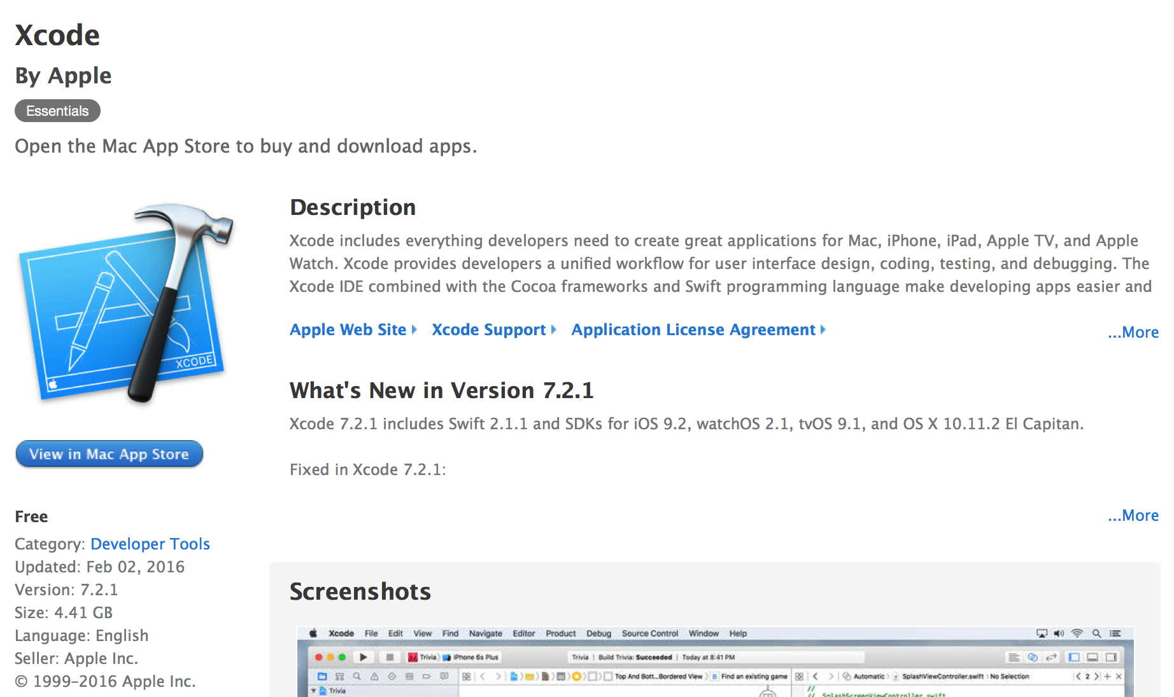

Slide 43
Installing The Command Line Tools
IF YOU HAVE INSTALLED Xcode but HAVEN'T installed the Command Line Tools, you also need to download the command line tools. Do so by (a) starting Xcode, then (b) going to the Xcode→Preferences→Downloads tab and clicking "Install" next to the Command Line Tools entry.
IF YOU HAVEN'T INSTALLED Xcode (and don't WANT to!), you can try downloading JUST the command line tools by entering $ xcode-select --install That MAY be all you actually need.
Regardless of the approach you use, signify that you accept the Command Line Tool license by entering in a Terminal window: $ sudo xcodebuild -license Hit space, space, space, etc., to scroll down through the text of the legal agreement. When you get down to the very bottom, enter: agree

Slide 44
Linux Users, You Should Start Paying Attention Here
If you're a Linux person and you want to build GNU Privacy Guard from scratch, start paying attention here, please!
The command line process is basically the same for Mac users and for you...

Slide 45
Downloading GPG 1.4.20 Source Code
Download a copy of the GPG 1.4.20 source code by going to a Terminal window, and then entering (at the dollar sign prompt): $ curl -O https://www.gnupg.org/ftp/gcrypt/gnupg/gnupg-1.4.20.tar.bz2 (that's curl space dash capital oh, not curl space dash zero, and continue the second line as part of the first line, without any intervening space
Next, verify the checksum of that file (and thus its integrity): $ shasum gnupg-1.4.20.tar.bz2 cbc9d960e3d8488c32675019a79fbfbf8680387e gnupg-1.4.20.tar.bz2 That checksum should match what's shown above (and what's shown online at https://lists.gnupg.org/pipermail/gnupg-announce/2015q4/000382.html )

Slide 46
Unpack The GNUPG Distribution
Uncompress the archive you downloaded: $ bunzip2 gnupg-1.4.20.tar.bz2 This will leave you with the uncompressed archive file gnupg-1.4.20.tar
Untar that tar archive: $ tar xfv gnupg-1.4.20.tar That will unpack the GNU Privacy Guard distribution into the subdirectory gnupg-1.4.20

Slide 47
Installing GPG
Change directory down into the gnupg-1.4.20 subdirectory: $ cd gnupg-1.4.20
Configure the package: $ ./configure ← NOTE THE DOT at the start of that command!
Build and check the program: $ make $ make check
Install gpg if all checks are reported as passing okay: $ sudo make install Note: sudo will ask for your administrator password to run.

Slide 48
Confirm That GPG Is Installed
$ gpg --version gpg (GnuPG) 1.4.20
Copyright (C) 2015 Free Software Foundation, Inc.
License GPLv3+: GNU GPL version 3 or later <http://gnu.org/licenses/gpl.html>
This is free software: you are free to change and redistribute it.
There is NO WARRANTY, to the extent permitted by law.
Home: ~/.gnupg
Supported algorithms:
Pubkey: RSA, RSA-E, RSA-S, ELG-E, DSA
Cipher: IDEA, 3DES, CAST5, BLOWFISH, AES, AES192, AES256, TWOFISH,
CAMELLIA128, CAMELLIA192, CAMELLIA256
Hash: MD5, SHA1, RIPEMD160, SHA256, SHA384, SHA512, SHA224
Compression: Uncompressed, ZIP, ZLIB, BZIP2

Slide 49
See A Short Summary of GPG Commands
$ gpg --help | more [...] Syntax: gpg [options] [files] Sign, check, encrypt or decrypt Default operation depends on the input data Commands: -s, --sign [file] make a signature --clearsign [file] make a clear text signature -b, --detach-sign make a detached signature -e, --encrypt encrypt data [etc]

Slide 50
See Also The GPG Unix Manual Page
$ man gpg GPG(1) GNU Privacy Guard 1.4 GPG(1) NAME gpg - OpenPGP encryption and signing tool SYNOPSIS gpg [--homedir dir] [--options file] [options] command [args] DESCRIPTION gpg is the OpenPGP only version of the GNU Privacy Guard (GnuPG). It is a tool to provide digital encryption and signing services using the OpenPGP standard. gpg features complete key management and all bells and whistles you can expect from a decent OpenPGP implementation. This is the standalone version of gpg. For desktop use you should con- sider using gpg2 from the GnuPG-2 package [etc]

Slide 51
Mac-2. Mac [and Linux] Users: Creating and Managing YOUR OWN Keypair

Slide 52
Create A Keypair For Yourself
$ gpg --gen-key [...] Please select what kind of key you want: (1) RSA and RSA (default) (2) DSA and Elgamal (3) DSA (sign only) (4) RSA (sign only) Your selection? 1 RSA keys may be between 1024 and 4096 bits long. What keysize do you want? (2048) 4096 Requested keysize is 4096 bits

Slide 53
Key Duration/Validity Period
Please specify how long the key should be valid. [...] Key is valid for? (0) 5y Key expires at Sat May 16 16:53:55 2020 PDT Is this correct? (y/N) y
Notes: You can pick whatever duration you like. I recommend five years as a reasonable key validity period. Some people like a shorter period (such as just 1 year), other people might do 20 years. I think 5 years is a reasonable compromise value.
Make a mistake? Hit a control-C to abort and then re-run $ gpg --gen-key

Slide 54
Put In Your Name, Email, and An Optional Comment
You need a user ID to identify your key [etc]: Real name: Joe St Sauver Email address: joe@stsauver.com Comment: Code 40 You selected this USER-ID: "Joe St Sauver (Code 40) <joe@stsauver.com>" Change (N)ame, (C)omment, (E)mail or (O)kay/(Q)uit? o
Note: Enter your own information, obviously Please also note that you do NOT need to enter a comment (this would be a good time not to just blindly copy what I enter)

Slide 55
Enter A Strong Passphrase
You need a Passphrase to protect your secret key. [enter a long/strong passphrase]
Notes: Do NOT forget/lose this password. If you do, you'll be totally "out of luck." There is no magic backdoor for recovering your passphrase! Also, while you DO want a long/strong passphrase, don't "go overboard" because you're going to be entering this all the time. If you make it TOO long/TOO strong, you'll regret it. You're going to be typing this password a LOT. 15-25 characters should be fine

Slide 56
Do Some Other Stuff While Your Keys Gets Created
We need to generate a lot of random bytes. [etc] .........+++++ ..........+++++ gpg: key 36AD91D7 marked as ultimately trusted public and secret key created and signed. gpg: checking the trustdb gpg: 3 marginal(s) needed, 1 complete(s) needed, PGP trust model gpg: depth: 0 valid: 1 signed: 0 trust: 0-, 0q, 0n, 0m, 0f, 1u gpg: next trustdb check due at 2020-05-16 pub 4096R/36AD91D7 2015-05-18 [expires: 2020-05-16] Key fingerprint = 54A7 02D4 E156 1037 4ADF 2290 9D54 F6B4 36AD 91D7 uid Joe St Sauver (Code 40) <joe@stsauver.com> sub 4096R/964600F3 2015-05-18 [expires: 2020-05-16]

Slide 57
Backup Your PRIVATE Key
You routinely backup everything, right? Be sure to ALSO backup your SECRET (private) key
To get a copy of your private key, enter: $ gpg --export-secret-key --armor "joe@stsauver.com" > sec.key Obviously, use YOUR email address, not mine, in this command.
Save "sec.key" somewhere safe (perhaps on a thumb drive you can put in your bank's safety deposit box), then securely delete sec.key ($ srm sec.key). Note that you will still need your passphrase to use your private key, so be sure to save THAT some place safe, too (ideally separate from the thumb drive, e.g., in your other bank safety deposit box)

Slide 58
Push Your PUBLIC Key to the Keyservers
We'll now push your public key to the keyservers. The first step to doing this is finding the key ID of your key. List your keys with the gpg --list-keys command: $ gpg --list-keys "joe@stsauver.com" Notes: Substitute YOUR email address for my email address in this command. Look for the key ID (8 digit hexadecimal number) identifying your key; my key ID is 36AD91D7
Now push your public key to one or more key servers (most of them periodically synchronize with each other). In my case I'd say: $ gpg --keyserver pool.sks-keyservers.net --send-keys 36AD91D7

Slide 59
Sharing Your PUBLIC Key 1:1 With Someone
Sometimes people either can't (or won't) work with public key servers. You can share your public key with them directly.
For example, to export a copy of my public key to send to someone, I'd say: $ gpg --export --armor joe@stsauver.com > temp.pubkey $ cat temp.pubkey -----BEGIN PGP PUBLIC KEY BLOCK----- Version: GnuPG v1 mQINBFVae+sBEACt1jsKMhRlTthHI6qou4Dnr/O6frVPZkqBe+TG9oZddtiMAOZk NG8tKKB4Qn3BOOnxaN4OikAql96uFs9sfr9B0hBcMVuiOQPvO7c59o+W3kTlKMNn [etc]
Cut and paste the entire public key block (including the dashed line bits) into a mail message to your potential correspondent.

Slide 60
A Quick Cut and Paste Review
If you're working with GPG at the command line, you may be "cutting and pasting" stuff a lot.
Most of you already know how, but just as a Mac refresher: -- Highlight a block of text by clicking at the start of what you want to copy, and then dragging the mouse downwards (while holding down the mouse button) -- Copy the text by hitting Command-C (or by going to the menus and navigating to Edit → Copy) -- Click where you want the text to go, then hit Command-V (or go to Edit → Paste)

Slide 61
Mac-3. Mac [and Linux] Users: Getting and Managing Other People's Public Keys

Slide 62
Find a Correspondent's Public Key (And Automatically Downloading A Copy Of It)
Assume we want to find the PGP public key for a correspondent, perhaps info@us-cert.gov We'd search for that key by saying: $ gpg --keyserver pool.sks-keyservers.net \ --search-keys "<info@us-cert.gov>" Notes: Put less than/greater than brackets around the email address as shown, within the enclosing double quote marks! If there is more than one matching key, as in this case, you'll be asked to pick which one you want. Once you've selected the one you want, it will be downloaded and imported to your keyring

Slide 63
Getting A Correspondent's Public Key Shared 1:1, And Then Incorporating It Into Your Keychain
Some correspondents may prefer to share their public key directly, rather than via a public keyserver. Perhaps they'll send it to you in an email message, or they may publish it on the web as the REN-ISAC does ( http://www.ren-isac.net/0x4DFD37BE.asc ) To add such a key to your local key ring, put a copy of it into a file, perhaps called tempkey.txt. Any easy way to do that is to just copy and paste the key into that file using your favorite text editor (vi, emacs, Apple TextEdit.app, etc.)
Then, at the $ prompt, import that key by saying: $ gpg --import < tempkey.txt

Slide 64
Mac-4. Mac [and Linux] Users: Signing A Message You've Made

Slide 65
Getting Ready to Cryptographically Sign A Message
Cryptographically signing a message proves that you are taking responsibility for it, and that it hasn't been tampered with during delivery (assuming the signature validates OK on the other end).
To do this, begin by creating a message using a text editor of your choice (vi, emacs, or the Apple TextEdit.app).
Let's save that file as "sample.txt"

Slide 66
Now Sign That Message...
$ gpg --clearsign < sample.txt > sample.gpg You need a passphrase to unlock the secret key for user: "Joe St Sauver (Code 40) <joe@stsauver.com>" 4096-bit RSA key, ID 36AD91D7, created 2015-05-18
Important Note: a digitally SIGNED message is NOT ENCRYPTED
Signing provides cryptographic proof of attribution and non-tampering, it does NOT provide protection against eavesdropping.
You MUST encrypt the message if you want to protect it against potential eavesdropping!

Slide 67
Looking at the clearsign'd Message
$ cat sample.gpg -----BEGIN PGP SIGNED MESSAGE----- Hash: SHA1 This is a sample message, Joe -----BEGIN PGP SIGNATURE----- Version: GnuPG v1 iQIcBAEBAgAGBQJVcL6oAAoJEJ1U9rQ2rZHXG2UQAIo6h/r6mBK8uwVmQTOCblxI NyCnyi4+OKUvW9LN5TsuDPM/kW9XsHaPDUiDgH6RB2pyJabFqbRDov894Q1TZ5UB lerfUbpPJeF6DwwTcZy/f94rGXPz3CKxfWNDCr30u8AYNWmnjuR5qarMab6HyOQg [etc] -----END PGP SIGNATURE-----
Note that the message has two parts: the original message body, and the associated signature part, all in one file. This is only one of multiple signature formats (but we're not going into that today)

Slide 68
Sending The clearsign'd Message
Highlight the PGP message (including the signature and the dashed lines) with your mouse, and copy it (Cmd-C)
Go to your favorite email client and compose a new message
Paste the message into the body of the message (Cmd-V)
Send the message as you normally would

Slide 69
Mac-5. Mac [and Linux] Users: Validating A Signed Message You've Received

Slide 70
Validating A Signed Message You've Just Received
Received a PGP/GPG signed message sent "inline?" Highlight the PGP part of the message (including the dashed lines) with your mouse, and then copy it (Cmd-C)
Go to your favorite editor, create a new file, and paste the message into file (Cmd-V). Save the file as temp.txt
Run that file through GPG: $ gpg < temp.txt
Receive a PGP/GPG signed message sent as an attachment? Save the attachment(s) as a file, then run that file through GPG as shown above.

Slide 71
What You'll See For a Sample Valid Signature
$ gpg < sample.out This is a sample message, Joe gpg: Signature made Mon Jun 1 17:20:21 2015 PDT using RSA key ID 36AD91D7 gpg: Good signature from "Joe St Sauver (Code 40) <joe@stsauver.com>"
You're looking for "Good signature"
You're also looking to make sure the message came from who you think it should have come from

Slide 72
Mac-6. Mac [and Linux] Users: Encrypting a Message To Protect Against Eavesdropping

Slide 73
Getting Ready to Encrypt A Message
Encrypting a message protects that message against eavesdropping
To do this, begin by creating a message using a text editor of your choice (vi, emacs, or the Apple TextEdit.app).
Let's save that file as "sample.txt"

Slide 74
Now Encrypt That Message...
$ gpg --encrypt --armor < sample.txt > sample.gpg You did not specify a user ID. (you may use "-r") Current recipients: Enter the user ID. End with an empty line: ren-isac@iu.edu gpg: 1AF9AF6A: There is no assurance this key belongs to the named user [...] It is NOT certain that the key belongs to the person named in the user ID. If you *really* know what you are doing, you may answer the next question with yes. Use this key anyway? (y/N) y Current recipients: 2048g/1AF9AF6A 2005-08-08 "REN-ISAC <ren-isac@iu.edu>" Enter the user ID. End with an empty line: <just hit return>

Slide 75
Side Bar: "What's 'ASCII armor'?"
PGP/GPG can produce binary files, or 'ASCII armored' files, an easily transmitted ASCII-encoded file (think of ASCII armor as a "base64"-like encoding using printable ASCII characters only)
If you ever go to cut and paste a PGP/GPG file and see something that looks like an ugly binary mess, you're probably looking at a file that was NOT sent in ASCII armor format.
Simple rule for you: ALWAYS use PGP/GPG ASCII armor format when sending an encrypted file.

Slide 76
Some Notes About Encrypting
When you are sending an encrypted message to someone, you need to specify the recipient of that message (e.g., you're encrypting the message with YOUR CORRESPONDENT's public key)
If GNU Privacy Guard doesn't want to let you encrypt the message with their key (perhaps because it doesn't have a copy of it), do you actually have a copy of your correspondent's public key? If not, go get it, either from a key server or directly from him or her.
If you think you DO already have their public key in your key ring, check to see if you're got a typo in their email address
If your correspondent has a unique string in their name (perhaps they're the only person named "Freddy" in your PGP/GPG key chain), you can just enter that unique string to select their key.
If you plan to keep a carbon copy of your encrypted message for reference, be sure to ALSO encrypt with your own key as an additional recipient.

Slide 77
Sending The Encrypted Message
$ cat sample.gpg -----BEGIN PGP MESSAGE----- Version: GnuPG v1 hQIOAzmmxFoa+a9qEAgArFjMBpCyt+bQcssD4Io2Jdc40tbpxCmgpzlBQ6i3Circ 4yrfJ4IvI/6T0lX5Tadw5lSwy8mZinz1Nbuo/T56g5aVQ1PLHGIhcVcJiytCJAoj JQR/uNKnk43FNuY+DSwI/Ok3dl6/D9fIeBR+cL8gZG64dOfmPmXOpzhoNNpZHI9s /GHj+6QP9S6dht+CpKw+DL+qz04PiIk7L/dMdhlnfKAc+e1TGw9FnRdoIxUoYryH 0fJDowVKNxdPd9j47nqDd9GvmDDJED2WhhFSa4p66E07n0o7hgIO2i93PIQJ9Nyb [etc] -----END PGP MESSAGE-----
Highlight the PGP message (including the dashed lines) with your mouse, and then copy it (Cmd-C)
Go to your favorite email client and compose a new message
Paste the message into the body of the message (Cmd-V)
Send the message as you normally would

Slide 78
Quick Notes About Sending Encrypted Messages
If you're sending an ASCII armored message, you do NOT need to send it as an attachment. It's plain text, generally safe to send in the body of a regular message.
If you are sending sensitive content in an encrypted message, "perhaps" it would be a good idea to NOT tip your hand by using an informative Subject line for your message. In general, NO subject line is the best Subject line for encrypted messages.
Some sites may refuse ALL encrypted email messages since they normally can't scan those messages for malware. If you have a rejected message returned for that reason, contact your recipient via an alternative method.

Slide 79
Mac-7. Mac [and Linux] Users: Decrypting an Encrypted Message You've Just Received

Slide 80
Decrypting An Encrypted Message You've Just Received
PGP encrypted message sent "inline?" Highlight the PGP part of the message (including the dashed lines) with your mouse, and then copy it (Cmd-C). Now Go to your favorite editor, create a new file, and paste the message into file (Cmd-V). Save the file as temp.txt
Run the message through GPG: $ gpg < temp.txt You will need to enter your passphrase to decrypt the message
PGP/GPG encrypted message sent as an attachment? Save the attachment as a file, then run it through GPG as shown above.

Slide 81
Notes About Decrypting An Encrypted Message
Encrypted messages normally aren't (and can't be!) scanned for malware, phishing, spam, or other undesirable content. You've been warned. Be careful! You may be potentially decrypting dangerous content when you decrypt a PGP/GPG message!
NOTE: Now you understand one reason why I just show decrypting messages to the screen on the previous slide. While you could decrypt a message to a file, doing so increases the chance that you will end up decrypting a troublesome/unsafe file.
In general, strongly encourage your correspondents to only send you plain text files through PGP/GPG.

Slide 82
Mac-8. Mac [and Linux] Users: Signing Another User's Public Key

Slide 83
Signing Another User's Public Key
Import the user's public key to your key ring if you haven't already done so. See Section Mac-3, earlier in this talk.
Confirm that they key you have for the user is actually the key the user uses (check the fingerprint of the key). For example: $ gpg --list-keys johnsmith@example.com
Confirm the user's identity by inspecting the user's government-issued identification (his passport, driver's license, etc.)
If that all checks out okay, sign the key: $ gpg --sign-key johnsmith@example.com [...] Really sign? (y/N) y You need a passphrase to unlock the secret key for [your userID]:[enter your passphrase here]
Export the key you've signed, and send that file to the user: $ gpg --export --armor johnsmith@example.com

Slide 84
Why Not Send The Key You've Signed Directly to the Keyserver?
Generally speaking, you should NOT send a key you've signed directly to a public keyserver.
Why?
Some users may not want their public key distributed via the public keyserver infrastructure.
Since you generally can't remove a key once it's been published to the public keyservers, please do NOT send another user's key to the public keyservers unless they explicitly ask you to do so.
Send the signed public key back to the user for them to handle.

Slide 85
Mac-9. Mac [and Linux] Users: Importing Your Own Key After It Has Been Signed

Slide 86
Updating Your Key Ring With A Key That Someone Has Signed For You
Once you've received a newly signed key, you will likely want to update your key ring with that new signature.
Save the signed key you've received to a file, such as temp.key
Import/merge that key: $ gpg --import < temp.key

Slide 87
Updating Your Key As Saved On The Public Keyservers
When you've received a newly signed key, you may also want to update your key on the public keyservers.
After merging the signed key into your own keychain, update the key by pushing the signed key to the keyserver as described previously (see "Push Your PUBLIC Key to the Keyservers" in section Mac-2)

Slide 88
Mac-10. Mac [and Linux] Users: PRACTICE!

Slide 89
Okay Mac/Linux Users, Now Practice For A Few Minutes!
You've now got all the skills you need to do simple PGP/GPG messages. We're now going to work with the Windows folks a little
Pair up with another Mac [or Linux] user, and do the following: a) create a key pair for yourself if you haven't already done so b) get a copy of your partner's public key c) send a signed message to your partner d) send an encrypted message to your partner e) verify the signature of the message you received from your partner f) decrypt the message you received from your partner g) if so inclined, sign your partner's key and send it back to them

Slide 90
WINDOWS USERS

Slide 91
Windows-1: Windows GNU Privacy Guard Installation

Slide 92
Installing The Windows Gpg4win Binary
Most attendees should have received a note last week asking them to download Gpg4win 2.3.0 (26Mbyte version) from http://www.gpg4win.org/download.html If you've not already done so, please do so now.
This is the official Windows implementation of GNU Privacy Guard.

Slide 93
Why Do A Binary Version For Windows Users?
I'd generally have preferred to do a built-from-source version for Windows users, just as we did for Mac users, but there are a variety of complexities associated with doing so that makes that less practical.
In a somewhat ironic twist, for example, Gpg4win, the binary we'll be using, actually gets cross-compiled on a Linux system, not built "native" on Windows
See http://www.gpg4win.org/build-installer.html for details – it just isn't realistic/practical to try to walk you through it for today's session.
We're going with the binary as a result, sorry.

Slide 94
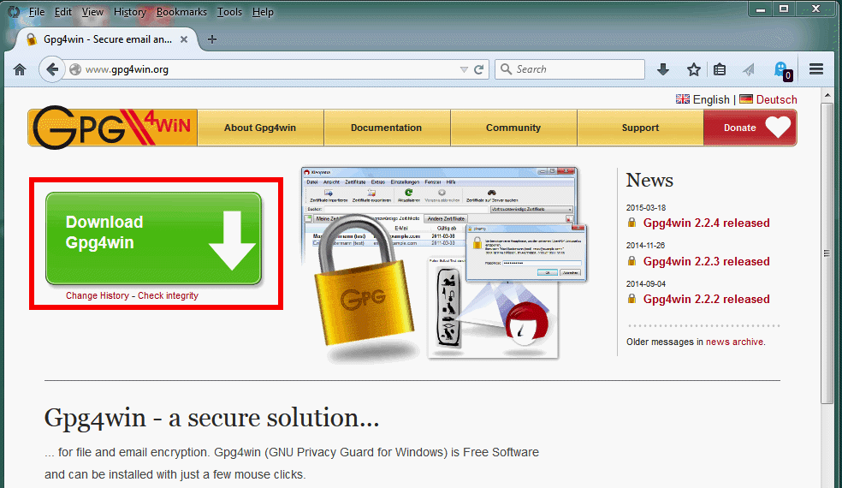
The Gpg4Win Top Level Web Site's Download Link

Slide 95
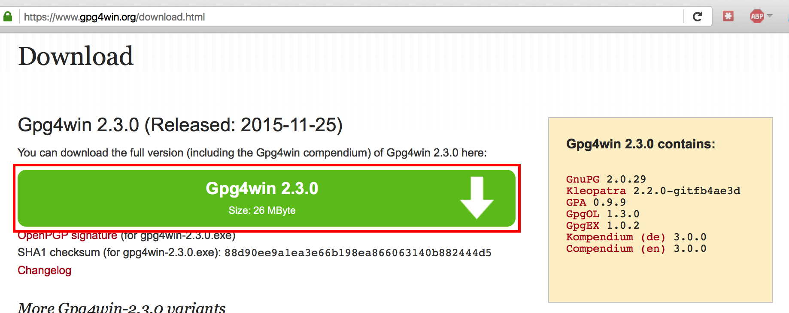
There Are Several Download Options; Unless Space Is Really Tight, Do The Full One

Slide 96
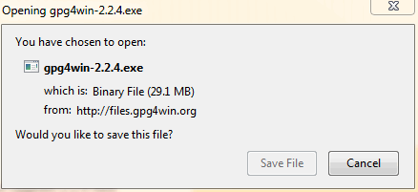
Normal Firefox Download Process, Yielding...

Slide 97
Verifying The Distribution's Integrity
To check that the binary has not been tampered with, you can check it's sha1 checksum value. For information on how to do this, see: https://support.microsoft.com/en-us/kb/889768 The sha1 checksum you see should be 8ddcbf14eb6df11139f709320a71d197a83bf9e1 (and as shown at http://www.gpg4win.org/download.html )
However, note that the Gpg4Win installers are signed with a globally trusted cert, which may incline you to skip or deprioritize this step (See http://www.gpg4win.org/package-integrity.html )

Slide 98
Anyhow, When Ready to Proceed, Just Double Click The Downloaded File to Start the Installer
Note: Depending on the version of Windows you're running, you may need to explicitly allow the installer to modify your computer (please allow this, if asked).
You may also be asked to pick a preferred language.

Slide 99
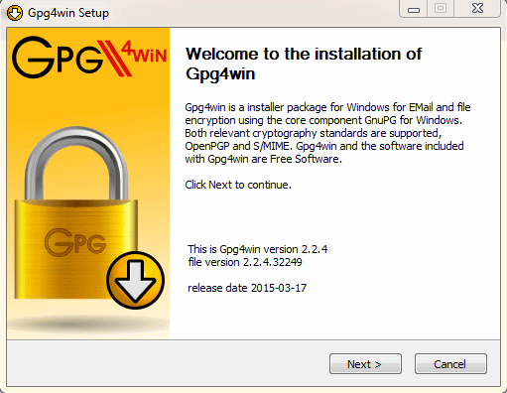
Opening Screen

Slide 100
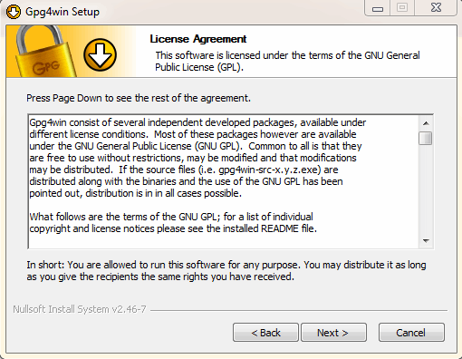
Accept The GNU GPL

Slide 101
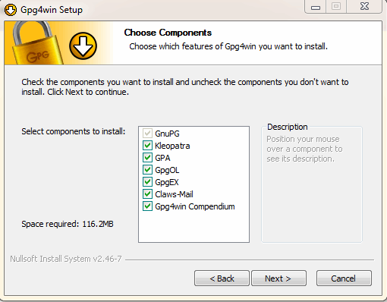
Choose Components To Install (Go Ahead and Choose Everything)

Slide 102
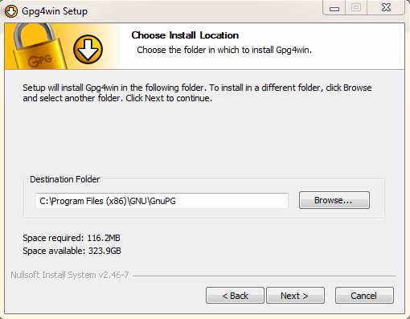
Pick An Install Location (I Suggest Accepting the Default Location)

Slide 103
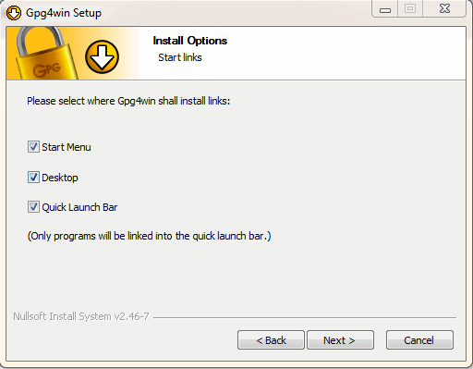
Stick Start Links "Everywhere"

Slide 104
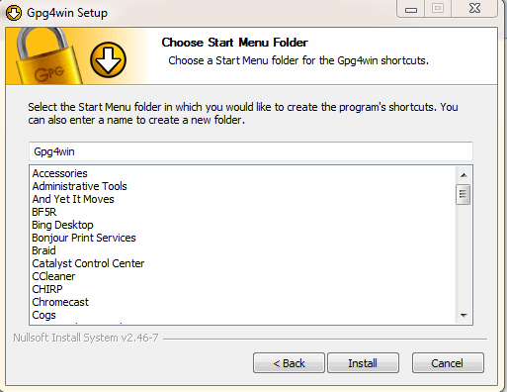
Confirm The Default Start Menu Folder Name

Slide 105
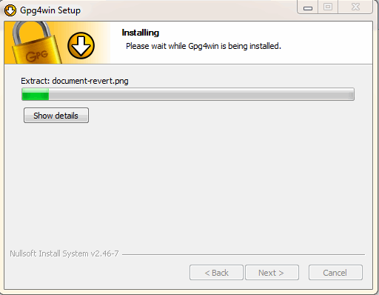
Installing...

Slide 106
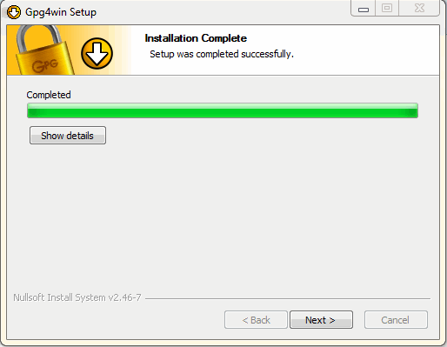
Normal End of Installation

Slide 107
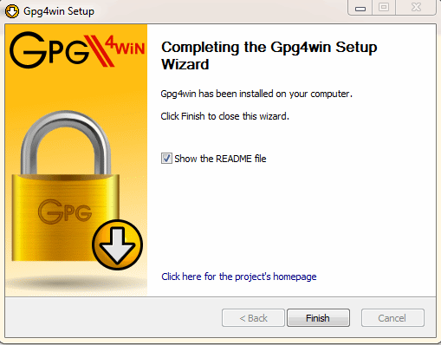
Setup Process' Last Step Shows You the README

Slide 108
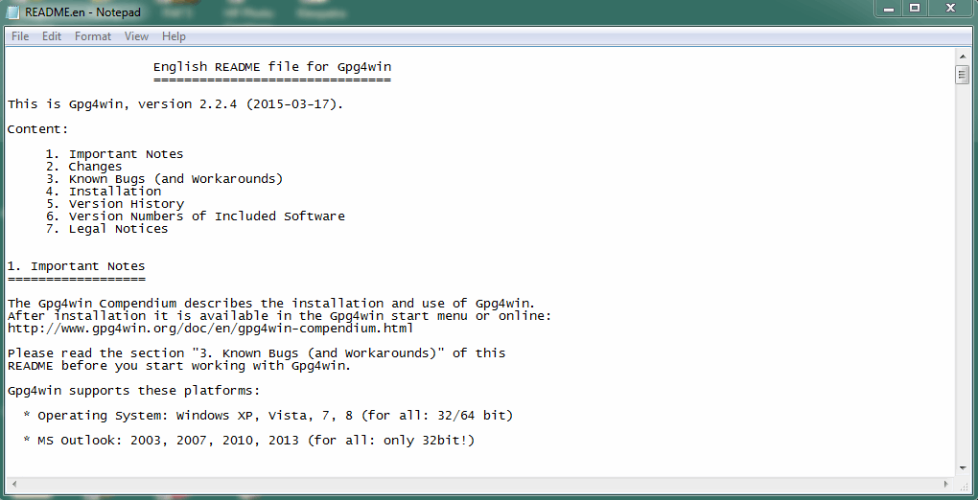
The README file
Note: The "Gpg4win Compendium" == the Gpg4win user manual

Slide 109
Windows-2: Creating and Managing YOUR OWN Keypair

Slide 110
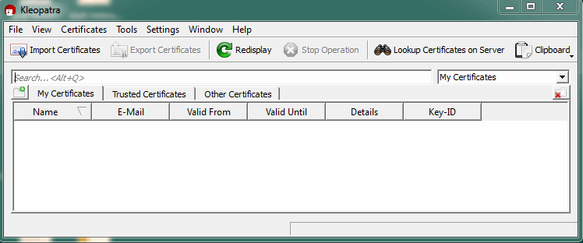
Start Kleopatra From Your Desktop or From The "All Programs" Menu
Note: You may be prompted to create a key pair the first time you run Kleopatra; if not, simply go to File → New Certificate

Slide 111
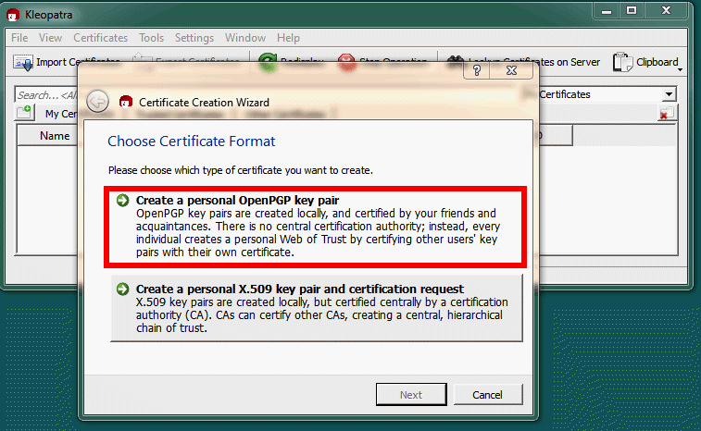
Choose Your Key's Format: Select OpenPGP

Slide 112
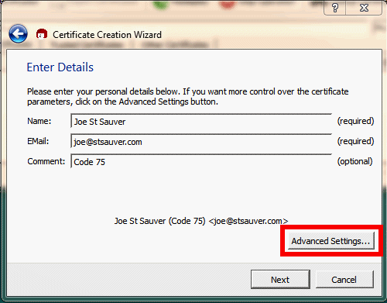
Create Your Keypair
Note: Enter your own information; a comment is optional.
Note: Do NOT just click NEXT! Click on Advanced Settings, instead!

Slide 113
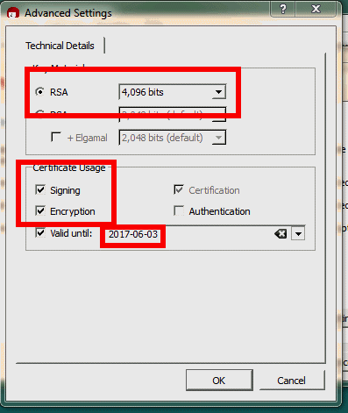
Create Your Keypair: Advanced Settings
Note: Do an RSA 4096 bit key, used for signing and encryption
Note: Pick a reasonable expiration date (1-5 years is usually fine)

Slide 114
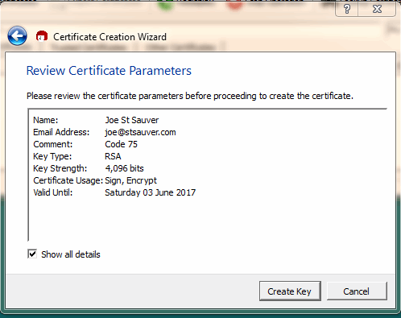
Review Certificate Parameters

Slide 115
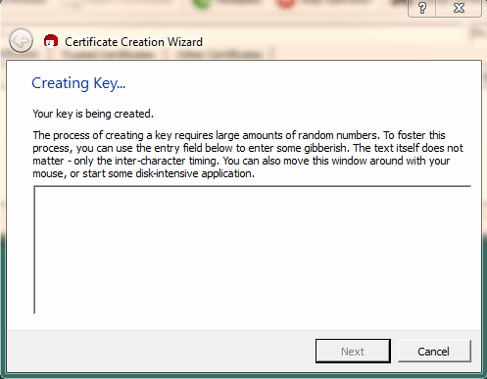
Do Stuff While Your Keys Are Being Created

Slide 116
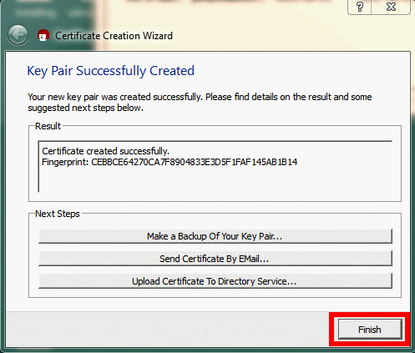
Key Pair Successfully Created

Slide 117
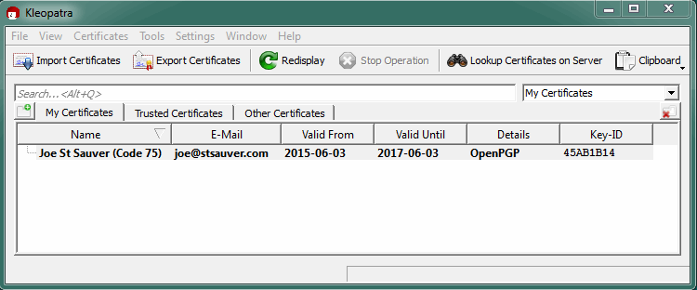
My New Key in the Kleopatra Certificate Display

Slide 118
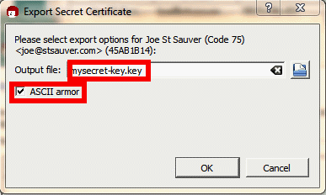
Export Your SECRET Key For Backup Purposes
Select your new keypair in the Kleopatra Certificate Display Window, then go to File → Export Secret Key
Provide a file name, and confirm the directory where you'll be
saving this file. Also be sure to check the "ASCII armor" box. Save this file somewhere safe, such as on a thumb drive in your safe deposit box. Safely save your passphrase somewhere else.

Slide 119
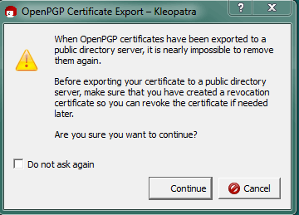
Now Push Your PUBLIC Key To the Keyservers
Select your new keypair in the Kleopatra Window, then go to File → Export Certificates to Server
Note: You may also want to export a copy of your certificate (File → Export Certificate) for mailing directly to those who
prefer not to use keyservers.

Slide 120
Windows-3: Getting and Managing Other People's Public Keys

Slide 121
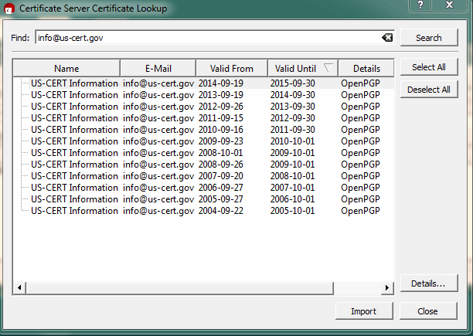
Look Up A Cert on the Public Keyservers
For example, let's find the one for info@us-cert.gov...
Suggestion: select the one that's currently valid! ☺

Slide 122
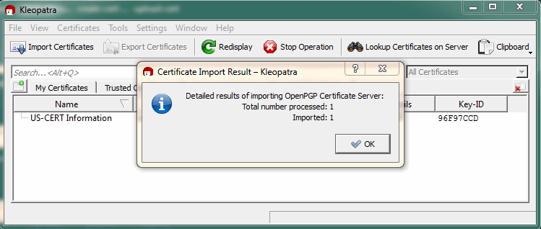
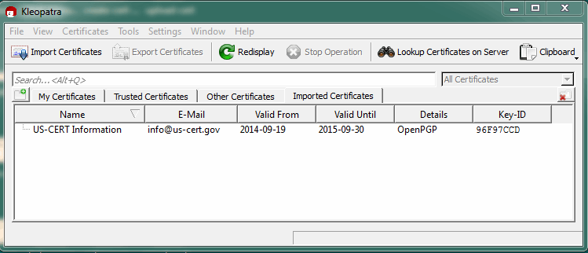
After Importing, You'll See...

Slide 123
Windows-4: Signing A Message You've Made

Slide 124
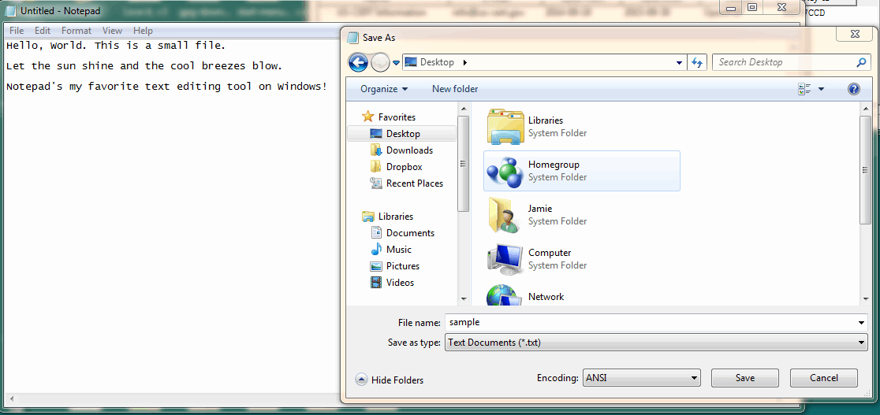
Create a Small Sample Message Using Notepad And Save It On Your Desktop (sample.txt) in ANSI Format
Note: If you don't normally use Notepad, you can find it under All Programs → Accessories folder → Notepad

Slide 125
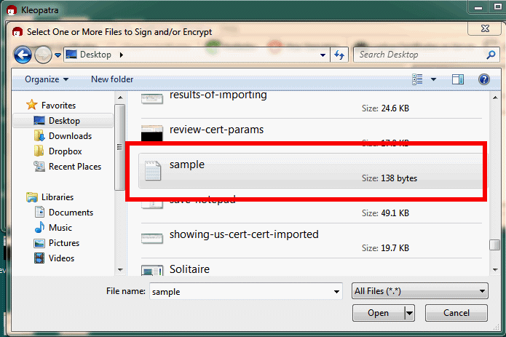
Select That File For Signing
Go to File → Sign/Encrypt Files..., then select the sample.txt
file from the Desktop (the .txt extension may not show by default

Slide 126
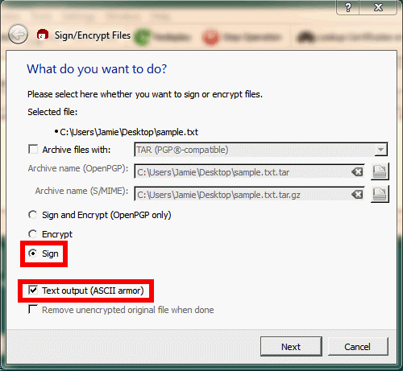
Sign The File

Slide 127
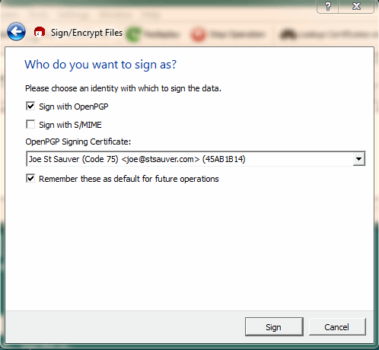
Pick HOW You'll Sign

Slide 128
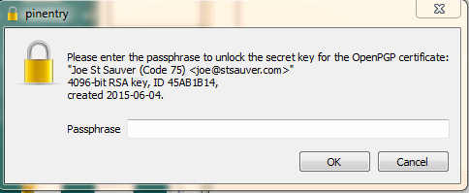
Enter Your Passphrase

Slide 129
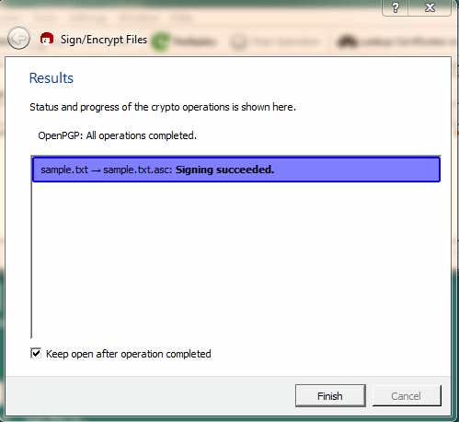
Signing Successful

Slide 130
Windows-5: Validating A Signed Message You've Received

Slide 131
When You Receive A PGP-Signed Message...
Save the message to a file.
In Kleopatra, go to File → Decrypt/Verify Files... and select the file whose signature you want to verify
If you don't have the key needed to validate that file, see the Windows-3 section above discussing how to get a user's public key (you probably WILL already have that key, at least if it's someone you routinely exchange PGP/GPG messages with)

Slide 132
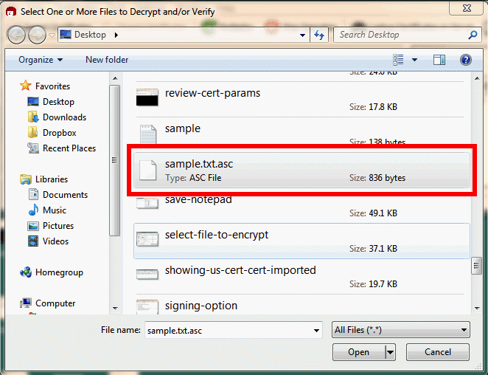
Select A Signed File To Validate – Heck, Let's Validate The Sig on the Msg We Just Signed!

Slide 133
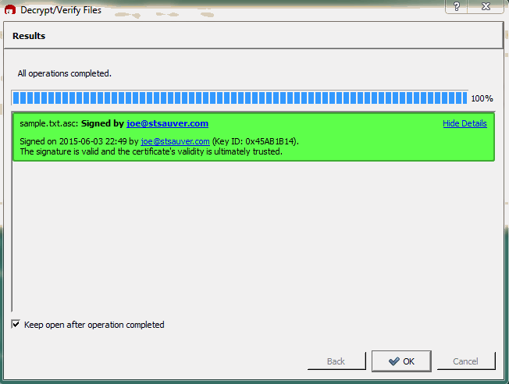
The Signature On Our File Is Valid

Slide 134
Different PGP/GPG Signature Structures
One of PGP/GPG's challenges is the wealth of features it has accumulated over time. This is true for signatures as well as for other aspects of PGP/GPG.
Signed documents can be in clearsign'd form, binary form, or ASCII armored form.
Signatures can also be sent either as part of the file itself, or as a separate ("detached") signature. If you're signing a text document, either will work, but if you're signing a binary file, the detached signature will ensure that the binary file isn't accidentally "munged" by the signing process. (The downside of doing a detached signature is that both the original file AND the separate signature file need to get sent)

Slide 135
Files Damaged In Transit
Some mail clients may try to be "helpful" by doing things like wrapping lines or otherwise messing around with a message.
In other cases, some sites may intentionally rewrite URLs in messages so that if any of those URLs ultimately "go rogue," security software can remotely break those dangerous links.
Sadly, ANY change to the body of a PGP/GPG-signed message, even just reformatting lines, will invalidate the signature associated with that message.

Slide 136
Windows-6: Encrypting a Message To Protect Against Eavesdropping

Slide 137
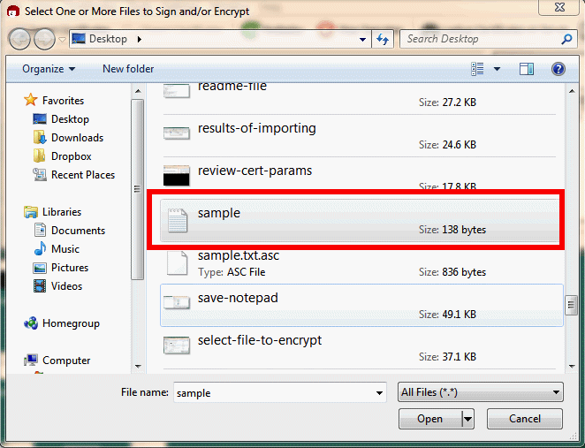
Encrypting a File With Gpg4win
Start the encryption process by going to File → Encrypt/Sign...
and picking the file you want to encrypt.

Slide 138
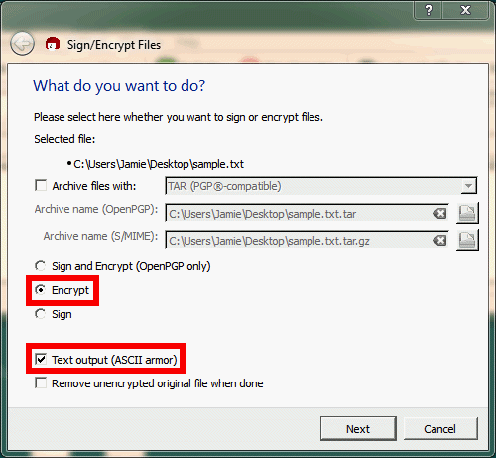
Select "Encrypt" and "Text Output"
BE CAREFUL! Do NOT accidentally click "remove unencrypted original file!"

Slide 139
On NOT Deleting Unencrypted Original Files
The encryption panel in Gpg4win gives you the option of deleting your original unencrypted file after producing the encrypted version. While this is a tempting "convenience" option, I would encourage you to NOT routinely use it.
My thinking: a) Sometimes you simply want to keep an unencrypted copy of your original file b) Other times you may think you're going to send an encrypted copy to yourself, but forget to actually do so – won't you be happy that you still have the unencrypted original? c) You can manually delete the file with a file wiping program

Slide 140
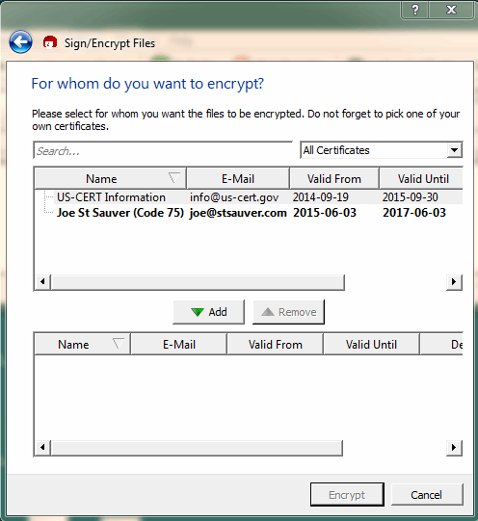
Select A Recipient For The Encrypted File Then Hit the Green "Down Arrow" Add Button

Slide 141
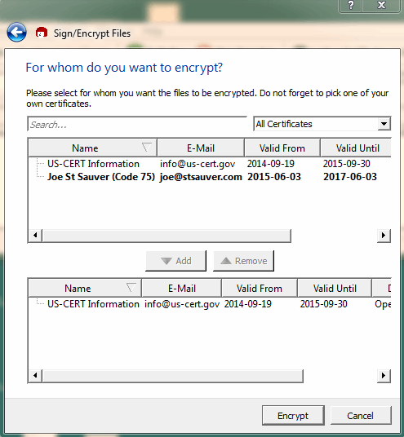
For Example, We Chose US-CERT...

Slide 142
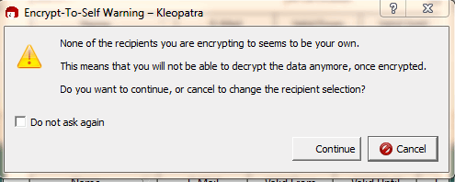
Since We DIDN'T Also Add Ourselves, We're Going to Get A Warning

Slide 143
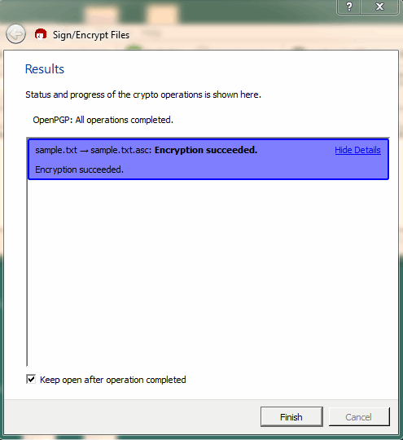
Wingpg4 Verifies That The Encryption's Done

Slide 144
Send That Encrypted File To Your Recipient
The encrypted file temp.txt.asc can then be sent to your recipient by cutting and pasting it into a regular email message
NOTES: Be SURE you get the right file, e.g., the encrypted one!
Encrypted files about sensitive topics should NOT have revealing email subject lines (remember, those are NOT encrypted)
If you encrypt one file to multiple people, each person will be able to ascertain the identities of all the other recipients also able to read that file; in some circumstances, this may be sensitive information. You can deal with this by encrypting your message for just one user at a time.

Slide 145
Windows-7: Decrypting an Encrypted Message You've Just Received

Slide 146
To Decrypt an Encrypted Message You've Received
Copy and paste or save the encrypted message to a file.
In Kleopatra, go to File → Decrypt/Verify
Choose the file you want to decrypt

Slide 147
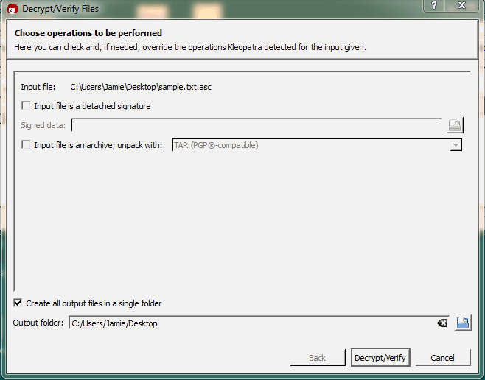
Decrypting...

Slide 148
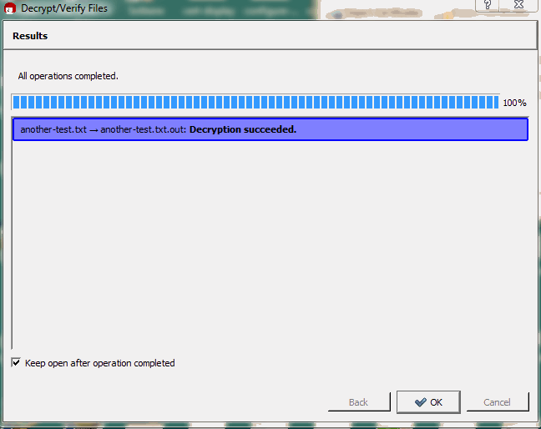
Successful Decryption!

Slide 149
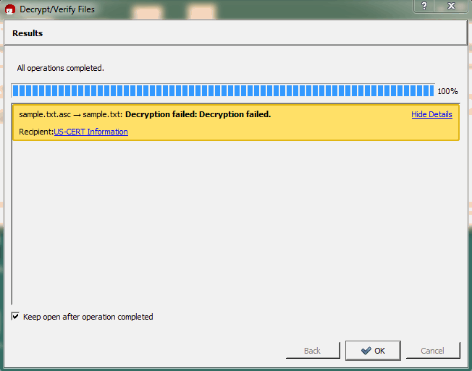
What You'll See If You CAN'T Decrypt (Since I'm Not US-CERT, And This Message Was Encrypted ONLY For Them With Their Key, This Makes Sense, Right?)

Slide 150
Windows-8: Signing Another User's Public Key

Slide 151
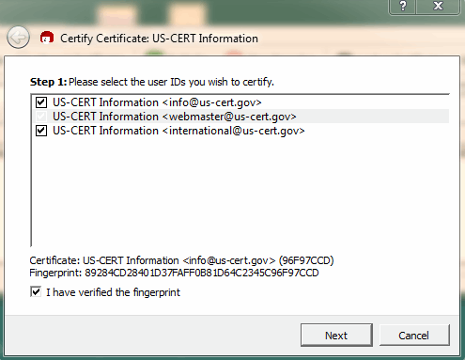
To Sign Another User's Key (After You've Verified Their Passport & Confirmed Their Key Fingerprint)...
Select the public key you want to sign from the Kleopatra's
List of "Other" certificates, then go to Kleopatra's Certificates Menu → Certify Certificates and pick the relevant IDs

Slide 152
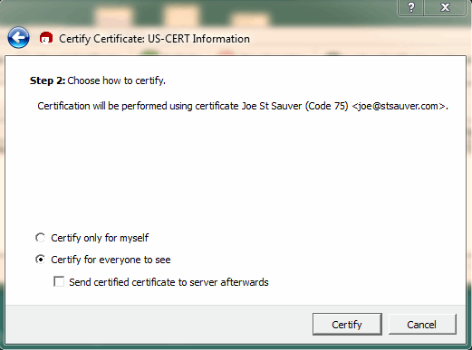
Confirm That You Want To Publicly Sign It...
Do NOT click "send certified certificate to server afterwards"

Slide 153
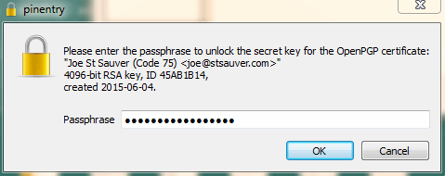
Enter Your Passphrase

Slide 154
Send The Signed Key Back To Its Owner
Select the key you just signed
Click "Export Key"
Save that key to a file
Send that file to its owner by email for their use (or for THEM to publish to a public key server, if they want to do so)
Is this a bit of a hassle? Yes. Is it the courteous way to sign a key? Yes.

Slide 155
Windows-9: Importing Your Own Key After It Has Been Signed

Slide 156
Assume Someone's Just Sent You Your Public Key, Signed By Them
Check your notes: is this someone who properly validated my ID and key fingerprint somewhere? If so, save the signed key to a file. If not maybe check with the user and figure out what's going on?
In the Kleopatra certificate viewer, use the Import Certificates button to select the file you just created (containing the newly signed key) and add it to your key ring.
Optionally, export that signed file to a key server by going to File → Export Certificates to Server... ONLY EXPORT YOUR OWN PUBLIC KEYS TO A KEYSERVER; DO NOT PRESUME TO MAKE THIS IRREVOCABLE CHOICE FOR OTHERS!

Slide 157
Windows-10: PRACTICE!

Slide 158
Windows Users: Practice For A Few Minutes!
You've now got all the skills you need to do simple PGP/GPG messages.
Pair up with another user from class, and do the following: a) create a key pair for yourself if you haven't already done so b) get a copy of your partner's public key c) send a signed message to your partner d) send an encrypted message to your partner e) verify the signature of the message you received from your partner f) decrypt the message you received from your partner g) if so inclined, sign your partner's key and send it back to them

Slide 159
GPG CONVENIENCE TOOLS

Slide 160
Integrate GPG With Thunderbird Using Enigmail
The approach we've shown up until now is (candidly) pretty clunky, often involving copying and pasting stuff. While that works fine for an occasional message, you probably wouldn't want to have to do it for a hundred messages a day.
If you're going to be routinely using GPG all the time, you probably want it to be closely integrated with a point-and-click email client such as Mozilla Thunderbird.
The best way to integrate GPG with Thunderbird is by installing the free Enigmail plugin. It works on Macs, PCs, Linux, etc.
It's available from https://www.enigmail.net/download/index.php or in Thunderbird go to Tools → Addons and search for enigmail
If you don't already have Thunderbird installed, you can get it from https://www.mozilla.org/en-US/thunderbird/

Slide 161
Thunderbird Configuration Caution #1
Thunderbird supports both POP and IMAP connections.
Thunderbird will attempt to heuristically configure your connection the first time you run it.
BE CAREFUL. Do NOT configure Thunderbird to use POP to access your existing email account! If you do, you will download all your existing email to your laptop and it may be deleted from your server!
Use IMAP instead! Do NOT use POP!

Slide 162
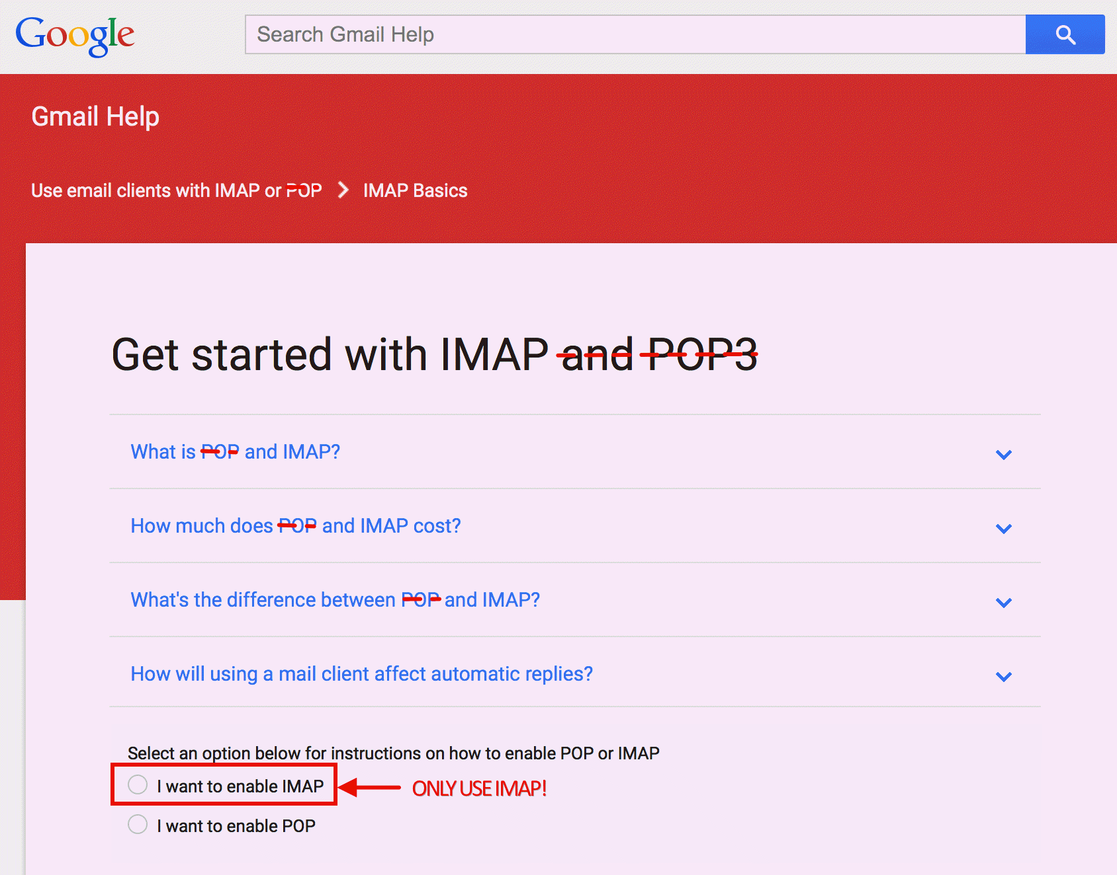
GMail and IMAP

Slide 163
Caution #2: Enigmail and Thunderbird Updates
From time-to-time, the Thunderbird project may produce updated versions of Thunderbird. When that happens, the Enigmail plugin may continue to be compatible, or it may need to be tweaked and updated in order to continue to interoperate. If you routinely use and heavily rely on Enigmail, do NOT update Thunderbird unless you're SURE Enigmail is compatible with the new version.
Normally you will be automatically prevented from "shooting yourself in the foot" this way, but sometimes folks will override the compatibility check and install an incompatible new version without pondering the implications of their decision.
Don't do that. Really. Just don't.

Slide 164
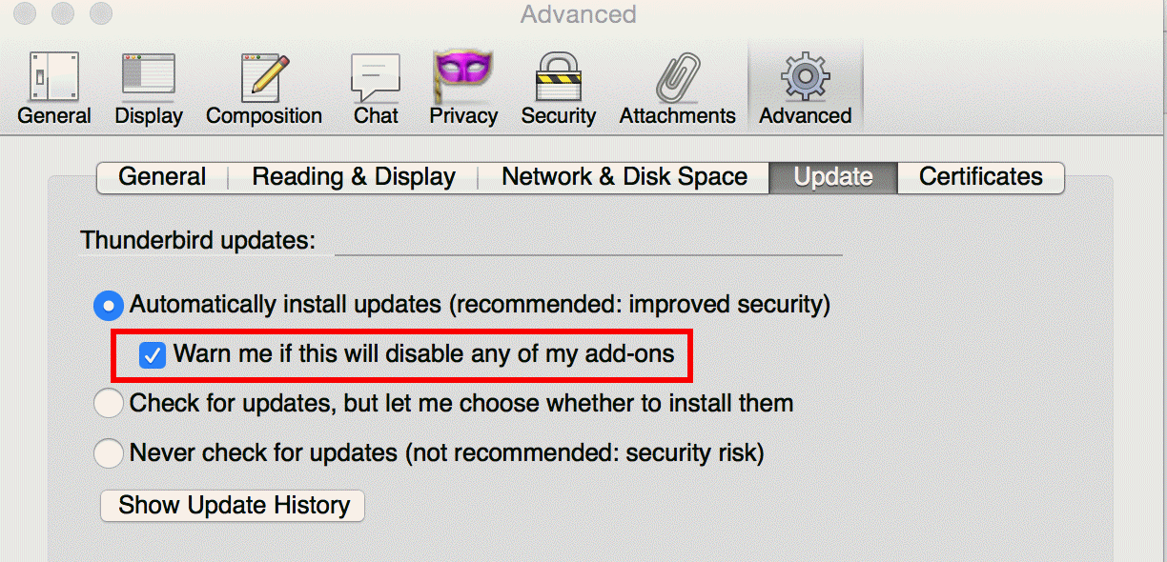
The Critical Check In Thunderbird Advanced Prefs

Slide 165
Caution #3: Last Version to Support Classic GPG
Note: one Enigmail option is to install GNU Privacy Guard 2.x along side GNU Privacy Guard 1.4.19.
Let's proceed, notwithstanding this...

Slide 166
Installing Enigmail From Within Thunderbird

Slide 167
There's a Setup Wizard, But You Don't Need It

Slide 168
Basically Just Click Done

Slide 169
Manually Configuring Settings For Your Account

Slide 170
NO HTML! Compose in Plain Text ONLY

Slide 171
Configuring OpenPGP Security

Slide 172
Configuring Enigmail Preferences: Basic Is OK As-Is

Slide 173
Configuring Enigmail Preferences: Sending Tab Tweaks

Slide 174
Notes: Enigmail Can Be Quite Particular
Enigmail "works best" if your GPG key matches the account you've got configured in Thunderbird, character for character.
If you want to use an existing keypair (associated with a different userid) for an account you've got configured in Thunderbird, you can go to Enigmail → Key Management and add an additional identity to your existing key pair: -- select the key that's going to get the additional identity -- right click on that key -- click on Manage User IDs -- click on Add -- provide the new identity -- provide your passphrase for the existing ID -- select one of the IDs to be "primary"

Slide 175
Write A Message With Thunderbird & Enigmail

Slide 176
Receive A Message Using Thunderbird & Enigmail

Slide 177
"But Joe! I Use A Webmail Account!"
There are solutions for that circumstance, too.
For example, many popular webmail account providers allow IMAP clients (such as Thunderbird) to connect to the "webmail" account. You don't HAVE to use the web email interface. You can use Thunderbird instead.
However, if you like using a webmail account, as long as you're using your own laptop with Firefox or Chrome, you can use Mailvelope to add GPG support to most popular webmail interfaces. See https://www.mailvelope.com/ for more information

Slide 178
"Any Other Options I Could Consider?"
Another relatively new PGP/GPG convenience product you might want to experiment with is Mailpile, see https://www.mailpile.is/
Mailpile is under active development, so be sure you're comfortable working with beta code
Read the known issues at https://github.com/mailpile/Mailpile/wiki/Release-Notes-201507-Beta-III and the security roadmap at https://github.com/mailpile/Mailpile/wiki/Security-roadmap

Slide 179
KEY SIGNING PARTY

Slide 180
That's About All The Formal Presentation For Today
I suspect you're full up to the gills at this point. That's okay. You've learned a lot today! We'll skip doing a summary here...
By now you may have signed at least one class partner's account.
If we have time, I'd like to offer the chance for other people to also arrange to have their keys signed.
This is often done at a "PGP key signing party." See for example http://www.cryptnet.net/fdp/crypto/keysigning_party/en/keysigning_party.html

Slide 181
OPTIONAL: IF You'd Like To Participate
Upload your public key to the keyserver so others can easily find it
Write your name, email address, and the fingerprint for your key on a slip of paper. If you want one other person to sign your key, make one such slip. If you're hoping to have six other people sign your key, make six such slips, etc. PRINT *LEGIBLY*, PLEASE!
Ask a colleague to sign your key. IF THEY'RE WILLING: -- give them one of your slips -- show them your passport or driver's license -- your colleague makes a notation that they've confirmed your identity on the slip they've received from you, saving that slip
If you've agreed to sign someone's key, sometime in the next day or so, download a copy of their key, check to make sure the name and fingerprint match your slip for them, sign their key, and email it back to them. PLEASE DO IT IF YOU SAY YOU'RE GOING TO!

Slide 182
Thanks for Coming To Today's Training!
Are there any questions?
Please also remember to fill out the evaluations!
Copies of this presentation are available online at https://www.stsauver.com/joe/pgp-tutorial-sfo/ and may be freely shared with others who may be interested (even outside of M3AAWG)

