Slide 1
"Those Dang Passwords – They're Just Driving Me Crazy!" Some Introductory Remarks For A Panel on Passwords in Portland, Organized By The Oregonian
Joe St Sauver, Ph.D.
Disclaimer: All opinions strictly my own

Slide 2
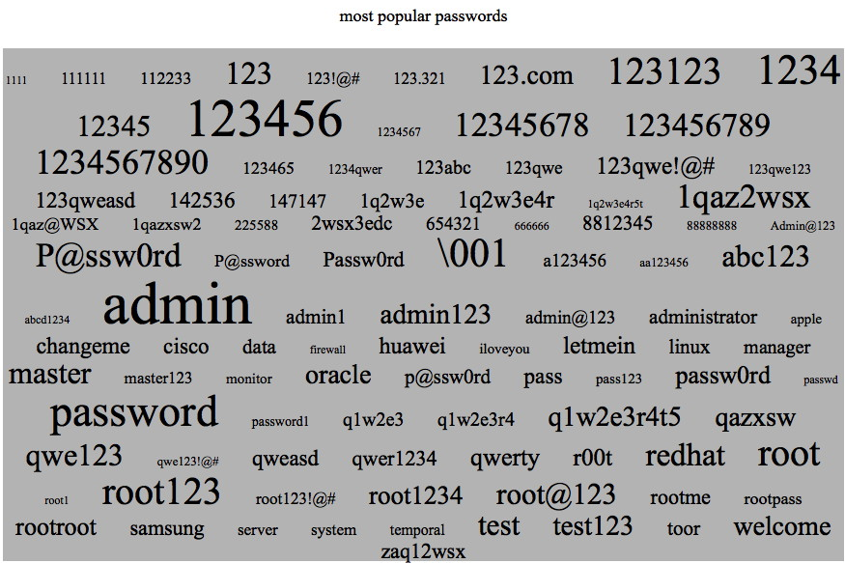
Tonight's Focus? Those Dang PASSWORDS!
Source: https://www.dragonresearchgroup.org/insight/sshpwauth-cloud.html

Slide 3
Do YOU Use Any Of Those Passwords? (Or Any OTHER Weak Passwords?)
I sure hope not!
Those are the passwords that the Dragon Research Group (DRG) found hacker/crackers try most often when guessing the passwords of ssh (secure shell) accounts.
Why do attackers try those passwords? The passwords on that list include some known default passwords (that may never have gotten changed), plus passwords that are empirically known to be popular with many average users. Users may use them for their email accounts, or for accounts at online merchants, etc.
If you use one of those passwords (or any other simple password, including any word from a dictionary), it's just a matter of time until bad things happen.

Slide 4
Why Do The Bad Guys Want Passwords?
In most cases, it's nothing personal, it's "just business."
Most cybercrime is monetarily motivated: hacking your accounts is just a way for a cyber criminal to make a buck.
Maybe they'll "just" send spam from your account.
Then again, maybe they'll clean out your bank account.
So HOW do bad guys steal your passwords?

Slide 5
The Malware Problem
Malware is the most common way that passwords get popped.
If your computer does get infected with some types of malicious software, that malware may snoop and report on whatever you type – including your secret passwords.
It's therefore critical that you strive to keep your computer malware free (one good option is to use an operating system that doesn't get hit by malware much, since antivirus really isn't all that effective any more).
Regardless of which operating system you use, make sure you keep everything patched up-to-date! (Try Secunia PSI on your personal Windows systems, see http://secunia.com/vulnerability_scanning/personal/ )

Slide 6
A Few Other Attacks Against Passwords
Maybe we'll just "look over your shoulder" as you type your password in at a meeting (or maybe you'll sit under a conveniently-placed ceiling-mounted security camera!)
Maybe you'll "volunteer" your password if we just ask you to tell us (e.g., social engineering/phishing attacks).
Maybe your password is being transmitted over the Internet in clear text (e.g., unencrypted) -- if so, maybe we can try to eavesdrop upon it ("sniff it") as it goes past.
If I have physical access to your system, maybe we'll just plug in a USB hardware key logger, and intercept everything you type (including your password) that way.
There are a million ways that plain old passwords can easily fail...

Slide 7
Password Resets: Another Weak Spot
I'm sure everyone here has had to reset a password at least once. You know how that tends to work – normally you see one of two options: - You supply answers to trivia questions ("What's your favorite football team?" – how hard is that to guess?) Attackers may also look up trivia on social media sites. - The other common alternative? You get a "password reset link" sent to an email account you've preregistered. Does that make you feel a little nervous? It should.
If I can just get control of your email account, I can then try to "reset" the passwords to all your other accounts.

Slide 8
One Option: Avoid Creating Accounts
The simplest step: if possible, avoid creating accounts in the first place. Resist "signing up."
If you don't have a username and password for a site, there's nothing to get hacked, and you've got one less account to worry about.
Of course, if you don't sign in, you may not be able to access some content or some services.
However, if you don't "sign in" (and if you don't accept cookies, etc.), it also becomes harder for marketers to track your online activities.

Slide 9
When You Have No Option...
Sometimes you have no choice but to create an account and password.
When that's the case, create a username and password that's unique to just that site.
You and I both know what a "good" password "should" look like, right?
It should be "long" (but somehow still easy to remember), while being formed from a "rich character set" including upper & lower case letters, numbers, plus punctuation or oddball symbols (e.g., .,?!;:`~@#$%^&*-+=/|\<>[](){})

Slide 10
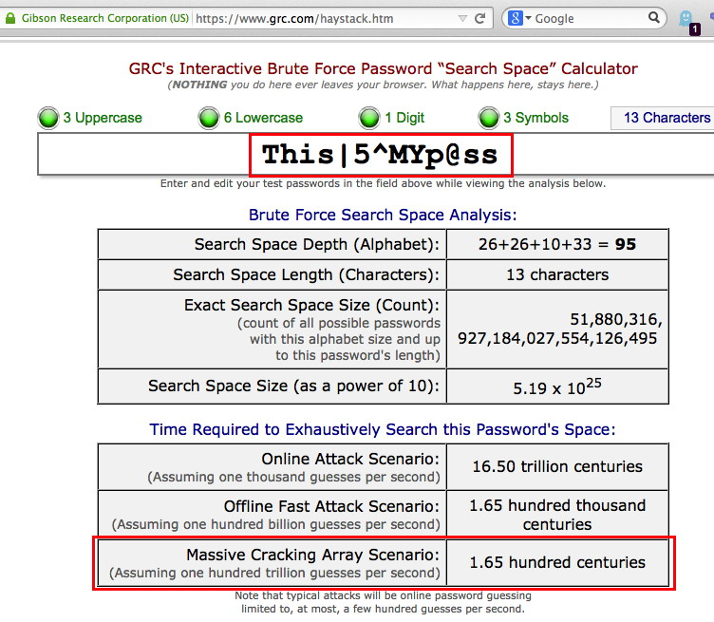
A Sample "Complex" Password

Slide 11
One Slight Problem With Complex Passwords
People have a hard time remembering complex strings. For example, I bet you don't remember the password I just showed you on the preceding slide... or do you?
People being people, they tend to use easier-to-remember passwords, instead. For example, perhaps they set their password to something like "baseball" or "hockey"
While that's easier to remember, it's also easy to brute force, or even to just guess through a dictionary attack. [What's a dictionary attack? Try all the words in the dictionary as possible passwords. FWIW, there are only about 250,000 words even in a big English dictionary, so that's a pretty short list for an attacker to try...]

Slide 12
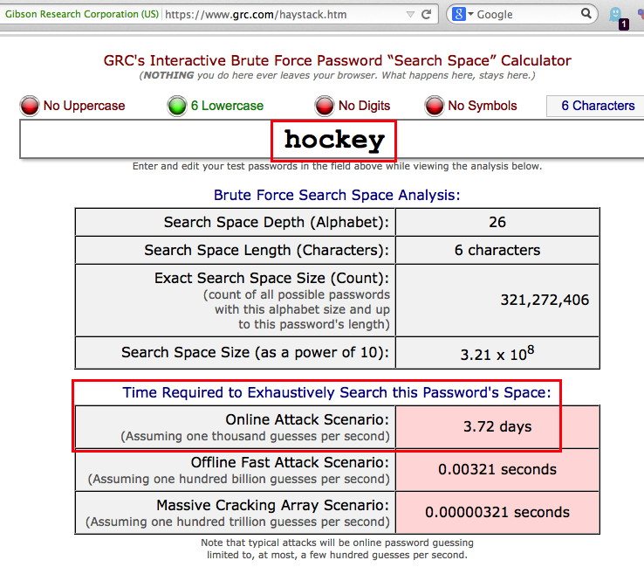
Sample Six Character Password

Slide 13
Passphrases To The Rescue (Maybe)
While people have a hard time remembering random unpronounceable strings with numbers and weird characters and odd capitalization, most people CAN remember a relatively long "passphrase..."
Pass phrases can be a more secure alternative, at least if: -- the site you're logging into allows you to use long passwords (some will, some may not) -- the site allows you to use words from the dictionary in your password (again, some may, some may not) -- your pass phrase isn't a well known cliché or otherwise overly common ("a penny saved is a penny earned")

Slide 14
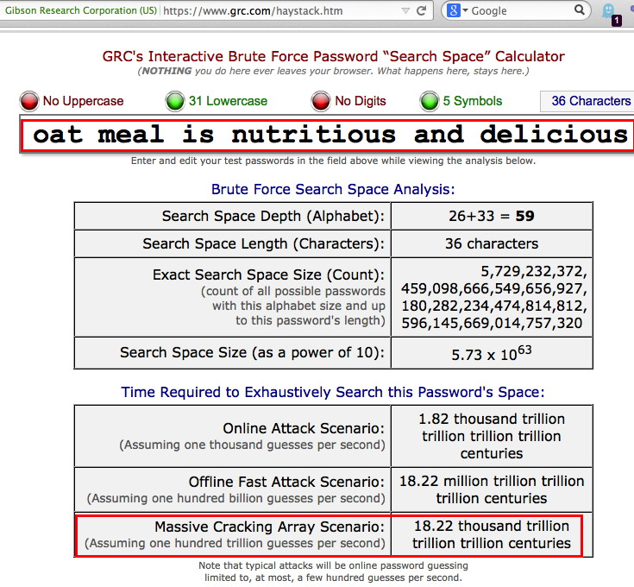
Sample 36 Character Passphrase

Slide 15
Another Problem: Lots of Accounts
Another problems is that we all have too many accounts to keep straight. So what do people do? - Maybe you use the same username and password "everywhere..." When that happens, if an attacker can crack your username and password on one site, they can use it on on all the sites where you have accounts. - People may save their passwords (insecurely) in their web browsers... - Still other users just give up and continually "reset" their passwords every time they need to login.
Is there no better solution if you have lots of accounts?

Slide 16
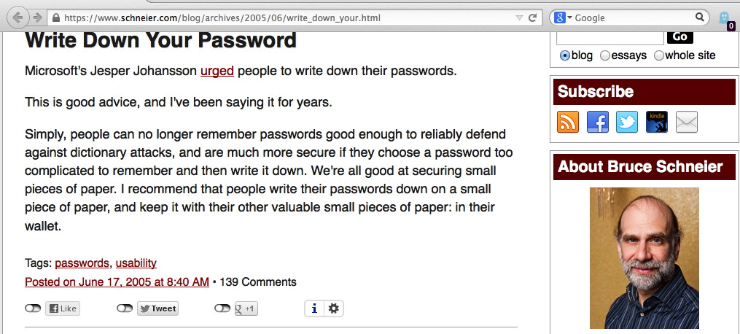
Important Note From Joe: this only works if you trust those who have access to the content of your wallet, and you never lose your wallet...
Additional Important Note From Joe: this is NOT a recommendation that you should tape your username and password to the side of your computer where anyone walking by can see it!

Slide 17
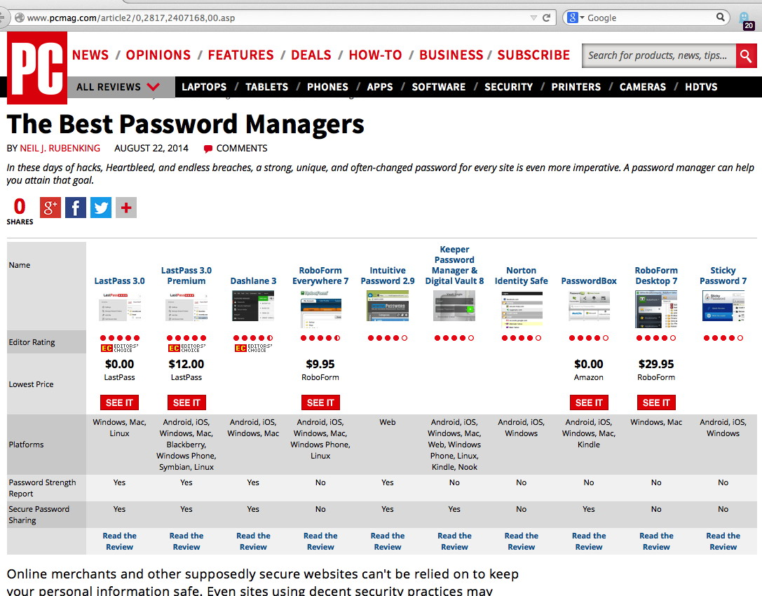
Or Maybe Try A Password Manager?

Slide 18
Multifactor: Better Than Passwords Alone
If you use an ATM card you're already familiar with one type of multifactor authentication: you need to supply your ATM card (something you have), PLUS you need to supply your PIN code (something you know).
Two factor authentication for your computer accounts works in a similar way: after you login as you normally would with your username and password, the service you're logging into might contact you via your registered cell phone to confirm that it's "really you."
You might need to enter a six digit code that they give you; other times you may simply push "ok" button on your phone to signal that you really want to proceed.
If the sites you use offer some sort of multifactor authentication, please, USE IT!

Slide 19
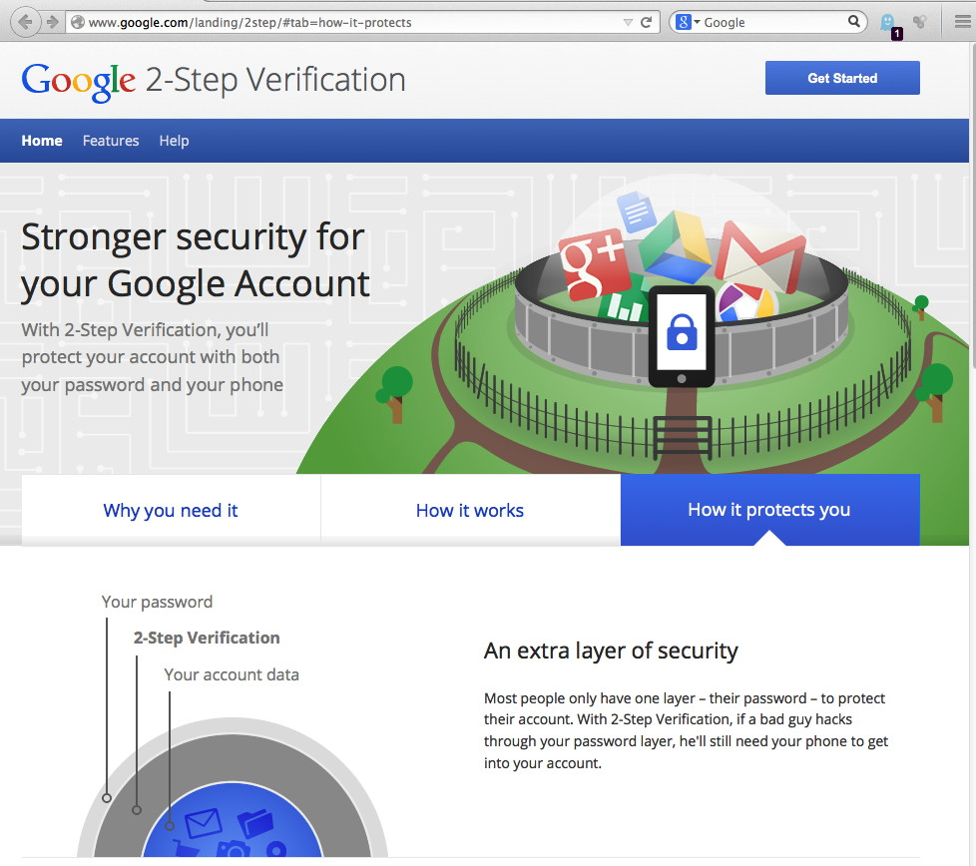

Slide 20
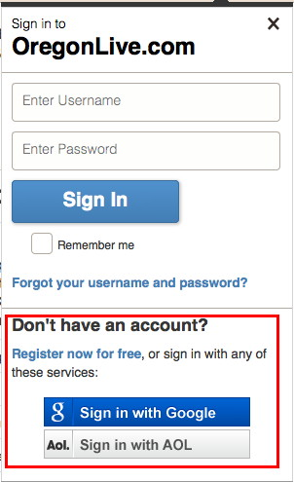
Another Alternative... Federated Auth
You could also try using "federated auth."
For example, you may have noticed that some sites will let you login with your credentials from another site (such as Facebook or Google). That's usually a sign that you're at a site that's doing some type of federated authentication.

Slide 21
Important Notes About Federated Auth
Federated authentication is NOT the same as just using the same username and the same password on multiple sites! Doing THAT is a REALLY BAD idea. (Fortunately, federated auth is NOT the same thing at all!)
Some illegitimate sites may try to trick you into thinking that you're doing federated authentication when you're really not (this is a not uncommon phishing ploy). Pay very careful attention to the site you're actually logging into!
Logging in with social media credentials may share more about you and your friends than you realize or intend. The best types of federated authentication strictly limit the information about you that get shared with 3rd party sites to just the minimum amount necessary. (Other types of federated auth may simply share way, way, too much)

Slide 22
Conclusion: It's Your Choice. What Will You Choose To Do?
Many users ignore cyber security issues. That's probably not you, or you wouldn't be here tonight.
Others will take modest steps, such as at least making sure your computer is virus free and patched up-to-date, and maybe trying a password manager.
A still smaller group of people may decide to do whatever it takes to live a "security-oriented lifestyle" (including using multifactor authentication).
And a few may become so discouraged that they decide to stop using the Internet altogether (but that's a shame – there's a lot of terrific benefits to using the Internet)
What will YOU choose to do?

