Slide 1
Nowhere To Hide: Using Passive DNS
To Find Spammer Infrastructure
M³AAWG Paris, France
12:30-14:30, October 24th, 2016
Forum ABC Room, Level 0
Joe St Sauver, Ph.D. (stsauver@fsi.io)
M3AAWG Sr. Technical Advisor
Scientist, Farsight Security, Inc.
https://www.stsauver.com/joe/nowheretohide/

Slide 2
– Social Media Posting Allowed –
Twitter, Facebook, LinkedIn, other social media posts are permitted during this session, PROVIDED THAT YOU...
DO NOT post the private link provided for attendees to use to obtain a free account for training purposes
Only post comments made by the speaker
Do not post comments or questions from the audience (but you can share the speaker’s responses to questions)
Do not post the name, position or company of other meeting attendees
Do not post conversations with attendees
M³AAWG is not a deliverability conference; we are
  An industry working group meeting
  An anti-abuse conference, or
  A gathering of security experts
All of the M³AAWG Membership, Trademarks and Logo guidelines apply
https://www.m3aawg.org/members/how-promote-m3aawg#TrademarkGuidelines

Slide 3
Welcome To The Paris Passive DNS Training!
Let me begin by thanking Anna, Chris & Udeme for the invitation to do passive DNS training for you here in Paris.
I also want to thank all of you for making the time to sit in on today's session – I know that you're in "La Ville Lumière" with lots of tempting sites to see and wonderful bars/restaurants to enjoy, so I'll do my best to make sure your training time is well spent.
We're going to begin by talking about passive DNS, and then, after that, if we still have time and there's interest, we'll go back and provide some optional backfill about "regular DNS"
(normally I'd reverse those sections, but I suspect that many of you already have a working fluency about DNS)
There will be a sign-in sheet going around if you need a certificate of attendance for your files back home.
Please also take the time to fill out a session evaluation.

Slide 4
A Disclaimer About The IPs and Domains Used Today
To illustrate the tools and techniques we'll be talking about today, I'll be showing examples that involve various IP addresses, netblocks, ASNs, and domains. Unless stated to the contrary,
I do NOT mean to imply that these are bad (or good!) IPs, domains, etc. (I'll often use colleges) These are JUST EXAMPLES.
You, however, when practicing with passive DNS, may want to try investigating domains that you believe to be suspicious.
Some of those sites may even be involved with malware.
Please do NOT investigate any sites that may be involved with malware while here at M3AAWG (we don't want anyone getting infected, or spreading an infection to others). If you do choose
to investigate such sites elsewhere, you do so at your own risk.

Slide 5
My Odd Slide Style
Let me also get one other thing "out of the way" up front: as you've seen by now, I produce detailed slides. Some people don't get why I use this style, so I now routinely try to explain this
I've tried the more-typical 3-4 bullets/slide (with ~15 slides for an hour long talk), but I find myself getting sidetracked, rambling/running over, or I end up missing/skipping stuff.
I also deal with complex issues, and I HATE to be misquoted.
My slide style prevents a lot of those problems, and means that you don't need to try to take notes.
That said, I'm not going to read my slides word-for-word for you. You don't need to try to do so, either, although they are a sort of "closed captioning" if you're deaf or hard-of-hearing.
I also write detailed slides to help people looking at them after the fact, and to facilitate indexing by web search engines.

Slide 6
Today's Session
I've prepared some material I'm planning to go over, but I encourage you to ask questions as we go along, should questions arise – I've explicitly left some time for you to do so.
I will also suggest some exercises you can try. The exercises are optional -- you can do them or skip them as you may like, but I think people learn more effectively when they actually try stuff.
Farsight is providing all attendees at today's session with complimentary temporary access to DNSDB for use as part of this training. If you don't want to use DNSDB, you're welcome to use another passive DNS system you may have access to, instead.
There are unavoidable differences between various passive DNS implementations and we can't document everything, but the techniques and approaches I'll show should broadly generalize. We want you to learn skills that will help you in your work.

Slide 7
Some Entities Offering Passive DNS Services
Farsight Security, Inc.'s DNSDB (see https://dnsdb.info/ )
  DNSDB is a commercial product, but individual law enforcement officers (LEOs), vetted academic researchers, and vetted-but-unfunded "Internet superheroes" can request free (grant) access from Farsight.
Some other passive DNS implementations include:
  Florian Weimer's BFK, http://www.bfk.de/bfk_dnslogger.html
  CERT.at/Aconet Passive DNS (inquire: kaplan@cert.at or lendl@cert.at)
  CIRCL Passive DNS, http://www.circl.lu/services/passive-dns/
  http://passivedns.mnemonic.no/search/
  https://www.opendns.com/enterprise-security/resources/data-sheets/investigate/
  https://www.cs.auckland.ac.nz/research/groups/sde/dhdb-index.php
  VirusTotal, https://www.virustotal.com/#search
  360.cn Passive DNS, https://www.passivedns.cn/help/
If I missed any other passive DNS sites, please drop me a note...

Slide 8
This slide intentionally omitted – it contained details about how in person attendees could get a DNSDB account for use during the training

Slide 9
PART I. BASIC PASSIVE DNS VIA YOUR WEB BROWSER
1) Introduction

Slide 10
What's DNS? (A Quick One Slide Intro)
DNS is one of the Internet's core protocols. DNS maps domain names (such as www.cnn.com) to numeric IP addresses (such as 151.101.20.73), and vice versa.
We use the Domain Name System all the time without even thinking about it, in part because DNS seems to "just magically work," and symbolic domain names are much easier to remember than all-numeric IP addresses.
Domain names can also be very convenient for server admins.
For example, if a server administrator needs to move her web server to a new provider, she can do so without having to manually tell each user her site's new IP address. She can just change the DNS for her site, and then her users will automatically go to the right place when they next try to visit.

Slide 11
Spammers and Other Cyber Criminals ALSO Use DNS
DNS is convenient for everyone, good guys and bad guys alike.
A typical spammer might have many web sites, perhaps different ones for each different affiliate sender, or different ones for each spamvertised item. DNS make it easy for the spammer to manage those sites, and to share their limited pool of IP addresses.
If a cyber criminal has a "bit of a set back," and ends up kicked off a hosting provider they've been using, they can just update their DNS when they find a new rock to hide under. Clearly, that's a convenience for the bad guy.
However, DNS can also work AGAINST cyber criminals...
Key idea: If we can discover one initial bad guy site, we
may be able to use passive DNS to "PIVOT" and find related
sites also being used by that bad guy, or OTHER bad guys.

Slide 12
Pivoting:
Using "Initial
Clues" To Find "Related Resources"
Key....................
-- Passive DNS
Based
-- NOT Passive
DNS-Based pivot attributes
ASN
Whois
Domain Name
IP Address(es)
Name Server
Domain Name(s)
ASN
Name Servers
IP Address(es)
Domain Name(s)
Whois

Slide 13
What's The Point of Pivoting via Passive DNS?
By exploring shared "evil" IPs (or CIDR netblocks)
  We can identify compromised machines that may need remediation,
  It avoids leaving the miscreant with a foundation from which to recover
  You maximize your chances of successfully chasing financial payment details and other business records
  You may even discover additional unknown criminal "lines of business"
Identifying related bad domains
  Cyber criminals tend to be using more and more domain names, so there's no choice but to scale up right along with them.
  More domains seized = more "news worthy" law enforcement actions, and more incentive for the good guys to spend their limited cycles on this case, not some other alternative ones
  You wouldn't want to end up with an incomplete takedown/seizure (you know, potentially spawning online remarks such as "Hah hah hah, they seized a dozen of my domains, but they missed two thousand other
  ones I also have, so I didn't even really notice it")

Slide 14
One Small Problem: Regular DNS Isn't Designed To Facilitate Hunting Spammers/Cybercriminals
Hunting down bad guys was never a DNS design goal.
It shouldn't be surprising, therefore, that normally we can't...
  Find all the fully qualified domain names under a base domain
  Find all the domains that use a specific name server
  Given the IP used by one fully qualified domain name, find all other domain names that are also on that same IP address
  Given a net block, find all the domains in that network range
  Given a domain name, see if it has resolved to multiple different IPs over time, and if so, what were those IPs?
These queries are all examples of the sort of things that "regular DNS" was just NOT set up to do...
Fortunately, passive DNS *can* handle those sort of queries.
By using passive DNS, we can make it harder for bad guys to hide

Slide 15
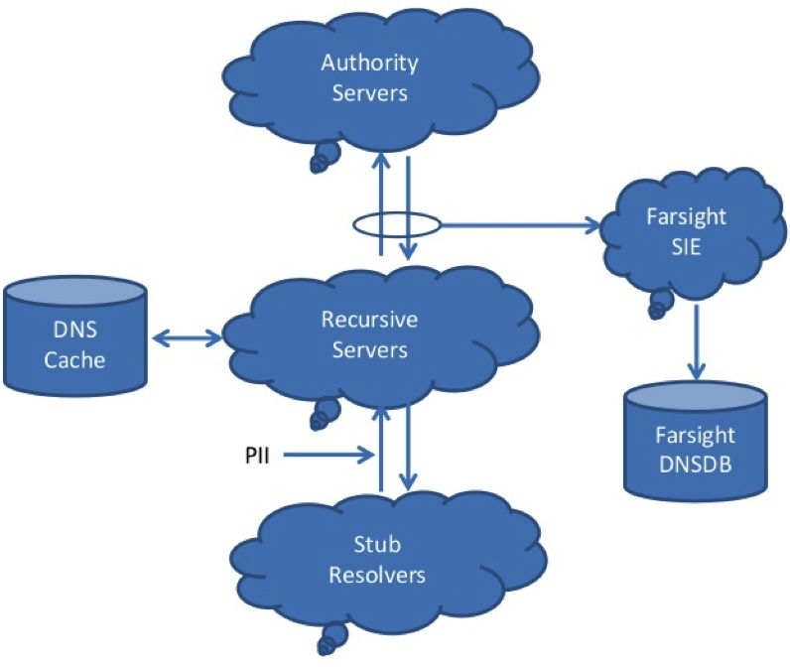
Where Does Passive DNS Data Come From?
At least in Farsight's
case, our passive DNS
data is collected by
passively monitoring
DNS cache miss traffic
above large recursive
resolvers – actual
DNS queries and
responses.
That primary data is
also augmented with
information from
zone file access programs,
as may be available.

Slide 16
An Aside About Passive DNS and Privacy
Farsight Security and I both care a great deal about user privacy,
and we hope that you do, too.
At the same time, we want and need to ensure that spammers and cyber criminals can be held accountable. Law breakers must not be free to perpetrate their online crimes with impunity.
Passive DNS, collected properly, comes from above large shared recursive resolvers. Queries appear to originate from the recursive resolver, not from any individual user. As a result, no personally identifiable information gets collected or stored.
Because of this architecture, passive DNS does NOT raise the sort of pervasive monitoring concerns that are associated with things like bulk metadata collection and traditional traffic analytic methods, as discussed in "The Enduring Challenges of Traffic Analysis," https://www.stsauver.com/joe/dublin-traffic-analysis/

Slide 17
2) The Simple Web Interface to DNSDB

Slide 18
Accessing DNSDB
DNSDB can be accessed multiple different ways, including:
Via a simple web interface. We'll talk about that first.
Via a versatile RESTful API (see https://en.wikipedia.org/wiki/Representational_state_transfer if you're curious about REST)
  Often the API is accessed via a Unix command-line interface tool.
  We'll show you the Python DNSDB API client in the next section.
  You can also access it via a Splunk plugin, convenient if you "live in Splunk"
  From your own C language (or other programming language) applications, programmatically. We'll even show you skeleton libcurl code for doing that
There are some other mechanisms that you can use to access DNSDB, too, but we'll forego talking about them today.
Let's begin with the simple web interface.

Slide 19
Limitations/Advantages of the Web Interface
Limitations:
  The web interface is primarily meant for casual/occasional usage, and as such, is intentionally kept simple.
  The web interface returns at most 10,000 results (attempting to render larger tables of results can make some web browsers sluggish)
  The web interface currently lacks the ability to do time fencing or sorting of query results. It also doesn't offer
  special output formats (such as JSON-format output).
  Advantages:
  The web interface is simple to use
  The web interface works on pretty much any system with a browser, with no software installation required

Slide 20
Prerequisites For Using The DNSDB Web Interface
In order to be able to use the web interface, you'll need a DNSDB username and password. If you requested one via the link provided earlier, that information should be waiting for you in your inbox.
The web interface to DNSDB is at https://www.dnsdb.info/
You should be able to access that web site from Firefox, Chrome, Safari or any other popular web browser – just type that address into your web browser's address bar and hit return.
Please try logging on to your test account now.

Slide 21
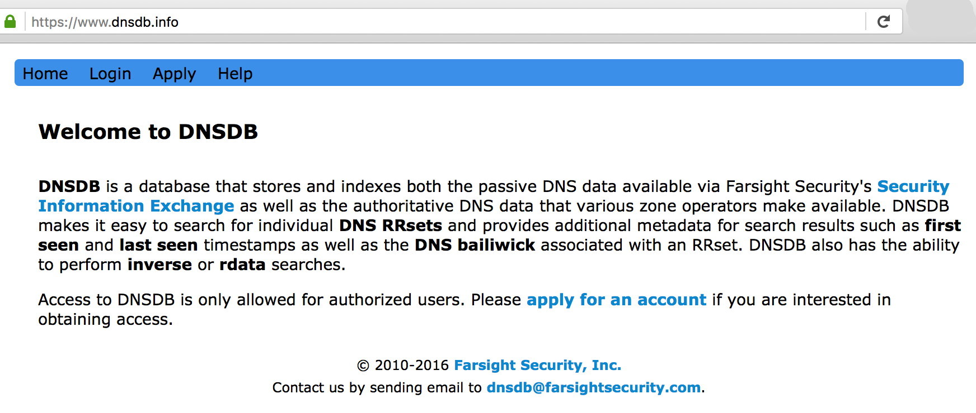
The DNSDB Web Client's Opening Screen

Slide 22
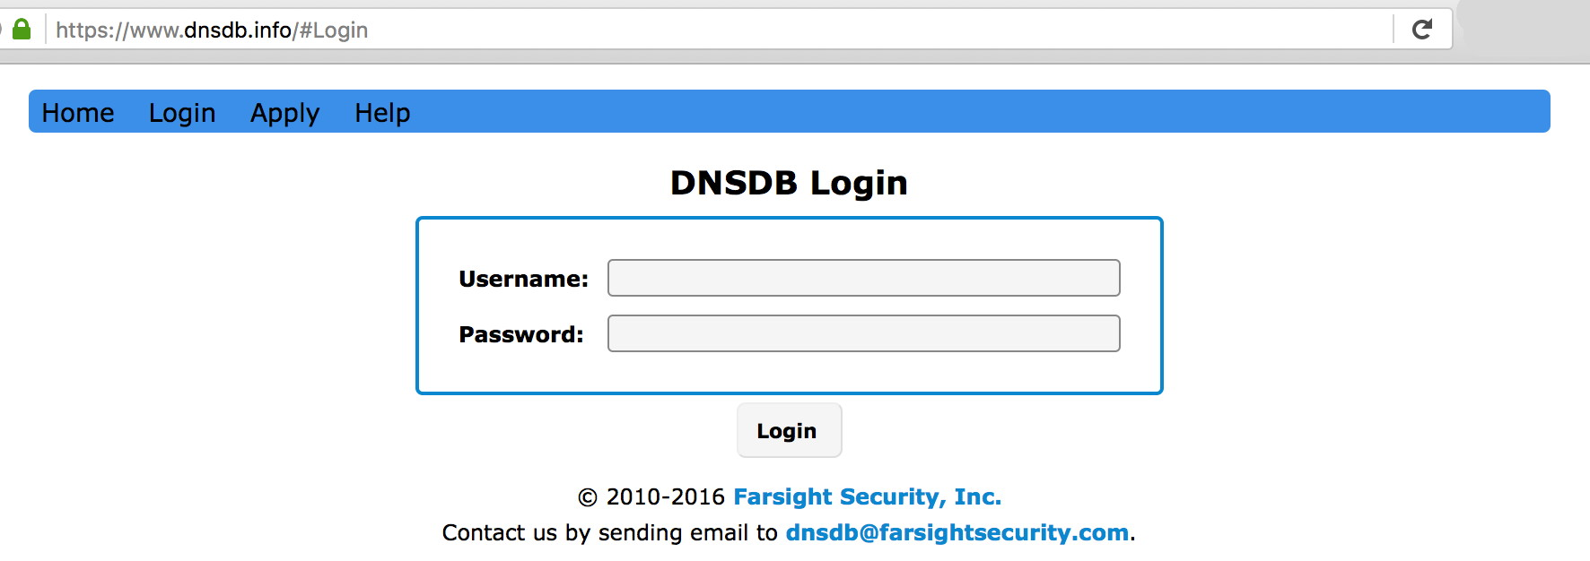
Click "Login" on the Blue Menu Bar, Then Login...

Slide 23
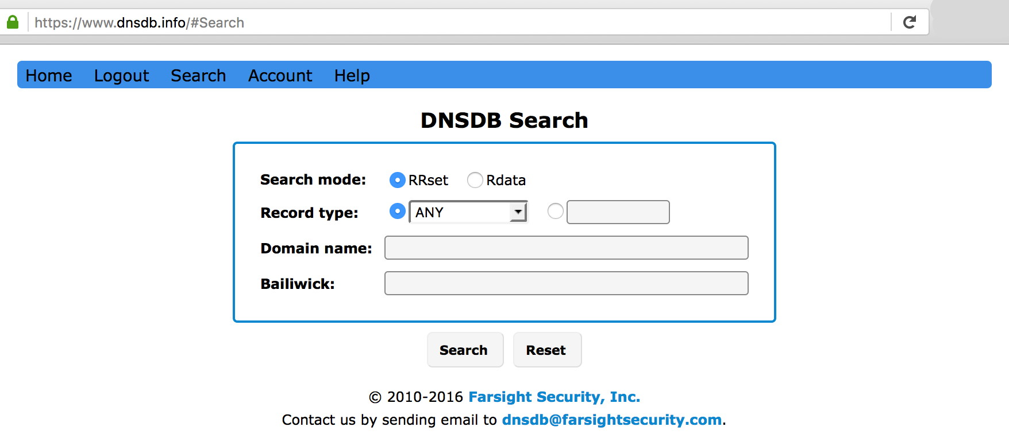
This Is The Opening Search Screen You Should Then See

Slide 24
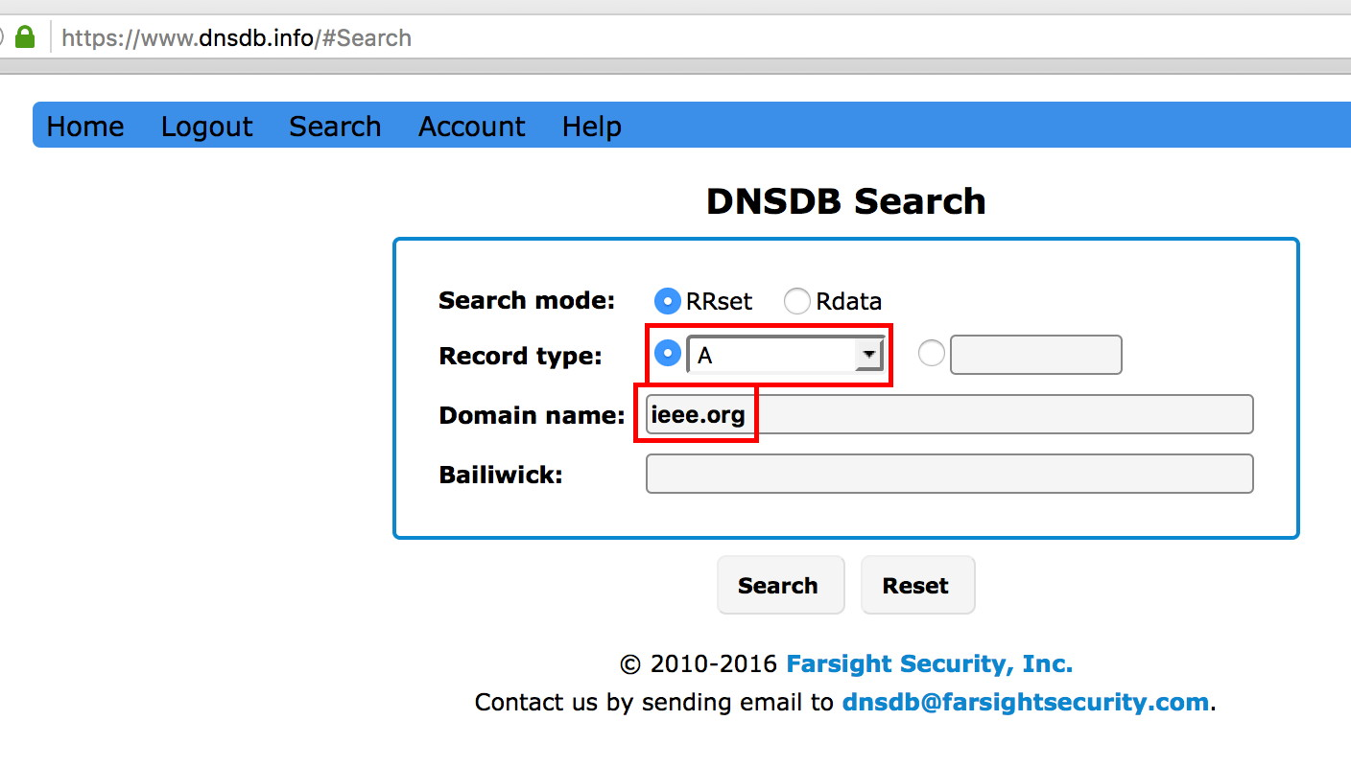
Make a Simple Sample Query...
What IPv4 Addresses Have Been Used By ieee.org?

Slide 25
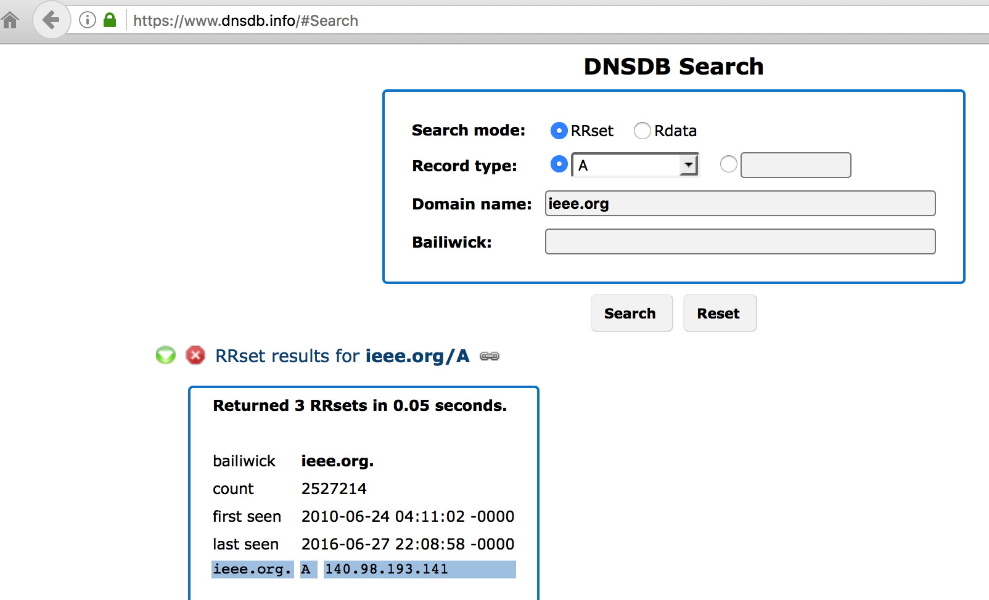
Results For That Query

Slide 26
Some Tips For Working With The Web Interface
If you make multiple queries, results from later queries will get added to the bottom of the output screen. Scroll down to see them. [Very helpful to know if you think "nothing's happening" :-) ]
To retain results from the web interface, copy and paste the results into a text file and save that file.
If there are query results you no longer need, remove them from your output window by clicking the red X icon
If there are query results you'd like to just temporarily hide, hit the green arrow icon. To restore those results, hit that green arrow icon again.

Slide 27
Making Correct Choices In The Web Interface
The parameters you set in the web interface control what gets
searched for and found in DNSDB.
The web form will change somewhat as you ask DNSDB to do different sorts of searches.
If you pay attention to what DNSDB wants (e.g., "domain name" vs. "IP address or network") you shouldn't have too much trouble.
If you do make a mistake, no big deal, just take a closer look and try it again...

Slide 28
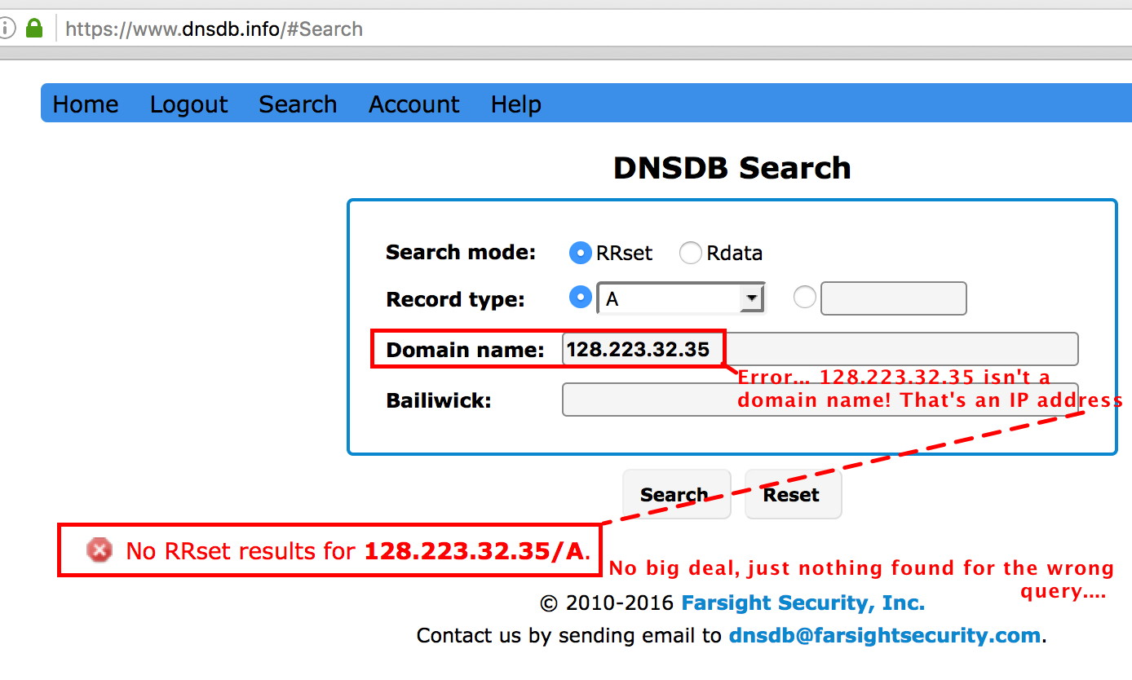
Sample Mistake: Mistakenly Putting In
An IP Where A Domain Name Is Needed...

Slide 29
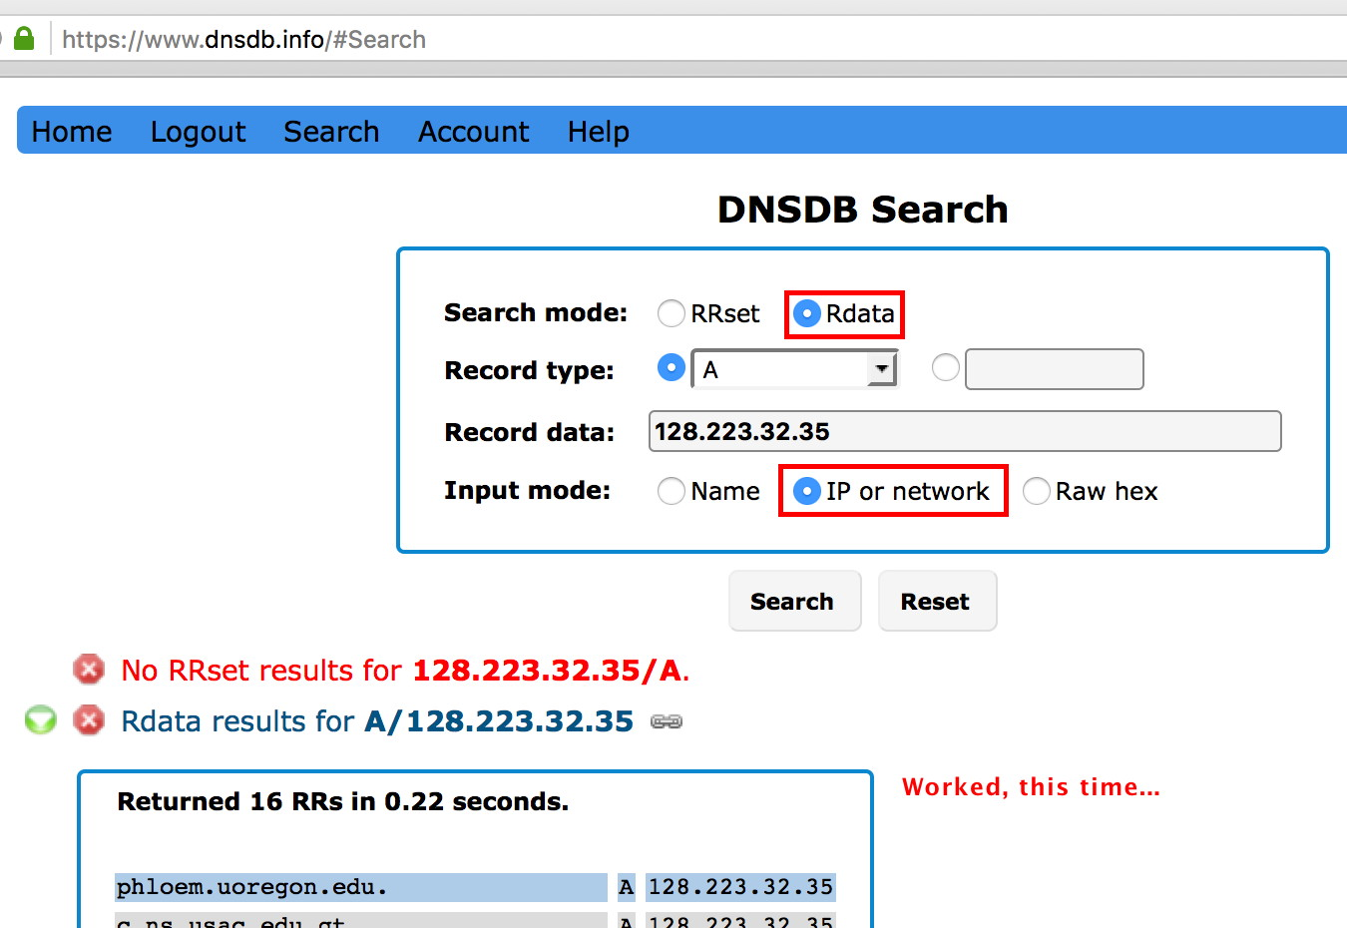
Trying It Again, After Correcting The Query Settings

Slide 30
Avoiding DNSDB Errors In The First Place
The settings you pick in the web interface control what gets searched in the DNSDB data. Records in the DNSDB database are conceptually similar to regular DNS records:
RRSET NAME RECORD TYPE RDATA
ieee.org. A 140.98.193.141
"LEFT HAND SIDE" "RIGHT HAND SIDE"
A RRset (Resource Record Set) name search looks for the specified domain name on the left hand side and returns any associated IPs
If you wanted to see all known hosts (or "fully qualified domain names") that live "under" a domain, you'd do an rrset search for *.domain
To see the hosts that have been seen using an IP address, do an rdata ("right hand side") search for that IP
Want the domains using a nameserver? Do an Rdata name search

Slide 31
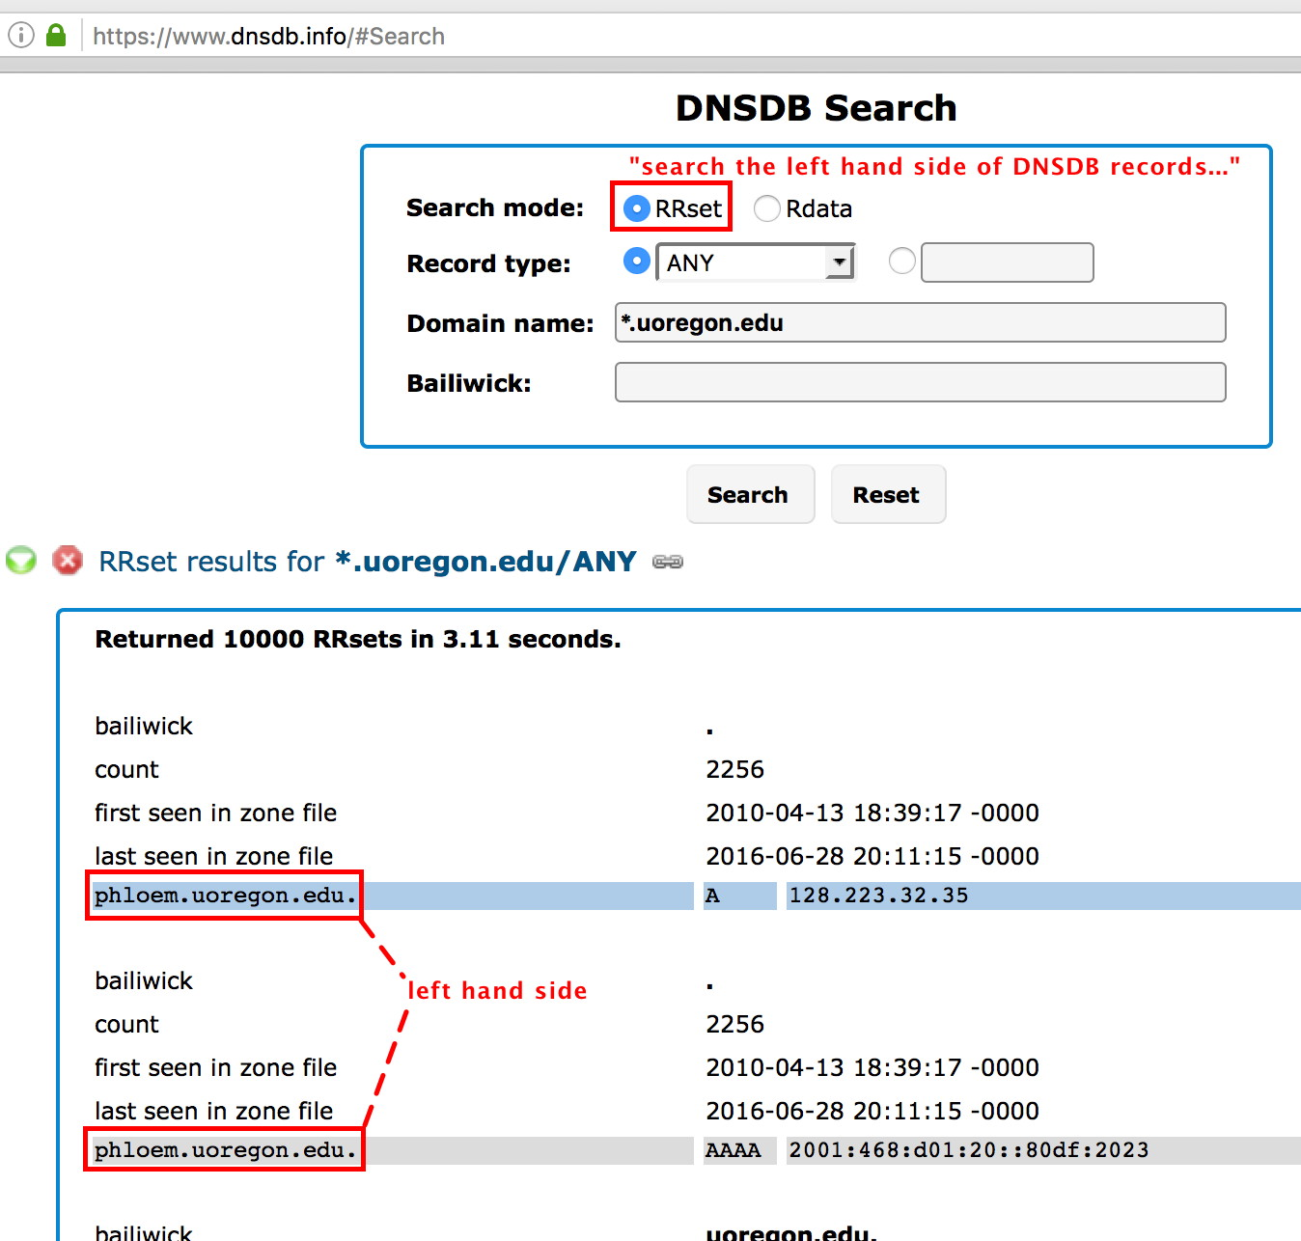
RRset searches: find left hand side matches

Slide 32
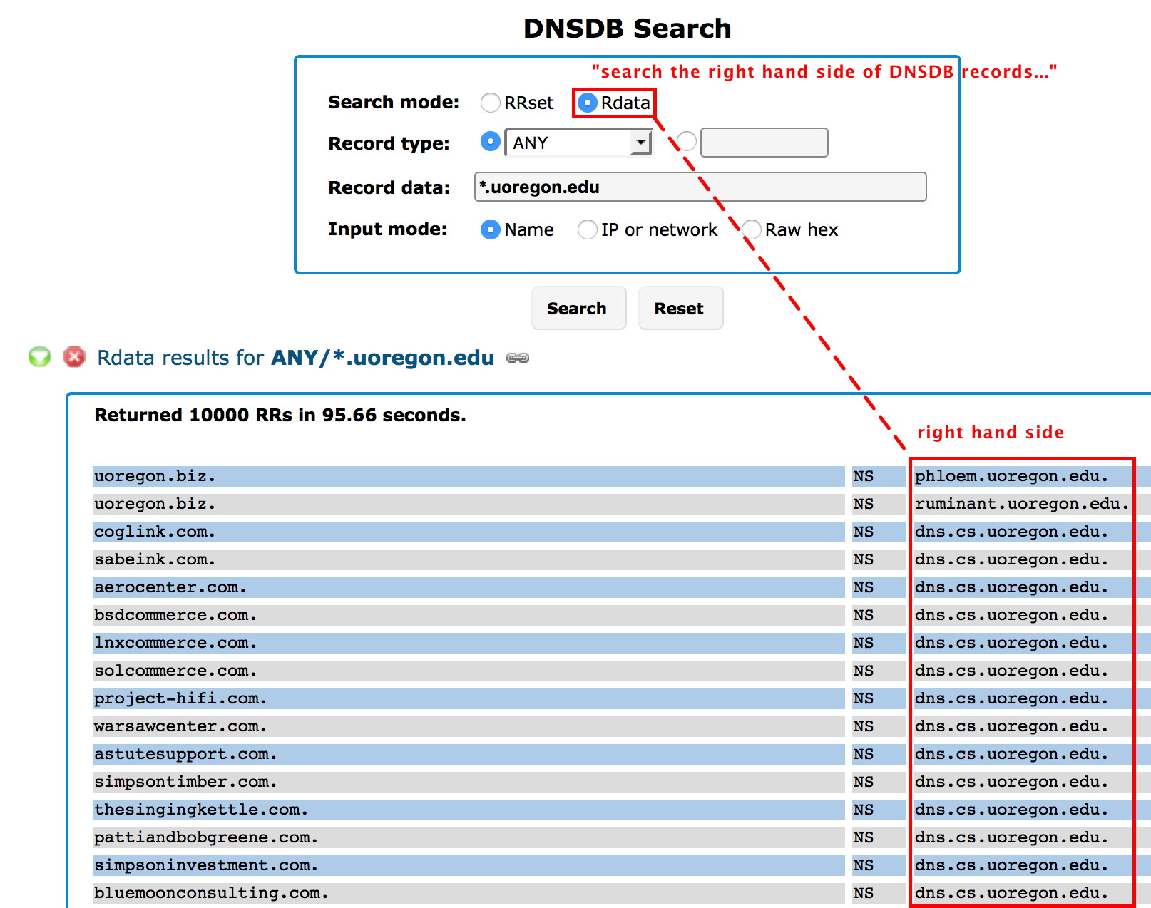
Rdata searches: find right hand side matches

Slide 33
A Brief DNS Record-Type "Cheat Sheet"
If you don't choose a DNS record type, you'll see ALL record types by default. If you're not sure, just leave the record type set to ALL, and see what looks relevant to your needs (learn by playing with the tool).
Too many results? Pick a record type to reduce unwanted "noise:"
  "A" ➔ name to IPv4 address records ("regular DNS records")
  "AAAA" ➔ name to IPv6 address records
  "CNAME" ➔ aliases for other names
  "NS" ➔ name server records
  "TXT" ➔ text records (often used for creative purposes)
  "MX" ➔ mail exchanger records
  "SOA" ➔ Start Of Authority records
  "PTR" ➔ pointer (or "inverse address") records
  "SRV" ➔ (relatively uncommon) server records
  "RRSIG" ➔ one (of several types) of DNSSEC records

Slide 34
What About the "Bailiwick" Field In The Interface?
Just ignore the bailiwick field for now... everything should work fine if you just leave it blank.
If you're an enthusiast (or just overcome with curiosity):
  If you find you're getting too many results, or puzzling results, you can set the bailiwick to be equal to the base domain that you're querying. This may reduce the number of records you're shown.
  For example, if you're doing an rdata search for www.example.com, you could try setting the bailiwick to be equal to example.com
  If you'd like to read more about bailiwicks, see section 2.4 of
  https://archive.farsightsecurity.com/Passive_DNS/passive-dns-architecture.pdf

Slide 35
"How Do I Get More Than 10,000 Results?"
You can't in the simple web interface. If we were to allow you to try, it would make at least some web browsers go completely catatonic as the browser struggled to render such a huge table.
That said, even 10,000 results is far more than many web-based passive DNS implementations allow.
If you need more than 10,000 results, try the command-line API client, which we'll be talking about in the next section. It will let you retrieve up to a million results (1,000,000) per query.

Slide 36
Exercises
These exercises are optional, but why not give them a try, eh?
a) Using DNSDB, look up your company's main web site (this is an RRset query, Record type=A, Domain name=www.example.com (or whatever)). Find the most recent IP address it has used.
b) Now click on that IP. Are there any other hosts sharing that IP address? (you may need to scroll down to see!)
c) Let's now try doing a search for your company's nameservers.
Close the previous results (click the little red X stop signs above the results). Go back to the search box. Do an RRset query, Record type="NS", Domain name=example.com (or whatever). Do NOT include the www as part of the domain name you provide...
Look for one of the most recent name servers used by the domain and make a note of it. Now go on to exercise d) on the next slide.

Slide 37
Exercises (continued #1)
d) Let's see what other domains also use that name server.
Do an Rdata (not RRset) search. Set the record type= NS.
Record data= the name of the name server you found in part c).
Input mode= Name.
How MANY domains appear to be using that name server?
e) What hosts are known to be part of the europa.eu domain?
RRset search.
Record type= ANY
Record data= *.europa.eu (note the leading asterisk followed by a dot and then the domain name)
Bailiwick (optional)= europa.eu
f) What hosts are in 147.67.0.0/17 ? (Rdata search, record type=A, Record data=147.67.0.0/17 , Input mode="IP or network").
Do you see www.clubenglishhp.com? Does it look out of place? When was that host last seen by DNSDB? (how can you find out?)

Slide 38
Exercises (continued #2)
g) Different passive DNS systems may have slightly different interfaces, but you should be able to "cross walk" what you've learned without too much effort.
For instance, try some of the preceding exercises on
http://www.bfk.de/bfk_dnslogger_en.html
Try searching for europa.eu (see the next screen)
Note that some queries may NOT be available from some passive DNS implementations.
There may also be differences in the number (or format) of the results returned.

Slide 39
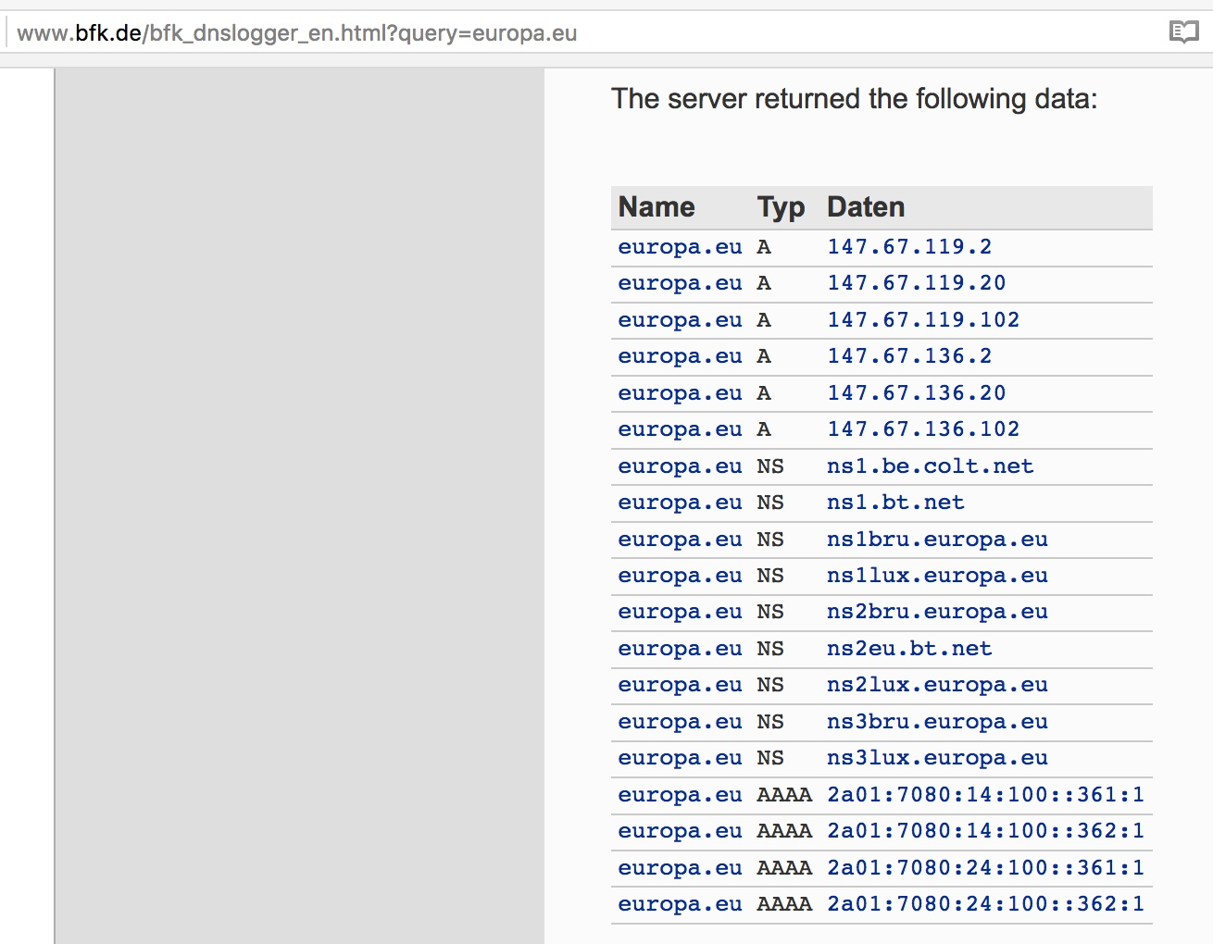
europa.eu from BFK Passive DNS

Slide 40
End of Part I
Assuming you successfully completed the exercises on the preceding few slides, congratulations, you're now able to do basic passive DNS tasks!
If you're NOT a technical person and you're itching to hit a museum or see the Eiffel tower, you can "escape" now, and maybe try doing some further queries with your temporary access later tonight or in a few days. You should have access
for about 15 days.
On the other hand, we'd encourage you to stay here and keep going! We've got more to share with you!

Slide 41
PART II. PASSIVE DNS API/Command Line Interface
3) Installing the Command Line Interface (CLI)
Python Client

Slide 42
Limitations And Advantages of Using The DNSDB API
Limitations:
  The API Command Line Client works best if you're comfortable working at the Unix shell prompt
  You will need to install software (but just once!) to use the API Command Line Client from the command line
  Advantages:
  The API interface is easy to script if you're comfortable using Unix pipes and redirection
  The API can be asked to return up to 1,000,000 results/query
  The API can do time fencing and sorting of query results
  The API offers JSON output format, in addition to traditional
  plain text output

Slide 43
Prerequisites For Accessing DNSDB Via The API
You'll need your DNSDB API key. You were sent one along with your DNSDB username and password, so check your email!
If at all possible, access the API from a Linux, BSD or Mac OS system.
  If you MUST run under Windows:
    You can try running the DNSDB command line client in a Unix virtual machine on top of Windows
    Virtualbox is one free virtual machine environment you can try for this purpose. This is a relatively large download, so you may not want to download it right now, but directions are available in the MS Word document "installing-virtualbox-m3aawg.docx" in the
    https://www.stsauver.com/joe/nowheretohide/ directory

Slide 44
Python DNSDB API Command Line Client
There are actually multiple DNSDB command line clients available.
For this training, we're going to use the Python DNSDB client known as "dnsdb_query.py"
To get that software (and instructions for its installation), see
https://github.com/dnsdb/dnsdb-query
You will need to be comfortable installing software, or get help from someone who is, to install dnsdb_query.py
If you're not comfortable installing that software, you can also just watch while we go through this section.

Slide 45
Prerequisites
(per https://github.com/dnsdb/dnsdb-query)
Linux, BSD, OS X
Curl [see https://curl.haxx.se/ ]
Python 2.7.x [see https://www.python.org/ ]
Farsight DNSDB API key [see your email, if you signed up
for a free DNSDB training account]
Curl and python 2.7.x often come pre-installed on many Unix-ish systems, so we will not address installing them further here. If you do need to install them, they will usually be available from your operating system's package management system.

Slide 46
Installing dnsdb_query.py per https://github.com/dnsdb/dnsdb-query
You will only need to do this ONCE:
1) Create a directory
mkdir ~/dnsdb
2) Download the software:
curl https://codeload.github.com/dnsdb/dnsdb-query/
tar.gz/debian/0.2-1 -o ~/dnsdb/0.2-1.tar.gz
(continues on next slide)

Slide 47
Installing dnsdb_query.py (continued)
3) Extract the software
tar xzvf ~/dnsdb/0.2-1.tar.gz -C ~/dnsdb/
--strip-components=1
4) Create an API key file [note the dot before dnsdb-query.conf!]
nano ~/.dnsdb-query.conf
5) Cut and paste the following, substituting your API Key where shown [there should be quotes shown around the API key in the file!]
APIKEY="putYourAPIkeyhere"

Slide 48
Installing dnsdb_query.py (continued #2)
6) Test the software:
python dnsdb/dnsdb_query.py -i 104.244.13.104
...
www.farsightsecurity.com. IN A 104.244.13.104
7) Recommended: Copy dnsdb_query.py to a directory in your path
If dnsdb_query.py is copied to a directory that's in your Unix system's default path and is executable, you will then simply be able to say:
dnsdb_query.py -i 104.244.13.104

Slide 49
Debugging Errors Trying To Run dnsdb_query.py
If your API key is wrong, you may see:
$ dnsdb_query.py -r yahoo.com
HTTP Error 403: forbidden
Seeing a silent "error" with no error message/feedback?
$ dnsdb_query.py -r stsauver.com
$
Do you have a .dnsdb-query.conf file in your home directory? (note the leading dot!) Does it contains an APIKEY line, with your actual key where it says YourLongAlphaNumericAPIKeyHere ?
APIKEY="YourLongAlphaNumericAPIKeyHere"

Slide 50
Learning A Little About The Command Line Client
Some (comparatively terse) information about the DNSDB API is available online at https://api.dnsdb.info/
You can also read the command line synopsis...

Slide 51
$ dnsdb_query.py --help
Usage: dnsdb_query.py [options]
Options:
-h, --help show this help message and exit
-c CONFIG, --config=CONFIG config file
-r RRSET, --rrset=RRSET
rrset <ONAME>[/<RRTYPE>[/BAILIWICK]]
-n RDATA_NAME, --rdataname=RDATA_NAME
rdata name <NAME>[/<RRTYPE>]
-i RDATA_IP, --rdataip=RDATA_IP
rdata ip <IPADDRESS|IPRANGE|IPNETWORK>
-s SORT, --sort=SORT sort key
-R, --reverse reverse sort
-j, --json output in JSON format
-l LIMIT, --limit=LIMIT limit number of results
--before=BEFORE only output results seen before this time
--after=AFTER only output results seen after this time
Time formats are: "%Y-%m-%d", "%Y-%m-%d %H:%M:%S", "%d" (UNIX timestamp),
"-%d" (Relative time in seconds), BIND format (e.g. 1w1h, (w)eek, (d)ay,
(h)our, (m)inute, (s)econd)

Slide 52
Learning By Examples and Mucking Around A Little
The best way to learn to use passive DNS in API mode is probably by seeing some examples, and then playing with the tools a bit yourself.
The DNSDB API basically has three modes in which it can be used:
-i
-r
-n
Let's start with -i, our only option if we're searching for an IP address or a CIDR netblock.

Slide 53
4) Investigating An IP Address or CIDR Block
-i

Slide 54
If Your Starting Point Is An IP Address
You'll want to make a "dash i" query (that's the ONLY option that's available for searching IP addresses, network ranges, etc.).
You may find IPs of interest in your mail server logs, firewall logs, email message headers, etc.
$ dnsdb_query.py -i 199.48.133.170
3sea.ru. IN A 199.48.133.170
mail.3sea.ru. IN A 199.48.133.170
mail.it-solver.ru. IN A 199.48.133.170
[etc]

Slide 55
Why Would You Want To Search For An
IP Address In Passive DNS?
Some reasons include...
You have an IP address, and you want to know what domains
have been seen on that IP address. Is there anything unexpected?
Do the domain names found look suspicious? (l33t speak, names that appear confusingly similar to popular phishing targets,
names that mention prohibited activities such as carding, etc.)
Ultimately, you'll typically want to "pivot" from that IP address to related domain names (start with a clue (that's an IP address) and follow that lead to the domain names that use that IP)
Searching passive DNS by IP address is a fundamental skill....

Slide 56
Time Fencing: Show Results From Just the Last 90 Days
Operational security analysts often don't care about historical results. They're intensely focused on what's happening NOW, or what's just happened in the immediate past.
If that's true for you, maybe limit what you get shown to the last thirty or ninety days...
$ dnsdb_query.py -i 199.48.133.170 --after=90d

Slide 57
A Few Other Ways To Specify Times....
$ dnsdb_query.py -i 199.48.133.170 --after=2015-08-22
$ dnsdb_query.py -i 128.223.0.0/16 --before=2016-01-01
--after=2015-01-01
$ dnsdb_query.py -i 199.48.133.170 --after="2015-08-22 14:36:10"
$ dnsdb_query.py -i 199.48.133.170 --before=2013-01-22
$ dnsdb_query.py -i 128.223.0.0/16 --after="-3600"
You Can Even Use Raw Unix epoch seconds...
$ dnsdb_query.py -i 199.48.133.170 --after=1467074500
Basics of working with Unix epoch second dates (on a Mac)...
$ date +%s ⬅ if you want the current time in seconds
1477022891
$ date -j -f "%b %d %Y %T" "Aug 28 1991 00:00:00" "+%s"
683362800
$ date -r 683362800
Wed Aug 28 00:00:00 PDT 1991

Slide 58
What If You Want To See What's In A CIDR Netblock?
Sometimes you want to see what's in an entire net block, not just what's related to a single IP address:
$ dnsdb_query.py -i 199.48.128.0/21 > temp.txt
$ wc -l temp.txt
10000 temp.txt ⬅ max of 10,000 results by default
If you need more results, increase the max results limit...
$ dnsdb_query.py -l 1000000 -i 199.48.128.0/21 > temp.txt
$ wc -l temp.txt
22205 temp.txt
$ more temp.txt
rootbsd.daleco.biz. IN A 199.48.129.182
[etc]

Slide 59
What If I'm Interested in IPv6 Addresses or Blocks?
$ dnsdb_query.py -i 2607:f010:2e8:228:0:ff:fe00:152
gateway.lb.it.ucla.edu. IN AAAA 2607:f010:2e8:228:0:ff:fe00:152
gateway-v6.lb.it.ucla.edu. IN AAAA 2607:f010:2e8:228:0:ff:fe00:152
$ dnsdb_query.py -i 2607:F010::/32 > temp.txt
$ wc -l temp.txt
932 temp.txt
$ more temp.txt
ip-list.emileaben.com. IN AAAA 2607:f010::1
secure.math.ucla.edu. IN AAAA 2607:f010:2a8:8fe4::44
secure.math.ucla.edu. IN AAAA 2607:f010:2a8:8fe4::45
webmail.math.ucla.edu. IN AAAA 2607:f010:2a8:8fe4::211
webmail2.math.ucla.edu. IN AAAA 2607:f010:2a8:8fe4::211
[etc]

Slide 60
How About An Arbitrary Network IP Range?
$ dnsdb_query.py -i 199.48.128.33-199.48.128.43
ns1.whittingtonpark.org. IN A 199.48.128.42
ns2.whittingtonpark.org. IN A 199.48.128.42
ns1.musicman.com. IN A 199.48.128.34
[etc]
But that output is unsorted! What if we want it sorted by IP?
$ dnsdb_query.py -i 199.48.128.33-199.48.128.43 --sort rdata
ns1.musicman.com. IN A 199.48.128.34
drjohngreenphotos.com. IN A 199.48.128.34
persianenglishtranslations.com. IN A 199.48.128.34
ilcr.x.rootbsd.net. IN A 199.48.128.34
[etc]

Slide 61
Some -i Sorting Notes
"valid sort keys are count, rdata, rrname, rrtype, zone_time_first, zone_time_last"
To reverse the sort order, specify -R (or --reverse). No ability to sort by multiple keys (e.g., you can't sort by IP and then rrname within IP)
But try:
$ dnsdb_query.py -i 199.48.128.33-199.48.128.43 | grep
-v ";;" | awk '{print $3 " " $1 " " $2}' | sort -u | awk '{print $2 " " $3 " " $1}'
drjohngreenphotos.com. A 199.48.128.34
ilcr.x.rootbsd.net. A 199.48.128.34
ns1.musicman.com. A 199.48.128.34
persianenglishtranslations.com. A 199.48.128.34
[etc]

Slide 62
Some Of The Sort-Related Jargon...
count=number of times DNSDB has seen this unique RRset
rdata=right hand side of the record (e.g., the IP info for "A" records)
For "ucla.edu. IN A 128.97.27.37", the rdata is 127.97.27.37
rrname=left hand side of the record (e.g., the domain name for "A" records). For "ucla.edu. IN A 128.97.27.37", the rrname is ucla.edu
rrtype=is this an "A" record? a "AAAA"? an "NS" record? a "CNAME?" an "MX" record? an "SOA"? For "ucla.edu. IN A 128.97.27.37" the rrtype is "A"
zone_time_first, zone_time_last=for data gleaned from ICANN zone files, when was the first time the record was seen? when was the last time it was seen?

Slide 63
5) Searching Domain Names Seen On
The LEFT Side ("rrnames")
-r

Slide 64
If You've Got A Domain Name and Want To Know
The IPs It Has Used, Think "I'll make a -r query"
$ dnsdb_query.py -r farsightsecurity.com/A --sort time_last
;; bailiwick: farsightsecurity.com.
;; count: 628
;; first seen: 2013-07-17 22:08:50 -0000
;; last seen: 2013-09-25 15:47:47 -0000
farsightsecurity.com. IN A 149.20.4.207
;; bailiwick: farsightsecurity.com.
;; count: 6,350
;; first seen: 2013-09-25 15:37:03 -0000
;; last seen: 2015-04-01 06:17:25 -0000
farsightsecurity.com. IN A 66.160.140.81
[etc]
["valid sort keys are bailiwick, count, rdata, rrname, rrtype, time_first, time_last"]

Slide 65
Selecting Just A Specific DNS Record Type
On the preceding slide, we specified:
$ dnsdb_query.py -r farsightsecurity.com/A --sort time_last
That returned only "A" (name to IPv4 address) records. Other
options:
AAAA ➔ name to IPv6 address records
CNAME ➔ aliases for other names
NS ➔ name server records
TXT ➔ txt records
SOA ➔ start of authority records
MX ➔ mail exchanger records
PTR ➔ pointer (or "inverse address" records)
SRV ➔ server records
RRSIG ➔ one of several types of DNSSEC records

Slide 66
Find All *.farsightsecurity.com Hostnames With
"AAAA" Records, Seen Since 1-May-2016?
$ dnsdb_query.py -r \*.farsightsecurity.com/AAAA --after=2016-05-01 --sort=count --reverse ⬅ Note use of a backslash to avoid shell expansion of the asterisk
;; bailiwick: farsightsecurity.com.
;; count: 17,106
;; first seen: 2015-04-01 13:05:08 -0000
;; last seen: 2016-06-27 14:15:53 -0000
dl.farsightsecurity.com. IN AAAA 2620:11c:f004::105
;; bailiwick: farsightsecurity.com.
;; count: 7,903
;; first seen: 2015-04-09 13:31:11 -0000
;; last seen: 2016-06-27 09:16:20 -0000
www.farsightsecurity.com. IN AAAA 2620:11c:f004::104
[etc]

Slide 67
Show Me All Domains Containing *paypal* ...
You CAN'T search for *paypal* (at least not via the DNSDB API; you CAN do this via direct access to raw DNSDB files via DNSDB Export).
You CAN do a left hand wildcard OR a right hand wildcard, but not both at the same time. You also can't do an embedded ("middle") wildcard search (foo*info)
WORKS:
$ dnsdb_query.py -r _dkim._domainkey.\*/TXT > temp.txt
[shows DKIM TXT records]
[right hand queries can be potentially time consuming to run!]
WORKS:
$ dnsdb_query.py -r \*.va > temp2.txt
[this command shows all domains in the Vatican's ccTLD]
[do not try this for larger domains, remember: <=1,000,000 results!]

Slide 68
More -r "Wildcarding" Notes
Wilcarding happens for an entire dot-delimited label, not just part of dot-delimited labels. If we're interested in stuff related to "stsauver"....
$ dnsdb_query.py -r *tsauver.com
HTTP Error 404: Not Found
$ dnsdb_query.py -r stsauve*
HTTP Error 404: Not Found
vs....
$ dnsdb_query.py -r *.stsauver.com > temp.txt
$ wc -l temp.txt
118 temp.txt
Wildcards CAN match one OR MORE entire labels (e.g., a wildcard will find subdomains (multiple labels) rather than just matching within a single label):
$ dnsdb_query.py -r \*.uoregon.edu/A | grep www\.cs\.uoregon.edu | uniq
www.cs.uoregon.edu. IN A 128.223.4.25

Slide 69
IDNs? Yes -- In Punycode Format
$ dnsdb_query.py -r www.bbc.* does NOT find www.bbc.在线 (display-format simplified Chinese Internationalized Domain Name TLD
meaning "online")
Convert the display format label www.bbc.在线 to punycode via
the converter that's at http://mct.verisign-grs.com/ , then try:
$ dnsdb_query.py -r www.bbc.xn--3ds443g
the punycode'd version of that domain also isn't found...
We do have SOME punycode'd domains for that TLD, however:
$ dnsdb_query.py -r \*.xn--3ds443g | wc -l
62277
FWIW, a list of all IDNs (actually, all top level domains) can be found at
https://en.wikipedia.org/wiki/List_of_Internet_top-level_domains

Slide 70
6) Match Domain Names Seen On The RIGHT Side ("rdata"), Typically Used To Find
Domains Sharing The Same Name Server
Or Domains Sharing a Common Mail Server
-n

Slide 71
If You've Got a Name Server's FQDN, Think -n
$ dnsdb_query.py -n phloem.uoregon.edu/NS > temp.txt
$ wc -l temp.txt
1575 temp.txt
$ more temp.txt
uoregon.biz. IN NS phloem.uoregon.edu.
maoz.com. IN NS phloem.uoregon.edu.
bogus.com. IN NS phloem.uoregon.edu.
jhome.com. IN NS phloem.uoregon.edu.
o-gig.com. IN NS phloem.uoregon.edu.
otsys.com. IN NS phloem.uoregon.edu.
flyeug.com. IN NS phloem.uoregon.edu.
[etc]
What will -n return besides NS records? You may see SOA's, PTR's, CNAME's, MX's – IF you don't limit the records returned to just /NS's

Slide 72
List Just Effective 2nd-Level Domains From a NS Search (Also Omitting Any .arpa. Domains)
$ dnsdb_query.py -n phloem.uoregon.edu/NS | awk '{print $1}' | 2nd-level-dom | grep -v "\.arpa\." | sort -u > temp.txt
$ more temp.txt
1-4-5.net.
3bcomm.gq.
55tours.tj.
aboutlanegov.com.
ac.ci.
ac.mz.
agd.gov.jm.
aha-intl.org.
ahastudyabroad.com.
[etc]

Slide 73
The Little 2nd-level-dom Script
#!/usr/bin/perl
use strict;
use warnings;
use IO::Socket::SSL::PublicSuffix;
my $pslfile = 'your_path_here/effective_tld_names.dat';
my $ps = IO::Socket::SSL::PublicSuffix->from_file($pslfile);
my $line;
foreach $line (<>) {
chomp($line);
my $root_domain = $ps->public_suffix($line,1);
printf( "%s.\n", $root_domain );
}
The required data file? See https://publicsuffix.org/list/

Slide 74
Testing the 2nd-Level Domain Script....
$ echo "www.bbc.co.uk" | 2nd-level-dom
bbc.co.uk
$ echo "www.cs.uoregon.edu" | 2nd-level-dom
uoregon.edu
$ echo "www.springfield.k12.or.us" | 2nd-level-dom
springfield.k12.or.us
WHY would you want to do this sort of domain name reduction? Imagine a large file with thousands of wildcarded domains... you may not care about the random leading gibberish, you just want the base (effective 2nd-level) domains...

Slide 75
Why Do You Call Them Effective 2nd Level Domains?
For "normal" top level domains, such as dot com, new domains are registered immediately under the top level domain. For instance,
example.com is a typical hypothetical 2nd level domain.
Other pseudo TLDs, such as dot co dot uk, may actually see many domains registered as what look like "third" level domains (e.g., because .co.uk "uses up" the first and second level domains). Because of the effective 2nd level domain concept, "co.uk" gets treated as a single "chunk," as if it were its own TLD.
Some domains may even have longer effective TLDs, such as k12.or.us, leading to effective 2nd level domains such as springfield.k12.or.us
(the three domains, k12.or.us, gets treated as a single "chunk")
See the list at https://publicsuffix.org/list/public_suffix_list.dat

Slide 76
Another Example:
Finding Domains That Share a Common Mail Server
$ dnsdb_query.py -n mx.berkeley.edu/MX > temp.txt
$ wc -l temp.txt
292 temp.txt
$ more temp.txt
athletics.calbears.com. IN MX 5 mx.berkeley.edu.
engineeringpathway.com. IN MX 10 mx.berkeley.edu.
engineeringpathway.com. IN MX 15 mx.berkeley.edu.
berkeley.edu. IN MX 10 mx.berkeley.edu.
berkeley.edu. IN MX 15 mx.berkeley.edu.
ce.berkeley.edu. IN MX 10 mx.berkeley.edu.
ce.berkeley.edu. IN MX 15 mx.berkeley.edu.
cs.berkeley.edu. IN MX 5 mx.berkeley.edu.
[etc]

Slide 77
7) Formatting CLI Query Output

Slide 78
Choice of Output Formats for dnsdb_query.py
The default output format for dnsdb_query.py is plain text
However, at your option, you can also request JSON output:
$ dnsdb_query.py -r stsauver.com/A -j
{"count": 3617, "time_first": 1407639108, "rrtype": "A",
"rrname": "stsauver.com.", "bailiwick": "stsauver.com.",
"rdata": ["199.48.133.170"], "time_last": 1467065919}
{"count": 5, "time_first": 1321883198, "rrtype": "A", "rrname": "stsauver.com.", "bailiwick": "stsauver.com.", "rdata": ["209.151.96.70"], "time_last": 1385778016}
JSON output can be "pretty printed" using jq
See https://github.com/stedolan/jq for information on jq
Tips on using https://stedolan.github.io/jq/

Slide 79
Sample jq-formatted Output From dnsdb_query.py
$ dnsdb_query.py -r stsauver.com/A -j | jq '.'
{
"count": 3617,
"time_first": 1407639108,
"rrtype": "A",
"rrname": "stsauver.com.",
"bailiwick": "stsauver.com.",
"rdata": [
"199.48.133.170"
],
"time_last": 1467065919
}
[etc]

Slide 80
Outputting Just One Selected Field With jq
$ dnsdb_query.py -r farsightsecurity.com/A -j |
jq .rdata | tr -d '[]" ' | grep -v "^$"
66.160.140.81
104.244.13.104
149.20.4.207
Translating...
-- jq .rdata
Select the rdata values from JSON output
-- tr -d '[]" '
Delete any square brackets, double quotes or spaces
-- grep -v "^$"
Delete any blank lines

Slide 81
Reversing Domains For Ease of Sorting
$ dnsdb_query.py -l 1000000 -i 104.140.106.223 | awk '{print $1}' | 2nd-level-dom | reverse-domain-names | sort -u > temp.txt
$ wc -l temp.txt
704 temp.txt
$ more temp.txt
date.15cmw
date.4a7pb
date.bhj6k
date.d19rq
date.d4ors
date.fqgd0
date.g69vs
date.gctgn
[etc]

Slide 82
The Little reverse-domain-names Script
#!/usr/bin/perl
my @lines = <>;
chomp @lines;
@lines =
map { join ".", reverse split /\./ }
sort
@lines;
print "$_\n" for @lines;

Slide 83
8) Querying DNSDB At Scale:
Querying For The Domains In All Prefixes Announced by an Autonomous System
Gentle reminder: You've only got a modest 100 queries/day quota, so be careful you don't exhaust ALL your queries with just one or two runs of this sort. Each time you do a dbsdb_query.py command, that "counts" against your limited quota, and some ASNs may have scores or even hundreds of prefixes!

Slide 84
What If We Want To Look At All Prefixes For An ASN?
Assume we want to look at the domains found in passive DNS for "all prefixes associated with the ASN that's routing 104.140.106.223"
Begin by mapping the IP to ASN (see the script on the next page):
$ ip2asn 104.140.106.223
62904 104.140.106.223
Now go to Hurricane Electric's BGP data site and check it for AS62904 to find the full list of associated prefixes...
http://bgp.he.net/AS62904#_prefixes
http://bgp.he.net/AS62904#_prefixes6
We'll just do the IPv4 ones for now (feel free to do the IPv6 ones as an exercise)

Slide 85
The ip2asn Script (As Used On The Previous Page)
#!/bin/sh
origip=`echo $1`
revip=`echo $1 | sed 's/\([0-9]*\)\.\([0-9]*\)\.\([0-9]*\)\.\([0-9]*\)/\4.\3.\2.\1/'`
listing=`host -w -t txt ${revip}.asn.routeviews.org 2>/dev/null | tail -1 `
listing2=`echo ${listing} | awk '{print $4}' | sed 's/"//g'`
echo "${listing2} ${origip}"

Slide 86
Processing the HE BGP Data To Build The Queries...
Copy the prefixes from http://bgp.he.net/AS62904#_prefixes
and paste them into the temporary file called temp.txt
Massage temp.txt, keeping just the first column...
$ awk '{print $1}' < temp.txt | sort -u > temp2.txt
Reformat the resulting file with vi (or your favorite editor)
$ vi temp2.txt
[manually dd (e.g., delete) any lines other than CIDR prefixes, then add on....]
:1,$s/^/dnsdb_query.py -l 1000000 -i /
:1,$s/$/ >> temp3.txt ; sleep 2/
:1
[x out (delete) one of the > signs on the first line]
:wq
This should leave you with a file that looks like the following...

Slide 87
dnsdb_query.py -l 1000000 -i 104.140.104.0/22 > temp3.txt ; sleep 2
dnsdb_query.py -l 1000000 -i 104.140.140.0/22 >> temp3.txt ; sleep 2
dnsdb_query.py -l 1000000 -i 104.140.184.0/22 >> temp3.txt ; sleep 2
dnsdb_query.py -l 1000000 -i 104.140.216.0/24 >> temp3.txt ; sleep 2
dnsdb_query.py -l 1000000 -i 104.140.223.0/24 >> temp3.txt ; sleep 2
dnsdb_query.py -l 1000000 -i 104.140.252.0/22 >> temp3.txt ; sleep 2
dnsdb_query.py -l 1000000 -i 104.140.68.0/22 >> temp3.txt ; sleep 2
dnsdb_query.py -l 1000000 -i 104.140.80.0/22 >> temp3.txt ; sleep 2
dnsdb_query.py -l 1000000 -i 104.193.40.0/22 >> temp3.txt ; sleep 2
dnsdb_query.py -l 1000000 -i 104.206.104.0/22 >> temp3.txt ; sleep 2
dnsdb_query.py -l 1000000 -i 104.206.116.0/22 >> temp3.txt ; sleep 2
dnsdb_query.py -l 1000000 -i 104.206.144.0/22 >> temp3.txt ; sleep 2
dnsdb_query.py -l 1000000 -i 104.206.156.0/22 >> temp3.txt ; sleep 2
dnsdb_query.py -l 1000000 -i 104.206.172.0/22 >> temp3.txt ; sleep 2
dnsdb_query.py -l 1000000 -i 104.206.176.0/22 >> temp3.txt ; sleep 2
dnsdb_query.py -l 1000000 -i 104.206.178.0/23 >> temp3.txt ; sleep 2
[...]
dnsdb_query.py -l 1000000 -i 50.3.240.0/22 >> temp3.txt ; sleep 2
dnsdb_query.py -l 1000000 -i 75.75.227.0/24 >> temp3.txt

Slide 88
Now Process Those Queries...
$ time sh -x temp2.txt
real 7m50.108s ⬅ less than 8 minutes wall clock time
user 1m45.125s
sys 0m13.536s
$ wc -l temp3.txt
2990981 temp3.txt ⬅ nearly 3 million total results
$ more temp3.txt
ns1.finalhost.biz. IN A 104.140.104.100
ns1.betterhosting.biz. IN A 104.140.104.100
ns2.finalhost.biz. IN A 104.140.104.101
ns2.betterhosting.biz. IN A 104.140.104.101
ns1.jindalbullion.biz. IN A 104.140.106.228
ns2.jindalbullion.biz. IN A 104.140.106.228
ns1.servicioscloudperu.com. IN A 104.140.104.20
[etc]

Slide 89
Simplify The Results, Output-ing The Largest Results
$ time awk '{print $1}' < temp3.txt | 2nd-level-dom | sort | uniq -c | sort -nr > temp4.txt
real 1m46.661s
user 1m50.297s
sys 0m1.216s
$ wc -l temp4.txt
84031 temp4.txt
$ more temp4.txt
277476 seguards.su.
86621 bai.su.
78603 xstats.su.
75081 westats.cc.
72534 sxo.su.
57789 sge.su.
[etc]

Slide 90
9) Administrivia and Debugging

Slide 91
Out of Queries?
Most DNSDB accounts have a limited quota of queries (unless you have a DNSDB account that's been configured to have an unlimited number of queries). You can check to see how many queries you've got left with code such as:
$ curl --header "X-API-Key: PutYourLongNumericAPIKeyHere" \
https://api.dnsdb.info/lookup/rate_limit
{
"rate": {
"reset": "n/a",
"limit": "unlimited",
"remaining": "n/a"
}
}

Slide 92
Some dnsdb_query.py Errors
$ dnsdb_query.py foo.com
Usage: dnsdb_query.py [options]
[followed by the full command line syntax summary]
You forgot to specify -i, -r, or -n or otherwise mis-entered something – the dnsdb_query.py client can't figure out what you're trying to do
$ dnsdb_query.py -i stsauver.com
HTTP Error 400: Bad Request
In this example, you supplied a domain name as a -i parameter. The -i parameter needs an IP address, address range, or CIDR prefix, not a domain name.

Slide 93
dnsdb_query.py Errors (continued)
$ dnsdb_query.py -r 128.223.32.35
HTTP Error 404: Not Found
You supplied an IP address to a -r parameter, which searches the left hand side. There are no IP addresses on the left hand side, and cannot be. A -r parameter needs to be given a domain name
"Q. But Joe! What about in-addrs? They're on the left side, right?"
A. Yet, but in-addr's are actually names, not a purely numeric IP address...

Slide 94
Searching For An in-addr.arpa
$ dnsdb_query.py -r 35.32.223.128.in-addr.arpa
;; bailiwick: 223.128.in-addr.arpa.
;; count: 180,166
;; first seen: 2010-06-24 14:40:38 -0000
;; last seen: 2016-06-28 01:18:28 -0000
35.32.223.128.in-addr.arpa. IN PTR phloem.uoregon.edu.
Contrast that result with with:
$ dnsdb_query.py -i 128.223.32.35
phloem.uoregon.edu. IN A 128.223.32.35
c.ns.usac.edu.gt. IN A 128.223.32.35
[etc]
Note: some pDNS imputed IP RRs may not be trustworthy, and in-addrs are definitely able to be used in misleading ways.

Slide 95
10) Farsight's Splunk Plugin and Passive DNS

Slide 96
How Does Splunk "Fit?"
Splunk is a very popular log management tool, terrific for digging into syslog data and similar data sources. Multiple versions of Splunk are available, including a free version, and trial versions of the Enterprise and Cloud versions.
The Farsight Splunk plugin requires use of the Enterprise version of Splunk. To get a free 60 day trial of Splunk Enterprise (registration required; limited to indexing 500MB of data per day):
https://www.splunk.com/en_us/products/splunk-enterprise.html
You can even install and run the trial version of Enterprise Splunk and the Farsight DNSDB plugin on your Mac!
The installation is pretty straightforward.

Slide 97
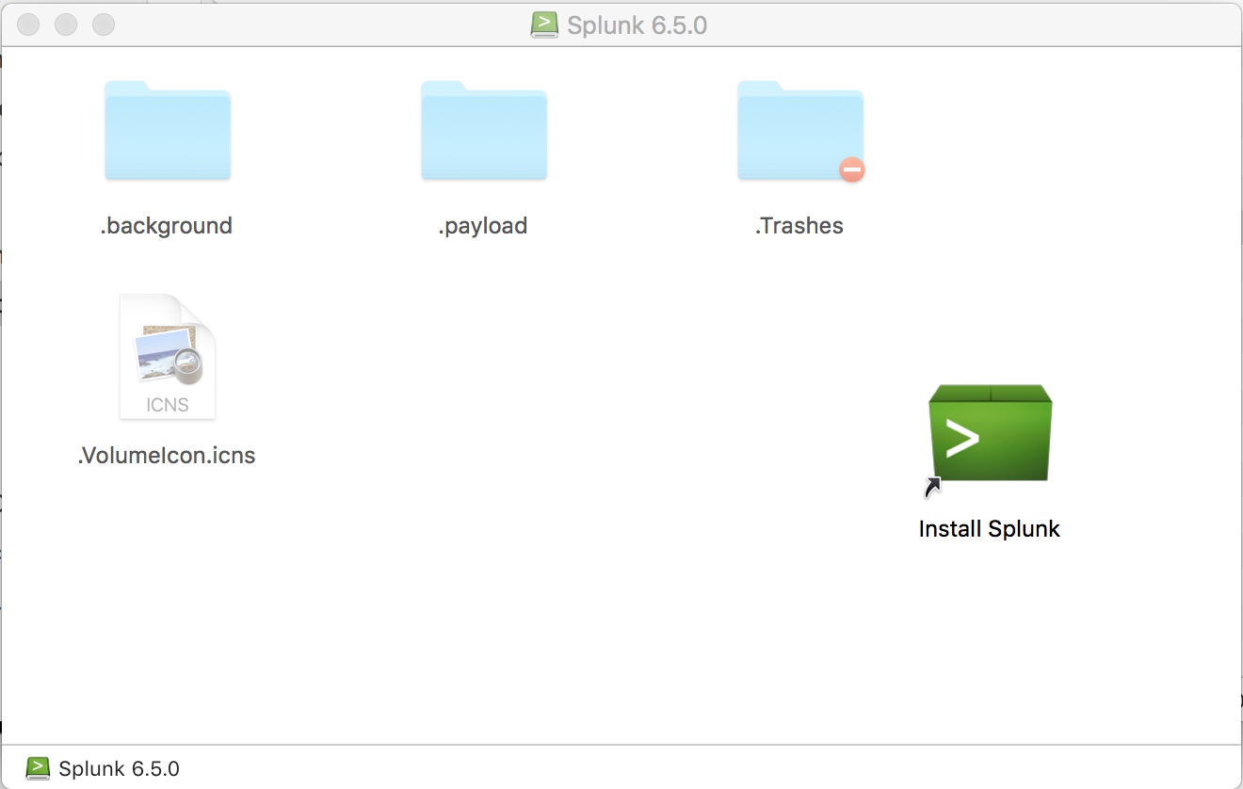
Installation Is Straightforward on the Mac

Slide 98
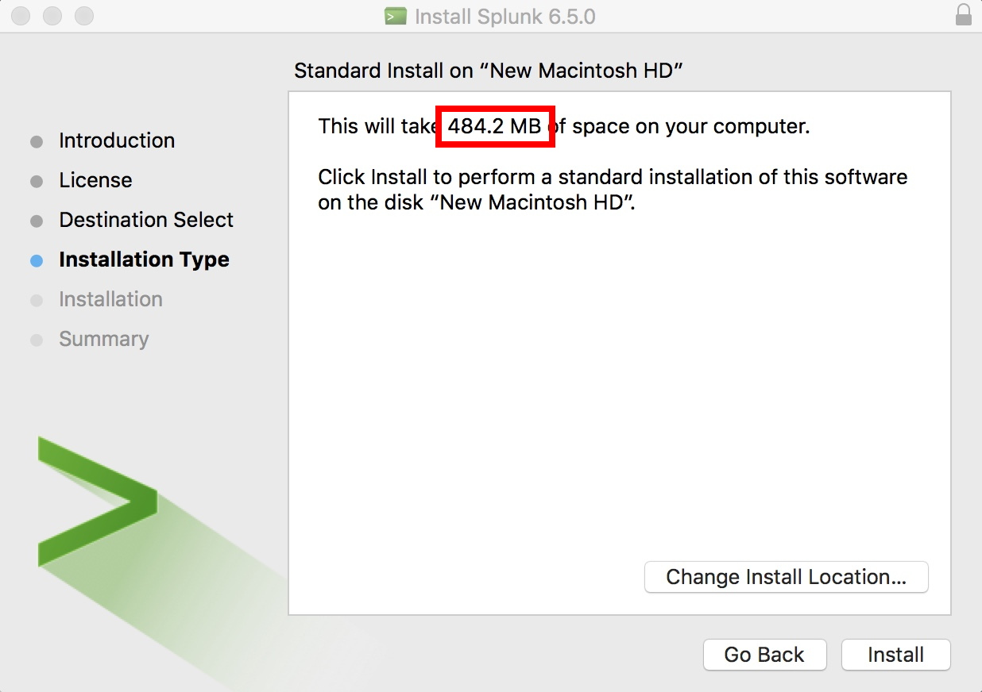
Installation (2)

Slide 99
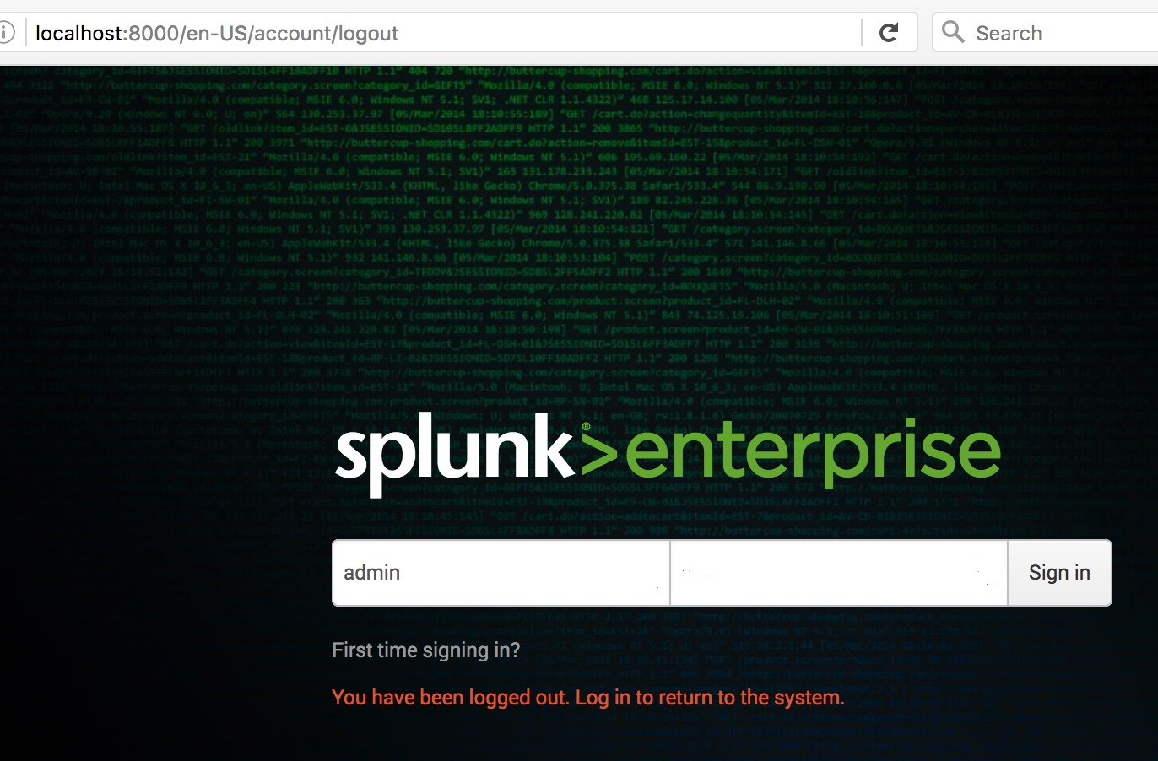
Once You've Got Splunk Installed,
Launch It From Your Desktop

Slide 100
The Farsight Security Splunk Plugin
To get the plugin, see:
https://www.farsightsecurity.com/FarsightDNSDBforSplunk/
https://splunkbase.splunk.com/app/3050/
https://www.farsightsecurity.com/splunk/
FarsightSplunkAppUserGuide.pdf ← must-have guide!
Note that you will need a Farsight API key to use the DNSDB plugin for Splunk. Your regular DNSDB API key will work fine for this purpose.

Slide 101
What You See After You Download the Splunk Plugin

Slide 102
Confirming The Integrity Of That Download On A Mac
It's always good to confirm the integrity of your
downloads, including the Farsight Splunk plugin:
$ /sbin/md5 farsight-dnsdb-for-splunk_101.tgz
MD5 (farsight-dnsdb-for-splunk_101.tgz) =
188a52f070d1168d1feb05d9372fc83e
The quoted checksum matches the highlighted value on
the welcome message shown on the preceding screen,
so you're good to install as described on the preceding
screen.

Slide 103
The Splunk DNSDB Ad Hoc Query Interface In Action

Slide 104
Using The DNSDB Splunk Connector More Aggressively
While you can use the Farsight plugin for Splunk as just another web interface for making manual ad hoc DNSDB queries, the Splunk plugin really shines as an automated way to enhance large databases you import into Splunk.
Note: enhancing large datasets can generate a large number of DNSDB queries. Because your training query quota is very modest, we are NOT going to show you how to use Splunk this way today.

Slide 105
11) Making Programmatic
Passive DNS Queries With libcurl

Slide 106
libcurl
To make RESTful TLS-protected queries against the DNSDB API from your own code, you'll want a library to handle the TLS "heavy listing" work.
I chose libcurl, the API version of the command line web client we all know and love. See https://curl.haxx.se/libcurl/
Installation instructions are available at
https://curl.haxx.se/docs/install.html
Documentation is available at https://curl.haxx.se/libcurl/
If you want to check out other alternatives, take a look at
https://curl.haxx.se/libcurl/competitors.html

Slide 107
A Few Quick libcurl Notes
Libcurl is under active development.
The version I installed and used for the following sample was:
$ curl-config --version
libcurl 7.50.3 [released on Sept 14, 2016]
Release history? See https://curl.haxx.se/docs/releases.html
Lots of work on-going, see https://curl.haxx.se/changes.html
Always use a current version of libcurl
Be sure that your copy of openssl is fully up-to-date, too

Slide 108
Skeleton libcurl DNSDB Query C Language Code
$ cat sample.c
#include <stdlib.h>
#include <string.h>
#include <curl/curl.h>
int main (void)
{
CURL *curl;
CURLcode res;
char mydomain[1024], tempstring[1024], fullcommand[1024];
/* initialize curl. call this once and only once. */
curl_global_init(CURL_GLOBAL_ALL);

Slide 109
Sample libcurl code (2)
while (scanf("%s",mydomain) == 1)
{
/* build the command we want to pass to curl */
/* all our commands use the same basic RESTFUL API endpoint... */
strcpy(fullcommand,"https://api.dnsdb.info/lookup/rrset/name/");
/* now tack on the domain */
strcpy(tempstring,mydomain);
strcat(fullcommand,tempstring);
/* just give me a token dozen results */
strcpy(tempstring,"?limit=12");
strcat(fullcommand,tempstring);
/* get curl ready for action */
curl = curl_easy_init();

Slide 110
Sample libcurl code (3)
/* pass the API key */
struct curl_slist *chunk = NULL;
chunk = curl_slist_append(chunk, "X-API-Key: YourActualAPIKeyHere");
res = curl_easy_setopt(curl, CURLOPT_HTTPHEADER, chunk);
/* do the actual curl command */
curl_easy_setopt(curl, CURLOPT_URL, fullcommand);
res = curl_easy_perform(curl);
if(res != CURLE_OK) { return(EXIT_FAILURE); }
curl_easy_cleanup(curl);
}
curl_global_cleanup();
return (EXIT_SUCCESS);
}

Slide 111
Sample Run
$ cat test-domains.txt
www.stsauver.com
[etc]
$ gcc -Wall -O3 -o sample sample.c -I/usr/local/include -L/usr/local/lib/ -lcurl
$ ./sample < test-domains.txt > output.txt
$ less output.txt
;; bailiwick: stsauver.com.
;; count: 1
;; first seen: 2011-04-30 04:19:39 -0000
;; last seen: 2011-04-30 04:19:39 -0000
www.stsauver.com. IN A 209.151.96.70
[etc]

Slide 112
Notes About That Sample API Invocation
That's just a proof of concept/illustration, it is NOT meant as production grade code (it would need to be a lot more paranoid about the way it handles some things, including doing extensive data sanitization and error checking). You've been warned!
You can (and should!) do better, after getting the sample code to actually run, assuming you're a programmer interested in doing so.

Slide 113
Exercises
a) Get the dnsdb_query.py client installed and running. Successfully make a couple of test queries, perhaps:
$ dnsdb_query.py -r m3aawg.org/A --after=30d
$ dnsdb_query.py -i 67.192.153.75 --after=30d
b) What 2nd-level domains share the same netblock as m3aawg.org?
(note: this requires you to install the little 2nd-level-dom script):
$ dnsdb_query.py -i 67.192.153.64-67.192.153.95
--after=30d | awk '{print $1}' | 2nd-level-dom |
sort -u > temp.txt
c) Find some IPs from messages in your spam folder. Try using the passive DNS API to investigate them. If you have no spam message of your own to "mine", perhaps see:
-- https://www.spamhaus.org/sbl/latest/
-- http://www.senderbase.org/static/spam/#tab=2

Slide 114
This Ends Part II
This is another opportunity for you to "escape," whether because your head is full, or because you don't need a review of DNS.
Again, however, we'd encourage you to consider staying for the rest of what we'll cover if you can.

Slide 115
PART III. DNS Backfill
1) Introduction

Slide 116
Referring to Computers on the Internet
Internet users refer to Internet sites by their domain names.
A domain name that refers to a specific site is normally referred to as a "Fully Qualified Domain Name" or "FQDN." The FQDN of a typical web server might be www.farsightsecurity.com
FQDN's normally resolve (or "get translated into") numeric IP addresses.
FQDNs can also be set up as an alias for another domain name.
And of course, typo'd/broken FQDNs may not resolve at all.
Notionally, we can represent this process as shown on the following slide...

Slide 117
Notional Diagram Showing Web Browser Relying
On Domain Name System For the Information
Needed To Reach A Web Server

Slide 118
The Description In The Preceding Section Was Highly Simplified. For Example, Caching Was Omitted
If we drill down, there's a lot more that's going on. A lot of what happens is designed to ensure that unnecessary work is avoided, and performance remains good even as DNS usage scales up.
Caching (or "saving recently-received results") is a big part of that strategy.
Pretty much all parts of the DNS ecosystem strive to remember what they've recently seen so they don't need to repeatedly ask – time after time after time – for answers to the same questions.
This is key for DNS use by highly popular sites such as Amazon, Google, Facebook, Twitter, YouTube, online advertising sites, etc.
Depending on how often things might need to change, answers may only be cached for some few seconds, while in other cases, answers may be made to persist for hours, days or even weeks – each domain administrator can pick what they think is best.

Slide 119
Time-To-Live Value (TTLs)
Cache durations are controlled by Time-To-Live values ("TTLs").
TTLs are specified in seconds. You'll see them (among lots of other places) in the output from the Unix "dig" command:
$ dig www.farsightsecurity.com
[...]
www.farsightsecurity.com. 3589 IN A 104.244.13.104
[snip]
These TTLs "decrement," or "cook down." Rechecking a bit later:
$ dig www.farsightsecurity.com
[...]
www.farsightsecurity.com. 3541 IN A 104.244.13.104
[snip]
When the TTL hits 0, the saved data will be discarded from the cache.

Slide 120
Should TTLs Be Long or Short, and Why?
Long TTLs (e.g., tens of thousands of seconds) mean:
  Fewer queries for the name servers to service, which translates to lower name server load
  If a remote name server does go down, local name servers that have cached values may not even notice
  On the other hand, if you need to change the address that a server is using, you'll need to wait while a long TTL "cooks down" and expires so that the new value can get discovered.
Short TTLs (hundreds of seconds) mean:
  The name servers will see more requests
  Resolution may be slightly slower (as some stuff that could have been efficiently cached gets re-looked-up)
  You've got reduced breathing room in an outage, BUT more flexibility if you need to make an "emergency change" (as in cases where you may be dealing with a DDoS attack)

Slide 121
UNsuccessful Resolutions
What if a domain name CANNOT be successfully resolved?
Should that NEGATIVE information be remembered, too?
Why sure! What's the point of asking:
"Do you know how to resolve asodaosdjasodjasodasd.com? No? Okay." and then potentially immediately repeating that question again, and again, and again, and again....
The idea of remembering the fact that a domain name could NOT be resolved is customarily known as a "negative TTL."
Negative TTLs, like most DNS things, are defined in RFCs.
RFCs are "Requests for Comments," Internet Engineering Task Force technical standards. (Name notwithstanding, by the time they're published, no additional audience input is actually being solicited.)
Anyhow, see https://tools.ietf.org/html/rfc2308 for details about negative TTLs.

Slide 122
Distributed Name Servers, Not One Central One
Another thing that was simplified in the earlier diagram was the way name servers were represented. The Domain Name System was just shown in that diagram as one "blob."
In fact, there is no single central unified "god" name server that is omniscient about all the domain names on the Internet.
Instead, there's a distributed set of name servers that work together to resolve domain names "collaboratively" as required
Resolution begins with the root of the domain name tree ("."). After that, authoritative name servers provides information about a domain name, OR pointers ("referrals") to a name server that will get you closer to completing resolution of your domain name.

Slide 123
"Huh?"
Start with the stub resolver (a very simple name server) running on the user's laptop.
If the stub resolver hasn't recently cached the answer to a particular DNS query, the stub resolver asks the user's ISP's recursive resolver for help. Does the ISP's recursive resolver
know how to resolve that name?
If the ISP's recursive resolver doesn't have the required bit of information cached, the recursive resolver begins asking a series of questions of authoritative name servers in order to find the ultimate answer.
See the diagram on the following slide.

Slide 125
DNS Resolution Is Iterative, and Recursive
In the worst case, a name server is brand new and knows nothing but the address of the DNS root servers ("dot"). It would begin by asking the root name servers, "Hey, what's the address of the name servers that know about dot com?"
After it learned the address of the dot com name servers, it would ask one of those name servers, "OK! Now let me ask you:
what's the address of the name servers that know about the domain farsightsecurity.com?"
After it learned the address of those, it would finally ask one of them, "Hey, what's the address of www.farsightsecurity.com?"
This process is shown diagrammatically in the following graphic.

Slide 127
Redundant Authoritative Name Servers
There's still a bit more complexity that has been omitted from the diagrams you just saw, and that relates to redundancy:
name servers are "critical infrastructure" and you always want them to work. That normally means deploying "more than one of them," even if we didn't show that on the preceding diagrams.
This means that there will be multiple root servers, multiple top level domain servers, and multiple authoritative name servers.
By deploying multiple name servers, even if one (or more) servers is down or unreachable, one of the others can respond, instead.
Q: "But how do they stay synchronized?" A: "One server acts as the "master" for each zone. The slave servers periodically check that master server, and if necessary, downloads updated data."
You can see the presence of redundant name servers in the output of the Unix "dig +trace" command on the next slides...

Slide 128
How Do We Resolve www.farsightsecurity.com? (showing redundant name servers at each stage)
$ dig +trace www.farsightsecurity.com
[...]
. 491686 IN NS j.root-servers.net. [13 root servers]
. 491686 IN NS m.root-servers.net.
. 491686 IN NS k.root-servers.net.
. 491686 IN NS i.root-servers.net.
. 491686 IN NS b.root-servers.net.
. 491686 IN NS c.root-servers.net.
. 491686 IN NS l.root-servers.net.
. 491686 IN NS e.root-servers.net.
. 491686 IN NS f.root-servers.net.
. 491686 IN NS d.root-servers.net.
. 491686 IN NS g.root-servers.net.
. 491686 IN NS a.root-servers.net.
. 491686 IN NS h.root-servers.net.
;; Received 508 bytes from 75.75.75.75#53(75.75.75.75) in 221 ms
[continued]

Slide 129
(continued #1)
com. 172800 IN NS f.gtld-servers.net. [13 gTLD servers]
com. 172800 IN NS l.gtld-servers.net.
com. 172800 IN NS c.gtld-servers.net.
com. 172800 IN NS h.gtld-servers.net.
com. 172800 IN NS k.gtld-servers.net.
com. 172800 IN NS m.gtld-servers.net.
com. 172800 IN NS b.gtld-servers.net.
com. 172800 IN NS j.gtld-servers.net.
com. 172800 IN NS g.gtld-servers.net.
com. 172800 IN NS a.gtld-servers.net.
com. 172800 IN NS i.gtld-servers.net.
com. 172800 IN NS e.gtld-servers.net.
com. 172800 IN NS d.gtld-servers.net.
;; Received 502 bytes from 192.112.36.4#53(192.112.36.4) in 279 ms

Slide 130
(continued #2)
farsightsecurity.com. 172800 IN NS ns5.dnsmadeeasy.com. [3 servers]
farsightsecurity.com. 172800 IN NS ns6.dnsmadeeasy.com.
farsightsecurity.com. 172800 IN NS ns7.dnsmadeeasy.com.
;; Received 184 bytes from 192.43.172.30#53(192.43.172.30) in 85 ms
www.farsightsecurity.com. 3600 IN A 104.244.13.104
farsightsecurity.com. 3600 IN NS ns7.dnsmadeeasy.com. [3 servers]
farsightsecurity.com. 3600 IN NS ns5.dnsmadeeasy.com.
farsightsecurity.com. 3600 IN NS ns6.dnsmadeeasy.com.
;; Received 124 bytes from 208.94.148.13#53(208.94.148.13) in 17 ms

Slide 131
No Matter What Gets Shown, There Are Actually
More Than 13 Root/gTLD Name Servers
While the dig +trace command we just showed mentioned 13 root name servers and 13 gTLD name servers, there are actually *many* more than that. This is accomplished via "anycast."
Anycast involves announcing the *same* IP address block at multiple sites. For example, ICANN advertises the "L" root server IP address block from 158 sites (as of the time this was written), and the University of Maryland announces the "D" root server IP address block from 106 sites (as of the time this was written)
Thanks to the magic of the Internet's wide area routing system ("BGP"), you always automatically end up using the "closest" instance for any given name server.

Slide 132
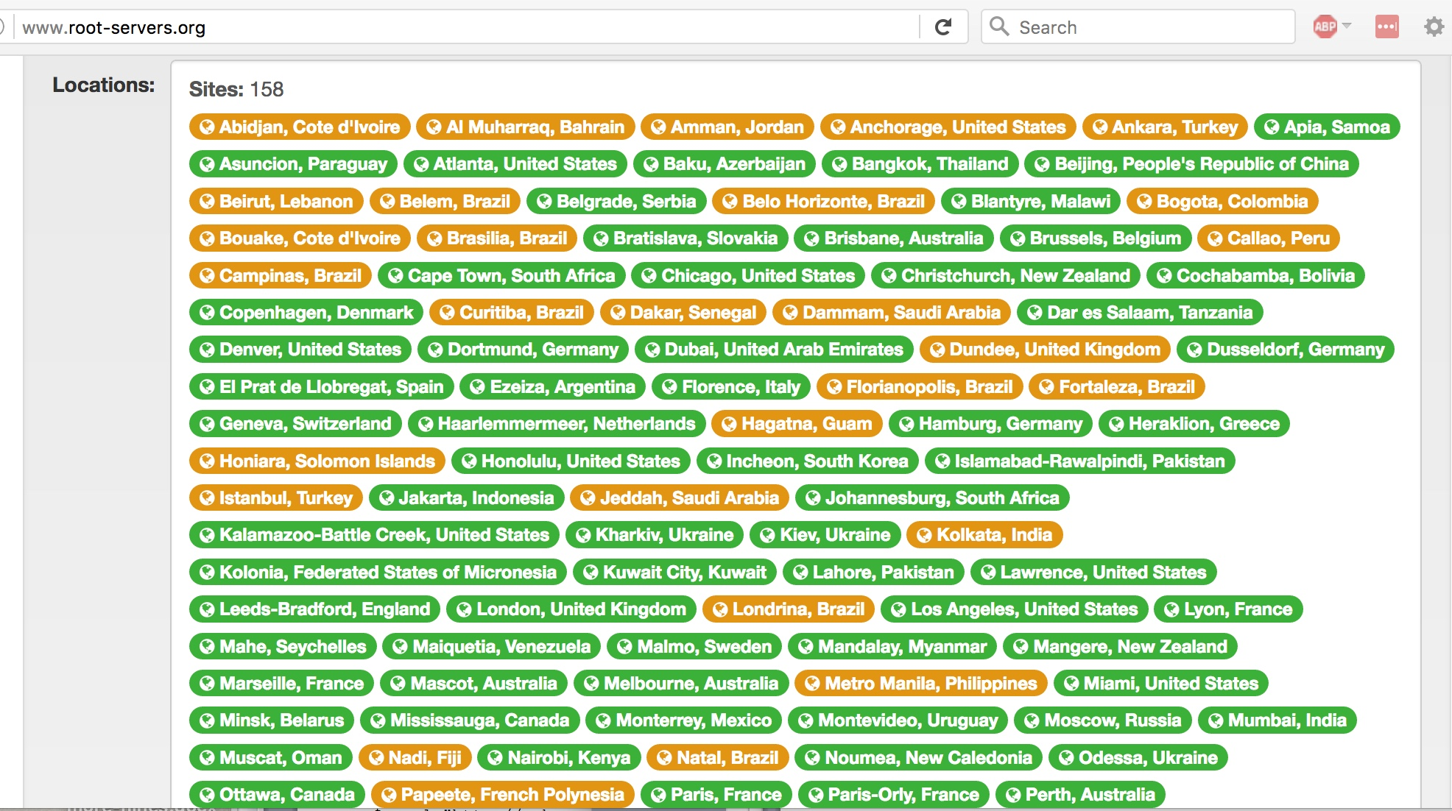
Look at Just The Locations Where The "L" Root Lives
[Green=IPv6 enabled; Brown=IPv4 only]

Slide 133
2) Domain Name
Structure and Nomenclature
"Look, I know there's a lot of jargon but
some of these really are self-explanatory."
Dan Rydell (a character in the movie "Sports Night"),
in response to being asked if throwing a
"perfect game" is "good"
Like sports, DNS also has a lot of jargon,
but unfortunately very little of it is self-explanatory

Slide 134
Fully Qualified Domain Name Nomenclature
Decomposing a FQDN, such as www.alumni.caltech.edu, we see:
-- edu is a Top Level Domain (TLD)
-- caltech.edu is the 2nd Level Domain (what a domain
registrant normally registers with a registrar)
-- alumni.caltech.edu is a subdomain of caltech.edu
-- www.alumni.caltech.edu is the FQDN (or "hostname")
There's also an implicit/unwritten "dot" at the right side of
www.alumni.caltech.edu – that's the "root" of the
entire DNS. It is normally not shown or specified when domain names are used (although you will see it in DNSDB output)
See the following diagram.

Slide 135
Hierarchical Domains

Slide 136
Subdomains
In a large organization, some units may be (more-or-less) autonomous, and might want to manage their own domain names. For example, a university's engineering school and the alumni association might both want to run their own DNS.
In that case, the school's central DNS admin team might create
and delegate two subdomains of the institution's domain, e.g., engineering.example.edu, and alumni.example.edu
Departmental DNS people might then create FQDN's under that subdomain, or delegate further sub-sub-domains, perhaps:
-- chemical.engineering.example.edu
-- civil.engineering.example.edu
-- electrical.engineering.example.edu
-- mechanical.engineering.example.edu
And going one step further, a FQDN (hostname) might look like
ilovemanualtransmissions.mechanical.engineering.example.edu

Slide 137
How Do I Know If A Label Is A "Hostname"?
When you see a label such as "alumni.caltech.edu", you can't tell just by looking at it whether that's a hostname in it's own right, or just a subdomain (with other FQDNs appearing below it), or both.
Caltech.edu (all by itself) might be/is a perfectly OK hostname.
You also can't tell (just by looking at it) whether there's a server "behind" any given name, or whether all servers are only assigned below that label, or, for that matter, what a server's being used for.
Domain name labels can sometimes be used in misleading ways:
-- www.something will often be a web server, but it doesn't have
to be
-- mail.something will often be a mail server, but it doesn't have
to be
-- ns1.something will often be a name server, but it doesn't have
to be

Slide 138
More Than One FQDN May Point At One IP
For example, imagine a big web server.
It might host hundreds or even thousands of different smaller web sites all serviced from a single IP address. For example, maybe a site has a set of athletic web sites all handled by a big shared web server:
[Note: 192.0.2.153 is an IP from a special block of IP's reserved for use in documentation, see https://tools.ietf.org/html/rfc5735 ]

Slide 139
A Single FQDN May Point At More Than One IP
On the other hand, imagine a really busy web server. A single site might have so much (potentially crushing!) traffic that it needs multiple physical servers to handle it all.
The domain name system makes it easy to accommodate that load: just point the busy web server name at a set of servers, each on a different IP address. Traffic gets sent to IPs on a round-robin basis, much the way a commercial load balancer (such as an F5 box) often is used....

Slide 140
A Domain Name Can Point At Another
Domain Name Rather Than At An IP Address
Domain names that point at other domain names are normally called "CNAMES." You can think of these as additional aliases that can be used in lieu of a host's primary name. For example:
senate.uoregon.edu. IN CNAME faprod.uoregon.edu.
parking.uoregon.edu. IN CNAME faprod.uoregon.edu.
committees.uoregon.edu. IN CNAME faprod.uoregon.edu.
facilities.uoregon.edu. IN CNAME faprod.uoregon.edu.
courseevals.uoregon.edu. IN CNAME faprod.uoregon.edu.
riskmanagement.uoregon.edu. IN CNAME faprod.uoregon.edu.
[etc]
If faprod.uoregon.edu ever needed to move to a new IP address, you could just change it, not each and every one of these sites...

Slide 141
IP Addresses Can (Sometimes) Also
Be Mapped Back To A Domain Name
Just as you can map a domain name to an IP address, you can also (sometimes) map an IP address back to a domain name:
Normal domain name to IP DNS resolution might look like:
drupal-cluster5.uoregon.edu ➔ 128.223.142.244
Reverse (IP to domain name) DNS resolution might look like:
244.142.223.128.in-addr.arpa ➔
drupal-cluster5.uoregon.edu
These are normally called "inverse address" or "pointer" records. Does the following help you to see why?
$ dig -x 128.223.142.244
[...]
244.142.223.128.in-addr.arpa. 86400 IN PTR
drupal-cluster5.uoregon.edu.

Slide 142
Generic TLDs (Regular Domain Names)
gTLDs are managed by ICANN, the Internet Corporation for Assigned Names and Numbers. Traditional generic TLDs include .com, .net, .org, .edu, .gov, .mil, .int, .biz, .info, .mobi,
.name, .jobs, .me, .xxx, .pro, .aero, .jobs, .asia, .museum, .tel,
and .travel.
Some gTLDs are unrestricted (e.g., anyone can register a domain in them), such as .com, .net, .org, and .info
Other gTLDs are limited to just particular communities.
For example: .edu's are now limited to just accredited US colleges and universities; .gov is restricted to just American government agencies; .mil is limited to just the US Army, Navy, Air Force, Marines, and Coast Guard; .int is just for international organizations (such as NATO)
gTLDs are most common, but there are also many other types of top level domains.

Slide 143
ccTLDs
ccTLDs are two letter "Country Code" top level domains such as:
.ar Argentina .au Australia .be Belgium
.br Brazil .ca Canada .ch Switzerland
.co Colombia .cn China .de Germany
.es Spain .eu European Union .fr France
.in India .it Italy .nl Netherlands
.pl Poland .ru Russia .tk Tokelau
.uk United Kingdom .us United States etc.
Most ccTLD abbreviations are self explanatory, but there are some noteworthy exceptions such as ch= Switzerland (Cantons of Helvetica), de=Deutschland, dz = Algeria (Dzayer in Berber), etc.
There are 254 ccTLDs in total, see the country code TLDs listed
as part of https://icannwiki.com/CcTLD

Slide 144
Weird ccTLD Factoids
So-called "open" ccTLDs have been "disconnected" from the countries they're named after. For example, .tk was sold by the Tokelau government and is now largely used for free domain registrations (and not by the 1,400 or so people of Tokelau)
Some ccTLDs register new 2nd-level domains differently than .com, .net, etc., do. For example, most commercial domains in the uk get registered under .co.uk, not directly under .uk (we call .co.uk and similarly situated domains "effective TLDs")
Some legacy ccTLDs still exist even if the associated country no longer exist. For example: .su (Soviet Union)
ccTLDs are not subject to ICANN contractual requirements. This
means that they are run as the individual ccTLD operators deem appropriate. In some cases, this translates to things like no requirement for publicly available whois service (whois normally tells you who owns/controls a given domain)

Slide 145
IDNs (Internationalized Domain Names)
Most TLDs use "normal" ("Roman" or "Latin") letters, numbers
and/or hyphens, and can be up to 63 characters long.
IDNs were created to meet the needs of those using languages with other scripts, such as:
-- Arabic
-- Chinese
-- Cyrillic (Russian)
-- Greek
-- Hangul (Korean)
-- Hebrew
-- Indian (Bangla, Devanagari, Gujarati, Gurmukhi, Tamil, Telugu)
-- Katakana (Japanese), etc.
IDNs get represented two ways: as a "U label" (presentation format, using the international character set, such as 中信), and as an "A label" (the ASCII-encoded form, such as xn--fiq64b)

Slide 146
Internationalized Domain Names (cont)
This is now a valid domain name: はじめよう.みんな
Plug it into your browser, and you'll be taken to that web site.
[Anyone want to attempt pronunciation of that domain name?]
That same name in Punycode ASCII format gets written:
xn--p8j9a0d9c9a.xn--q9jyb4c
Note: Punycode-format IDNs always begin "xn—"
Need to manually convert between the two? See
http://idna-converter.com/
More resources relating to IDN's:
https://www.icann.org/resources/pages/more-2012-05-08-en

Slide 147
New gTLDs
Recently ICANN has begun the creation of over 1,300 new gTLDs, such as .xyz, .red, .faith, .london, stream, etc., see 1,188 listed at http://newgtlds.icann.org/en/program-status/delegated-strings for the new gTLDs delegated to-date
Some of these new gTLDs are restricted to designated communities, others are open and new domains can be registered by anyone (sometimes for as little as $0.49/domain, as can be seen at https://tld-list.com/ (click on "Cheapest Register" to sort by domain name cost))
Trademark holders can use the new Trademark Clearinghouse to protect their marks against possible dilution by registrants in the new gTLDs, see http://newgtlds.icann.org/en/about/trademark-clearinghouse.
Question: has your company protected its own marks via the Trademark Clearinghouse?

Slide 148
We've Been Talking About Names, What About IPs?
Even though domain names are important, and we like talking about domain names, computers and computer networks also need IP addresses.
Just as there's a lot of jargon around domain names, there's a lot of jargon around IP addresses, too.

Slide 149
3) IPv4 and IPv6 Addresses

Slide 150
The Critical Role of IP Addresses
While we often refer to Internet resources according to their domain names, each server/workstation/laptop/tablet/smartphone/etc. requires an IP address to connect to the Internet.
A host may have a traditional ("IPv4") address, a much longer "new-fangled" IPv6 address, or both.
We'll talk about IPv4 addresses a little first.

Slide 151
IPv4 Addresses and Prefixes
Traditional ("IPv4") IP addresses, consist of four integers separated by dots (that's why these are also often known as "dotted quads"). Each of the four values can have a value from
0 to 255. For example: 104.244.13.104
Ranges of IPv4 addresses are expressed in a variety of forms, most simply by stating a starting and ending address. For example: 104.244.12.0 - 104.244.15.255
IPv4 address ranges can also be expressed as "CIDR prefixes." CIDR prefixes consist of a starting address and a "mask length" or "prefix length" indicative of the size of the block (see the table in a few pages). For example, 104.244.12.0 - 104.244.15.255 can also be represented in CIDR notation as 104.244.12.0/22

Slide 152
Classless (CIDR) Addressing:
Much More Flexibility...
Some commonly seen CIDR lengths – note the pattern (each longer mask has ½ the number of addresses of the preceding)
[...] /23 512 IPv4 addresses
/14 262,144 IPv4 addresses /24 256 IPv4 addresses
/15 131,072 IPv4 addresses /25 128 IPv4 addresses
/16 65,536 IPv4 addresses /26 64 IPv4 addresses
/17 32,768 IPv4 addresses /27 32 IPv4 addresses
/18 16,384 IPv4 addresses /28 16 IPv4 addresses
/19 8,192 IPv4 addresses /29 8 IPv4 addresses
/20 4,096 IPv4 addresses /30 4 IPv4 addresses
/21 2,048 IPv4 addresses /31 2 IPv4 addresses
/22 1,024 IPv4 addresses /32 1 IPv4 address

Slide 153
Whois
Whois tells you "who is" responsible for a given number or name.
You can query whois for domain names, IP addresses, and ASNs.
You can access whois information from the command line.
In a Unix terminal window, you can enter:
$ whois farsightsecurity.com
You can also query whois over the web from a variety of 3rd party web gateways, such as https://dnsquery.org/whois/
Some domain whois data may be hidden behind proxy/private registrations, obfuscating the true owner of the domain name.

Slide 154
Types of IPv4 Addresses
Globally routable IP addresses: these addresses are usable worldwide, and will be unique worldwide. These are "regular" or "normal" IPv4 addresses. We can further subdivide regular IPv4 addresses into:
  Provider independent (PI) globally routable IP addresses: these addresses can be used with any single provider, or with any combination of providers.
  Provider assigned (PA) globally routable IP addresses: these addresses are provided for your use by your upstream provider. If you leave that provider, you "can't take them with you." If you leave, you'll need to "renumber out of that block" into a new block of address space, returning your previous block for some other customer to eventually use.
  Do NOT attempt to have some third party ISP advertise PA address space on your behalf (the third party ISP normally won't do it, anyhow).

Slide 155
RFC1918 Addresses for Private Intranets
RFC 1918 address space consists of three IP address ranges:
10.0.0.0-10.255.255.255 (10/8 prefix)
172.16.0.0-172.31.255.255 (172.16/12 prefix)
192.168.0.0-192.168.255.255 (192.168/16 prefix)
You can use these addresses however you like – within your own site. However, you CANNOT route those addresses to the Internet as a whole. To understand why, realize that thousands
of sites might have networks using addresses from the address range 10.0.0.0-10.255.255.255 – how would the Internet know which one of those was the "right one?"
RFC1918 addresses are perfect, however, for things like networked printers that should only be used by local people.

Slide 156
Network Address Translation (NAT)
You may use already be using RFC1918 addresses on your own home network. A common scenario is that you:
  Receive a publicly routable address from Comcast, CenturyLink, etc.
  You then use a wireless access point/"router" to connect all of your family's devices to the Internet, sharing that one public IP.
  This is done through use of RFC 1918 address space within your home, with those private addresses automatically "translated" to the single public IP address you received from your ISP.
Sounds like magic, right? It sort of is, but, unfortunately, it does have some downsides:
  It is difficult (although not impossible) to run servers from behind a NAT'd IP address (most broadband providers ban home servers, anyhow)
  NAT boxes, because they need to rewrite IP addresses, need to be "protocol aware" – this means that H.323 video conferencing may have trouble traversing some NAT boxes
  An ISP can't tell which host behind a NAT box might be botted, if bad traffic is seen getting emitted from a shared IP

Slide 157
Localhost/Loopback Address
127.0.0.1 is a special IPv4 "loopback" address that refers to the host itself.
The host can talk to it's own 127.0.0.1 (and other addresses in 127.0.0.0/8), but no one is able to talk to someone else's 127.0.0.0 addresses.

Slide 158
Assigning IPs to Systems: Static vs Dynamic
Servers in a department probably need "static" IP addresses. These are IPs that have been manually/permanently assigned for use by that particular computer. They will normally be associated with a meaningful public hostname, such as finance.example.edu
User laptops, tablets, smart phones, etc. will probably be automatically given temporary, or "dynamically assigned," IP addresses from a site's DHCP server. These address "leases" might last for just a few hours, but can be renewed if needed for a longer period. DHCP names are seldom very exciting (perhaps looking like dhcp-250.example.edu or dyn-110-72.something.edu)
Samantha Smith's laptop might use dhcp-250.example.edu this morning, and dhcp-18.example.edu this afternoon, while Jimmy Johnson's iPad might use dhcp-250.example.edu this afternoon.
DHCP allows IPs to be easily assigned, and allows a relatively small pool of addresses to be shared by a large(r) pool of users.

Slide 159
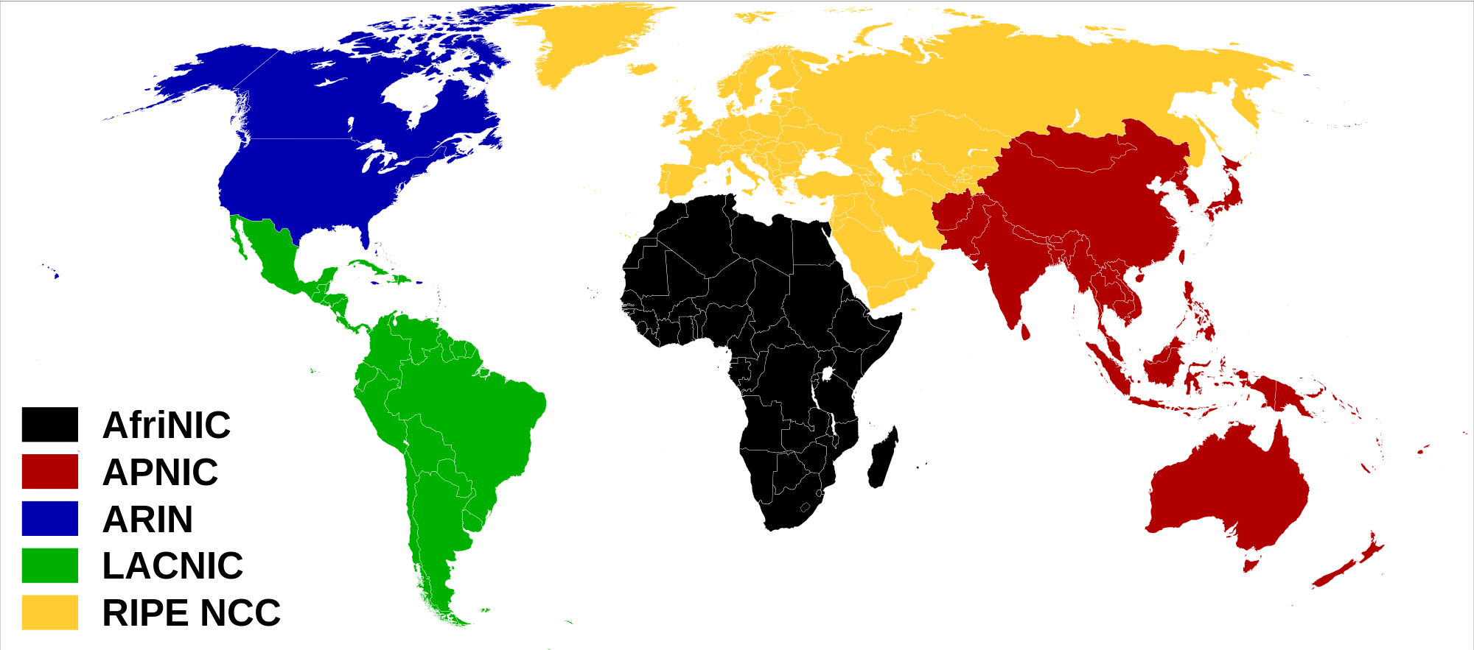
Where Do Sites Request Blocks of IP Addresses?
Small customers (such as an individual or a new startup business) normally get small blocks of IP address space from their upstream Internet Service Provider.
Larger sites (such as an established national or regional ISP that is multi-homed (connected to two or more upstream providers using BGP)) normally request provider-independent address space from their regional registry.
https://upload.wikimedia.org/wikipedia/commons/thumb/9/95/Regional_Internet_
Registries_world_map.svg/2000px-Regional_Internet_Registries_world_map.svg.png

Slide 160
Sadly, The World's Largely Run Out of Unassigned IPv4 Addresses
IPv4 addresses are just 32 bits long. That means that there's only a maximum of 2^32=4,294,967,296 potential addresses available.
There's actually not that many potential addresses, and in fact they've run out fast. See the graph on the following page.

Slide 161
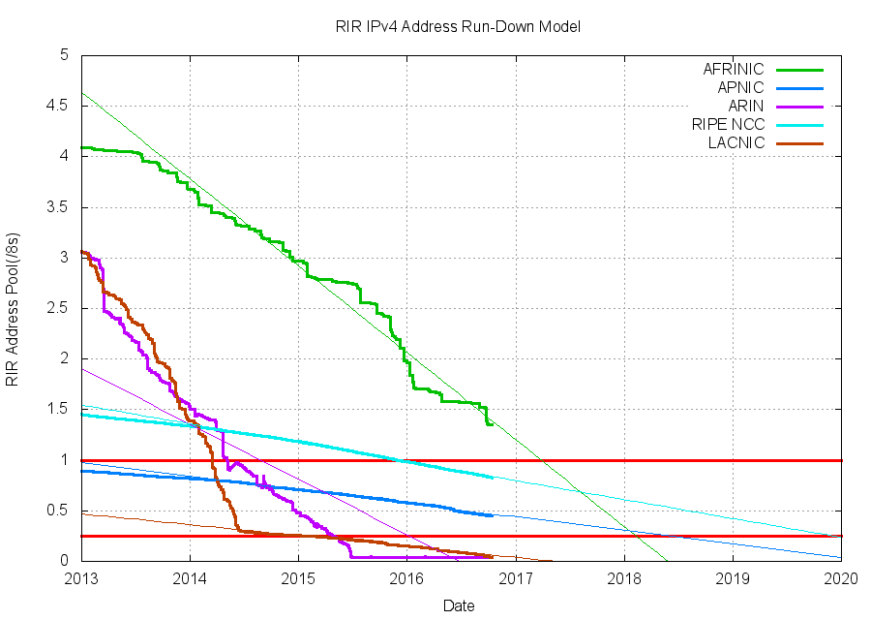
IPv4 Address Run Out By Regional Registry
Source: http://www.potaroo.net/tools/ipv4/

Slide 162
Fortunately We Have Lots of IPv6 Addresses
IPv6 addresses are a little different. For example, IPv6 addresses are written a little differently than IPv4 addresses.
IPv6 addresses are normally written as a series of 32 hexadecimal letters, broken into colon-separated 4-character chunks.
One such sample IPv6 address: 2620:11c:f004::104
When writing IPv6 addresses, leading zeros within a chunk can be omitted (as was done in the "11c" and "104" chunks above).
If there's a run of zeros in an IPv6 address, those can be replaced, in one location only, with two successive colons.
Verbose form: 2620:011c:f004:0000:0000:0000:0000:0104

Slide 163
"What's That About Hexadecimal Numbers Again?"
Decimal (base 10) numbers are written using the digits 0 - 9. Hexadecimal numbers (base 16) are written using 0 - 9 PLUS
the letters A (=10), B (=11), C (=12), D (=13), E (=14), F (=15)
Place Decimal: Hexadecimal:
1st 10^0=1's 16^0=1's
2nd 10^1=10's 16^1=16's
3rd 10^2=100's 16^2=256's
4th 10^3=1,000's 16^3=4096's
Convert 5178 (decimal) to hexadecimal:
5178/4096=1 with 1082 left over
1082/256=4 with 58 left over
58/16=3 with 10 left over
10/1=10 (written as "A") ➔ 143A (hexadecimal)

Slide 164
"So How Many IPv6 Addresses Can I Get?"
The Internet may be just about out of IPv4 addresses, but IPv6 addresses are available in barge-size quantities. Then again,
we use IPv6 addresses a little more liberally, too.
In IPv4 world, a typical subnet was a /24, or 256 addresses.
In the IPv6 world, a normal subnet is an IPv6 /64, or
2^64= 18,446,744,073,709,551,616 addresses. That's many more addresses than all the addresses in the IPv4 Internet, worldwide.
Each IPv6 subnet gets that many addresses even though a typical subnet might only have a handful (or perhaps a few hundred) of those addresses in use. This seems horribly weird and wasteful, but don't worry, IPv6 is intended to be used this way.
Mentally think "an IPv6 /64 represents a host, or maybe a small number of hosts," and you'll be okay. If you think "an IPv6 /64 is 18,446,744,073,709,551,616 addresses," you'll need therapy.

Slide 165
Normal IPv6 Allocations and IPv6 CIDR Sizes
A single local network normally uses a /64.
A smaller end site needing multiple subnets normally gets an
IPv6 /56. How many IPv6 /64's can that site deploy? (see table)
A provider (such as a small local ISP) might gets an IPv6 /48;
how many small end sites can they give a /56 to? (see table)
If you use up what you've initially received, you can request more [more about IPv6 allocations: https://tools.ietf.org/html/rfc6177 ]
Prefix # of IPv6 48's # of IPv6 /56's # of IPv6 /64's
/36 4,096 1,048,576 268,435,456
/40 256 65,536 16,777,216
/44 16 4,096 1,048,576
/48 1 256 65,536
/56 1 256
/64 1

Slide 166
Types of IPv6 Addresses
There are a wide number of different types of IPv6 addresses, in part because there were many attempts to map IPv4 addresses "automagically" over into IPv6 through gateway services.
A summary of those types can be seen at https://www.ripe.net/participate/member-support/new-lir/ipv6_reference_card.pdf
The most commonly seen types of native IPv6 addresses?
-- Globally routeable unicast addresses
-- Unique Local Addresses, the IPv6 equivalent of RFC1918 IPv4
private address space (all from fc00::/7)
-- Link Local Addresses, most commonly seen when looking at
IPv6-enabled hosts that don't have a globally routeable address
or ULA address (seeing just an fe80 address is often a sign that
you don't actually have IPv6 internet connectivity)

Slide 167
4) DNS: Connecting Domain Names to IPs

Slide 168
Connecting Names to IPs and IPs to Names
We've talked a little about names and a little about IPs.
Now let's come back to talking a little about how DNS connects the two together.

Slide 169
Resource Record Format
DNS relationships are defined in "resource records."
A sample DNS resource record looks like this:
www.farsightsecurity.com. 3600 IN A 104.244.13.104
The first field is the domain name.
The second field is the TTL, or time to live (which we've already introduced in our earlier caching discussion).
The third field, the "class code," will almost always be "IN" ("Internet"), and can normally be ignored.
The fourth field is the DNS record type. In this example, we have an "A" record (a normal IPv4 name-to-IP address record)
The fifth and final field is RDATA, in this case, an IPv4 address.

Slide 170
DNS Record Types
As we've previously mentioned, here are many different types of DNS records:
  A: Normal domain name→IPv4 address record
  AAAA: Normal domain name → IPv6 address records
  CNAME: Domain name → different domain name
  NS: Name Server records (tells what name servers to use for a domain)
  MX: Mail eXchanger records (where should I send email for this domain?)
  TXT: Text records, capable of carrying arbitrary text
  SOA: Start Of Authority records, defines the TTL and other zone
  parameters
  SRV: Server pointer records, explaining where to find a service (IP address and port information)
  And there are others, but only a comparative handful get widely used.

Slide 171
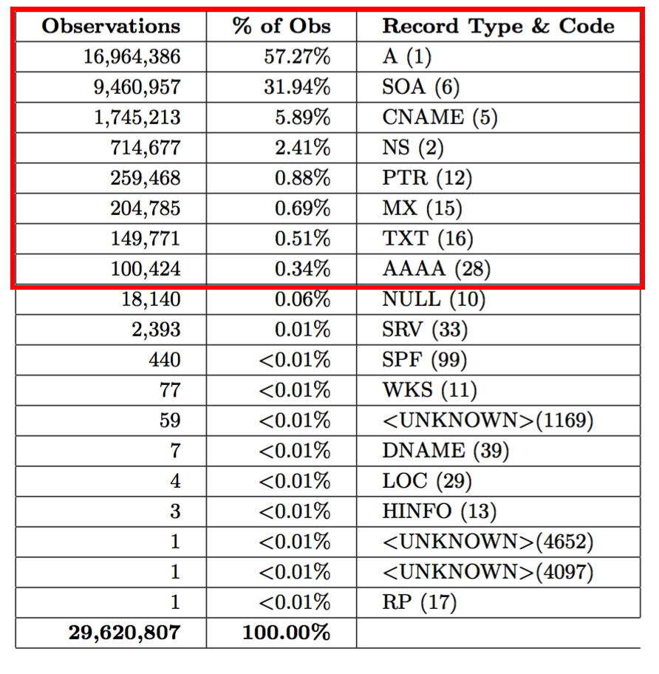
Record Types Seen In A Day's Worth of DNS Data

Slide 172
A Less Commonly Talked-About Record Type: SOA
$ dig farsightsecurity.com SOA +short
fsi.io. hostmaster.fsi.io. 2016101202 7200 3600 604800 3600
Decoded...
Primary master server for the zone? That's at the FQDN fsi.io
Contact address? hostmaster@fsi.io (sub an @ sign for the first .)
Serial Number/date gets updated whenever the zone is changed
Refresh: secondary servers are told to wait this long between checks to see if primary has updated (7200 seconds in this case)
Retry: secondary can't talk to primary? try again in 3600 seconds
Expire: secondary can't talk to primary? treat cached zone data as being still valid for a week (604800 seconds)
Negative caching time: if you get an NXDOMAIN for names in this domain, remember that negative response for 3600 seconds
See also dig's +multiline option for SOA records

Slide 173
Wildcard DNS
Normally DNS servers only send out answers for specific FQDNs.
However, some name servers will get configured to support wildcarding, in which case the name server will answer for ANY pattern matching the wildcard
For example, assume you're a marketer, and you've uniquely tagged a hidden tracking URL in each message you send. E.G.,
xfasd-ttsuoa.campaign7.example.com
hruak-adhdwr.campaign7.example.com
[etc]
You want your name server to respond to each such address when resolved. Using DNS wildcarding, you could tell a name server to return a response for *.campaign7.example.com

Slide 174
Zone Transfers
If you wanted to get a copy of all the records in a zone, such as all the hosts defined under uoregon.edu, you'd do a "zone transfer."
Zone transfers can be full (AXFR) or incremental (IXFR).
Because a full listing of all hosts in a domain would be hugely useful if you were a hacker/cracker planning an attack, normally zone transfers are only allowed for a small set of explicitly authorized parties who have a legitimate need for such access. (Sometimes zone files transfers are accidentally/unintentionally allowed as a result of operator error/configuration problems, see the next slide)
By the way, you now also understand why providers of passive DNS normally like to carefully vet their users – having access to passive DNS is like being able to get copies of a site's zone file.

Slide 175
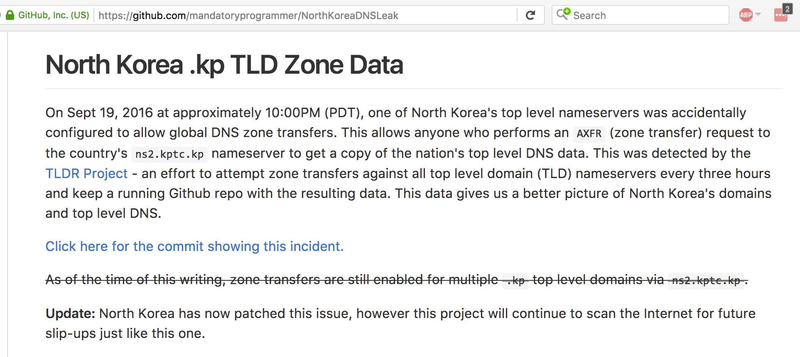
Example of a Zone Transfer Leaking: .kp

Slide 176
DNS Response Codes
When a DNS query is made, it may succeed or it may fail. The status code that's returned is called as a "DNS response code."
$ dig google.com
[...]
;; ->>HEADER<<- opcode: QUERY, status: NOERROR [etc]
google.com. 180 IN A 216.58.193.110
NOERROR == normal successful completion status code
$ dig asasdjasjnasfjnasfnkafs.com
[...]
;; ->>HEADER<<- opcode: QUERY, status: NXDOMAIN [etc]
NXDOMAIN == domain does not exist
There are other (relatively obscure) additional error codes, too

Slide 177
Thanks For the Chance to Talk Today!
Are There Any Questions?
Please remember to fill out your session evaluation!
THANK YOU for Participating In
M3AAWG's Paris Training Program

