Slide 1
Understanding Network Performance
Joe St Sauver, Ph.D. <jstsauver@gmail.com> M3AAWG Expert Advisor M3AAWG 64 June 2nd, 2025 Vancouver, BC Canada 2.0 TLP:CLEAR – Distribution Unlimited

Slide 2
Part 0. Introduction

Slide 3
**ATTENTION**
DO NOT run Speedtest, iperf3 or any other active bandwidth tester while you're here at M3AAWG. Bandwidth testing can interfere with other users' ability to use the network.
RUNNING WIRESHARK (or similar network packet capture technology) is also PROHIBITED while at M3AAWG. Wait to run Wireshark or similar packet capture technologies until you're on your own network (or another network where you're authorized to do so).
Always ensure you have a CLEAN RECENT BACKUP of your system before you make ANY changes to it.
System tuning is an experimental process. Success can depend on many factors, including some factors that may be beyond your direct control (such as the performance of remote systems or networks). We do NOT claim that all attempts at improving performance will be successful. In fact, your system may even end up performing WORSE than it did originally if you adjust the default settings. Proceed accordingly!

Slide 4
Joe! Is network performance really a 'M3AAWG thing'? YES
M3AAWG's all about "messaging, malware and mobile," e.g., network applications and cyber security topics. That directly relates to network performance, particularly now that our online environment is dramatically evolving. How are things evolving? Well, residential connections have gotten REALLY fast & cheap.
Multi-gigabit+ Fiber To The Home (FTTH) connections are now routinely available in North America. For example, in the suburban area of Oregon where I live, some sample FTTH offers include (at least as of the time this deck was prepared): Xfinity: 2.1 Gbps for USD$85/month Hunter Communications: 2.5 Gbps for USD$120/month [Consult your local providers for specific offers available in your area]
Imagine if fast connections like these were to fall under the control of bad guys!

Slide 5
Aside: "Are You Going To Talk About 5G Home Wireless, Too?"
"Mobile" IS 1/3rd of M3AAWG's portfolio. That said, vendors have indicated that while 5G wireless networks may eventually get up to 20 Gbps, multi-Gbps speeds are not routinely available on 5G wireless connections today.
For example, in 2023, OpenSignal reported that [users of the fastest 5G US carrier they identified] "enjoy average 5G download speeds clocking in at 186.3Mbps — more than 100Mbps faster than the speeds" [that users of the 2nd fastest 5G US carrier enjoy]. [https://www.opensignal.com/reports/2023/01/usa/mobile-network-experience-1]
While 100-200 Mbps speeds are a huge upgrade from 4G wireless speeds, they're still an order of magnitude behind speeds routinely available from fiber optic links. For that reason, we will NOT be focusing on enhancing the performance of 5G wireless network connections today
Let's move on to corporate network connectivity.

Slide 6
Corporate Connectivity: Internet Transit and Peering
When talking about corporate Internet connectivity, it is important to be clear on the difference between peering and Internet transit.
Peering is when two (normally similarly-sized) providers agree to exchange customer traffic (and only customer traffic). This may happen at exchange points or via private interconnections. Peering is how traffic flows from one backbone provider to another. Peering may be selective and bilateral (just between two particular parties), or open and multilateral. Peering may happen "settlement free" but you'll also see "paid peering" (depending on the relative role of the peers, their traffic balance, and other factors).
On the other hand, when you buy Internet transit, you pay a network provider for full Internet connectivity. You can send traffic to anyone on the Internet, and anyone on the Internet can reach you. This simple ("don't worry about it, we'll handle all the details") sort of access comes at a cost (you'll pay to get transit service from a network provider), but you won't have to arrange for and maintain a bunch of peerings.
Corporate networks of at least a certain size will often have a mix of some peering (typically to help keep local traffic local, and to skim off some the highest volume traffic sources and sinks), plus Internet transit to handle everything else.

Slide 7
Internet Transit Has Been Getting Substantially Faster and CHEAPER
At one point, 10 Gbps or OC-192 connections were considered to be very fast, but these days transit providers are routinely offering 100 Gbps (and sometimes even 400 Gbps).
A sample backbone provider, Arelion (formerly Telia), states, "For IP Transit, 10Gb and 100Gb ports are the current standard. Arelion can offer 400Gb ports in many locations, as many as 50 at the moment." (https://www.arelion.com/products-and-services/internet-and-cloud) Way back in 2020, they went on to claim that "In 2019 alone, Telia Carrier deployed 10,000 global 100-gigabit Ethernet ports," see https://blog.arelion.com/2020/08/03/ip-transit-everything-old-is-new-again/
TeleGeography states that "In Q2 2024, the lowest 10 GigE prices on offer in the most competitive markets were at the brink of $0.07 per Mbps per month. The lowest for 100 GigE was $0.05 per Mbps per month." and "Across key cities in the U.S. and Europe, 400 GigE prices range from $0.07 to $0.08 per Mbps." See "IP Transit Price Erosion: Significant Regional Differences Remain," https://blog.telegeography.com/ip-transit-price-erosion-significant-regional-differences-remain
For comparison, our 2.5Gbps FTTH, $120/2500 Mbps ==> $0.048/Mbps/month.

Slide 8
Peering at The Seattle Internet Exchange, A Sample PNW Peering Point
Reference: https://www.seattleix.net/join

Slide 9
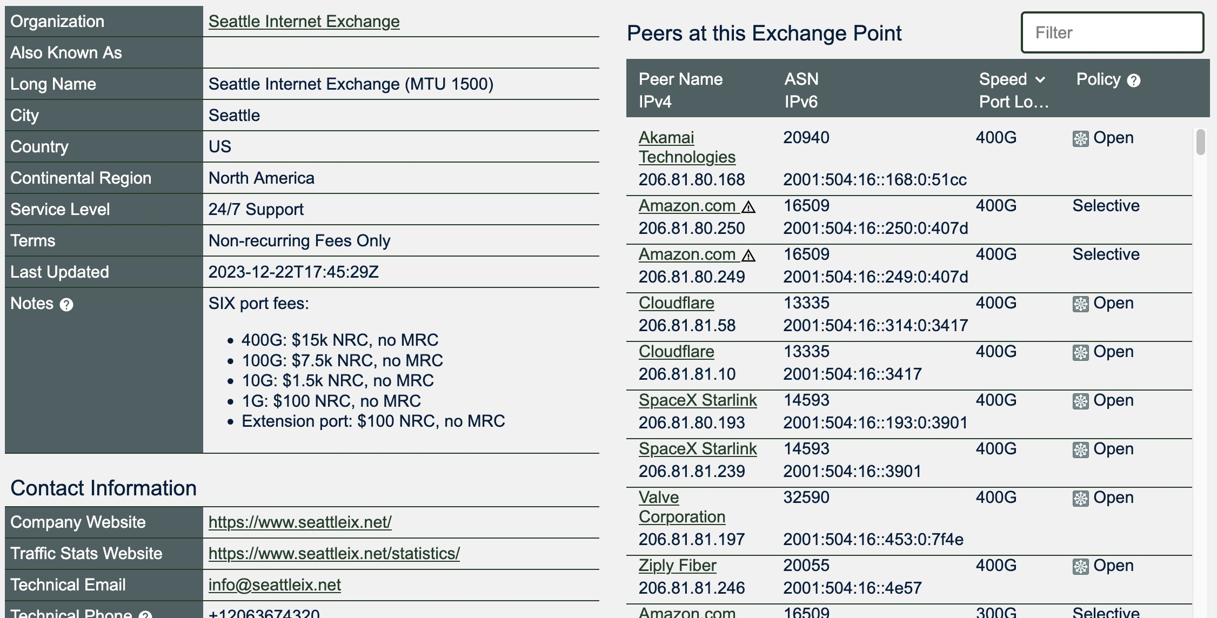
PeeringDB Details For the SIX (https://www.peeringdb.com/ix/13)

Slide 10
Some Canadian Exchange Points Offering 100Gbps+ Peering Connections
TorIX, Toronto https://www.peeringdb.com/ix/24
ONIX, Toronto https://www.peeringdb.com/ix/4059
QIX, Montreal https://www.peeringdb.com/ix/355
YYCIX, Calgary https://www.peeringdb.com/ix/639
VANIX, Vancouver https://www.peeringdb.com/ix/863

Slide 11
Security Challenges Can Arise From Fast (100Gbps+) Connections
At 100 to 400 Gbps, it can be "tricky" (that's pronounced "hard/expensive") to manage, monitor, and secure those connections. Multiple companies ARE trying to fill that niche... Some high-performance network monitoring companies include (in alphabetical order):
Cpacket (https://www.cpacket.com/) Cubro (https://www.cubro.com/en/), Endace (https://www.endace.com/), FMADIO (https://www.fmad.io/), MantisNet (https://www.mantisnet.com/), NEOX (https://neoxnetworks.com/), NTOP (https://www.ntop.org/) etc. But just how fast can these security solutions go? And what do they cost? Ensuring that providers maintain secure networks and adequate internal network visibility feels like something else that should be within M3AAWG's remit.

Slide 12
Are You Fighting Abuse? That Will Drive Your Need For Higher Bandwidth
If you're going to effectively fight online abuse on fast networks, YOU will need to be able to collect empirical evidence at scale.
Monitoring high performance connections drives a need for YOU as an anti-abuse analyst to HAVE and be able to USE high performance network connections yourself.
Waiting for bulk data to transfer from remote sites represents a delay in the analysis process (and a window during which the bad guys can continue their shenanigans). It is critical that your processing of abuse-related data be as timely as possible.

Slide 13
The Structure For The Rest of This Training
First part of this training: There are practical aspects to getting a connection upgraded to multi-gigabit speeds. This information will be directly helpful for you if you're thinking about upgrading your own connectivity. The network we create in this process will also represent the "lab" environment where we'll work on topics in the 2nd part of this talk.
In the second part of this training, we'll consider some specific technical topics you'll bump into as you begin to work with "long fat networks" (aka high latency, high bandwidth networks), including:
Latency and its impact on bandwidth delay products
Packet loss, and the impact of your choice of TCP congestion control algorithms
Bufferbloat
We've also provided a brief glossary at the end of this document given the large and unique vocabulary this talk employs.

Slide 14
Part I. Getting A 2.5 Gbps Network Established

Slide 15
1. Measuring Performance To Get A Starting Baseline
Bottom Line Up Front (BLUF): You can't tell if things have gotten better if you don't know where you were in the first place. Therefore, start by measuring where you're currently at. Speedtest is a GUI web tool you can use for that process.

Slide 16
Before You Do ANY Testing or Tweaking
Before you test, disable any "power saving" settings that may be enabled – you want to be able to "put your foot down on the accelerator" and get full power from your gear.
Most testing should be done using wired Ethernet, but if you do want to use wireless, get as close as possible to your access point. Distance (or walls) can cut your wireless throughput by half or more.
Decide if you're testing IPv4 or IPv6 or both. Speeds should be roughly comparable.
Be sure to also test download AND upload speeds – they may be different.
Plan to do multiple runs. Individual runs may be unusually good (or bad) just due to other network traffic or random factors, so do multiple runs and look at the average.
Minimize network traffic from other applications or users to the extent possible.

Slide 17
Document Your Starting Network Architecture
Our starting home network consisted of gigabit (symmetric) fiber connectivity from a local provider, terminating at a Nokia XS-110G-A Optical Network Terminal (ONT).
The ONT connected to a Calix Gigaspire BLAST u4 Tower. That provided WiFi and gigabit wired Ethernet connections.
Our test hosts, chosen to be representative of typical endpoints, connect via wired or wireless Ethernet to the Calix. They are: a) A Mac Apple Silicon (M1) laptop, initially connecting wirelessly. b) A Windows 11 (AMD Ryzen AI 9) laptop, initially connecting wirelessly. c) An Alienware R8 PC server (Intel Core i5) running Debian Linux, connected over gigabit wired Ethernet.
Your network architecture be different. Document it prior to upgrading.

Slide 18
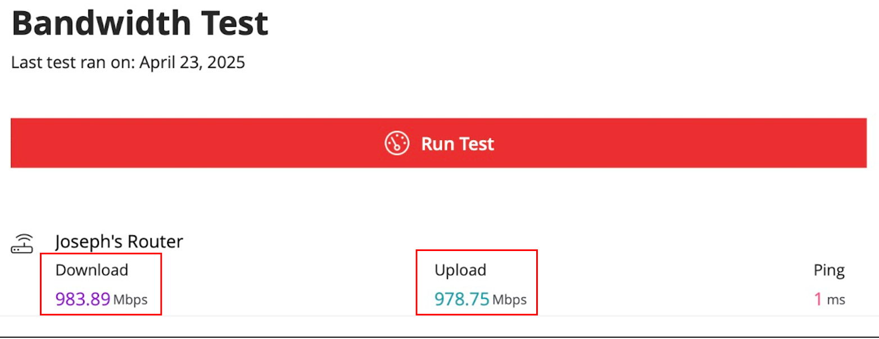
Pre-Upgrade Bandwidth Tested From Our Calix BLAST u4 Tower
Running this test directly from the Calix (via the ISP-provided app) eliminated any potential issues or impact that might be associated with my test systems or my home network.
Note that this is reporting multi-stream TCP bandwidth run against a VERY close test endpoint (note the ping time of 1 msec).

Slide 19
That Was What We Hoped For/Expected...
978.75/1000*100=97.875% of our nominal 1000 Mbps expected rate.
No, we didn't see exactly 1000 Mbps (likely due to Ethernet overhead), and granted, this testing was done by running multiple parallel TCP streams for a fairly short period to a very close bandwidth testing endpoint, but seeing 978 Mbps (basically full line rate) was encouraging.
What do we see if we test from actual end-user devices?
Let's test a Windows 11 PC using Speedtest.

Slide 20
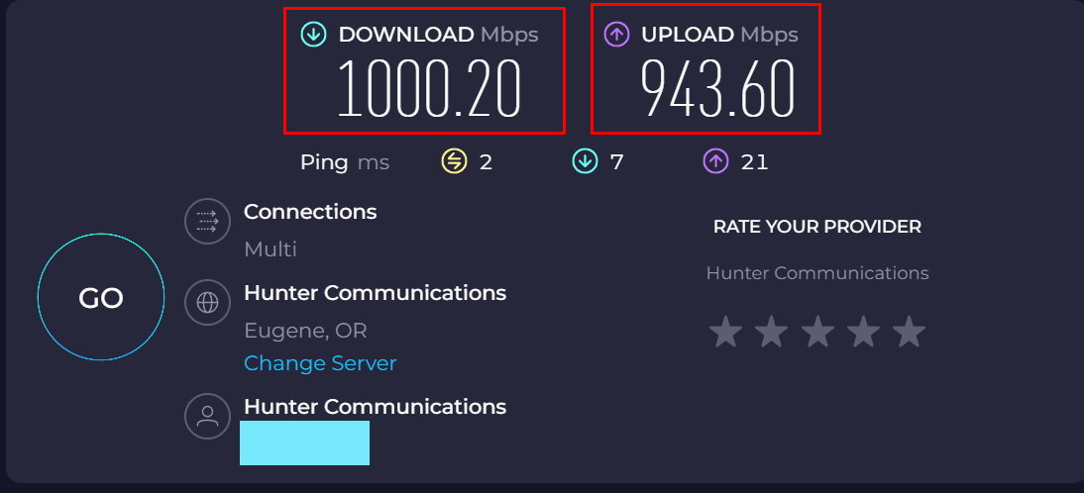
WIRELESS Win11 Laptop tested using https://www.speedtest.net/

Slide 21
Things To Note About The Preceding Windows Results
Baseline performance was excellent from the Windows 11 laptop. That system (borrowed from a family member for testing since we don't personally have any Microsoft Windows systems) was a current-generation HP Omnibook Ultra (AMD Ryzen AI 9 HX 375 2.0 GHz with Radeon 890M, 32 GB of RAM, and 802.11ax WiFi 6 running at 160MHz). This is a typical current generation ~$1200-class Windows laptop.
What did we see for an older Mac PowerBook M1, also connected wirelessly?

Slide 22
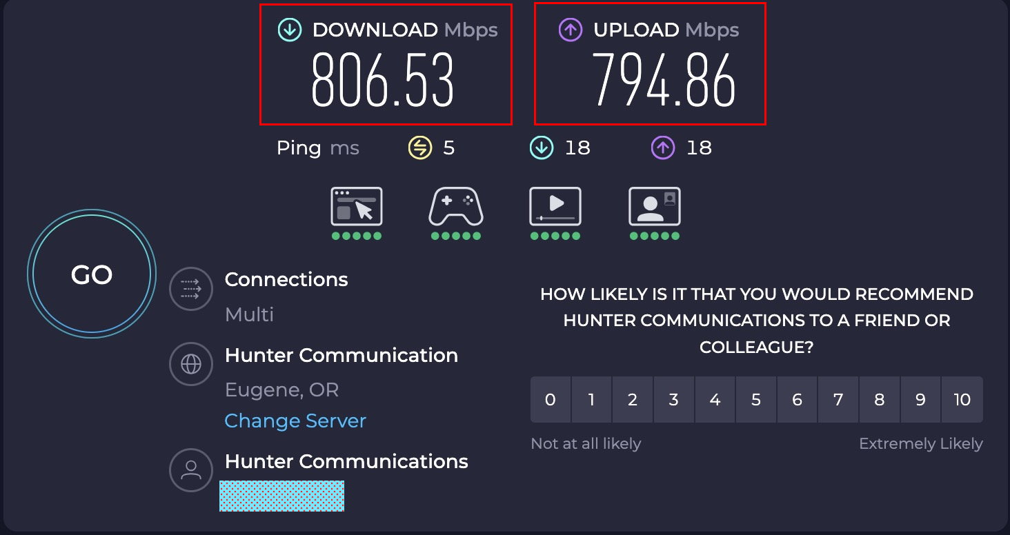
WIRELESS Mac M1 Laptop using https://www.speedtest.net/

Slide 23
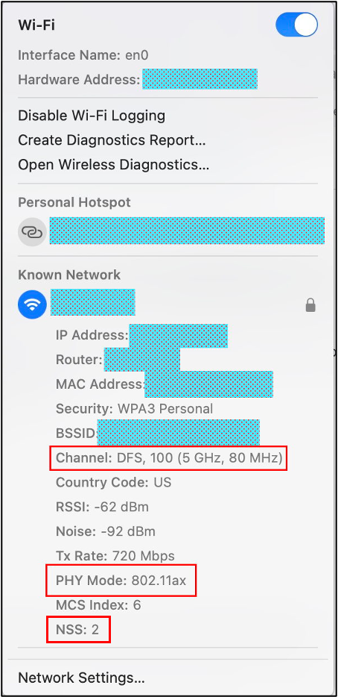
Some Notes About The Preceding Mac Results
The Mac results were obviously slower than the Windows 11 results, but 800 Mbps will often be just fine for many users for routine use.
This was from a 2020 MacBook Pro M1 running MacOS Sequoia 15.4.1, connected over 5GHz 802.11ax wireless with two spatial streams and 80 MHz bandwidth. Aside: How did we find out what our WiFi connection used? Under Mac OS/X, hold down the Option key while clicking the WiFi icon in the top menu bar. That will give you a display that should look like the panel that's over to the right ➔ That summary gives us important information about our WiFi connection, including the protocol (802.11ax), the number of spatial streams (NSS) (2), and the bandwidth (80MHz).

Slide 24
Obligatory Sample AI-Derived Content: WiFi Throughput by Protocol
802.11b (real world throughput between 5-7 Mbps)
802.11a or 802.11g (real world throughput around 20 Mbps)
802.11n (real world throughput around 100 Mbps)
802.11ac (real world throughput of maybe 400-720 Mbps)
802.11ax:

Slide 25
"Test Using Hardwired Connections, Not Wireless..."
It is generally well accepted that high bandwidth network throughput testing should be done over a wired Ethernet (rather than WiFi) connection – WiFi just isn't fast enough in many cases, serving as an inherent bottleneck link.
We had a genuine Apple USB-to-Ethernet adapter that we'd had knocking around for some years, so we decided to try it to see what sort of throughput we'd get from it...

Slide 26
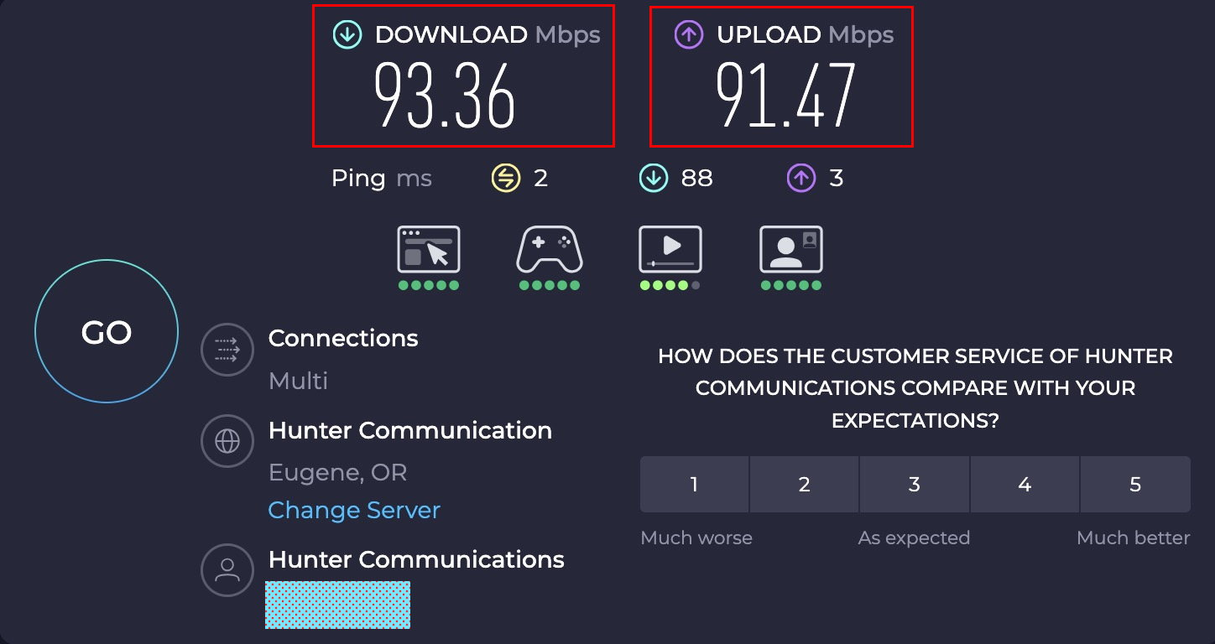
Testing Our Macbook With the Apple Mac Wired Ethernet Adapter

Slide 27
Wired Ethernet Performance WORSE Than Wireless? WHAT?
Could it be that our laptop ports are too slow? After all, we used a dongle plugged into a USB port – how fast do those ports go? Answer: even USB 3.0 supports 1 Gbps, but USB 3.1 (what we're using) supports up to 10 Gbps. The issue here was not one of USB port throughput.
The "clue" here was that we're basically seeing Fast Ethernet (100 Mbps) speeds. So, what's the spec for our genuine Apple Ethernet adapter? Checking the Apple site, this old adapter is actually a 10/100BASE-T unit! It's going as fast as it can, its just not very fast.
ALWAYS TEST! AND ALWAYS CHECK THE SPECIFICATIONS FOR THE GEAR YOU'RE USING!

Slide 28
What If We Try A DIFFERENT Wired Ethernet Dongle on the Mac? (Such As An $11 UGREEN Gigabit USB-C to Ethernet Adapter)?

Slide 29
We Now Have A Pretty Good Starting Performance "Baseline"
We saw near line-rate when we tested from our Calix WiFi router.
We saw true line-rate (1000 Mbps) throughput from a Windows 11 PC, even when connecting wirelessly
We saw just under 930 Mbps using a cheap wired Ethernet gigabit adapter on our old test Mac laptop.
We even saw roughly 800 Mbps to our old test Mac laptop over 802.11ax wireless.
That's all perfectly okay for most users, but we wanted substantially faster speeds.
Fortunately, we could get 2.5 Gbps service for our ISP for not much more per month.

Slide 30
2. Upgrading Client-Side Gear for 2.5Gbps Networks
Bottom Line Up Front (BLUF): You can build out what you need client-side for 2.5Gbps for not a lot of money, but be sure to test any hardware you buy to confirm it can do the job.

Slide 31
Upgrading Client Hardware: What Will We Need For 2.5Gbps?
If we were going to continue to use laptops, we needed faster Ethernet USB-to-Ethernet dongles (neither of our test laptops came with a built-in 2.5Gbps Ethernet adapter). We'll use those external Ethernet dongles for both Mac laptops and Windows 11 laptops that need wired Ethernet support.
Mac: If you're aren't a "Mac geek", you should know that there are two types of 2.5 Gbps USB Ethernet dongles for Mac laptops: One sort uses "networking control model" drivers ("ncm"). These run fast. The other sort uses an older "ethernet control model" driver ("ecm"). These run more slowly. It's rare to see details about Mac drivers on Amazon (or other online marketplaces) for USB dongles, so you may need to order devices and check to see what driver they use.

Slide 32
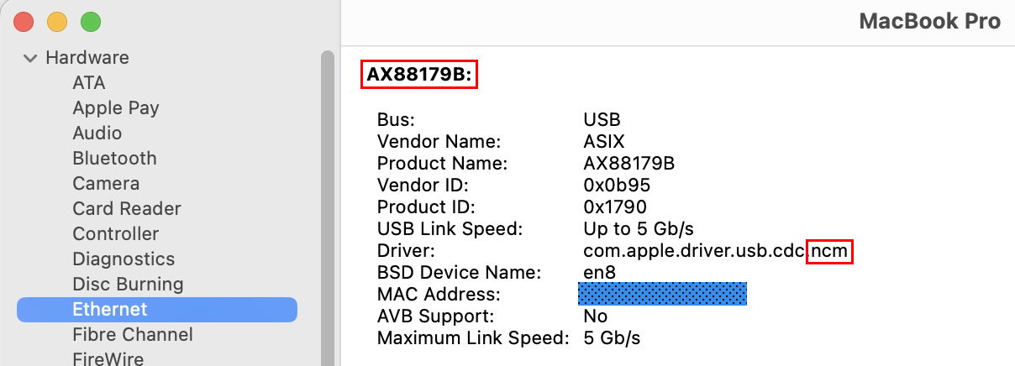
Checking Mac USB Dongle Ethernet Adapter Driver Usage
Check: About This Mac → More Info → General → About → System Report → Ethernet to see what driver's actually being used. One example device (this one's our cheapo $11 UGreen 1 Gbps Adapter):
In spite of mentioning "USB Link Speed up to 5 Gb/s", this device was truly JUST a gigabit adapter (as the vendor clearly stated in their ad).

Slide 33
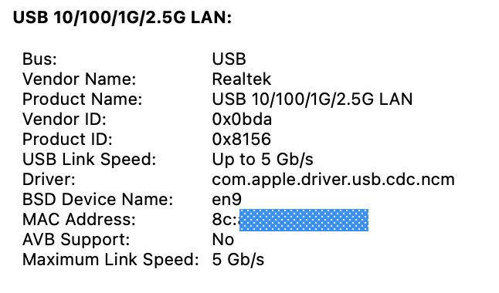
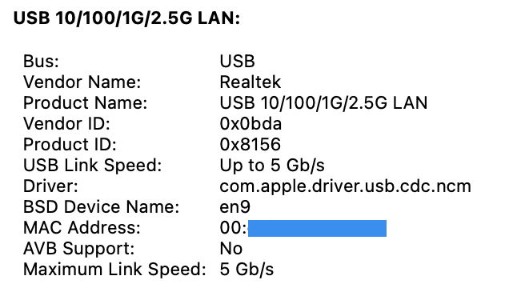
Checking a Couple of Actual 2.5Gbps USB-C to Ethernet "Dongles"...
Pluggable Brand 2.5G USB Dongle (NCM driver), https://www.amazon.com/dp/B084L4JL9K ($28.95)
Anker Brand 2.5G USB Dongle (NCM driver), https://www.amazon.com/dp/B097N5WJY9 ($39.99) Both used Realtek chips. The only real difference between the two? The MAC address...

Slide 34
What About 2.5 Gbps PCIe NICs for Our Alienware Linux x86 Box?
We tested three different 2.5 Gbps PCIe network cards:
A Leagy 2.5GBase-T PCIe Network Card with RTL8125B Chipset, $12.99, https://www.amazon.com/dp/B0BYDH6HWY
A Glotrends LE8105 2.5Gbps PCIe Ethernet Network Card, RTL8125BG Chip, also $12.99, https://www.amazon.com/dp/B0BLN82WQ4
A TP-Link 2.5GB PCIe Network Card (TX201) (PCIe to 2.5 Gigabit Ethernet Network Adapter), $26.99, https://www.amazon.com/dp/B0BG685PKM
Each of the three cards installed easily (no external drivers required) on our test Alienware Aurora R8 desktop minitower with an Intel Core i5 9400 (6 cores), 16 GB of memory, and a 2TB NVMe disk running Debian 12 (kernel: 6.1.0-34-amd64). Each delivered a satisfying 2.3 Gbps up and 2.3 Gbps down when tested using Speedtest.

Slide 35
Wired Ethernet Connections? Don't Forget About Your Cables!
All Ethernet cables may "look the same," but there is a difference when you begin trying to go fast(er). "Vanilla" Cat5 cables won't reliably deliver multi-Gbps speeds. What will?
Cat5E cables are rated for Gigabit speeds and 100 MHz for a permanent link length (PLL) of up to 90 meters – too slow.
Cat6 cables are rated for 10 Gigabit speeds and 250 MHz for a PLL of up to 90 meters.
Cat6A cables are rated for 10 Gigabit and 500 MHz for a PLL of up to 90 meters.
Cat8 cables will handle up to 40 Gigabit speeds with 2000 MHz for a PLL of 24 meters, or they can do 10 Gigabit for a normal PLL of up to 90 meters.
Rather than worrying about "what cable's what," my recommendation is to only buy and use Cat6A or Cat8 for everything moving forward (in most cases, pricing differences between the various categories will be negligible, unless you're buying miles of cable).

Slide 36
3. Remaining 2.5Gbps Network Infrastructure
Bottom Line Up Front (BLUF): At least some of your network gear will likely be provided by your ISP. Confirm that it is correctly configured for the speed you bought. Recognize that you may need to add a supplemental switch to get the Ethernet port count you need. Test and CONFIRM your throughput!

Slide 37
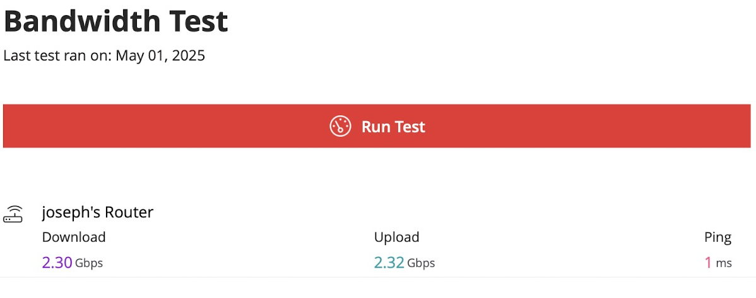
Our Provider-Provided Wireless Calix Router Was Upgraded for Free!
This was done by a provider technician, and it tested OK from the provider's app. This was another Calix Gigaspire, just a different (more powerful) model, the u6.

Slide 38
The router gateway was initially left configured for just gigabit

Slide 39
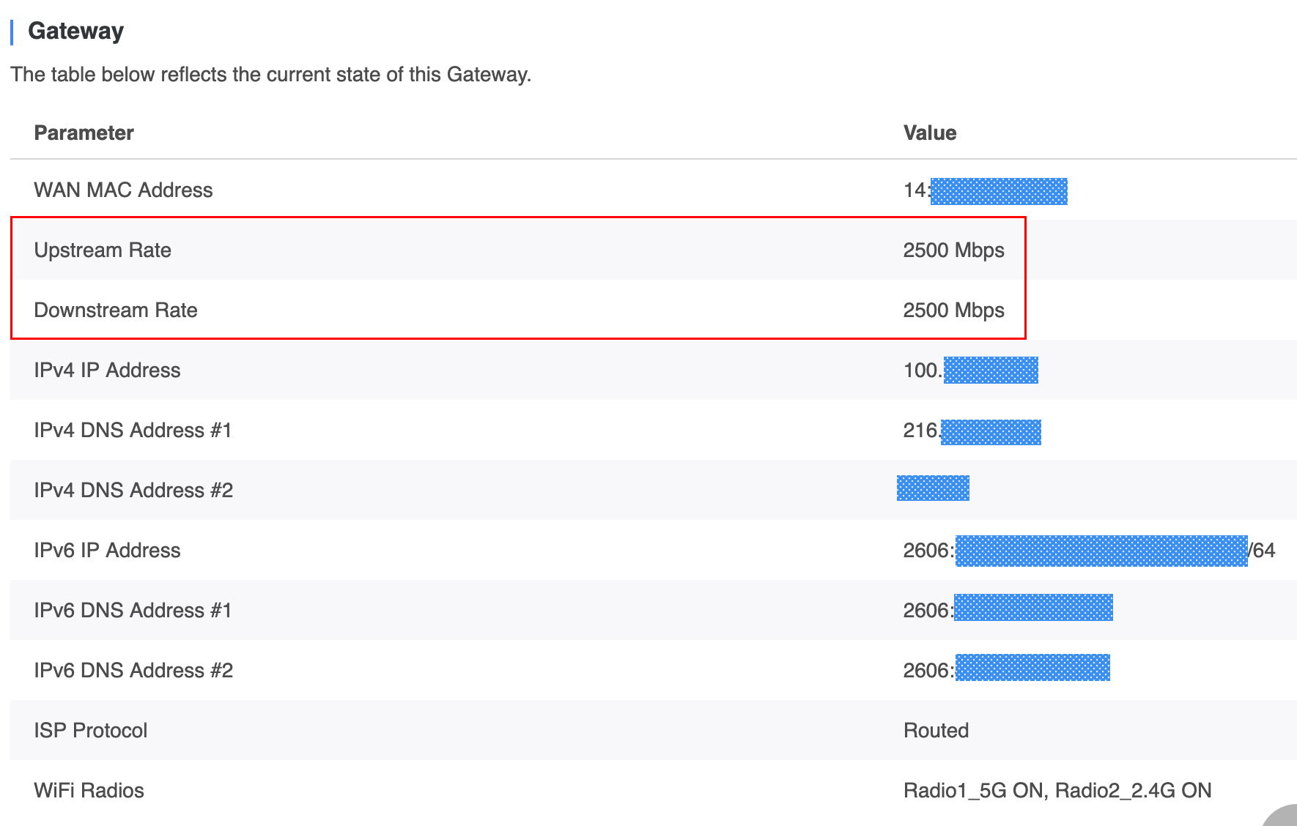
A support ticket with the provider (and a reboot) got that corrected

Slide 40
2.5 or 10 Gig Physical RJ45 Port Counts
CPE devices provided to customers by ISP's may have a limited number of faster-than-gigabit RJ45 ports (ours had just ONE upstream and one downstream 10gig port).
If you need additional 2.5 Gbps/10 Gbps ports, you'll need to purchase a switch.
The cost for a 2.5gbps or 10gbps Ethernet switch will vary depending on multiple factors:
Who makes the switch? (This is relevant if you're subject to National Defense Authorization Act (NDAA) restrictions and/or the Trade Agreements Act (TAA)).
Is the switch managed or unmanaged? Put another way, is the switch just "plug-and-play" (effectively functioning as a "one-port-to-multiport adapter"), or can you fully configure & monitor it, etc.? (Can I use VLANS? Jumbo frames? Read SNMP counters?)
What's the switch's port count? 4 ports? 8 ports? 24 ports?
Does the switch support power-over-Ethernet (POE), thereby making it easy to deploy infrastructure (such as WiFi access points) even where "wall power" is unavailable?
Are ports copper (100/1000/2.5G/5G/10Gbase-T) or fiber optic (perhaps SFP+)?
What's the architecture of the switch? Cut-through, or store-and-forward?
Is the switch fully redundant? Can it lose a power supply or fan w/o going offline?

Slide 41
A Simple Unmanaged 2.5 Gig Switch
The unmanaged 2.5 Gbps switch we went with was a TP-Link Omada TL-SG108S-M2 8-Port 2.5G Ethernet Switch, $199.99 ($15/port).
It's small but still rather beefy feeling, only 6.2x4x1" in size. This is a store-and-forward switch, reportedly able to handle 40 Gbps/29.8 Mpps. It's also quiet due to being fan-less. It takes its power from a "wall-wart"-style power supply.
It's obviously NOT a carrier grade switch, but we hoped it would work for our needs (and it seems to be doing so, at least so far). The box the switch came in states the switch has a 3-year warranty, but the matrix at https://www.tp-link.com/us/support/replacement-warranty/ is somewhat unclear (and there's a long list of exclusions and conditions).

Slide 42
Greater-Than-Gbps Switches CAN Sometimes Involve Fiber Ports
If you ONLY see "10Gbase-T" or "2.5Gbase-T" or "RJ45" mentioned when you're shopping for an Ethernet switch, you're looking at switches that support copper Ethernet. That's typically what you're going to want for most smaller networks.
Sometimes, however, you may see "SFP+" mentioned for at least some switch ports. If so, BEWARE, because that means FIBER. Are you sure that's what you want or need? Yes, you CAN get SFP+ network interface cards for your Windows or Linux desktop systems, and yes, you can even get 10 Gbps SFP+ to USB dongles for your laptops. But using fiber jumpers instead of just using Cat6E or Cat8 copper Ethernet cords is a bit overkill unless you have distance issues (runs longer than 90-100 meters) or you need to protect against electrical signals from electrical storms or poorly shielded equipment, etc. If you DO end up buying an SFP+-based switch and you subsequently want to connect 2.5 or 10Gbps copper Ethernet cables into those SFP+ ports, you CAN do so, you'll just need to ALSO purchase pluggable transceivers, typically $25-$30+ per port.

Slide 43
Testing
In our earlier baseline testing, we used Speedtest. We could continue to use that, but that's not the only bandwidth speed testing option that's available.
For higher speeds, we rather like iperf3, available from https://iperf.fr/
You'll need a remote iperf3 endpoint to test against. One list of available test hosts is https://iperf3serverlist.net/ In picking a host from that list, note the location of these test hosts (the importance of latency will be discussed later in this talk). Also note the configured bandwidth. If you're testing a 2.5 Gbps (or faster!) link, a test endpoint with just 1 Gbps obviously won't be very satisfactory.

Slide 44
Throughput Tested From the Mac Using Wired Ethernet and iperf3
$ iperf3 -c speedtest.sea11.us.leaseweb.net -p 5201-5210
Connecting to host speedtest.sea11.us.leaseweb.net, port 5201
[ 5] local 2606:[snip] port 59736 connected to 2607:[snip] port 5201
[ ID] Interval Transfer Bitrate Retr Cwnd
[ 5] 0.00-1.00 sec 281 MBytes 2.36 Gbits/sec 0 9.74 MBytes
[ 5] 1.00-2.00 sec 276 MBytes 2.32 Gbits/sec 0 9.74 MBytes
[ 5] 2.00-3.00 sec 278 MBytes 2.33 Gbits/sec 0 9.74 MBytes
[ 5] 3.00-4.00 sec 276 MBytes 2.32 Gbits/sec 0 9.74 MBytes
[ 5] 4.00-5.00 sec 276 MBytes 2.32 Gbits/sec 0 9.74 MBytes
[ 5] 5.00-6.00 sec 278 MBytes 2.33 Gbits/sec 0 9.74 MBytes
[ 5] 6.00-7.00 sec 276 MBytes 2.32 Gbits/sec 0 9.74 MBytes
[ 5] 7.00-8.00 sec 276 MBytes 2.32 Gbits/sec 0 9.74 MBytes
[ 5] 8.00-9.00 sec 278 MBytes 2.33 Gbits/sec 0 9.74 MBytes
[ 5] 9.00-10.00 sec 276 MBytes 2.32 Gbits/sec 0 9.74 MBytes
- - - - - - - - - - - - - - - - - - - - - - - - -
[ ID] Interval Transfer Bitrate Retr
[ 5] 0.00-10.00 sec 2.71 GBytes 2.32 Gbits/sec 0 sender
[ 5] 0.00-10.02 sec 2.67 GBytes 2.29 Gbits/sec receiver

Slide 45
What About The Other Direction?
$ iperf3 -c speedtest.sea11.us.leaseweb.net -p 5201-5210 -R
Connecting to host speedtest.sea11.us.leaseweb.net, port 5201
Reverse mode, remote host speedtest.sea11.us.leaseweb.net is sending
[ 5] local 2606:[snip] port 58860 connected to 2607:[snip] port 5201
[ ID] Interval Transfer Bitrate
[ 5] 0.00-1.00 sec 244 MBytes 2.05 Gbits/sec
[ 5] 1.00-2.00 sec 275 MBytes 2.31 Gbits/sec
[ 5] 2.00-3.00 sec 277 MBytes 2.32 Gbits/sec
[ 5] 3.00-4.00 sec 277 MBytes 2.32 Gbits/sec
[ 5] 4.00-5.00 sec 277 MBytes 2.32 Gbits/sec
[ 5] 5.00-6.00 sec 277 MBytes 2.32 Gbits/sec
[ 5] 6.00-7.00 sec 277 MBytes 2.32 Gbits/sec
[ 5] 7.00-8.00 sec 277 MBytes 2.32 Gbits/sec
[ 5] 8.00-9.00 sec 277 MBytes 2.32 Gbits/sec
[ 5] 9.00-10.00 sec 277 MBytes 2.32 Gbits/sec
- - - - - - - - - - - - - - - - - - - - - - - - -
[ ID] Interval Transfer Bitrate Retr
[ 5] 0.00-10.02 sec 2.69 GBytes 2.31 Gbits/sec 2376 sender
[ 5] 0.00-10.00 sec 2.67 GBytes 2.29 Gbits/sec receiver iperf Done.

Slide 46
Why Do We "Only" Get ~2.3 Gbps instead of A Full 2.5 Gbps?
The issue is largely one of network overhead...
12-byte interframe gap
8-byte preamble
Ethernet header
DST MAC 6-bytes
SRC MAC 6-bytes
Type 2-bytes
1500-byte frame
IPv4 header 20-bytes
Standard TCP header 20-bytes
Timestamps (RFC7323) 10-bytes SACK Permitted (RFC2018) 2-bytes
SACK Blocks (up to 3-4 blocks, 8 bytes each) 24-32 bytes
Leaving 1500 – (76 to 84 bytes for headers) <= 1416 to 1424 for payload
Ethernet trailer
FCS 4-bytes
1424/(12+8+14+1500+4) * 2500 = 2.314 Gbps (for IPv4). Add 20 more bytes of headers if using IPv6. Doing that, we get 2.282 Gbps for IPv6.

Slide 47
Note: Our Realized Speed Can Also Be Impacted By OTHER TRAFFIC
We might fantasize that our path to anywhere on the Internet is completely unloaded, just sitting there totally idle, awaiting our measurement (or other) traffic.
That's likely not the case. Other people do use the Internet, so if you don't see the full bandwidth you expect, test again later. Someone else may just have been using part of "your" bandwidth.
We'll also discuss (later in this session) how your choice of TCP congestion control algorithm can impact your ability to "take your fair share" or "MORE THAN your fair share" of network bandwidth across shared network links.
But in any event, we now have a functional 2.5 Gbps testbed.
Now let's use it to understand network performance.

Slide 48
Part II. Understanding Network Performance

Slide 49
Our Implicit Goal: Use All or Most of The Bandwidth We've Got
That seems like it should be self-evident, but a surprisingly large fraction of people may never actually use the network capacity they've purchased (sort of like a sports car enthusiast who never really push their car over 65-70 MPH).
Of course, some users may also want something OTHER THAN high throughput (for example, gamers may be primarily interested in low lag). For the purposes of this training, we're going to assume high utilization/high throughput is the primary objective.
Achieving high utilization may mean different things for different workloads.
Are you sharing your bandwidth with many other users, as happens with the M3AAWG wireless conference network at our meetings? If so, that sort of common scenario may more-or-less "just work" out of the box.
Or are you trying to ensure that ONE user and ONE SINGLE application can take full advantage of all the available network capacity? Does the application connect to many different sites all over the world, or largely just to one specific remote site (perhaps your office or a cloud site)? Highly specialized consistent workloads may be easier to optimize.

Slide 50
Factors Impacting Your Network Performance
Multiple factors can impact your network performance, including:
Latency between you and your destination(s)
Packet loss
Congestion control algorithms in use
These factors will all interact.
We're going to talk about them now, beginning with the latency between you and your destination(s).

Slide 51
4. Latency: The Bandwidth Delay Problem for Long Fat Network (LFN) Connections
Bottom Line Up Front (BLUF): All network connections have latency. Ping can be used to estimate round-trip latency. The TCP protocol is potentially limited by buffer sizing when TCP is used over long fast networks, but you can tune those. We explain how to do so for Apple Macs, Windows 11, and Debian 12.

Slide 52
Estimating Network Latency With ping
It takes time for your network traffic to go from one location to another over the Internet.
That's "network latency." Network latency can and will materially impact the performance of TCP network traffic, even if its just 50 or 100 msec worth of delay.
But do you know how much latency exists between YOUR location and destination sites?
There are many paid commercial network monitoring tools that can be used to track latency, BUT M3AAWG is non-commercial so we won't discuss specific products (if interested, see Gartner's report on "Digital Experience Monitoring" for some pointers).
We can get a basic estimate of round-trip latency just using free/open-source ping.

Slide 53
Finding Round Trip Latency With Ping: Oregon to a Random Site
Going from our test location in Eugene, Oregon to the IETF's main web site, doing six pings (-c 6) with the ping command, we see:
$ ping -c 6 www.ietf.org PING www.ietf.org (104.16.45.99): 56 data bytes 64 bytes from 104.16.45.99: icmp_seq=0 ttl=54 time=15.710 ms 64 bytes from 104.16.45.99: icmp_seq=1 ttl=54 time=16.694 ms 64 bytes from 104.16.45.99: icmp_seq=2 ttl=54 time=16.785 ms 64 bytes from 104.16.45.99: icmp_seq=3 ttl=54 time=15.727 ms 64 bytes from 104.16.45.99: icmp_seq=4 ttl=54 time=23.354 ms 64 bytes from 104.16.45.99: icmp_seq=5 ttl=54 time=17.417 ms --- www.ietf.org ping statistics --- 6 packets transmitted, 6 packets received, 0.0% packet loss round-trip min/avg/max/stddev = 15.710/17.614/23.354/2.636 ms Those are pretty reasonable levels of latency.

Slide 54
Going Coast-to-Coast Involves MORE Latency
St. Joseph's University is located in Philadelphia, Pennsylvania. Again, testing from Eugene, we see: $ ping -c 6 www.sju.edu
PING www.sju.edu (52.202.179.64): 56 data bytes
64 bytes from 52.202.179.64: icmp_seq=0 ttl=40 time=78.068 ms
64 bytes from 52.202.179.64: icmp_seq=1 ttl=40 time=80.726 ms
64 bytes from 52.202.179.64: icmp_seq=2 ttl=40 time=88.071 ms
64 bytes from 52.202.179.64: icmp_seq=3 ttl=40 time=88.647 ms
64 bytes from 52.202.179.64: icmp_seq=4 ttl=40 time=86.132 ms
64 bytes from 52.202.179.64: icmp_seq=5 ttl=40 time=86.484 ms
--- www.sju.edu ping statistics ---
6 packets transmitted, 6 packets received, 0.0% packet loss
round-trip min/avg/max/stddev = 78.068/84.688/88.647/3.915 ms

Slide 55
Paths (and Hence Network Latency) Won't Always Be "Optimal"
In a best-case world, traffic would go directly ("as the crow flies") from source to destination and back. This would minimize the latency involved.
In reality, traffic flows twist and turn as fiber runs follow various right-of-way paths.
Networks may even send traffic "in the wrong direction," perhaps to a regional hub, before that traffic finally heads out "in the right direction" (this is the same sort of back-haul that you may run into when flying commercially out of smaller airports).
Multiple networks may work together to deliver your traffic. They may only interconnect at certain locations (which may not necessarily be directly on the natural direct route).
A direct link might be down, requiring traffic to take a "detour" onto a less optimal route.
VPNs may intentionally route traffic through remote locations (Iceland, Panama, ...)

Slide 56
Going From the West Coast of the U.S. To A Site In Europe
$ ping -c 6 iperf.online.net
PING iperf.online.net (51.158.1.21): 56 data bytes
64 bytes from 51.158.1.21: icmp_seq=0 ttl=43 time=158.980 ms
64 bytes from 51.158.1.21: icmp_seq=1 ttl=43 time=159.222 ms
64 bytes from 51.158.1.21: icmp_seq=2 ttl=43 time=167.050 ms
64 bytes from 51.158.1.21: icmp_seq=3 ttl=43 time=165.766 ms
64 bytes from 51.158.1.21: icmp_seq=4 ttl=43 time=161.161 ms
64 bytes from 51.158.1.21: icmp_seq=5 ttl=43 time=169.655 ms
--- iperf.online.net ping statistics ---
6 packets transmitted, 6 packets received, 0.0% packet loss
round-trip min/avg/max/stddev = 158.980/163.639/169.655/4.077 ms
Theoretically, 51.158.1.21 is in Paris, France, but note the following (free) GeoTraceroute report showing that IP may somehow actually be in Warrington UK? (Dunno. Geolocation can be a bit of a black art)

Slide 57
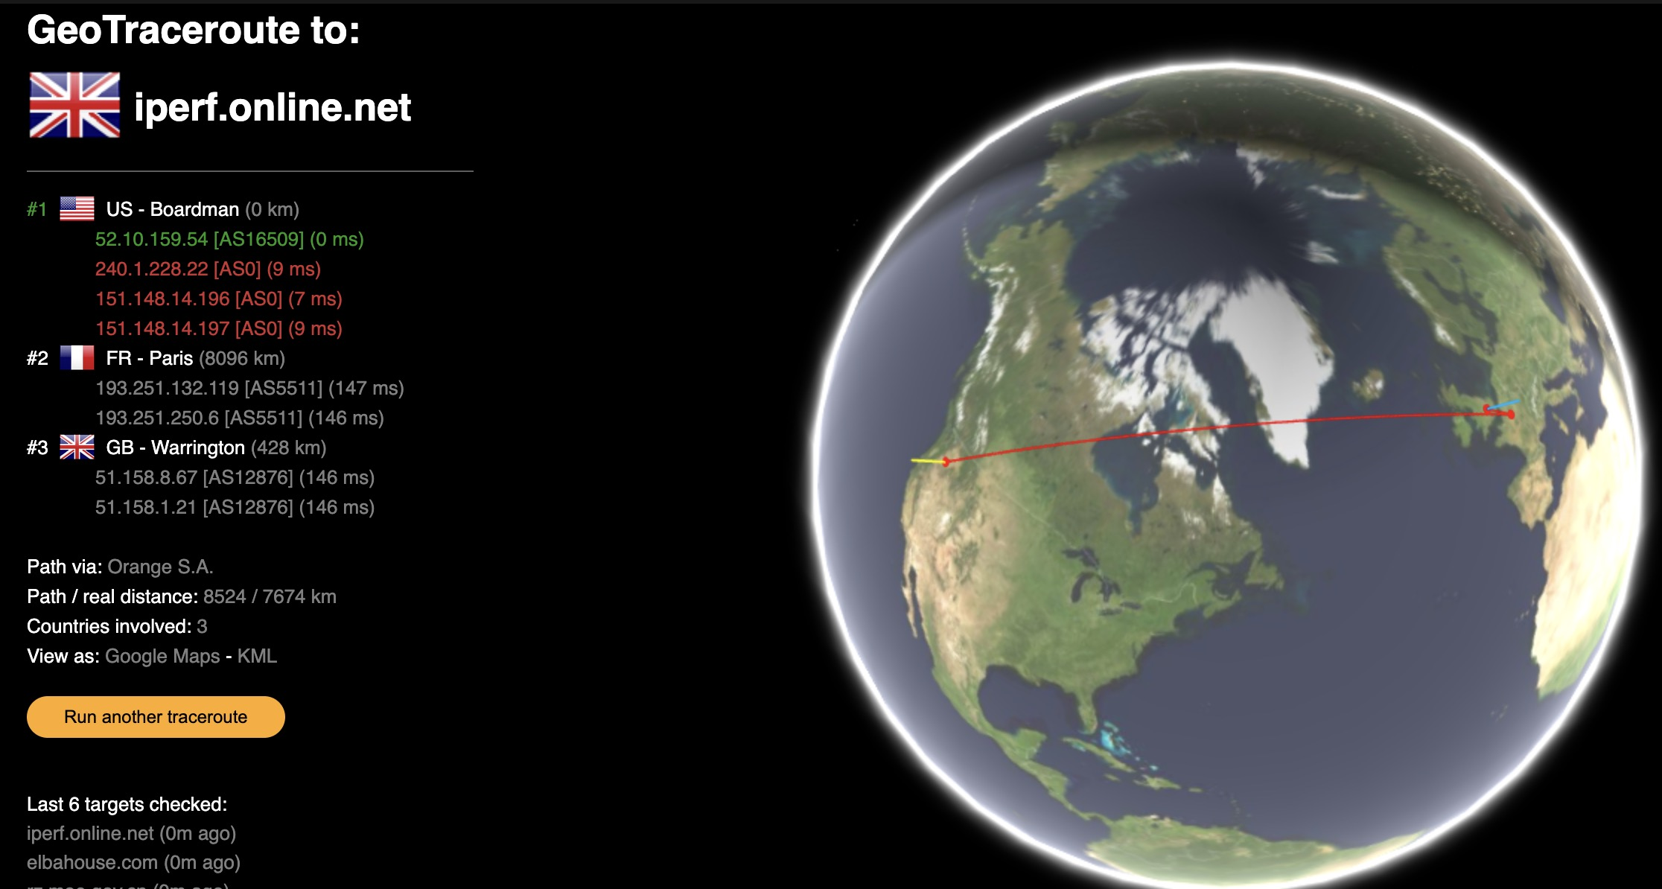

Slide 58
Going Even Further: Darwin University, Northern Territory, AU
Charles Darwin University, located in Australia's Northern Territory ("one-sixth of Australia’s landmass and yet is home to just one per cent of the population"), is still further away: $ ping -c 6 www.cdu.edu.au
PING www.cdu.edu.au (138.80.162.69): 56 data bytes
64 bytes from 138.80.162.69: icmp_seq=0 ttl=233 time=208.307 ms
64 bytes from 138.80.162.69: icmp_seq=1 ttl=233 time=208.869 ms
64 bytes from 138.80.162.69: icmp_seq=2 ttl=233 time=251.510 ms
64 bytes from 138.80.162.69: icmp_seq=3 ttl=233 time=276.133 ms
64 bytes from 138.80.162.69: icmp_seq=4 ttl=233 time=215.322 ms
64 bytes from 138.80.162.69: icmp_seq=5 ttl=233 time=208.593 ms
--- www.cdu.edu.au ping statistics ---
6 packets transmitted, 6 packets received, 0.0% packet loss
round-trip min/avg/max/stddev = 208.307/228.122/276.133/26.333 ms
It's hard to even visually depict that path on the globe, given how far it's going!

Slide 59
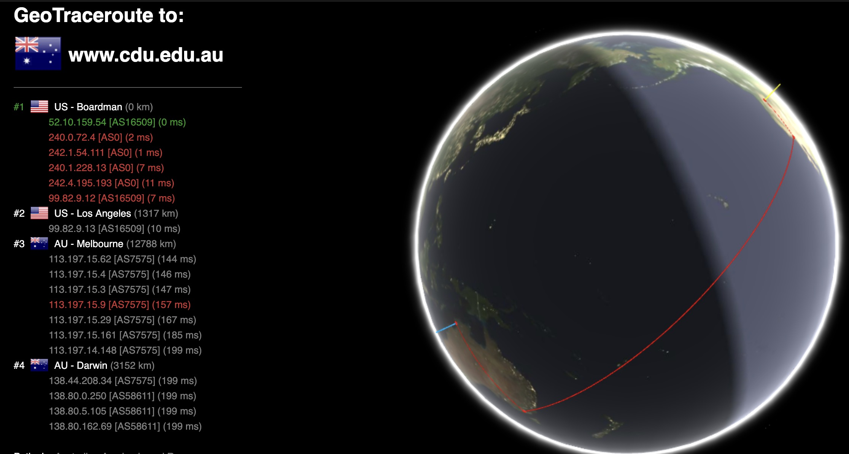

Slide 60
An Aside: Potential Problems With Using Ping To Estimate Latency
While ping seems like a convenient tool for estimating latency, it can run into some complications, including:
Content Distribution Networks (CDNs) have become very popular as a way to improve web site performance -- that's why I didn't show ping times to Columbia or NYU or U Penn institutional home pages: they all use content distribution networks to accelerate the delivery of their web sites. When CDNs get used, they artificially reduce the latency to specific CDN-ified web pages (such as the institution's main web page), but everything that's actually hosted "on campus" will still have normal latencies.
Blocking of ICMP traffic: Ping uses ICMP traffic to find and report latency. Some sites may block ICMP traffic entirely. When that happens, ICMP-based-ping won't work. M3AAWG's own website is an example of a site that blocks ICMP.
ICMP traffic may be passed but given low priority by network devices: Some network devices will pass ICMP traffic, but at a very low priority relative to all other network traffic. That lower-priority handling may artificially-increase reported latency times or loss.
Ping's not perfect, but it's the basic tool we've got in our open source toolkit.

Slide 61
We Now Understand How to At Least Roughly ESTIMATE Latency
Now let's see how latency IMPACTS some Internet traffic.
We'll need to provide a quick networking refresher, first.
To begin with, you all probably already know that Internet traffic is broken up into chunks called "packets." Each "packet" is a chunk of data (normally <= 1500 octets in length). Short messages may fit into a single packet; longer messages may be broken up and sent using multiple packets. When network packet traffic gets to its destination, the stream of packets get reassembled and consumed by the application.

Slide 62
Most Internet Packet Traffic Will Either Be UDP or TCP
UDP is connectionless, "fire and forget," and MAY have packet loss. UDP is used for some important applications (including most DNS traffic) plus VoIP and video traffic. UDP traffic can be spoofed (since it doesn't involve a three-way handshake the way TCP does). UDP normally DOEN'T have wide-area performance problems.
TCP is connection-oriented, has assured delivery (effectively zero packet loss), and includes flow control. TCP is used for HTTP (and HTTPS), SMTP, and many other popular Internet applications. The TCP "three-way handshake" (SYN, SYNACK, ACK) makes TCP flows un-spoofable. TCP traffic is what people struggle with when it comes to going fast over long fat pipes.
Traffic can also include other miscellaneous traffic, such as ICMP, SCTP and QUIC, but we mostly won't worry about those in this talk.

Slide 63
"Reliable Delivery" – The Root of TCP Performance Challenges
Packets sent via TCP enjoy "reliable delivery" – that is, packets sent by the sender WILL be received by the receiver, and that's certainly terrific. The way TCP accomplishes that is by having the sender "hold onto" a copy of all the packets that are "in flight" until they've been acknowledged by the receiver. If a packet doesn't get acknowledged as having been received, TCP can (and will) resend it from the copy it still has in its buffer.
But here's the potential high performance stumbling block: TCP transmission buffers need to hold ALL the packets that are "in flight" UNTIL they get acknowledged.
This means that the faster the network or the longer the latency between the source and the destination, the greater the number of packets that must be retained for potential retransmission. If that buffer fills up, new packets can't be sent until the buffer drains enough to accommodate the new packets. Long fat network links can be demanding!
Network buffers can be made larger on the sending system, but each connection will have its own buffer, and systems have finite memory available to be dedicated for buffer use.

Slide 64
Other Constraints Also Apply
Packets need to "fit" into the available network capacity. There may be links of different speeds, and with different levels of unutilized network capacity. If the "bottle neck link" has less capacity than you're demanding, traffic may queue or ultimately be dropped. Network capacity can also change dynamically.
The receiving system also needs to have buffer space to hold inbound traffic until it gets taken and processed by the application that's consuming that traffic. This can be particularly tricky if there are large mismatches in connectivity. Conceptually, imagine a system that's sending sustained flows at 10 gigabit per second to a receiving system that's connected at just 100 megabits per second. The receiving system and the sending system need to work out how fast traffic should be sent if they want to avoid sending traffic faster than the receiving system can ingest it.
But let's return to our transmission buffers on the sending system.

Slide 65
Exactly How Much Room Do We Need To Hold Traffic In Flight? Let's Compute the Bandwidth Delay Product
BDP = bandwidth (bits/second) * RTT (seconds) Gigabit Ethernet: 1,000,000,000 bits/second 10Gig Ethernet: 10,000,000,000 bits/second Eugene, Oregon to: iperf.online.net: 163.6 msec or 0.1636 seconds www.cdu.edu.au: 228.1 msec or 0.2281 seconds
So, for 2.5 Gbps, Eugene OR to iperf.online.net ➔ 2,500,000,000 * 0.1636 / 8 = 51,125,000 or 51.125 megabytes/buffer.
And for 2.5 Gbps, Eugene OR to www.cdu.edu.au ➔ 2,500,000,000 * 0.2281 / 8 = 71,281,250 or 71.281 megabytes/buffer.

Slide 66
Sizing Systems for the Required Bandwidth Delay Product
We now know that we need buffers big enough to accommodate the bandwidth delay product. But how do we actually tweak or tune systems to handle "long fat networks?"
First of all, what's our target sending rate? See https://fasterdata.es.net/host-tuning/linux/ We could choose to set our buffers to a level that should allow us to fill a 2.5Gbps link with four parallel flows. That means that if we're using the iperf3 bandwidth testing tool, we'd specify that we wanted to use four parallel flows with dash capital P 4: $ iperf3 -c iperf.online.net -p 5200-5209 -P 4
On the other hand, if you want to realize a full 2.5 Gbps in just a single stream to remote hosts, you may need to set your buffers to value that's four times larger.

Slide 67
Macs: Will "Auto-Tune" (But Only Up To A Point)
Mac OS typically will auto-tune send and receive buffers up to a level that's set in sysctl variables. If you're on a Mac, you can check yours values in a Terminal window with: $ sysctl net.inet.tcp.autorcvbufmax net.inet.tcp.autorcvbufmax: 4194304 $ sysctl net.inet.tcp.autosndbufmax net.inet.tcp.autosndbufmax: 4194304
If you've got a connection that's 2.5 gigabit or faster, and you potentially want single stream 2.5Gbps throughput, you can try temporarily increasing those limits to 80MB with: $ sudo sysctl -w net.inet.tcp.autorcvbufmax=83886080 $ sudo sysctl -w net.inet.tcp.autosndbufmax=83886080 Do NOT tweak these values this high if you're on a slow connection or very busy system.

Slide 68
Macs: Bumping Up the Autotuning Max Values Persistently
You can make those values persistent by adding the following lines to /etc/sysctl.conf # Increase maximum receive buffer for TCP autotuning to 80MB
net.inet.tcp.autorcvbufmax=83886080
# Increase maximum send buffer for TCP autotuning to 80MB
net.inet.tcp.autosndbufmax=83886080
Note: Theoretically Macs with Apple's SIP (System Integrity Protection) enabled (the default) will NOT allow you to modify /etc/sysctl.conf, but at least on my test Apple MacBook Pro, changes to /etc/sysctl.conf DO appear to be allowed and recognized across reboots. (An easy test: try creating that file and see if the values are as-specified after you reboot) If SIP does get in the way, see https://unix.stackexchange.com/questions/689295/values-from-sysctl-a-dont-match-etc-sysctl-conf-even-after-restart

Slide 69
Macs: Network Link Conditioner
Sometimes you may want to test how things would perform if latencies were at a particular level, but you don't have time to hunt for a test endpoint with the right latency.
Fortunately, Mac Xcode (the free Apple developer toolkit) offers a supporting utility application called "Network Link Conditioner."
Network Link Conditioner allows you to easily add synthetic network delay (and/or synthetic packet loss) to your actual network connectivity.
This makes it easy to see the impact of network latency (or packet loss) on your throughput.
See the example on the following slide, showing creation of a profile with 200 msec of extra artificial latency.

Slide 70
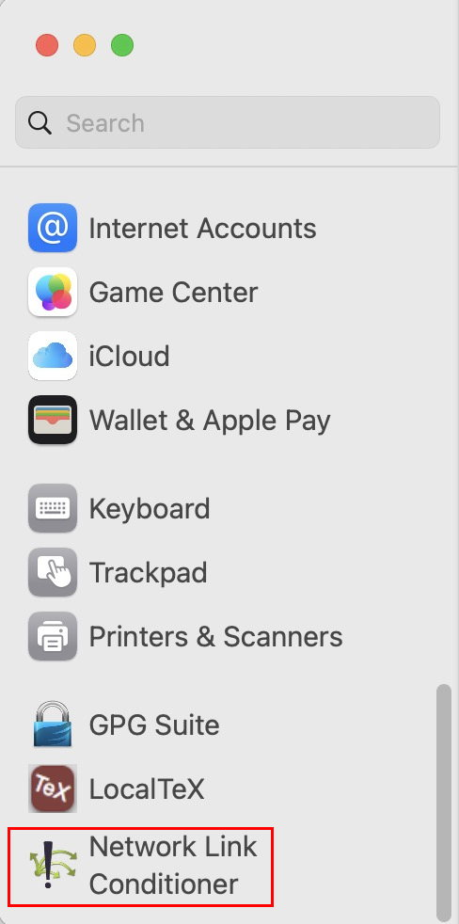
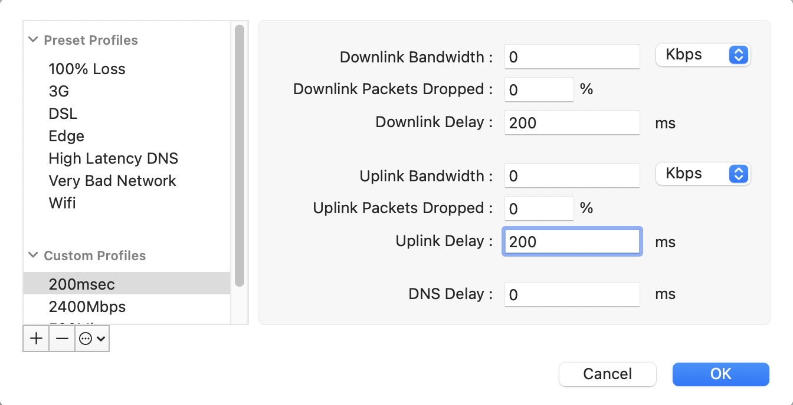
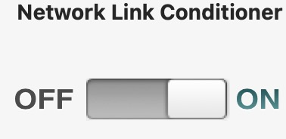
Macs Synthetically Adding Latency with "Network Link Conditioner"
Install Xcode
Install Xcode "Additional Tools"
Run Network Link Condition.prefPane
Network Link Conditioner will then appear in System Settings
Create a new profile with the desired level of latency
Activate that profile, and run Speedtest or iperf3 for testing...
Don't forget to disable Network Link Conditioner afterwards!

Slide 71
Testing With An Extra 200 msec of Synthetic Latency
$ iperf3 -c speedtest.sea11.us.leaseweb.net -p 5201-5210
Connecting to host speedtest.sea11.us.leaseweb.net, port 5201
[ 7] local 2606:[snip] port 50393 connected to 2607:[snip] port 5201
[ ID] Interval Transfer Bitrate
[ 7] 0.00-1.01 sec 128 KBytes 1.04 Mbits/sec
[ 7] 1.01-2.00 sec 0.00 Bytes 0.00 bits/sec
[ 7] 2.00-3.00 sec 768 KBytes 6.29 Mbits/sec
[ 7] 3.00-4.00 sec 1.50 MBytes 12.6 Mbits/sec
[ 7] 4.00-5.00 sec 6.12 MBytes 51.3 Mbits/sec
[ 7] 5.00-6.00 sec 7.50 MBytes 63.0 Mbits/sec
[ 7] 6.00-7.00 sec 5.88 MBytes 49.2 Mbits/sec
[ 7] 7.00-8.00 sec 21.5 MBytes 180 Mbits/sec
[ 7] 8.00-9.01 sec 16.0 MBytes 134 Mbits/sec
[ 7] 9.01-10.01 sec 18.8 MBytes 157 Mbits/sec
- - - - - - - - - - - - - - - - - - - - - - - - -
[ ID] Interval Transfer Bitrate
[ 7] 0.00-10.01 sec 78.1 MBytes 65.5 Mbits/sec sender
[ 7] 0.00-10.42 sec 78.2 MBytes 62.9 Mbits/sec receiver Significantly worse throughput with the extra latency! (Remember to turn it back off!)

Slide 72
Linux: Like Macs, Linux Will Also "Auto-Tune" (Up To A Point)
Linux hosts will auto-tune send and receive buffers up to a level that's set in sysctl variables. If you're on a Linux host, you can see your current default settings with: Max TCP buffer size $ sysctl net.core.rmem_max net.core.rmem_max = 212992 $ sysctl net.core.wmem_max net.core.wmem_max = 212992 Current autotuning TCP buffer limits (the three values are minimum (even under memory pressure), default, and maximum): $ sysctl net.ipv4.tcp_rmem net.ipv4.tcp_rmem = 4096 131072 6291456 $ sysctl net.ipv4.tcp_wmem net.ipv4.tcp_wmem = 4096 16384 4194304

Slide 73
Linux: Temporarily Increasing Buffer Limits
To temporarily increase the buffers: Adjusting max TCP buffer size $ sudo sysctl net.core.rmem_max=209715200 $ sudo sysctl net.core.wmem_max=209715200 Adjusting autotuning TCP buffer limits $ sudo sysctl net.ipv4.tcp_rmem="4096 87380 83886080" $ sudo sysctl net.ipv4.tcp_wmem="4096 87380 83886080"

Slide 74
Linux: Persistently Increasing the Autotuning Values
Add: net.core.rmem_max=209715200 net.core.wmem_max=209715200 net.ipv4.tcp_rmem=4096 87380 83886080 net.ipv4.tcp_wmem=4096 87380 83886080
to /etc/sysctl.conf

Slide 75
Linux: tc - Linux's equivalent of the Mac's Network Link Conditioner
Find your interface with ifconfig: # ifconfig -a
Then force additional latency to be added to that interface with tc ("traffic control"). Assuming our interface is named enp7s0:
# tc qdisc replace dev enp7s0 root netem loss 0% latency 200ms
As we did for the Mac Link Conditioner example, you can test with iperf3 to see the impact of the additional latency. To return to normal minimal latency (don't forget to do so):
# tc qdisc replace dev enp7s0 root netem loss 0% latency 0ms

Slide 76
Windows 11: May Be Adequately "Self-Tuned" Out-of-the-box
Windows 11 does not appear to require additional tuning to self-tune. The stock as shipped configuration appears to be adequate "out of the box"
For more, see "Performance Tuning Network Adapters," https://learn.microsoft.com/en-us/windows-server/networking/technologies/network-subsystem/net-sub-performance-tuning-nics#bkmk_tcp and see "MS Windows Tuning" https://fasterdata.es.net/host-tuning/ms-windows-2/ "Set-NetTCPSetting" https://learn.microsoft.com/en-us/powershell/module/nettcpip/set-nettcpsetting

Slide 77
Windows 11: Addding Synthetic Network Latency Under Windows
Commercial applications are available to handle adding synthetic network latency for Windows 11. If interested, you should be able to find them pretty easily.
OR you might also consider trying clumsy, see https://jagt.github.io/clumsy/ Caveats: https://jagt.github.io/clumsy/download.html says "clumsy is alpha quality software and does have some gotchas. Be sure to read the manual page before using it." clumsy builds from source using zig (see https://ziglang.org/). I'm not personally acquainted with using zig (nor any considerations that using zig may introduce). The documentation at https://jagt.github.io/clumsy/manual.html states that "Lag is much [...] higher than the parameter set."

Slide 78
5. Congestion Control Algorithms (CCA): Managing Congestion on LFNs with CUBIC and BBR
Bottom Line Up Front (BLUF): TCP can't tell in advance how much bandwidth it has available. TCP uses congestion control algorithms (CCAs) to try to figure that out and set an approximately optimal sending rate. Most systems use the CUBIC congestion control algorithm (CCA). BBR, an alternative CCA, will likely outperform CUBIC, particularly in the face of network loss. However, as a result, systems using BBR may end up using more than their "fair share" of network bandwidth. We explain how to enable BBR on Debian 12 and Windows 11.

Slide 79
The Congestion Window (CWND)
We've already talked a little about the TCP transmit buffers and the TCP receive buffers. The transmit buffer holds onto traffic waiting to be acknowledged, while the receive buffer holds onto traffic that's waiting to be consumed by the application. The sizes of those respective buffers get exchanged by the sender and receiver during the initial three-way handshake and are fixed for the duration of the connection.
But now, what about the dynamically-changing available network capacity between the sending and receiving host? That gets managed by the sender via the congestion window ("CWND"). The CWND may (and often will) change during the course of a file transfer or other flow.
As Wikipedia states, "When a connection is set up, the congestion window, a value maintained independently at each host, is set to a small multiple of the maximum segment size (MSS) allowed on that connection. Further variance in the congestion window is dictated by an additive increase/multiplicative decrease (AIMD) approach." See https://en.wikipedia.org/wiki/Transmission_Control_Protocol [emphasis added]

Slide 80
The Sawtooth Throughput Graph Implied by AIMD
Whatever specific TCP congestion control algorithm gets deployed, it will usually additively increase (and then typically multiplicatively decrease) throughput over time.
Traffic gets sent onto the network in bursts of packets. But how many packets per burst?
"Additive increase" implies a relatively-gradual "ramp up:" add an extra packet to the burst, then send the burst. Did it get there okay? It did? Okay, add another packet to the next burst. Did that make it okay, too? Add another, etc.
"Multiplicative decrease" implies a relatively abrupt reaction to detected congestion. If traffic gets dropped, cut the size of the packet bursts dramatically – maybe by 30%, maybe by 50%, maybe by some other amount (the amount of the drop will vary by the congestion control algorithm used).
One popular congestion control algorithm is called CUBIC.

Slide 81
"CUBIC For Fast and Long-Distance Networks" (RFC 9438)
"CUBIC has been adopted as the default TCP congestion control algorithm in the Linux, Windows, and Apple stacks, and has been used and deployed globally. Extensive, decade-long deployment experience in vastly different Internet scenarios has convincingly demonstrated that CUBIC is safe for deployment on the global Internet and delivers substantial benefits over classical Reno congestion control [RFC5681]. It is therefore to be regarded as the currently most widely deployed standard for TCP congestion control. [* * *]
"The design of CUBIC was motivated by the well-documented problem classical Reno TCP has with low utilization over fast and long-distance networks [K03] [RFC3649]. This problem arises from a slow increase of the congestion window (cwnd) following a congestion event in a network with a large bandwidth-delay product (BDP). [* * *]
"CUBIC, originally proposed in [HRX08], is a modification to the congestion control algorithm of classical Reno to remedy this problem. Specifically, CUBIC uses a cubic function instead of the linear window increase function of Reno to improve scalability and stability under fast and long-distance networks." [emphasis added]

Slide 82
What Does "Safe for Deployment On the Global Internet" Mean?
Congestion control algorithms can go catastrophically wrong.
What could go potentially go wrong? Well, bottom line, you'd REALLY like to AVOID congestive collapse (the entire network gets congested, and instead of politely backing off, algorithms might actually try "pushing harder," with the net result being that the network becomes totally unusable for everyone).
After AVOIDING congestive collapse, "nice to have" congestion control features deliver:
Efficiency, with good throughput and minimal delay and loss, and
Fairness to other traffic that shares the network
For more, see "Specifying New Congestion Control Algorithms," https://www.rfc-editor.org/rfc/rfc5033.txt

Slide 83
Aside: Both CUBIC and BBR Leverage ECN (We'll Talk About BBR A Little Later)
"[Explicit Congestion Notification] allows end-to-end notification of network congestion without dropping packets. ECN is an optional feature that may be used between two ECN-enabled endpoints when the underlying network infrastructure also supports it. Conventionally, TCP/IP networks signal congestion by dropping packets. When ECN is successfully negotiated, an ECN-aware router may set a mark in the IP header instead of dropping a packet in order to signal impending congestion. The receiver of the packet echoes the congestion indication to the sender, which reduces its transmission rate as if it detected a dropped packet." https://en.wikipedia.org/wiki/Explicit_Congestion_Notification
ECN is defined in "The Addition of Explicit Congestion Notification (ECN) to IP," https://www.rfc-editor.org/rfc/rfc3168 and
"Relaxing Restrictions on Explicit Congestion Notification (ECN) Experimentation," https://www.rfc-editor.org/rfc/rfc8311

Slide 84
If You Want To Ensure ECN is Enabled (ECN will normally default to "On")
Windows 11: netsh interface tcp set global ecncapability=enabled
Mac:
sudo sysctl -w net.inet.tcp.ecn_negotiate_in=1 sudo sysctl -w net.inet.tcp.ecn_initiate_out=1
To make the settings persistent, put the following lines in /etc/sysctl.conf: net.inet.tcp.ecn_negotiate_in=1 net.inet.tcp.ecn_initiate_out=1

Slide 85
If You Want To Ensure ECN is Enabled (ECN will normally default to "On") (continued)
Debian 12: As root, enable ECN by editing /etc/sysctl.conf to include: net.ipv4.tcp_ecn=1 Reload that file by running: sysctl -p

Slide 86
CUBIC's Popular BUT IT Can Have Issues in Loss-Prone Environments
"In [some common scenarios] it is difficult to achieve full throughput with loss-based congestion control in practice: for CUBIC, sustaining 10Gbps over 100ms RTT needs a packet loss rate below 0.000003% (i.e., more than 40 seconds between packet losses), and over a 100ms RTT path a more feasible loss rate like 1% can only sustain at most 3 Mbps." "BBR Congestion Control," https://www.ietf.org/archive/id/draft-ietf-ccwg-bbr-00.html
"Our testing shows that BBR can help a lot on certain links. 10X performance improvements are common on some paths. BBR also works much better than CUBIC on network paths where packet loss is due to small switch buffers. Our testing also shows that for parallel stream tool, BBR works much better with paced streams, so that the streams [are able?] to not step on each other." https://fasterdata.es.net/host-tuning/linux/recent-tcp-enhancements/bbr-tcp/

Slide 87
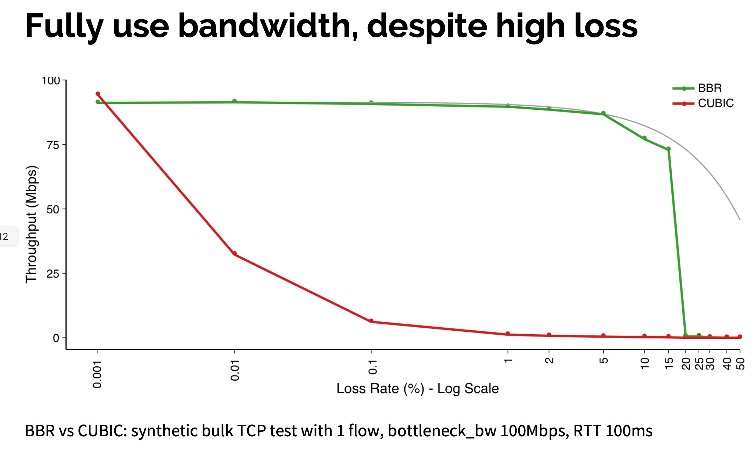
The Case FOR BBR In One Graph...
"BBR Congestion Control," Neal Cardwell et. al., IETF 97: Seoul, Nov 2016, https://www.ietf.org/proceedings/97/slides/slides-97-iccrg-bbr-congestion-control-02.pdf

Slide 88
The Case AGAINST BBR In One Slide...
"Buffers, Bufferbloat and BBR," Geoff Huston, https://labs.apnic.net/presentations/store/2020-01-31-bbr.pdf

Slide 89
So Why Hasn't BBR Become the New Default (Displacing Cubic)?
Network engineers are inherently conservative and tend to move slowly on stuff that can go really badly. There are an awful lot of different weird environments in which a given congestion control algorithm needs to be able to work, and a new CCA needs to work in ALL (or almost all) of them. It may take a decade to gradually change from one production congestion control algorithm to another. Other factors include...
BBR may not "play nicely" with Cubic and other congestion management algorithms, taking a disproportionate share of bandwidth on bottleneck connections (in fact, one commentator described BBR as a "sociopathic protocol").
BBR isn't readily available on all platforms (for example, you can't run bbr on Apple Macs)
But let's assume that you've decided that you DO actually want to try using BBR on Linux or Windows 11. How would you go about doing that?

Slide 90
Running BBR if you're on Debian 12
As root, edit /etc/sysctl.conf Add the following two lines to the bottom of that file: net.core.default_qdisc = fq net.ipv4.tcp_congestion_control=bbr
Re-load /etc/sysctl.conf by saying: sysctl –p
Finally, confirm that you're running bbr: sysctl net.ipv4.tcp_congestion_control net.ipv4.tcp_congestion_control = bbr

Slide 91
Reverting to the default (CUBIC) congestion control on Debian 12
Comment out the two lines you added to /etc/sysctl.conf and reboot.
Confirm that you're running CUBIC once more: sysctl net.ipv4.tcp_congestion_control net.ipv4.tcp_congestion_control = cubic

Slide 92
Using BBR2 on Windows 11 via Powershell
netsh int tcp set supplemental Template=Internet CongestionProvider=bbr2
netsh int tcp set supplemental Template=Datacenter CongestionProvider=bbr2
netsh int tcp set supplemental Template=Compat CongestionProvider=bbr2
netsh int tcp set supplemental Template=DatacenterCustom CongestionProvider=bbr2
netsh int tcp set supplemental Template=InternetCustom CongestionProvider=bbr2
If you need or want to revert to CUBIC:
netsh int tcp set supplemental Template=Internet CongestionProvider=CUBIC
netsh int tcp set supplemental Template=InternetCustom CongestionProvider=CUBIC
netsh int tcp set supplemental Template=Compat CongestionProvider=NewReno
netsh int tcp set supplemental Template=Datacenter CongestionProvider=CUBIC
netsh int tcp set supplemental Template=DatacenterCustom CongestionProvider=CUBIC

Slide 93
Nice Analysis of Using BBR on Ultrafast Hosts from ESnet
"Exploring the BBRv2 Congestion Control Algorithm for use on Data Transfer Nodes" https://internet2.edu/wp-content/uploads/2022/12/techex22-AdvancedNetworking-ExploringtheBBRv2CongestionControlAlgorithm-Tierney.pdf

Slide 94
Aside: "What About Satellite Latencies?"
We've been implicitly considering latency over terrestrial circuits, but some connections may actually be delivered over satellite. Not all satellites are the same – some satellites may be in higher or lower orbits.
Geostationary satellites orbit at a high altitude (35,786 km). As a result, Internet connections delivered over geostationary satellite tend to have latencies of 600 msec or more – that's a LOT of latency by traditional terrestrial standards. That can be tricky to accommodate. One comparative review: "Competing TCP Congestion Control Algorithms over a Satellite Network," https://pinhanzhao.com/papers/ccnc22.pdf
Low earth orbit satellites, on the other hand, orbit at just 250-1000 km. They deliver latencies that tend to feel just like terrestrial fiber latencies – 25 to 100 msec (see, e.g., https://www.starlink.com/legal/documents/DOC-1470-99699-90?regionCode=US ). They have a different issue, namely frequent handoffs from one satellite to another (connections to a particular satellite may last from just some seconds to 3+ minutes). A comparative review of CCAs for the LEO environment is at "A Comparative Evaluation of TCP Congestion Control Schemes over Low-Earth-Orbit (LEO) Satellite Networks," https://dl.acm.org/doi/fullHtml/10.1145/3630590.3630603

Slide 95
6. RFC 1323 Window Scaling
Bottom Line Up Front (BLUF): High performance networking requires large buffers. RFC 1323 Windows Scaling makes large buffers possible, even when the window size field would normally limit the buffer size to just 64KB. The Congestion Window (CWND) effectively controls the amount of bandwidth the sender attempts to use during the course of a transfer. You'll see it reported during bandwidth testing with iperf3.

Slide 96
Returning To The TCP Congestion Window (CWND)
To avoid congestive collapse, TCP uses a multi-faceted congestion-control strategy. For each connection, TCP maintains a CWND, limiting the total number of unacknowledged packets that may be in transit end-to-end. [* * *] The congestion window is maintained by the sender and is a means of preventing a link between the sender and the receiver from becoming overloaded with too much traffic. [* * *] When a connection is set up, the congestion window, a value maintained independently at each host, is set to a small multiple of the maximum segment size (MSS) allowed on that connection. Further variance in the congestion window is dictated by an additive increase/multiplicative decrease (AIMD) approach. This means that if all segments are received and the acknowledgments reach the sender on time, some constant is added to the window size. It will follow different algorithms. A system administrator may adjust the maximum window size limit, or adjust the constant added during additive increase, as part of TCP tuning.
https://en.wikipedia.org/wiki/TCP_congestion_control [emphasis added]

Slide 97
Maximum CWND and RFC 1323 Windows Scaling
So what's the MAXIMUM CWND? The CWND field is part of the TCP headers. That field is only 16 bits long. That means the maximum unscaled value it can store is just 64KB (65,535 bytes). That's far too small for modern "long fat" networks. That's why the RFC 1323 Window Scaling option exists and is important.
"Since the [TCP window] size field can't be expanded, a scaling factor is used. TCP window scale is an option used to increase the maximum window size from 65,535 bytes to 1 Gigabyte.
The window scale option is used only during the TCP three-way handshake. The window scale value represents the number of bits to left-shift the 16-bit window size field. The window scale value can be set from 0 (no shift) to 14.
To calculate the true window size, multiply the window size by 2^S where S is the scale value."
https://learn.microsoft.com/en-us/troubleshoot/windows-server/networking/description-tcp-features

Slide 98
Window Scaling Factor Table (Assuming Initial Window = 64KB)
64KB * 2^N
N=0 ➔ 64KB N=1 ➔ 128KB N=2 ➔ 256KB N=3 ➔ 512KB
N=4 ➔ 1MB [...]
N=8 ➔ 16MB
N=9 ➔ 32MB
N=10 ➔ 64MB
N=11 ➔ 128MB
N=12 ➔ 256MB
N=13 ➔ 512MB
N=14 ➔ 1GB

Slide 99
You'll See CWND Values Reported As Part of The iperf3 output
iperf3 -c speedtest.sea11.us.leaseweb.net -p 5201-5210
Connecting to host speedtest.sea11.us.leaseweb.net, port 5201
[ 5] local 2606:[snip] port 60366 connected to 2607:[snip] port 5201
[ ID] Interval Transfer Bitrate Retr Cwnd
[ 5] 0.00-1.00 sec 289 MBytes 2.42 Gbits/sec 10 8.24 MBytes
[ 5] 1.00-2.00 sec 278 MBytes 2.33 Gbits/sec 0 8.26 MBytes
[ 5] 2.00-3.00 sec 276 MBytes 2.32 Gbits/sec 0 8.23 MBytes
[ 5] 3.00-4.00 sec 276 MBytes 2.32 Gbits/sec 0 8.24 MBytes
[ 5] 4.00-5.00 sec 278 MBytes 2.33 Gbits/sec 0 8.25 MBytes
[ 5] 5.00-6.00 sec 276 MBytes 2.32 Gbits/sec 0 8.26 MBytes
[ 5] 6.00-7.00 sec 278 MBytes 2.33 Gbits/sec 0 8.26 MBytes
[ 5] 7.00-8.00 sec 276 MBytes 2.32 Gbits/sec 0 8.24 MBytes
[ 5] 8.00-9.00 sec 276 MBytes 2.32 Gbits/sec 0 8.29 MBytes
[ 5] 9.00-10.00 sec 278 MBytes 2.33 Gbits/sec 0 8.26 MBytes
[snip]
Note that you will NOT see CWND data if you're using the –R flag (so the remote system is doing the sending) because ONLY the sender knows the current CWND data value.

Slide 100
Default Window Scaling Factors May Have Too-Low Starting Values
Checking Mac OS Sequoia 15.4.1:
sysctl net.inet.tcp.win_scale_factor net.inet.tcp.win_scale_factor: 3
If on a 2.5 Gbps link, you may want to increase the Window Scaling Factor to 11 or 12:
Modify /etc/sysctl.conf by appending the line:
net.inet.tcp.win_scale_factor=11 Reload that file (as root) with:
sysctl -f /etc/sysctl.conf

Slide 101
Leave ALL RFC 1323 Options Alone ("Enabled" Is Normally The Default)
At this point, all RFC 1323 options (Windows Scaling, Timestamps and SACK) should come pre-enabled on virtually all system.
Leave them alone (e.g., keep them enabled).
Even though Timestamps and SACK may cause some packet header overhead, their benefits FAR outweigh their costs.

Slide 102
7. "What About Bufferbloat?"
Bottom Line Up Front (BLUF):
Large single queue buffers mean that jitter-sensitive packets may end up blocked by other bulk transfers. This is normally referred to as "bufferbloat." Systems that use active queue management, or BBR for congestion control, normally will not be impacted by bufferbloat. You can empirically test to see if your systems are vulnerable to this issue.

Slide 103
What Is Bufferbloat?
When someone on your network sends a large file, a lot of packets get sent all at once. The router temporarily "buffers those packets", holding them before they’re sent. Any new data packets get stuck behind the existing queue of buffered packets. They will arrive at the destination much later than if the router’s buffers hadn't been full.
This is “bufferbloat” - undesirable high latency caused by other traffic on your network. It happens when a flow uses more than its fair share of the bottleneck. Bufferbloat is the primary cause of bad performance for real-time Internet applications like VoIP calls, video games, and videoconferencing. Source: https://www.waveform.com/tools/bufferbloat

Slide 104
We've NOT Been Working to "Avoid Jitter and Lag"
OUR tuning objective has been to use our full available bandwidth. We've NOT been working to avoid jitter and lag. Is bufferbloat even really an issue we'll run into?
If your system is using FQ_codel ("Fair Queuing" Coddle), bufferbloat will likely NOT be an issue for you.
If you're using BBR instead of CUBIC for congestion control, bufferbloat may also likely NOT be an issue for you.
But you can test and empirically see! One easy-to-use web page is at https://www.waveform.com/tools/bufferbloat (sample output on the next slide)
Another cool tool to use to test for buffer bloat is flent, see: https://flent.org/

Slide 105
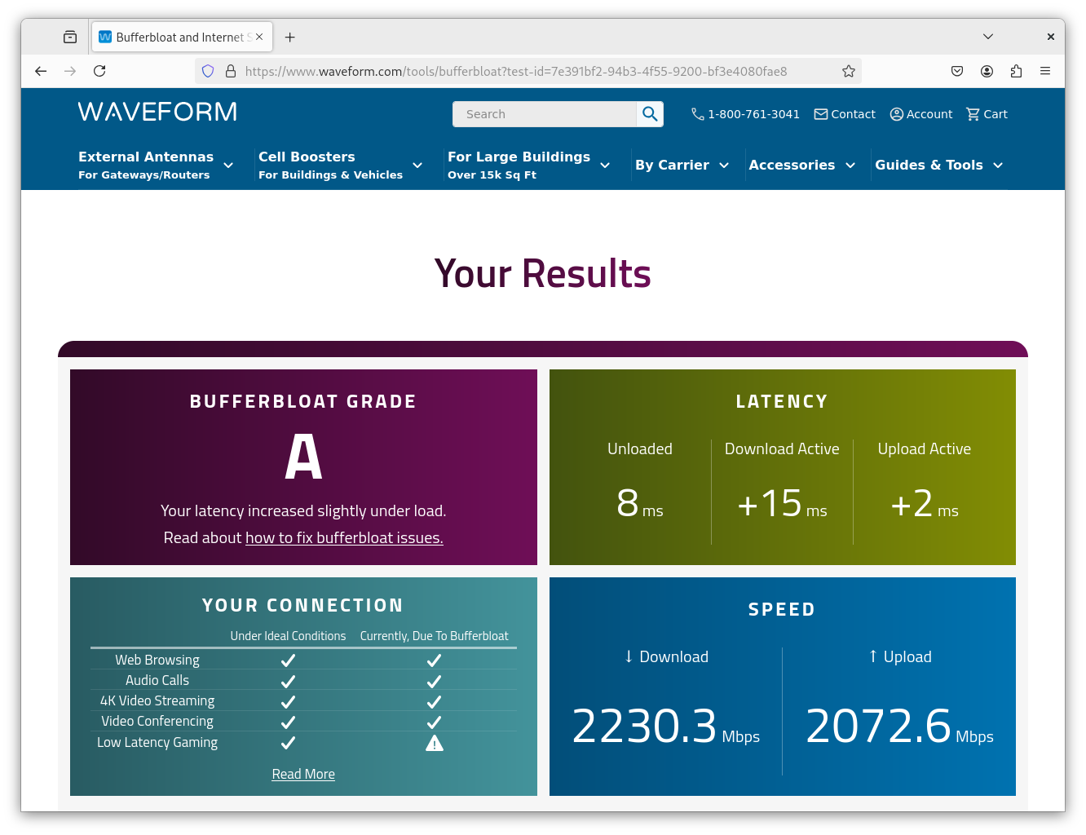
Sample https://www.waveform.com/tools/bufferbloat Results

Slide 106
Preventing Bufferbloat Symptoms with FQ_codel
Modern versions of Linux will use FQ_codel by default. That should limit or completely eliminate bufferbloat symptoms (at least on the host side of things). For more on FQ_codel, check out: "Controlled Delay Active Queue Management" https://www.rfc-editor.org/rfc/rfc8289.html "The Flow Queue CoDel Packet Scheduler and Active Queue Management Algorithm" https://www.rfc-editor.org/rfc/rfc8290.html The Codel Wiki: https://www.bufferbloat.net/projects/codel/wiki/ The status of active queue management with FQ_codel or the equivalent is less clear on MacOS and Windows 11. Anyone able to speak authoritatively on this? (Using BBR, as is possible on Window 11, will also fix bufferbloat)

Slide 107
8. Using tcpdump and Wireshark To Begin To Dig Into Network Traffic
Bottom Line Up Fron (BLUF): If you're going to do performance-related work, you need suitable tools to help you see what's going on. tcpdump and Wireshark are virtually ideal tools for this. wireshark can seem daunting to get started with, but we'll show you how to bring in a PCAP and get going. You'll be analyzing traffic, producing summary statistics and graphs in no time at all.

Slide 108
Why Go Over tcpdump and Wireshark today?
Much of what drives network performance happens "under the surface" in network traffic where it can't be "seen by the naked eye."
Seeing what's going on in network traffic requires instrumentation, just as an astronomer needs a telescope or a microbiologist needs a microscope. One basic tool for network performance is a protocol analyzer. We'll use Wireshark, since it's the most popular option (and it's free/open source). See https://www.wireshark.org/
Wireshark needs traffic to analyze. While Wireshark has integrated capture capabilities, I prefer to decouple packet capture from the actual analysis of the captured traffic. For that reason, we'll use tcpdump, see https://www.tcpdump.org/
We won't have time to do a deep dive on either product, but hopefully we can bootstrap you far enough fast enough that you'll at least be able to get rolling. Once we've got you "hooked" you can dig deeper on your own (there are lots of training materials online)

Slide 109
Identifying Your Active Network Interface Under Linux
Wireshark requires a packet capture. When you're NOT AT M3AAWG you can easily grab one using tcpdump. Remember, do NOT do ANY packet captures while at M3AAWG!
The first step is figuring out your active network interface. Your active network interface has various indicators, including: it will have a "RUNNING" flag, it will show up with your system's IP address(es), and it will show traffic having been received and transmitted in the packet counters. For example: # ifconfig -a enp7s0: flags=4163<UP,BROADCAST,RUNNING,MULTICAST> mtu 1500
inet 192.[snip] netmask 255.255.255.0 broadcast 192.[snip]
inet6 2606:[snip] prefixlen 64 scopeid 0x0<global>
[* * *]
RX packets 35726607 bytes 48263675457 (44.9 GiB)
RX errors 0 dropped 225 overruns 0 frame 0
TX packets 65284248 bytes 85450529828 (79.5 GiB) [* * *]

Slide 110
Capturing Some Network Traffic Using tcpdump on Linux
If you don't already have tcpdump installed, install it via your package manager:
apt install tcpdump
After tcpdump is installed, start capturing (as root) with:
tcpdump -i enp7s0 -n -w sampletrace.pcap tcpdump: listening on enp7s0, link-type EN10MB (Ethernet), snapshot length 262144 bytes
In a second window, run an application to generate some network traffic to capture. We'll limit this to five seconds to keep the capture to semi-reasonable size:
iperf3 -c speedtest.sea11.us.leaseweb.net -p 5201-5210 –t 5
After our iperf3 run finishes, go to the tcpdump window and stop capturing packets by hitting control-C. That will stop the capture and finish writing out our captured data.

Slide 111
Our sample pcap file
# ls -lh sampletrace.pcap -rw-r--r-- 1 tcpdump tcpdump 1.5G May 14 10:31 sampletrace.pcap
When opening or looking at that file in Wireshark on a Mac, be patient – a gig and a half capture file is relatively large, and may take a minute to open in Wireshark (you can watch the progress bar on the bottom of the frame).
You will run into similar "opportunities for patience" while analyzing that file (e.g., some filters require the entire dataset to be re-read in order to apply the specified filter). Watch that progress bar!

Slide 112
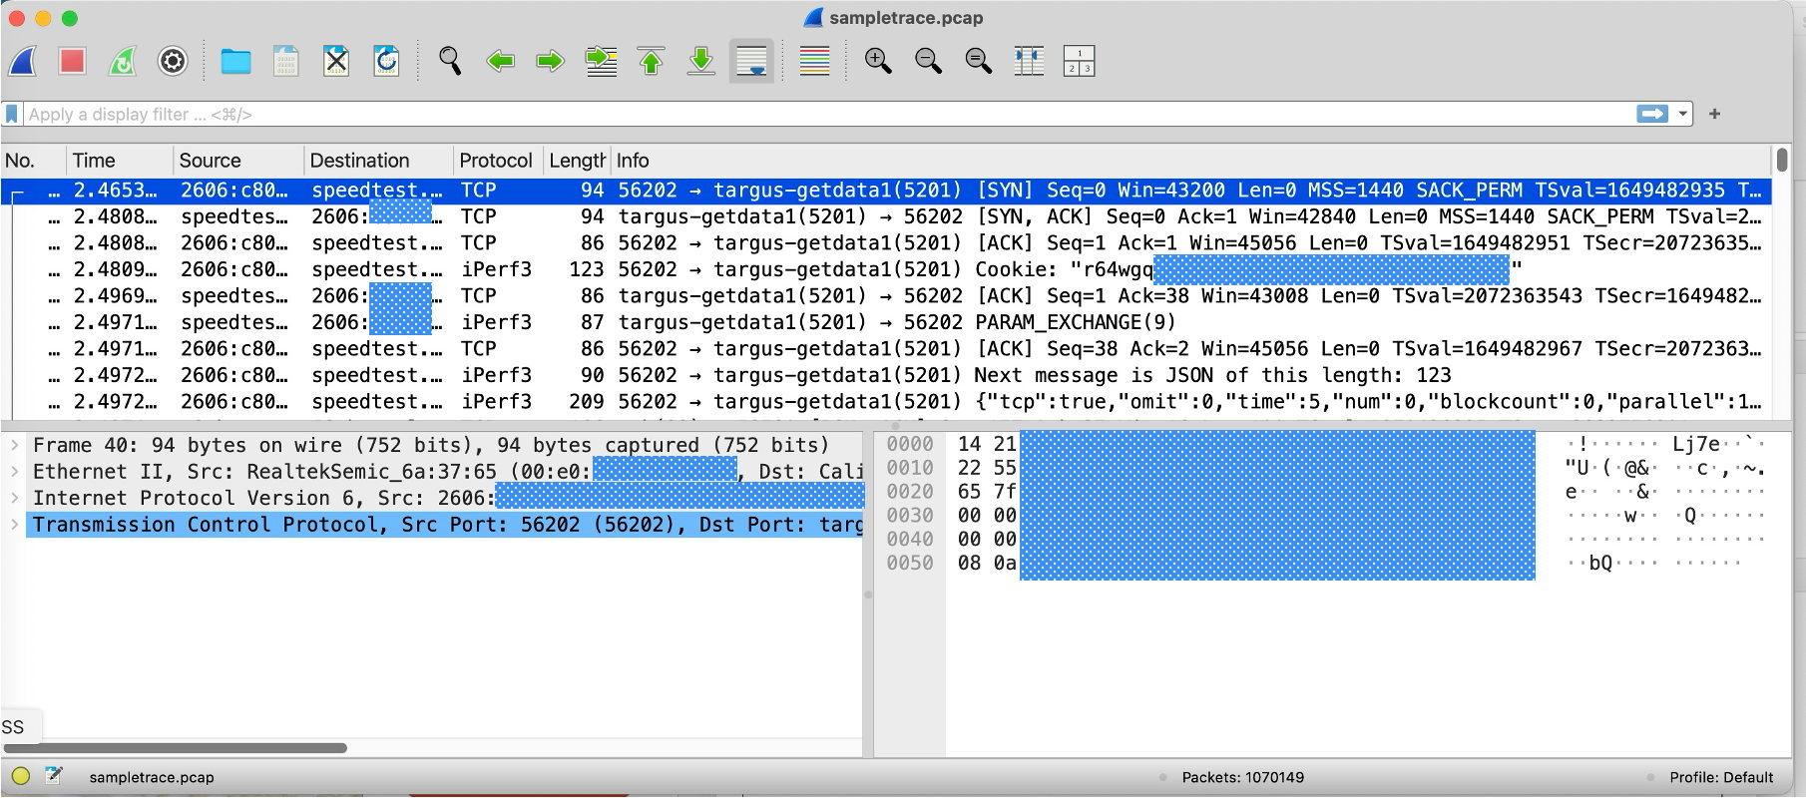
A (Somewhat Daunting) Opening Wireshark Window for a PCAP
Do NOT let this scary looking opening screen frighten you!

Slide 113
Once you've got a capture opened in Wireshark...
You can easily work with it. The biggest impediment to using Wireshark is all the irrelevant stuff that's included in Wireshark (meant to help people working on really weird traffic do so).
Much of Wireshark is configurable to your preferences. For example, if you don't find yourself using the packet dump display (shown on the bottom right side of the screen on the preceding slide), you can just drag the middle slider over to the right-hand side and give that screen "real estate" back to the protocol display that's shown on the left-hand side. Similarly, if you want more room to look at particular packet details (bottom of the screen), or more room to pick packets from the capture (top of the screen), you can move the slider between the top and bottom regions to match your preferences.
Wireshark will also popup new windows when appropriate. For example, in the Wireshark menu, try going to Statistics → Protocol Summary

Slide 114
Statistics → Protocol Summary (Opens In a New Window)
Hey, it's our iperf3 Speedtest over IPv6! Looks like we captured traffic from it successfully!

Slide 115
We can get stats about our flows from Statistics → Conversations
Layer 2 (Note the Ethernet MAC Addresses)
Layer 3 (Note the IP Addresses)
TCP (Note the Port Numbers)
Also note the "stream ID" field for each of those. This helps us ID just the data we want.

Slide 116
Let's Look at a Traffic-Specific Plot
For example, since this is a performance session, what does the throughput (and goodput) look like for our iperf3 run over time? We can easily get a "big picture" graph once we know a few basic skills...
Select Statistics → TCP Stream Graphs → Time Sequence from the Wireshark menus
Select Throughput from the left-hand side pull-down menu
Select Throughput (and/or Goodput) from the bottom middle what-to-display buttons
Pick the right stream to look at (hint: we showed you how to identify streams in the previous slide -- we're interested in the TCP Stream number with the big packet counts)
Ensure you're looking "in the right direction" (outbound, not inbound, in this case). You can flip the direction of the flows with the Switch Direction button.
The result should be a display something like what you see on the next slide...

Slide 117
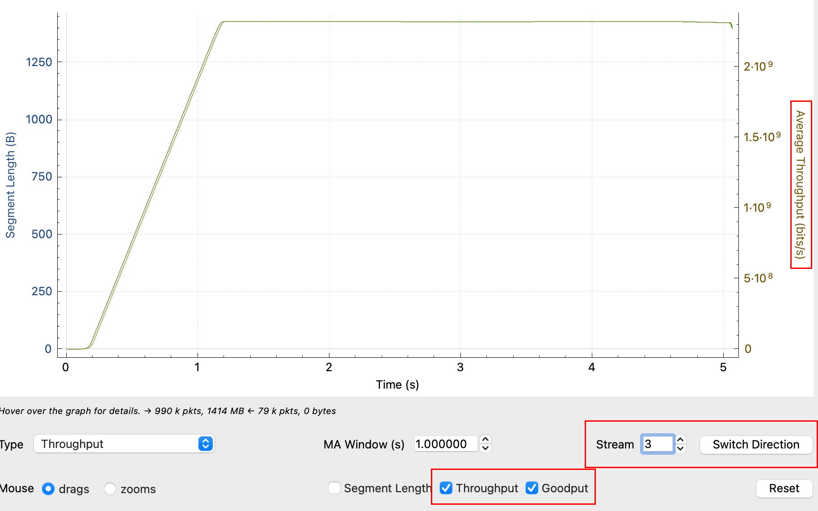
Statistics→TCP Stream Graphs→Time Sequence (Throughput, No Zoom)

Slide 118
Mastering The Somewhat Peculiar Wireshark Graph Interface
Ensure you've got a suitable level of granularity for your graph.
Adjust the MA (moving average) setting to a smaller value (the graph on the next page shows the result for a setting of 0.025 seconds). You may need to play with different values until you find something that's works (and looks) right.
The default display covers the whole capture interval. As a result, it's hard to see details.
To zoom in, ensure you've got "Mouse zooms" selected, then drag a box around the region of interest. Wireshark will zoom in. Need to zoom in still more? Repeat.
Zoom in too much (or in the wrong area)? Use the Reset button to "self-rescue."
Not seeing the region of the graph you're interested in? Select "Mouse drags" and drag the display port to the show the portion of the graph you're interested in.
Move to the wrong region of the graph? Use the Reset button to get back to the "big picture" display you started with.

Slide 119
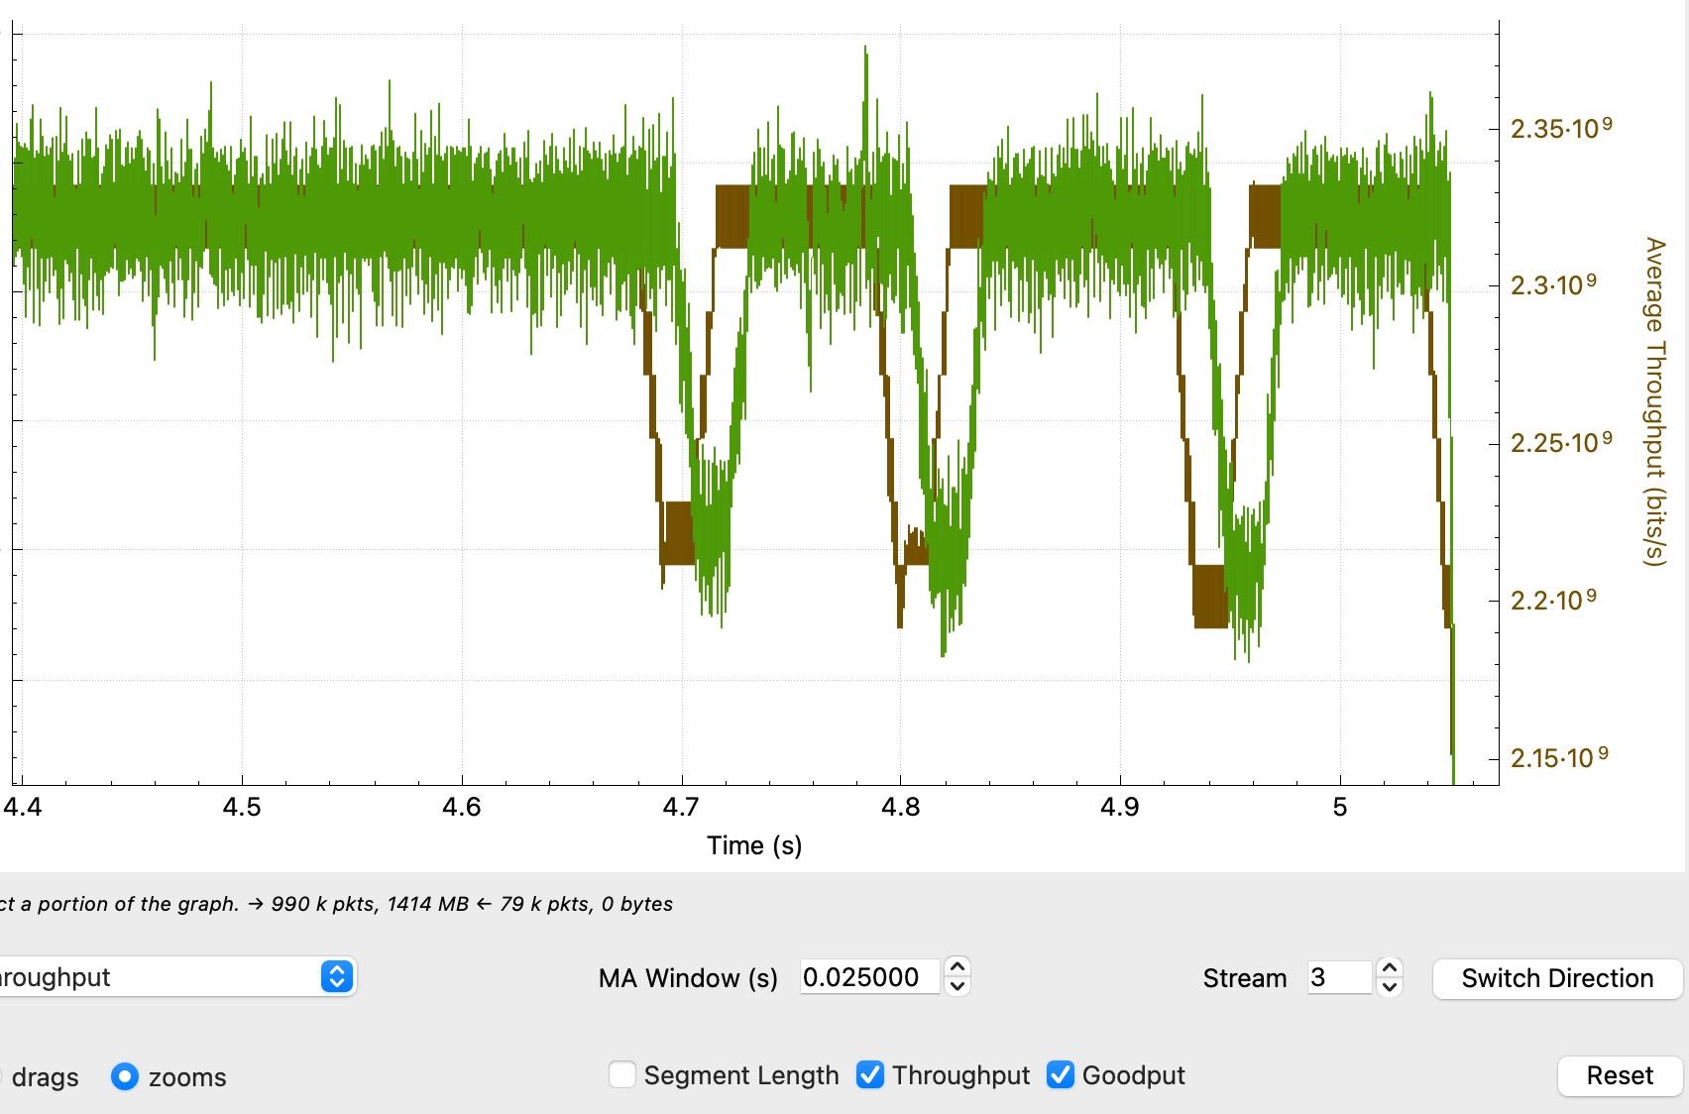
Sample "Zoomed In" Statistics→TCP Stream Graphs→Time Sequence

Slide 120
More "Exotic" Graphs Are Also Available
The Stevens Time Sequence Graph (Sequence Number vs. Time) – our example really demonstrates the accelerating packet transfer rate over time.
The Window Scaling Graph lets you see what congestion window was arrived at, and how that window changes over time. In our case, after startuo it's near flat, except for a few brief blips.
We'll also highlight the RTT or Round-Trip Time Graph. This is a graph of observed latencies. Note the vertical scale (and small variance to the RTT values) in this trace.

Slide 121
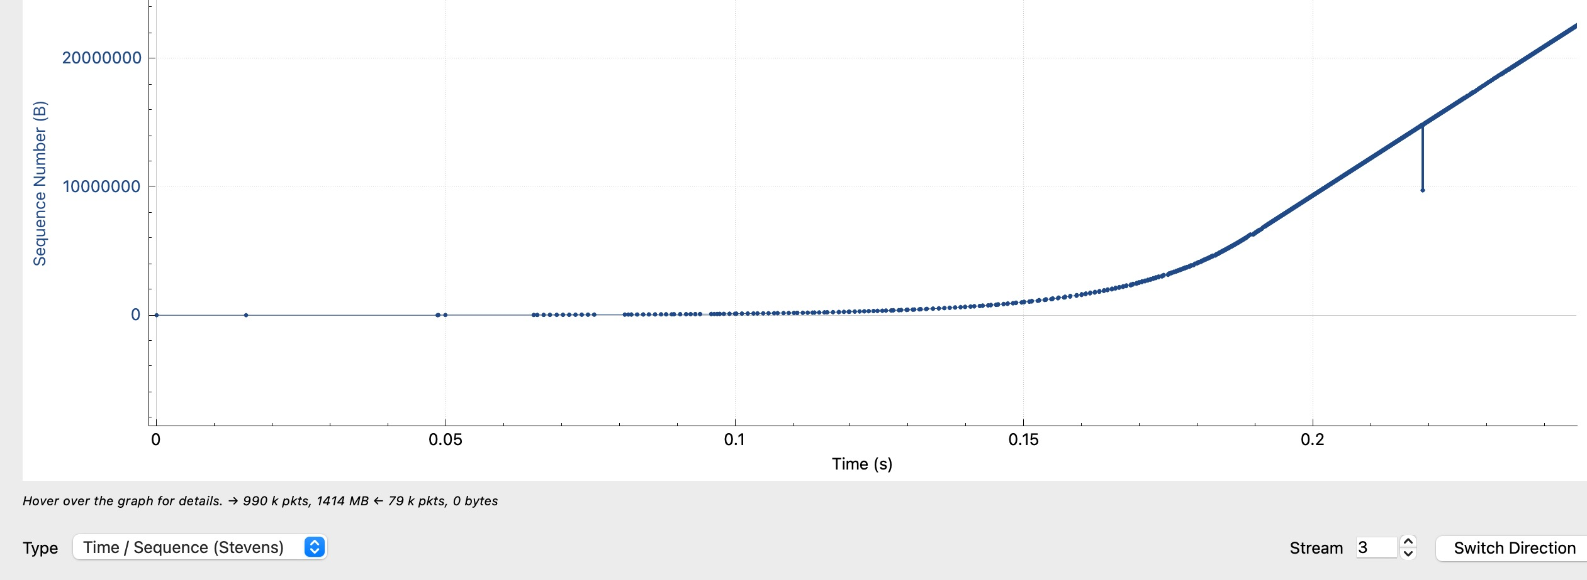
Statistics → TCP Stream Graphs → Time Sequence (Stevens)
Note the initially sparse dots that quickly begin to appear more rapidly and then begin to climb rapidly within just a quarter of a second.

Slide 122
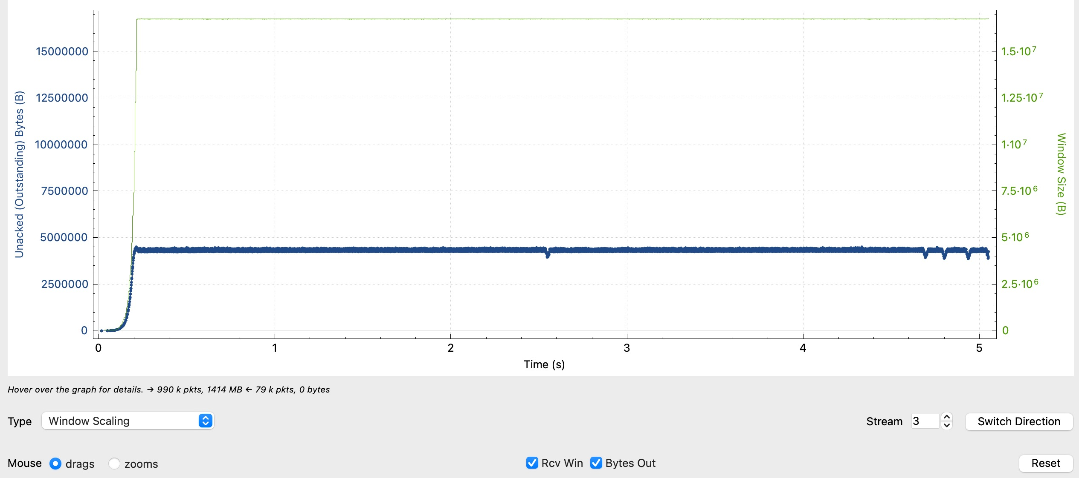
Statistics → TCP Stream Graphs → Time Sequence (Window Scaling)
The window scale climbs rapidly, and then basically stays flat...

Slide 123
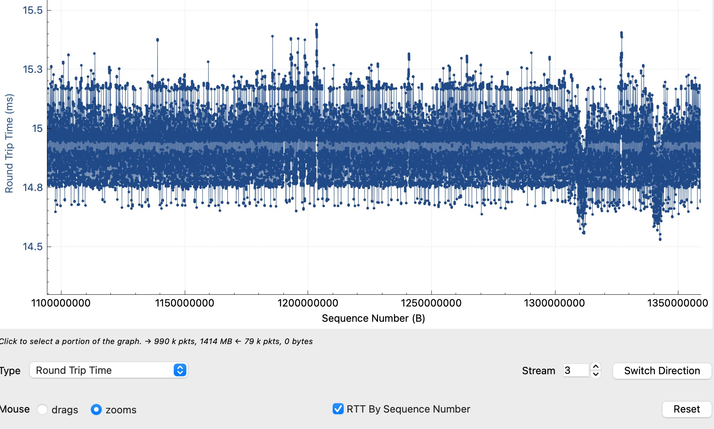
Statistics → TCP Stream Graphs → Time Sequence (RTT, Zoomed)
Not much variation in round trip times (half a milisecond or so?)

Slide 124
It's Not All "Just About Graphs"
You can also just dig in on specific packets that may be of interest.
For example, we talked about various options that get set during the TCP three-way handshake.
Let's look at a sample SYN, SYNACK, and ACK sequence, and confirm the window scaling factor and TCP options.

Slide 125
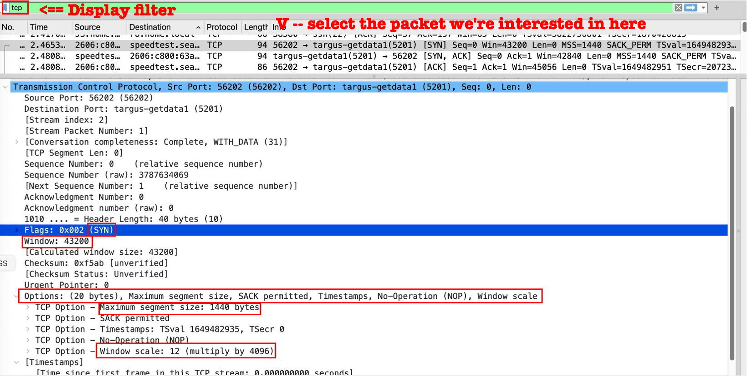
Digging In To TCP Packets Details (Set the Display Filter to tcp)
SYN packet, setting maximum segment size, Window Scale; OK'ing SACK and TImestamps

Slide 126
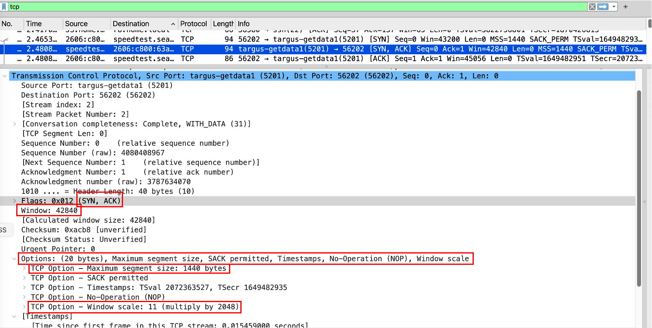
We saw a SYN, next we see a SYN, ACK
SYNACK, setting maximum segment size, Window Scale, OK'ing SACK and TImestamps

Slide 127
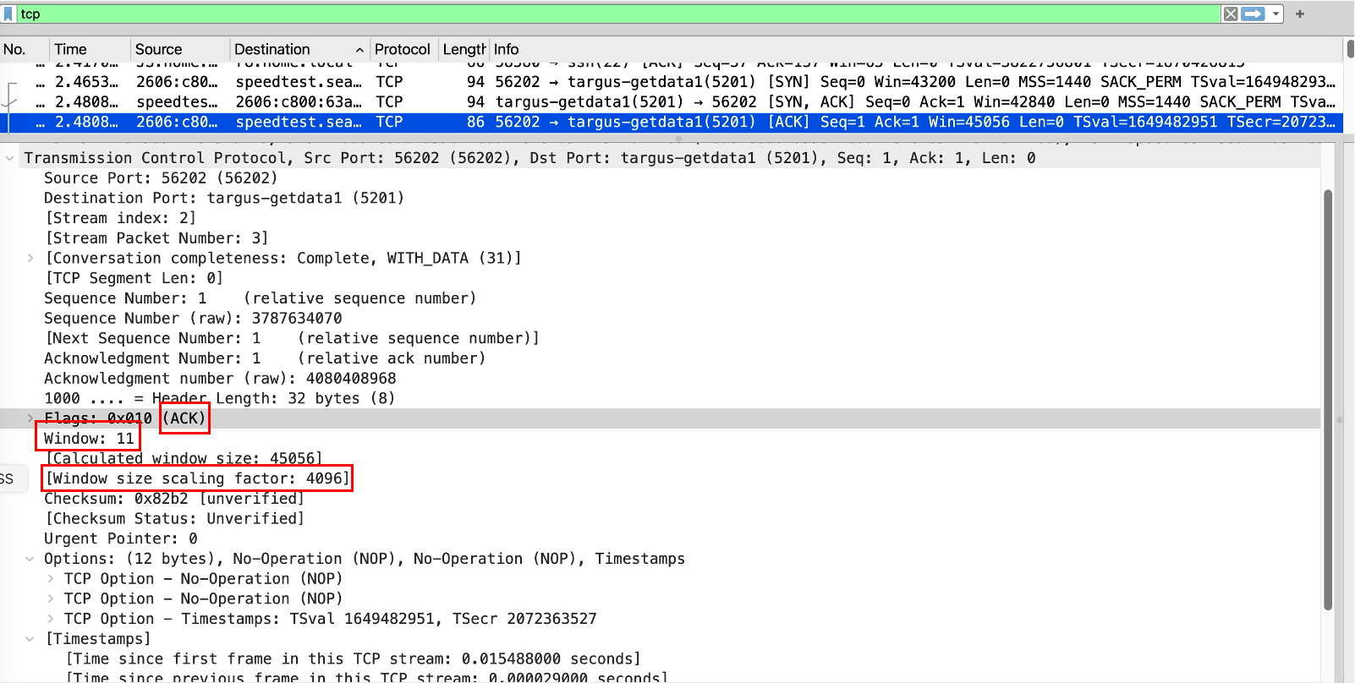
We saw a SYN and a SYNACK, finally we see an ACK
Our three-way handshake is now complete...

Slide 128
There's A Ton More You Can Do With Wireshark, But...
We've got limited time today!
The trick is taking it a step at a time. Spend some time playing with Wireshark, digging into using your own sample captures. There are also some books you may want to check out, such as: Troubleshooting with Wireshark: Locate the Source of Performance Problems, https://www.amazon.com/Troubleshooting-Wireshark-Locate-Performance-Problems/dp/1893939979

Slide 129
Aside: Need Something To Investigate? Run $ netstat -st
$ netstat -st tcp:
[...] 500 data packets sent after flow control
79 challenge ACKs sent due to unexpected SYN
41 challenge ACKs sent due to unexpected RST [...]
13504 completely duplicate packets (35068032 bytes)
43 old duplicate packets [...] 1986 packets with some dup. data (6469008 bytes duped)
3570597 out-of-order packets (4290634244 byte)
[...] 236971 packets recovered after loss
7498 packets received after close
41 bad resets
[...]

Slide 130
Part III. Summary

Slide 131
We've Covered A Lot of Material Today – TAKE AWAYS
We explained that multigigabit residential networks have become affordable and easy to deploy, and we showed you how (if you use MacOS, Windows 11, or Debian 12 Linux).
Corporate networks are similarly growing in speed and dropping in price – 100 Gbps is routine & 400 Gbps isn't rare any longer (but YOUR network may not be keeping up!)
These new powerful networks are (or should be) on M3AAWG's "radar" as a potential source of abusive traffic.
We showed you how to use SpeedTest & iperf3 to actively measure network throughput.
We talked about some of the factors that can technically impact network performance, such as latency. We made recommendations for coping with this by suitably-sizing buffers and adopting an alternative to the CUBIC congestion control algorithm known as BBR.
We talked briefly about bufferbloat and its potential impact on jitter and latency sensitive traffic, and how BBR can largely eliminate it as an issue.
We finished up by showing you how to get started using tcpdump and Wireshark to look more closely at network traffic.
We hope you learned at least something new today! Are there any questions?

Slide 132
Part IV. Glossary

Slide 133
Glossary
AIMD Additive Increase, Multiplicative Decrease – the general rule for congestion management
amd64 Modern Intel-compatible 64-bit CPU family
Apple SIP System Integrity Protection – protective measure meant to avoid O/S compromises
Apt Linux package manager, used to manage add-on software packages (like brew for the Mac)
Baseline Starting profile
Bandwidth Network capacity (measured in bits per second)
Bandwidth Delay Product (BDP) bandwidth * latency == size of required buffers
BBR Bottleneck Bandwidth and Round-Trip propagation time, a congestion control scheme
Bit One binary digit (0 or 1); eight bits make up a byte (also known as an octet)
Bottleneck In a network with multiple sequential links, the link with the lowest available capacity
Buffer Area for temporary storage of incoming or outgoing packets
Bufferbloat Undesirable condition where large bulk flows delay delivery of small (jitter sensitive) flows
Byte One octet (eight bits)
Cat<N> cable Copper Ethernet cable rated to handle a particular speed of traffic. You want Cat6a or Cat8.
CDN Content distribution network: service that replicates content at diverse locations to
ensure content is close to where its demanded, and there's sufficient redundancy CLI Command Line Interface (type-commands-in/non-graphical interface)
Congestion Network that's facing more demand than it has capacity

Slide 134
Glossary (cont. 1)
Congestion Control Algorithm Algorithm that specifies what happens when sending traffic through
limited-capacity network links – how fast does traffic grow? how does traffic decrease?
Congestion Control Window CWND: dynamically manages the speed at which traffic gets transferred
Congestive Collapse A disaster where a network fills up, and then, instead of backing off, multiple senders just keep blasting away
CUBIC Most common congestion control algorithm
Cut-through Network switch that begins forwarding a packet as soon as it has partially received it
Debian 12 The latest version of Debian Linux as of the time this was written (known as "Bookworm")
Dongle Adapter that dangles from the side or back of a system
Download Transfer data down from the Internet to the user
Driver Software that is supplied with a peripheral that allows a system to see and use the device
ECN Explicit Control Notification: way of explicitly telling a sender when the receiver's full
Ethernet Fundamental data link protocol (running at layer 2 of the OSI model)
Ethernet switch Layer 2 device allowing Ethernet devices to interconnect
Fairness Scenario where multiple users get an appropriate share of network capacity
FTTH Fiber To The Home
Gbps 1,000,000,000 bits per second (125,000,000 bytes per second)
Fairness Scenario where multiple users get an appropriate share of network capacity

Slide 135
Glossary (cont. 2)
FTTH Fiber To The Home
Gbps 1,000,000,000 bits per second (125,000,000 bytes per second)
Geolocation Mapping an IP to a physical location on the globe
Geostationary satellite Satellite orbiting at 22,236 miles above the equator, matching the earth's rotation GUI Graphical (Point-and-Click) User Interface
ICMP Internet Control Message Protocol – used for error reporting, flow control and other tasks
Interframe gap Space between two Ethernet frames (12 bytes long)
Iperf3 Command-line interface bandwidth testing tool
IPv4 Classic dotted quad format addresses (www.m3aawg.org is 34.214.179.220)
IPv6 New longer-form addresses (www.ietf.org uses 2606:4700::6810:2d63)
Jitter Variability in packet pacing
Jumbo frames Most networks use 1500-byte frames, but some may be configured to use 9,000 byte "jumbos" Lag Undesirable delay when playing an interactive online game
Lambda Optical wavelength used for dedicated point-to-point high bandwidth connections
Latency Network delay between two locations, normally measured in milliseconds
Layer 2 Switch Ethernet traffic based just on hardware MAC addresses
Layer 3 Route Ethernet traffic based on IP addresses
LFN Long Fat Network (a long distance, high-capacity network)

Slide 136
Glossary (cont. 3)
Line rate Traffic running at the full capacity of the connection (e.g., 1000 Mbps over a gigabit link)
LEO satellite Satellite in Low Earth Orbit (under 2,000 kilometers), relying on a constellation of multiple
satellites that "hand off" traffic from one satellite to another as they pass overhead MAC address A (normally globally unique) hardware address associated with an Ethernet adapter
Managed switch "Smart" switch that can be manually configured or monitored by a network administrator
Mbps 1,000,000 bits per second (125,000 bytes per second)
MHz Megahertz (amount of wireless spectrum used)
Mpps Million packets per second, a measure of a switch's packet handling capacity
MRC Monthly recurring charge
Msec 1 millisecond (1/1,000th of a second)
Multistream Application that uses multiple parallel streams instead of relying on just a single stream
M1/M2/M3/M4 Family of Apple Silicon CPUs used for MacBooks and similar systems
NDAA U.S. National Defense Authorization Act, limits purchase of some networking equipment
Network interface Ethernet connection or wireless link used to send/receive traffic on a system
Nominal Satisfactory, normal
NRC Non-recurring charge ("one time fee")
Optical Terminal Fiber optic "modem"
O/S Operating system (Windows 11, MacOS, Linux, etc.)

Slide 137
Glossary (cont. 4)
OSI 7 Layer Model Way of stratifying the network connection process: physical layer, data link layer,
network layer, transport layer, session layer, presentation layer, application layer.
Paced traffic Network traffic released to the network at a chosen bitrate
Packet capture Also known as a PCAP file. Often captured using tcpdump or directly within Wireshark.
Packets Traffic on the Internet is broken up into 1500 byte or smaller chunks known as packets
Packet loss What happens to traffic on a congested network after the buffers fill up and data overflows
PCAP Packet capture file (e.g., as created with tcpdump or Wireshark) PCIe PCI Express, a high-speed interface to the computer's bus used for some network cards
Peering Exchange customer traffic only (may be "settlement (fee) free," or paid)
Peering point Location where multiple networks meet to exchange customer traffic
Ping Un*x command line tool for estimating network latency.
PLL Permanent link length (length of permanently installed network cabling)
Pluggable transceivers Modules that can be used on SFP+ switches to connect different types of cable
POE Power over Ethernet. Allows you to connect remote wireless access points w/o wall power.
Port Place on a network device where you can plug in a network cable. Alternatively, the number of a network service (port 443=https, 25=SMTP, 53=DNS, etc.)
Port fee Amount paid by an ISP to connect a circuit to the network service provider's network device
QUIC Quick UDP Internet Connections (see https://quicwg.org/ for more)

Slide 138
Glossary (cont. 5)
Redundant A switch with "redundant power supplies" can lose one power supply and keep running.
Reliable delivery Traffic that's sent are guaranteed to be received, and will be resent if necessary
RFC 1323 Window Scaling Extension that allows transmission windows to scale up to sizes required
for Long Fat Networks
Right of way Right to run cable along a highway, railroad, powerline, pipeline, etc.
RJ45 Copper Ethernet cable connection format
Round trip time The time it takes to go from source to destination and back, usually measured in msec
SACK RFC2018 Selective Acknowledgements (way of efficiently acknowledging packet reception)
SCTP Stream Control Transmission Protocol (RFC9260)
Sequoia 15.4.1 Latest operating system from Apple for laptops and servers (as of the time this was written)
SFP+ Pluggable fiber optic connection standard
SNMP counters Simple counters on some devices that track and report things like packets sent in/out
Spatial streams Number of streams simultaneously sent over individual WiFi antennas
Speedtest Consumer GUI/web-based bandwidth testing tool
Store-and-forward Switch that receives an entire packet before it subsequently forwards it back out.
Symmetric Same in both directions (as in "same bandwidth whether uploading or downloading")
TAA U.S. Trade Agreements Act, requires some to purchase America-made products
TCP Transmission Control Protocol

Slide 139
Glossary (cont. 6)
Tcpdump Command line tool used to capture packet traffic for subsequent analysis
Three-Way Handshake The SYN, SYNACK, ACK process used to establish a TCP connection
Timestamps RFC1323 timestamps put into packets to enable packet pacing & delay measurement
Transit Obtain access to the full Internet (involves a charge for service)
Tuning Tweaking (adjusting) network parameters to try to achieve desired network performance
UDP User Datagram Protocol, a fire-and-forget packet delivery protocol, alternative to TCP
Unmanaged switch "Dumb" switch that auto-negotiates all connections; non-manually configurable.
Upload Transfer data up from the user to the Internet
USB Universal Serial Bus (socket for plugging in mice, keyboards, dongles, etc. on a system)
VLANs Virtual LANs -- way of logically separating traffic on a switch's physical interfaces
VPN Virtual Private Network (temporary encrypted tunnel from a workstation to a concentrator) WiFi Wireless Ethernet network
Windows 11 Latest operating system from Microsoft for laptops and servers (as of the time this written)
Wireshark Packet capture analysis tool
X86 Family of Intel (and Intel-compatible) CPUs
10/100/1000/2.5Gbase-T 10/100/1000/2500 Mbps Ethernet over copper cable
5G Fifth-generation advanced cellular wireless service
802.11ax Example of one specific WiFi protocol

Slide 140
"I can't get no satisfaction I can't get no satisfaction 'Cause I try and I try and I try and I try" Rolling Stones, "Satisfaction" (1981) https://www.youtube.com/watch?v=qAzqSYQ9X9U 3.44 million views

