Slide 1
Identity Management -- Background Concepts, Goals and Jargon
Joe St Sauver, Ph.D.
MAAWG Senior Technical Advisor (joe@uoregon.edu)
MAAWG Vienna, Klimt 2&3
1-2 PM, Wednesday, June 5th, 2013
http://pages.uoregon.edu/joe/maawg-id-mgmt/
Disclaimer: Any opinions expressed in this presentation are those of the author and not necessarily those of any other entity.

Slide 2
1. Introduction

Slide 3
MAAWG's New Identity Management SIG
Michael O'Reirdan, now MAAWG Chairman Emeritus, came up with the idea of a MAAWG Identity Management Special Interest Group at the Spring 2013 meeting in San Francisco. His idea was enthusiastically received by the MAAWG Board, and Mike has been good enough to allow me to co-lead that activity with him.
This session has been designed to provide a little backfill relating to identity management so that we're all "on the same page," hopefully allowing us to collectively get traction on this topic.
While I've put together some slides, I'd prefer this to be an interactive session so please feel free to bring up topics or ask questions at any time, seminar-style. We know that many of you have significant expertise in this field and are well positioned to make significant contributions to MAAWG's work in this area.

Slide 4
A Disclaimer and a Little About My $DAYJOB
Part of my normal daily work is with Internet2 and InCommon under contract through UO Information Services, however I'm not speaking on behalf of any of those entities today, nor am I articulating any official position of MAAWG.
I mention Internet2 and InCommon in particular because at least some of the work we're going to talk about today involves open source identity management software that originated with Internet2 (e.g., Shibboleth), and similarly, the primary higher education identity federation in the United States, InCommon, is administered by InCommon, a unit of Internet2. I want you to know about my affiliations so you can understand my perspective/biases, if any.

Slide 5
MAAWG Does Have Some History When It Comes to Identity Management...
Even though MAAWG's Identity Management SIG is brand new, MAAWG's Public Policy working group did submit a couple of pages of comments back in July 2010 in response to a request for feedback on the "National Strategy for Trusted Identities in Cyberspace," see http://www.maawg.org/sites/maawg/files/news/MAAWG_DHS_NSTIC_2010-07.pdf
For those who may not have noticed NSTIC when it first turned up...

Slide 6
NSTIC ("EN-stick" not "NYST-ick")
NSTIC is the "National Strategy for Trusted Identities in Cyberspace" project, see http://www.nist.gov/nstic/
The NSTIC site says, among other things: "The National Strategy for Trusted Identities in Cyberspace (NSTIC) envisions a cyber world - the Identity Ecosystem – that improves upon the passwords currently used to log-in online. It would include a vibrant marketplace that allows people to choose among multiple identity providers - both private and public - that would issue trusted credentials that prove identity."

Slide 7
The NSTIC-Envisioned Identity Ecosystem
An example of what the "Identity Ecosystem" means from the NSTIC web site: "For example, student Jane Smith could get a digital credential from her cell phone provider and another one from her university and use either of them to log-in to her bank, her e-mail, her social networking site, and so on, all without having to remember dozens of passwords. If she uses one of these credentials to log into her Web email, she could use only her pseudonym, "Jane573." If however she chose to use the credential to log-in to her bank she could prove that she is truly Jane Smith. People and institutions could have more trust online because all participating service providers will have agreed to consistent standards for identification, authentication, security, and privacy."

Slide 8
NSTIC Identity Ecosystem Steering Group
The Identity Ecosystem Steering Group (IESG) was created by NSTIC to "administer the development of policy, standards, and accreditation processes for the Identity Ecosystem Framework," see http://www.idecosystem.org/
Anyone can become a member, see the form that's at: http://www.idecosystem.org/page/join-idesg-0
Once you're a member, you can participate in the work of the IESG committees by joining the committee mailing lists, and you can also participate in upcoming events.

Slide 9
2. But What Is "Identity Management?" Is It Really About NSTIC's Identity Ecosystem? Or Is It Just Usernames and Passwords?

Slide 10
From the POV of Some Users, Identity Management IS Just All About Usernames/PWs
Everyone has got too dang many usernames and passwords. We just can't keep them all straight unless we write them down (and we know that we probably shouldn't be doing that)
Half the time we're forced to pick crazy passwords that are so complex we can't even remember them
Resetting our passwords (e.g., when we forget it/lock ourselves out) can be a real PITB – except when it feels *too* easy to us...
Using passwords doesn't really feel very safe to many of us given all the computer viruses out there that are trying to mine stuff from the various password stores that may be on our computers
Then there's the worry that someone's trying to phish us, and the worry that we've accidentally gone to some "look-alike" site
As users, we *hate* usernames and passwords!

Slide 11
Identity Management From Some Providers' POV
Users resist signing up for accounts (OR they want a dozen accounts instead of just the one we want them to consistently use)
We never know who anyone *really* is, which is a pain for many reasons (especially if they're trying to buy stuff from us)
Users are always forgetting or mis-entering their username and password, resulting in their getting locked out (which means that we then have to help them somehow reset their passwords)
Users are always getting their credentials guessed or stolen, and then our service ends up abused
Users never tell us when they die or otherwise stop using our service, so we've got tons of stale accounts, thereby keeping new users from getting "good" usernames and serving as potential targets for abusers looking for accounts they can hijack
As providers, we *hate* managing usernames and passwords!

Slide 12
In Reality, However...
Identity management is a lot more than "just" usernames and passwords.
Let's consider an example of how student identities get managed in higher ed...

Slide 13
Academic (Student) Identity Management Lifecycle
An applicant becomes interested in a school and creates an initial account so that they can begin getting and submitting info
The applicant's status transitions to accepted/waitlisted/rejected, enrolled, and (eventually) graduated/transferred/withdrawn. Then we have new alumni/alumnae, or in some cases graduate students...
Password reset requests need to be handled
Attributes need to be set (example: academic major and minor, local address, cell phone number, 3rd party email address, etc.)
An online directory needs to be populated, while honoring any directory information restriction requests made under FERPA
Legal name changes need to be handled (e.g., marriages/divorces)
Account holds need to be processed (example: student account gets hacked and begins sending spam, so account gets disabled, etc.)
And there are many more identity management tasks...

Slide 14
A Canonical Identity Source, Or Chaos?
Ideally, in the preceding student example, authoritative identity management information about the student will be maintained in a canonical system, such as the university's Student Information System (perhaps part of a larger integrated campus ERP system).
In the case of faculty/staff, comparable information might reside in the university's Human Resources System, and for alumni, that data might be stored in a parallel Alumni Relations System.
When identity management gets handled badly, however, multiple non-authoritative identity management systems may get turned up (for example, in individual departments and offices), and the data in those shadow systems tends to quickly become inconsistent, out-of-date, and unavailable for use by other applications.
Shadow systems of that sort get created because authoritative identity data isn't being managed in the right sort of way. When you notice shadow systems, they should serve as a warning to you.

Slide 15
Contemporary Identity Management
In modern practice, identity management is also (or should also be) about improving the "user experience," including:
Reducing the number of usernames and passwords a user has to create, remember and manage. This can be done through the effective use of federation and trust relationships. This reduces the amount of time users need to spend creating accounts and logging in, while simplifying things like online purchases.
Allowing users better control over their online privacy, while also offering "high assurance" identity credentials where necessary or appropriate for sensitive applications such as banking or health care.

Slide 16
3. Why An Identity Management SIG Now? Why Is Identity Management a "MAAWG Thing?"

Slide 17
Why Identity Management Now? Social Media
Social media applications (such as Facebook and Google+) are becoming increasingly central to Internet activity, and of course, social applications are, at their core, all about your online identity:
845 million active users on Facebook during a typical month
465 million Twitter accounts
135 million LinkedIn users
That's a LOT of user identities, from my POV...
----
Source: http://www.jeffbullas.com/2012/04/23/48-significant-social-media-facts-figures-and-statistics-plus-7-infographics/

Slide 18
Social Media Can Help Establish Your Online Identity -- But Also Increase Your Risk of ID Theft
There's a tension when it comes to use of social media.
On the one hand, your social network presence includes a "web of trust" consisting of friends and other individuals who know and interact with you. By doing so, they provide "proof" of your legitimacy. This is a web of "social trust" that may remind you of PGP/Gnu Privacy Guard's web of "cryptographic trust." We know that you really exist because other Facebook users friend you. :-;
On the other hand, use of social media will result in details of your personal and professional life being publicly exposed and that may increase your risk of having your identity stolen (trivial example: if your password reset question is "What high school did you attend?" and your social media page talks about the fact that you will be attending the Lincoln High School reunion in August, well...)

Slide 19
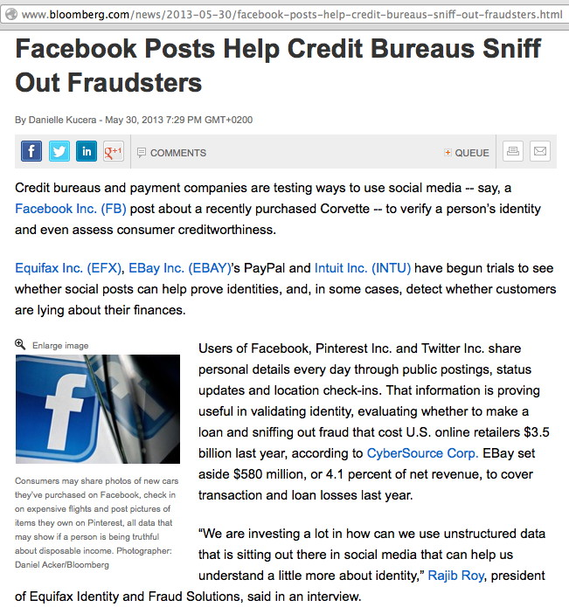

Slide 20
Why Identity Management Now? The Cloud
Many organizations want to take advantage of "cloud-based services" delivered by 3rd parties entities, which increases the importance of scalable online identity management beyond traditional organizational boundaries.
You really don't want each new cloud-based service to have its own new username and password, right? That's what makes users go crazy/get confused/reuse the same password everywhere.
Other options are even worse, including periodically copying passwords from some master system over to the the cloud based service(s) – wow, now there's a nightmare.
You really want a federated approach, where the cloud-based service provider will trust the local identity provider to authenticate the user in question on their behalf.

Slide 21
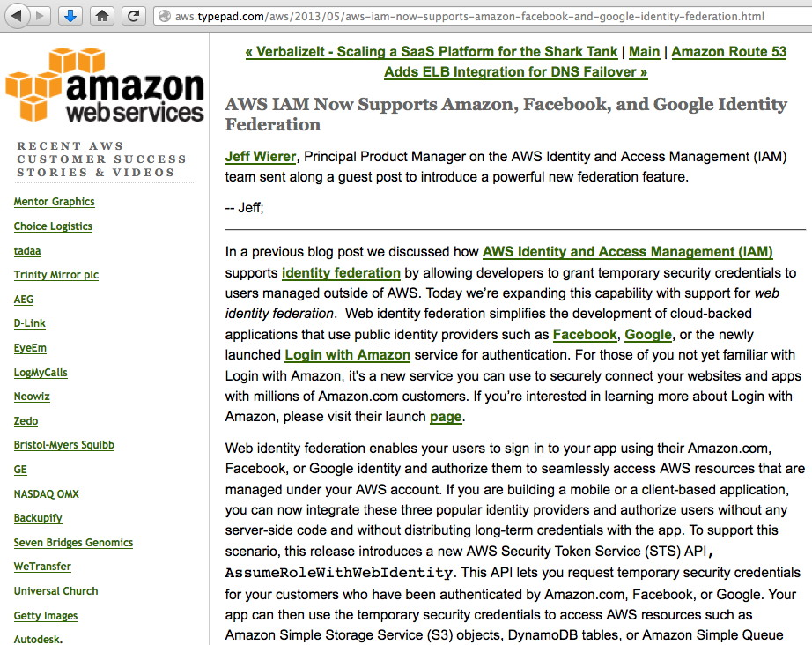
Example: AWS and Federated ID Management

Slide 22
Why Identity Management Now? Do Not Track
For a long time, regular cookies, Flash cookies and other persistent identifiers made it relatively easy for marketers and others to track user identities over time... but that tradition of tracking online activity is now being challenged as a result of things like community "Do Not Track" efforts and free technical browser anti-tracking/tracker-blocking tools such as Ghostery.
The trustworthiness of online tracking identifiers is also being eroded by things like "Persistent ID" cloning tools for Apple iTunes, potentially allowing multiple iTunes installations to appear to have the same Persistent ID.

Slide 23
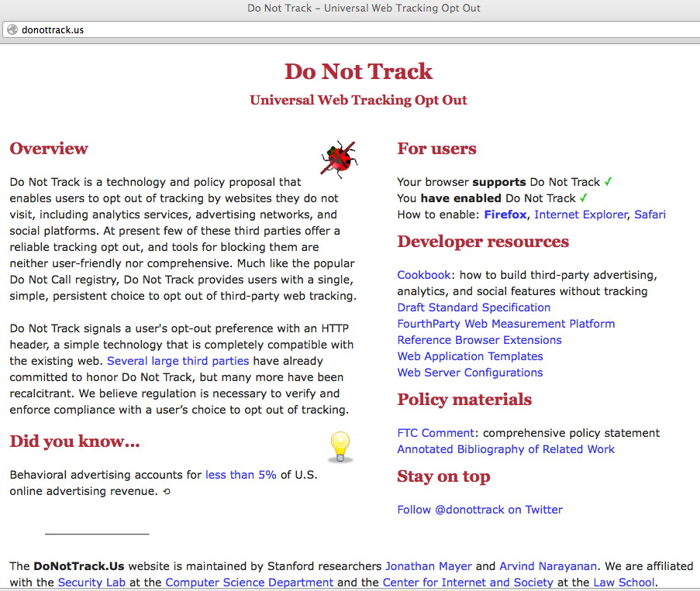

Slide 24
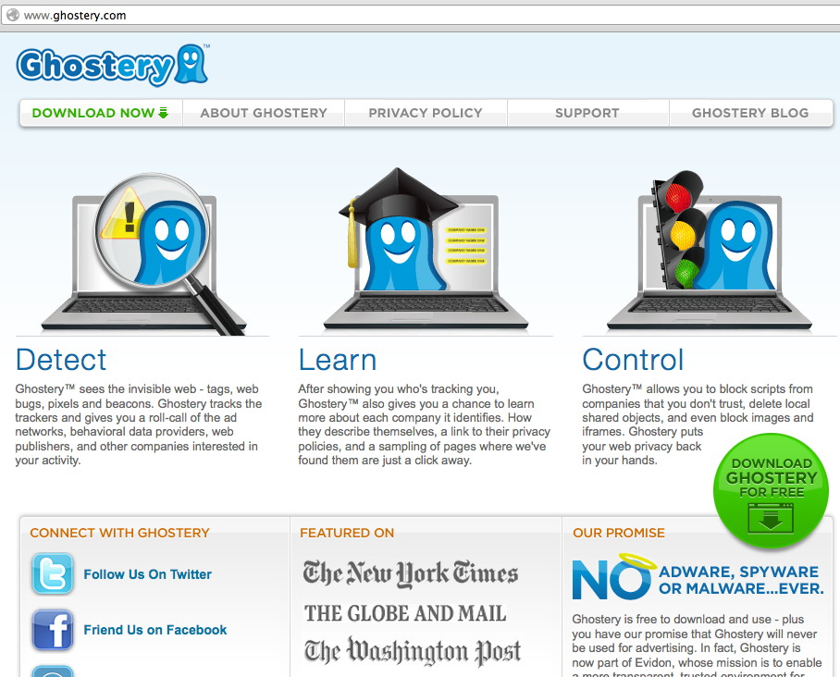

Slide 25
Why Identity Management Now? Account Hijacks
"The way we daisy-chain accounts, with our email address doubling as a universal username, creates a single point of failure that can be exploited with devastating results. Thanks to an explosion of personal information being stored in the cloud, tricking customer service agents into resetting passwords has never been easier. [* * *] This summer, hackers destroyed my entire digital life in the span of an hour. My Apple, Twitter, and Gmail passwords were all robust—seven, 10, and 19 characters, respectively, all alphanumeric, some with symbols thrown in as well—but the three accounts were linked, so once the hackers had conned their way into one, they had them all." "Kill the Password: Why a String of Characters Can’t Protect Us Anymore," Matt Honan, Wired, 11.15.12, www.wired.com/gadgetlab/2012/11/ff-mat-honan-password-hacker/

Slide 26
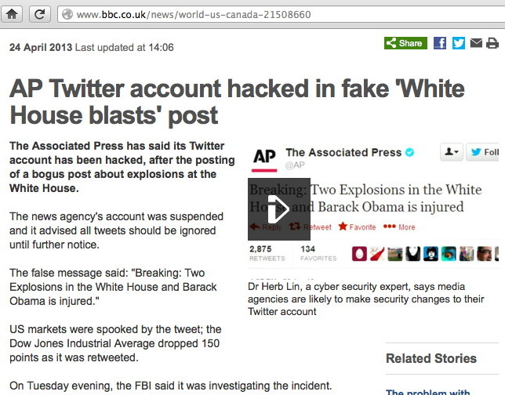
[See also: http://www.zerohedge.com/news/2013-04-23/ twitter-hack-compete-evaporation-all-market-liquidity-one-chart ]

Slide 27
Why Identity Management Now? Passwords Are "Dead"
"Passwords are dead."
Bill Gates, RSA, 2004
Or are they? Passwords seem to have lingered onwards for nearly ten years in Bill Gate's authentication purgatory, never ascending into heaven or descending into hell.
"The sad truth is that passwords are a problem that nobody really wants to solve. Users want to do whatever is easiest, and don’t want to be burdened by the inconvenience of strong authentication. System owners don’t want to spend any money on stronger authentication, and lack the will to enforce an unpopular mechanism on users." http://blogs.gartner.com/jay-heiser/2012/08/01/passwords-are-dead-long-live-the-password/

Slide 28
Why Identity Management Now? The Promise of Much-Hyped "Big Data"
Finally, we need to recognize that identity management underlies and supports much of the interest in "big data" -- whether you're a marketer who's delighted by what you've been able to accumulate, or a privacy advocate horrified at the loss of online privacy.
Identity management is a double edged sword that can cut both directions, helping advertisers to better track your preferences and interests so as to better meet your needs (whether latent or expressed), while also potentially allowing you to reduce the amount of information shared with third parties (for example, a federated approach to identity may allow your email identity to be kept confidential, with only relevant attributes being released to third parties who have a legitimate need-to-kow)

Slide 29
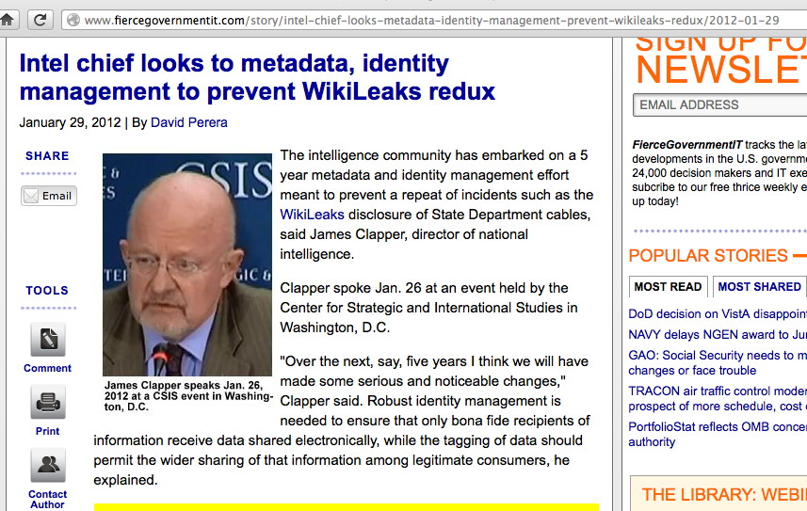
In Other Communities, Identity Management Is Being Driven By Problems With "Leaks"

Slide 30
Why Identity Management at MAAWG?
MAAWG member companies already enable hundreds of millions of user identities worldwide. Everyone who sends email (or who uses a smart phone or other mobile device) already has an "online identity" in the form of an email address or phone number, right?
Creating and administering those identities is both a huge potential expense and a potentially invaluable treasure trove of marketing information – IF you're the organization providing and logging the use of those identities.
Online identities are also the focus of identity thieves, e.g., phishing/social engineering, and credential harvesting by crimeware such as Zeus or Brasilian banker trojans.
It seems clear that identity management is really quite central to much of the work that MAAWG and its membership worries about.

Slide 31
Identity Management and... Personal Reputation?
MAAWG and its members have worked on many different reputation-related areas, including IP address reputation and domain reputation – maybe the time has come for user-level reputation work, too? After all, if MAAWG members could confidently tie mail to actual users, that would be a very fine-grained reputation accumulation mechanism, right?
This topic ties closely to issues such as use of PGP/Gnu Privacy Guard, or the use of S/MIME for per-user cryptographic message signing (but are people actually willing to swallow the message-level crypto pill?) [Note that we've previously talked about client certs and using S/MIME at MAAWG, see "Client Certs and S/MIME Signing and Encrypting: An Introduction," Feb 2012, http://pages.uoregon.edu/joe/maawg24/maawg24.pdf ]

Slide 32
4. Stepping Back For a Minute, How Did We Get Where We Are Today?

Slide 33
At The Dawn Of The Modern Era...
In "the beginning" -- let's say fifty years ago -- there was no identity management because computers were accessed directly, e.g., you computed in person.
Identifying approved users was easy, because only a small number of people had physical access to those early systems, and users needed to be physically present to run jobs (unless they were using a system where they'd turn in their jobs to a computer operator who'd then run it for them)
It was easy to recognize authorized users: the number of people interested in using those systems (and skilled enough to practically do so) was small.

Slide 34
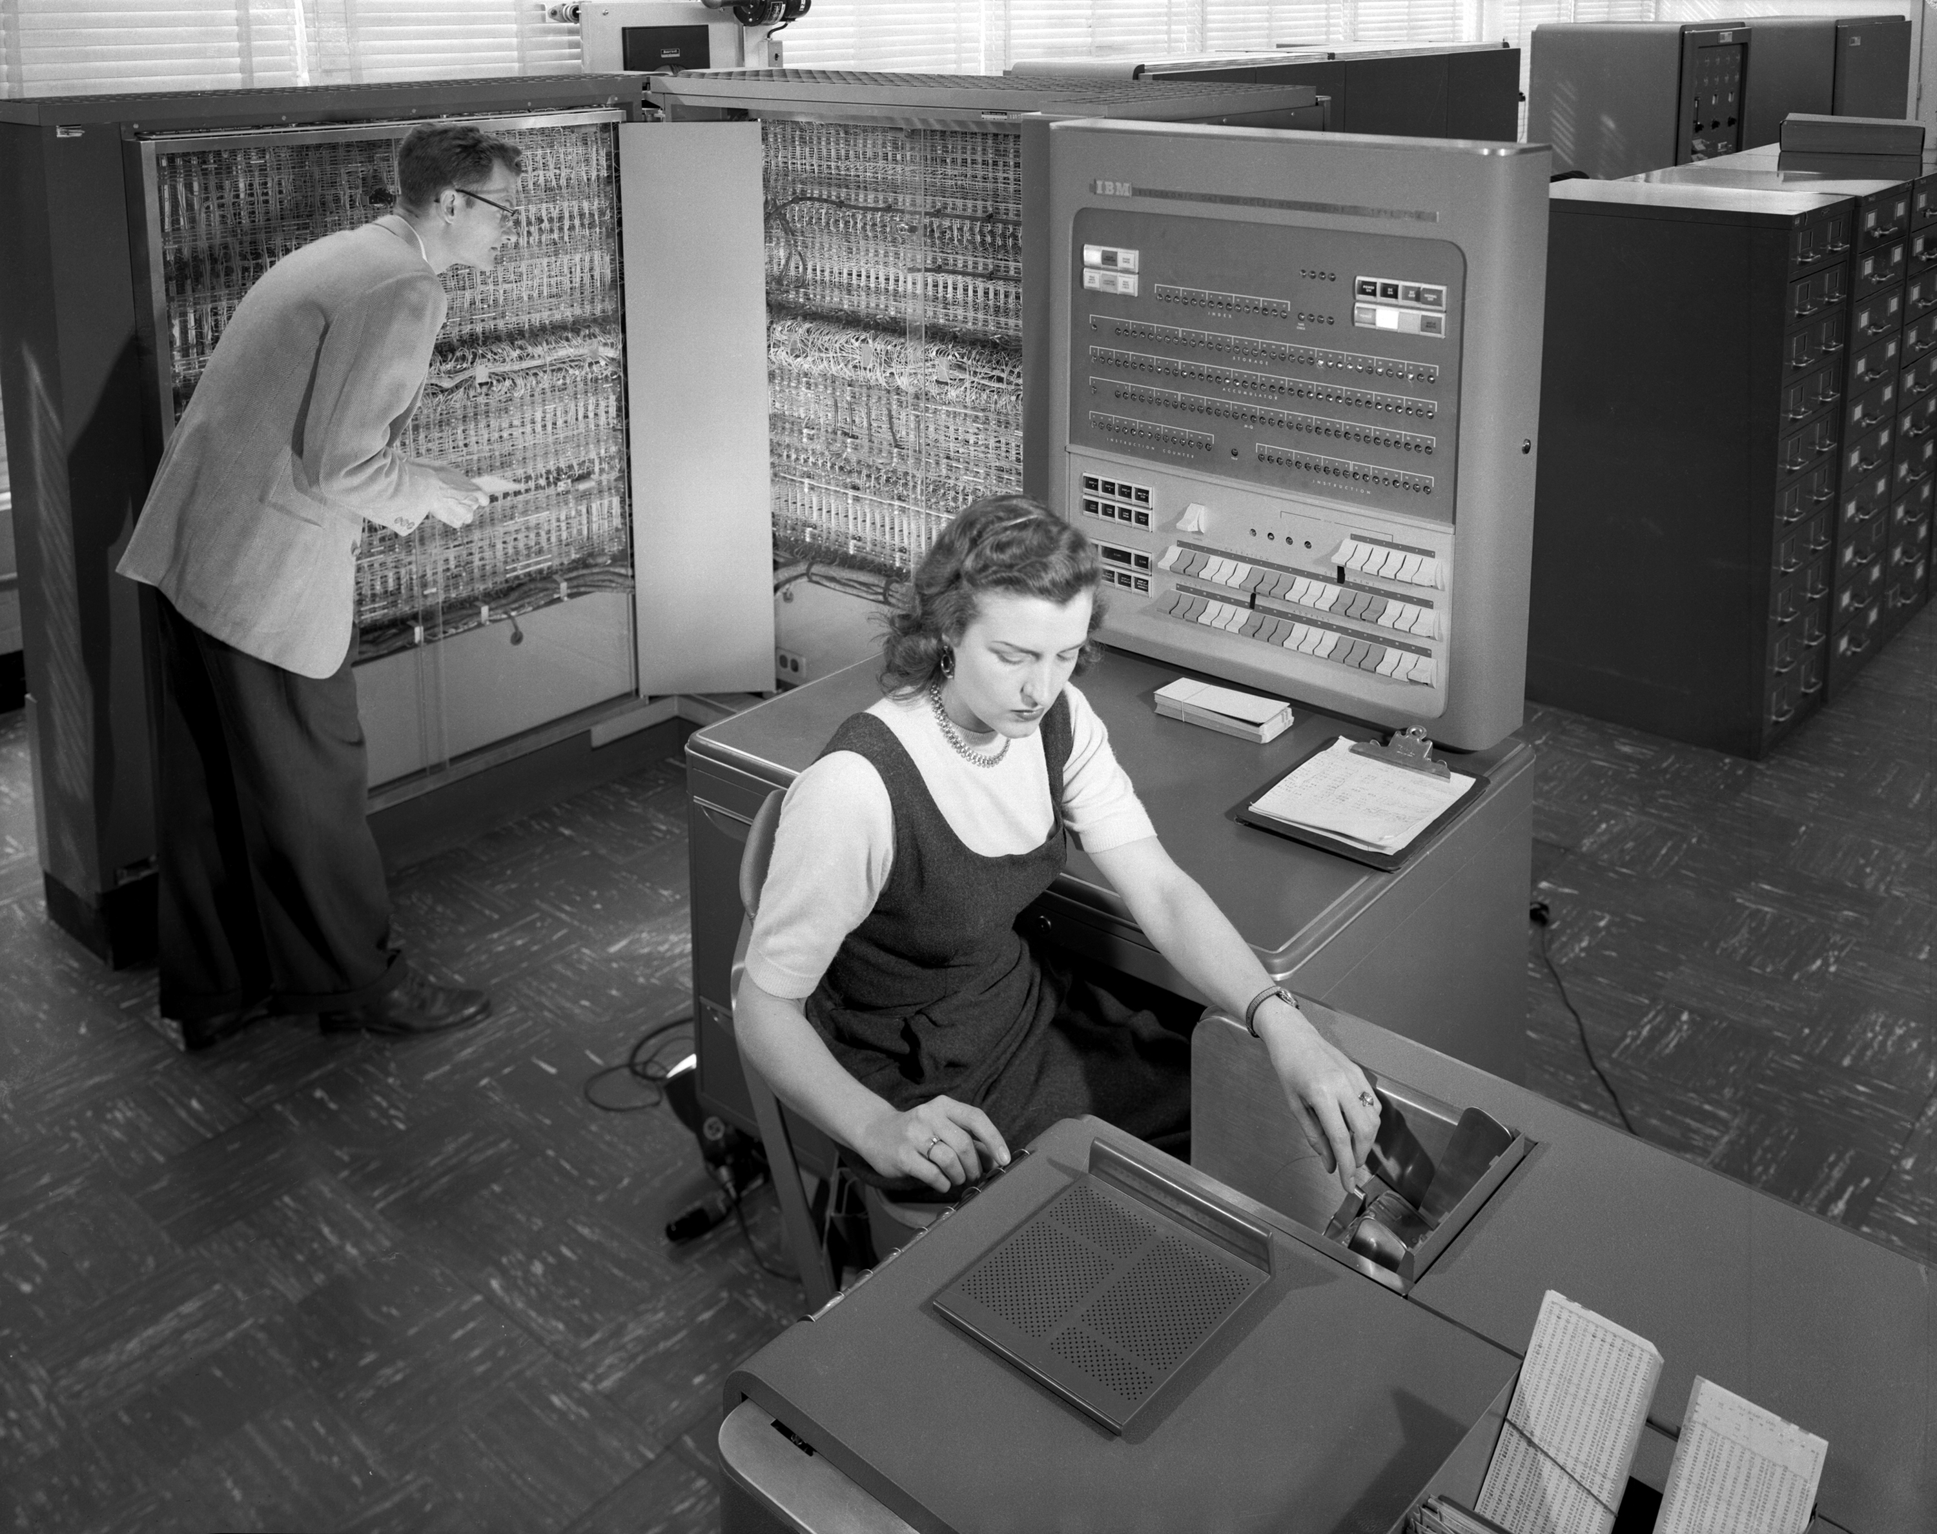
A Computer From That Era: The IBM 704
Credit: http://en.wikipedia.org/wiki/File:IBM_Electronic_Data_Processing_Machine_-_GPN-2000-001881.jpg

Slide 35
A Brief Geek Digression on the IBM 704
First mass-produced computer with floating point hardware, a big deal to computationally-oriented guys of the time.
123 were sold from 1955-1960
Vacuum tube-based
(Real) core memory (4K 36-bit words)
Programs entered via punched cards; output via printer or (an optional) 21" long persistence phosphor CRT display
4K instructions per second
FORTRAN was created for use with this system
Access to the system? As we mentioned, go to the computer....
Lots more at http://en.wikipedia.org/wiki/IBM_704

Slide 36
Local Usernames/Passwords and Local Files
Now let's make this scenario just a little more complicated.
Let's pretend that this is still the old days, but not quite as far back. At that point, maybe you're using a 110 baud ASR33 teletypewriter or a 300 baud DECwriter to connect to a remote time sharing computer, dialing in with an acoustical coupler or modem.
On the remote system, inbound modems would have been connected directly to serial ports on the system (Ethernet wasn't part of the picture at that point).
You would have an identity on that timesharing system, but it existed primarily to track/limit your usage, and to allow files you'd saved to be connected to (and charged against) your quota.

Slide 37
When Was The First Username/Password?
This is a bit of an open question. In 2012, Wired magazine ran an article crediting MIT CTSS, see www.wired.com/wiredenterprise/2012/01/computer-password/ which noted:
According to Fernando Corbató [the person who was responsible for the CTSS project] even though the MIT computer hackers were breaking new ground with much of what they did, passwords were pretty much a no-brainer. "The key problem was that we were setting up multiple terminals which were to be used by multiple persons but with each person having his own private set of files," he told Wired. "Putting a password on for each individual user as a lock seemed like a very straightforward solution."

Slide 38
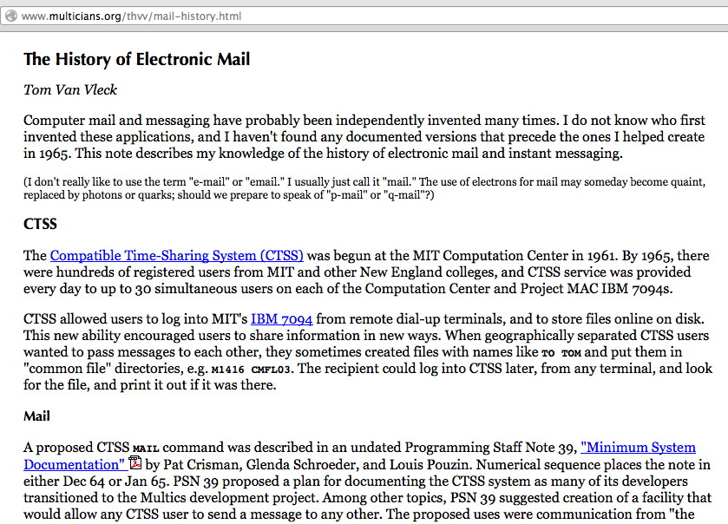
Why Else Should We Recall CTSS?

Slide 39
Link Between Identity Management & Messaging
That early connection between identity management and messaging is natural, and, I'd argue, a virtually inescapable one.
If you have multiple users of a shared system, there needs to be a way to map each resource owners to their stuff, limit access to private resources, and account for usage. That implies a need for identities.
Once you have multiple users on a shared resource, the desire for those users to communicate with each other also becomes inescapable, if only for things like griping about some colleague hogging too much in the way of shared resources, or asking an operator about the status of submitted jobs, etc.
Thus, it is entirely natural and appropriate that MAAWG should continue to develop a thread of work around identity management. Messaging and identity management just go together well!

Slide 40
User IDs and Group IDs
Coming back to our remote access example, that system, assuming it was running some version of Unix, would have had a unique numeric identifier (a user ID) for each user, defined in /etc/passwd (plus /etc/shadow later). Each user also was also assigned to a particular numeric group ID (as defined in /etc/group). For example, all users from the chemistry department might be in one group, all users from the physics department might be in another; users with special admin privileges might be in the "wheel" group.
Group IDs are nice examples of a couple of features that we'll see pop up again in other identity management-related contexts: -- group memberships -- attributes or assertions about users ("jsmith is an administrator," or "sallyjones is a member of the Physics Department")

Slide 41
Exporting Files, Sharing Authentication
Now let's make things just a bit more complicated still...
Instead of one system and some locally attached disk, assume we're talking about a set of "powerful" networked Unix scientific workstations, perhaps a lab of Sun SPARCstation 2 systems from 1990 or thereabouts.
Those nodes are going to share a set of usernames and passwords (so that a user can login to any of those nodes) and a network file system mounted on all the nodes (so that the user can work on the same set of files regardless of what node he or she is logged into).

Slide 42
NFS and NIS/YP
To export the files, let's use NFS v2, created circa 1989 (see http://en.wikipedia.org/wiki/Network_File_System#NFSv2 )
To manage the identities, let's use NIS/YP (see http://en.wikipedia.org/wiki/Network_Information_Service)
Identity management is still "tiny scale:" a lab of local systems, perhaps with a few hundred users, all within the same administrative domain. You may see people running this architecture even today (even though NIS has severe security limitations, see https://access.redhat.com/site/documentation/en-US/Red_Hat_Enterprise_Linux/3/html/Security_Guide/s1-server-nis.html )
At the same time, other developments were taking place. For example, imagine providing dial in service to multiple time sharing systems from a shared pool of modems connected to a terminal server, and those users would also need to be authenticated...

Slide 43
RADIUS
RADIUS (Remote Authentication Dial In User Service) was created by Livingston Enterprises to handle authentication, authorization and accounting for Merit Networks dial in users circa 1991. An extensive suite of RFCs document the protocol, see http://en.wikipedia.org/wiki/RADIUS#RFCs
RADIUS is still in use today for enterprise AAA chores, with the most popular implementation probably being http://freeradius.org/
Because RADIUS supports the use of different realms, it can also be used to support cross-ISP roaming users.
RADIUS was supposed to be replaced by Diameter ("Diameter is twice RADIUS!"), but largely hasn't been, except in mobile network contexts (e.g., 3G, LTE and IMS). See RFC6733 for more about the Diameter protocol.

Slide 44
Other Enterprise AAA Technologies
LDAP (Lightweight Directory Access Protocol, see en.wikipedia.org/wiki/Lightweight_Directory_Access_Protocol )includes the ability to "bind" (authenticate) users, and contributes a lot to what you'll see later in this talk when we talk about federated authentication, including things like schemas.
Kerberos is another enterprise AAA technology, see RFC4120. Kerberos may be deployed in classic Unix form (MIT Kerberos), or in the form of Active Directory, as used by Microsoft Windows.
And then there's CAS (Central Authentication Service), a popular web-based single sign on option, see http://www.jasig.org/cas
Clearly there are a lot of enterprise-scale authentication options...

Slide 45
Auth Drives Architectural Choices And (Easily Integrated) Application Options
You will notice by this point that at this point there is the potential for a bit of a battle when it comes to who will do identity management for the organization, and with potentially very high stakes -- if you control the enterprise identity management infrastructure, you have a real leg up when it comes to guiding the direction of the rest of your architecture.
That is, for example, if you decide to do Microsoft Active Directory in the enterprise, that might push you toward different enterprise application choices than if you're using LDAP or RADIUS as a core authentication technology, perhaps.

Slide 46
5. The Inter-Domain, Non-Enterprise Case (Really, The World Wide Web)

Slide 47
We Don't Need Identity Management For All Internet Applications, Just For The Web
To a first approximation, for most users, "the Internet" is synonymous with what they can access via the web.
Thus, at least if we're talking about typical users, they don't care about things like ssh command line access, or pretty much anything except the web (even their email and other messaging probably happens within a web browser, rather than using a dedicated POP or IMAP client).
Thus, the goal these days, at least when it comes to "Internet" authentication and authorization for normal users," we just need to handle the web-based case. (I know this seems like an incredible oversimplification, but I think it is likely an accurate one)

Slide 48
Public, Internal, and Private Web Access
If you're just accessing publicly available web pages, no authentication or authorization is normally required.
If you're accessing non-public "internal only" web pages (what's often referred to as an organizational "intranet"), authorization and access control is often handled by hosting the web server on non-routable address space, or by explicitly limiting access to the company's IP address blocks, with off site access being handled through use of a VPN
If you're accessing personal web pages (for example, a web email account), you'll normally login with some sort of credential, hopefully over a TLS/SSL protected/encrypted channel, at which point the server will normally set a "cookie" on your browser, thereby logging your browser in. That cookie may be persistent, or a temporary cookie that's discarded when your session's over.

Slide 49
Single Sign On (SSO) and OpenID
Users working from dedicated personal laptops also want to be able to "stay signed on," and not have to repeatedly login just to access other applications from the same provider.
Thus, for example, a Google user, once they've signed on to access Gmail, will want to be able to access other Google person-specific resources without having to repeatedly "re-login" – and they can. This is true not just for Google accounts, but also for accounts from other providers, such as Yahoo, too – once logged in, your credentials will work for all (or virtually all) applications offered by that provider.
The question, though, is "What of third party providers?" For example, what if you want to access some third party provider's service, authenticating to that service with your Google account or your Yahoo account? Yes, that can be done, too.

Slide 50
6. Federated Authentication With OpenID

Slide 51
We're Not Going To Rehash The Step-By-Step Process By Which OpenID Works
If you want a nice step-by-step summary of how OpenID works, see the discussion and diagrams that are available at https://developers.google.com/accounts/docs/OpenID
I also rather like: "Single Sign-On For the Internet: A Security Story," https://www.blackhat.com/presentations/bh-usa-07/Tsyrklevich/Whitepaper/bh-usa-07-tsyrklevich-WP.pdf While this is a 2007 document, it does a nice job of summarizing not just how OpenID is meant to work, but some of the ways that OpenID could potentially be abused (at least if people are casual about how they implement/use it)

Slide 52
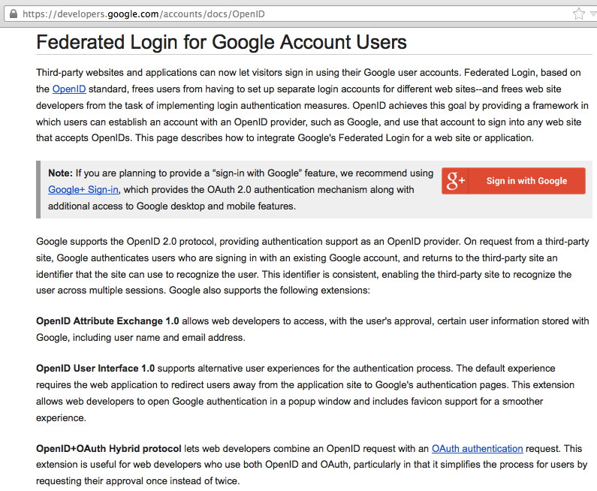

Slide 53
Google Is Not the Only OpenID Provider, But It Is Probably the Most Widely Used One
There are literally hundreds of OpenID providers out there, although just a handful account for the vast majority of OpenID logins, see http://janrain.com/blog/what-are-most-popular-networks-social-login-and-sharing-web/ which quotes the values: Google: 38% 38% (cumulative %) Facebook: 27% 65% Yahoo: 14% 79% (top 3 providers = ~80%) Twitter: 7% 86% Windows Live: 6% 92% Other: 8% 100%
That same article notes that OpenID provider popularity varies according to the type of web site that's being accessed.

Slide 54
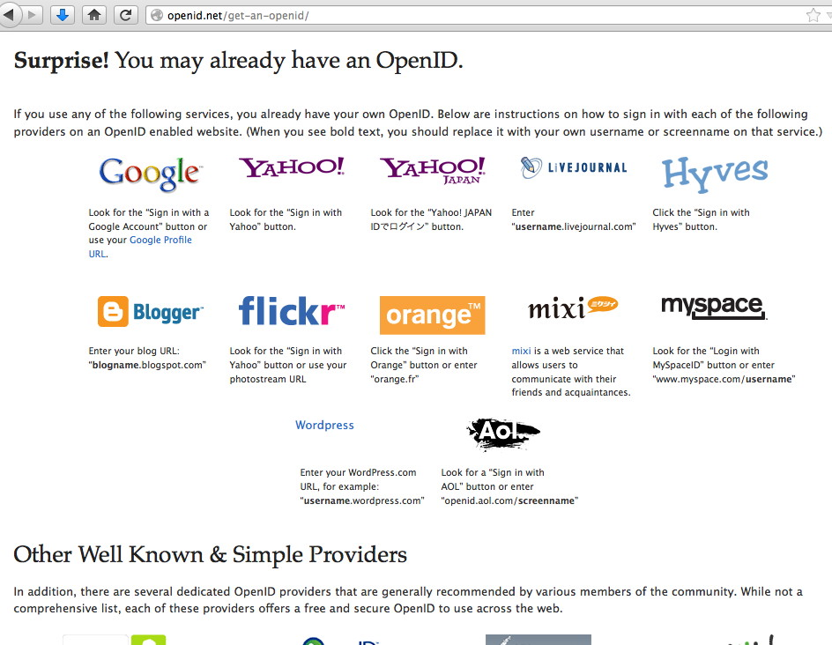

Slide 55
Not All OpenID Providers Will Necessarily Work The Way Originally Intended...
For example, imagine an OpenID provider that provides a redirection layer between an OpenID, concealing/protecting a user's real email address from disclosure... This is not a hypothetical service – this is exactly what LiquidID does, see http://liquidid.net/home.php (does this remind you of privacy/proxy domain name registrations? It sure strikes a chord for me in this respect...)
Even more "interestingly," imagine an OpenID provider that offers completely anonymous "throw away" OpenID credentials, much in the way that Mailinator offers completely anonymous throw away email addresses...

Slide 56
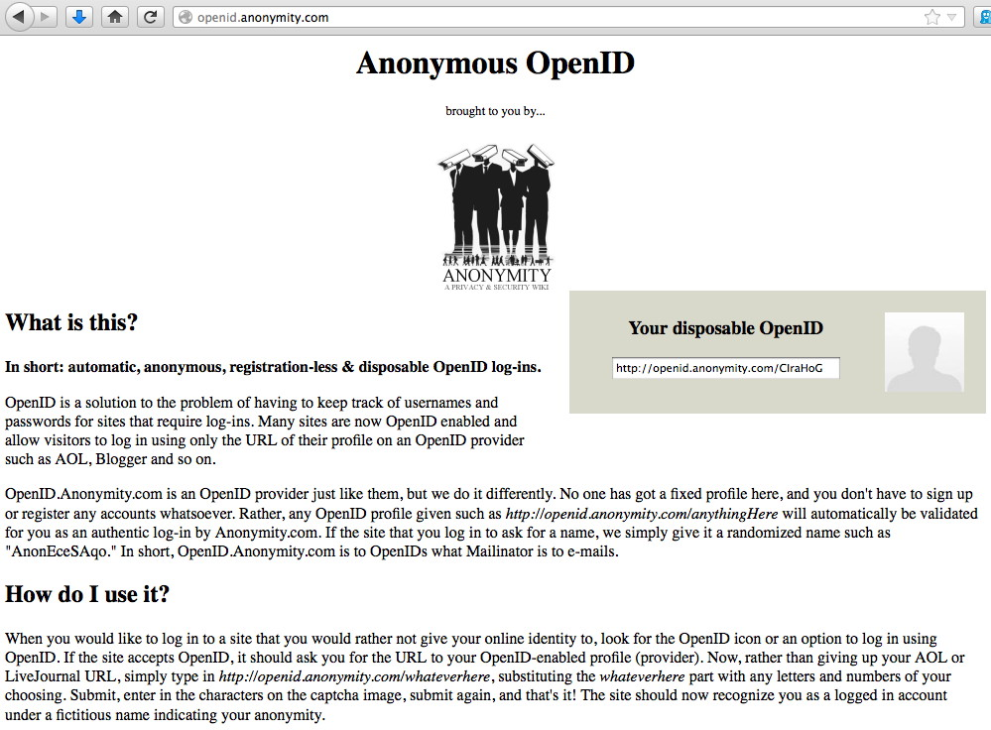

Slide 57
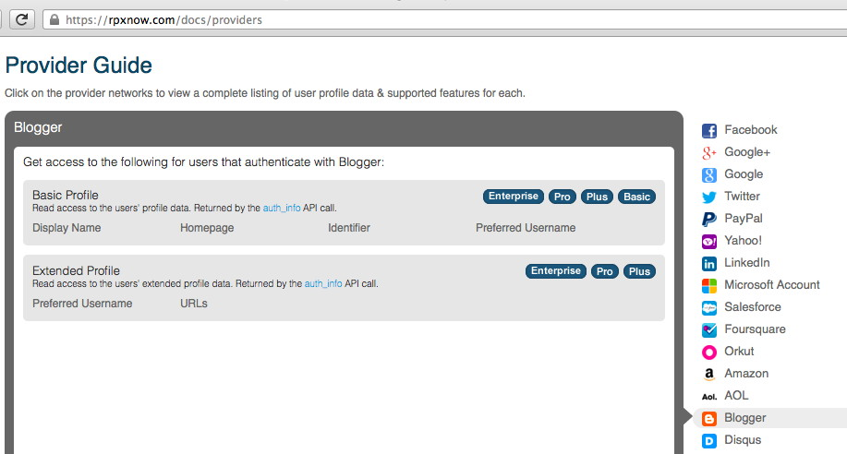
So What DOES Gets Shared When OpenID Is Used? Answer: It Varies By Provider. Blogger?
"Display Name, Homepage, Identifier, Preferred Username, URLs "

Slide 58
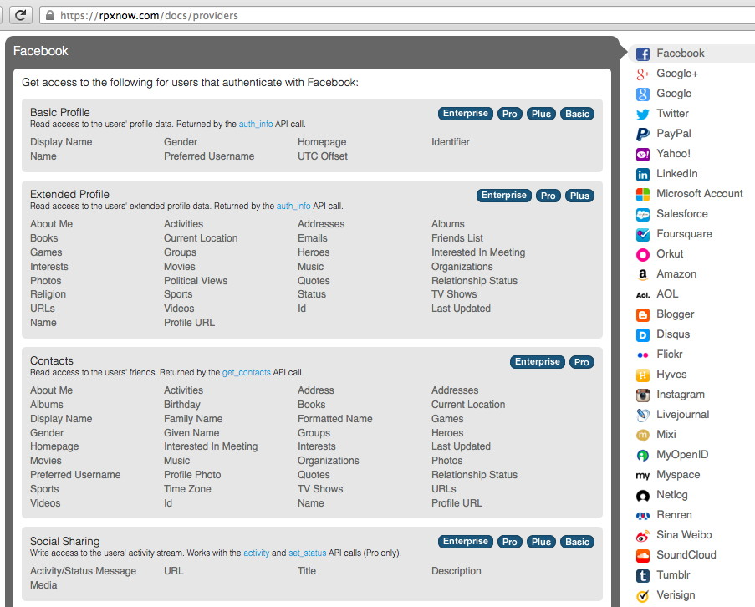
Facebook? LOTS More Gets Shared

Slide 59
Is Disclosing More Information About Users A Good Thing, or A Bad Thing?
If a legitimate service is relying on an OpenID for authentication, having more information about a user helps them to potentially identify and manage problematic users.
On the other hand, if I'm a bad site attempting to leverage OpenID to mine information about users, the more information that gets shared with them, the bigger the potential risk to user privacy.
Presumably privacy-aware users would prefer to use whatever OpenID identity provider releases the LEAST information about me (while still being acceptable to the services I use), but most users just don't seem to know/care.
One more point: virtually all of these user attributes are "self-asserted"/"user-supplied" – should you even bother paying attention to them anyway? What if users simply choose to lie?

Slide 60
Other Issues: Does OpenID Have "Critical Mass?" Perhaps Not, At Least For Drupal
"Remove OpenID from core," https://drupal.org/node/556380

Slide 61
Still Others Have Tried Supporting OpenID, And Have Ended Up Transitioning Away From It For Process-Related Reasons
Consider the following commentary from Tekpub...

Slide 62
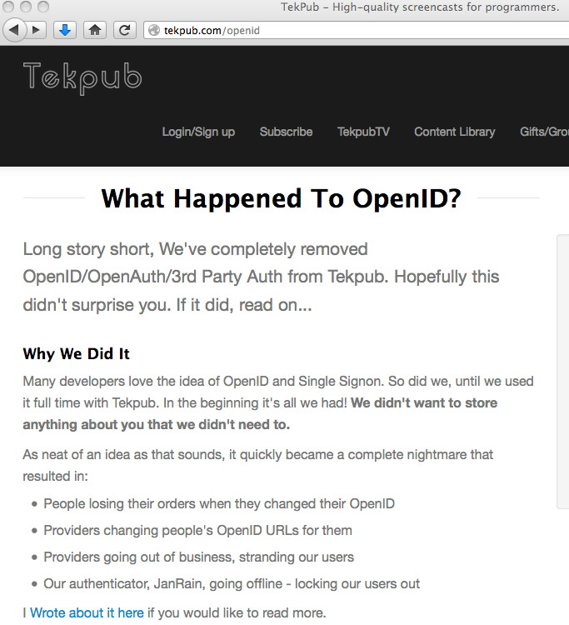

Slide 63
I'd Love To Hear What You All Think About OpenID Based on Your Own Experiences...
Are you using OpenID to login? Are you accepting it for authentication on your web site? Do you like it? Is OpenID the federated web authentication solution you like and need?
Beyond OpenID, there are other federated web authentication solutions. One of these is Shibboleth, a SAML-based federated identity solution.

Slide 64
7. Federated Authentication: Shibboleth

Slide 65
Shibboleth
"Shibboleth is among the world's most widely deployed federated identity solutions, connecting users to applications both within and between organizations. Every software component of the Shibboleth system is free and open source."
"Shibboleth is an open-source project that provides Single Sign-On capabilities and allows sites to make informed authorization decisions for individual access of protected online resources in a privacy-preserving manner."
http://shibboleth.net/

Slide 66
Shibboleth Relies on SAML ("SAM-uhl")
SAML stands for "Security Assertion Markup Language."
SAML is too complex to describe in detail here, but http://saml.xml.org/wiki/saml-introduction links both to an "executive overview" (seven pages long!), https://www.oasis-open.org/committees/download.php/13525/sstc-saml-exec-overview-2.0-cd-01-2col.pdf as well as to a 51 page "technical overview," see https://www.oasis-open.org/committees/download.php/27819/sstc-saml-tech-overview-2.0-cd-02.pdf

Slide 67
How Shibboleth Works (In A Nutshell)
Step 1: User Accesses A Resource
Step 2: Service Provider Issues Authentication Request
Step 3: User Authenticated at Identity Provider
Step 4: Identity Provider Issues Authentication Response
Step 5: Service Provider Checks Response
Step 6: Resource Returns Content
http://shibboleth.net/about/basic.html goes over these steps in more detail...

Slide 68
A Higher Ed Use Case
Imagine a situation where an institution (like UO) contracts for access to a proprietary web database, licensed for use by all faculty.
The database provider needs some way for UO faculty, and only UO faculty, to "login" to access that database, but the provider and the university don't want to use a single shared common password that everyone will know (shared passwords quickly leak to unauthorized users), nor does the university or the provider want to set up per-user, per-database credentials.
Federated authentication, if supported by both the institution and the database provider, is perfect for this sort of application. The service provider trusts the identity provider to authenticate university users, and the provider then applies normal business rules to determine what access is legitimately authorized.
Authentication gets decoupled from authorization

Slide 69
Authentication vs Authorization
Authentication (often referred in "shorthand" within the community as "AuthN") is the question, "Have we identified who this is?"
Authorization (in shorthand, "AuthZ") is a separate question, e.g., "Are they allowed access to this resource?"
Staying with a university context, imagine a student who is delinquent in paying her tuition and fees. We may still have total confidence that we know who that student is when she authenticates with her university-supplied credentials, but that non-paying student may not be authorized access to any classes or campus resources until she settles her pending bill.

Slide 70
Two Federation Roles: IdPs vs SPs
IdPs, or Identity Providers, supply user information. For example, a university might be an identity provider for its faculty, staff and students. IdPs create and manage user identities/accounts.
SPs, or Service Providers, consume user information. (SPs are also sometimes known as "relying parties.") A common example of a service provider is our online subscription database example: it wants to allow access from organizational subscribers, but deny access from non-subscribers.
An IdP can also be an SP, providing and consuming identity data. For example, maybe a university has a federated wiki, as well as offering federated identity data for faculty, students and staff members.

Slide 71
A Sample Federation With IdPs and SPs
InCommon is the US higher education community's identity federation. InCommon currently has 295 IdPs and 1,128 SPs, as listed at https://incommon.org/federation/info/all-entities.html and it services just under 6 million users (admittedly tiny compared to typical national or international-scale commercial ISPs, but non-trivial in size compared to some local/regional federations).
There's an InCommon page that has a listing of all InCommon participants, by type... The first two categories are pretty self-explanatory (high ed institutions, and non-profits/government labs/etc.); the third category, sponsored participants, represents commercial entities that have been sponsored by an existing community member because the community would like to be able to access services offered by that commercial entity with federated authentication. See the next page...

Slide 72
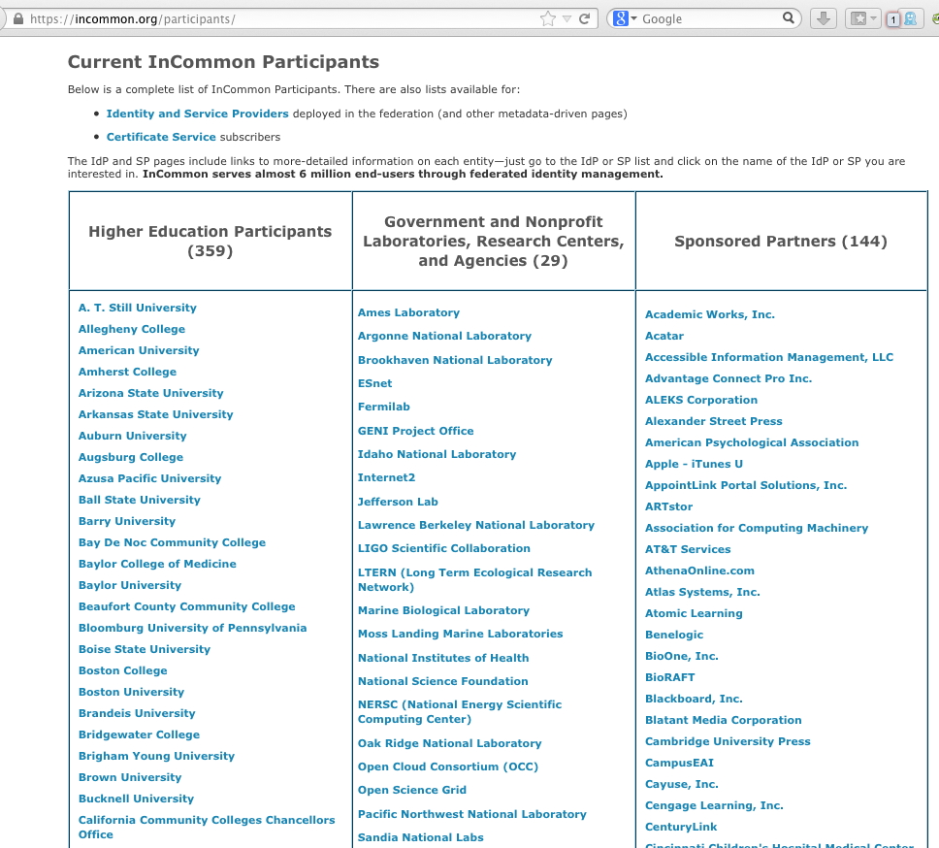

Slide 73
Higher Ed Identity Federations Worldwide
REFEDS is a TERENA activity (http://www.terena.org/about/) that is meant to be "the voice that articulates the mutual needs of research and education identity federations worldwide."
You can see from the following REFEDS map how many countries currently have R&E identity federations, either in production or in pilot.

Slide 74
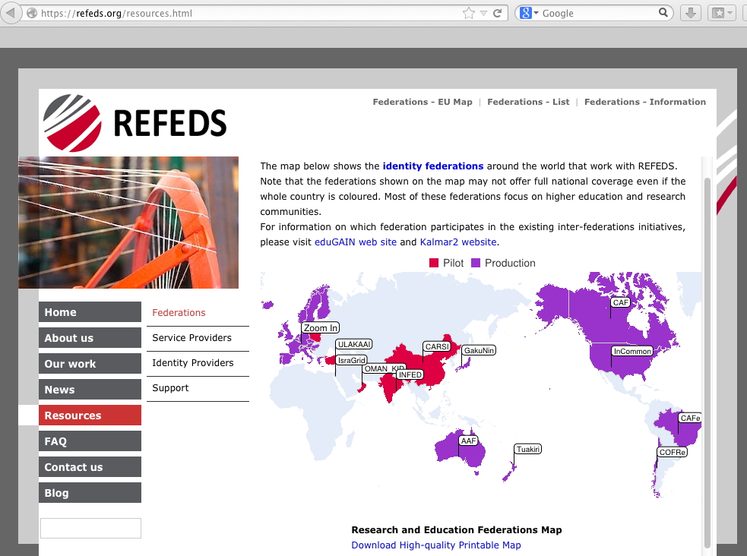

Slide 75
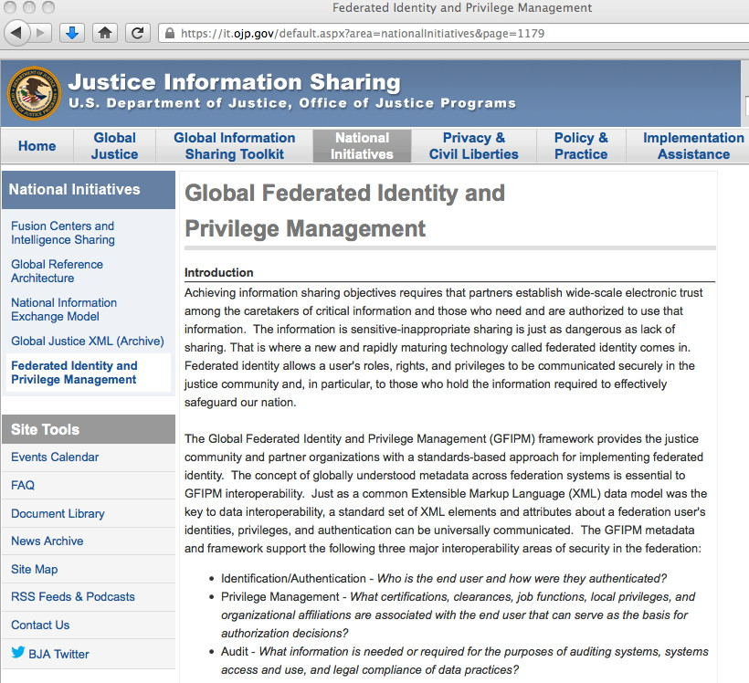
There Are Non-Higher Ed SAML Federations, Too

Slide 76
How Shibboleth Practically Works: IdP Discovery Pages ("WAYF?")
When a user runs into a service provider that offers Shibboleth federated login, the user needs to use an "IdP discovery page" (often referred to as a "Where are you from?" page) to get the user of the service to the IdP they'd like to use.
FWIW, I have some worries about the scalability of this sort of thing – long lists of sites to choose from can quickly get unwieldy, but we're still at a do-able number of sites at this point...
For example...

Slide 77
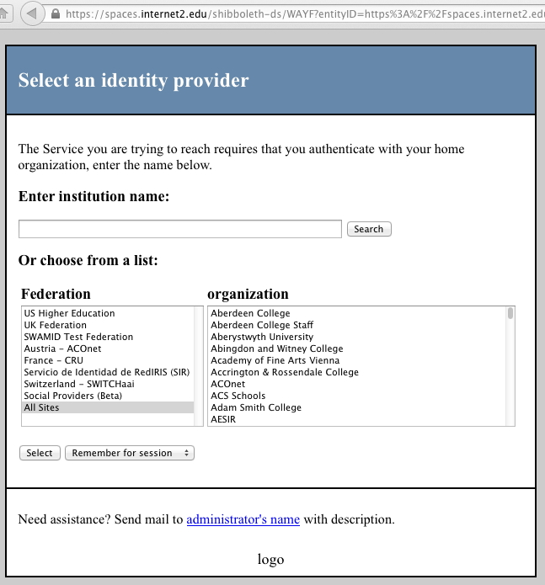
Sample WAYF Page

Slide 78
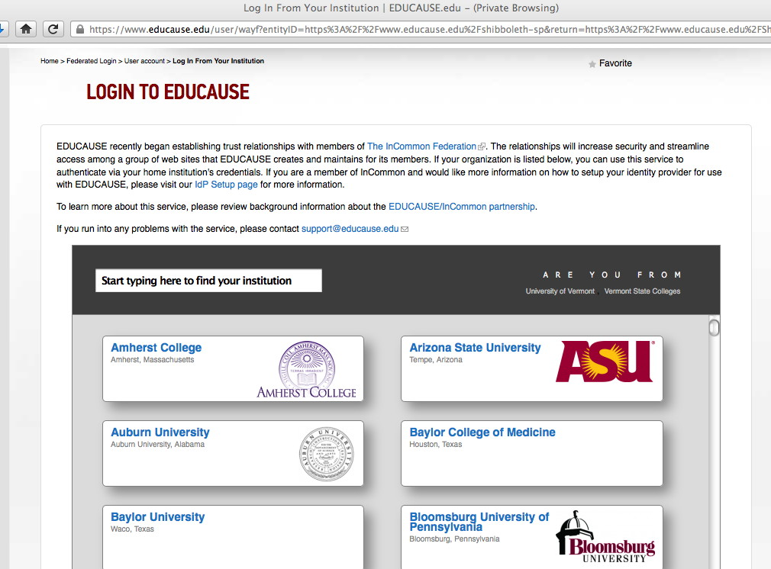
Another Sample WAYF Page

Slide 79
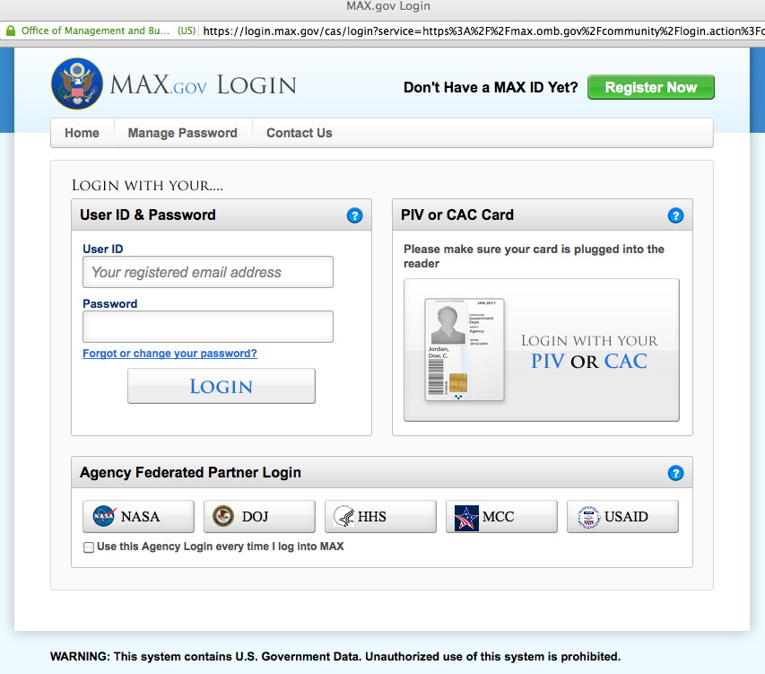
A Federal WAYF Page

Slide 80
Institutional Login Pages
Once the user selects their home institution, they are then redirected to/shown their home institution's federated login page
Each school's federated login page will normally be localized according to traditional institutional look-and-feel, using institutional logos and colors, etc., and secured with https (SSL/TLS), and will be located at/show the institutional URL in the user's browser bar
Once the user authenticates, a cookie will be set and then the user will be taken... -- back to the page they were originally trying to visit (if login was successful) or -- to an error page (if login failed or the required attributes weren't configured to be released for this site)

Slide 81
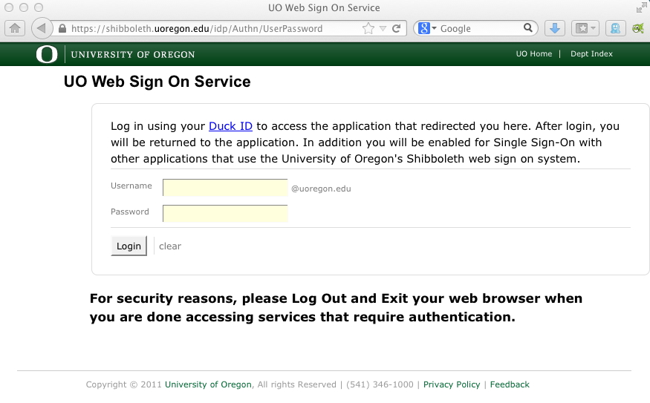
Sample Institutional Login Page

Slide 82
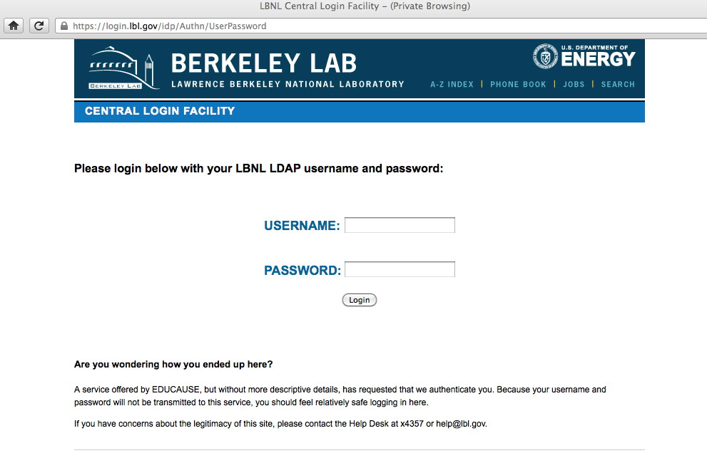
Another Sample Institutional Login Page

Slide 83
Attributes
Each federated user has a set of common attributes associated with them. In higher ed's case, these are defined via eduPerson, an LDAP schema developed and maintained by MACE, an Internet2 working group that focuses on directories and identity issues.
Attributes have officially assigned OIDs (Object IDs), see for example http://middleware.internet2.edu/oid-mace/ and http://middleware.internet2.edu/dir/edu-schema-oid-registry.html
A summary list of eduPerson attributes can be seen at http://www.incommon.org/federation/attributesummary.html
Attributes include eduPersonScopedAffiliation (student, faculty, staff, alumni, etc.), sn (surname), givenName (first name), mail (email address), eduPersonPrincipalName (aka EPPN), eduPersonTargetedID, and multiple eduPersonEntitlement's (a list of URIs representing licenses, permissions, rights, etc.)

Slide 84
Email Addresses vs. ePPNs vs. ePTIDs
While many may assume that most users are identified by their email address, in federated authentication, at least in InCommon, the unique identifier is actually normally the ePPN (eduPersonPrincipalName), see http://middleware.internet2.edu/eduperson/docs/internet2-mace-dir-eduperson-201203.html#eduPersonPrincipalName
While ePPNs look like an email address (having a user@domain form), and will be consistently shown to each SP, they should not be assumed to be a published/deliverable addresses. They may also change from time to time (example: name changes due to marriage)
The eduPersonTargetedID (ePTID) is an even more privacy-preserving "opaque identifier," consisting of a stable blob of characters, although the ePTID will usally be different for different SPs, preventing potential cross-SP identification and tracking.

Slide 85
Why Not Just Use Email Addresses?
Email addresses don't preserve the user's privacy: many email addresses are effectively a version of the user's real life name, and may connect the user to his/her behavior more than it should.
At the same time, there's nothing that prevents a person from picking a completely misleading email address – Jane Smith could choose the email address bobdoe@example.com if she wanted to.
Email addresses aren't perpetual. An email address that exists today might be gone tomorrow. Even worse, email addreses also aren't guaranteed against reassignment, either: johns@example.com may be John Smith today, but John Samuelson tomorrow
Some may have N email addresses (... and thus N identities?)
Some might not use email (perhaps preferring some sort of instant messaging), but the use of email addresses as a default identifier conflates their role as an identifier with a protocol, e.g., email, "forcing" people to sign up for a service they might never use...

Slide 86
Attributes and "Need to Know"
You may notice that this sort of scheme puts a substantial emphasis on only releasing the attributes that the service provider "needs to know" -- not all SPs will have access to all potentially available user attributes (including email addresses!) by default.
IdPs, in negotiation with each SP, determine which attributes they're willing to release to those SPs.
Sometimes that may mean an SP know a lot about an authenticated user, while other times you may know very little. It can also mean that some IdPs may not be able to authenticate to some services.
This privacy-preserving property is an important aspect of Shib-based federated authentication, both in higher education, and in more serious government contexts.
A government federated authentication example may help illustrate this...

Slide 87
Law Enforcement/Intelligence "Need to Know"
Assume that you're a law enforcement agency working to combat illegal drugs Your team includes drug cops from state and local police departments, federal LEOs, international partners, and even members of the intelligence community.
Intelligence sharing entities don't want to have to create usernames and passwords for each user, and users don't want per-site creds.
More importantly, from an opsec POV, you don't want "everything" about each officer to be exposed by default to all service providers – at least some of those officers may be working undercover.
Attributes may also be important: some officers may hold Top Secret or Secret security clearances, while others may not.
Federated authentication is a perfect fit for this case: it allows each officer to be authenticated by their home agency, with only required attributes getting released to the intelligence sharing site.

Slide 88
Federal Law Enforcement Doesn't Use eduPerson
Law enforcement agencies needed a schema with attributes that aren't in eduPerson.
The most widely known law enforcement federated ID schema is GFIPM, from the Department of Justice.

Slide 89
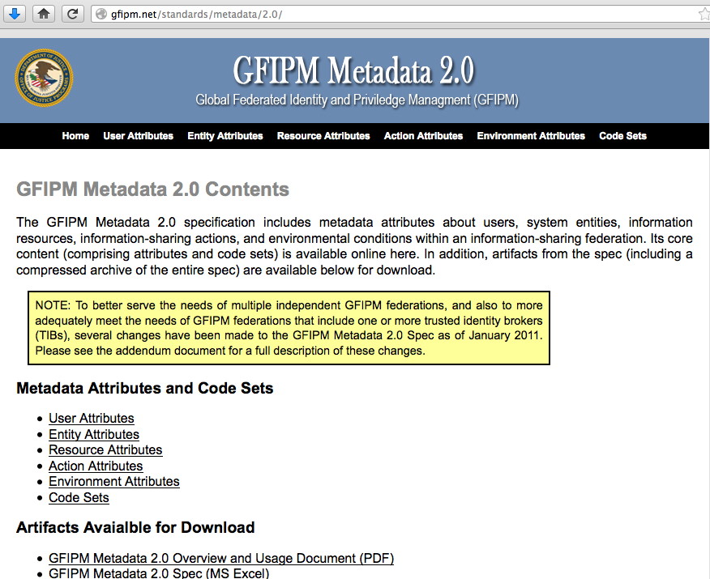

Slide 90
GFIPM Is Long and Very Inclusive
If you look at the user attributes defined in http://gfipm.net/standards/metadata/2.0/ you'll see that it defines a large number of user attributes. Some are familiar (such as "Full Name" or "Telephone Number")
Others are more unique to the law enforcement and intelligence community ("Fingerprint Set Image", "Security Clearance Level Code," "Sworn Law Enforcement Officer Indicator," "Counter Terrorism Data Agency Search Home Privileged Indicator," and many more...)
You can look at each of these attributes, and what they mean, if you're curious...

Slide 91
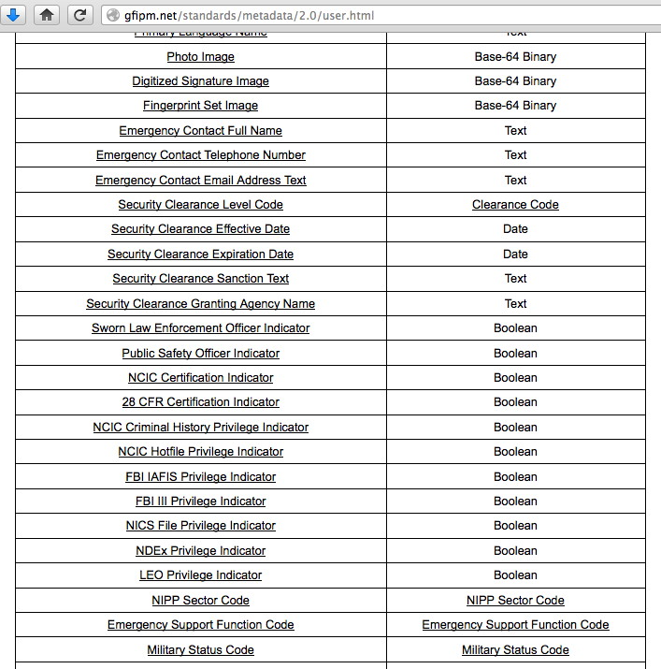

Slide 92
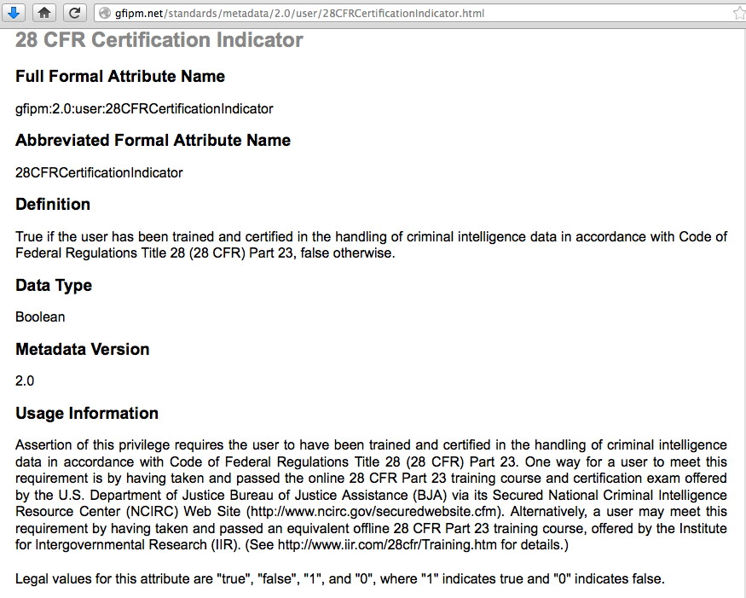

Slide 93
GFIPM: A Top 10 DOJ BJA Global Achievement
https://www.bja.gov/Publications/GlobalTop10.pdf

Slide 94
Coming Back to InCommon: Metadata
"InCommon metadata is the basis for trust within the InCommon Federation. In a very real sense, SAML metadata powers the federation. Without metadata, trusted operations within the Federation would grind to a halt. Put another way, SAML metadata represents the trust backbone of the InCommon Federation. Within the federation, trust is based on what effectively is a SAML-based PKI (as opposed to a more traditional X.509 Certificate-based PKI) built on top of trusted SAML metadata. Federation participants trust InCommon to vet the metadata content submitted by other participants. In turn, InCommon vouches for the integrity of the metadata it makes available to participants. This implicit trust agreement underlies and strengthens the security of the SAML protocol exchanges used throughout the Federation." http://www.incommon.org/federation/metadata.html

Slide 95
What Does Metadata Look Like?
<!-- University of Oregon -->
<EntityDescriptor entityID="https://shibboleth.uoregon.edu/idp/shibboleth" xmlns="urn:oasis:names:tc:SAML:2.0:metadata" xmlns:ds="http://www.w3.org/2000/09/xmldsig#" xmlns:shibmd="urn:mace:shibboleth:metadata:1.0" xmlns:xsi="http://www.w3.org/2001/XMLSchema-instance">
<IDPSSODescriptor protocolSupportEnumeration="urn:mace:shibboleth:1.0 urn:oasis:names:tc:SAML:1.1:protocol urn:oasis:names:tc:SAML:2.0:protocol">
<Extensions>
<shibmd:Scope regexp="false">uoregon.edu</shibmd:Scope>
<mdui:UIInfo xmlns:mdui="urn:oasis:names:tc:SAML:metadata:ui">
<mdui:DisplayName xml:lang="en">University of Oregon</mdui:DisplayName>
<mdui:Description xml:lang="en">University of Oregon's Shibboleth Identity Provider</mdui:Description>
<mdui:Logo height="239" width="200" xml:lang="en">https://shibboleth.uoregon.edu/images/Large_UO_Logo.jpg</mdui:Logo>
</mdui:UIInfo>
</Extensions>
<KeyDescriptor use="signing">
<ds:KeyInfo>
<ds:X509Data>
<!-- Serial No. 468082133872964124381250680193044146864260986, expires on Mon Aug 21 17:07:58 2028 GMT -->
<ds:X509Certificate>
MIIDQjCCAiqgAwIBAgITFP1Rwp3clPykVwEUThiy/rAHejANBgkqhkiG9w0BAQUF
[etc]

Slide 96
Some Metadata Repositories
http://wayf.incommonfederation.org/InCommon/InCommon-metadata.xml (6.5 MB)
http://metadata.ukfederation.org.uk/ukfederation-metadata.xml‎ (12MB)
Note: while some federations may only sign and publish metadata a couple times a day, each participating site will commonly conditionally retrieve a copy of the relevant metadata file every hour, raising interesting scaling considerations if metadata were to be highly dynamic (e.g., if it were to change every hour), or the number of sites were to increase by orders of magnitude.
Also note: if for any reason a site cannot retrieve metadata, they typically continue to use their current copy by default. This means that meta data doesn't represent a centralized single point of failure.

Slide 97
POP Statements
The process of doing federated authentication involves more than just technology – it also involves policies. Policies will typically be created by a governance group such as a steering committee or board (in the case of federation policies), or by local administrative authorities (in the case of local POPs).
To make this concrete...
The federation as a whole has a federation operating policy and practices ("FOPP") statement, for example, see https://www.incommon.org/docs/policies/InCommonFOPP.pdf
Each individual participant also publishes a POP (Participant Operational Practice) statement; you can see an outline for a typical POP at https://www.incommon.org/docs/policies/incommonpop_20080208.pdf

Slide 98
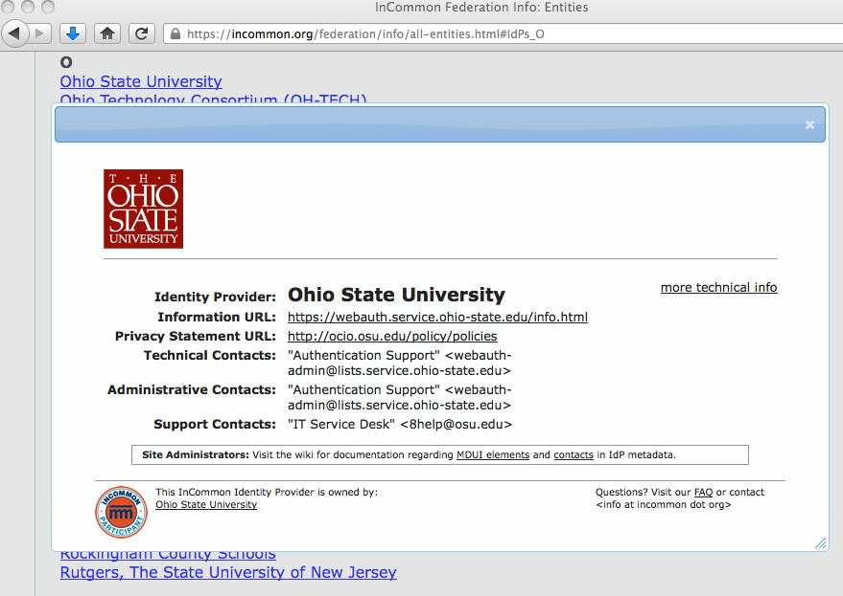
Finding Specific Policies in InCommon

Slide 99
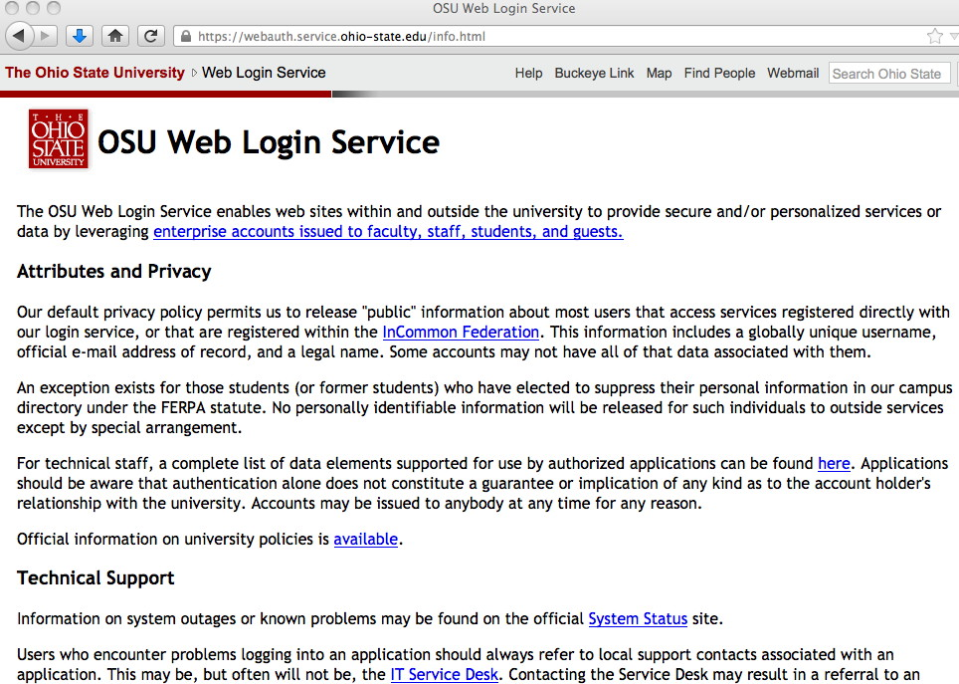
OSU's Specific Information URL

Slide 100
Security Response to Incidents Involving Federated Authentication
One side effect of doing federated authentication is that you, as a service provider, may not be able to directly identify a problematic user – you may only have a subset of the user's attributes, not including the user's real identity or even their username.
Thus, working security incidents observed by a Service Provider will typically require the cooperation of the Identity Provider.
Point of contact information is included in each IdP's metadata (e.g., look back at the Ohio State example just shown)

Slide 101
8. Some Additional Interesting Bits (Including Work In Progress)

Slide 102
Grouper (Remember those UIDs, GIDs?)
Grouper helps collaboration to work in a federated environment by allowing groups to be managed in a centralized and scalable way, see http://www.internet2.edu/grouper/
For a MAAWG-related example, consider MAAWG working groups. If those working groups were managed using a tool like Grouper, once someone was added to a particular working group, their status would also be made known to things like associated wiki pages (so they could be automatically allowed to edit them), and to associated mailing lists (so that they would be automatically subscribed to that working group's mailing list). Similarly, if a person wanted to stop being part of that working group, removing them from that group would reverse all those settings.
Grouper enables delegation, too, so a subcommittee chair could be authorized by a committee chair to handle their own subcommittee groups

Slide 103
Scaling Attribute Release
In the federated model, each IdP needs to permit the release of required attributes to each SP, which means that there would be N(IdP) times N(SP) attribute release policies that might need to be negotiated (if every IdP was used in conjunction with every SP).
To simplify this, and to improve the scalability of attribute release, one approach that is currently being tried is the use of communities such as InCommon Research and Scholarship (R&S) community, https://spaces.internet2.edu/display/InCFederation/Research+and+Scholarship+Category
In a nutshell, IdPs can decide that they will release a standard set of attributes (the ones that are normally needed by most service providers) to all service providers of a defined type.
An SP then just needs to get approved as an R&S SP to automatically get access to standard attributes from all R&S IdPs.

Slide 104
What About Handling Potential Users Who Don't Have A "Home" IdP?
Many times higher education people assume that everyone who wants to do federated authentication will "belong" to an institution that is Shibboleth enabled, but obviously that's not always going to be the case:
Some users may not be from a university.
Some users may be from a university, but one that doesn't offer a Shibboleth IdP service.
What do we tell users in those sort of categories? How do we help them use Shibboleth?
For a long time, we'd recommend that users get a free ProtectNetwork individual account, see https://app.protectnetwork.org/registration.html?execution=e1s1

Slide 105
(Experimental) Social-to-SAML Gateways
A more recent experimental approach to dealing with unaffiliated folks involves using Social-to-SAML gateways.
Social-to-SAML gateways would allow you to trust a social identity, such as one from Facebook, Google, LinkedIn, PayPal, Twitter, VeriSign, Windows Live, Yahoo, etc., and then gateway that identity across to a traditional SAML-based environment.
See https://samlgwtest.theotislab.com/servDetails.html and https://spaces.internet2.edu/display/socialid/Social-to-SAML+Gateway+FAQ
Should MAAWG be encouraging deployment of Social-to-SAML Gateways by social identity providers themselves?

Slide 106
NIST 800-63 Levels of Assurance (LOAs)
NIST 800-63-1, Electronic Authentication Guideline, see http://csrc.nist.gov/publications/nistpubs/800-63-1/SP-800-63-1.pdf defines four levels of assurance. Grossly oversimplifying:
LOA-1: Self-asserted user identity, basically just assurance that this is the same user from session-to-session, simple password/PIN works okay, no identity proofing is required.
LOA-2: Strong passwords required, proof of identity required (drivers license or passport), can be done remotely or in person
LOA-3: Multifactor auth required, identity documents must be verified through record checks, can be done remotely or in person
LOA-4: Cert-based multifactor on hard tokens or smart cards, extremely strong identity proofing (multiple documents, in person, verified via record checks, biometric data collected to prevent repudiation, in person only)

Slide 107
An Example of an LOA-4 Type Credential
Some of you traveling today may be familiar the US "Trusted Traveler" program, which is associated with various efforts such as Global Entry, NEXUS, Sentri, TSA PreCheck, see: http://www.globalentry.gov/
If you sign up for that program, you can normally avoid long lines at Customs coming into the United States (or depending on the programs you sign up for, when travelling to Canada or Mexico), and if you're exhausted from traveling, this is just wonderful.
On the other hand, the semi-painful part about the Trusted Traveler program is that you need to complete a long application and submit a lot of information about your identity, so it can be verified and so that Customs and Border Protection can tell you're not a criminal, and you need to appear in person for identity proofing and for biometric data collection. Why? These are LOA-4 class credentials, one of the few you may routinely run into in civilian circles.

Slide 108
Assurance Within InCommon
For the most part, in the InCommon federation, sites trust their colleagues to satisfy their articulated policies and practices. That is, there is not any sort of formal assurance program involving audits or other formal compliance checks.
InCommon is working on deploying an assurance program, beginning with "Bronze," a NIST 800-63 LOA-1-like self-asserted assurance standard, and "Silver," a NIST 800-63 LOA-2-like audited standard, see http://www.incommon.org/assurance/
Currently one site, Virginia Tech, has been certified for both, but we know that many other schools are currently working to get certified for Bronze and/or Silver. There's a nice write up for VaTech meet the applicable assurance requirements at https://spaces.internet2.edu/display/InCAssurance/Assurance+Implementation+Example+-+Virginia+Tech

Slide 109
Thanks For the Chance To Talk Today! Are There Any Questions?

