Slide 1

Select Cathedrals and Other Sacred Buildings of
The Medieval Era
(ca. 500-1500 A.D.)
(Reduced Resolution)
Notes:
https://www.youtube.com/watch?v=tNF_cHDazZ4 (1:35 of chant extracted and processed with Camtasia for this
abbreviated deck (loops))

Slide 2
Western Rite (Roman Catholic)
Aachen Cathedral
Archbasilica of St. John Latern
Avila Cathedral
Basilica St Denis
Beehive Hut Monastery
Borgund Stave Church
Burgos Cathedral
Cathedral of Notre Dame
Chartres Cathedral
Cologne Cathedral
Duomo di Milano
Duomo di Pisa
Ely Cathedral
Florence Cathedral
Great Mosque of Cordoba
Mont Saint-Michel
Old Cathedral of Coimbra
Palais Des Papes
Palma Cathedral
Parma Cathedral
Reims Cathedral
Roskilde Cathedral
Sainte-Chapelle
Salisbury Cathedral
San Marcos Basilica
Sanctuary of The Holy Sepulchre
Seville Cathedral
Siena Cathedral
St. Nicholas Church, Ghent
St. Vitus Cathedral
Notes:
http://www.oxfordartonline.com/public/page/themes/medievalartandarchitecture
Music from "Old Roman Catholic chant Megamix : 1 Hour Full HD"
https://www.youtube.com/watch?v=tNF_cHDazZ4
See also http://www.discogs.com/Ensemble-Organum-Marcel-P%C3%A9r%C3%A8s-Chant-De-L%C3%89glise-De-Rome-VIe-XIIIe-Si%C3%A8cles-Incarnatio-Verbi/release/2525172
http://www.ccwatershed.org/media/pdfs/11/12/19/16-41-43_0.pdf

Slide 3
Eastern Orthodox
Bete Giyorgis
Cathedral of St. Dominus
Cathedral of the Dormition
of the Theotokos
Cathedral of the holy mandylion
Etchmiadzin Cathedral
Rila Monastery
Saviour Cathedral
Sedlec Ossuary
St. Catherine's Eastern Orthodox Monastery
St. Mary's Church, Gdansk
St. Sophia's Cathedral, Kiev
Trinity Lavra of St. Sergius
Voronet Monastery
Islamic
Great Mosque of Samara
Hagia Sofia
Kaaba
Temple Mount
Ulugh Beg Madrasa
Jewish
Alteneu Shul
Dubrovnik Synagogue
Notes:
http://www.oxfordartonline.com/public/page/themes/medievalartandarchitecture
Music from "Old Roman Catholic chant Megamix : 1 Hour Full HD"
https://www.youtube.com/watch?v=tNF_cHDazZ4
See also http://www.discogs.com/Ensemble-Organum-Marcel-P%C3%A9r%C3%A8s-Chant-De-L%C3%89glise-De-Rome-VIe-XIIIe-Si%C3%A8cles-Incarnatio-Verbi/release/2525172
http://www.ccwatershed.org/media/pdfs/11/12/19/16-41-43_0.pdf

Slide 4
Aachen Cathedral,
Germany
805
Oldest in Northern Europe

Slide 5
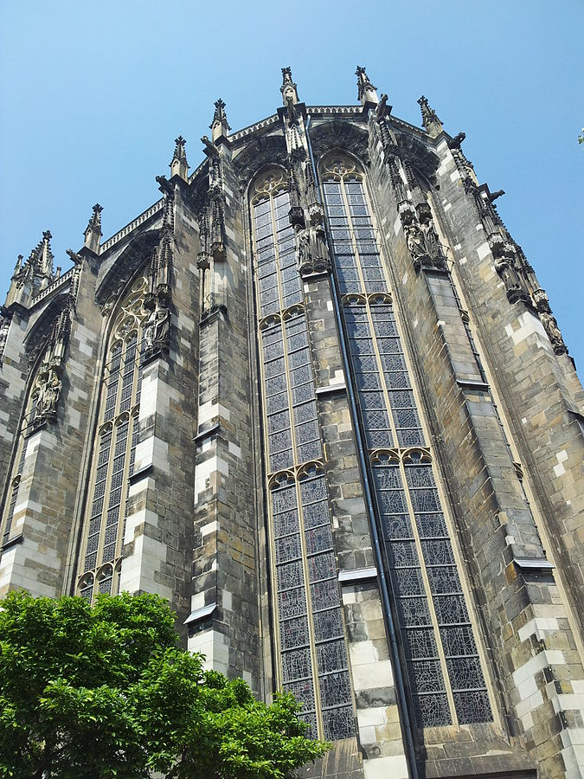
Notes:
https://commons.wikimedia.org/wiki/Aachener_Dom#/media/File:Dom_van_Aken_1.jpg (LR)

Slide 6
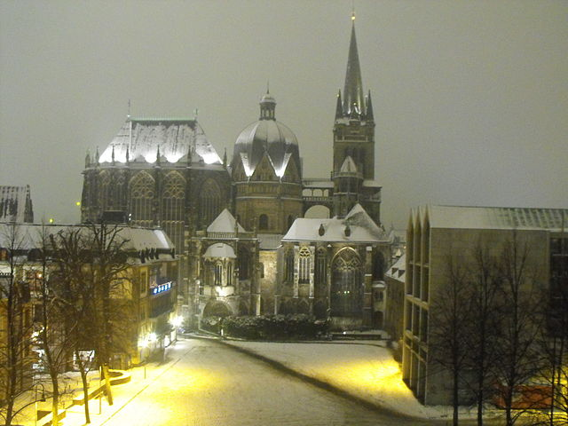
Notes:
https://commons.wikimedia.org/wiki/File:AC_Dom_Katschho_Winter.JPG (LR)

Slide 7
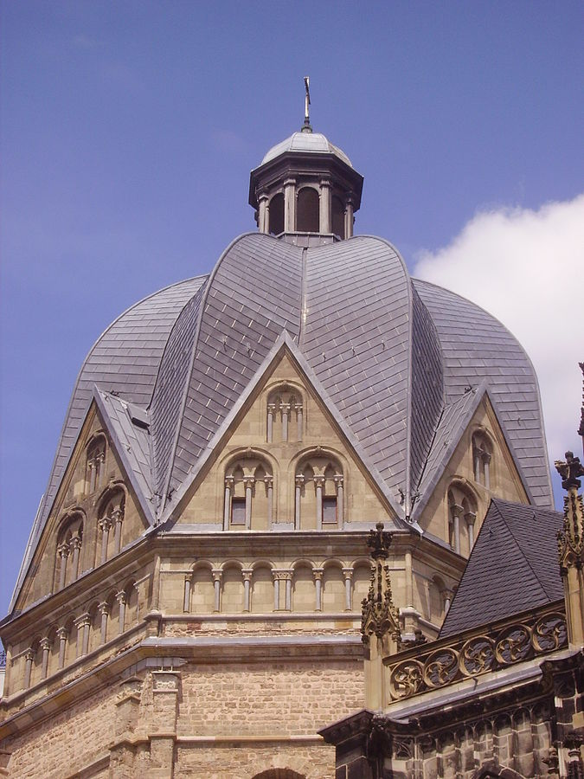
Notes:
https://commons.wikimedia.org/wiki/Aachener_Dom#/media/File:Aachen_Kaiserdom_Kuppel_6.JPG (LR)

Slide 8
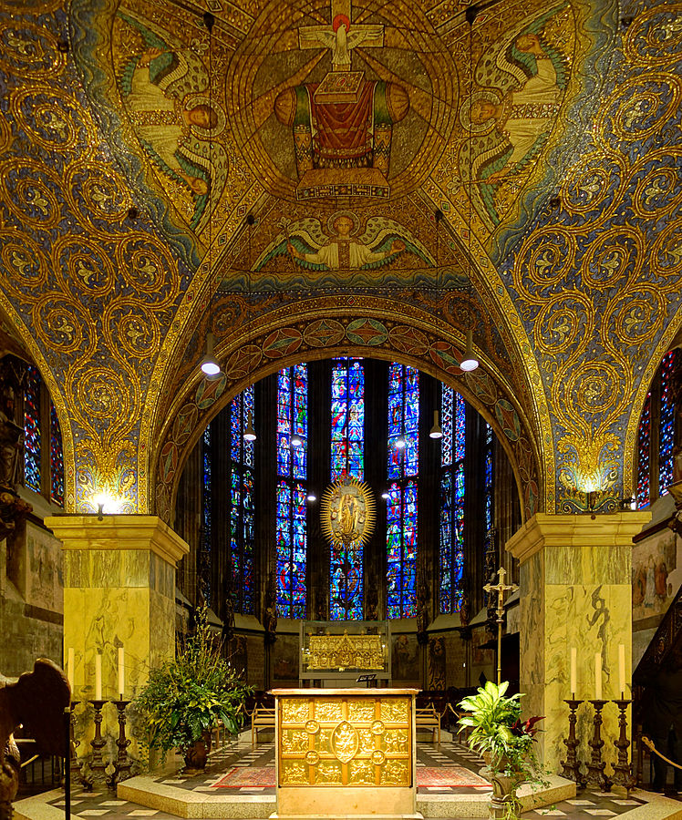
Notes:
https://commons.wikimedia.org/wiki/Aachener_Dom#/media/File:Aix_dom_autel_1.jpg (LR)

Slide 9
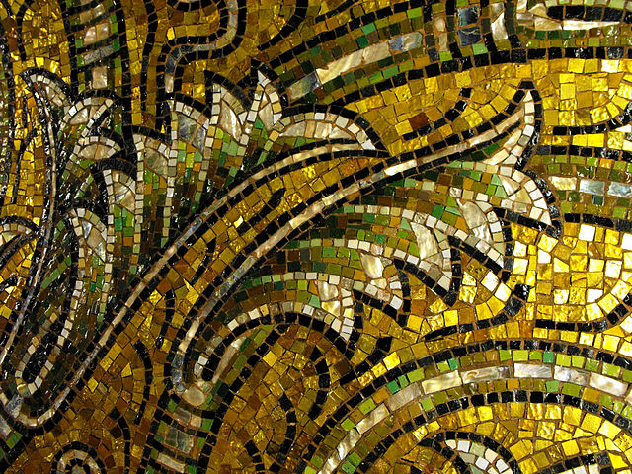
Notes:
https://commons.wikimedia.org/wiki/Aachener_Dom#/media/File:Aachen_Dom_Kuppelmosaik_Detail_6.JPG (LR)

Slide 10
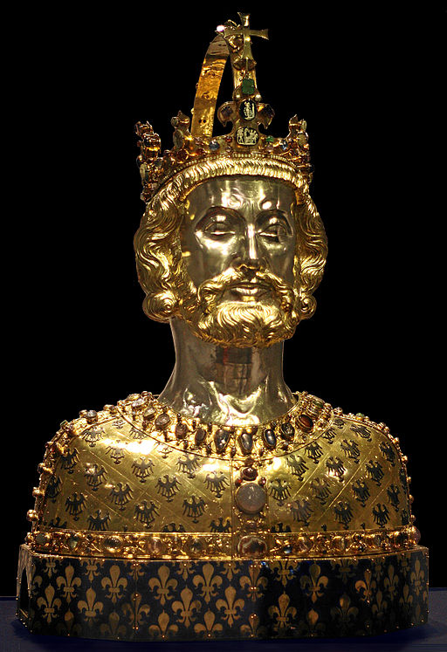
Bust of Charlemagne (Reliquary Bust);
Holds his skullcap.
"...when he died in 814, Charlemagne’s empire encompassed much of Western Europe, and he had also ensured the survival of Christianity in the West. Today, Charlemagne is referred to by some as the father of Europe."
Notes:
https://commons.wikimedia.org/wiki/File:Aachen_Domschatz_Bueste1.jpg (LR)
http://www.history.com/topics/charlemagne

Slide 11
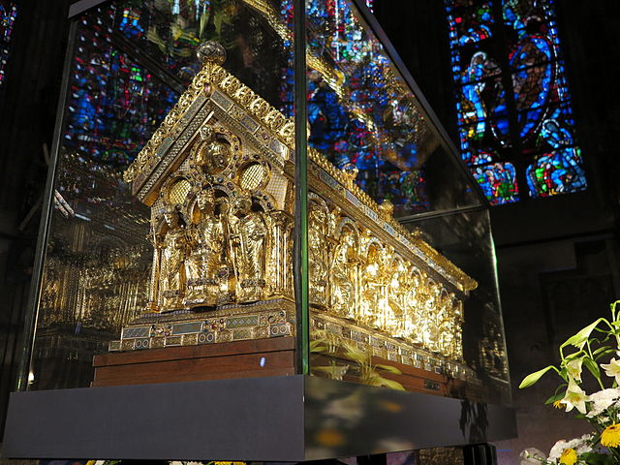
Notes:
https://commons.wikimedia.org/wiki/Aachener_Dom#/media/File:Karlsschrein_front_side_left.jpg (LR)

Slide 12
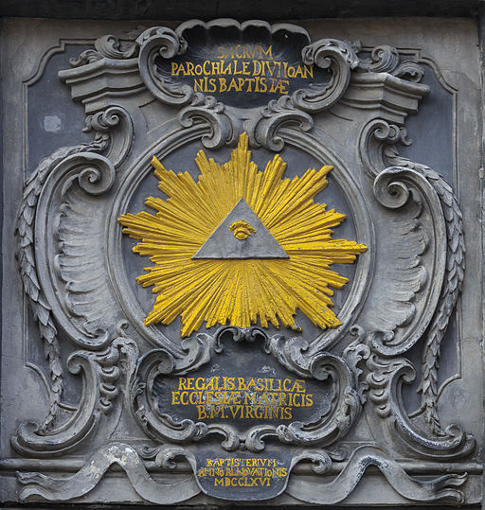
Eye of God
(symbolizes omnipresence /omniscience of God;
the triangle also represents the Trinity)
this is the earliest
"Eye of God"
within a triangle in a medieval church
Notes:
https://commons.wikimedia.org/wiki/File:Aachen_Germany_Imperial-Cathedral-10.jpg (LR)
Quote from http://catholicbridge.com/catholic/all_seeing_eye_churches.php

Slide 13
Alteneu Shul
["Old New Synagogue"],
Prague
Completed 1270
oldest active synagogue in Europe

Slide 14
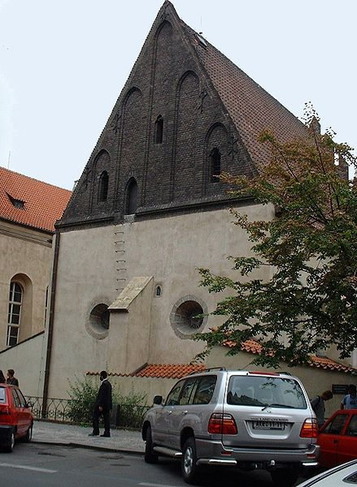
Notes:
https://commons.wikimedia.org/wiki/File:AltneuschulPrague.agr.jpg

Slide 15
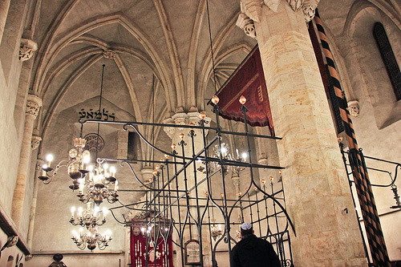
Notes:
https://apinnick.wordpress.com/tag/jewish-quarter/

Slide 16
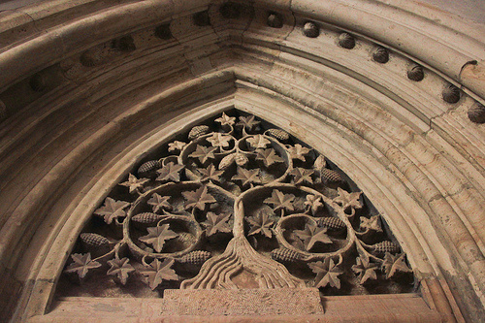
Notes:
https://apinnick.wordpress.com/tag/jewish-quarter/

Slide 17
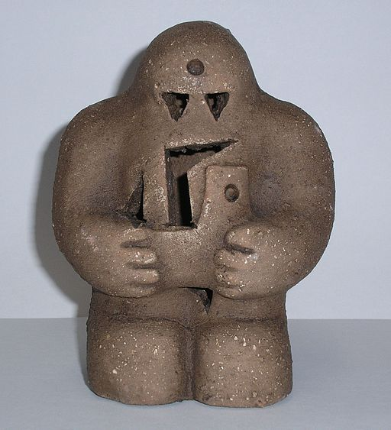
Prague Golem
"[...] an animated anthropo-morphic being, magically created entirely from inanimate matter. [...]"
Legend has a famous Golem lying in the loft of the Altneu synagogue
Notes:
https://commons.wikimedia.org/wiki/File:Prague-golem-reproduction.jpg (LR)
https://en.wikipedia.org/wiki/Golem

Slide 18
Archbasilica of St. John Latern,
Rome
Ground broken 4th Century A.D.
"It is the oldest and ranks first among the five Papal Basilicas of the world [...] the oldest church in the West [...] It has the title of ecumenical mother church among Roman Catholics. "
Notes:
https://en.wikipedia.org/wiki/Archbasilica_of_St._John_Lateran

Slide 19
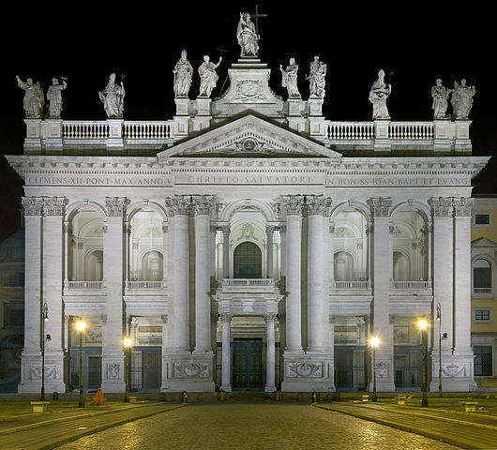
Notes:
https://en.wikipedia.org/wiki/Archbasilica_of_St._John_Lateran#/media/File:Archbasilica_of_St._John_Lateran_HD.jpg (LR)

Slide 20
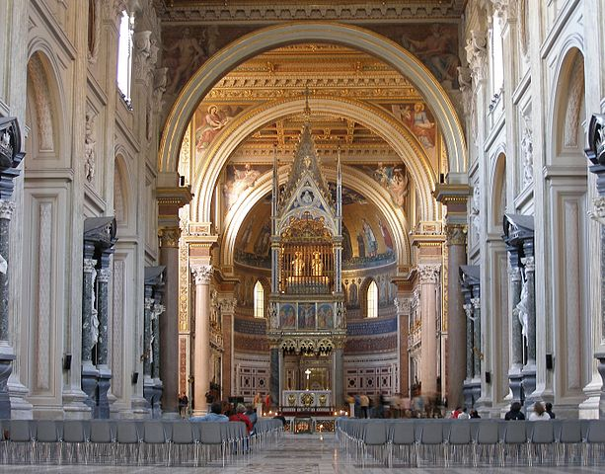
Notes:
https://commons.wikimedia.org/wiki/Basilica_di_San_Giovanni_in_Laterano#/media/File:Rom,_San_Giovanni_in_Laterano,_Innenansicht.jpg (LR)

Slide 21
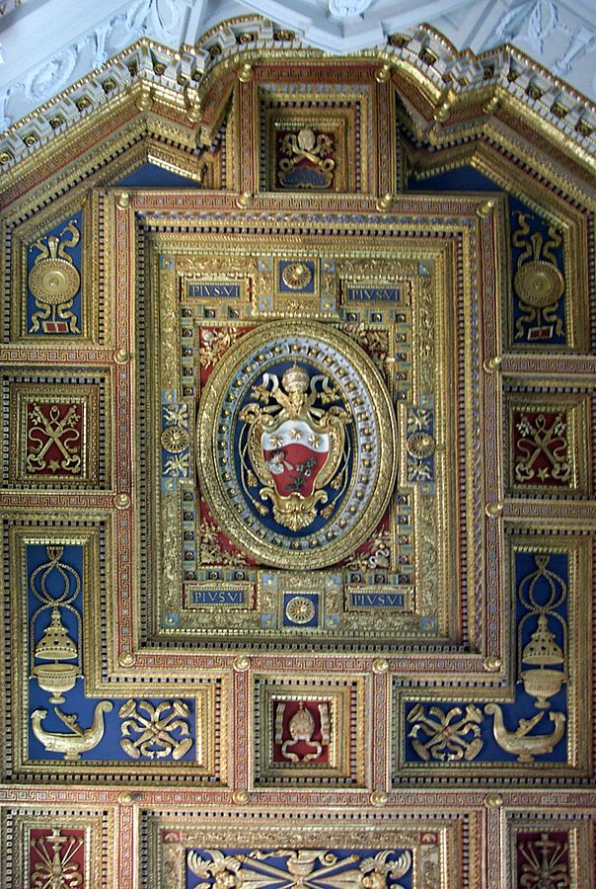
Notes:
https://commons.wikimedia.org/wiki/Basilica_di_San_Giovanni_in_Laterano#/media/File:Roma-san_giovanni08.jpg (LR)

Slide 22
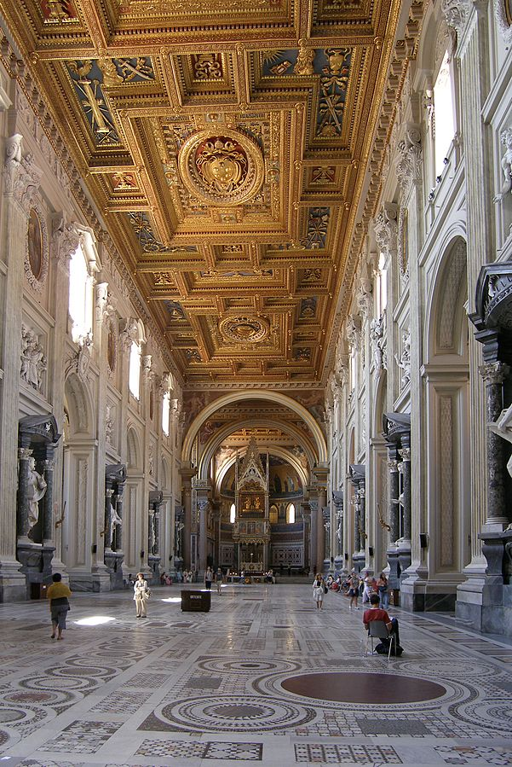
Notes:
https://commons.wikimedia.org/wiki/Basilica_di_San_Giovanni_in_Laterano#/media/File:Rom,_San_Giovanni_in_Laterano,_Innenansicht,_Hochformat.jpg (LR)

Slide 23
Avila Cathedral,
Spain
12th Century
One of the first two gothic cathedrals in Spain

Slide 24
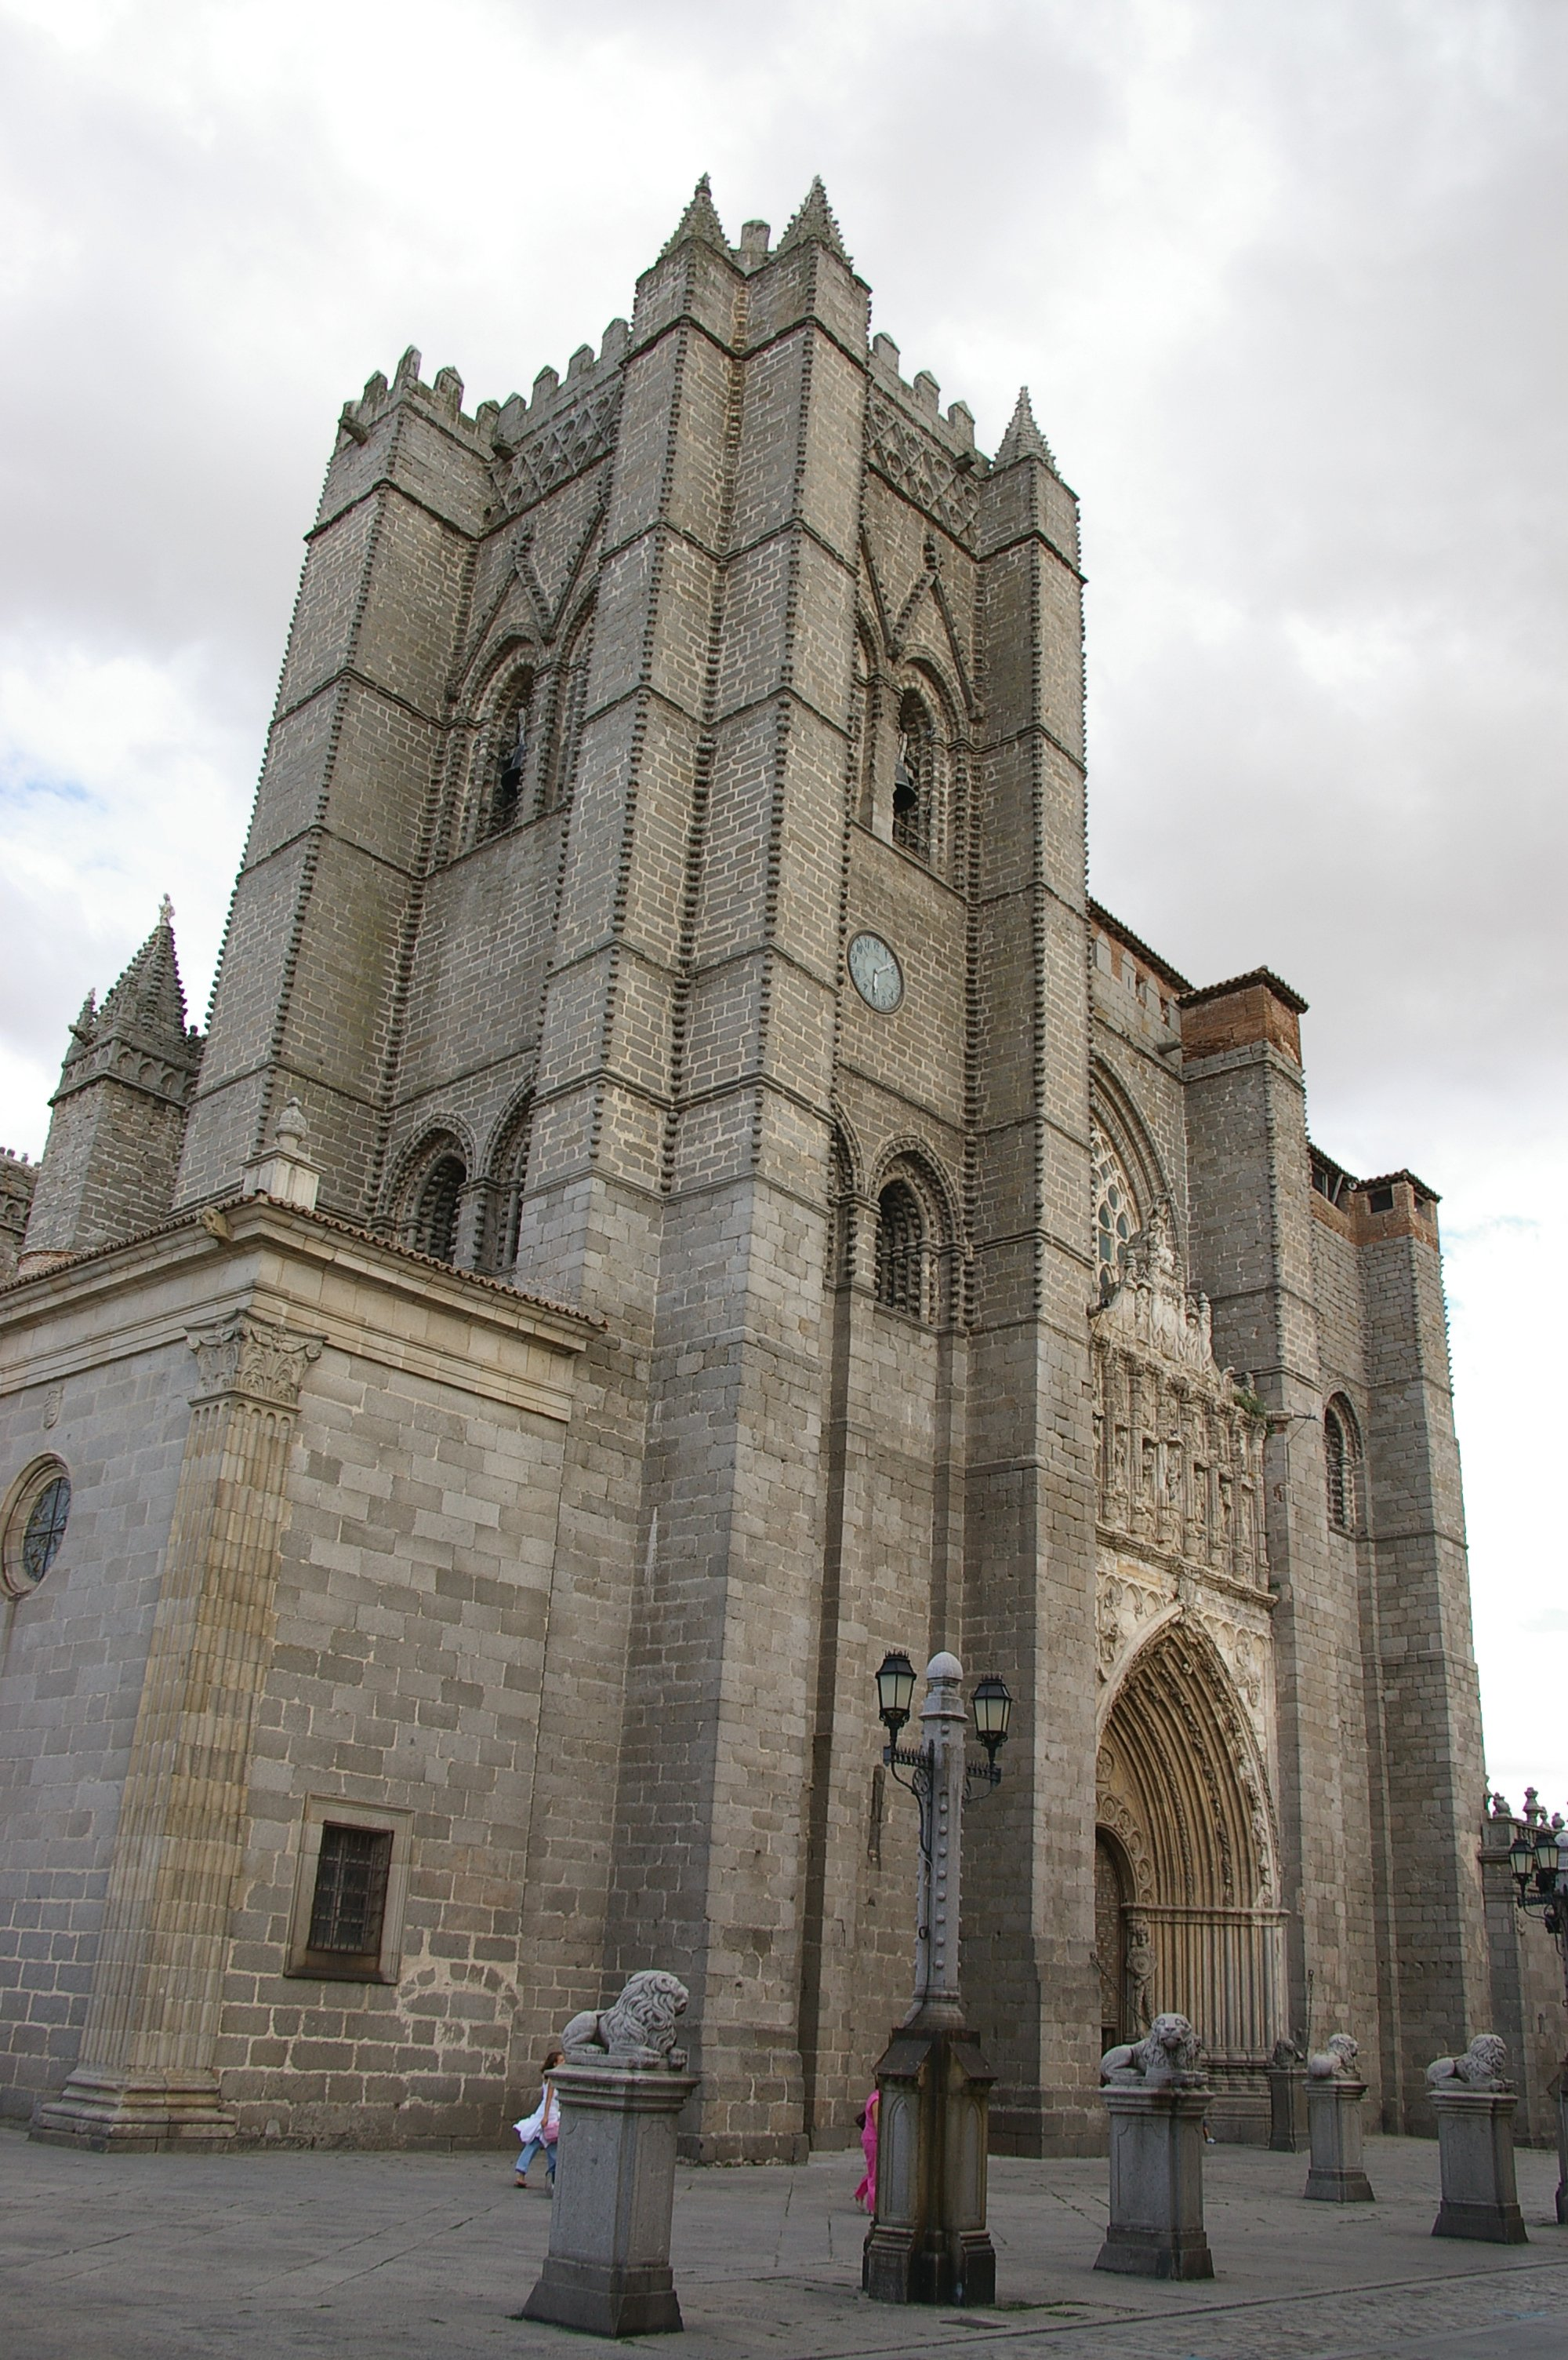
Notes:
https://upload.wikimedia.org/wikipedia/commons/2/21/%C3%81vila_Chatedral_main_view.jpg

Slide 25
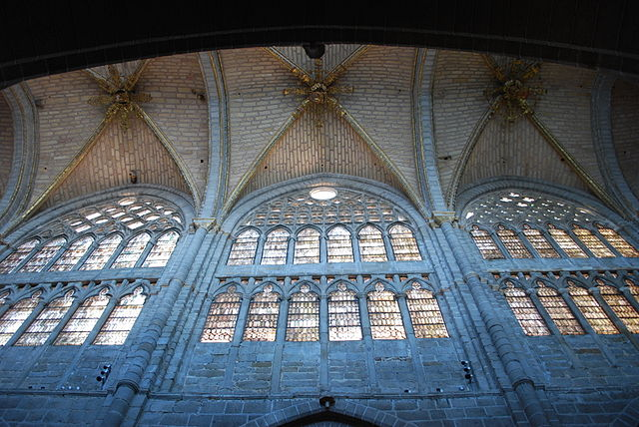
Notes:
https://commons.wikimedia.org/wiki/Category:Interior_of_the_Cathedral_of_%C3%81vila#/media/File:%C3%81vila_-_Catedral_-_Nave.jpg (LR)

Slide 26
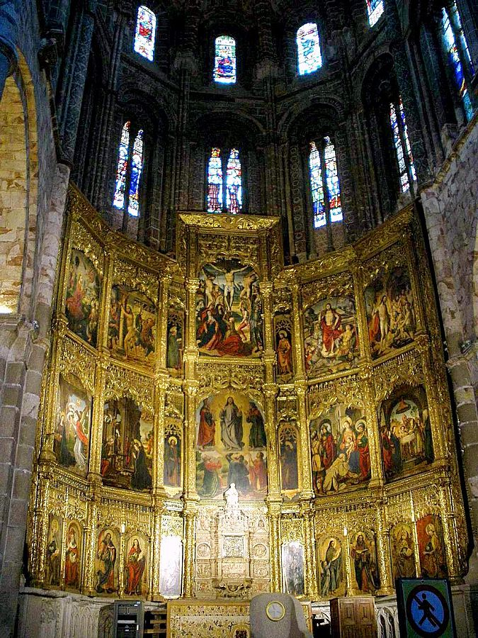
Notes:
https://commons.wikimedia.org/wiki/Category:Interior_of_the_Cathedral_of_%C3%81vila#/media/File:Avila_-_Catedral,_interiores_29_%28retablo_mayor%29.jpg (LR)

Slide 27
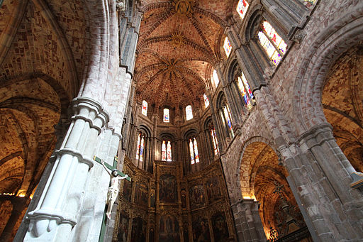
Notes:
https://commons.wikimedia.org/wiki/File:%C3%81vila_-_Catedral_-_Romanesque_chancel.jpg (LR)

Slide 28
Basilica St. Denis,
Paris
1144
all but three French kings are entombed here
Notes:
https://en.wikipedia.org/wiki/Basilica_of_St_Denis

Slide 29
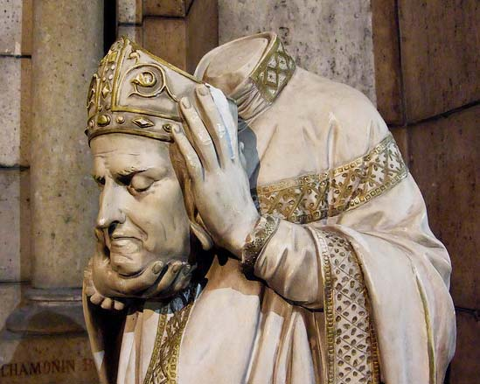
"[Denis] was martyred [...] in connection with the Decian persecution of Christians, shortly after 250 AD. Denis is said to have picked his head up after being decapitated, walked ten kilometres (six miles), while preaching a sermon of repentance the entire way, making him one of many cephalophores
in hagiology."
"The site where he
[...] actually died
was marked by a
small shrine that
developed into the
Saint Denis
Basilica, which
became the burial
place for the
kings of France."
Notes:
https://ivarfjeld.files.wordpress.com/2012/08/saint1.jpg
https://en.wikipedia.org/wiki/Denis

Slide 30
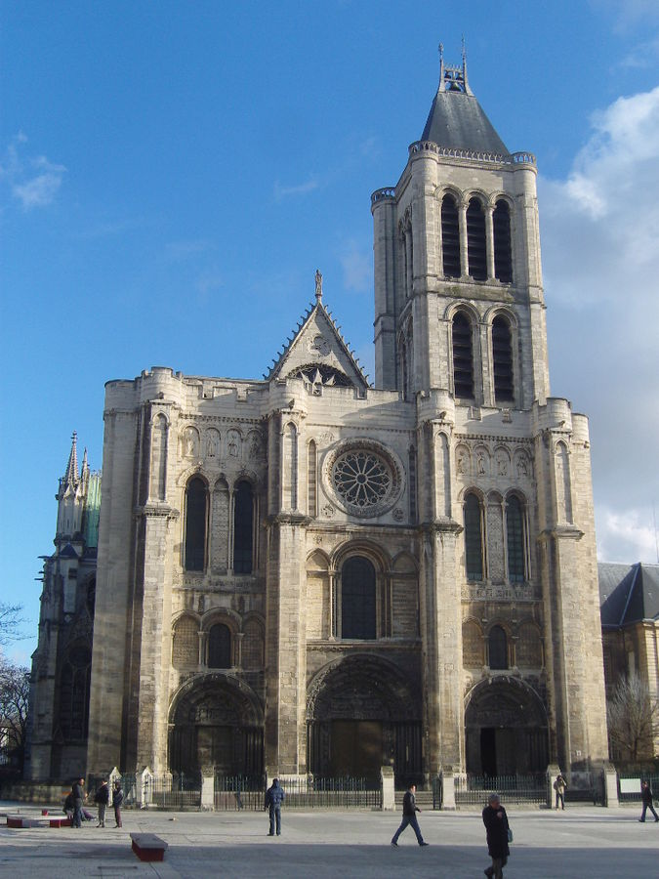
Notes:
https://commons.wikimedia.org/wiki/Category:West_facade_of_the_Basilique_Saint-Denis#/media/File:Saint-Denis_-_Basilique_-_Ext%C3%A9rieur_fa%C3%A7ade_ouest.JPG (LR)

Slide 31
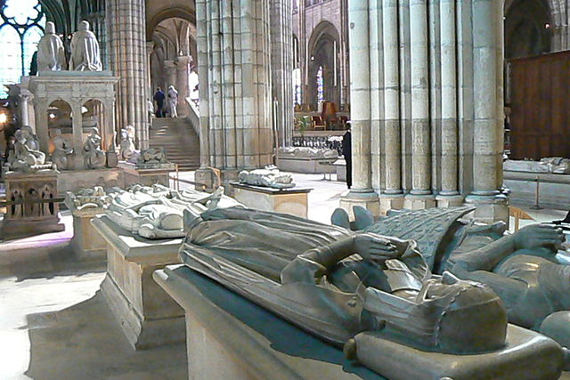
Notes:
https://commons.wikimedia.org/wiki/Category:Tombs_in_Saint-Denis#/media/File:Basilica_of_Saint_Denis,_Paris,_interior,_tombs.jpg (LR)

Slide 32
Beehive Hut Monastery,
Skellig Michael, Ireland
6th-8th century
Shows, "as no other site can, the extremes of a Christian monasticism characterizing much of North Africa, the Near East and Europe"
UNESCO World Heritage Site
Notes:
https://commons.wikimedia.org/wiki/File:Skellig_Michael03%28js%29.jpg
https://commons.wikimedia.org/wiki/File:Skellig_Michael_-_cell_E_and_F.jpg

Slide 33
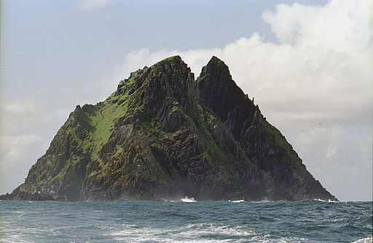
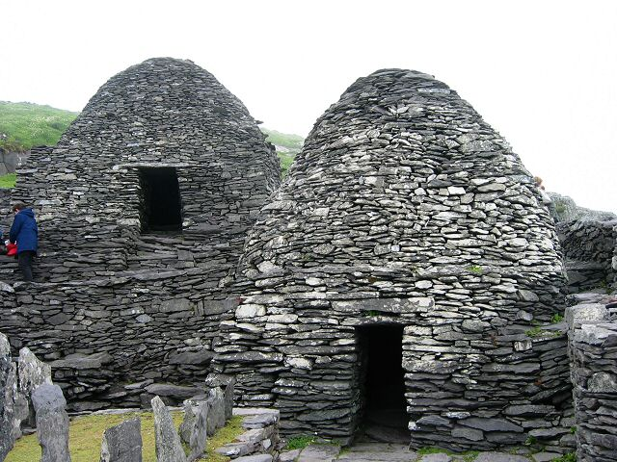
"[...] estimated that
no more than twelve
monks and an abbot lived here at any one time"
Notes:
https://commons.wikimedia.org/wiki/File:Skellig_Michael03%28js%29.jpg (LR)
https://commons.wikimedia.org/wiki/File:Skellig_Michael_-_cell_E_and_F.jpg (LR)

Slide 34
Bete Giyorgis
["Church of St. George"],
Lalibela, Ethiopia
Late 12th or Early 13th Century
"... the church itself is part of the UNESCO World Heritage Site "Rock-Hewn Churches, Lalibela"
Notes:
https://en.wikipedia.org/wiki/Church_of_Saint_George,_Lalibela

Slide 35
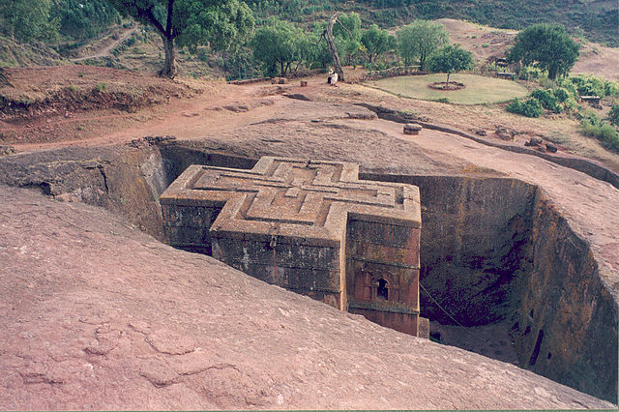
Notes:
https://commons.wikimedia.org/wiki/Category:Bete_Giyorgis#/media/File:Bet_Giyorgis_church_Lalibela_03color.jpg (LR)

Slide 36
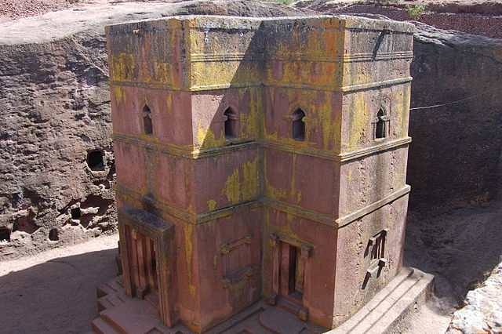
Notes:
https://commons.wikimedia.org/wiki/Category:Bete_Giyorgis#/media/File:Bet_Giyorgis_%285498439545%29.jpg (LR)

Slide 37
Borgund Stave Church,
Borgund, Norway
12th Century
"The [stave church] name derives from the buildings' structure of post and lintel construction, a type of timber framing where the load-bearing posts are called stafr in Old Norse and stav in modern Norwegian."
Notes:
Quote from https://en.wikipedia.org/wiki/Stave_church

Slide 38
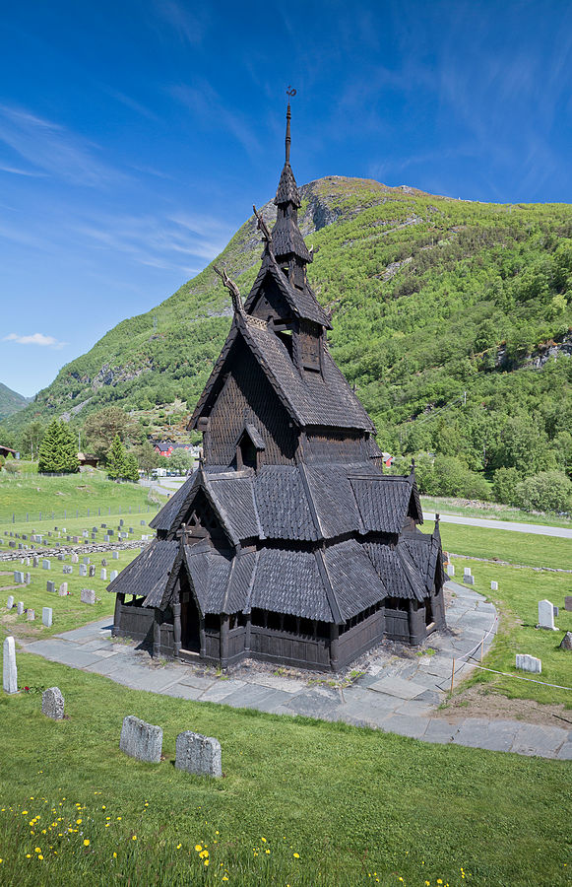
Notes:
https://en.wikipedia.org/wiki/Borgund_Stave_Church#/media/File:Borgund_Stave_Chuch_in_L%C3%A6rdalen,_2013_June.jpg (LR)

Slide 39
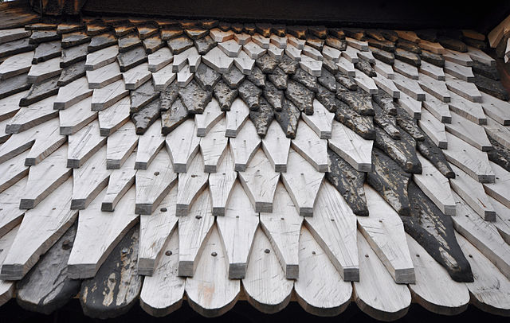
Roof "tiles"
Notes:
https://commons.wikimedia.org/wiki/Category:Borgund_stavkirke#/media/File:Stave_church_Borgund_roofing_tiles.jpg (LR)

Slide 40
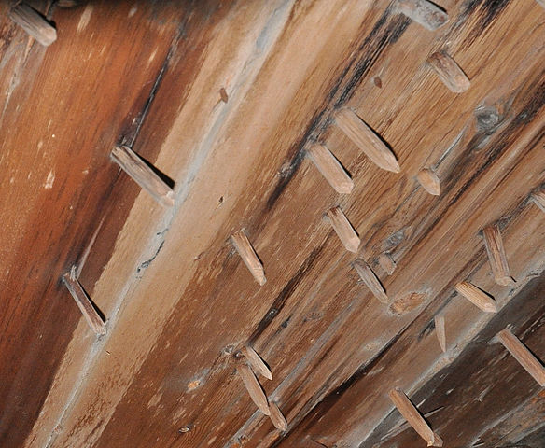
Wooden "Nail" Construction
Notes:
https://commons.wikimedia.org/wiki/Category:Borgund_stavkirke#/media/File:Stave_church_Borgund_wood_nails.jpg (LR)

Slide 41
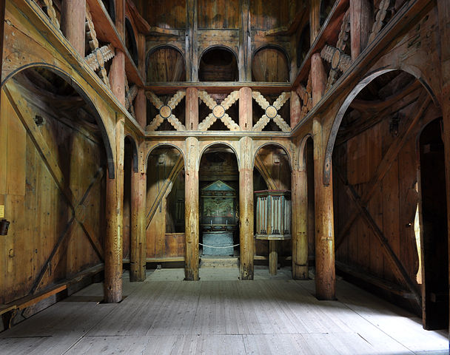
Notes:
https://commons.wikimedia.org/wiki/Category:Borgund_stavkirke#/media/File:Stave_church_Borgund_interior.jpg (LR)

Slide 42
Burgos Cathedral,
Spain
1221
"The cathedral was declared a World Heritage Site by UNESCO..."
Notes:
https://en.wikipedia.org/wiki/Burgos_Cathedral

Slide 43
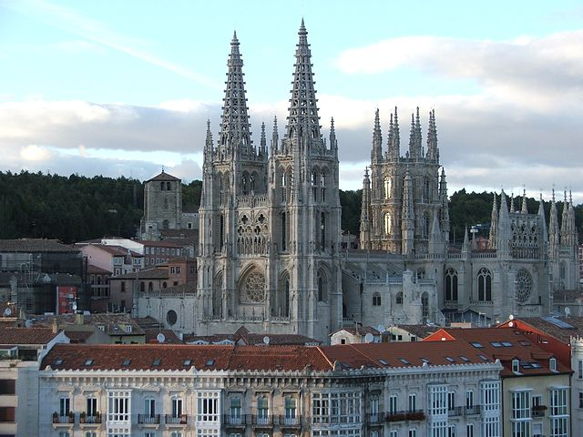
Notes:
https://commons.wikimedia.org/wiki/Cathedral_of_Burgos#/media/File:Catedral_de_Burgos_II.jpg (LR)

Slide 44
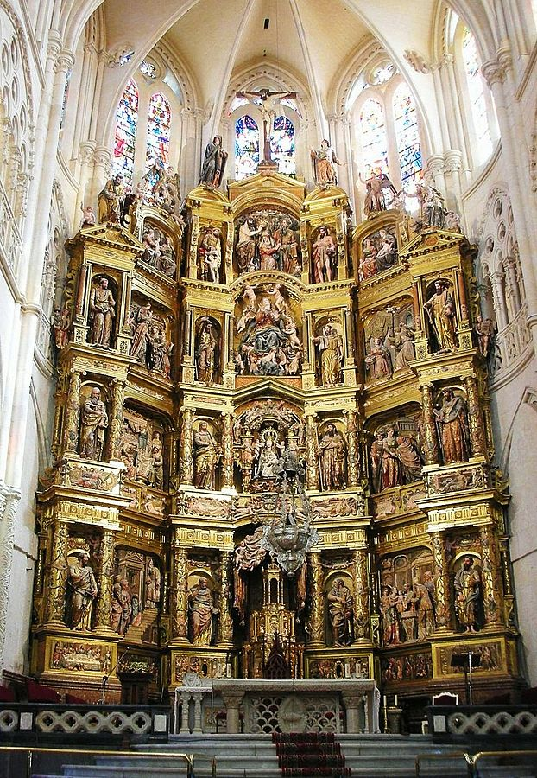
Notes:
https://commons.wikimedia.org/wiki/Cathedral_of_Burgos#/media/File:Retablo_Mayor_Burgoscat.jpg (LR)

Slide 45
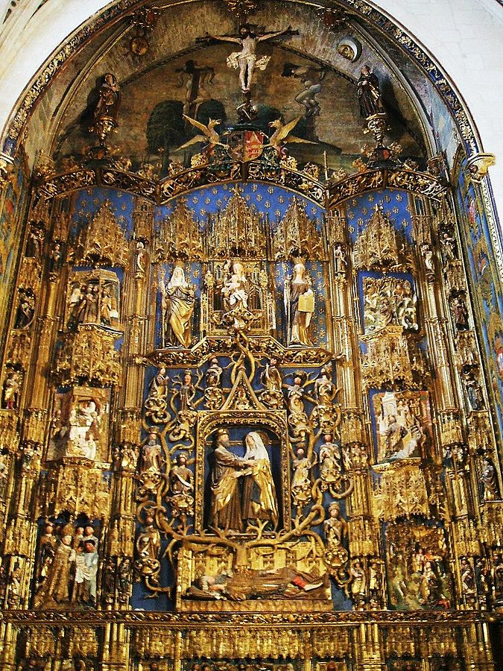
Notes:
https://commons.wikimedia.org/wiki/Cathedral_of_Burgos#/media/File:Burgos_-_Catedral_039_-_Capilla_de_Santa_Ana.jpg

Slide 46
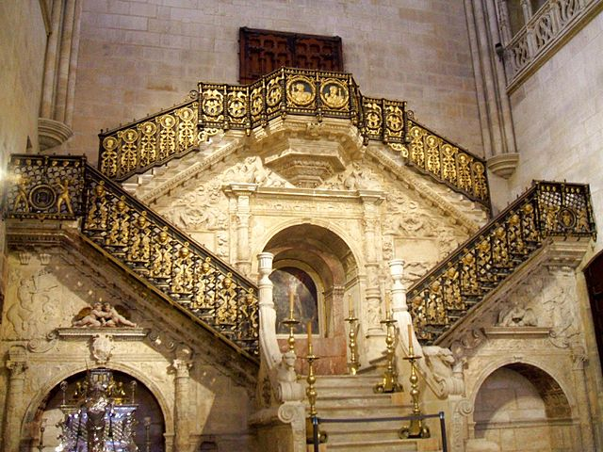
Notes:
https://commons.wikimedia.org/wiki/Cathedral_of_Burgos#/media/File:Burgos_-_Catedral_046_-_Escalera_Dorada.jpg (LR)

Slide 47
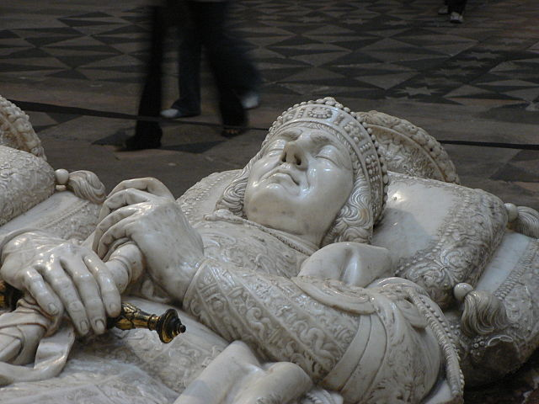
Notes:
https://commons.wikimedia.org/wiki/Cathedral_of_Burgos#/media/File:Pedro_Fern%C3%A1ndez_de_Velasco.jpg (LR)

Slide 48
Cathedral of Notre Dame de Paris
1163
"The cathedral is widely considered to be one of the finest examples of French Gothic architecture, and it is among the largest and most well-known church buildings in the world. The naturalism of its sculptures and stained glass are in contrast with earlier Romanesque architecture."
Notes:
https://en.wikipedia.org/wiki/Notre_Dame_de_Paris

Slide 49
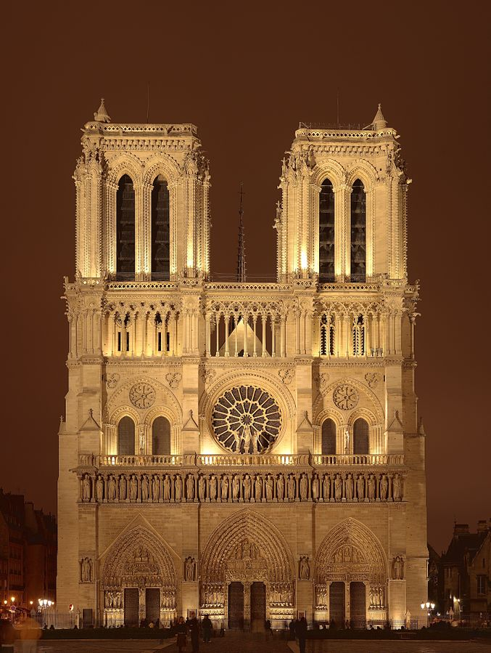
Notes:
https://commons.wikimedia.org/wiki/Cath%C3%A9drale_Notre-Dame_de_Paris#/media/File:NotreDameDeParis.jpg (LR)

Slide 50
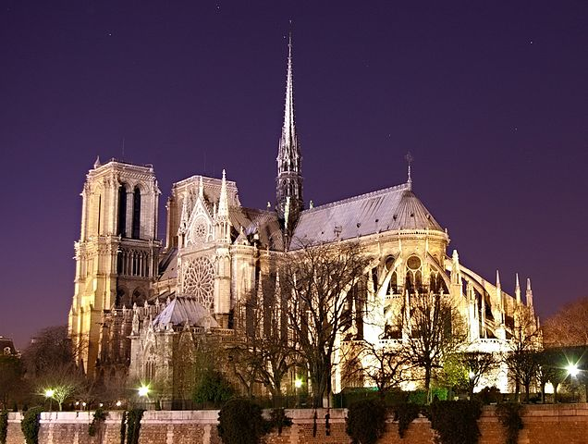
Notes:
https://commons.wikimedia.org/wiki/Cath%C3%A9drale_Notre-Dame_de_Paris#/media/File:Notre_Dame_de_Paris_by_night_time.jpg (LR)

Slide 51
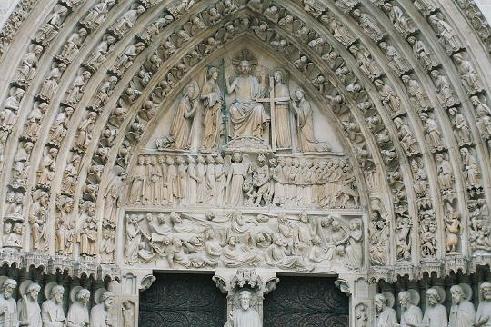
Notes:
https://commons.wikimedia.org/wiki/Cath%C3%A9drale_Notre-Dame_de_Paris#/media/File:Voorgevelnotredame2.jpg

Slide 52
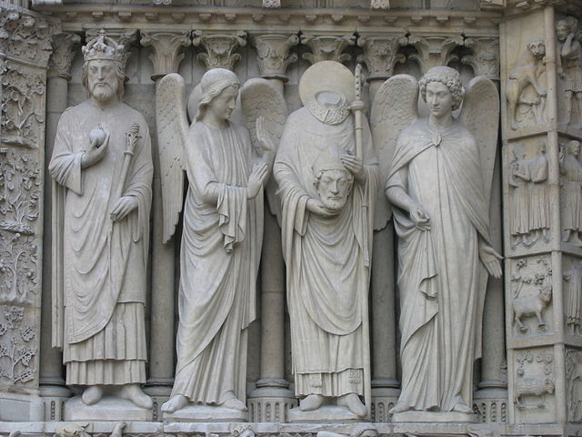
Notes:
https://commons.wikimedia.org/wiki/Cath%C3%A9drale_Notre-Dame_de_Paris#/media/File:ND_Portail_gauche_gauche.jpg (LR)

Slide 53
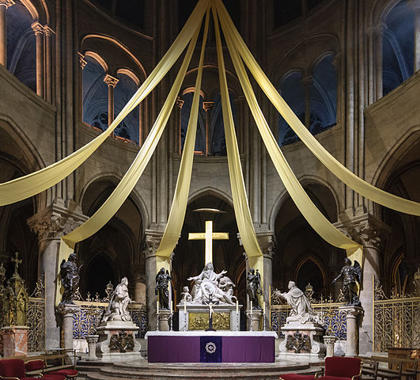
Notes:
https://en.wikipedia.org/wiki/Notre_Dame_de_Paris#/media/File:Cathedrale_Notre-Dame_de_Paris_maitre-autel.jpg (LR)

Slide 54
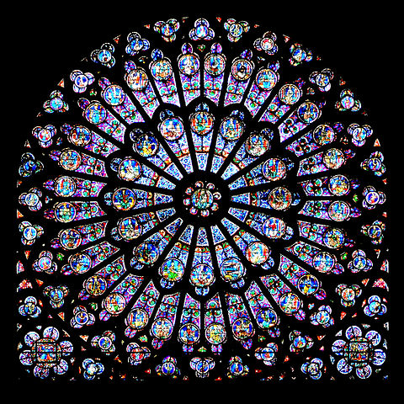
Notes:
https://commons.wikimedia.org/wiki/Cath%C3%A9drale_Notre-Dame_de_Paris#/media/File:GothicRayonnantRose003.jpg (LR)

Slide 55
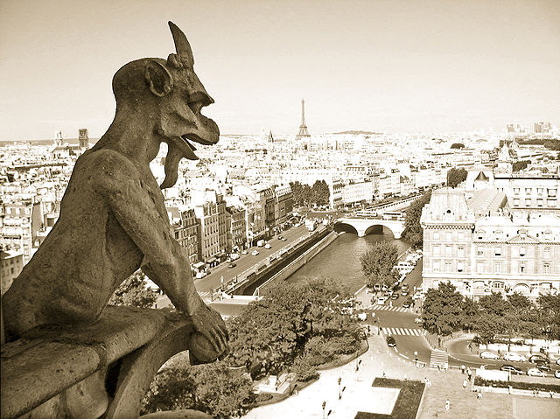
Notes:
https://commons.wikimedia.org/wiki/Cath%C3%A9drale_Notre-Dame_de_Paris#/media/File:G%C3%A1rgola_en_Notre-Dame.jpg (LR)

Slide 56
Cathedral of St. Domnius
["Katedrala Sv. Duje"],
Split, Croatia
Consecrated 7th Century
"... the oldest Catholic cathedral in the world that remains in use in its original structure, without near-complete renovation at a later date."

Slide 57
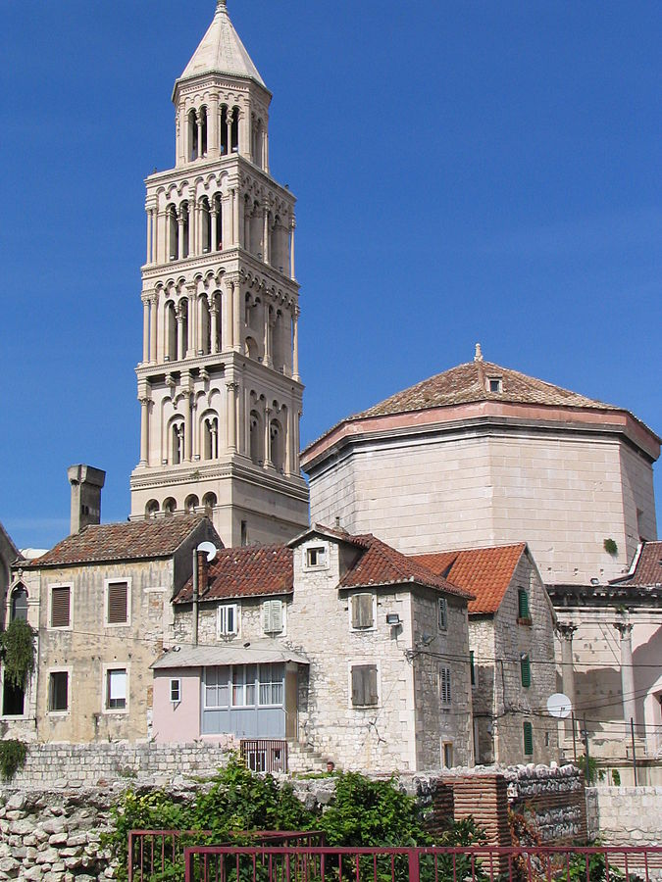
Notes:
https://commons.wikimedia.org/wiki/Category:Cathedral_of_Split#/media/File:Cathedral_of_Split.jpg (LR)

Slide 58
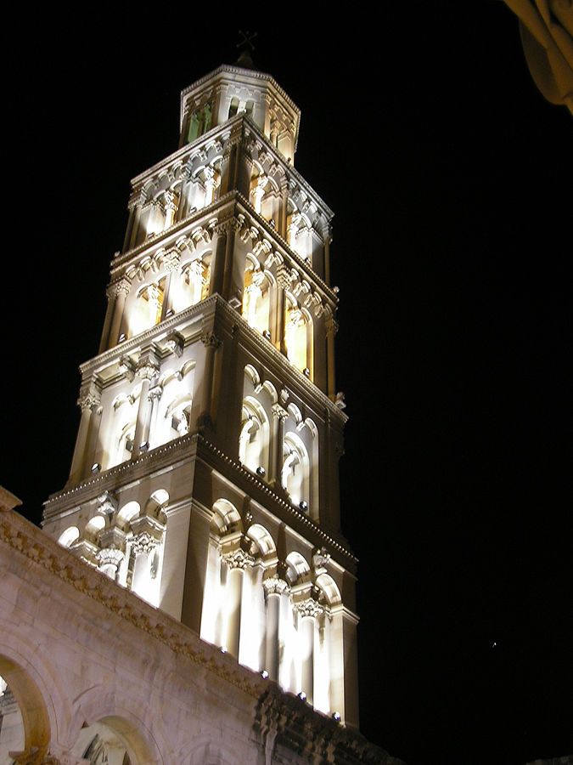
Notes:
https://commons.wikimedia.org/wiki/Category:Church_tower_of_the_Cathedral_of_Split#/media/File:Croatia_-_Split_-_Cathedral_under_night.JPG (LR)

Slide 59
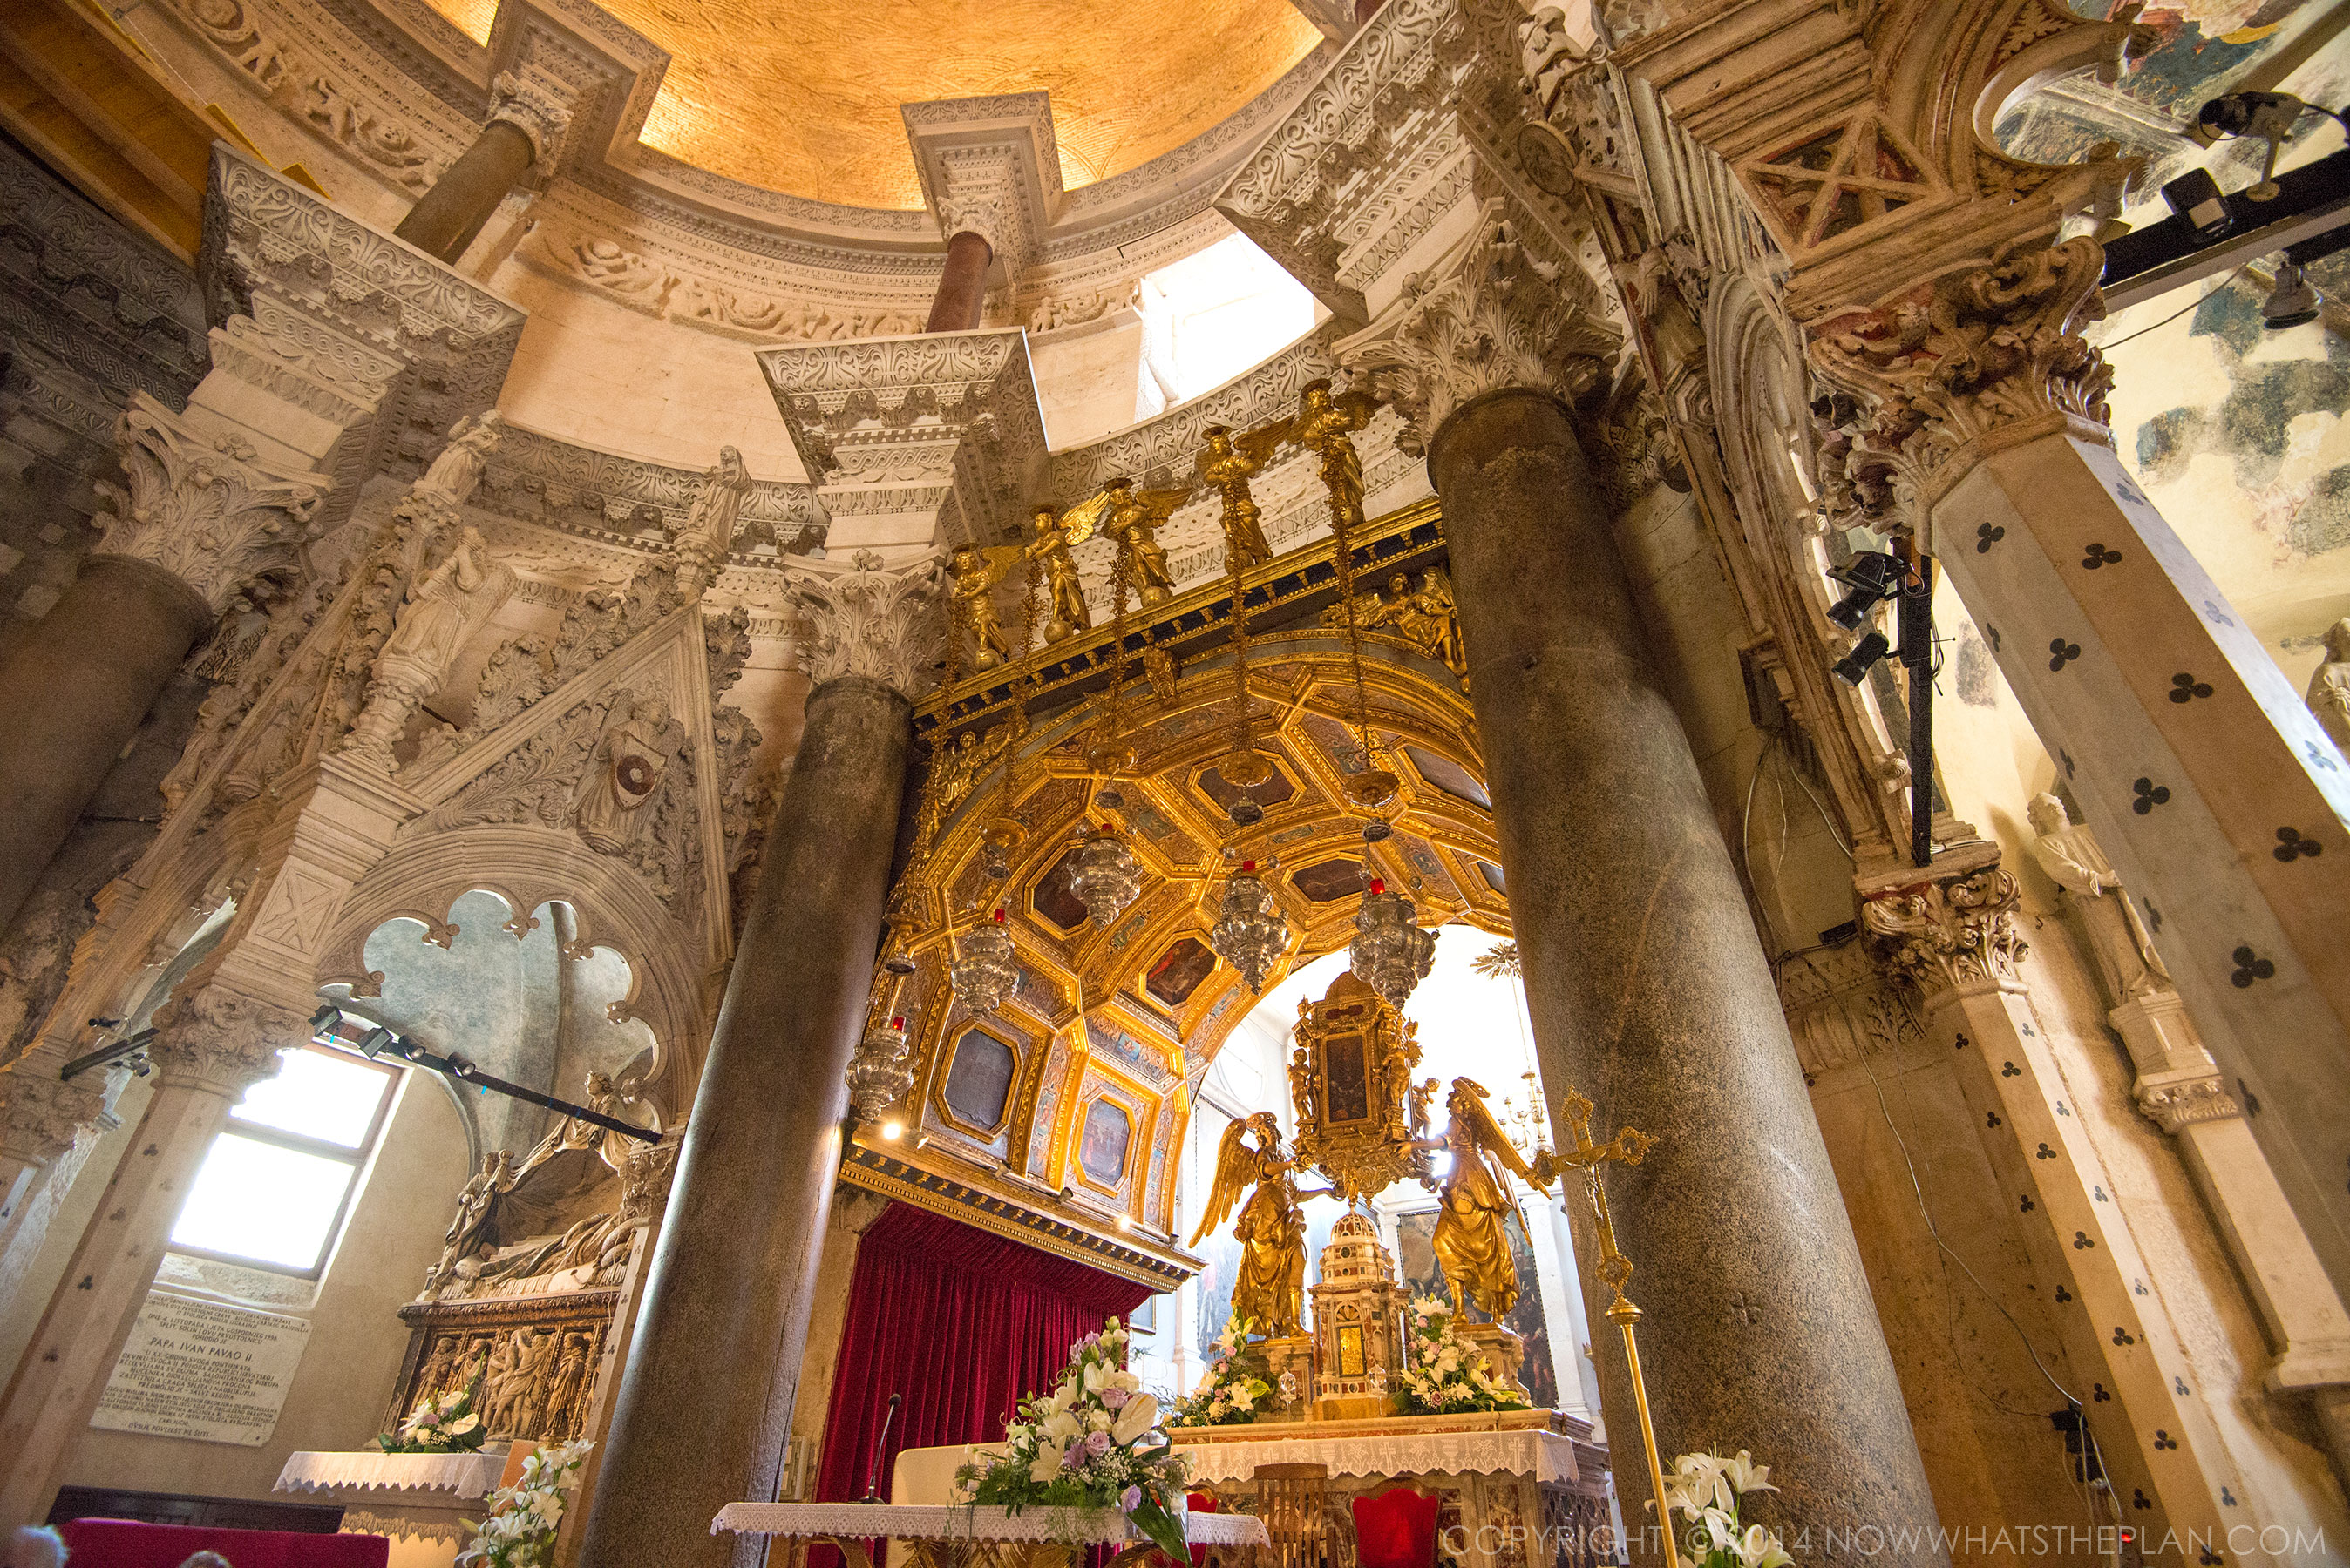
Notes:
http://nowwhatstheplan.com/2014/08/04/sea-views-from-split-croatia/
Note explicit (c) watermark

Slide 60
Cathedral of the Dormition of the Theotokos [e.g., the passing of the Virgin Mary from earthly life]
Vladimir, Russia
1160
"the 6-pillared 5-domed cathedral was expanded in 1185-1189 [...] Embracing the area of 1178 sq. meters, it remained the largest of Russian churches for the following 300 or 400 years."

Slide 61
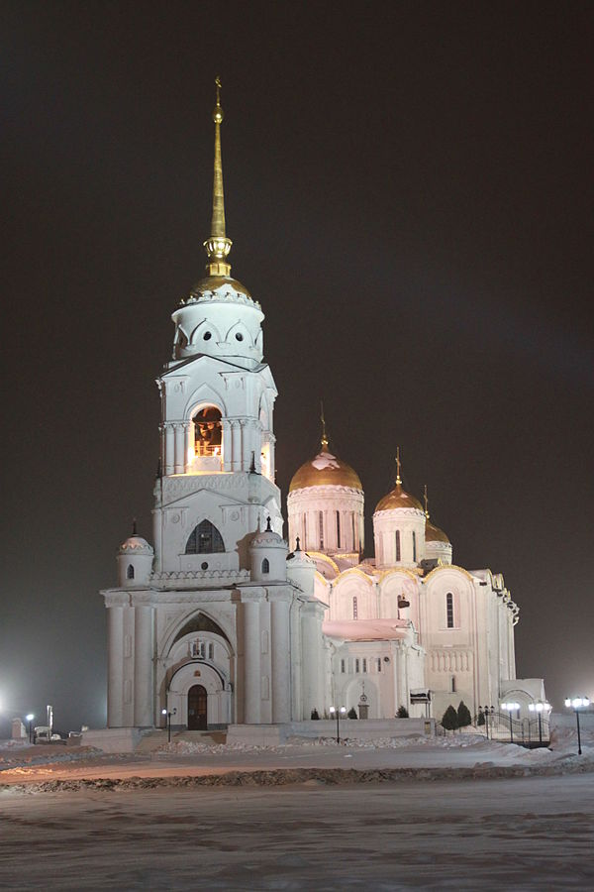
Notes:
https://commons.wikimedia.org/wiki/Category:Cathedral_of_the_Dormition_of_the_Theotokos_%28Vladimir%29,_bell_tower#/media/File:%D0%A3%D1%81%D0%BF%D0%B5%D0%BD%D1%81%D0%BA%D0%B8%D0%B9_%D1%81%D0%BE%D0%B1%D0%BE%D1%80_%D0%B2_%D0%B3._%D0%92%D0%BB%D0%B0%D0%B4%D0%B8%D0%BC%D0%B8%D1%80.JPG (LR)

Slide 62
Cathedral of the holy mandylion, Andronikov Monastery,
Moscow, 1420
Named in honor of the "Mandylion:"
"the Image of Edessa was a holy relic consisting of a [...] cloth upon which a miraculous image of the face of Jesus was imprinted — the first icon ("image"). In Eastern Orthodoxy, and often in English, the image is known as the Mandylion."

Slide 63
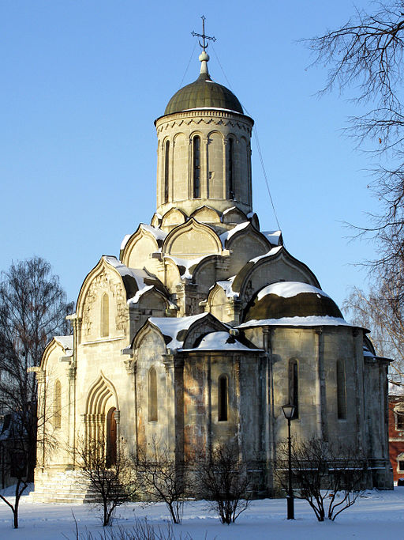
Notes:
https://commons.wikimedia.org/wiki/File:Cathedral_of_the_Holy_Mandylion_%28Andronikov_Monastery%29_36.jpg (LR)
Quote: https://en.wikipedia.org/wiki/Image_of_Edessa

Slide 64
Chartres Cathedral,
France
12th Century
"By the end of the 12th century [Chartres] had become one of
the most important [...]
pilgrimage destinations
in Europe."

Slide 65
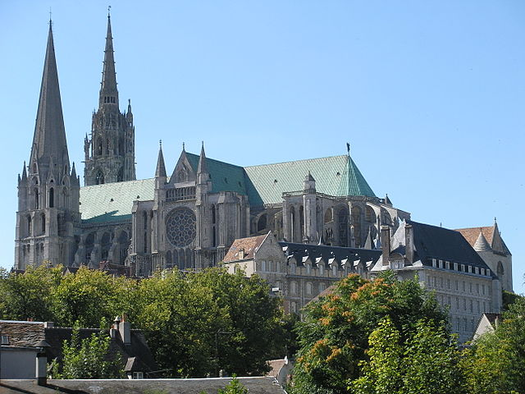
Notes:
https://commons.wikimedia.org/wiki/File:Chartres_cathedral.jpg (LR)

Slide 66
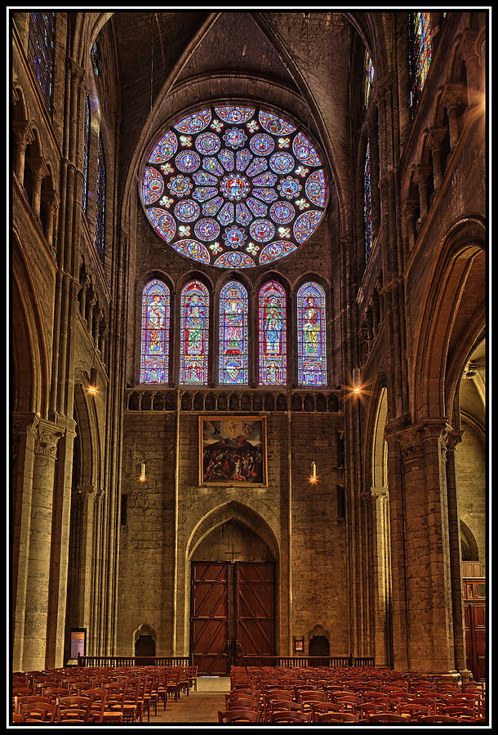
Notes:
https://commons.wikimedia.org/wiki/Cath%C3%A9drale_Notre-Dame_de_Chartres#/media/File:Chartres_-_Cath%C3%A9drale_%282012.01%29_08.jpg (LR)

Slide 67

Notes:
https://commons.wikimedia.org/wiki/Category:Astronomical_clock_of_Cath%C3%A9drale_Notre-Dame_de_Chartres#/media/File:Cathedrale_nd_chartres_nord006.jpg (LR)

Slide 68

Notes:
https://commons.wikimedia.org/wiki/Category:Astronomical_clock_of_Cath%C3%A9drale_Notre-Dame_de_Chartres#/media/File:Cath%C3%A9drale_de_Chartres_-_horloge.JPG (LR)

Slide 69

Notes:
https://commons.wikimedia.org/wiki/Category:Central_bay_of_Royal_portal_of_Cath%C3%A9drale_Notre-Dame_de_Chartres#/media/File:Chartres,_Cath%C3%A9drale_Notre-Dame-F_138.jpg (LR)

Slide 70

Notes:
https://commons.wikimedia.org/wiki/Category:Central_bay_of_Royal_portal_of_Cath%C3%A9drale_Notre-Dame_de_Chartres#/media/File:Chartres_-_portail_royal,_tympan_central.jpg (LR)

Slide 71

Notes:
https://commons.wikimedia.org/wiki/Category:Central_bay_of_Royal_portal_of_Cath%C3%A9drale_Notre-Dame_de_Chartres#/media/File:Cenral_tympanum_Chartres.jpg (LR)

Slide 72

Notes:
https://commons.wikimedia.org/wiki/Category:Central_bay_of_Royal_portal_of_Cath%C3%A9drale_Notre-Dame_de_Chartres#/media/File:Cath%C3%A9drale_de_Chartres_210209_05.jpg (LR)

Slide 73

Notes:
https://commons.wikimedia.org/wiki/Cath%C3%A9drale_Notre-Dame_de_Chartres#/media/File:Labyrinth_at_Chartres_Cathedral.JPG (LR)

Slide 74
Cologne Cathedral
[In German: "Kölner Dom"]
Germany
1248
the largest Gothic church in Northern Europe
The largest façade of any church
in the world
Notes:
Claims from https://en.wikipedia.org/wiki/Cologne_Cathedral

Slide 75

Built in the form of a Latin Cross
Notes:
https://commons.wikimedia.org/wiki/K%C3%B6lner_Dom#/media/File:Koeln_RdFlug_2.JPG (LR)

Slide 76

Notes:
https://commons.wikimedia.org/wiki/K%C3%B6lner_Dom#/media/File:CologneCathedral-FlightOverCologne001a.jpg (LR)

Slide 77

Notes:
https://commons.wikimedia.org/wiki/K%C3%B6lner_Dom#/media/File:Dom_und_Hauptbahnhof_%28Flight_over_Cologne%29.jpg (LR)

Slide 78

Flying Buttresses
Notes:
https://commons.wikimedia.org/wiki/File:Koelner_dom_blick_nach_osten.jpg (LR)

Slide 79

Flying Buttresses
"The purpose of any buttress is to resist the lateral forces pushing a wall outwards (which may arise from stone vaulted ceilings or from wind-loading on roofs) by redirecting them to the ground."
Notes:
https://commons.wikimedia.org/wiki/File:VillardButtressReims.jpg (max res)

Slide 80

Notes:
https://commons.wikimedia.org/wiki/K%C3%B6lner_Dom#/media/File:CathedralCologneView.jpg (LR)

Slide 81

Notes:
https://commons.wikimedia.org/wiki/K%C3%B6lner_Dom#/media/File:Wiki-01-Choir-of-Cologne-Cathedral.jpg (LR)

Slide 82

Notes:
https://commons.wikimedia.org/wiki/K%C3%B6lner_Dom#/media/File:Koelner_dom_nordseite_des_chors.jpg (LR)

Slide 83
Dubrovnik Synagogue,
Croatia
14th Century
"the oldest Sefardic synagogue
still in use today in the world and the second oldest synagogue in Europe"

Slide 84

Notes:
https://realhousewifeofbelgrade.files.wordpress.com/2011/04/img_3164.jpg
https://realhousewifeofbelgrade.wordpress.com/category/travel-2/croatia/
That page reports "Today, Dubrovnik has 17-40 Jewish residents.."

Slide 85

Notes:
http://www.tripadvisor.com/Attraction_Review-g295371-d527841-Reviews-Synagogue-Dubrovnik_Dubrovnik_Neretva_County_Dalmatia.html

Slide 86
Duomo di Milano,
Italy
1386
"The Gothic cathedral took nearly six centuries to complete. It is the 5th-largest church in the world and the second largest in Italy"
Notes:
https://en.wikipedia.org/wiki/Milan_Cathedral

Slide 87

Notes:
https://commons.wikimedia.org/wiki/File:20110724_Milan_Cathedral_5260.jpg (LR)

Slide 88

Notes:
https://commons.wikimedia.org/wiki/Duomo_di_Milano_-_Inside#/media/File:Milano-duomo01.jpg (original size)

Slide 89

Notes:
https://en.wikipedia.org/wiki/Milan_Cathedral#/media/File:IMG_3712_-_Milano_-_Duomo_-_Interno_-_Foto_di_Giovanni_Dall%27Orto_-_13-jan-2007.jpg (LR)

Slide 90

Notes:
https://commons.wikimedia.org/wiki/Duomo_di_Milano_-_Inside#/media/File:IMG_6849_-_Duomo_-_Menorah_Trivulzio_-_Foto_Giovanni_Dall%27Orto_3-Mar-2007.jpg (LR)
See also https://commons.wikimedia.org/wiki/Category:Candelabro_Trivulzio

Slide 91

Notes:
https://commons.wikimedia.org/wiki/Duomo_di_Milano_-_Inside#/media/File:DSC03020_-_Duomo_di_Milano_-_La_Menorah_Trivulzio_-_Foto_di_Giovanni_Dall%27Orto_-_29-1-2007.jpg (LR)

Slide 92

Notes:
https://commons.wikimedia.org/wiki/Duomo_di_Milano_-_Inside#/media/File:IMG_6876_-_Duomo_-_Menorah_Trivulzio_-_Drago_e_scimmie_-_Foto_Giovanni_Dall%27Orto_3-Mar-2007.jpg (LR)

Slide 93

St Bartholomew
One of the twelve apostles
'Christian tradition has three stories about Bartholomew's death:
[...] The account of Bartholomew being
skinned alive is the most represented in works
of art [...]'
Notes:
https://en.wikipedia.org/wiki/Bartholomew_the_Apostle#/media/File:San_Bartolomeo_Scorticato.jpg (original size)
https://en.wikipedia.org/wiki/Bartholomew_the_Apostle#Art_and_literature

Slide 94
Duomo di Pisa,
Pisa, Italy
1064
"... set the model for the distinctive Pisan Romanesque style of architecture. The mosaics of the interior, as well as the pointed arches, show a strong Byzantine influence. [...]
[The baptistery] is the largest baptistery in Italy..."
Notes:
https://en.wikipedia.org/wiki/Piazza_dei_Miracoli

Slide 95

Notes:
https://en.wikipedia.org/wiki/Piazza_dei_Miracoli#/media/File:Duomo_of_the_Archdiocese_of_Pisa.jpeg (LR)

Slide 96

Notes:
https://commons.wikimedia.org/wiki/Duomo_%28Pisa%29#/media/File:Pisa.Duomo.ceiling01.jpg (LR)

Slide 97

Notes:
https://commons.wikimedia.org/wiki/Category:Views_of_the_Baptistry_and_the_Duomo_of_Pisa#/media/File:2004_11_01_-_Pisa_002.JPG (LR)

Slide 98

Notes:
https://commons.wikimedia.org/wiki/Category:Views_of_the_Baptistry_and_the_Duomo_of_Pisa#/media/File:Batist%C3%A9rio_%283842237105%29_%283%29.jpg (LR)

Slide 99

Notes:
https://en.wikipedia.org/wiki/Pisa_Baptistry#/media/File:Toscana_Pisa7_tango7174.jpg (original size)

Slide 100

Notes:
https://en.wikipedia.org/wiki/Pisa_Baptistry#/media/File:Interior_of_the_Baptistry_of_St._John_dome,_Piazza_dei_Miracoli_%28-Square_of_Miracles-%29,_Pisa,_Tuscany,_Central_Italy-3.jpg (LR)

Slide 101
Ely Cathedral,
United Kingdom
1083-1375
"Architecturally it is outstanding both for its scale and stylistic details. Having been built in a monumental Romanesque style, the galilee porch, lady chapel and choir were rebuilt in an exuberant Decorated Gothic."

Slide 102

Notes:
https://upload.wikimedia.org/wikipedia/commons/b/bb/Ely_Cathedral_Exterior%2C_Cambridgeshire%2C_UK_-_Diliff.jpg (LR)

Slide 103

Notes:
https://commons.wikimedia.org/wiki/Category:Interior_of_Ely_Cathedral#/media/File:Ely_Cathedral_-_East_end_-_geograph.org.uk_-_1484386.jpg (original res)

Slide 104

Notes:
https://commons.wikimedia.org/wiki/Category:Interior_of_Ely_Cathedral#/media/File:Ely_Cathedral_Nave_Ceiling,_Cambridgeshire,_UK_-_Diliff.jpg (LR)

Slide 105

Notes:
https://commons.wikimedia.org/wiki/Category:Interior_of_Ely_Cathedral#/media/File:Ely_Cathedral_High_Altar,_Cambridgeshire,_UK_-_Diliff.jpg (LR)

Slide 106

Notes:
https://en.wikipedia.org/wiki/Ely_Cathedral#/media/File:Ely_Cathedral_Octagon_Lantern_3,_Cambridgeshire,_UK_-_Diliff.jpg (LR)

Slide 107

Notes:
https://en.wikipedia.org/wiki/Ely_Cathedral#/media/File:Ely_Cathedral_Organ,_Cambridgeshire,_UK_-_Diliff.jpg (LR)

Slide 108

Notes:
https://commons.wikimedia.org/wiki/Category:Ely_Cathedral#/media/File:A_tower_on_the_south-west-transept_of_Ely_Cathedral.png (LR)

Slide 109
Etchmiadzin Cathedral,
Vagharshapat, Armenia
Completed 483
Oldest Cathedral in the world

Slide 110

Notes:
https://commons.wikimedia.org/wiki/Category:Etchmiadzin_Cathedral#/media/File:Echmiadzin_Cathedral_dome.jpg (LR)

Slide 111

Notes:
https://commons.wikimedia.org/wiki/Category:Interior_of_Etchmiadzin_Cathedral#/media/File:Erevan_-_Armenia_%282888422290%29.jpg (LR)

Slide 112

Notes:
https://commons.wikimedia.org/wiki/Category:Interior_of_Etchmiadzin_Cathedral#/media/File:Etchmiadzin_cupola.jpg

Slide 113
Florence Cathedral,
Italy
1296-1436
"part of the UNESCO World Heritage Site covering the historic centre of Florence [...] a major attraction to tourists visiting the region of Tuscany. The basilica is one of Italy's largest churches, and until development of new structural materials in the modern era, the dome was the largest in the world."

Slide 114

Notes:
https://en.wikipedia.org/wiki/Florence_Cathedral#/media/File:Florence_Duomo_from_Michelangelo_hill.jpg (LR)

Slide 115

Notes:
https://commons.wikimedia.org/wiki/Category:Santa_Maria_del_Fiore_%28Florence%29_seen_from_the_West_at_night#/media/File:Santa_Maria_del_Fiore_%28Florence%29_facade_2013_February.jpg (LR)

Slide 116

Notes:
https://commons.wikimedia.org/wiki/Category:Santa_Maria_del_Fiore_%28Florence%29_-_Dome_-_Stairs_and_inner_passages#/media/File:Scale_interne_per_l%27ascesa_alla_cupola_del_duomo_di_firenze_04.JPG (LR)

Slide 117

Notes:
https://commons.wikimedia.org/wiki/Category:Santa_Maria_del_Fiore_%28Florence%29_-_Lanterna#/media/File:Duomo_di_firenze_da_terrazza_in_p._duomo,_cupola,_lanterna.JPG (LR)

Slide 118

Notes:
https://commons.wikimedia.org/wiki/Category:Interior_of_Santa_Maria_del_Fiore_%28Florence%29#/media/File:Santa_maria_del_fiore,_tribuna_di_san_zanobi,_altare_di_san_zanobi_2.JPG (LR)

Slide 119

Notes:
https://commons.wikimedia.org/wiki/Category:Floors_in_Santa_Maria_del_Fiore_%28Florence%29#/media/File:Santa_maria_del_fiore,_pavimento_1.JPG (LR)

Slide 120

Notes:
https://en.wikipedia.org/wiki/Florence_Cathedral#/media/File:Florence_Duomo_Ceiling.jpg (LR)

Slide 121

Notes:
https://commons.wikimedia.org/wiki/Category:Stained_glass_windows_in_Santa_Maria_del_Fiore_%28Florence%29#/media/File:Lorenzo_Ghiberti_e_Bernardo_di_Francesco,_ascensione,_1443.JPG (LR)

Slide 122


Notes:
https://commons.wikimedia.org/wiki/Category:Santa_Maria_del_Fiore_%28Florence%29_-_Flanks#/media/File:Duomo_di_firenze,_medaglioni_intarsiati_in_marmi_nei_timpani_delle_finestre_sui_fianchi_17,1.jpg (original size)
https://commons.wikimedia.org/wiki/Category:Santa_Maria_del_Fiore_%28Florence%29_-_Flanks#/media/File:Duomo_di_firenze,_medaglioni_intarsiati_in_marmi_nei_timpani_delle_finestre_sui_fianchi_20,1.jpg (original size)

Slide 123

Solar Gnonmon (highest in the world): At the summer solstice, the sunlight lands in the circle.
Notes:
https://commons.wikimedia.org/wiki/Category:Santa_Maria_del_Fiore_%28Florence%29_-_Solar_gnomon#/media/File:Osservazione_del_solstizio_21.06.12,_fi,_12.JPG (LR)

Slide 124
Great Mosque-Cathedral ["Mezquita"]
of Cordoba, Spain
built 780; converted into a Catholic Church in 1236
"The structure is regarded as one of the most accomplished monuments of Moorish architecture. [...] After the Reconquista, it was converted to a Roman Catholic church, culminating in the insertion of a Renaissance cathedral nave in the 16th century."
Notes:
https://en.wikipedia.org/wiki/Mosque%E2%80%93Cathedral_of_C%C3%B3rdoba

Slide 125

Notes:
https://commons.wikimedia.org/wiki/Category:Views_of_the_Mosque_of_Cordoba#/media/File:C%C3%B3rdoba_%28Spain%29,_Puente_Romano_and_Mezquita.jpg (LR)

Slide 126

Notes:
https://commons.wikimedia.org/wiki/Mezquita_de_C%C3%B3rdoba#/media/File:Mezquita_de_C%C3%B3rdoba_desde_el_aire_%28C%C3%B3rdoba,_Espa%C3%B1a%29.jpg (LR)

Slide 127

Pillar Forest/Hypostyle Hall
Notes:
https://commons.wikimedia.org/wiki/Mezquita_de_C%C3%B3rdoba#/media/File:Mosque_Cordoba.jpg (LR)

Slide 128

Notes:
https://commons.wikimedia.org/wiki/Category:Grilles_of_Hypostyle_Hall,_Mosque_of_C%C3%B3rdoba#/media/File:Celos%C3%ADa_-_Mezquita_de_C%C3%B3rdoba_001.jpg (LR)

Slide 129

Notes:
https://commons.wikimedia.org/wiki/Category:Grilles_of_Hypostyle_Hall,_Mosque_of_C%C3%B3rdoba#/media/File:Foto_191_-_panoramio.jpg (LR)

Slide 130

Notes:
https://commons.wikimedia.org/wiki/Category:Grilles_of_Hypostyle_Hall,_Mosque_of_C%C3%B3rdoba#/media/File:Patio_de_los_naranjos_-_Mezquita-catedral_de_C%C3%B3rdoba.jpg (original res)

Slide 131

Notes:
https://commons.wikimedia.org/wiki/Category:Ceiling_of_Capilla_Mayor,_Mosque_of_Cordoba#/media/File:Cordoba_-_Mezquita-Catedral_38.jpg (LR)

Slide 132

Notes:
https://commons.wikimedia.org/wiki/Category:Ceiling_of_the_choir_of_the_Mosque_of_C%C3%B3rdoba#/media/File:90%C2%BA_%284759825881%29.jpg (LR)

Slide 133

Notes:
https://commons.wikimedia.org/wiki/Category:Dome_of_Capilla_de_Villaviciosa,_Mosque_of_Cordoba#/media/File:Ceiling_arches_in_the_Mezquita,_Cordoba,_Spain.jpg (LR)

Slide 134
Great Mosque of Samara,
Iraq
Completed 851
"The Great Mosque was [...] the largest mosque in the world for
the next 400 years before it was destroyed [...] in the year 1278.
The outer walls and the imposing
52-meters minaret is all that remains of this once Great Mosque."

Slide 135

Notes:
http://lh4.ggpht.com/-gF4hVd5vmOQ/U-RzKJE7pGI/AAAAAAAA0-c/8jFS6XvPCKk/great-mosque-samarra-2%25255B6%25255D.jpg?imgmax=800

Slide 136

Notes:
https://en.wikipedia.org/wiki/Great_Mosque_of_Samarra#/media/File:Samara_spiralovity_minaret_rijen1973.jpg

Slide 137

Notes:
http://www.atlasobscura.com/places/great-mosque-of-samarra

Slide 138
Hagia Sofia [literally
"The Church of Holy Wisdom"],
Istanbul, Turkey
532
'[Hagia Sophia] is considered the
epitome of Byzantine architecture and is said to have "changed the history of architecture". It remained the world's largest cathedral for nearly a thousand years [...]'

Slide 139

Notes:
https://commons.wikimedia.org/wiki/Ayasofya#/media/File:Aya_sofya.jpg (LR)

Slide 140

Notes:
https://commons.wikimedia.org/wiki/Ayasofya#/media/File:571IstanbulSSofia.JPG (original res)

Slide 141

Notes:
https://commons.wikimedia.org/wiki/Ayasofya#/media/File:Istanbul.Hagia_Sophia021.jpg (LR)

Slide 142

Notes:
https://commons.wikimedia.org/wiki/Ayasofya#/media/File:Hagia_Sophia_-_coupole.jpg (LR)

Slide 143

Notes:
https://commons.wikimedia.org/wiki/Ayasofya#/media/File:Istanbul.Hagia_Sophia031.jpg (LR)

Slide 144

Notes:
https://en.wikipedia.org/wiki/Hagia_Sophia#/media/File:Apse_mosaic_Hagia_Sophia_Virgin_and_Child.jpg (LR)
Quote from https://en.wikipedia.org/wiki/Hagia_Sophia#Mosaics

Slide 145

Notes:
https://commons.wikimedia.org/wiki/Ayasofya#/media/File:Johnchrysostom.jpg (LR)

Slide 146

"The Omphalion is [...] the location where the coronation of every Byzantine [...] Emperor took place. This is also the spot where the Emperor would sit & participate during church ceremonies."
Notes:
https://en.wikipedia.org/wiki/Omphalion#/media/File:Omphalion_ste-sophie_istanbul_15_oct_2011.jpg (orig size)
https://en.wikipedia.org/wiki/Omphalion

Slide 147

Lustration Urn
Notes:
https://commons.wikimedia.org/wiki/Ayasofya#/media/File:587IstanbulSSofia.JPG (orig size)
Lustration urns

Slide 148
Kaabah ["The Cube"],
Al-Masjid al-Haram Mosque,
Mecca, Saudi Arabia
[Available for pilgrimage from 629]
"The Kaabah is the holiest site in
Islam. [...] In 624 [...] the Qiblah
(Prayer Direction) was changed
from [the Dome of the Rock in] Jerusalem to the Kaabah in Mecca."
Notes:
https://en.wikipedia.org/wiki/Kaaba
2nd holiest site: https://en.wikipedia.org/wiki/Al-Masjid_an-Nabawi
3rd: https://en.wikipedia.org/wiki/Al-Aqsa_Mosque

Slide 149

Notes:
https://en.wikipedia.org/wiki/Kaaba#/media/File:Mosqu%C3%A9e_Masjid_el_Haram_%C3%A0_la_Mecque.jpg (LR)

Slide 150

Blackstone:
Said to date
to Adam and
Eve.
"eastern
cornerstone
of the Kaaba
[...] revered
by Muslims
as an Islamic
relic [...] now
cemented
into a silver
frame in the
side of the
Kaaba [...]"
Notes:
https://en.wikipedia.org/wiki/Black_Stone#/media/File:The_Blackstone.jpg (orig size)
https://en.wikipedia.org/wiki/Black_Stone

Slide 151

Notes:
https://commons.wikimedia.org/wiki/Category:Mecca#/media/File:A_packed_house_-_Flickr_-_Al_Jazeera_English800x600x300.jpg (orig size)

Slide 152
Mont Saint-Michel,
Normandy, France
8th century
"One of France's most recognizable landmarks, Mont Saint-Michel and its bay are part of the UNESCO list of World Heritage Sites and more than 3 million people visit it each year."
Notes:
https://en.wikipedia.org/wiki/Mont_Saint-Michel

Slide 153

Notes:
https://commons.wikimedia.org/wiki/Category:General_views_of_Mont_Saint-Michel#/media/File:France-Mont-Saint-Michel-1900_bordercropped.jpg (LR)
https://en.wikipedia.org/wiki/Mont_Saint-Michel notes "According to legend, the Archangel Michael appeared in 708 to St. Aubert, the bishop of Avranches, and instructed him to build a church on the rocky islet. Aubert repeatedly ignored the angel's instruction until Michael burned a hole in the bishop's skull with his finger."

Slide 154

Notes:
https://commons.wikimedia.org/wiki/Category:Interior_of_Abbatiale_de_Mont_Saint-Michel#/media/File:Le_Mont-Saint-Michel_France_Abbey-Church-03.jpg (LR)

Slide 155

Notes:
https://commons.wikimedia.org/wiki/Category:Interior_of_Abbatiale_de_Mont_Saint-Michel#/media/File:Abbaye_du_Mont-Saint-Michel_%282%29.JPG (LR)

Slide 156

Notes:
https://commons.wikimedia.org/wiki/Category:Exterior_of_Abbatiale_de_Mont_Saint-Michel#/media/File:Mont_Saint-Michel,_Frankreich24.jpg (LR)

Slide 157

Human-Powered
Tread wheel Crane
Notes:
https://commons.wikimedia.org/wiki/Category:Treadwheel_crane_of_Mont_Saint-Michel#/media/File:Abbaye_du_Mont-Saint-Michel._Tympan..JPG (LR)

Slide 158

Notes:
https://commons.wikimedia.org/wiki/Category:Treadwheel_crane_of_Mont_Saint-Michel#/media/File:Mont-Saint-Michel_2008_PD_89.JPG (LR)

Slide 159

Notes:
https://commons.wikimedia.org/wiki/Category:Treadwheel_crane_of_Mont_Saint-Michel#/media/File:Mont-Saint-Michel_2008_PD_85.JPG (LR)

Slide 160

Notes:
https://commons.wikimedia.org/wiki/Category:Treadwheel_crane_of_Mont_Saint-Michel#/media/File:PSmichel4297.JPG (LR)

Slide 161

Notes:
https://en.wikipedia.org/wiki/Mont_Saint_Michel_Abbey#/media/File:Blason_abbaye_fr_Mont_Saint_Michel_%2850%29.svg

Slide 162
Old Cathedral of Coimbra
["Sé Velha de Coimbr"],
Portugal
13th Century
"... Coimbra Cathedral is the only one of the Portuguese Romanesque cathedrals from the Reconquista times to have survived relatively intact up to the present. "
Notes:
https://en.wikipedia.org/wiki/Old_Cathedral_of_Coimbra

Slide 163

Notes:
https://en.wikipedia.org/wiki/Old_Cathedral_of_Coimbra#/media/File:Lisboa_May_2013-1.jpg (LR)

Slide 164

Notes:
https://en.wikipedia.org/wiki/Old_Cathedral_of_Coimbra#/media/File:Karinecyril_coimbra_cathedrale_1.jpg (LR)

Slide 165

Notes:
https://en.wikipedia.org/wiki/Old_Cathedral_of_Coimbra#/media/File:Se_Velha_de_Coimbra_4.jpg (LR)

Slide 166
Palais Des Papes,
Avignon, France
13th century
"one of the largest and most important medieval Gothic buildings
in Europe. [...] the papal residence was the seat of Western Christianity during the 14th century." "Not only [...] the largest Gothic building of the Middle Ages, it is also one of the best examples of the International Gothic architectural style."
Notes:
Quotes: https://en.wikipedia.org/wiki/Palais_des_Papes

Slide 167

Notes:
https://commons.wikimedia.org/wiki/File:Avignon,_Palais_des_Papes_by_JM_Rosier.jpg (LR)

Slide 168

"... a deadlocked conclave finally elected Clement V,
a Frenchman, as
Pope in 1305. Clement declined to move to Rome, remaining in France, and in 1309 moved his court to
the papal enclave at Avignon, where it remained for the
next 67 years. This absence from Rome
is sometimes referred to as the "Babylonian Captivity of the Papacy..."
Notes:
https://commons.wikimedia.org/wiki/Category:Interior_of_Palais_des_Papes#/media/File:Avignon_palais_serrur_clement_V.JPG (LR)
https://en.wikipedia.org/wiki/Avignon_Papacy

Slide 169

Notes:
https://upload.wikimedia.org/wikipedia/commons/d/d8/Pope_Palace_Avignon_France.jpg (original size)

Slide 170

Notes:
https://commons.wikimedia.org/wiki/Palais_des_Papes#/media/File:Cour_du_cloitre,_vieux_palais_par_JM_Rosier.jpg (LR)

Slide 171
Palma Cathedral ["LA Seu"],
Majorca, Spain
1229
"t is 121 metres long, 55 metres wide and its nave is 44 metres tall. By way of comparison, the height of the central nave reaches 33m in Notre Dame de Paris, 38m in Reims, 42m in Notre-Dame d'Amiens and 48m in Saint-Pierre de Beauvais, the highest of all
Gothic cathedrals."
Notes:
https://en.wikipedia.org/wiki/Palma_Cathedral

Slide 172

Notes:
https://commons.wikimedia.org/wiki/Category:Cathedral_of_Palma_de_Mallorca#/media/File:Mallorca_-_Kathedrale_von_Palma8.jpg (LR)

Slide 173

Notes:
https://commons.wikimedia.org/wiki/Category:Cathedral_of_Palma_de_Mallorca_-_Inside#/media/File:Iglesia_de_Santa_Mar%C3%ADa._Catedral_de_Mallorca_%28s._XIV%29.jpg (LR)

Slide 174

Notes:
https://commons.wikimedia.org/wiki/Category:Cathedral_of_Palma_de_Mallorca_-_Full#/media/File:Seu_de_Mallorca_%28Palma%29_-_5.jpg (LR)

Slide 175
Parma Cathedral,
Italy
1059
"It is an important Italian Romanesque cathedral: the dome, in particular, is decorated by a highly influential illusionistic fresco by Renaissance painter Antonio da Correggio."

Slide 176

Notes:
https://commons.wikimedia.org/wiki/Parma_cathedral#/media/File:Duomo_e_Battistero_di_Parma.jpg (LR)

Slide 177

Notes:
https://commons.wikimedia.org/wiki/Category:Cathedral_%28Parma%29_-_Interior#/media/File:Parma_Duomo_di_Parma_003.JPG (LR)

Slide 178

Notes:
https://commons.wikimedia.org/wiki/Parma_cathedral#/media/File:Parma_Duomo_di_Parma_004.JPG (LR)

Slide 179

Notes:
https://commons.wikimedia.org/wiki/Parma_cathedral#/media/File:Parma-cupola_duomo.jpg (LR)

Slide 180

Notes:
https://commons.wikimedia.org/wiki/Category:Descent_from_the_Cross_by_Antelami#/media/File:Deposizione_dalla_croce_di_benedetto_antelami_01.JPG (LR)

Slide 181

Notes:
https://commons.wikimedia.org/wiki/Category:Baptistry_%28Parma%29#/media/File:Battistero_Parma.jpg (original size)

Slide 182

Notes:
https://commons.wikimedia.org/wiki/Baptistry_%28Parma%29#/media/File:Parma,_Italy_-_baptistry_dome_interior.JPG (LR)

Slide 183

Notes:
https://commons.wikimedia.org/wiki/Category:Baptistry_%28Parma%29_-_Inside#/media/File:Battistero_di_parma,_interno,_fonte_battesimale_01.JPG (LR)

Slide 184
Reims Cathedral,
France
1275
"[...] With the baptism of Clovis
by Saint Remi in 498-499, the
precedent of royal unction was established in the Reims Cathedral."
Notes:
Quote from http://www.reims-cathedral.culture.fr/origin-history.html

Slide 185

Notes:
https://commons.wikimedia.org/wiki/File:ReimsCathedral0116.jpg (LR)

Slide 186

Notes:
https://commons.wikimedia.org/wiki/Cath%C3%A9drale_Notre-Dame_de_Reims#/media/File:Reims_Kathedrale.jpg

Slide 187
Rila Monastery,
Bulgaria
927
"Founded in the 10th century,
the Rila Monastery is regarded as one of Bulgaria's most important cultural, historical and architectural monuments and is a key tourist attraction for both Bulgaria and Southern Europe."

Slide 188

Notes:
https://en.wikipedia.org/wiki/Rila_Monastery#/media/File:Rila_Monastery,_August_2013.jpg (LR)

Slide 189

West Portico Frescos, Rila Monastery
Notes:
https://en.wikipedia.org/wiki/Rila_Monastery#/media/File:Rila_Monastery_Portico,_August_2013.jpg (LR)

Slide 190
Roskilde Cathedral,
Zealand, Denmark
1170
"The first Gothic cathedral to be built of brick"

Slide 191

Notes:
https://commons.wikimedia.org/wiki/File:Roskilde_domkirke_west_fassade.jpg

Slide 192

Notes:
https://commons.wikimedia.org/wiki/Roskilde_domkirke#/media/File:Roskilde_domkirke_fr%C3%A5n_R%C3%A5dhustorvet.jpg (LR)

Slide 193

Notes:
https://commons.wikimedia.org/wiki/Roskilde_domkirke#/media/File:Roskilde_Dom02.jpg (LR)

Slide 194

Notes:
https://commons.wikimedia.org/wiki/Roskilde_domkirke#/media/File:Roskilde_Dom08.jpg (LR)

Slide 195
Sainte-Chapelle,
Paris
1239
"among the highest achievements of the Rayonnant period of Gothic architecture"
Notes:
Quote from https://en.wikipedia.org/wiki/Sainte-Chapelle

Slide 196

Notes:
https://commons.wikimedia.org/wiki/Category:Exterior_of_Sainte-Chapelle#/media/File:Par%C3%ADs_Sainte_Chapelle_01.JPG (LR)

Slide 197

Notes:
https://commons.wikimedia.org/wiki/Category:Exterior_of_Sainte-Chapelle#/media/File:Sainte-Chapelle_Paris_5.jpg (LR)

Slide 198

Notes:
https://en.wikipedia.org/wiki/Sainte-Chapelle#/media/File:Sainte_Chapelle_-_Upper_level_1.jpg (LR)

Slide 199

Notes:
https://commons.wikimedia.org/wiki/Sainte-Chapelle#/media/File:Paris-SainteChapelle-Interieur.jpg (LR)

Slide 200

Notes:
https://commons.wikimedia.org/wiki/Category:Sainte-Chapelle_%28Paris%29#/media/File:Sainte-Chapelle_gnosne.jpg (LR)

Slide 201

Notes:
https://commons.wikimedia.org/wiki/Category:Details_of_Sainte-Chapelle_%28Paris%29#/media/File:Sainte-Chapelle_-_detail_%282862668999%29.jpg (LR)

Slide 202
Salisbury Cathedral,
Wiltshire UK
1220-1320
"one of the leading examples of Early English architecture [...]
The cathedral has the tallest church spire in the United Kingdom (123m/404 ft). It [...] has the best surviving of the four original copies of Magna Carta [...]"
Notes:
https://en.wikipedia.org/wiki/Salisbury_Cathedral

Slide 203

Notes:
https://commons.wikimedia.org/wiki/File:SalisburyCathedral-wyrdlight-811594East.jpg (LR)

Slide 204

Notes:
https://commons.wikimedia.org/wiki/Category:Interior_of_Salisbury_Cathedral#/media/File:Catedral_de_Salisbury,_Salisbury,_Inglaterra,_2014-08-12,_DD_35-37_HDR.JPG (LR)

Slide 205

Notes:
https://commons.wikimedia.org/wiki/Category:Interior_of_Salisbury_Cathedral#/media/File:1023581-Cathedral_Church_of_St_Mary_%2811%29.jpg (LR)

Slide 206

Notes:
https://commons.wikimedia.org/wiki/Category:Interior_of_Salisbury_Cathedral#/media/File:Altar_Salisbury_Cathedral_01.JPG (LR)

Slide 207

Notes:
https://commons.wikimedia.org/wiki/Category:Interior_of_Salisbury_Cathedral#/media/File:Salisbury_Cathedral_Ceiling_5_%285691313014%29.jpg (LR)

Slide 208

Polychrome Statuary,
Salisbury
Cathedral
Notes:
https://commons.wikimedia.org/wiki/Category:Salisbury_Cathedral#/media/File:Salisbury_01.jpg (LR)

Slide 209
San Marcos Basilica,
Venice, Italy
1092
"... one of the best known examples of Italo-Byzantine architecture. [...] For its opulent design, gold ground mosaics, and its status as a symbol of Venetian wealth and power, from the 11th century on the building has been known by the nickname [...] Church of gold [...]"
Notes:
https://en.wikipedia.org/wiki/St_Mark's_Basilica

Slide 210

Notes:
https://commons.wikimedia.org/wiki/Basilica_di_San_Marco#/media/File:Ven_basil_matin_082005.JPG (LR)

Slide 211

Notes:
https://commons.wikimedia.org/wiki/Basilica_di_San_Marco#/media/File:Markusdom_Kuppeln.jpg (LR)

Slide 212

Notes:
https://commons.wikimedia.org/wiki/Basilica_di_San_Marco#/media/File:Pala_D%27OroII.jpg (LR)

Slide 213

"[most of
mosaics]
use the
traditional
background
of gold
glass
tesserae,
creating
the
shimmering
overall
effect."
Notes:
https://commons.wikimedia.org/wiki/File:Veneza118.jpg (LR)
Quote from https://en.wikipedia.org/wiki/St_Mark's_Basilica

Slide 214

Notes:
https://en.wikipedia.org/wiki/St_Mark's_Basilica#/media/File:San_Marco_cathedral_in_Venice.JPG (LR)

Slide 215
Sanctuary of the Holy Sepulchre,
Jerusalem, reconstructed 1048
"The site is venerated as Calvary (Golgotha), where Jesus [...] was crucified, and also contains the place where Jesus is said to have been buried and resurrected [...]
for many Christians the most important pilgrimage destination since at least the 4th century [...]"
Run by Orthodox & Roman Catholics
Notes:
https://commons.wikimedia.org/wiki/Category:Chapel_of_the_Division_of_the_Raiment#/media/File:Church_of_the_Holy_Sepulchre_%2810804893146%29.jpg
https://en.wikipedia.org/wiki/Church_of_the_Holy_Sepulchre#Status_quo

Slide 216

The Imovable Ladder
"... a wooden ladder
[...] first mentioned in
1757 [...] has remained
in the same exact
location since [then].
The ladder is
referred to as
immovable due to an
understanding that
no cleric of the six
ecumenical Christian
orders may move,
rearrange, or alter
any property without
the consent of all
six orders."
Notes:
https://commons.wikimedia.org/wiki/Category:Immovable_Ladder#/media/File:Immovable_ladder_on_ledge_over_entrance_to_Church_of_the_Holy_Sepulchre.jpg (original size)

Slide 217

Notes:
https://en.wikipedia.org/wiki/Church_of_the_Holy_Sepulchre#/media/File:The_Church_of_the_Holy_Sepulchre-Jerusalem.JPG (RS)

Slide 218

Notes:
https://commons.wikimedia.org/wiki/Category:Golgotha#/media/File:Cross_in_Church_of_the_Holy_Sepulchre.jpg (RS)

Slide 219

Tomb of Jesus
Notes:
https://commons.wikimedia.org/wiki/Category:Tomb_of_Jesus_in_Holy_Sepulchre_church#/media/File:Tomb_of_Jesus_from_above,_Church_of_Holy_Sepulchre.jpg (RS)

Slide 220

Notes:
https://commons.wikimedia.org/wiki/Category:Tomb_of_Jesus_in_Holy_Sepulchre_church#/media/File:Tomb_of_Jesus3.jpg (RS)

Slide 221

Notes:
https://commons.wikimedia.org/wiki/Category:Tomb_of_Jesus_in_Holy_Sepulchre_church#/media/File:Entry_of_the_Aedicule._Church_of_the_Holy_Sepulchre,_Jerusalem_044_-_Aug_2011.jpg (RS)

Slide 222

Vigil Lamps at the Edicule (Jesus' Tomb)
Notes:
https://commons.wikimedia.org/wiki/Category:Tomb_of_Jesus_in_Holy_Sepulchre_church#/media/File:Jesus%27_tomb._Church_of_the_Holy_Sepulchre,_Jerusalem_051_-_Aug_2011.jpg (RS)

Slide 223
Saviour Cathedral
["Cathedral of the Transfiguration"],
Chernihiv, Ukraine
1036
"One of the oldest stone buildings in Ukraine and the finest extant monument of the medieval Chernihiv principality"
Notes:
http://www.encyclopediaofukraine.com/display.asp?linkpath=pages\T\R\TransfigurationCathedralofthe.htm

Slide 224

Notes:
https://commons.wikimedia.org/wiki/File:Spasopreobrazh-cathedral-chernihiv.JPG (RS)

Slide 225
Sedlec Ossuary,
Kutna Hora, Czech Republic
circa 1400
"The ossuary is estimated to contain the skeletons of between 40,000 and 70,000 people, whose bones have in many cases been artistically arranged to form decorations and furnishings for the chapel. The ossuary is among the most visited tourist attractions of the Czech Republic"
Notes:
https://en.wikipedia.org/wiki/Sedlec_Ossuary
Note: "In 1278, Henry, the abbot of the Cistercian monastery in Sedlec, was sent to the Holy Land by King Otakar II of Bohemia. He returned with him a small amount of earth he had removed from Golgotha and sprinkled it over the abbey cemetery. The word of this pious act soon spread and the cemetery in Sedlec became a desirable burial site throughout Central Europe."

Slide 226

Notes:
https://commons.wikimedia.org/wiki/Category:Sedlec_Ossuary_-_Exterior#/media/File:Sedlec,_kaple_V%C5%A1ech_svat%C3%BDch_s_kostnic%C3%AD.JPG (RS)

Slide 227

Notes:
https://commons.wikimedia.org/wiki/Category:Sedlec_Ossuary_-_Interior#/media/File:Sedlec_Ossuary_bone_pyramid_1.JPG (RS)

Slide 228

Notes:
https://commons.wikimedia.org/wiki/Category:Sedlec_Ossuary_-_Interior#/media/File:Skeletal_Arrangements,_Sedlec_Ossuary_%286282842433%29.jpg (RS)

Slide 229
Seville Cathedral,
Spain
1402-1506
"After its completion in the early 16th century, the Seville Cathedral supplanted Hagia Sophia as the largest cathedral in the world, a title the Byzantine church had held for nearly a thousand years. The cathedral is also the burial site of Christopher Columbus."
Notes:
https://en.wikipedia.org/wiki/Seville_Cathedral

Slide 230

Notes:
https://commons.wikimedia.org/wiki/Catedral_de_Sevilla#/media/File:Sevilla2005July_043.jpg (RS)

Slide 231

Notes:
https://commons.wikimedia.org/wiki/Catedral_de_Sevilla#/media/File:Catedral_002.jpg (RS)

Slide 232

Notes:
https://commons.wikimedia.org/wiki/Catedral_de_Sevilla#/media/File:Sevilla_cathedral_-_vault.jpg (RS)

Slide 233

Notes:
https://commons.wikimedia.org/wiki/Category:Main_altar_piece_of_Cathedral_of_Seville#/media/File:9524603769_da5f5325b1_o_catedral_sevilla.jpg (RS)

Slide 234

Notes:
https://commons.wikimedia.org/wiki/Catedral_de_Sevilla#/media/File:Custodia_de_Juan_de_Arfe,_Catedral_de_Sevilla.jpg (RS)

Slide 235

Notes:
https://commons.wikimedia.org/wiki/Catedral_de_Sevilla#/media/File:FerranSev.jpg (original size)

Slide 236

Tomb of
christopher
Columbus
Notes:
https://commons.wikimedia.org/wiki/Category:Tomb_of_Christopher_Columbus_%28Sevilla%29#/media/File:Mausoleum_of_Christopher_Columbus.jpg (LR)

Slide 237

Penitents, Semana Santa de Sevilla
Notes:
https://commons.wikimedia.org/wiki/Category:Interiors_of_the_Cathedral_of_Seville#/media/File:Penitentes_en_el_interior_de_la_catedral_de_sevilla.jpg (LR)

Slide 238
Siena Cathedral,
Italy
1215-1263
"The exterior and interior are constructed of white and greenish-black marble in alternating stripes, with addition of red marble on the façade. Black and white are the symbolic colors of Siena, etiologically linked to black and white horses of the legendary city's founders [...]"

Slide 239

Notes:
https://commons.wikimedia.org/wiki/Category:Cathedral_%28Siena%29_-_Exterior#/media/File:Duomo_di_Siena.jpg (LR)

Slide 240

Notes:
https://commons.wikimedia.org/wiki/Category:Cathedral_%28Siena%29_-_Belltower#/media/File:Cattedrale_di_Siena_-_campanile.jpg (LR)

Slide 241

Notes:
https://commons.wikimedia.org/wiki/Category:Cathedral_%28Siena%29_-_Interior#/media/File:Duomo_Siena_interior_Apr_2008_%282%29.JPG (LR)

Slide 242

Notes:
https://commons.wikimedia.org/wiki/Category:Cathedral_%28Siena%29_-_Stained_glass_windows#/media/File:Cathedral_%28Siena%29_-_Stained_glass_window.JPG (LR)

Slide 243

Notes:
https://commons.wikimedia.org/wiki/Category:Cathedral_%28Siena%29_-_Chigi_chapel#/media/File:Duomo_di_siena,_cupola,_interno_02.JPG (LR)

Slide 244

Notes:
https://commons.wikimedia.org/wiki/Category:Cathedral_%28Siena%29_-_Floors/The_Sienese_She-wolf_sorrounded_by_the_simbols_of_the_allied_cities#/media/File:Pavimento_di_siena,_lupa_senese_tra_i_simboli_delle_citt%C3%A0_alleate_02.jpg (LR)

Slide 245

Notes:
https://commons.wikimedia.org/wiki/Category:Allegory_of_the_Hill_of_Knowledge#/media/File:Pavimento_di_siena,_allegoria_del_colle_della_sapienza_%28pinturicchio%29_03_cratete.jpg (LR)

Slide 246
St Catherine's Eastern
Orthodox Monastery,
Sinai, Egypt, 565
Reportedly At the Site of Moses' Burning Bush. "...the oldest working Christian monastery in the world."
"...the world's oldest continually operating library" with "the second largest collection of early codices and manuscripts in the world" after the vatican.
Notes:
Quote from https://en.wikipedia.org/wiki/Saint_Catherine's_Monastery

Slide 247

Notes:
https://commons.wikimedia.org/wiki/File:Katharinenkloster_Sinai_BW_2.jpg (LR)

Slide 248

The Ladder of Divine
Ascent, 12th century by
Abba John, Abbot of
the monks of Mount Sinai, St Catherine's
Monastery, Sinai.
30 steps to reach heaven, including asceticism, hesychia
("peace of the soul"),
and others.
www.prudencetrue.com/images/TheLadderofDivineAscent.pdf
Notes:
https://en.wikipedia.org/wiki/The_Ladder_of_Divine_Ascent#/media/File:The_Ladder_of_Divine_Ascent_Monastery_of_St_Catherine_Sinai_12th_century.jpg (LR)
See https://en.wikipedia.org/wiki/The_Ladder_of_Divine_Ascent

Slide 249
St. Mary's Church,
Gdansk, Poland
1379
"... currently the largest brick church in the world."

Slide 250

Notes:
https://commons.wikimedia.org/wiki/Category:Exterior_of_the_Church_of_St._Mary_in_Gda%C5%84sk#/media/File:Gdansk_Kosciol_mariacki2.jpg (LR)

Slide 251

Notes:
https://commons.wikimedia.org/wiki/Category:Interior_of_the_Church_of_St._Mary_in_Gda%C5%84sk#/media/File:Gda%C5%84sk_%28DerHexer%29_2010-07-12_056.jpg (LR)

Slide 252

Notes:
https://commons.wikimedia.org/wiki/Category:Interior_of_the_Church_of_St._Mary_in_Gda%C5%84sk#/media/File:Gda%C5%84sk,_zesp%C3%B3%C5%82_ko%C5%9Bcio%C5%82a_par._p.w._Wniebowzi%C4%99cia_NMP,_tzw._Mariackiego,_1343,_1502_1.JPG (LR)

Slide 253

Notes:
https://commons.wikimedia.org/wiki/Category:Interior_of_the_Church_of_St._Mary_in_Gda%C5%84sk#/media/File:Wn%C4%99trze_ko%C5%9Bcio%C5%82a_Mariackiego_w_Gda%C5%84sku_2.jpg (LR)

Slide 254

Notes:
https://commons.wikimedia.org/wiki/Category:Interior_of_the_Church_of_St._Mary_in_Gda%C5%84sk#/media/File:8540a_Ko%C5%9Bci%C3%B3%C5%82_Mariacki_w_Gda%C5%84sku._Foto_Barbara_Maliszewska.jpg (LR)

Slide 255

Notes:
https://commons.wikimedia.org/wiki/Category:Towers_of_the_St._Mary_church_in_Gda%C5%84sk#/media/File:Ko%C5%9Bci%C3%B3%C5%82_Mariacki_z_Muzeum_Bursztynu_-_panoramio.jpg (LR)

Slide 256
St. Nicholas' Church,
Ghent, Belgium
13th Century

Slide 257

Notes:
https://commons.wikimedia.org/wiki/Gent#/media/File:St.Niklaaskerk.jpg (LR)

Slide 258

Notes:
http://cdn1.vtourist.com/19/6958930-Inside_St_Nicholas_Church_Gent.jpg?version=2

Slide 259

Notes:
https://en.wikipedia.org/wiki/Ghent_Altarpiece#/media/File:Lamgods_open.jpg (original size)

Slide 260
St. Sophia's Cathedral,
Kiev, Ukraine
11th Century
"[...] an outstanding architectural monument of Kievan Rus'. The cathedral is one of the city's best known landmarks and the first patrimony on territory of Ukraine to be inscribed on the World Heritage List [...]"
Notes:
https://en.wikipedia.org/wiki/Saint_Sophia's_Cathedral,_Kiev

Slide 261

Notes:
https://commons.wikimedia.org/wiki/File:St._Sophia's_Cathedral_2_-_Kiev.JPG (LR)
https://en.wikipedia.org/wiki/Saint_Sophia's_Cathedral,_Kiev
http://travel.kyiv.org/old/churches/uach2_e.htm

Slide 262

Notes:
http://sobory.ru/photo/19003

Slide 263

Notes:
http://n.sophiakievska.org/

Slide 264
St. Vitus Cathedral,
Prague, Czech Republic
1344
"This cathedral is an excellent example of Gothic architecture and is the biggest and most important church in the country. Located within Prague Castle and containing the tombs of many Bohemian kings and Holy Roman Emperors [...]"
Notes:
https://en.wikipedia.org/wiki/St._Vitus_Cathedral

Slide 265

Notes:
https://commons.wikimedia.org/wiki/Category:South_facade_of_St._Vitus_Cathedral#/media/File:2014_Praga,_katedra_%C5%9Bw._Wita.jpg (LR)

Slide 266

Notes:
https://commons.wikimedia.org/wiki/Category:Exterior_of_St._Vitus_Cathedral#/media/File:Praga,_katedra_%C5%9Bw._Wita_SDC10767.JPG (original size)

Slide 267

Notes:
https://commons.wikimedia.org/wiki/Category:Exterior_of_St._Vitus_Cathedral#/media/File:2011-06-11-praha-by-RalfR-028.jpg (LR)

Slide 268

Gargoyle waterspout
Notes:
https://commons.wikimedia.org/wiki/Category:Gargoyles_of_St._Vitus_Cathedral#/media/File:Gargoyle_St._Vitus_Cathedral_Prague_1.jpg (LR)

Slide 269
Temple Mount, Jerusalem
'The Crusader period began in 1099 with the First Crusade's capture of Jerusalem. After the city's conquest, the Crusading order Knights Templar was granted use of the Dome of the Rock on the Temple Mount [...]"

Slide 270

Notes:
https://commons.wikimedia.org/wiki/File:Temple_mount.JPG (LR)
https://en.wikipedia.org/wiki/Temple_Mount

Slide 271

Dome of the Rock
Notes:
https://en.wikipedia.org/wiki/Dome_of_the_Rock#/media/File:The_Dome_of_the_Rock.jpeg (original size)

Slide 272

Notes:
https://en.wikipedia.org/wiki/Dome_of_the_Rock#/media/File:Temple_Mount---Hetch_in_Dome.JPG

Slide 273

Foundation Stone/ Sanctum sanctorum
Holiest site in Judaism; closest access for non-muslims is via the western wall tunnels beneath temple mount.
The "Well of Souls"
is said to be beneath
the stone.
"The ciborium, a permanent canopy
over the altar in some churches [...] symbolizes the Holy of Holies."
Notes:
https://commons.wikimedia.org/wiki/Category:Foundation_Stone_%28Temple_Mount%29#/media/File:The_rock_of_the_Dome_of_the_Rock_Corrected.jpg (LR)
https://en.wikipedia.org/wiki/Holy_of_Holies

Slide 274

Al-Aqsa Mosque (smaller silver-colored dome in foreground): Third holiest site in Islam
Notes:
https://commons.wikimedia.org/wiki/Category:Aerial_views_of_the_Al-Aqsa_Mosque#/media/File:Israel-2013%282%29-Aerial-Jerusalem-Temple_Mount-Temple_Mount_%28south_exposure%29.jpg (LR)

Slide 275
Trinity Lavra of St. Sergius,
Sergiev Posad, Russia
1422
"From the times of St. Sergius, the Trinity Lavra of St. Sergius has been the center of Russian piety and nationalism."
"the most important Russian monastery and the spiritual centre of the Russian Orthodox Church."

Slide 276

Notes:
https://en.wikipedia.org/wiki/Trinity_Lavra_of_St._Sergius#/media/File:The_Trinity_Cathedral_Troitse_Sergiyeva_Lavra.jpg (LR)
http://orthodoxwiki.org/Holy_Trinity-St._Sergius_Lavra
https://en.wikipedia.org/wiki/Trinity_Lavra_of_St._Sergius

Slide 277

Notes:
http://www.tourofmoscow.com/sergiev-posad

Slide 278
Ulugh Beg Madrasa,
Samarkand, Uzbekistan
1417-1420
"Ulugh Beg was [...] notable for his work in astronomy-related mathematics, such as trigonometry and spherical geometry. [...]
He ruled Uzbekistan, Tajikistan, Turkmenistan, Kyrgyzstan, southern Kazakhstan and most of Afghanistan for almost half a century from 1411 to 1449."
Notes:
https://en.wikipedia.org/wiki/Ulugh_Beg

Slide 279

Notes:
https://en.wikipedia.org/wiki/Registan#/media/File:Rajasthan3.jpg

Slide 280

Notes:
https://commons.wikimedia.org/wiki/Category:Ulugbek_madrasah_-_Exterior_views#/media/File:Ulugbek_madrasah_-_6_pishtaq_-_central_porch_detail.JPG (LR)

Slide 281

Notes:
https://commons.wikimedia.org/wiki/Category:Ulugbek_madrasah_-_Exterior_views#/media/File:Rajasthan_Minaret.jpg (LR)

Slide 282

Notes:
https://commons.wikimedia.org/wiki/Category:Ulugbek_madrasah_-_Inside_views#/media/File:Ulugbek_madrasah_-_Inside_-_courtyard_3.JPG

Slide 283
Voronet Monastery,
Romania, 1488
One of the painted churches of Romania, it's a UNESCO World Heritage Site

Slide 284

Notes:
https://commons.wikimedia.org/wiki/Category:Vorone%C8%9B_Monastery_church#/media/File:Voronet_Monastery_-_Romania_-_02.jpg

Slide 285

Notes:
http://4.bp.blogspot.com/_duoAE0mCeww/S0ixn-_S3fI/AAAAAAAAC6M/jU02WXbwnF8/s1600-h/DSC_1668_1.jpg
linked from http://www.romaniaphotos.ro/2010/01/voronet-monastery.html

Slide 286
Ω

