Slide 1
Forming General Filter Rules Using BGP Prefix Data and Passive DNS
Joe St Sauver, Ph.D. (stsauver@fsi.io) PGP: 54A7 02D4 E156 1037 4ADF 2290 9D54 F6B4 36AD 91D7 Scientist, Farsight Security, Inc.
November 10th, 2016 16:30 – 17:30 FIRST TC Palau Robert, Barcelona, Catalonia
https://www.stsauver.com/joe/first-tc-barcelona/ TLP White: Disclosure is unlimited.

Slide 2
I. Introduction

Slide 3
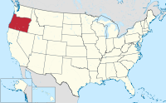
Thanks For The Chance To Talk Today!
I'd like to thank FIRST TC and Xavier Panadero of Centre de Seguretat de la Informació de Catalunya (CESICAT) for inviting me to present. I'm honored!
Thanks to to all of you for attending – I know we're close to the end of this week's meetings, and many of you will be catching trains or flights home soon.
Thanks, too, to my boss at Farsight Security, Inc., for giving me the time to attend today's meeting.
For those who may not know me, I live in Oregon -- that's the red state on the map of the United States. Some other background... ---- Oregon map by Tubs [CC BY-SA 3.0 (http://creativecommons.org/licenses/by-sa/3.0)], via Wikimedia Commons

Slide 4
Background
My Ph.D. is in Production and Operations Management from the University of Oregon.
I currently work as a Scientist for Farsight Security, Inc. Prior to working for Farsight, I was with the University of Oregon Computing Center/Information Services for about 28 years.
During part of that time, I worked under contract as Internet2's Nationwide Security Programs Manager, including running the very popular InCommon SSL/TLS Certificate Program and the popular InCommon Multifactor Authentication programs (at that time it included Duo Security and Safenet PKI hard tokens).
I'm currently one of 6 Sr Technical Advisors for M3AAWG, the Messaging, Malware and Mobile Anti-Abuse Working Group, and I'm involved with a variety of other cyber security efforts, such as the REN-ISAC TAG, the Global Cyber Alliance, and Cybergreen.

Slide 5
Content and Format
Despite all those affiliations and more, the content of today's slides represent solely my own opinions.
Speaking of my slides: as you've seen by now, I produce very detailed slides. Some people don't get why I create slides like this, so I now routinely explain my thinking on this..
I've tried the more-typical 3-4 bullets/slide (with maybe 15 slides for an hour long talk), but I found myself getting sidetracked, rambling/running over, or I end up missing/skipping stuff.
My slide style prevents a lot of those problems, and means that you don't need to try to take notes.
That said, I'm not going to read my slides word-for-word for you. You don't need to try to do so, either, although they are a sort of "closed captioning" if you are deaf or hard-of-hearing.
I also write detailed slides for those who think I talk too fast or find my American drawl hard to understand. :-)

Slide 6
What We're Going To Cover Today
I'm always torn when it comes to what to cover during a given talk. I usually end up talking about what's on my mind.
Most recently, Ponemon released a study that concerns me greatly: reportedly many sites do not know how to use network intelligence to effectively block basic incoming attacks such as brute force password cracking attacks against ssh, or email spam.
This is such a mundane (but highly critical) skill!
I know that you all already get it, and I know that it is dangerous to even bring this topic up at a meeting about incident response analytics, but I really want to enlist your help to ensure that every one can effectively use threat intelligence data!
I also specifically wanted to talk about how BGP routing data and passive DNS can be used to help you intelligently block threat sources while not causing unacceptable collateral damage.

Slide 7
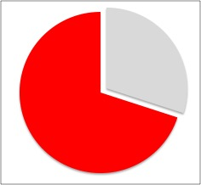
Is This Really A Problem? Yes. Ponemon Reports...
"Seventy percent of security pros said that their companies have problems taking actions based on threat intelligence because there is too much of it, or it is too complex, according to a report by Ponemon Research [....]"
"In particular, 69 percent said that their companies lacked staff expertise. As a result, only 46 percent said that incident responders used threat data when deciding how to respond to threats, and only 27 percent said that they were effective in using the data."
---- "Flood of threat intelligence overwhelming for many firms: The amount of threat information coming in from security systems is overwhelming for many companies," Nov 3, 2016 [emphasis added] http://www.csoonline.com/article/3138003/security/flood-of-threat-intelligence-overwhelming-for-many-firms.html

Slide 8
And This is True Even Though Many Of The Attacks Are Basic "unsophisticated, brute-force attacks."
Continuing with the Ponemon study... "According to a report based on two years of sensor data, 57 percent of attacks that get through firewalls and antivirus systems are unsophisticated, brute-force attacks. This is due to ongoing, automated activity by attackers running scans looking for unpatched software, default passwords, and misconfigured systems."
"These probes are constantly looking for ways that attackers can grab a foothold in a system, and there isn't much that companies can do to stop it without also locking out customers, partners, employees, and other legitimate services."
I DISAGREE.

Slide 9
This Is Just Crazy
If you can't effectively use security data to protect yourself, you're "going to war unarmed."
And as a person who works for a security data provider, hearing that people can't effectively use security data is also an obvious concern, kin to a car maker hearing that people find it hard to drive cars
The Ponemon report demands corrective training for the community.
Attacks should be -- and are -- block-able, and usually without unacceptable levels of collateral damage.
Let's make this concrete.

Slide 10
A Hypothetical System's Attack Surface
Let's think about a typical system.
Let's assume that it is a simple but well-run one, with just two Internet-accessible services:
sshd (e.g., perhaps OpenSSH)
smtpd (e.g., perhaps Postfix)
All other services are off/handled elsewhere (authoritative DNS, http and https web service, etc.)
We assume that the host is directly exposed to the Internet, and unmanaged, so it needs to do its own monitoring and defensive filtering.

Slide 11
Defensive Options (In Skeleton Form)
Option 1: Reactive (but better than nothing)
Attack observed
Block <something>
Attack observed
Block <something>
....
Option 2: Proactive (generally better than just being reactive)
Leverage one or more threat feeds to block threats already detected elsewhere
Continue to take action to block any unique local threats, too.
Share data to help others?

Slide 12
Out of Scope Today
I'm NOT going to address:
Doing housekeeping of local block lists (they can be like "Hotel California" -- "you can check in, but you can never leave")
Particularly sophisticated attacks (let's just focus the 57% of attacks that are basic/brute force attacks as first step)
Malware issues on MS Windows or Android platforms
DDoS attacks
IoT (looked like a problem with well-known passwords to me)
SCADA/control systems
Social media
The crypto wars
STIX/TAXII wars
Insider threat, etc., etc., etc.

Slide 13
We're Just Going to Cope With Two Simple Attacks
Persistent attempts to login via ssh, you know: "Hmm. Someone just tried to login as root from Africa... Do we have a sysadmin vacationing there? No? I didn't think so..."
Unwanted email, aka "spam." "Ahh. The toenail fungus email spammer. That guy just never takes no for an answer, does he?"

Slide 14
You Could Just Ignore Those Attacks, Or, You Could Try Blocking Them.
But what size filters should be applied?
Individual IP addresses, as actually seen delivering unwanted traffic?
Constant-size network blocks? (maybe the size of a subnet, such as an IPv4 /24, or an IPv6 /64? (trying to block individual IPv6 IPs is just nuts))
What if there are "rogue" net blocks sourcing unwanted traffic that are relatively large (say an IPv4 /15 or /16), while others are known to be relatively small (/27 or /28)? Should we use common sense and block those varying-size network ranges, small or large though they may be instead of blocking IP-by-IP or /24-by-/24?
What's current best-of-breed practice?

Slide 15
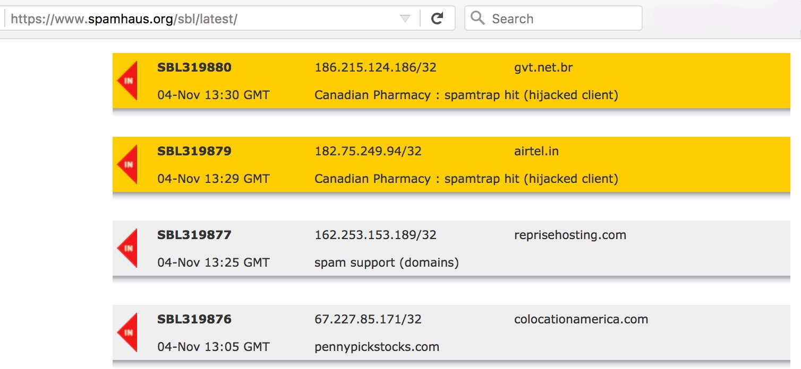
The Spamhaus SBL: It Often Lists Individual /32's
Note: While this example shows only /32's being listed, Spamhaus DOES also list larger net blocks on the SBL when it is appropriate to do so.

Slide 16
A Feed That Formerly Listed Just Fixed-Size CIDRs
# Entries consist of fields with identifying characteristics of a
# a source IP address that has been seen sending HTTP requests
# to Dragon Research Pods. This report lists hosts that are highly
# suspicious and are likely conducting malicious HTTP attacks.
# Each entry is sorted according to a route origination ASN. [...]
# netblock The source IPv4 or IPv6 network that is being reported.
# For IPv4 this will be the /24 the actual host IP is in.
# For IPv6 this will be the /64 the actual host IP is in.
[...]
https://www.dragonresearchgroup.org/insight/http-report.txt (sadly this feed is now apparently discontinued)

Slide 17
Another Spamhaus Feed That Routinely Uses Varying Size Filter Rules...
115.47.0.0/18 ; SBL299435
119.227.224.0/19 ; SBL237235
120.46.0.0/15 ; SBL262362
[...]
https://www.spamhaus.org/drop/edrop.txt
2803:5380:ffff::/48 ; SBL262056
2404:d880::/32 ; SBL297339
2401:c580::/32 ; SBL246818
2a05:4f80::/29 ; SBL257361 [...]
https://www.spamhaus.org/drop/dropv6.txt

Slide 18
Bottom Line: Block What "Makes Sense" To Block
If dealing with static point sources of unwanted traffic, adjacent IPs may be totally innocent, blocking IPv4 /32's make a lot of sense. Feel free to do that. It's the conservative choice, and easy enough if automated.
However, if we know (for example, from Whois or from a trusted source) that an attacker has gained exclusive control over a specific network range, or if the attack source is from a dynamic address range where a single abused host may be constantly renumbering, it may make more sense (or at least be more convenient) to just block a specific network range, instead. This is where judgment (or third party data) may be most helpful.
If you have no external data that will help you to more precisely localize, but you're seeing a concentrated range of IPs emitting unwanted traffic, blocking "typical" subnet-size chunks can be a pragmatic compromise.
Bu locking specific IPs is usually best, IF you can get away with it...

Slide 19
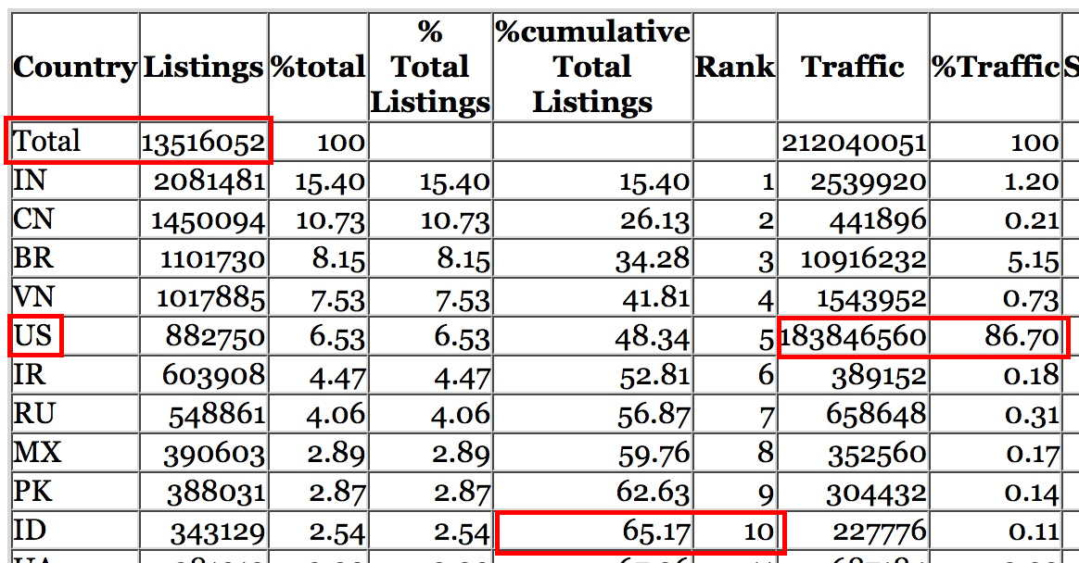
How Many IPv4 /32's Might We Have to Block? Consider the Spamhaus CBL (Composite Block List)
13.5+ million listed v4 addresses as of Nov 5 17:00:10 2016 UTC
Note: just 10 countries account for nearly 2/3rds of all listed hosts
The US alone accounts for nearly 87% of all spam traffic as sent!
Note: you will not normally be loading the whole CBL as a filter! :-;

Slide 20
Just How Patient Are You?
Beyond the issue of system capacity, how willing are you to play "whac-a-mole"* all day? If there is evidence that hundreds of hosts in a given subnet are sourcing problematic traffic, are you really going to handle that IP-by-IP? Or will you recognize that a pattern exists and deal with that entire netblock as an entity? Do you even HAVE any other realistic option if you're dealing with IPv6 addresses?
Or are you willing to go still further and block all the prefixes associated with an entire ASN or organization?
The key consideration is probably one of avoiding harm to innocent third parties, or "collateral damage." This implies keeping block sizes appropriate and understanding exactly what you're blocking. An example may help explain what I mean by this. * https://en.wikipedia.org/wiki/Whac-A-Mole

Slide 21
II. A Worked Example: ssh probes as seen in syslog data

Slide 22
syslog: A Terrific Resource That Too Few Look At
syslog is a terrific basic security diagnostic tool, but (apparently) all too few bother to look at what gets logged.
PLEASE ENCOURAGE PEOPLE TO LOOK AT THEIR LOGS!
It will improve your situational awareness/motivation: people really are trying to gain access to your systems! (no, you're not paranoid)
syslog also provides hard data to inform your blocking decisions. Making decisions based on data epitomizes the scientific process. Making decisions based on anything else is, well, an "artistic process" that I frankly don't get.

Slide 23
Centralize Your syslogging?
Use of a centralized syslogging facility (e.g. https://syslog-ng.org/ ) can potentially take many individually-unscrutinized distributed logs and convert them into a single unified resource. It's almost like having your own network of security data collection nodes!
Using centralized syslogging will:
Increase the chance that syslog data will get looked at (who is responsible for looking at syslog data at YOUR site?)
Eliminate the scenario where local/on-machine syslog data can end up being wiped by the attacker if a local node is successfully breached
Allow an integrated all-systems/"360 degree view" of attackers that may be doing an interleaved "low-and-slow" attack against multiple machines on your network all at once.

Slide 24
The Basics of Logging Authentication Failures
Checking /etc/syslog.conf (or just rummaging around /var/log a little), you should be able to figure out where authentication failures (failed logins) are getting logged on your local Unix systems. For example, one system's syslog.conf says: auth.info /var/log/authlog
If you then look at /var/log/authlog, you should see a list of failed login attempts, such as: Nov 3 20:38:04 hostname sshd[6330]: Failed password for root from 116.31.116.23 port 51925 ssh2 Nov 3 20:41:40 hostname sshd[5282]: Failed password for root from 116.31.116.23 port 13412 ssh2 [etc]

Slide 25
root logins and sshd
Just for the record, if you're seeing lots of sshd root login attempts, folks should know about a simple defense against that particular attack: -- After verifying that you can su or sudo from some other account -- In /etc/ssh/sshd_config set PermitRootLogin no -- Restart sshd # /etc/init.d/sshd restart

Slide 26
Attributing IPs to Responsible Parties: Whois
$ whois 116.31.116.23 [...] inetnum: 116.16.0.0 - 116.31.255.255 netname: CHINANET-GD descr: CHINANET Guangdong province network descr: China Telecom descr: No.31,jingrong street descr: Beijing 100032 country: CN
That's a big netblock, 116.16.0.0/12 (=16 x /16) or 1,048,576 IPv4 addresses – sure would be nice if there was some sort of indication of how those addresses were re-assigned in whois, eh?

Slide 27
Is There At Least a Crumby PTR Record for 116.31.116.23?
A PTR record, or inverse-address record, maps an IP to one or more fully qualified domain names (potentially in an untrustworthy sort of way, but nonetheless).
Unfortunately, many IP addresses (particularly in the APNIC region for some reason) will be found to NOT have PTR records. This is true for 116.31.116.23: $ dig -x 116.31.116.23 [...] ;; ->>HEADER<<- opcode: QUERY, status: NXDOMAIN, id: 5943 ;; flags: qr rd ra; QUERY: 1, ANSWER: 0, AUTHORITY: 1, ADDITIONAL: 0

Slide 28
What Do We Find If We Check Passive DNS?
There's not anything there for this specific IP in passive DNS: $ dnsdb_query.py -i 116.31.116.23 HTTP Error 404: Not Found
"What's that dnsdb_query.py command?" That's one (of multuple) ways you can access Farsight's DNSDB passive DNS API. See: -- https://api.dnsdb.info/ -- https://github.com/dnsdb/dnsdb-query Other passive DNS implementations will have analagous query capabilities...

Slide 29
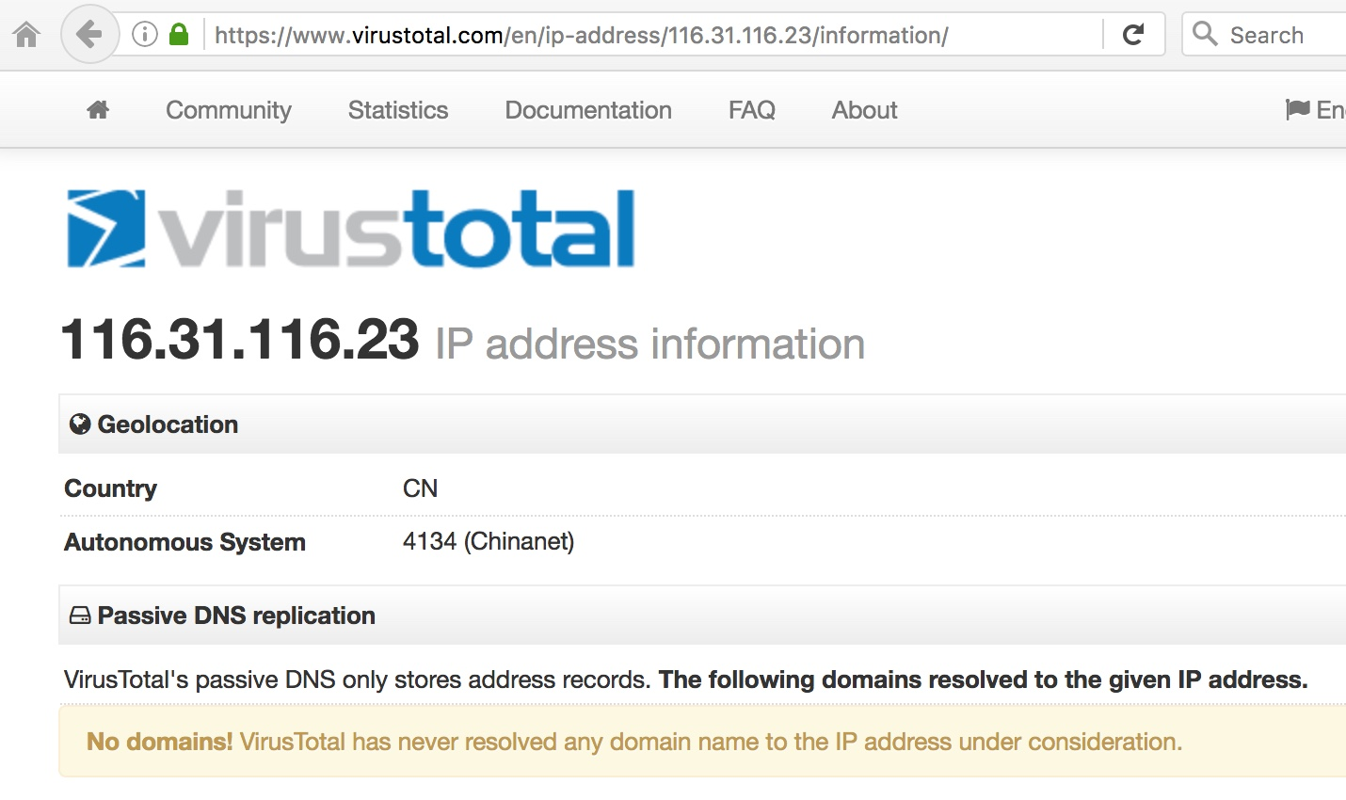
Example of Checking Another Passive DNS Provider

Slide 30
[Pink == Backfill]... What's "Passive DNS?"
Passive DNS is a NoSQL database created by watching DNS traffic, typically cache miss traffic (queries and responses) captured above large recursive resolvers. By collecting passive DNS data above large recursive resolvers, queries seen appear to come from the resolver, not a specific user (so privacy gets preserved).
Passive DNS allows a security analyst to get answers to queries that regular DNS can't address, including:
"What FQDNs have been seen on IP foo or in CIDR block bar?"
"What FQDNs use name server ns1.example.com?"
"Given FQDN alpha.bravo.charlie, where (what IP addresses) has that FQDN been seen using?"
"Given base domain bravo.charlie, what FQDNs are known to live under that base domain?"
Bottom line -- passive DNS is useful for "pivoting" or taking an initial clue and finding related items ("guilt by association").

Slide 31
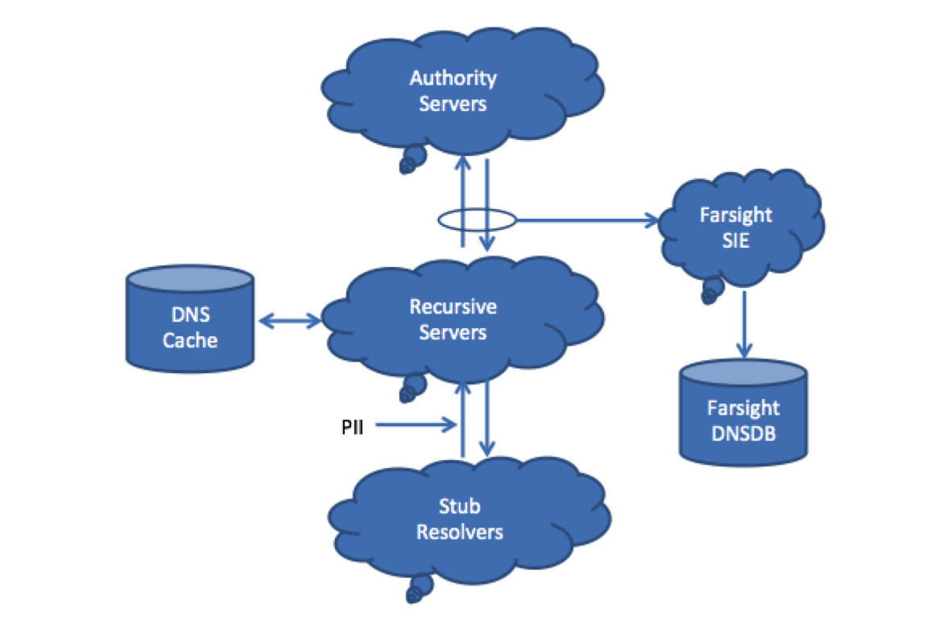

Slide 32
Some Entities Offering Passive DNS Services
Farsight Security, Inc. offers DNSDB (see https://dnsdb.info/ )
DNSDB is a commercial (licensed) product, but individual law enforcement officers (LEOs), vetted academic researchers, and vetted-but-unfunded "Internet superheroes" can request free (grant) access to DNSDB.
Some other passive DNS implementations include:
Florian Weimer's BFK, http://www.bfk.de/bfk_dnslogger.html
CERT.at/Aconet Passive DNS (inquire: kaplan@cert.at or lendl@cert.at)
CIRCL Passive DNS, http://www.circl.lu/services/passive-dns/
http://passivedns.mnemonic.no/search/
https://www.opendns.com/enterprise-security/resources/data-sheets/investigate/
https://www.cs.auckland.ac.nz/research/groups/sde/dhdb-index.php
VirusTotal, https://www.virustotal.com/#search (shown a few slides ago)
360.cn Passive DNS, https://www.passivedns.cn/help/
If I missed any other passive DNS sites, please drop me a note...

Slide 33
Let's Also Check Oregon Routeviews
$ telnet route-views.oregon-ix.net login: rviews route-views>show ip bgp 116.31.116.23 BGP routing table entry for 116.31.96.0/19, version 93702655 [...] 3549 3356 4134 134764 [...] q route-views>exit
What does this tell us? Well, we've now localized that abuse source from an IPv4 /12 (1,048,576 addresses) all the way down to an IPv4 /19, just 8,192 IPv4 addresses.
We also now have a responsible party, the ASN that's routing 116.31.96.0/19, AS134764.

Slide 34
Don't Like telnet? There's Also Two DNS Zone
$ dig -t txt 23.116.31.116.aspath.routeviews.org +short
"47872 3356 4134 134764" "116.31.96.0" "19"
You can easily write a little shell script or perl script to form asn or aspath zone queries for you. E.g., if you just want the origin asn: $ ip2asn 116.31.116.23 134764 116.31.116.23 See the next page.
Want the raw zone to run from a local server for lower latency, higher throughput, or total control? Mirror that zone locally. See http://ftp.routeviews.org/dnszones/

Slide 35
The Little ip2asn shell Script
#!/bin/sh
origip=`echo $1`
revip=`echo $1 | sed 's/\([0-9]*\)\.\([0-9]*\)\.\([0-9]*\)\.\([0-9]*\)/\4.\3.\2.\1/'`
listing=`host -w -t txt ${revip}.asn.routeviews.org 2>/dev/null | tail -1 `
listing2=`echo ${listing} | awk '{print $4}' | sed 's/"//g'`
echo "${listing2} ${origip}"
Notes: Required "host" command arguments may vary from system to system. This simple script shows only a single Route Origin ASN, and does not attempt to deal with Multiple ROAS. Beware tick vs backtick in the above, and multi-line commands. Inputs are not sanitized–not for use as a public Internet gateway

Slide 36
Sources of BGP Routing Data
In addition to Oregon Routeviews which we've already mentioned, see also:
RIPE's RIS Raw Data Service https://www.ripe.net/analyse/internet-measurements/routing-information-service-ris/ris-raw-data (including data from rrc18.ripe.net right here in Barcelona!)
Team Cymru's terrific IP to ASN mapping service, see http://www.team-cymru.org/IP-ASN-mapping.html (please be sure to note and honor their terms of service for bulk queries!)

Slide 37
But What Is "Routeviews"?
Numerous ISPs contribute BGP routing table views to the Oregon Routeviews project, see http://www.routeviews.org/
Routeviews was "originally conceived as a tool for Internet operators to obtain real-time information about the global routing system from the perspectives of several different backbones and locations around the Internet."
That said, it (and similar BGP resources, such as RIPE's BGP data) are also terrific tools to support data driven security research.
BGP data excels for four security-research-related purposes:
Identifying the origin/length of the most compact enclosing CIDR prefix that's routing an IP of interest
Finding additional related network blocks that are linked to an initial network address of interest
Tying address blocks to ASNs for reputational assessment purposes
Helping to identify appropriate reporting targets for problematic activity.

Slide 38
Closest Encompassing CIDR Netblock
In an ideal world, each provider would have one contiguous netblock, and that netblock would be advertised in aggregate via BGP with a consistent worldwide routing policy, etc.
In the real world, providers often have multiple discontinuous blocks, or they deaggregate large netblocks into smaller blocks with each of those blocks taking up a slot in global routing tables.
In thinking about what to block, we'd normally want the most closely encompassing CIDR netblock around a source of badness.
We may find that by looking at IP Whois, inspecting PTR records, or in the current case, by checking BGP data.
Yes, a bad guy certainly could have IP assets that span multiple netblocks as defined in IP Whois, or multiple BGP routing table entries, but these are the best options we have for hints about scoping initial filter blocks that I'm aware of.

Slide 39
Backup, Please -- What's An "ASN?"
Routing tables show who's announcing each CIDR prefix, and what's the best path to each of those prefixes. That path is expressed in terms of "autonomous system numbers," or "ASNs."
Each ASN represents a network. Large organizations running their own networks (like a university, ISP, or large company), will usually have their own ASN.
A convenient list of ASNs showing owners is available online at http://bgp.potaroo.net/cidr/autnums.html
You can also lookup ASNs in Whois, just like any other Internet number resource.

Slide 40
Whois AS134764? whois.apnic.net says...
$ whois -h whois.apnic.net as134764 [select records only] aut-num: AS134764 as-name: CT-FoShan-IDC descr: CHINANET Guangdong province network descr: Data Communication Division descr: 510000 country: CN "Foshan, formerly romanized as Fatshan, is a prefecture-level city in central Guangdong Province in southeastern China. [...] It forms part of the western side of the Pearl River Delta Economic Zone, which includes Guangzhou to the north and Shenzhen to the east. [...] Foshan is regarded as the home of the Cantonese forms of Chinese opera, kung fu, lion dancing, and dragon boat racing." https://en.wikipedia.org/wiki/Foshan

Slide 41
Have Others Seen Probes From That Same IP? Yep...
# Entries below consist of fields with identifying characteristics of a
# a source IP address that has been seen attempting to remotely login to
# a host using SSH password authentication. This report lists hosts
# that are highly suspicious and are likely conducting malicious SSH
# password authentication attacks. Each entry is sorted according to a
# route origination ASN. [...] 134764 | CT-FOSHAN-IDC CHINANET Guangdo | 116.31.116.4 | 2016-11-06 00:59:44 | sshpwauth
134764 | CT-FOSHAN-IDC CHINANET Guangdo | 116.31.116.5 | 2016-11-06 00:59:50 | sshpwauth
134764 | CT-FOSHAN-IDC CHINANET Guangdo | 116.31.116.6 | 2016-11-06 01:00:00 | sshpwauth
134764 | CT-FOSHAN-IDC CHINANET Guangdo | 116.31.116.7 | 2016-11-01 14:47:57 | sshpwauth
134764 | CT-FOSHAN-IDC CHINANET Guangdo | 116.31.116.8 | 2016-11-06 00:20:31 | sshpwauth
134764 | CT-FOSHAN-IDC CHINANET Guangdo | 116.31.116.9 | 2016-11-06 00:59:56 | sshpwauth
134764 | CT-FOSHAN-IDC CHINANET Guangdo | 116.31.116.10 | 2016-11-06 00:59:29 | sshpwauth
134764 | CT-FOSHAN-IDC CHINANET Guangdo | 116.31.116.11 | 2016-11-06 00:59:36 | sshpwauth
134764 | CT-FOSHAN-IDC CHINANET Guangdo | 116.31.116.14 | 2016-11-06 00:59:31 | sshpwauth
134764 | CT-FOSHAN-IDC CHINANET Guangdo | 116.31.116.17 | 2016-11-06 00:59:48 | sshpwauth
134764 | CT-FOSHAN-IDC CHINANET Guangdo | 116.31.116.18 | 2016-11-06 00:59:41 | sshpwauth
134764 | CT-FOSHAN-IDC CHINANET Guangdo | 116.31.116.20 | 2016-11-06 01:59:52 | sshpwauth
134764 | CT-FOSHAN-IDC CHINANET Guangdo | 116.31.116.21 | 2016-11-03 02:35:36 | sshpwauth
134764 | CT-FOSHAN-IDC CHINANET Guangdo | 116.31.116.23 | 2016-11-06 00:59:59 | sshpwauth
134764 | CT-FOSHAN-IDC CHINANET Guangdo | 116.31.116.24 | 2016-11-05 01:28:19 | sshpwauth
[etc]
Source: https://dataplane.org/sshpwauth.txt (selected records only, sorted, emphasis added)

Slide 42
Maybe Just Block Using 3rd Party Feeds?
If https://dataplane.org/sshpwauth.txt site (or some other publicly available ssh threat feed) is reflecting the same attack sources that we're seeing, maybe it would make sense to pre-emptively block those traffic sources when they first appear in that threat feed? Doing so might let you automatically block most of the specific /32's that might eventually be hitting you.
However, two points: you must trust the operator of any third party operator you rely on, and the badness that anyone else sees might or might not correspond to the badness that you see now or will see in the future (although I will say that the dataplane.org attackers seem to line up well with what I personally see, and I completely trust the operator of that resource).

Slide 43
Default Deny, Whitelisting Exceptions?
For some small sites with well defined populations, another option is to go to a default deny approach, only permitting connections from a closely defined list of allowed addresses. That is, for a first-match filter: Allow as an exception: IP_address_1 Allow as an exception: IP_address_2 Otherwise (default option): deny [etc]
You can certainly try that approach if your needs allow, but we'll assume that this isn't a practical option for most larger sites, particularly if you have a user base that connects via dynamic IPs, etc.
More common alternatives that can work well for larger sites or sites with authorized users connecting via dynamic IPs? See the next slide...

Slide 44
Block Heuristically? Rate Limit? Preshared Keys Only?
You could also just block ssh brute force attack traffic automatically with fail2ban ( http://www.fail2ban.org/ ), etc.
Some people don't like that approach, worrying that it may impact legitimate users or cause problems in heavily NAT'd environments, preferring a simpler approach that rate limits login attempts per IP per unit time, see http://serverfault.com/questions/216995/is-it-worth-the-effort-to-block-failed-login-attempts , suggesting, e.g.: iptables -I INPUT -p tcp --dport 22 -i eth0 -m state --state NEW -m recent –set iptables -I INPUT -p tcp --dport 22 -i eth0 -m state --state NEW -m recent --update --seconds 60 --hitcount 4 -j DROP
Use ssh preshared keys (only) (potentially leveraging smartcards such as https://developers.yubico.com/PGP/SSH_authentication/ ) or require multifactor (e.g., see https://duo.com/docs/duounix )

Slide 45
OR You Could Block Locally (And AT SCALE)
Yet another option: maybe you and your authorized users don't ssh in from Asia and you're fed up with being probed, and you're willing to be more aggressive, perhaps blocking the encompassing /19 we saw in the Routeviews data (or even the entire original /12 we saw from the original IP Whois)?
Before doing that, wouldn't it be nice to get an idea of what you'd be blocking, so you can avoid any unexpected false positives?
And maybe, if you do check, you might find an interesting potential connection to the unwanted traffic you may be seeing, either a resource purchased/controlled by the attacker, or a third party whose site has been successfully attacked and compromised by an attacker? Let's check passive DNS, either via the web interface at https://dnsdb.info (max 10,000 results) or via the API (next slide).

Slide 46
What Has DNSDB Seen For 116.31.96.0/19 During Just The Last Month?
$ dnsdb_query.py -l 1000000 --after=30d -i 116.31.96.0/19 --sort=rdata > 116.31.96.0.txt
$ wc -l 116.31.96.0.txt
8879 116.31.96.0.txt
$ less 116.31.96.0.txt
[...]
ly.ff768.com. IN A 116.31.115.92
pay.qiqiuc.net. IN A 116.31.116.130
server1.qiqiuc.net. IN A 116.31.116.130
lixingnz.com. IN A 116.31.116.185
frenchgo.servegame.com. IN A 116.31.116.40
digitalpartnerconnect.com. IN A 116.31.116.7 ← note the IP
yfwin.com. IN A 116.31.118.10
[...]

Slide 47
What Does Domain Whois Say About digitalpartnerconnect.com? (selected records)
$ whois digitalpartnerconnect.com Domain Name: digitalpartnerconnect.com
Creation Date: 2016-04-11T05:12:55Z
Registrant Name: DigitalPartner Solutions
Registrant Organization: Digita Partner Solutions
Registrant Street: 0
Registrant Street: Ortigas Extebsion
Registrant City: Pasig
Registrant State/Province: ph
Registrant Postal Code: 1600
Registrant Country: PH
Registrant Phone: +63.09236800000
Registrant Email: info@digitalpartnersolutions.com ← note domain

Slide 48
Chaining to digitalpartnersolutions.com (selected records)
$ whois digitalpartnersolutions.com Domain Name: DIGITALPARTNERSOLUTIONS.COM
Creation Date: 2015-03-09T14:47:24Z
Registrant Name: R G
Registrant Organization: Digita Partner Solutions
Registrant Street: One Oasis Ortigas Extension
Registrant City: Pasig
Registrant State/Province: NCR
Registrant Postal Code: 1600
Registrant Country: PH
Registrant Phone: +63.0000000000 ← Cool phone number
Registrant Email: info@digitalpartnersolutions.com
[etc]

Slide 49
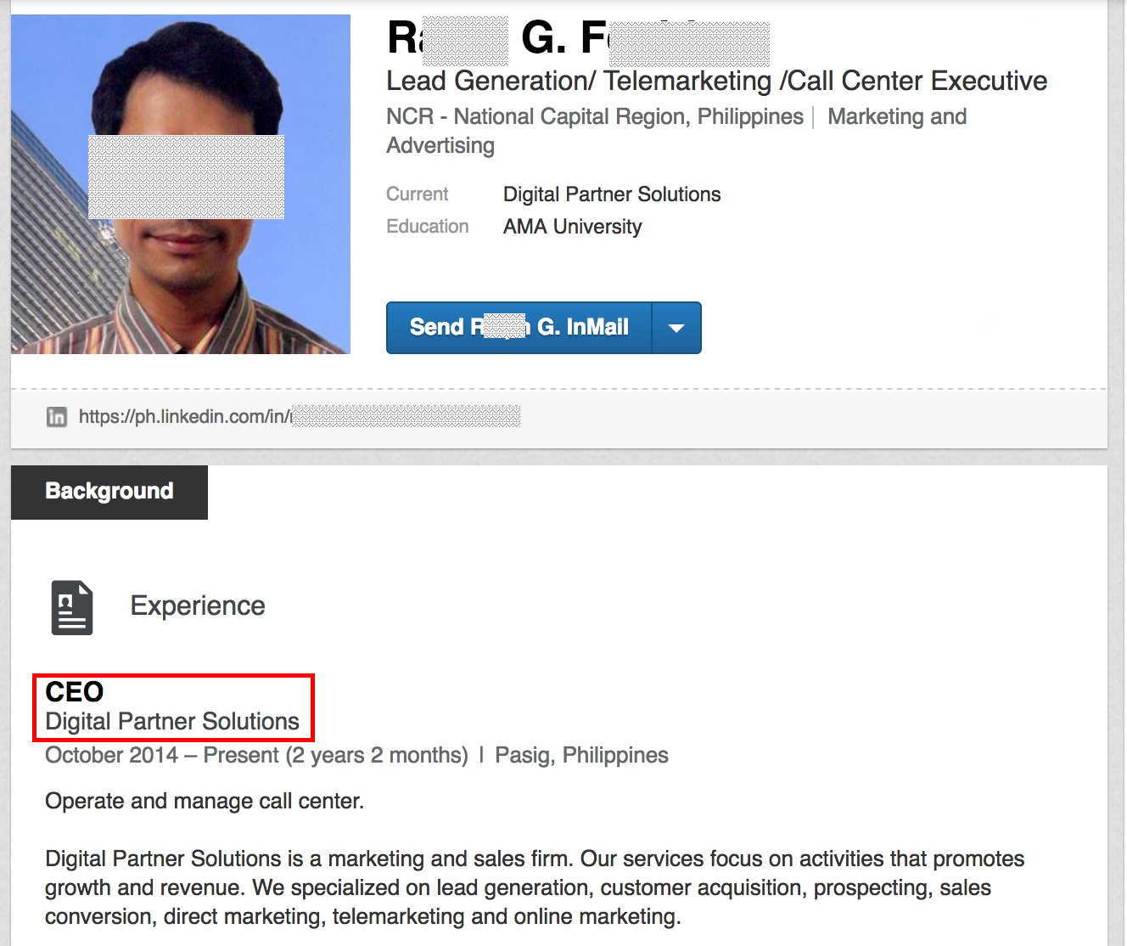
Connecting A Person To That Company...

Slide 50
Netblock Reputation: What Else Has Been Seen In 116.31.96.0/19 During The Last 30 Days? ["Snow"]
$ less 116.31.96.0.txt
[...] yiyue1.top. IN A 116.31.100.161
yiyue2.top. IN A 116.31.100.161
yiyue3.top. IN A 116.31.100.161
yiyue4.top. IN A 116.31.100.161
yiyue5.top. IN A 116.31.100.161
yiyue6.top. IN A 116.31.100.161
yiyue7.top. IN A 116.31.100.161
dongpo1.top. IN A 116.31.100.161
dongpo2.top. IN A 116.31.100.161
dongpo3.top. IN A 116.31.100.161
dongpo4.top. IN A 116.31.100.161
dongpo5.top. IN A 116.31.100.161
dongpo6.top. IN A 116.31.100.161 juntao1.top. IN A 116.31.100.161
juntao2.top. IN A 116.31.100.161
juntao3.top. IN A 116.31.100.161
juntao4.top. IN A 116.31.100.161
juntao5.top. IN A 116.31.100.161
juntao6.top. IN A 116.31.100.161
juntao7.top. IN A 116.31.100.161
juntao8.top. IN A 116.31.100.161
juntao9.top. IN A 116.31.100.161
jzbao81.top. IN A 116.31.100.161
jzbao82.top. IN A 116.31.100.161
jzbao83.top. IN A 116.31.100.161
jzbao84.top. IN A 116.31.100.161
jzbao85.top. IN A 116.31.100.161
jzbao86.top. IN A 116.31.100.161
jzbao87.top. IN A 116.31.100.161 [etc]

Slide 51
Also From 116.31.96.0/19 During The Last 30 Days? [almost looks algorithmic/random, eh?]
$ less 116.31.96.0.txt
[...] aghwg.cn. IN A 116.31.123.191
akavx.cn. IN A 116.31.123.191
aogrz.cn. IN A 116.31.123.191
apzls.cn. IN A 116.31.123.191
bftzi.cn. IN A 116.31.123.191
ccouw.cn. IN A 116.31.123.191
dkcvh.cn. IN A 116.31.123.191
drfle.cn. IN A 116.31.123.191
dvrhp.cn. IN A 116.31.123.191
dwsau.cn. IN A 116.31.123.191
ekntf.cn. IN A 116.31.123.191
elzjo.cn. IN A 116.31.123.191
fabqy.cn. IN A 116.31.123.191
fvmdt.cn. IN A 116.31.123.191
idvif.cn. IN A 116.31.123.191
ifuvq.cn. IN A 116.31.123.191
jdrfe.cn. IN A 116.31.123.191
jkzbr.cn. IN A 116.31.123.191
jpkur.cn. IN A 116.31.123.191
ofeuj.cn. IN A 116.31.123.191
oiasi.cn. IN A 116.31.123.191
okivw.cn. IN A 116.31.123.191 onfys.cn. IN A 116.31.123.191
rjuyn.cn. IN A 116.31.123.191
rkdhb.cn. IN A 116.31.123.191
robkd.cn. IN A 116.31.123.191
sijre.cn. IN A 116.31.123.191
syubf.cn. IN A 116.31.123.191
tvkkf.cn. IN A 116.31.123.191
[etc]

Slide 52
The Blocking Of That Which You Don't Want
A bake-off of blocking options is really beyond the scope of today's talk
We'll just mention one example by way of illustration: if your system uses pf (*BSD, Mac, etc) and you like pf, try adding to /etc/pf.conf table <unwanted> persist file "/etc/unwanted.txt" block in on interfacename from <unwanted> to any where /etc/unwanted.txt contains a list of prefixes you want to filter.
Remember to sanity check and then reload after any changes with: pfctl -v -n -f /etc/pf.conf pfctl -f /etc/pf.conf
The Book of PF by Hansteen is a nice potential addition to your library, or see the "PF - User's Guide" at https://www.openbsd.org/faq/pf/

Slide 53
What If I Just Want to Block Prefixes in Postfix?
Sometimes you may not want to block at the pf level. For example, maybe you just want to block access for a specific application, such as smtpd. We assume that you're running Postfix.
If so, create /etc/postfix/client.cidr, with one CIDR prefix to block per line
Reload after any changes with: # postmap client.cidr
Some Postfix documentation worth consideration:
The Book of Postfix by Hildebrandt and Koetter
Postfix: The Definitive Guide by Kyle Dent
The online documentation: http://www.postfix.org/documentation.html

Slide 54
Having Blocked 116.31.96.0/19, 117.21.224.127 Soon Made Its Appearance As A Replacement...
Nov 6 19:16:20 hostname sshd[30266]: Failed password for root from 117.21.224.127 port 3780 ssh2 Nov 6 19:28:27 hostname sshd[12513]: Failed password for root from 117.21.224.127 port 3907 ssh2
$ telnet route-views.oregon-ix.net Username: rviews route-views>show ip bgp 117.21.224.127 BGP routing table entry for 117.21.0.0/16, version 92690576 [etc] (that's "CHINANET Jiangxi province network" per whois)
Lather, rinse, repeat...

Slide 55
And Then There's...
Nov 7 13:32:29 hostname sshd[4592]: Failed password for invalid user admin from 91.200.12.61 port 1604 ssh2 $ ip2asn 91.200.12.61 35804 91.200.12.61 AS35804 = PP SKS-LUGAN (Ukraine), just 20,992 total IPv4 IPs
Nov 7 18:25:36 hostname sshd[15332]: Failed password for root from 58.115.32.106 port 52768 ssh2 $ ip2asn 58.115.32.106 9416 58.115.32.106 A9416 = Hoshin Multimedia Center, Inc (TW), 1,157,632 IPs (large provider)

Slide 56
And Then There's... (2)
Nov 7 17:48:59 hostname sshd[1838]: Failed password for invalid user ubnt from 123.31.35.50 port 60391 ssh2 $ ip2asn 123.31.35.50 45899 123.31.35.50 AS45899 = VNPT Corp (VN), 5,146,112 IPs (large provider)
Nov 7 19:38:38 hostname sshd[17544]: Failed password for root from 37.247.101.241 port 38376 ssh2 $ ip2asn 37.247.101.241 199366 37.247.101.241 AS199366 = Yesilbir Bilisim Teknolojileri Bilgisayar Yayincilik Sanayi ve Ticaret Ltd. Sti. (Turkey), just 4,352 IPs

Slide 57
And Then There's... (3)
Nov 7 20:16:27 hostname sshd[25639]: Failed password for root from 198.154.63.92 port 41213 ssh2 $ ip2asn 198.154.63.92 26272 198.154.63.92 AS26272 = Fortacloud (US), just 10,240 IPs
Nov 7 23:12:50 hostname shd[8272]: Failed password for root from 155.133.82.159 port 53134 ssh2 $ ip2asn 155.133.82.159 197226 155.133.82.159 AS197226 = "SPRINT" S.A. (PL), just 15,360 IPs [etc., etc., etc.]

Slide 58
And Then There's... (4)
Nov 9 18:12:03 hostname sshd[3657]: Failed password for invalid user admin from 195.154.57.248 port 8746 ssh2 $ ip2asn 195.154.57.248 12876 195.154.57.248 Online S.A.S, 311,296 IPv4 addresses (large provider)
Nov 9 18:23:33 hostname sshd[18770]: Failed password for root from 81.90.13.26 port 48392 ssh2 $ ip2asn 81.90.13.26 12739 81.90.13.26 CJSC Netline, just 10,240 IPv4 addresses [etc., etc., etc.] – do you have a new (boring) hobby?

Slide 59
Really "Going For It:" Blocking Entire ASNs
You may encounter some ASNs where legitimate uses of the ASN appears to be hard to find
In that case, at least on more specialized systems, you may decide to block entire ASNs, particularly if the ASN is obscure and only routing a comparative handful of prefixes.
To be clear: this is a big step, and not one to be undertaken casually. I officially recommend that you only take this approach VERY RARELY.
If you decide you ARE going to go down this road, you'll need a list of prefixes to block since most end-user systems can't block an ASN (as such) directly. Remember to think about IPv4 and IPv6. Routeviews can give you a list of prefixes associated with a given ASN. Once you have those, you can filter them as you otherwise would. (Note that any new additional prefixes will not somehow automatically get added over time)

Slide 60
Example: Finding All Prefixes Belonging to UO Itself
$ telnet route-views.oregon-ix.net login: rviews route-views>show ip bgp regex _3582$ Network Next Hop Metric LocPrf Weight Path * 128.223.0.0 208.51.134.254 2515 0 3549 3356 3701 35 [blah blah blah] * 163.41.128.0/17 208.51.134.254 2515 0 3549 3356 3701 35 [blah blah blah] * 184.171.0.0/17 208.51.134.254 2515 0 3549 3356 3701 3582 i [blah blah blah] * 207.98.72.0/21 208.51.134.254 2515 0 3549 3356 3701 3582 i [blah blah blah] route-views>quit
Notes:
This is just an example. I have no reason to believe that you should block all traffic from UO!
When searching for prefixes originated by an ASN, be careful not to overmatch (the _ before UO's ASN mean "must be a space before the ASN" and the $ after the ASN says that the "ASN must be at the end of the ASPath" (e.g., AS3582 is the originating ASN, not a transit ASN)

Slide 61
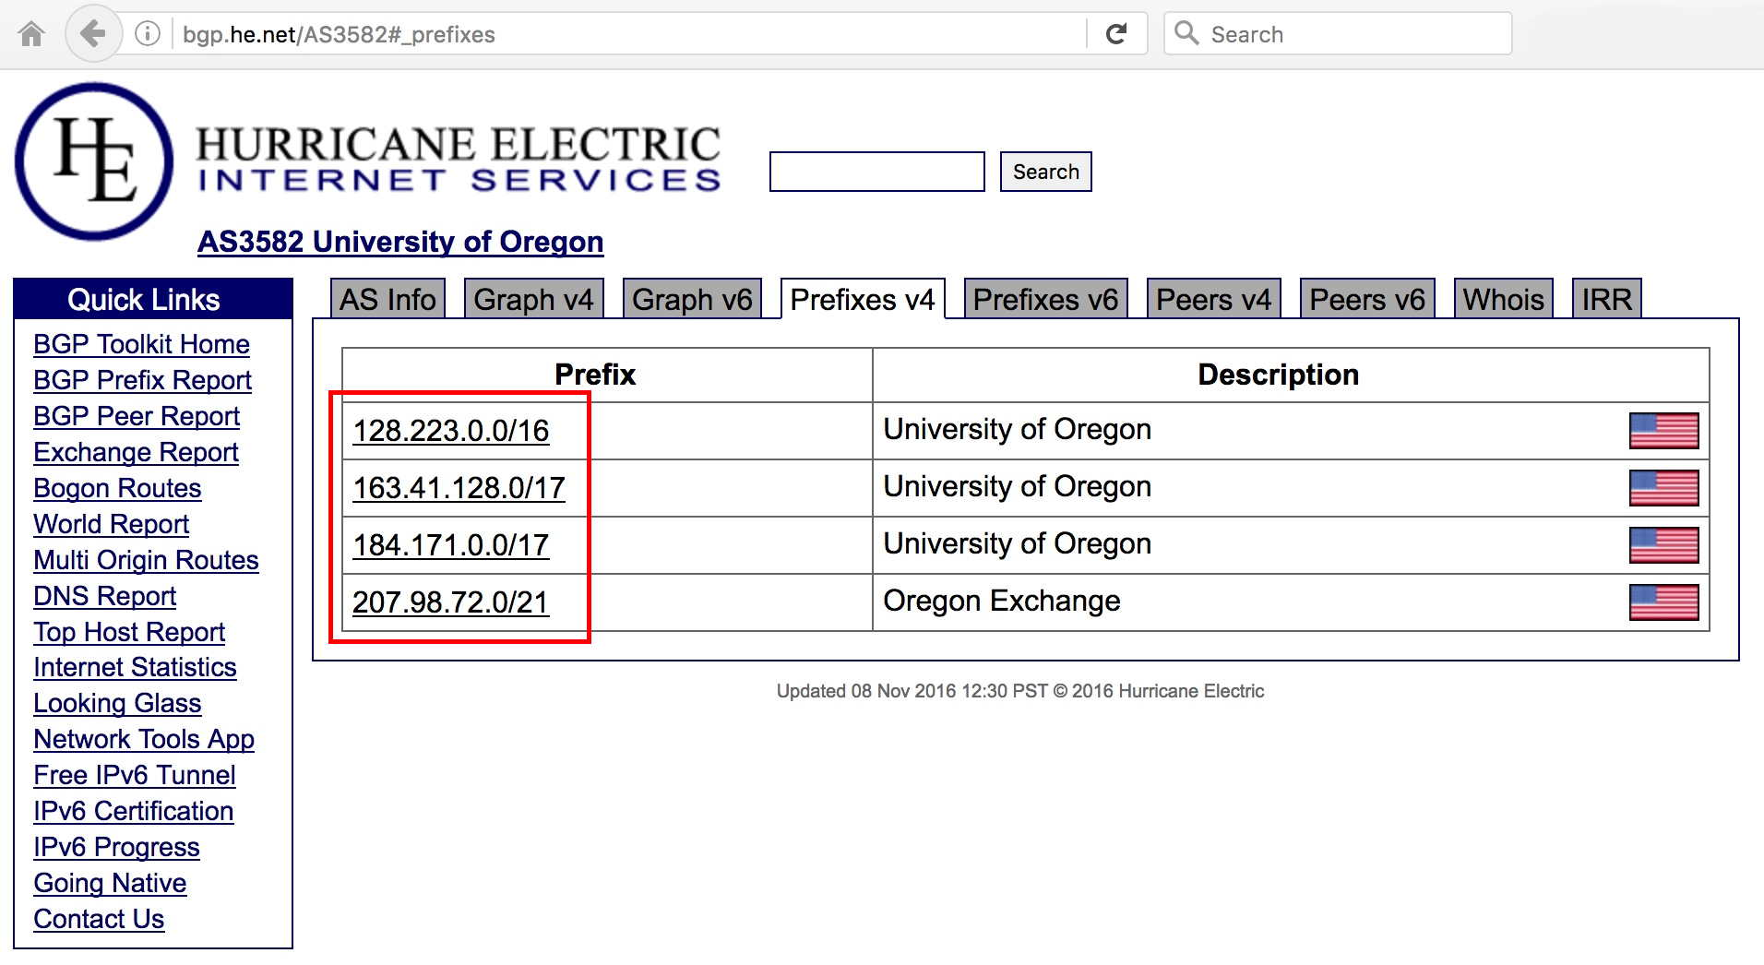
An Easier Alternative Approach To Finding Prefixes
[An amusing aside: I once had someone ask, "Is this sort of information supposed to be available?" :-) ]

Slide 62
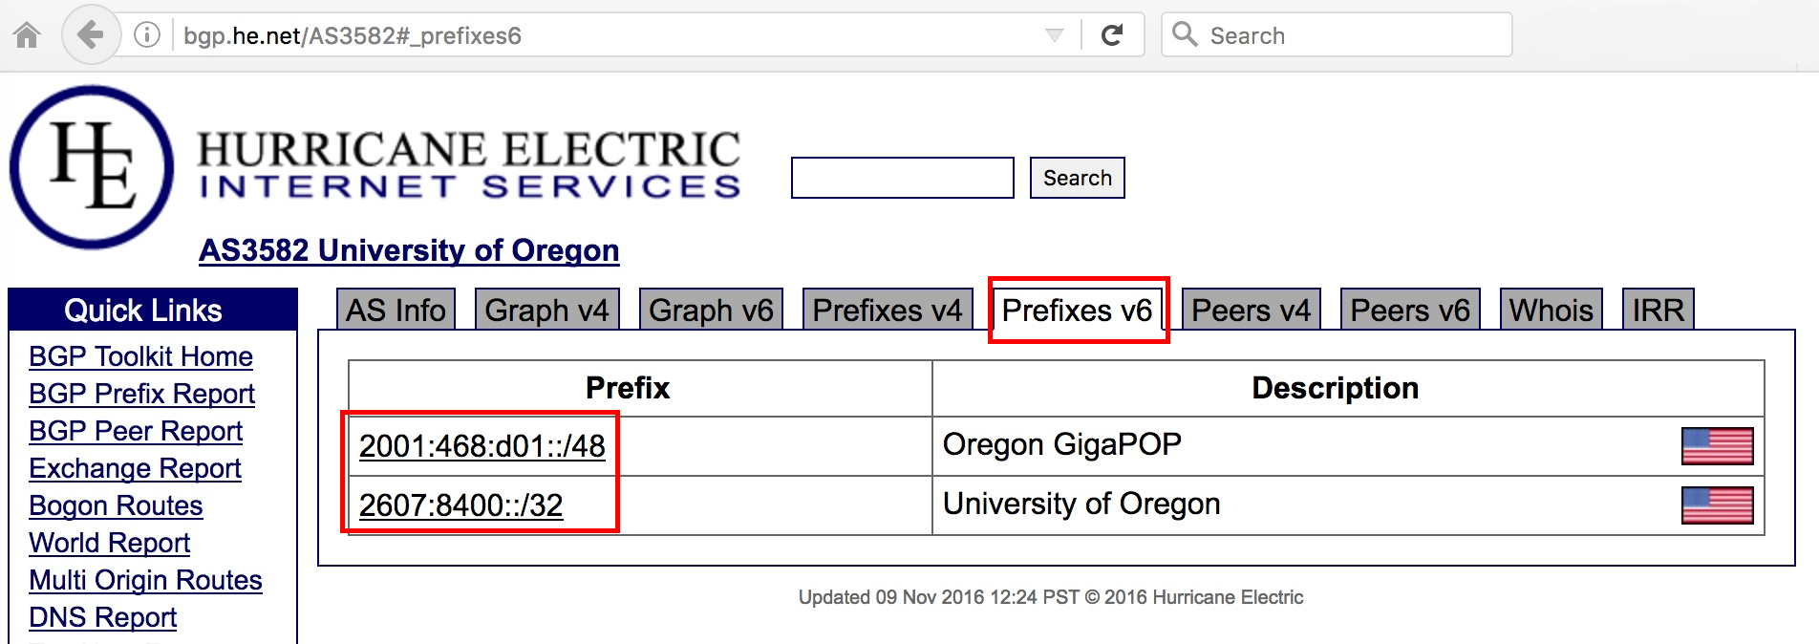
And Don't Forget About IPv6, Too...

Slide 63
If You Are Trying To Block An Entire Entity...
While most entities use only a single ASN, some entities may use more than one ASN. If you're attempting to block an entire specific entity, be sure to identify ALL the ASNs they may be using so that you can expand ALL those ASNs into the corresponding prefixes to block. Sometimes you can readily find these on a list of ASNs, otherwise you may need to scrutinize the Hurricane Electric site's BGP graphs for hints.
In other cases, some entities may NOT have an ASN of their own. They may simply be announced as part of some larger organization's network. Blocking large shared ASNs is virtually ALWAYS a BAD idea.
If you see lots of IPs or lots of prefixes, I'd ALSO strongly encourage you to think twice about blocking by ASN. The bigger the ASN, the greater the likelihood you'll cause unacceptable collateral damage.

Slide 64
Factors Impacting Collateral Damage Levels
You're at more risk of interfering with legitimate traffic if the candidate ASN is from: -- Your own home country -- Uses the same language(s) that you and your users use
Other attributes that correlate with a higher probability of problems: -- A large user base (the bigger the user base, the greater the statistical probability that someone will want to interact with any given prefix) -- A diverse international user base (universities tend to have students from "everywhere;" likewise international businesses may transact business with overseas customers from all over the place, for example) -- High value interactions (if the loss of even a single transaction might have an impact involving millions of dollars, broad filtering can become more potentially expensive) -- High user expectations for ease of use and universal availability (if you say "we'll bring you the whole world," don't block big chunks of it!) -- No way for users to opt out of the filtering.

Slide 65
"Courtesy Notices" To The Party Getting Blocked?
I should also touch on the idea of courtesy notices – some polite folks believe that it is good form to drop a responsible party at a network that's about to be blocked a note before you block them. I get that notion in theory, however in practice...
Abuse reporting contact addresses at troubled networks will often bounce (the address may now be non-existent, or the mailbox may be full), or the mailbox may go unread even if it's able to be delivered. (You may not be the only one sending courtesy notices/complaints)
You're likely wasting your time (a well run network will be monitoring its traffic with Netflow, and shouldn't need reports from 3rd parties to alert it to problematic behaviors (like outbound ssh to thousands of hosts))
This may be a bit like an ant notifying an elephant that he will no longer be saying "hello" in the morning (the third party provider may not care)
You may actually be helping to educate the bad guys (your notice may be passed along verbatim, directly to them, or the bad guys may actually be running some networks)

Slide 66
Sharing Data With Trusted Third Parties
On the other hand, if you do have the time and inclination, you may want to share information about badness you've noticed with trusted third parties, including national or regional CERTs, ISACs, etc.
By sharing data, you have the ability to positively impact not just the security of your own site, but also the security of other sites.
Sharing data will often result in others reciprocally sharing data with you.
Data sharing can be as simple as manual email to a trusted mailing list, or you may want to investigate a scalable data sharing format such as the Collective Intelligence Framework (see http://csirtgadgets.org/ )
Be sure to pay attention to any applicable laws or regulations: I am not an attorney and cannot provide legal advice, but you should talk with an attorney before embarking on any new data sharing project.
If your network is potentially interested in sharing passive DNS data with Farsight, we'd be glad to hear from you (the better/more inclusive the data in passive DNS, the better the decisions that people can make from it... including decisions NOT to block due to collateral damage)

Slide 67
III. Worked Example Two: Unwanted Mail

Slide 68
A Piece of Blocked Email That Was Meant For Me
Connecting host: yeua7oi.mastann.top [69.162.69.121]
EHLO gaui8as.ffcheek.top
MAIL FROM:<Toenail-Fungus-Awareness@gaui8as.ffcheek.top> BODY=7BIT RET=HDRS
Let's begin with three points relating to the connecting host's domain name...
What do we know about the "top" TLD?
What does the Valli Multi RBL checker think about the base domain (mastann.top) – is it listed on any block lists?
Once we've checked that, then let's check the domain Whois info

Slide 69
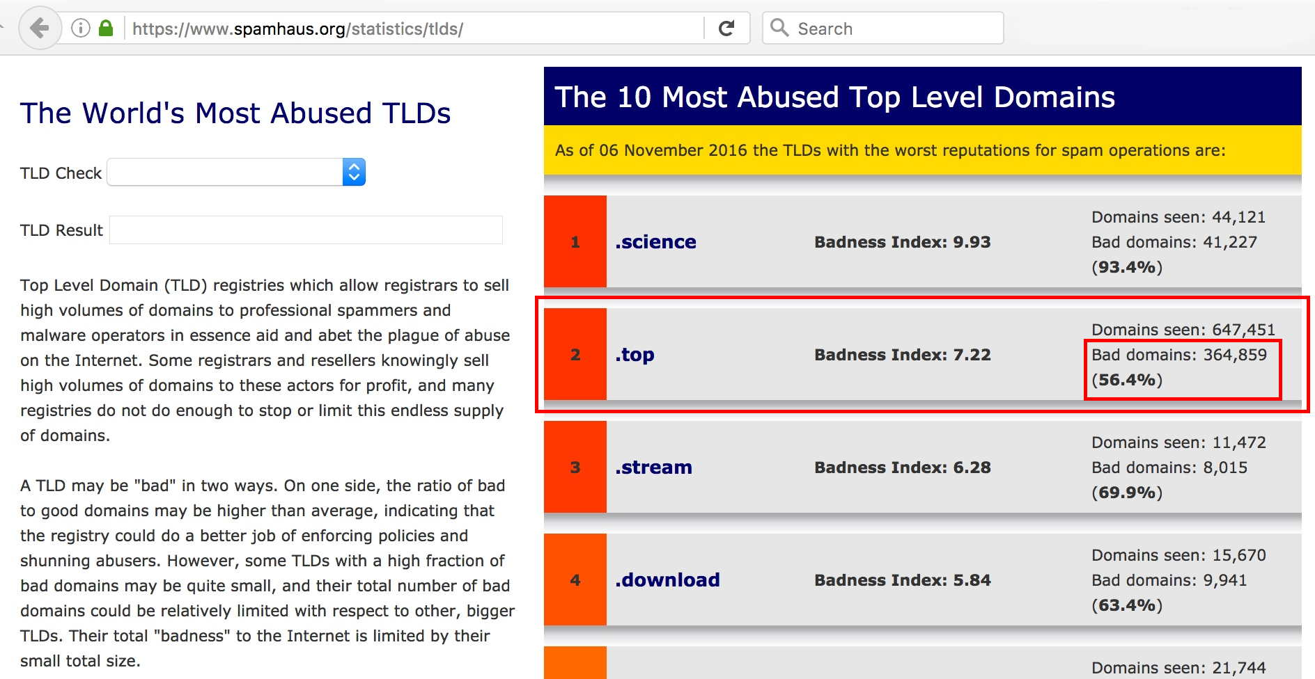
Spamhaus' Assessment of Most Abused TLDs
For those in the back, that's 364,859 bad domains, 56.4% of all .top domains are bad... wow.

Slide 70
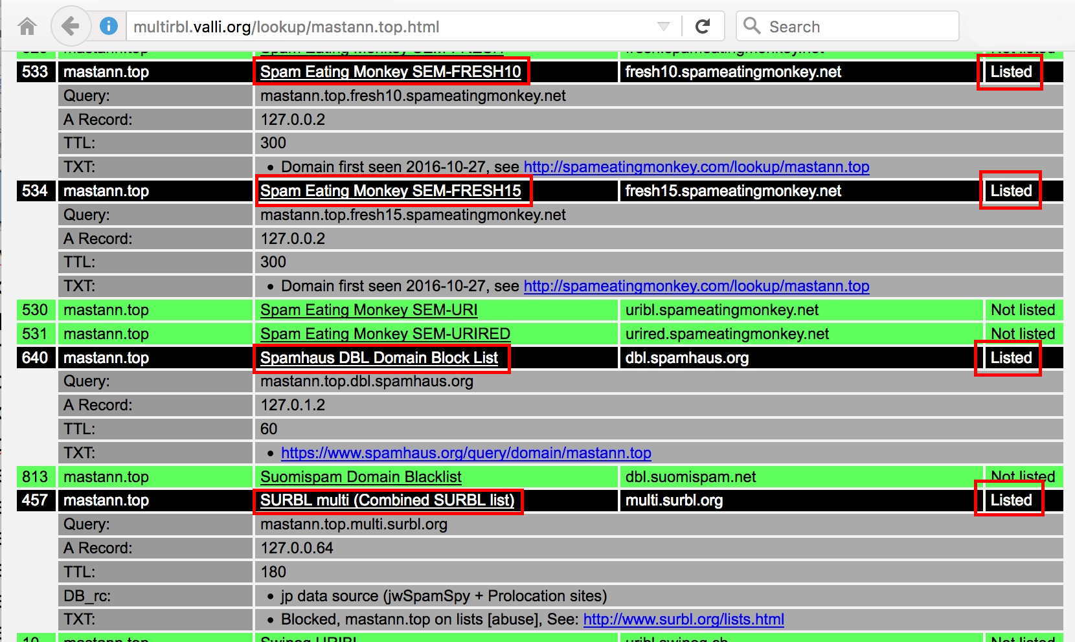
Partial Report From The Valli Multi-RBL Checker for mastann.top: It *IS* Block Listed

Slide 71
Domain Whois For Connecting Host (Select Records)
$ whois mastann.top
Domain Name: mastann.top
Updated Date: 2016-10-26T06:54:29Z ← Recently registered
Creation Date: 2016-10-26T06:34:39Z and updated
Sponsoring Registrar: Alpnames Limited ← See next slide
Domain Status: clientTransferProhibited https://www.icann.org/epp#clientTransferProhibited
Registrant Name: Cecille Wynn
Registrant Street: Roissy Charles de Gaulle ← The French airport
Registrant City: Roissy-en-France [and M3AAWG was meeting
Registrant State/Province: Paris in Paris at the time...]
Registrant Postal Code: 95700
Registrant Country: FR
Registrant Phone: +33.174258418
Registrant Email: alw6nrdlpdysambm3aum3krrwhva32j6pjeyqqln@yahoo.com ← That's sure a memorable email address!
[etc]
Name Server: mimi.ns.cloudflare.com ← Look forward 2 slides
Name Server: brett.ns.cloudflare.com

Slide 72
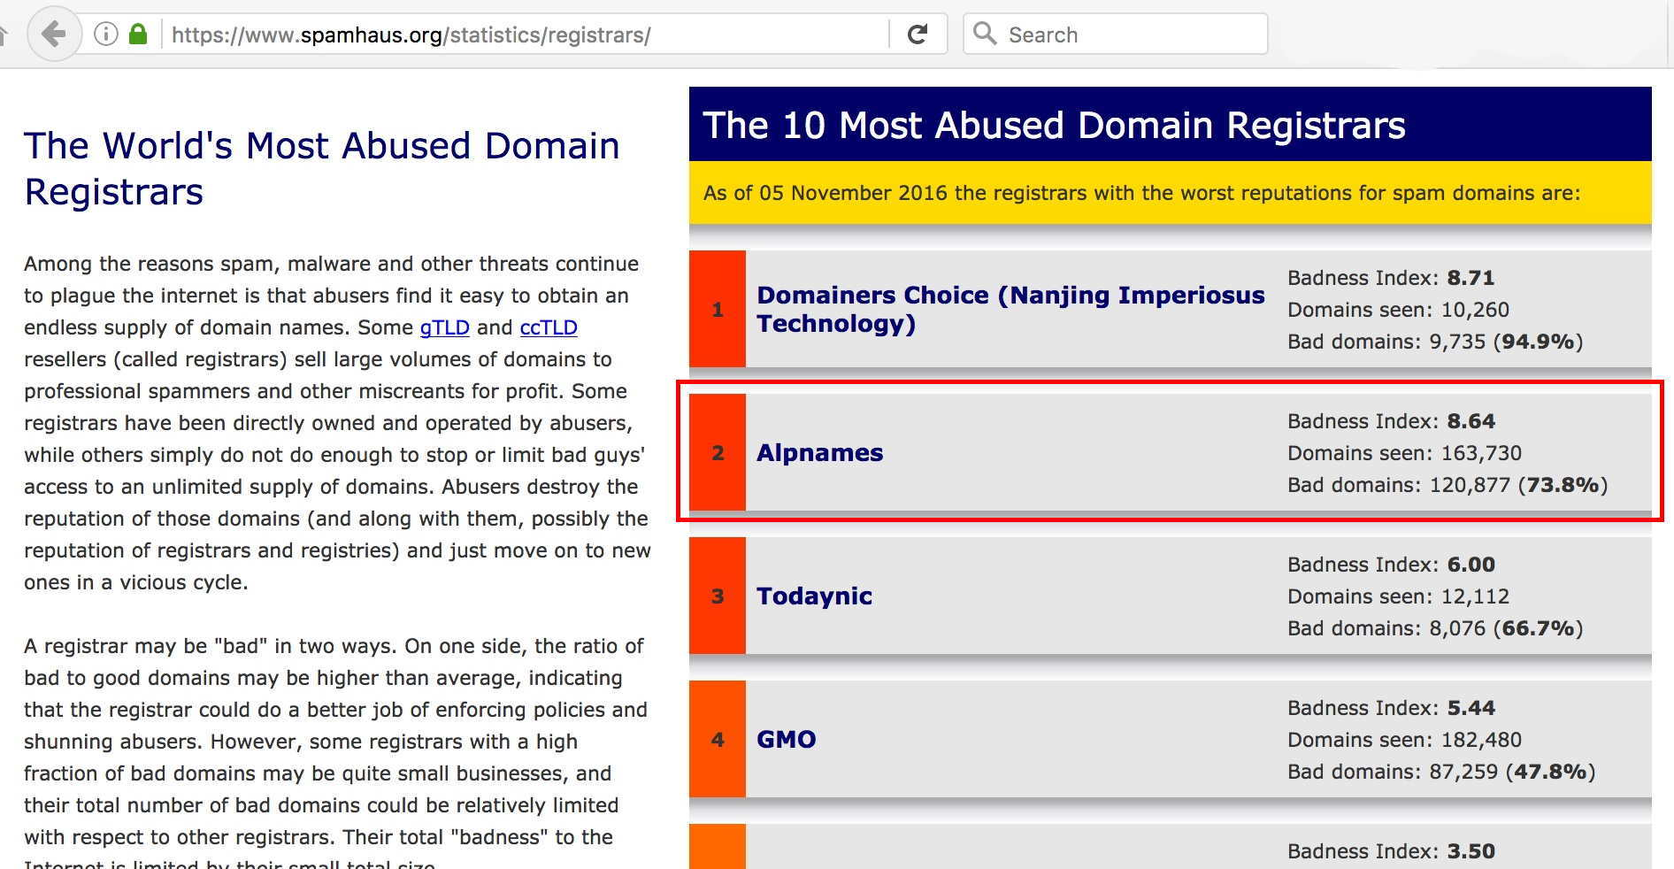
The Relevance of Alpnames?
That's 73.8% bad domains according to Spamhaus

Slide 73
And Cloudflare?
Cloudflare acts as a reverse proxy, interposing itself between a web site and the Internet. This is very useful service if your site has become the target of a DDoS attack.
HOWEVER, from the point when you put your "real" web site behind Cloudflare, traffic for your web site then goes to one of Cloudflare's IPs; only you and Cloudflare know your "real IP."
This means that third parties can't lookup the real IP address in the hope that you'll find clues to the identity of the web site's owner
Nor can you potentially determine the span of IPs the site owner controls
Cloudflare protected domains also typically use Cloudflare name servers; those servers are shared by many unrelated sites.
This means that you also can't use passive DNS to find just a set of closely related domains that all use a unique name server
And you can't do name server → IP, and look for other name servers sharing the same IP using passive DNS.
This arrangement frustrates both domain and IP reputation work

Slide 74
An Example Of A Cloudflare-Protected Domain
Domain Name: int-security-paypal[dot]com
Registrant Name: fuzay nsidik
Registrant Street: ABC
Registrant City: ABC ← ABC is lovely in the springtime :-)
Registrant State/Province: Arizona
Registrant Postal Code: 87102 ← That's an Albuquerque, NM zip)
Registrant Country: US
Registrant Phone: +1.3331143019 ← Guadalajara, Mexico area code
Registrant Email: sidikccuk@gmail.com
[...]
Name Server: MERLIN.NS.CLOUDFLARE.COM
Name Server: TANI.NS.CLOUDFLARE.COM

Slide 75
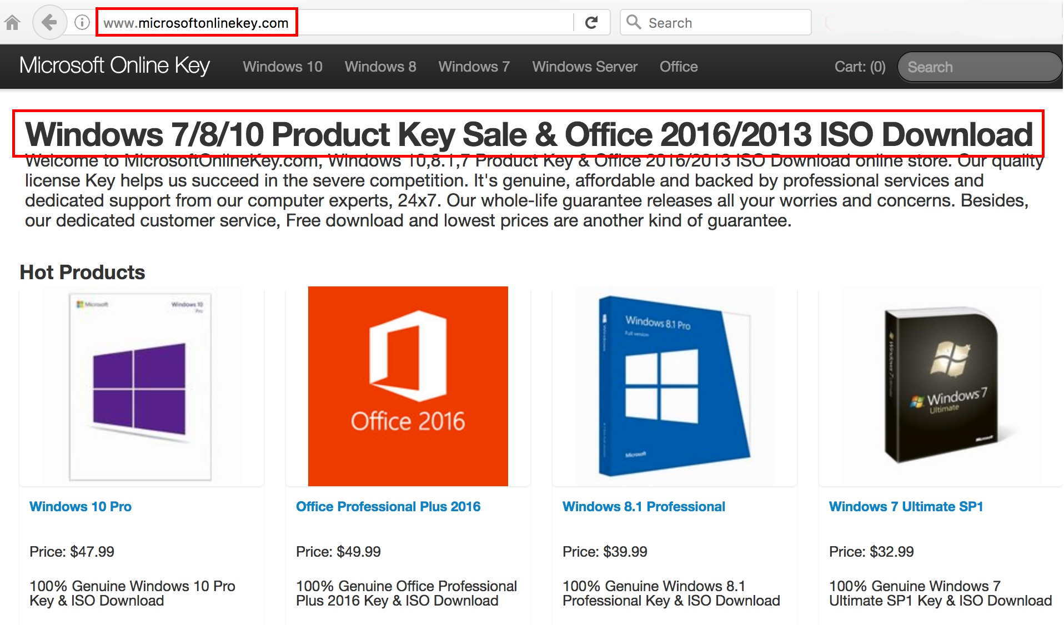
And Another Example...
Domain Name: MICROSOFTONLINEKEY[dot]COM [...]
Name Server: ASHLEY.NS.CLOUDFLARE.COM
Name Server: DILBERT.NS.CLOUDFLARE.COM

Slide 76
Our Original Domain...
Coming back to yeua7oi.mastann.top, it's clearly suspicious
In this case, however, the FQDN is NOT using a CloudFlare IP. The connecting mail server is actually using the IP address 69.162.69.121 Is that IP address suspicious?
Let's start by checking IP Whois for it...

Slide 77
IP Whois (Selected Records)
$ whois 69.162.69.121
Private Customer LSN-DLLSTX-1 (NET-69-162-69-112-1) 69.162.69.112 - 69.162.69.127 Limestone Networks, Inc. LSN-DLLSTX-2 (NET-69-162-64-0-1) 69.162.64.0 - 69.162.127.255
$ whois -h whois.arin.net NET-69-162-69-112-1
CIDR: 69.162.69.112/28
NetName: LSN-DLLSTX-1
Customer: Private Customer (C06228828) ← https://whois.arin.net/rest/customer/
C06228828.html says that's "this customer's" only netblock
RegDate: 2016-10-04
Updated: 2016-10-04
CustName: Private Customer
Address: Private Residence
City: Pathankot
StateProv: AG
PostalCode: 145101
Country: IN
RegDate: 2016-10-04
Updated: 2016-10-04

Slide 78
What Does Passive DNS Know About That /28?
$ dnsdb_query.py -i 69.162.69.112/28 --after=90d | awk '{print $1}' | 2nd-level-dom | sort -u | reverse-domain-names | sort > temp.txt
com.e8m
com.fmcgdirectory
com.jodhpurhomestay
com.kickerrorstoday
com.kristalklaws
com.nepalipoem
com.nepalityper
com.roomstoletin
com.timeandupdate
in.zebralive
np.com.suryodayalaghubitta
np.org.upakarsaccos
org.aicfellowship
org.bethelagindia
org.christianrevelation
org.hamrosambandha
top.amaterialswoodworking
top.backearlossalthough
top.bloodsugaropened
top.chatasianwomenactive
top.colourp
top.continuerewards
top.eranamt
top.fallenp
top.ffcheek ⬅ EHLO
top.ffmarch
top.ffraven
top.fftread
top.figurelosshearing
top.humogra
top.inbyeneuropathypain
top.jeffort
top.kusmoon
top.lczflex
top.lczitem
top.lczknow
top.manylottowinner
top.mastann
top.oancomp
top.onlylosshearingback
top.ourbrainhealthboss
top.pastrrx
top.pencilp
top.presentsnoringcure
top.reallyloanpersonal
top.seflare
top.seprobe
top.somerrx
top.stakedx
top.stseize ⬅ See next slide
top.tiedrrx
top.wyseare

Slide 79
stseize.top: This email pattern look familiar?
$ whois stseize.top
Domain Name: stseize.top
Updated Date: 2016-10-21T08:21:55Z
Creation Date: 2016-10-21T06:56:30Z
Registry Expiry Date: 2017-10-21T06:56:30Z
Sponsoring Registrar: Alpnames Limited
Domain Status: clientTransferProhibited https://www.icann.org/ epp#clientTransferProhibited
Registrant Name: Mathilde Craft
Registrant Street: Antistaseos 36← https://www.flickr.com/photos/mckroes/5502159284
Registrant City: Chalandri says that's a McDonald's...
Registrant State/Province: Attiki
Registrant Postal Code: 15232
Registrant Country: GR
Registrant Phone: +30.2106800852 Registrant Email: b45gc5ictwlu7z7tpgyg2xwb7cwiguqexggp5qe2@yahoo.com
[...]
Name Server: sue.ns.cloudflare.com
Name Server: jeff.ns.cloudflare.com

Slide 80
"2nd-level-dom? reverse-domain-names?"
2nd-level-dom is a small Perl script which, given a fully qualified domain name, returns the effective 2nd-level domain name.
$ echo "www.google.com" | 2nd-level-dom
google.com
reverse-domain-names is another Perl script; this one reverses the labels of a domain for ease of sorting and display, and for reduced risk of accidental blockage if "interesting" domains are mentioned in a document that's subsequently emailed, etc.
$ echo "www.springfield.k12.or.us" | reverse-domain-names us.or.k12.springfield.www
See the next slides for copies of these small scripts...

Slide 81
2nd-level-dom
#!/usr/bin/perl
use strict;
use warnings;
use IO::Socket::SSL::PublicSuffix;
my $pslfile = 'your_path_here/effective_tld_names.dat';
my $ps = IO::Socket::SSL::PublicSuffix->from_file($pslfile);
my $line;
foreach $line (<>) {
chomp($line);
my $root_domain = $ps->public_suffix($line,1);
printf( "%s.\n", $root_domain );
}
The required data file? See https://publicsuffix.org/list/

Slide 82
reverse-domain-names
#!/usr/bin/perl
my @lines = <>;
chomp @lines;
@lines =
map { join ".", reverse split /\./ }
sort
@lines;
print "$_\n" for @lines;

Slide 83
It Isn't Just One Netblock...
Our first netblock was 69.162.69.112/28. Now look at this observation, part of 69.162.93.96/28
Connecting host: p0kilee.yardalb.top[69.162.93.110] EHLO p0kilee.yardalb.top MAIL FROM:<Grocery_Coupons@p0kilee.yardalb.top> BODY=7BIT RET=HDRS Private Customer LSN-DLLSTX-1 (NET-69-162-93-96-1) 69.162.93.96 - 69.162.93.111 Limestone Networks, Inc. LSN-DLLSTX-2 (NET-69-162-64-0-1) 69.162.64.0 - 69.162.127.255 NetRange: 69.162.93.96 - 69.162.93.111 CIDR: 69.162.93.96/28 Customer: Private Customer (C06233555) RegDate: 2016-10-11 CustName: Private Customer Address: Private Residence City: Silay City StateProv: AG PostalCode: 6116 Country: PH RegDate: 2016-10-11

Slide 84
Or How About This One...
Not 69.162.69.112/28 or 69.162.93.96/28, now 69.162.124.128/28
Connecting host: unknown[69.162.124.140] EHLO a3houre.racketn.top MAIL FROM:<Medicare_Supplemental@a3houre.racketn.top> BODY=7BIT RET=HDRS Limestone Networks, Inc. LSN-DLLSTX-2 (NET-69-162-64-0-1) 69.162.64.0 - 69.162.127.255 Private Customer LSN-DLLSTX-1 (NET-69-162-124-128-1) 69.162.124.128 - 69.162.124.143 $ whois -h whois.arin.net NET-69-162-124-128-1 NetRange: 69.162.124.128 - 69.162.124.143 CIDR: 69.162.124.128/28 Customer: Private Customer (C06242492) RegDate: 2016-10-22 CustName: Private Customer Address: Private Residence City: Pathankot StateProv: AG PostalCode: 145101 Country: IN

Slide 85
Or This One...
Not 69.162.69.112/28, 69.162.93.96/28, 69.162.124.128/28, but 69.162.64.48/28
Connecting host: azik2lep.takefreeenergydevice.top[69.162.64.53] EHLO azik2lep.takefreeenergydevice.top MAIL FROM:<Tesla-Free-Energy@azik2lep.takefreeenergydevice.top> BODY=7BIT RET=HDRS
Limestone Networks, Inc. LSN-DLLSTX-2 (NET-69-162-64-0-1) 69.162.64.0 - 69.162.127.255 Private Customer LSN-DLLSTX-1 (NET-69-162-64-48-1) 69.162.64.48 - 69.162.64.63
$ whois -h whois.arin.net NET-69-162-64-48-1 NetRange: 69.162.64.48 - 69.162.64.63 CIDR: 69.162.64.48/28 Customer: Private Customer (C06243694) RegDate: 2016-10-24 Address: Private Residence City: Pathankot StateProv: AG PostalCode: 145101 Country: IN RegDate: 2016-10-24

Slide 86
Rather Than Blocking /28 After /28, Could We Get Away With Just Blocking 69.162.64.0/18 ?
After all, that's "just" 16,384 IPv4 IPs, right? How "hot" is that entire block?
$ dnsdb_query.py -l 1000000 --after=90d -i 69.162.64.0/18 > temp.txt $ wc -l temp.txt 791007 temp.txt
That's a pretty busy netblock... collateral damage would likely be significant.
And would blocking that range catch everything relevant, anyway?

Slide 87
Other "Private Customer" "LSN-DLLSTX-1"?
If we were to block the one large block, would that catch everything relevant, such as all LSN-DLLSTX-1 customers with StateProv: AG? Maybe not. Sorted by date, a partial list:
$ whois -h whois.arin.net NET-69-162-80-48-1 NetRange: 69.162.80.48 - 69.162.80.63
CIDR: 69.162.80.48/28
NetName: LSN-DLLSTX-1
Customer: Private Customer (C05599535)
RegDate: 2015-02-16
Address: Private Residence
City: Wanchai
StateProv: AG
PostalCode: 72022
Country: HK

Slide 88
Related To?
$ whois -h whois.arin.net NET-216-245-210-80-1 NetRange: 216.245.210.80 - 216.245.210.95
CIDR: 216.245.210.80/28
NetName: LSN-DLLSTX-1
Customer: Private Customer (C05690479)
RegDate: 2015-04-21
Address: Private Residence
City: Xiamen
StateProv: AG
PostalCode: 72022
Country: CN

Slide 89
Plus Of Course...
$ whois -h whois.arin.net NET-216-245-206-88-1 NetRange: 216.245.206.88 - 216.245.206.95
CIDR: 216.245.206.88/29
NetName: LSN-DLLSTX-1
Customer: Private Customer (C05696618)
RegDate: 2015-04-24
Address: Private Residence
City: xiamen
StateProv: AG
PostalCode: 72022
Country: CN

Slide 90
And Its Friend...
$ whois -h whois.arin.net NET-74-63-243-176-1 NetRange: 74.63.243.176 - 74.63.243.191
CIDR: 74.63.243.176/28
NetName: LSN-DLLSTX-1
Customer: Private Customer (C05706595)
RegDate: 2015-04-30
Address: Private Residence
City: Jaipur
StateProv: AG
PostalCode: 72022
Country: IN

Slide 91
And...
$ whois -h whois.arin.net NET-216-144-241-172-1 NetRange: 216.245.223.160 - 216.245.223.175
CIDR: 216.245.223.160/28
NetName: LSN-DLLSTX-1
Customer: Private Customer (C05911796)
RegDate: 2015-09-24
CustName: Private Customer
Address: Private Residence
City: Canterbury
StateProv: AG
PostalCode: CT2 8DD ← well, that's a change!
Country: GB

Slide 92
And...
$ whois -h whois.arin.net NET-74-63-197-168-1 NetRange: 74.63.197.168 - 74.63.197.171
CIDR: 74.63.197.168/30
NetName: LSN-DLLSTX-1
Customer: Private Customer (C05976890)
RegDate: 2015-12-01
Address: Private Residence
City: Olivos
StateProv: AG
PostalCode: 1636 ← Ditto
Country: AR

Slide 93
Plus...
$ whois -h whois.arin.net NET-216-144-241-172-1 NetRange: 216.144.241.172 - 216.144.241.175
CIDR: 216.144.241.172/30
NetName: LSN-DLLSTX-1
Customer: Private Customer (C06043883)
RegDate: 2016-02-16
Address: Private Residence
City: Belo Horizonte
StateProv: AG
PostalCode: 30580270 ← Ditto
Country: BR

Slide 94
And Also...
$ whois -h whois.arin.net NET-216-245-219-104-1 NetRange: 216.245.219.104 - 216.245.219.111
CIDR: 216.245.219.104/29
NetName: LSN-DLLSTX-1
Customer: Private Customer (C06086184)
RegDate: 2016-04-06
Address: Private Residence
City: Curitiba
StateProv: AG
PostalCode: 82130390 ← Ditto
Country: BR

Slide 95
And Then There Is...
$ whois -h whois.arin.net NET-74-63-253-184-1
NetRange: 74.63.253.184 - 74.63.253.187
CIDR: 74.63.253.184/30
NetName: LSN-DLLSTX-1
Customer: Private Customer (C06129634)
RegDate: 2016-05-18
Address: Private Residence
City: Medellin
StateProv: AG
PostalCode: 05001000 ← Ditto
Country: CO

Slide 96
Don't Forget...
$ whois -h whois.arin.net NET-192-169-81-136-1 NetRange: 192.169.81.136 - 192.169.81.139
CIDR: 192.169.81.136/30
NetName: LSN-DLLSTX-1
Customer: Private Customer (C06179624)
RegDate: 2016-07-27
Address: Private Residence
City: joinville
StateProv: AG
PostalCode: 89203100 ← Ditto
Country: BR
etc., etc., etc.
This very quickly becomes boring/tedious.

Slide 97
Alternative Strategy
Get a list of all the prefixes for AS46475 from bgp.he.net
Use your favorite editor to compose a command file that looks like:
dnsdb_query.py -l 1000000 --after=90d -i 103.3.166.0/24 > temp3.txt
dnsdb_query.py -l 1000000 --after=90d -i 135.84.217.0/24 >> temp3.txt
dnsdb_query.py -l 1000000 --after=90d -i 162.253.40.0/22 >> temp3.txt
dnsdb_query.py -l 1000000 --after=90d -i 192.169.80.0/20 >> temp3.txt
dnsdb_query.py -l 1000000 --after=90d -i 192.169.80.0/22 >> temp3.txt
dnsdb_query.py -l 1000000 --after=90d -i 192.169.92.0/22 >> temp3.txt
dnsdb_query.py -l 1000000 --after=90d -i 208.115.192.0/18 >> temp3.txt
dnsdb_query.py -l 1000000 --after=90d -i 216.144.240.0/20 >> temp3.txt
dnsdb_query.py -l 1000000 --after=90d -i 216.245.192.0/19 >> temp3.txt
dnsdb_query.py -l 1000000 --after=90d -i 2400:ed00::/48 >> temp3.txt
dnsdb_query.py -l 1000000 --after=90d -i 2400:ed00::/64 >> temp3.txt
dnsdb_query.py -l 1000000 --after=90d -i 2607:ff68::/32 >> temp3.txt
dnsdb_query.py -l 1000000 --after=90d -i 63.143.32.0/19 >> temp3.txt
dnsdb_query.py -l 1000000 --after=90d -i 64.31.0.0/18 >> temp3.txt
dnsdb_query.py -l 1000000 --after=90d -i 69.162.64.0/18 >> temp3.txt
dnsdb_query.py -l 1000000 --after=90d -i 74.63.192.0/18 >> temp3.txt

Slide 98
Alternative Strategy (continued)
What do we end up with after we run those commands in bash? $ wc -l temp3.txt 1,449,381 temp3.txt ← lot of hits! (commas added for readability)
Decide if you want to look at a particular TLD, such as .top... $ grep "top\. " temp3.txt > temp4.txt $ wc -l temp4.txt 9156 temp4.txt ← 0.6% the size of the original file
Now extract the associated IPs: $ awk '{print $4}' < temp4.txt | sort -u > temp5.txt $ wc -l temp5.txt 826 new-temp5.txt ← 0.06% the size of the original file
Condense the discovered IPs into CIDRs: $ aggregate-cidr-addresses.pl < temp5.txt > temp5-cidr.txt $ wc -l temp5-cidr.txt 469 temp5-cidr.txt ← 0.03% of the size of the original file
For one cidr-aggregation tool, see: https://gist.github.com/denji/17e30bddb9ce9e50294a

Slide 99
IV. Conclusion

Slide 100
Take Aways
Blocking unwanted traffic based on logged events is a fundamental skill, albeit one that many don't manage well.
We've now talked about a variety of approaches you can try when you need to manage unwanted traffic, from the simple to the complex.
You've seen how you can leverage passive DNS and BGP routing data to enhance what you can do with conventional tools such a Whois.
This material will only make sense and become useful if you try using these techniques on your own networks and with your own data. Once you do try it, I think you'll be pleased with the power of these approaches.
Finally, we're always interested in talking with about potentially running a passive DNS sensor. The data you contribute may help document relevant potential collateral damage, and help keep your site and its users safe from becoming collateral damage from overly broad blocking.
Are there any questions?

