Slide 1
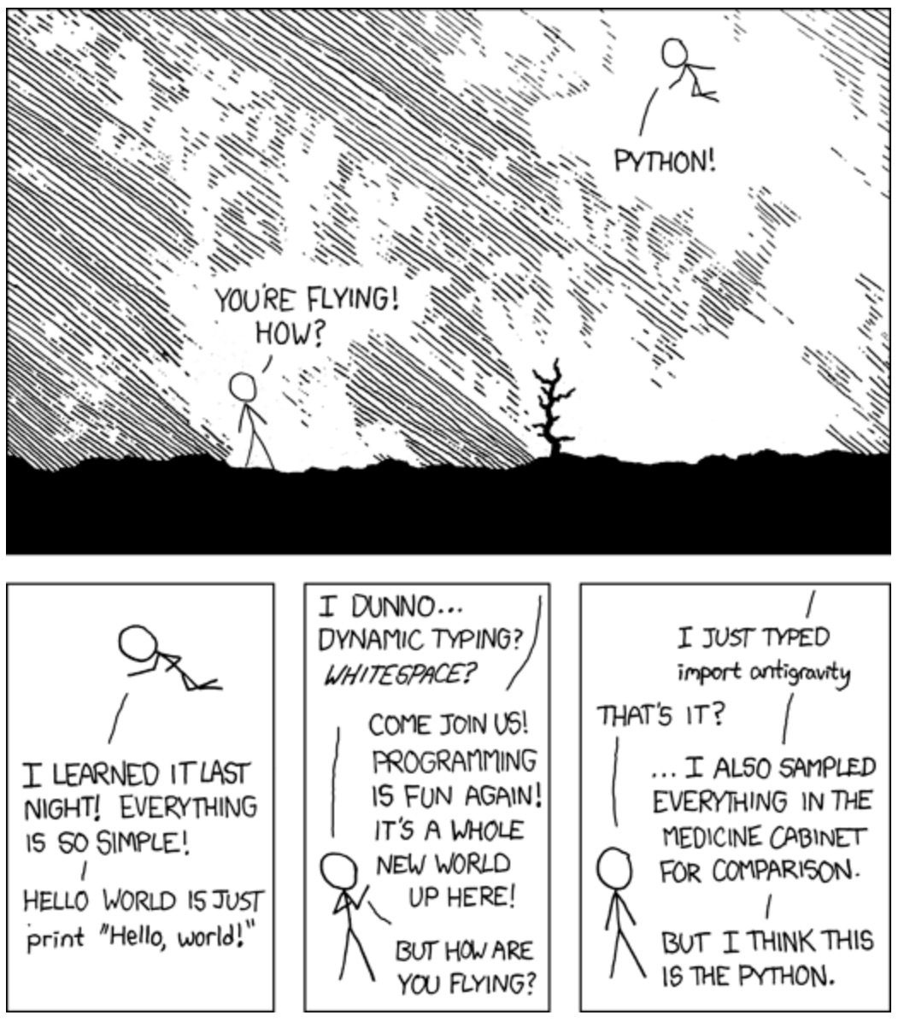
Writing Better Python3
M3AAWG 61 Vienna Austria 90 minutes Joe St Sauver, Ph.D. M3AAWG Expert Advisor
https://xkcd.com/353/ [license: https://creativecommons.org/licenses/by-nc/2.5/]

Slide 2
On Writing Python3 Code
Virtually anyone can learn to write Python3 code. Python3's a very forgiving language with excellent documentation and exceptionally clear and informative error messages.
Learning to code Python3 is like learning to fly in a good trainer aircraft: it seems designed to self-correct and works hard to keep you "in the air" and under control.
We don't have the time to make you into a full-fledged professional Python3 coder, but we'll review some basics and hopefully share at least a few new "tips" and "tricks" you can add to your existing Python3 skills (if any).
We're generally going to assume that you're working on a Mac laptop, but most of what we discuss will be equally applicable to those of you using Windows Subsystem for Linux under MS Windows (https://learn.microsoft.com/en-us/windows/wsl/install) or to those of you using a Linux distribution such as Debian or RedHat.

Slide 3
There Are a Lot of Things We're NOT Going To Cover Today
We're going to cover a lot of material today, but we're not going to have time to cover...
Using databases in Python3 (neo4j, PostgreSQL, Reddis, etc.)
Doing graphics with Seaborn, Matplotlib or other Python3 graphic APIs
Writing GUI Python3 applications with tkinter, PyQT5, etc.
Integrating Python3 with some other language, such as C
Machine learning in Python3 using Keras, PyTorch, Scikit-learn, or tensor-flow
Making maps with cartopy or some other Python3 mapping package
Message passing applications using MPI in Python3
Python3 in the "cloud" (e.g., we're not covering boto3, google-API-core, etc.)
Scientific computing with Pandas, Numpy, SciPy, etc.
Streaming applications in Python3 (using Kafka, pyzmq, etc.)
Writing threaded/multiprocessing parallel Python3 code
Today's training will hopefully get you ready to dig into some of these others areas later!

Slide 4
Copying & Pasting Code Snippets From Presentations
If you try cutting and pasting code from PowerPoints or PDFs, it will usually work fine.
However, sometimes "what you see" may not be "what you end up getting" due to some programs attempting to produce "pretty" documents using ligatures ("combined letters") or other font substitutions (such as "smart quotes" for "straight quotes").
Newlines may also end up replaced with special characters.
We've endeavored to disable this behavior to the maximum extent we can, but some examples of this behavior may have slipped through.
If you run into that, sorry about that. You may need to clean those up manually.

Slide 5
Today's Itinerary
1. Untangling Your Python3 Installation 6
2. Options for Writing Python3 Programs 13
3. Python3 and LLMs 18
4. Statements 28
5. I/O 43
6. Simple Data Types 56
7. Lists 60
8. Dictionaries 67
9. Other Python3 Data Structures 73
10. Packages/Libraries 78
11. Argparse 90
12. Sanitizing/Validating/Encoding Inputs/Fuzzing 94
13. Other Python3 Testing 100
14. Exercises 106

Slide 6
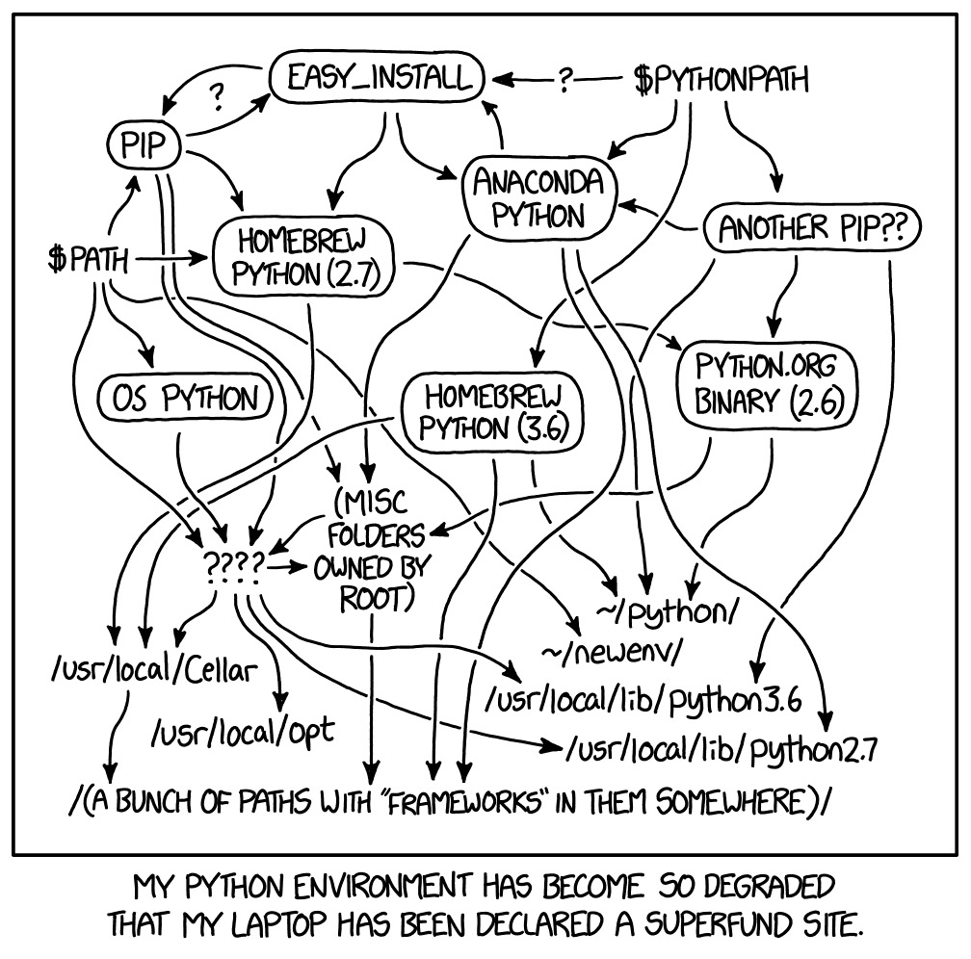
1. Untangling Your Python3 Installation Do you already have Python3 installed? What version(s)? Should you upgrade? Which version are you running by default? How can you change the default version? What if you must use some newly-released feature?
https://xkcd.com/1987/ [license: https://creativecommons.org/licenses/by-nc/2.5/]

Slide 7
Python3 on Your System
Caution: Depending on the system you're using, your system may come with a copy of Python3 already pre-installed. That pre-installed Python3 will often be used for system utilities and maintenance tools. Even though that pre-installed Python3 may be an older version, don't mess around with it. Let the system itself handle updating and managing any bundled version of Python3.
To check the version of Python you'll run by default, if any, open a terminal window (e.g., on a Mac, Applications → Utilities → Terminal) and then enter:
$ python3 –V Python 3.11.8 ← sample of what you may see as a response
You'll want to know the version of Python3 you've got installed because some functions and options may only be supported for certain versions of Python3.

Slide 8
You may even have multiple versions of Python3 pre-installed on your system. To check:
$ whereis -a -b python3 python3: /usr/bin/python3 /Library/Frameworks/Python.framework/Versions/3.11/bin/python3 /Library/Frameworks/Python.framework/Versions/3.12/bin/python3 /opt/homebrew/bin/python3 /usr/local/bin/python3
Those copies of Python3 may represent different versions. For example:
$ /opt/homebrew/bin/python3 -V Python 3.12.2
$ /usr/local/bin/python3 -V Python 3.11.8
$ /usr/bin/python3 –V Python 3.9.6
Other "copies" may actually just be "convenience" links:
$ ls -l /usr/local/bin/python3 lrwxr-xr-x 1 root wheel 70 Mar 13 16:49 /usr/local/bin/python3 -> ../../../Library/Frameworks/Python.framework/Versions/3.11/bin/python3

Slide 9
Which Specific Installation of Python3 Will I Run By Default?
We talked previously about what VERSION of Python3 you'd run by default, but WHERE is that program located on your system? To see the LOCATION of the Python3 you'll run by default (if you don't provide a full path to something else), use the which command:
$ which python3 /Library/Frameworks/Python.framework/Versions/3.11/bin/python3
If you want to change the default version of Python3 you run, change the order of the directories listed in your system's PATH in .bash_profile (or whatever's the appropriate hidden "dot configuration" file for the shell you've chosen to run).
Invoke a specific version of Python for just one run, assuming that version's installed and available on your system by mentioning that specific version when invoking Python3:
$ python3.11 (instead of just saying python3)

Slide 10
What About Upgrades? How To Install NEW Versions of Python3
Most users should run a currently supported production version of Python3 (such as Python 3.11 or 3.12). One good article on this: "Have you updated your Python recently?" https://www.mostlypython.com/have-you-updated-your-python-recently/
If your device is self-managed (and not centrally managed by your IT team on your behalf), you should be able to upgrade or install new versions of Python3 using either a standalone installer, or using a package manager (such as Homebrew, assuming you're on a Mac). Either approach will work, but we generally encourage folks to download official stand-alone installers from the Python web site:
https://www.python.org/downloads/
Building Python3 from source is possible but complex. Avoid attempting to do this.

Slide 11
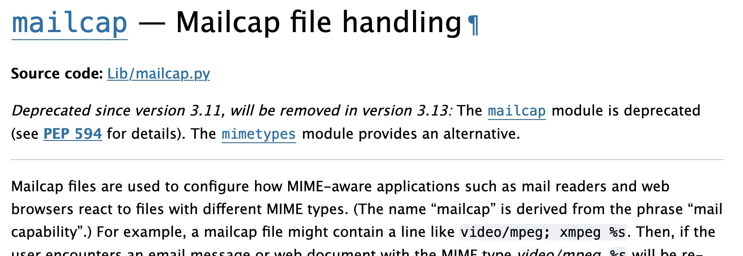
Feature Awareness and Explicitly Handling Required Versions
Python routinely adds new features, and periodically deprecates or removes old features (see https://docs.python.org/3/whatsnew/index.html). The module index and the documentation for individual routines will call out deprecated module status information:
If you ABSOLUTELY MUST use version-specific features (such as new and/or about-to-be-deprecated features), build explicit run-time version checks into your code, such as:
import sys if sys.version_info < (3,11): # pylint: disable-next=broad-exception-raised raise Exception("Must use Python 3.11 or later")

Slide 12
"What About Anaconda, etc.?"
Anaconda is a popular option for installing and working with Python3 and frameworks such as NumPy and SciPy, however Anaconda limits free use in commercial environments (requiring a paid license for most commercial use). See
https://legal.anaconda.com/policies/en/?name=anaconda-contracting-hub#purchased-vs-free-offerings
YOU may potentially qualify for free Anaconda access (e.g., for non-commercial use, for personal use, for educational use, etc), but due to the commercial affiliation of most attendees and M3AAWG's stict non-commercialization policies, we will not be considering Anaconda and related frameworks today.

Slide 13
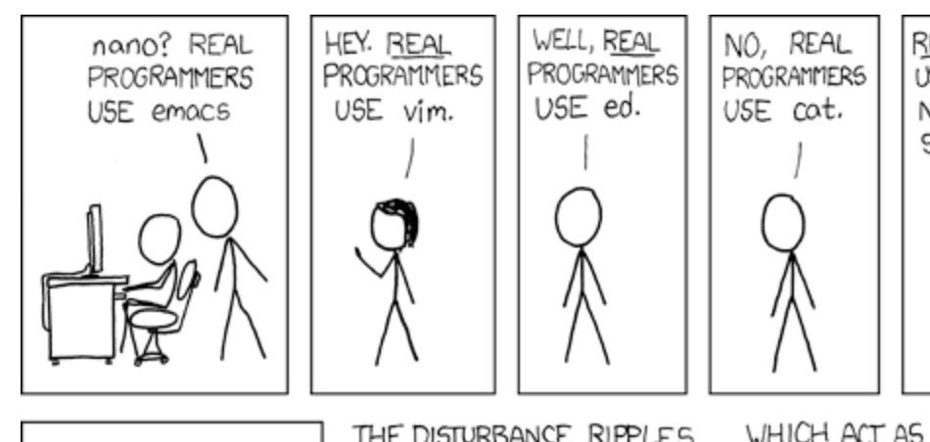
2. Options for Writing Python3 Programs Using IDEs, Notebooks, Editors Coding Style and PEP 8 Linting
https://xkcd.com/378/ [license: https://creativecommons.org/licenses/by-nc/2.5/ ]

Slide 14
Picking A Way To Write Python3
IDEs:
You can use an Integrated Development Environments ("IDE"): Many IDE's are paid commercial products (not discussed due to M3AAWG's non-commercial policies). Beware: the learning curve for IDE's may sometimes (initially) be pretty steep.
One free Python3 IDE that's available is PyCharm CE ("Community Edition"), see https://www.jetbrains.com/pycharm/download/ (scroll to the bottom).
Python3 also bundles a free (very basic) IDE called IDLE. If you have Python3 installed, you should be able to just say $ idle3 in a terminal window to try it.
Interactive "notebooks:"
Other Python3 users may swear by an interactive "notebook" style inteface such as the free one provided via Jupyter Notebooks. See: https://jupyter-notebook.readthedocs.io/en/stable/
You can also just use standard text editor such as vi, emacs, etc. This is what I usually do.
You can also try "bolting on" a variety of text editor "add-ons" to "help you" write code, but some of these are rather "gimmicky" and none are essential.

Slide 15
Follow PEP 8 Coding Style
Normal Python3 coding style varies in many ways from some well-known coding conventions (such as Linux Kernel coding style). Adherence to "normal Python3 coding style" is key to keeping your Python3 code readable and maintainable.
The "catechism" for Python3 is PEP 8, "Style Guide for Python Code." It's available at
https://peps.python.org/pep-0008/
it will teach you a LOT about how to write well-formatted Python3 (and how to avoid writing badly formatted Python3).
Use a Python3 linting program (such as pylint, see https://pypi.org/project/pylint/ ) to systematically flag any departures from PEP 8.
Be aware that some Python linting program scoring may be somewhat "twitchy..."

Slide 16
helloworld.py: one line of Python3 ➔ a 0/10 score from pylint...
Every developer in the world has created a "Hello, world!" program when learning to use a new programming language. For example, in Python3:
$ cat helloworld.py print("Hello, world!")
$ python3 helloworld.py Hello, world!
But if you pylint that code, you'll get a 0/10 rating!
$ pylint helloworld.py ************* Module helloworld helloworld.py:1:0: C0114: Missing module docstring (missing-module-docstring) ------------------------------------------------------------------ Your code has been rated at 0.00/10 (previous run: 0.00/10, +0.00)

Slide 17
helloworld.py: add a doc string to then get a 10/10 from pylint
The "cataclysmic problem" here? A missing doc string:
$ cat helloworld.py """ Everyone's favorite first program """ print("Hello, world!")
$ pylint helloworld.py -------------------------------------------------------------------- Your code has been rated at 10.00/10 (previous run: 0.00/10, +10.00)
Other program checkers may want still further stylistic tweaks. For example, black (https://github.com/psf/black), "The Uncompromising Code Formatter" insists that there should be a blank line between the doc string and the print command, too. Some may even lecture you about use of single vs double quote marks for strings.

Slide 18
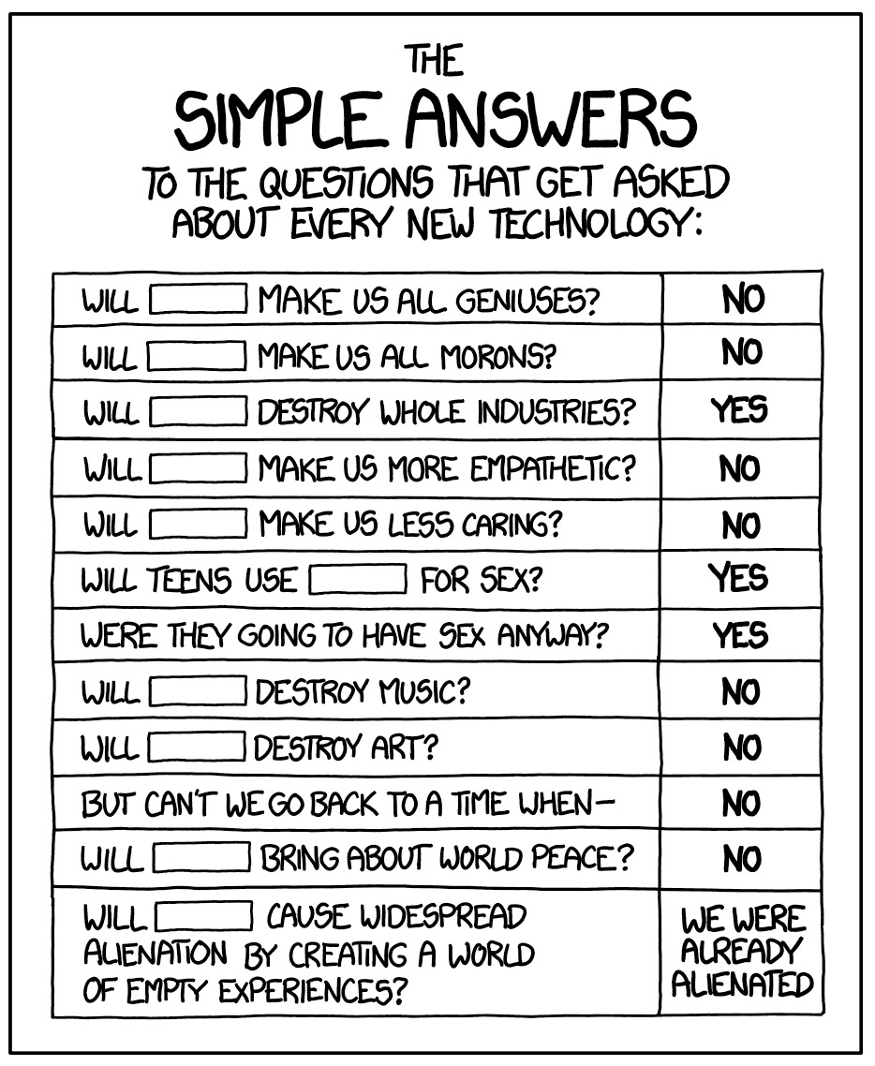
3. Python3 and LLMs Risks of Using An LLM to Write Code Dealing with Mechanical Issues When Cutting-and-Pasting LLM Generated Code LLM-Generated Code May Have Stylistic Problems LLMs May Make Wrong Assumptions LLMs Solutions May be Initially Be "Minimally Responsive" (Unless Pushed)
https://xkcd.com/1289/ [license: https://creativecommons.org/licenses/by-nc/2.5/ ]

Slide 19
Using An LLM To Write Code
ChatGPT and other "large language models" can now be used to produce Python3 code. They may at least help you get a starting point for some coding projects.
If you do decide to use a LLM as a "programming partner," carefully review and test the code it provides. Just like working with any coding partner do NOT assume that the code you get from ChatGPT or any LLM will even run! YOU are still responsible for all the code you deliver, even if your LLM "partner" drafted some (or all) of it for you.
Mechanical copy/paste issue? if you get code from ChatGPT (or a similar LLM) and then try pasting it into a vi or vim text editor window, you may find that it "auto-indents excessively" or "pastes weird." If you run into that, try setting vi "paste" mode first:
:set paste
When done pasting, you can turn paste mode back off (if you want to) with
:set nopaste

Slide 20
A Sample LLM Python Code Generation Project (In One Sentence)
"Write sample Python3 code to read in and parse sample spam email messages."
We tried the free version of Chat GPT 3.5 that's available at
https://chat.openai.com/

Slide 21
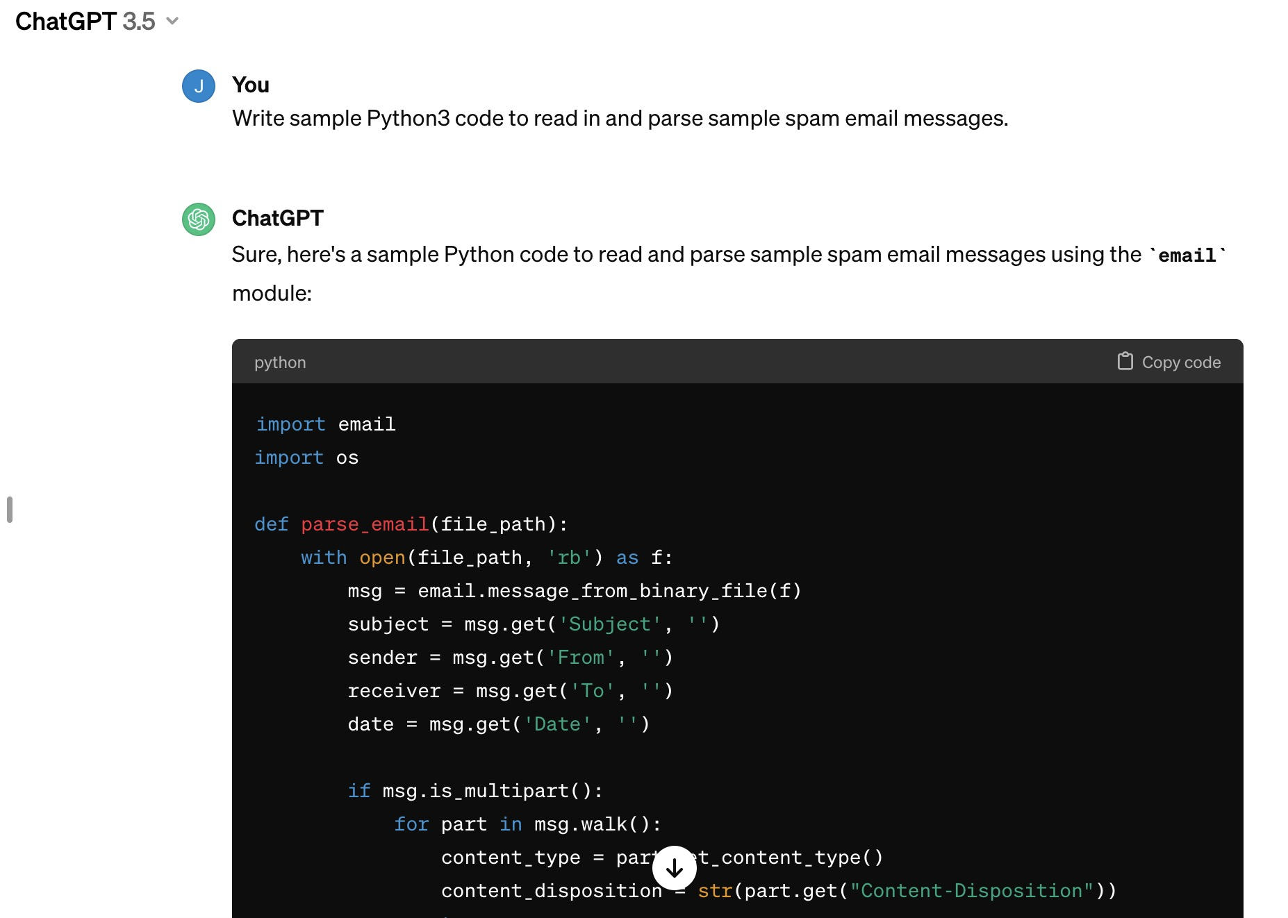
Sample ChatGPT Output (pylint rated the first code at 5.95/10.0)

Slide 22
Even After Repeated Iterations, ChatGPT Code STILL Didn't Follow Basic Python3 Coding Standards
$ pylint test5.py
************* Module test5
test5.py:43:0: C0303: Trailing whitespace (trailing-whitespace)
test5.py:46:0: C0303: Trailing whitespace (trailing-whitespace)
test5.py:56:0: C0305: Trailing newlines (trailing-newlines)
test5.py:1:0: C0114: Missing module docstring (missing-module-docstring)
test5.py:4:16: W0621: Redefining name 'file_path' from outer scope (line 48) (redefined-outer-name)
test5.py:16:8: W0621: Redefining name 'subject' from outer scope (line 49) (redefined-outer-name)
test5.py:17:8: W0621: Redefining name 'sender' from outer scope (line 49) (redefined-outer-name)
test5.py:18:8: W0621: Redefining name 'receiver' from outer scope (line 49) (redefined-outer-name)
[etc]
------------------------------------------------------------------
Your code has been rated at 7.30/10 (previous run: 7.30/10, +0.00)
You can obviously clean those up, but you shouldn't have to handle mechanical issues.

Slide 23
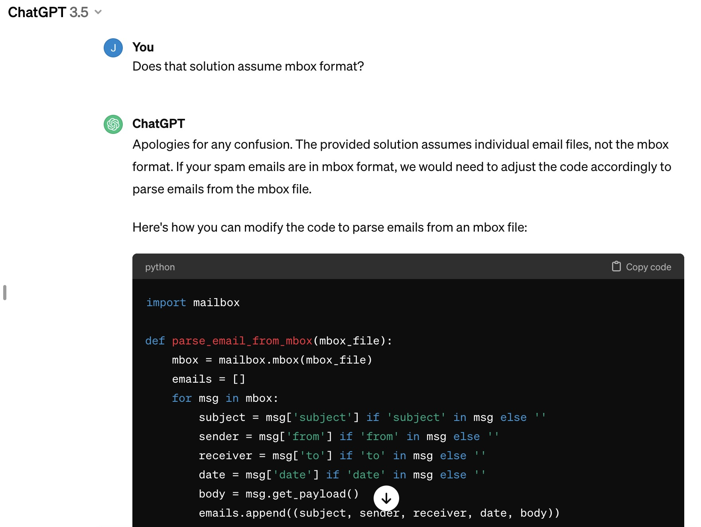
More Substantially, It Simply "Assumed" I'd Be Using Maildir Format

Slide 24
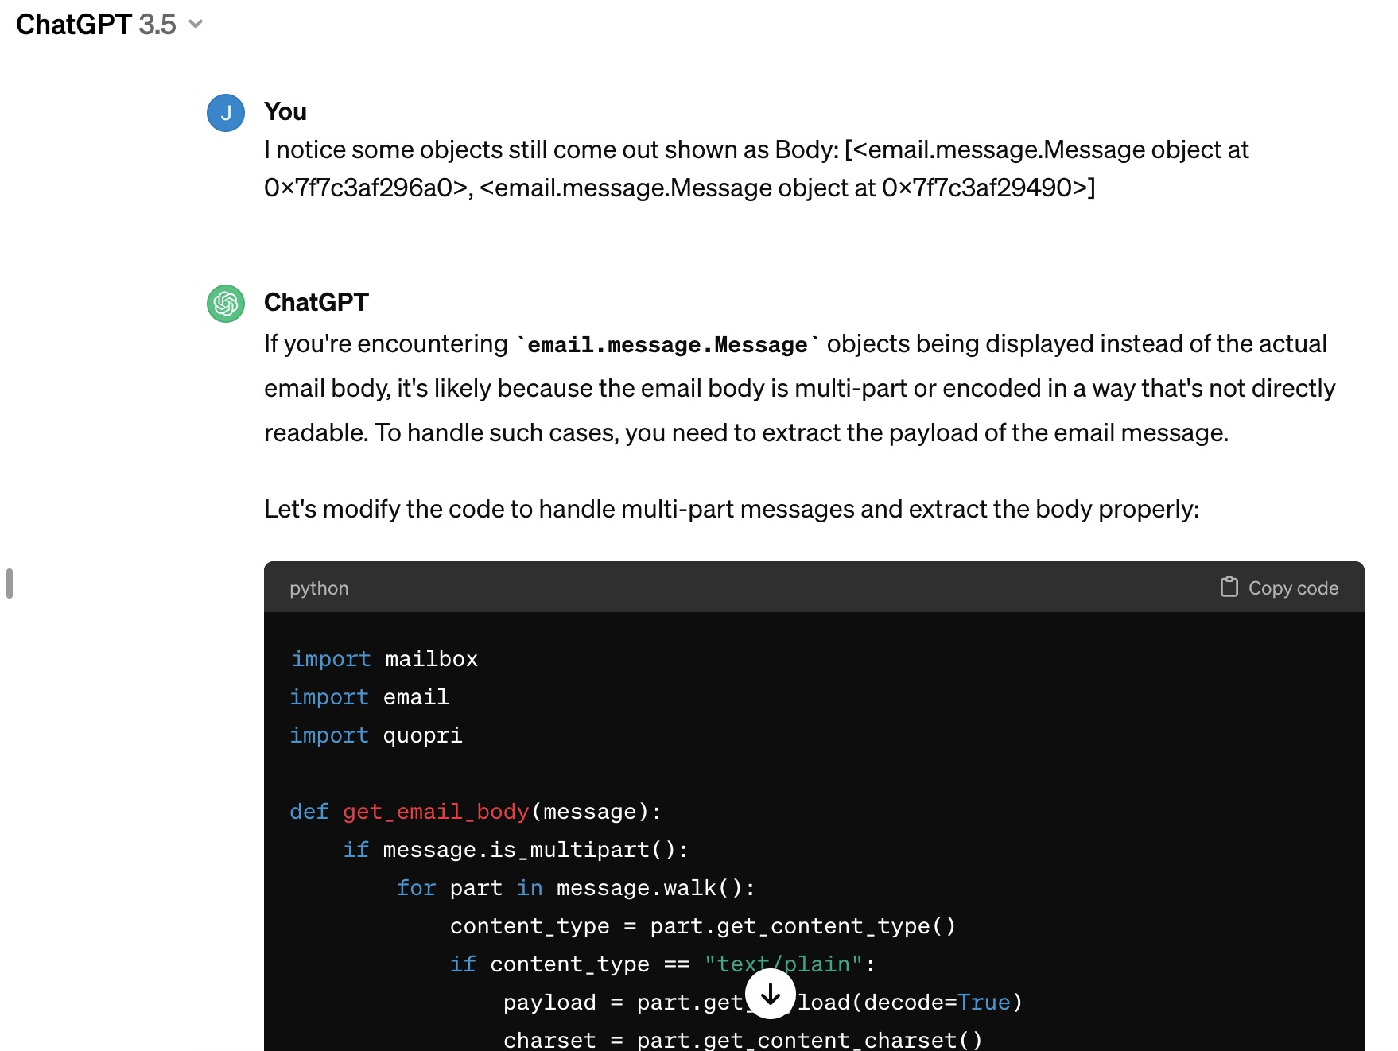
And What About MIME Multi-part Messages?

Slide 25
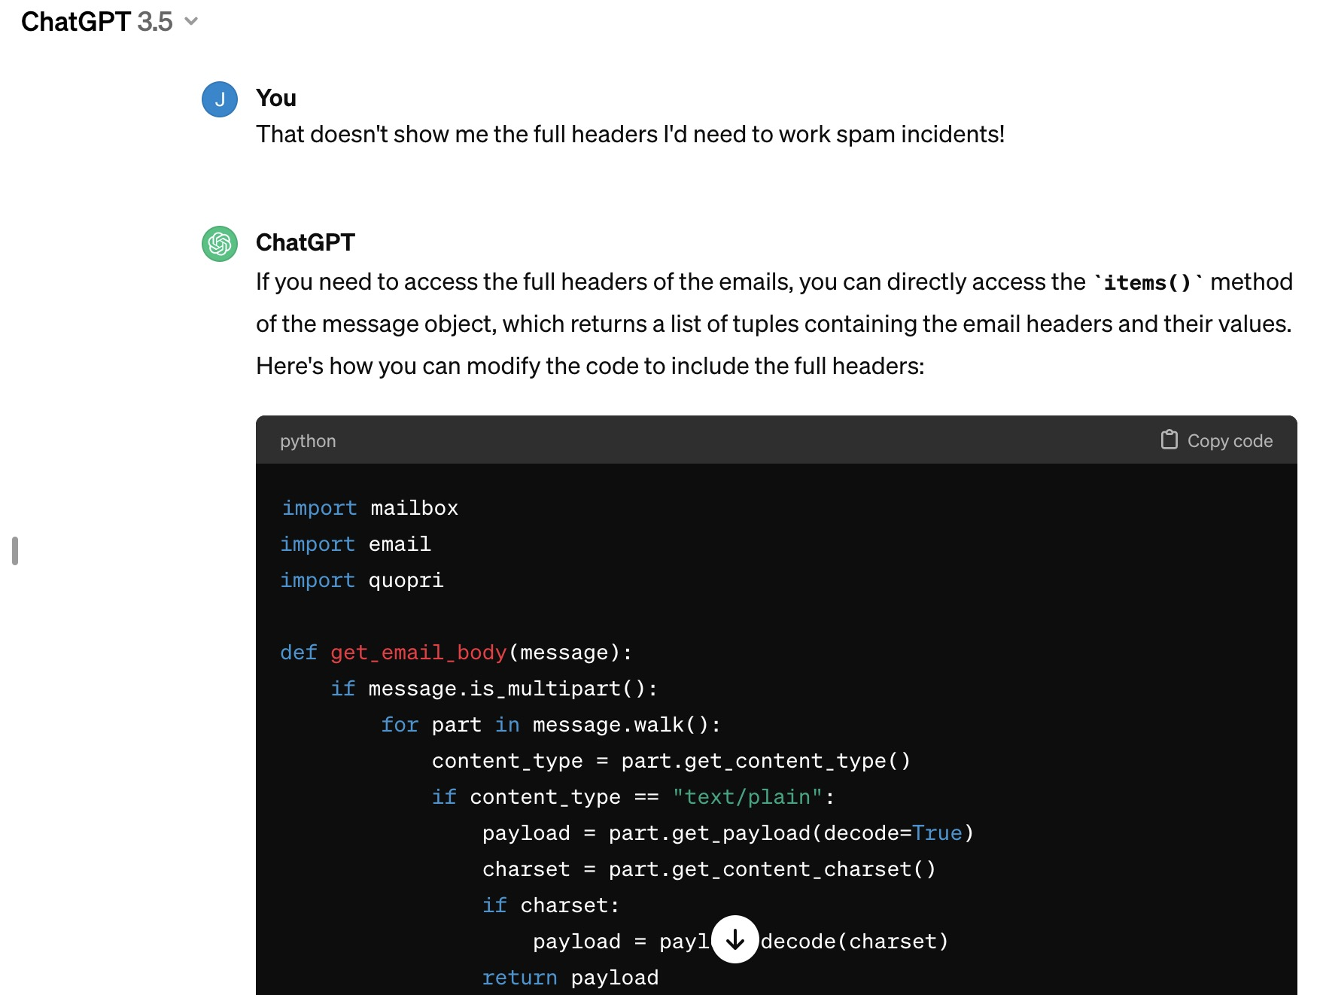
Full headers? (we ARE working with spam samples, after all)

Slide 26
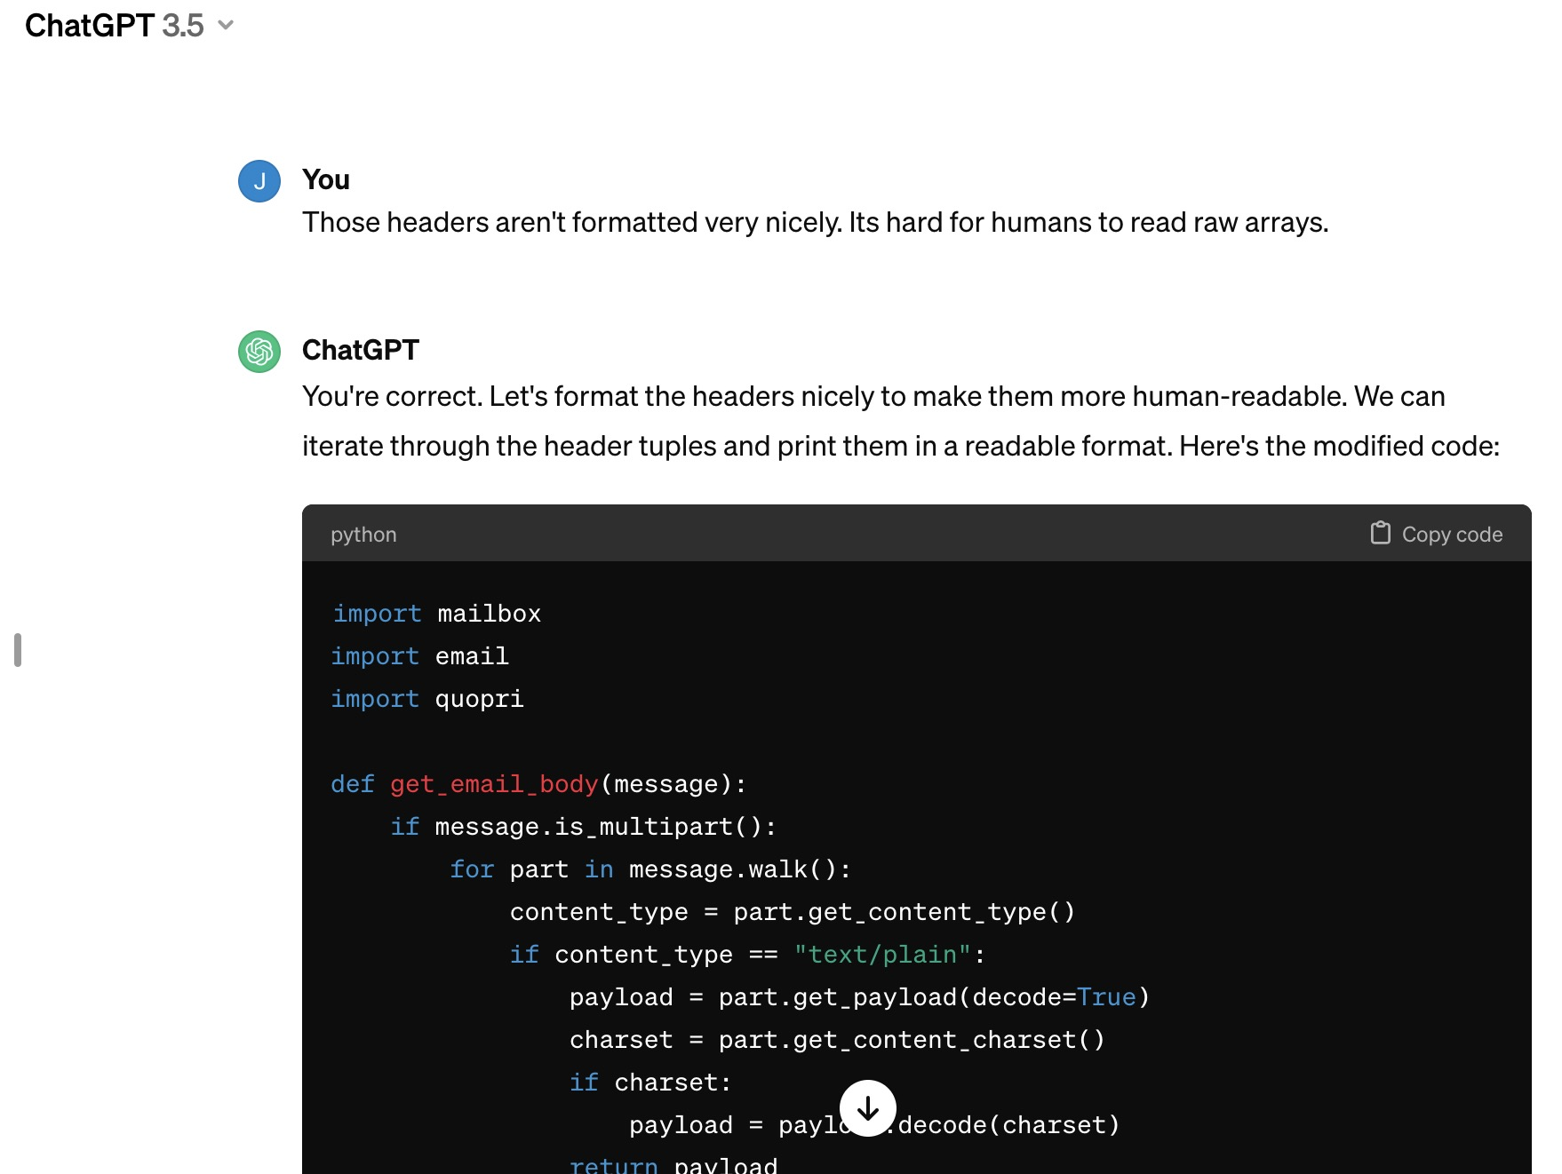
Human Users ➔ Should Get Human-formatted Output...

Slide 27
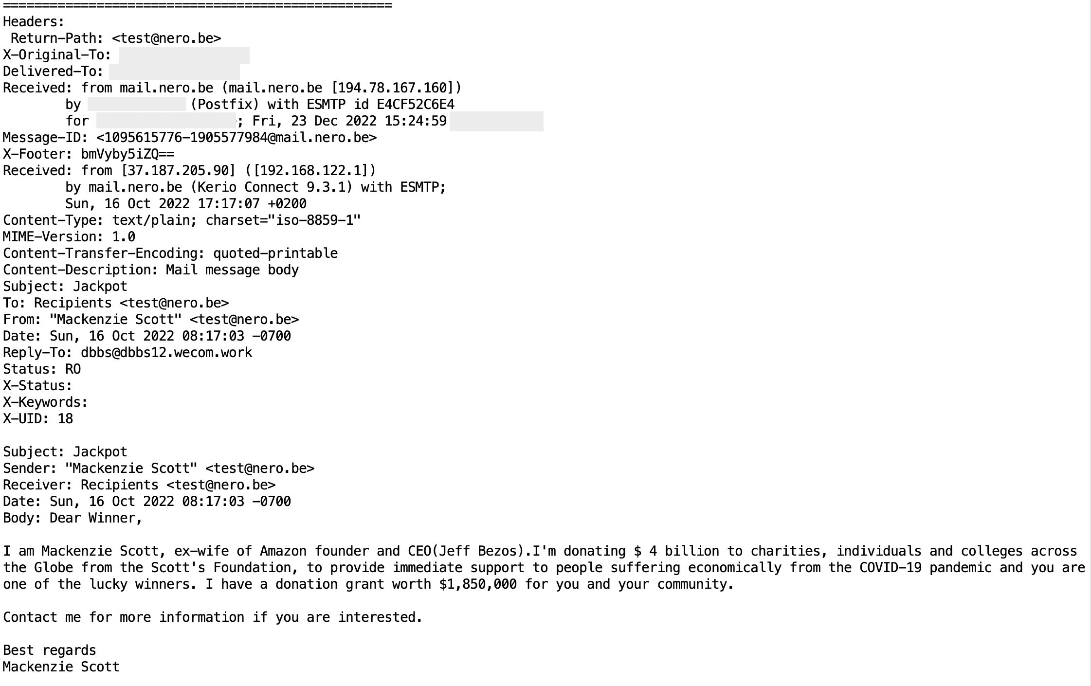
Sample output from the code... It DID (eventually) do what we'd wanted it to do...

Slide 28
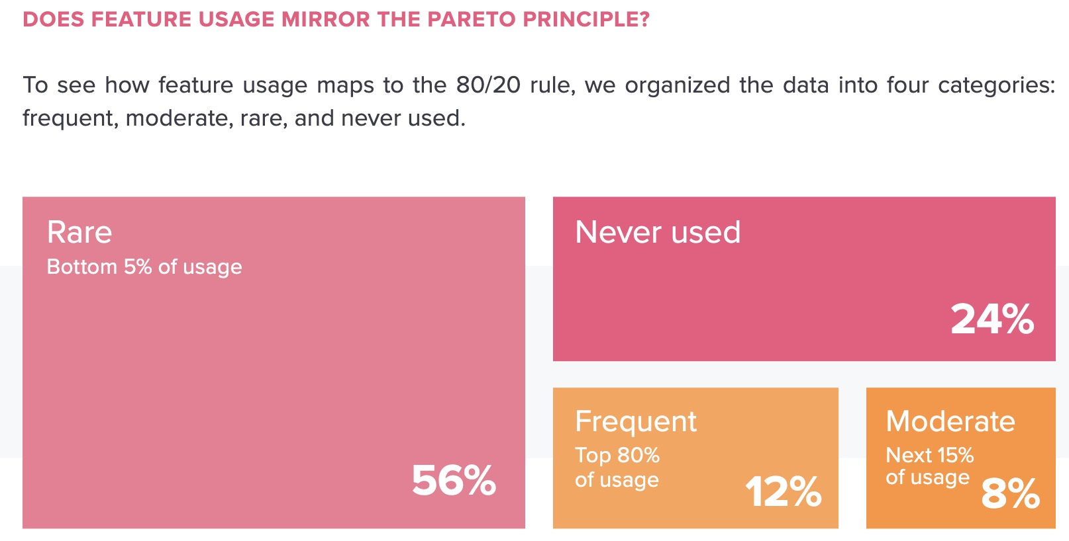
4: Quick Review of Basic Python3 Statements: You Don't Need to Know "Everything" To Have a Working Knowledge of Python3 Source: https://go.pendo.io/rs/185-LQW-370/imagess/ Pendo_Whitepaper_2020_FeatureAdoptionReport_Refresh.pdf

Slide 29
Statements
Python3 has a compact grammar of routinely-used statements (plus a lot of additional obscure features that most people never use). The ten key non-I/O statement types are:
Assignment (=)
Code Blocks (indentation)
Comments (#)
Error handling with try/except
for loops (plus break and continue)
if / elif / else (conditional statement execution)
import
User-Defined Functions (def / return (and invoking those functions))
while loops
with
I/O statements will be handled seperately in the next section

Slide 30
1) Assignment Statements (=)
Like most programming languages, Python3 has the ability to assign values to variables (see next slide for rules around variables). Unlike many programming languages, Python3 variables do NOT need to be typed – their type will be "inferred."
payment_amount = 1100 payer = "Joe's Garage" available_colors = ["red", "white", "blue", "green", "black"]
When assigning multiple values, you may be tempted to put multiple statements per line:
a = 1; b = 4; c = 3.4; d = 8.7; e = 12
While Python3 will LET you do that, DON'T. One statement per line, please!
For an overly-complex discussion of what should be a very simple topic, see: https://docs.python.org/3/reference/simple_stmts.html#assignment-statements

Slide 31
Variable Names
"There are only two hard things in Computer Science: cache invalidation and naming things." -- Phil Karlton [emphasis added]
Variables can be virtually any length (but in practice, keep them to a "reasonable" length). If you frequently mis-spell/confuse some variables, they're probably too long or too similar.
It's not a "crime" if some variables (such as loop indicies) are short: i, j, k, x, y, etc.
Variables are case sensitive (UPPER and miXeD are different than lower).
Besides letters, you can also use numbers or underbars (but variables must start with a letter, and should NOT have leading or trailing underbars)
Variables cannot be a reserved word, see https://docs.python.org/3/reference/lexical_analysis.html at 2.3.1 Some reserved words are incredibly common (I bumped into this when building a mapping app – using "or" was "out" for an Oregon variable, ditto "in" for an Indiana variable)

Slide 32
2) Blocks of Code
Some programming languages set off blocks of statements using curly braces or tags such as begin / end. Not Python3! Python3 uses indentation to set off blocks of statements. Indent 4 spaces to start a new block. DON'T use tabs!
Random/unnecessary indentation simply isn't allowed:
j = 10 k = 15 [...] k = 15 IndentationError: unexpected indent
Continuation lines are either inferred (as a result of a "dangling commas" or other dangling operator), or explicitly called out by ending the line with a backslash (my preference).
Do NOT have whitespace at the end of lines (Pylint will whine about it).

Slide 33
3) Comments
Anything after a # sign is just a comment (unless the # is inside a quoted string literal)
# https://mathworld.wolfram.com/GelfondsConstant.html # bonus factoids: https://xkcd.com/217/ and https://xkcd.com/179/ GELFONDS = 23.140692632 # this is e to the pi power gelfonds_constant_popularity_ranking = "#1" # obviously true
Don't lie in your comments
Lies may be the result of imprecision (the decimal value above is an approximation)
Other lies may be total fabrications (popularity ranking is obviously wrong)
You can also "lie by distraction" (the XKCDs are only marginally relevant)
Wrong comments may also be the result of code maintenance w/o comment updates

Slide 34
4) Error handling with try / except
$ cat sqr_rt.py
from math import sqrt
my_value = input("enter value: ")
my_value = float(my_value)
try:
sqr_rt = sqrt(my_value)
print(sqr_rt)
except:
print("couldn't compute square root for", my_value)
$ python3 sqr_rt.py
enter value: -3
couldn't compute square root for -3.0
It is preferable to specify the exact condition the except statement is meant to handle. (See a list of exceptions at docs.python.org/3/library/exceptions.html ). If taking that approach, you may need to have multiple except stanzas.

Slide 35
EAFP vs LBYL: What Kind of Programmer Are YOU?
There are two schools of thought in programming:
EAFP (Easier to Ask Forgiveness than Permission) vs. LBYL (Look Before You Leap).
EAFP people really love try/except. If you attempt to divide by zero, yeah, not gonna work, so we'll deal with that (hopefully uncommon) corner case if it happens to occur. That's why try/except exists, right? Keep your code simple, short, and sweet...
That EAFP "way of life" really drives the LBYL people nuts. To the LBYL people, you should have checked the potential operand for known bad values before ever attempting that mathematical operation. Sure there's additional overhead to checking for bad values when most values are going to be just fine, but it's a tiny amount of extra work and "good craftsmen" don't routinely rely on "emergency safety nets" to save them from known-bad situations they could have avoided encountering in the first place.

Slide 36
5) for loops – there are two main types of for loops in Python3
Numeric for loop:
for i in range(0, 5): # generates integer values from 0 to 4 print(i)
Iterative for loop, looping over values in an iterable (such as a list):
my_list_of_zip_codes = [97405, 97408, 97412, 97413, 97415] for zip_code in my_list_of_zip_codes: print(zip_code)
for loops may be nested, just remember to further-indent each subsequent for loop (each for loop starts a new block of code).
The break statement lets you immediately and completely exit the current for loop.
The continue statement lets you start the next iteration of the for loop immediately.

Slide 37
6) if / elif / else
Conditional statements are another "programming language staple." Python has 'em, too.
if gpa >= 3.9: grad = "Summa Cum Laude" elif gpa >= 3.7: grad = "Magna Cum Laude" elif gpa >= 3.5: grad = "Cum Laude" elif gpa >= 2.0: grad = "No honors" else: grad = "Didn't graduate"
If you want to check for an exact value, use == (not =, = is used to assign values)
NOT equal is represented by != (common alternatives such as <> or ~= won't work)
"Write it like you say it:" "greater than or equal to" (NOT =>)
Use and and or (rather than & and |)
A departure from PEP 8: when in doubt, use parentheses to clarify logical expressions.

Slide 38
7) import
import lets you bring in a predefined library or "package" such as the Python3 math library (we'll talk more about packages in section 10).
To import an entire library, simply supply the name of the library:
import math
In general, however, you should only import the particular function(s) you need:
from math import pi, sin # remember, the trig fn arguments are in radians, not degrees! print(sin(pi/4)) 0.7071067811865475
If an imported function "can't be found", mention the library name when referring to it: print(math.sin(math.pi/4))
Some libraries may be routinely associated with a shortened name when imported:
import matplotlib.pyplot as plt [...] plt.show()

Slide 39
8) User-Defined Functions in Python
$ cat dbl_sqr_root.py
from math import sqrt
def double_sq_rt(my_value):
try:
result = sqrt(sqrt(float(my_value)))
return(result)
except:
print("No double square root possible for ", my_value)
# try out our new sample function
test_value = double_sq_rt(17.3)
print(test_value)
$ python3 dbl_sqr_root.py
2.0394427838547187

Slide 40
Variable Scoping ("LEGB" ➔ local, enclosing, global, built-in)
Variables created in a user-defined function are local to that function, and unknown outside of that function.
Values from outer enclosing functions are available within any inner nested function(s).
Variables created in the main body of a Python3 program are "globally scoped," readable in the main body and in any function. Avoid trying to update the value of global variables in functions unless you explicitly declare the variables as global in that function.
If you create the SAME variable name in a function and in the main body of a Python3 program, those variables will be treated as being independent variables (unless the variables are declared to be global in the function). Avoid this confusing situation!
There are 35 built-in reserved tokens you may NOT use for variables. They're hard to find on the Python site (https://docs.python.org/3/reference/lexical_analysis.html sec 2.3.1)
Most names that begin with _ are special. You should usually NOT use names that begin with an underbar in most of your programs. See section 2.3.2 of the just-referenced page.
Want to see defined variables? print(local())(or print(global()), or print(dir()))

Slide 41
9) while: repeat a block of code until a condition is met
$ cat approx_pi.py
""" how many 'darts' do we need to throw at a unit circle to approximate Pi? """
from random import uniform
approx_real_pi = 3.14159265359
tolerance = 0.00005
diff = 10000000
iterations = 0
inside_the_circle = 0
test_pi = 0
while diff > tolerance:
# throw a dart
x = uniform(0, 1)
y = uniform(0, 1)
radius = (x**2) + (y**2)
if radius < 1:
inside_the_circle = inside_the_circle + 1
iterations = iterations + 1
test_pi = 4*(float(inside_the_circle)/float(iterations))
diff = abs(approx_real_pi - test_pi)
print("it took ", iterations, " darts to approximate pi=", test_pi)
print("that's just ", diff, " off from our assumed 'real' value for pi")

Slide 42
10) with
with is meant to help you avoid dangling open files (or other dangling resources)
If YOU are conscientious about remembering to close ALL files you open, you can ignore this statement entirely (I analogize this to the automatic "turn off the headlights" feature on most modern vehicles – if you are diligent about taking care of what needs to be taken care of YOURSELF, you simply don't need to avail yourself of this "convenience" feature).
If you DO want to take advantage of it, the basic approach is simple:
$ cat test_with.py
with open('best_goalies.txt', 'r') as f:
goalie_names = f.read()
print(goalie_names)
$ python3 test_with.py
Patrick Roy
Roberto Luongo
[etc]

Slide 43
5. I/O
https://upload.wikimedia.org/wikipedia/commons/3/33/Teletype-IMG_7287.jpg

Slide 44
Python3 Command Line I/O in general...
Input may be:
Interactive (taken from the user's keyboard), like the following "guess the number" example on the next slide
"Piped in" from <stdin>
Read from a file, either hardcoded in the program or specified on the command line
Output may be:
Sent to <stdout> (which may just be the console, or may be part of a pipeline), like our "guess the number" example
Written to a file, either hardcoded or specified on the command line
Output may also include error messages, which need to go to <stderr> (not <stdout>)
Handling more sophisticated input and output properly requires taking the right approach

Slide 45
Example of Simple Python3 Interactive Command Line Input/Output
""" Guess A Number (Illustrating Basic Python3 I/O) """
from random import randint
print("Guess the number from 0 to 10")
target = randint(0,10)
user_guess = -1 # an impossible starting value
while user_guess != target:
try:
user_guess = int(input("What's your guess? "))
except ValueError: # catch real numbers, alphanumerics
print("Please enter a whole number from 0 to 10")
continue # start a new interation of the loop
if user_guess < 0 or user_guess > 10:
print("Number's between 0 and 10. Try again.")
elif user_guess < target:
print(user_guess, " is too low. Try again.")
elif user_guess > target:
print(user_guess, " is too high. Try again.")
else:
print("You guessed it!")

Slide 46
Input: read from <stdin> OR from filenames supplied on the cmd line
The Un*x model traditionally emphasized combining single purpose tools into command "pipelines." The "modern" temptation is to build standalone code that specializes in doing one thing from "soup to nuts" instead of staying true to the Un*x "pipeline of tools" model. Using the fileinput library will let you read from <stdin> (or from filenames):
Sample: import fileinput for line in fileinput.input(encoding="utf-8"): print(line.rstrip())
Beware: <stdin> can include awaiting keyboard-entered input unless you explicitly check to make sure stdin is NOT a TTY with import sys if len(sys.argv) > 1 or not sys.stdin.isatty():
Reference: https://docs.python.org/3/library/fileinput.html

Slide 47
"Casual" Output with Print()
The basic print command is pretty straightforward:
print("something")
If printing multiple variables (or literal strings), separate them with commas
If you prefer to use plus signs to concatenate multiple variables (or literal strings), be sure all concatenated items are strings (or coerce them into becoming strings with str(x))
If you want to print stuff without an automatic newline, use end=""
import time print("Run started at:", time.asctime(time.gmtime()), end="") time.sleep(10) print(" ... Run ended at:", time.asctime(time.gmtime()))

Slide 48
"What about Unicode?"
It's tempting to assume that text will just be plain old ASCII text. That's not the case for Python3. Text in Python3 CAN and often WILL include Unicode characters.
To FIND a Unicode character to add, see https://codepoints.net/planes
To display a Unicode character in Python, three "easy" ways to refer to them:
x1 = "\u270B \u2699" x2 = "\N{RAISED HAND} \N{Gear}" x3 = "✋ ⚙" print(x1) (or x2 or x3 – they'll all display the same) print(f"{x3!a}") (Now Unicode characters will be shown escaped)
Note that some Unicode characters may appear "small" in text output; there's no easy way to scale individual characters (it's still just text, right?). Fonts may also differ in the number of Unicode characters they know how to display. A userful page: https://www.alanwood.net/unicode/fonts_macosx.html
When opening a unicode text file, specify encoding="UTF-8" in the open statement

Slide 49
Formatting Output with "f" strings
If you need to produce a carefully formatted report in Python3, use "f" strings
Assuming we've got a customer record as defined on slide 77, we could write:
import sys if sys.version_info < (3,6): # pylint: disable-next=broad-exception-raised raise Exception("Must use Python 3.6 or later")
[...]
print(f"{x.name:30}")
print(f"{x.address:30}")
print(f"{x.city}, {x.state}, {x.zip}")
print(f"attn: {x.poc:30}")
Acme Widgets
123 Main St
Springfield, Oregon, 97477
attn: John Smith

Slide 50
"f" string formatting characters
f"{variable_name<modifiers>}"
some modifiers:
:8 a right justified field 8 chars wide (wider string? it will keep going and still be "fully shown")
:8.8 right justified field, truncated to 8 characters
:<8 a left justified field 8 chars wide
:.<20 add .'s to right pad a 20 char wide field
:^8 a centered field 8 chars wide
:.2f a float with two digits past the decimal point
:, use commas as thousand seperators (can also use _ ) :,.2f formatted with commas and two digits past the dec. = show the variable name as part of the output
import datetime print(f"{datetime.datetime.now():%Y-%m-%d %H:%M}")

Slide 51
"Pretty Printing" Python3 Data Structures
Use pprint instead of print:
from pprint import pprint
b_list = [{'name': 'Bob Smith',
'email_address': 'bsmith@protonmail.com',
'html_format_email': False},
{'name': 'Jane Doe',
'email_address': 'jane@apple.com',
'html_format_email': True}]
for obs in b_list:
pprint(obs, indent=4)
See https://docs.python.org/3/library/pprint.html

Slide 52
Using print for Output in Python3 Will Sometimes Trigger Warnings
Many programs use print for output. Some linters may unexpectedly complain. For example, ruff (with some configs) will complain if it sees print in code:
$ ruff check helloworld.py helloworld.py:2:1: T201 `print` found Found 1 error.
So WHAT'S going on there? See https://docs.astral.sh/ruff/rules/print/ The assumptions seem to be: print statements are often used for "hillbilly" debugging purposes, and thus print statements may be "inappropriate" if seen in prod code. Thus print statements should apparently either be replaced with logging routines, instead (or you could substitute sys.stdout.write) Sorry, no, not doing either of these things.
"""Everyone's favorite first program.""" import sys sys.stdout.write("Hello, world!\n")

Slide 53
Writing Logging Entries From Python3 On A Mac
$ cat sample_logging.py
""" Sample write to syslog """
import syslog
syslog.openlog("Python3")
syslog.syslog(syslog.LOG_ALERT, "The frozbaz flibberted")
$ python3 sample_logging.py
$ tail /var/log/system.log
[...]
Mar 23 17:45:10 JS Python3[32420]: The frozbaz flibberted
[...]

Slide 54
What If I Want to Send ERROR Output To <stderr> (instead of a log)
Good tips can sometimes be found on StackOverflow and similar web programming forums. For example, https://stackoverflow.com/questions/5574702/how-do-i-print-to-stderr-in-python has a nice solution for consistently writing error output to <stderr> import os
import sys
from functools import partial
error = partial(print, file=sys.stderr)
myfilename='foobar-blah.txt'
# make sure the user-specified file exists
if not os.path.isfile(myfilename):
error("\n****FATAL ERROR: " + myfilename + " doesn't exist")
sys.exit(1)

Slide 55
"Isn't assert 'good enough' for printing errors?"
"Fans" of the assert statement might ask, "Why not just use assert?"
import os myfilename='foobar-blah.txt' # make sure the user-specified file exists assert os.path.isfile(myfilename), "myfilename doesn't exist"
Answer:
assert is ONLY meant for debugging, and is NOT meant for production error handling
In fact, -O (the PYTHONOPTIMIZE flag) will often be set for production Python runs. If that's done, it will suppress assert checks altogether. Errors should be explicitly sent to stderr, perhaps using the sample code shown on the earlier slide instead.

Slide 56
6. Simple Data Types: Integers, Floats, Strings, Booleans, etc.
Remember: Python3 strings can be of effectively unlimited length. Source: https://commons.wikimedia.org/wiki/File:TwineBallCawkerKs.jpg

Slide 57
foo = -29005 print(type(foo)) <class 'int'>
bar = 384.21599 print(type(bar)) <class 'float'>
baz = "The quick brown fox" print(type(baz)) <class 'str'>
within_tolerance = True print(type(within_tolerance)) <class 'bool'>
buff = b'Some bytes blah' ← avoid using bytes whenever possible print(type(buff)) <class 'bytes'>
str_buff = str(buff, encoding='utf-8') ← convert bytes to str print(type(str_buff)) <class 'str'>

Slide 58
Some Operations on Strings / String Methods
baz = "The brown fox" blah = "runs fast" combo = baz + " " + blah ← concatenate two strings and a literal print(combo) The brown fox runs fast
print(combo.index('brown')) ← find a substring 4
my_input = " ALL good stuff " ← strip leading or trailing whitespace print(my_input.strip()) ALL good stuff
revised_combo = combo.replace("fast", "slowly") print(revised_combo) The brown fox runs slowly for a_char in revised_combo: ← strings are iterables in their own right... print(a_char)

Slide 59
Using Regular Expressions on Strings with the re Library
import re
some_string = "The trees are greener in Oregon"
new_string = re.sub("The trees are", "Everything is", some_string)
print(new_string) Everything is greener in Oregon
another_string = "MINNESOTA has many lakes"
found_minnesota = re.search("Minnesota", another_string,
re.IGNORECASE) if found_minnesota:
print("Minnesota found in test string") Minnesota found in test string
For more information, see https://docs.python.org/3/library/re.html and https://docs.python.org/3/howto/regex.html ).

Slide 60
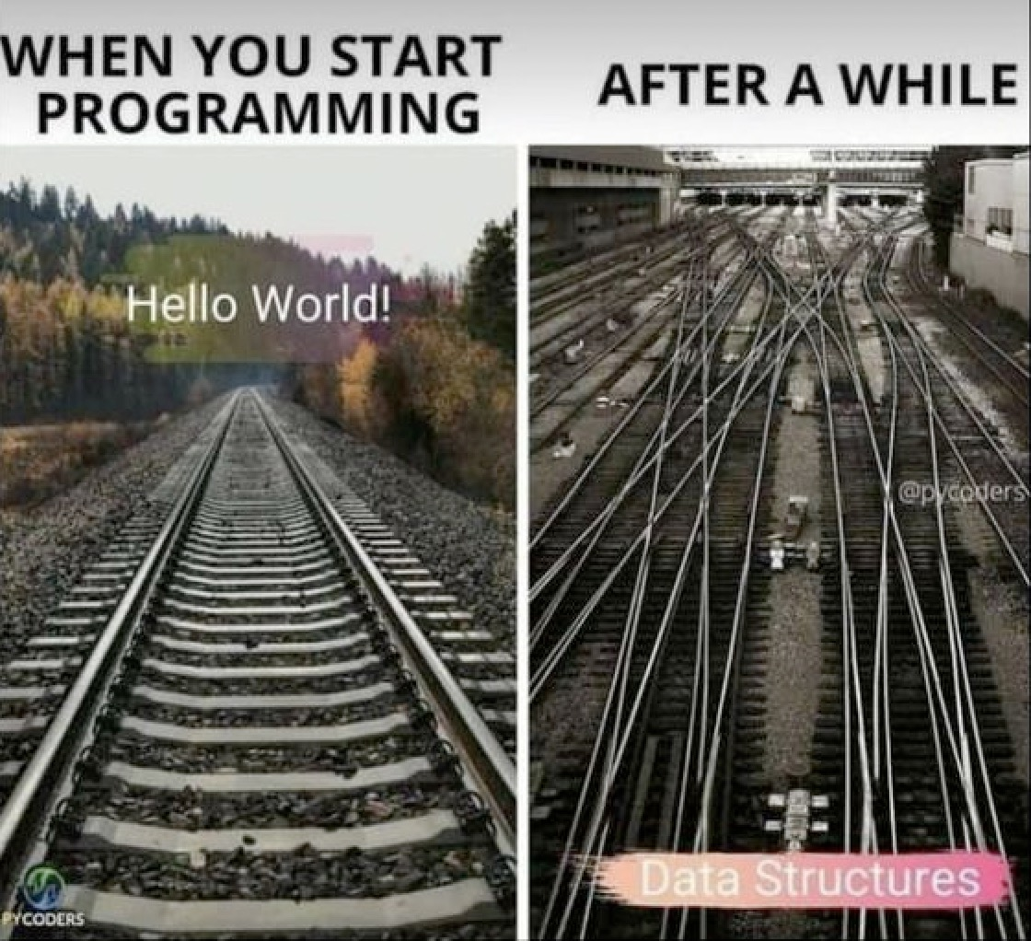
7. LISTS: A Fundamental Python3 Data Structure
Source: https://www.pinterest.com/pin/290834088447075737/

Slide 61
Python3 Lists
Python3 offers basic simple ("atomic") data types such as integers, floats, and strings.
Python3 ALSO offers several standard data structures, including lists, dictionaries, sets, tuples, and the ability to create user-defined custom data structures. Let's start with lists.
Lists:
Lists are ordered sets of comma-separate variables enclosed within square brackets.
List elements can be any data type (integers, strings, lists, etc.)
Lists are changeable.
Lists can have duplicate entries.
Lists act as a substitute for an actual "array" data type.
Many of Python3's most powerful (and most complicated/commonly misunderstood) commands operate on lists.

Slide 62
Basics of Creating and Referring To Parts of Lists
a_list = [0.8, 0.4, 0.2, 1.5, -3, 0.32, 0.01]
print(a_list[3]) ← 4th item in the list 1.5
print(a_list[-2]) ← counting inward from the right hand side 0.32
print(a_list[2:5]) ← starting and ending indicies (a "slice") [0.2, 1.5, -3]
The above examples are numeric, but elements could have been strings, dictionaries, etc.
b_list = [{'name': 'Bob Smith',
'email_address': 'bsmith@protonmail.com',
'html_format_email': False},
{'name': 'Jane Doe',
'email_address': 'jane@apple.com',
'html_format_email': True}]
for obs in b_list:
print(obs)

Slide 63
Some Approaches to Performing List "Surgery"
some_list = []
some_list.append('hamburger')
some_list.extend(['fries', 'soda'])
print(some_list) ['hamburger', 'fries', 'soda'] ← the added list items are "flattened"
some_list.remove('hamburger')
some_list.insert(0,'cheeseburger') ← "0" means at the start of the list
print(some_list) ['cheeseburger', 'fries', 'soda']
some_list[1] = 'onion rings' ← update a specific list element
print(some_list) ['cheeseburger', 'onion rings', 'soda']

Slide 64
Two common errors when working with list functions
Some fn's work on lists "in place" (top of the preceding slide); other fn's output a new list. Functions may be offered in BOTH variants. Classic example -- sort() vs sorted(): sort() sorts an existing list in place. sorted() produces a new sorted list, leaving the original list intact "as-is." See https://docs.python.org/3/howto/sorting.html Your first thought ANY time you use ANY function to manipulate a list should be to confirm: "does the function I've selected work "in place" or does it produce a new list?"
Some functions add a new label pointing to a shared existing list (like a Un*x file 'link'). Other functions produce a new (and totally independent) copy of the original list. This subtle difference is the different between a Python3 shallow copy and a deep copy. See https://docs.python.org/3/library/copy.html

Slide 65
zip: combine lists (if alpha/beta were sets, random pairs would form)
Using zip to compose tuples from two lists:
alpha = ["apples", "cherries", "peaches", "plums"] beta = ["green", "red", "pink", "purple"] fruit_colors = zip(alpha, beta) for elements in fruit_colors: print(elements) ('apples', 'green') ('cherries', 'red') ('peaches', 'pink') ('plums', 'purple')
Prefer a dictionary? That's an option as output from zip, too:
fruit_colors_dictionary = dict(zip(alpha, beta)) print(fruit_colors_dictionary) {'apples': 'green', 'cherries': 'red', 'peaches': 'pink', 'plums': 'purple'}

Slide 66
Comprehensions: A Succinct Way of Operating on A List's Elements
List comprehension example:
newlist = [] oldlist = [0.8, 0.4, 0.2, 1.5, -3, 0.32, 0.01] newlist = [x for x in oldlist if x < 0.5] print(newlist) [0.4, 0.2, -3, 0.32, 0.01]
Yes, that's shorter, but is that less confusing/more easily understood than the following?
newlist = [] oldlist = [0.8, 0.4, 0.2, 1.5, -3, 0.32, 0.01] for x in oldlist: if x < 0.5: newlist.append(x) print(newlist)
Reference: https://docs.python.org/3/tutorial/datastructures.html#list-comprehensions

Slide 67
8. DICTIONARIES
https://commons.wikimedia.org/wiki/File:OED2_volumes.jpg

Slide 68
Python3 Dictionaries
Dictionaries consist of key: value pairs, indexed by the key values. Dictionaries live within "curly braces:" {}
fruit_prices = {"apples":1.52, "bannanas":0.52, "cherries":3.43, "grapes":1.84, "oranges":1.21, "peaches":1.72, "pears":1.59}
Dictionary keys (left hand side values) MUST be unique. They can be any immutable type (quoted strings, integers, etc).
Dictionary values (right hand side values) can also be strings, integers, etc. They do NOT need to be unique.
New entries can be added to an existing dictionary, and existing dictionary entries can be updated. You'll likely find yourself using Python3 dictionaries a LOT when using Python3.
JSON data will often be read into a Python3 dictionary with json.loads()
A Python3 dictionary can be written out in JSON format with json.dumps()
See https://docs.python.org/3/library/json.html

Slide 69
Sample Code to Read and "Pretty Print" JSON Data
$ cat m3aawg-extract.jsonl {"count":364178,"time_first":"2013-08-20 01:41:16","time_last": "2024-03-22 08:55:23","rrname":"m3aawg.org.","rrtype":"NS","bailiwick": "m3aawg.org.","rdata":["udns1.ultradns.net.","udns2.ultradns.net."]}
{"count":214949,"time_first":"2011-12-29 18:24:28","time_last": "2024-03-22 09:52:38","rrname":"www.m3aawg.org.","rrtype":"CNAME", "bailiwick":"m3aawg.org.","rdata":["m3aawg.org."]}
$ cat sample-json.py """demonstrate reading a JSON file and converting it to a dictionary""" import json from pprint import pprint f = open("m3aawg-extract.jsonl", "r", encoding="utf-8") results = f.readlines() f.close() for some_element in results: one_obs = json.loads(some_element) pprint(one_obs, indent=4)

Slide 70
Sample Output
{ 'bailiwick': 'm3aawg.org.',
'count': 364178,
'rdata': ['udns1.ultradns.net.', 'udns2.ultradns.net.'],
'rrname': 'm3aawg.org.',
'rrtype': 'NS',
'time_first': '2013-08-20 01:41:16',
'time_last': '2024-03-22 08:55:23'}
{ 'bailiwick': 'm3aawg.org.',
'count': 214949,
'rdata': ['m3aawg.org.'],
'rrname': 'www.m3aawg.org.',
'rrtype': 'CNAME',
'time_first': '2011-12-29 18:24:28',
'time_last': '2024-03-22 09:52:38'}

Slide 71
A requested dictionary element MUST exist, or you'll get a KeyError
fruit_prices = {"apples":1.52, "bannanas":0.52, "cherries":3.43,
"grapes":1.84, "oranges":1.21, "peaches":1.72, "pears":1.59}
print("cranberries", fruit_prices["cranberries"])
Traceback (most recent call last):
File "/Users/joe/dictionary-test.py", line 4, in <module>
print("cranberries", fruit_prices["cranberries"])
~~~~~~~~~~~~^^^^^^^^^^^^^^^
KeyError: 'cranberries'
The prudent thing to do? Check to be sure the key you're interested in exists:
fruit_prices = {"apples":1.52, "bannanas":0.52, "cherries":3.43,
"grapes":1.84, "oranges":1.21, "peaches":1.72, "pears":1.59}
if "pears" in fruit_prices:
print ("pears", fruit_prices["pears"])
pears 1.59

Slide 72
You can loop ("iterate") over a Python3 dictionary...
Some entries in a Python3 dictionary may need to be interated over. You can do so over the keys, the values, or the key, value pairs. For the dictionary called dict --
Iterating over keys: for k in dict: [...]
Iterating over values: for v in dict.values(): [...]
Iterating over key, value pairs: for k, v in dict.items(): [...]

Slide 73
9. Other Python3 Data Structures
https://commons.wikimedia.org/wiki/Category:Pantex_Plant#/media/ File:Pantex_Plant_Magazine_4-42.png

Slide 74
Python3 Sets
Among other things, Python3 sets can be handy for accumulating unique values while iterating over a big bunch of values.
Python3 sets are unordered.
Sets (by definition) can't have duplicate elements.
Like dictionaries, sets live within curly braces.
https://docs.python.org/3/tutorial/datastructures.html#sets

Slide 75
Working With Sets
Make an empty set with the set() function: my_pets = set()
Add elements to a set:
my_pets.add("Fido") my_pets.update({"Fluffy","Smokey","Bootsy"}) print(my_pets) {'Fido', 'Smokey', 'Fluffy', 'Bootsy'}
Length of a set:
print(len(my_pets)) 4
Test to see if an entry is present:
if "Smokey" in my_pets: print("Smokey found in my_pets")

Slide 76
Python3 Tuples
Tuples are yet another built-in Python3 data structure. They're two or more values (integers, floats, strings, lists, ...) separated by commas (the parens are optional, but customary). The items in the tuple can be of different types.
x = (15, 8, 7, 12) y = ("ginger", "turmeric") z = ({5,8,12}, {10,8,7}, {-1, -3, -2})
Tuples can be "unpacked:"
j, k, l, m = x print(j, k, l, m) 15 8 7 12
individual elements and sub-elements can also be accessed from tuples:
print(z[1]) {10, 8, 7} print(list(z[2])[1]) -1

Slide 77
dataclasses and a sample user-defined custom dataclass
""" demonstrate use of dataclass to create a sample class """
import sys from dataclasses import dataclass
if sys.version_info < (3,7): # pylint: disable-next=broad-exception-raised raise Exception("Must use Python 3.7 or later")
@dataclass(kw_only=True)
class CustomerRecord:
""" customer record definition """
name: str
address: str
city: str
state: str
zip: int
phone: str
poc: str
x = CustomerRecord(name="Acme Widgets", address="123 Main St",
city="Springfield", state="Oregon", zip=97477, phone="555-343-1234",
poc="John Smith")
print(x) # example of accessing a single field from the object
print(x.phone)

Slide 78
10. Packages/Libraries The role of 3rd-party packages/libraries Installing 3rd-party packages Virtual environments What if there are multiple library options for a given task? Copyrights and Licensing Security of 3rd-party packages/libraries
Different kind of library (but note book at start of right 2nd shelf) https://commons.wikimedia.org/wiki/File:SteacieLibrary.jpg

Slide 79
The Role of Packages/Libraries
Much of the power of Python3 comes from a large portfolio of freely available packages/libraries
These are normally distributed via PyPI (see https://pypi.org/ ) . PyPi's HUGE:
Python3 packages are simple to install, in most cases by just saying:
$ pip3 install <package_name>
Before installing packages from PyPI, however, a few cautionary notes/recommendations

Slide 80
Use A Virtual Environment To Avoid Running Into "Package Conflicts"
The process in detail? See https://docs.python.org/3/tutorial/venv.html
In a nutshell, after you've used pip3 to install venv (only need to do that once):
$ mkdir some_project $ cd some_project $ python3 -m venv .venv $ source .venv/bin/activate [use or work on your project] $ deactivate $ cd
Special considerations to keep in mind:
You'll need to install any packages you want to have in the virtual environment
Use pipx instead of pip when installing packages in a virtual environment (see https://pipx.pypa.io/stable/)
Upgrading packages in one virtual environment will NOT automatically upgrade the packages in another environment (of course, this is just as intended)
It can be potentially easy to lose track of the virtual environments you may have in use

Slide 81
Choice of Packages: Pick Really Carefully!
Python3 gives you many community–contributed options for doing common tasks (such as for accessing a RESTful API over the Internet, or for parsing JSON data)
You may be tempted to just use the first package you find that seems to do what you need
This can be a mistake. Packages will vary across many dimensions, including:
Ease-of-use (Is there documentation? can you find examples of using the code?)
Popularity (Good libraries tend to be popular and used by many users)
Development status (Was the library developed and released, but then abandoned? Are bugs still getting chased and squashed? Are there multiple active contributors?)
Performance (For example, there may be orders of magnitude difference in the performance of various JSON parsing libraries)
Security (If you're carefully crafting your own code so it's secure, don't undercut that security with a potentially woefully-insecure (or overtly hostile!) 3rd party library!)
Check your favorite search engine for reviews, benchmarks and bakeoffs
One objective starting clue: look at package dates and popularity.

Slide 82
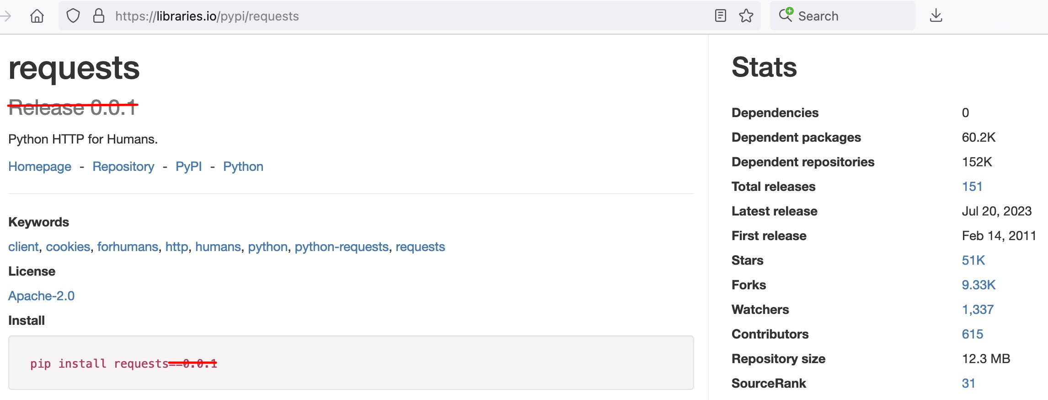
libraries.io Stats For Two Packages Used for Making RESTful Queries
Either of these
would be a
worthy choice... But avoid "similarly-named" (but "ancient," "brand new," or "little used")
packages...

Slide 83
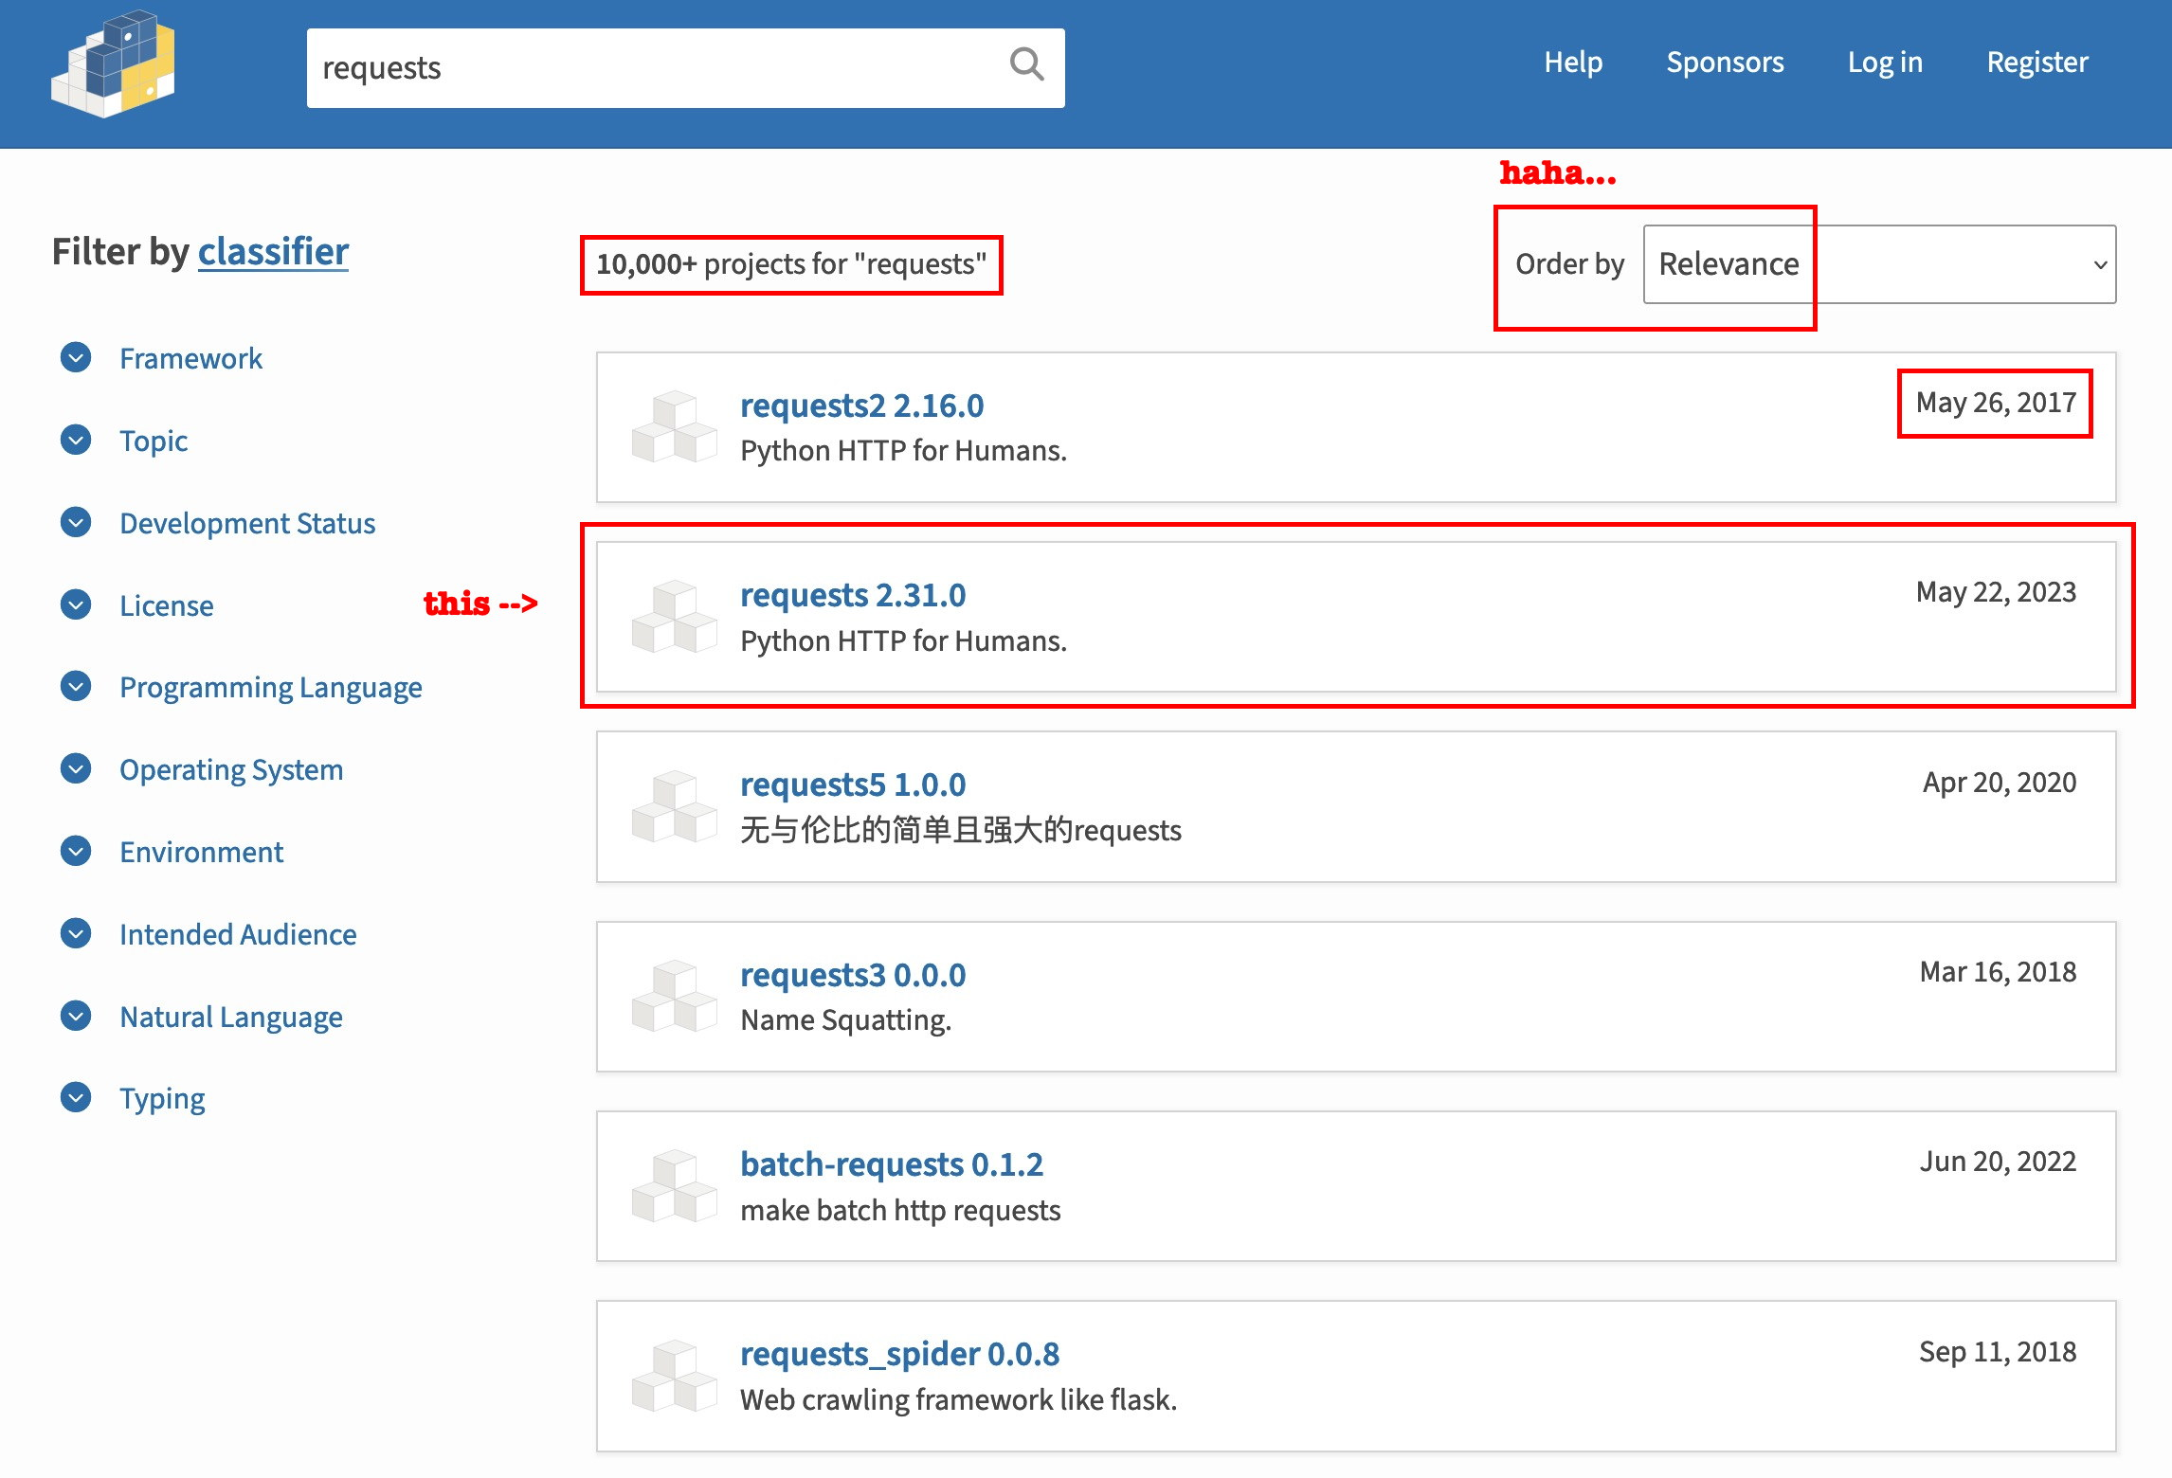
The "most relevant" package may not be the one you actually want

Slide 84
"So I Think I'd Like To Upgrade ALL My Python3 Packages..."
People (understandably) may want to keep their Python3 packages up to date. This can sometimes be "tricky." A common approach to try doing that looks like:
[check there isn't already a requirements.txt file in this dir then...] $ pip3 freeze > requirements.txt [review the list in requirements.txt before continuing] $ pip3 install --upgrade -r requirements.txt
Didn't use virtual environments? You MAY encounter tricky-to-resolve conflicts. Example:
INFO: pip is looking at multiple versions of argcmdr to determine which version is compatible with other requirements. This could take a while.
ERROR: Cannot install -r requirements.txt (line 14), argcmdr==1.0.1 and argcomplete==3.1.6 because these package versions have conflicting dependencies.
The conflict is caused by: The user requested argcomplete==3.1.6 argcmdr 1.0.1 depends on argcomplete<3 and >=1.9.4 [etc]

Slide 85
"So What Do I Do If I'm Trapped In Some Sort of Dependency Hell?"
Reconsider: do you REALLY need to upgrade all your packages? Are you SURE?
If so, the first step is to learn more about the packages that rely on the conflicting modules. A great tool for that: https://github.com/tox-dev/pipdeptree Once you've installed pipdeptree, try:
$ pipdeptree –r
Now that you can see what conflicts exist, internalize the classic Stones song "You Can't Always Get What You Want," see https://www.youtube.com/watch?v=ZUqSNbJuGOw After you've finished listening to that immortal song, begin by deciding what conflicting packages you're going to remove. Remove the first of those with pip3 uninstall Now rerun pipdeptree -r and resolve the next conflict that still exists. Iterate until done. Attempt to update again (if you still want to try to do this).

Slide 86
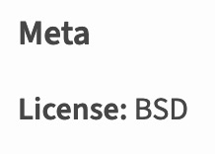
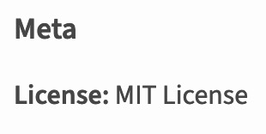
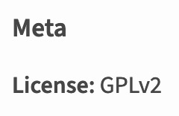
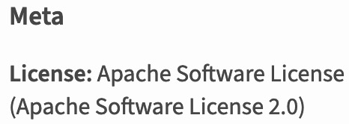
Python Package Copyright and Licensing
Each package on https://pypi.org/ has a license summary. Some examples include:
Be SURE you know which license(s) apply to the libraries/packages you're using! If you installed the handy pipdeptree package mentioned a slide or two back, try:
$ pipdeptree --license
You should ALSO be sure you know your rights and obligations under those licenses! A good starting point: https://opensource.org/licenses
Trying to pick a license for YOUR OWN code? Talk to your management and company legal counsel. For a private project, maybe see https://choosealicense.com/

Slide 87
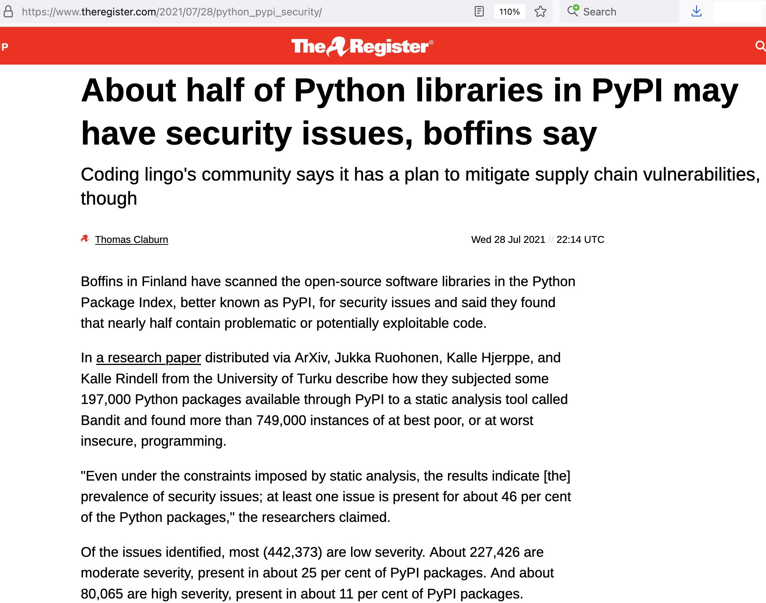
"Can I TRUST the
packages/libraries
I download from PyPI?"
One analysis from circa 2021...

Slide 88
Running The Same Static Code Checker Those Researchers Used...
Sample Bandit run (https://github.com/PyCQA/bandit) on the Python requests library:
$ bandit -r requests-2.31.0 -n 3 -lll
[...]
Test results:
>> Issue: [B324:hashlib] Use of weak MD5 hash for security. Consider usedforsecurity=False
Severity: High Confidence: High
CWE: CWE-327 (https://cwe.mitre.org/data/definitions/327.html)
More Info: https://bandit.readthedocs.io/en/1.7.9.dev1/plugins/b324_hashlib.html
Location: requests-2.31.0/requests/auth.py:148:23
147 x = x.encode("utf-8")
148 return hashlib.md5(x).hexdigest()
[...]
Run metrics: Total issues (by severity): Undefined: 0 Low: 532 Medium: 116 High: 3
[etc]
Are those flaws a "big deal?" YOU'LL have to review them & decide
for yourself...

Slide 89
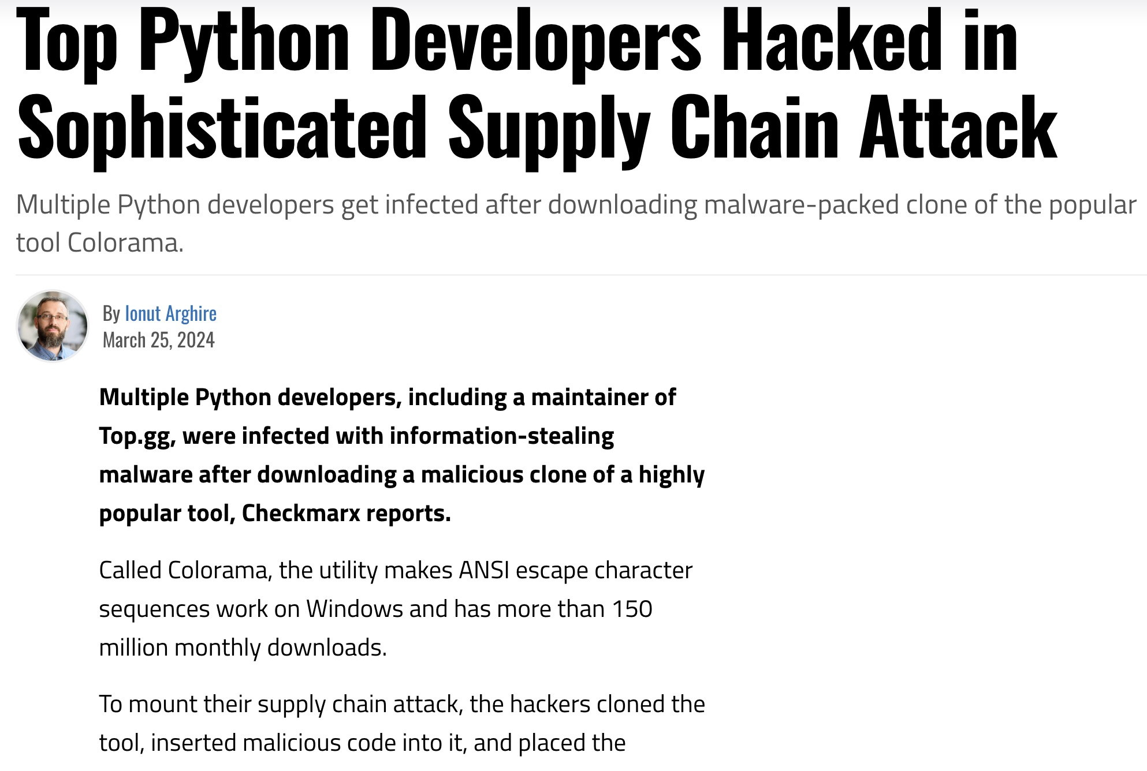
And A Recent Example of a Supply Chain Attack...
Ref: https://www.securityweek.com/top-python-developers-hacked-in-sophisticated-supply-chain-attack/ and https://arstechnica.com/gadgets/2021/03/more-top-tier-companies-targeted-by-new-type-of-potentially-serious-attack/

Slide 90
11: argparse: a built-in library that simplifies documenting your command-line interface
https://xkcd.com/1168/

Slide 91
Producing An In-Program Help Synopsis with argparse
In addition to other program documentation, it can be helpful to be able to get a brief command summary in your program. Use argparse to do that automatically:
import argparse
parser = argparse.ArgumentParser(description="Plot lat, long, count points.",
allow_abbrev=False)
parser.add_argument('-v', '--version', action='store_true', dest='version')
parser.add_argument("--myfilename", type=str, action="store")
# going to let the user pick one (and only one) geographical extent
group = parser.add_mutually_exclusive_group()
group.add_argument('--world', '-w', action="store_true")
group.add_argument('--US', '--united_states', '--usa', '--us',
action="store_true")
group.add_argument('--ca', '--cal', '--california', action="store_true")
group.add_argument('--fl', '--fla', '--florida', action="store_true")
# "or" would run into Python reserved words
group.add_argument('--ore', '--oregon', action="store_true")
group.add_argument('--tx', '--tex', '--texas', action="store_true")
args = parser.parse_args()
You then need to grab the bits you want from those parsed arguments...

Slide 92
Accessing Arguments from Argparse
if args.version:
print("plot_lat_long Version 1.0")
sys.exit(0)
myfilename = args.myfilename
if args.world:
[...]
elif args.US:
[...]
elif args.ca:
[...]
elif args.fl:
[...]
elif args.ore:
[...]
elif args.tx:
[...]

Slide 93
Sample Automatically Generated Help Summary
$ plot_lat_long -h
usage: plot_lat_long [-h] [-v] [--myfilename MYFILENAME] [--world | --US | --ca | --fl | --ore | --tx]
Plot lat, long, count points.
options:
-h, --help show this help message and exit
-v, --version
--myfilename MYFILENAME
--world, -w
--US, --united_states, --usa, --us
--ca, --cal, --california
--fl, --fla, --florida
--ore, --oregon
--tx, --tex, --texas

Slide 94
12. Sanitizing/Validating/Encoding Inputs/Fuzzing
https://xkcd.com/327/

Slide 95
Defensive Coding: Sanitizing/Validating/Encoding Input
If you are developing an application for general use, assume that users WILL accidentally (or intentionally) throw unexpected/malicious/random input at it. As some people put it, "expect cats to dance on the user's keyboard while the program is running."
It is UP TO YOU to ensure that you don't inadvertently allow unexpected input to impact your system, your code, or the data your program interacts with. There are different approaches to handling this issue, with potentially different levels of protection:
Static typing (perhaps using my[py])
Full input validation (perhaps using pydantic, building on static typing)
Escaping all HTML-format input
Using specially tailored validators (for example, for email addresses)
Think you've got it all handled? Try using a fuzzer to test it (the bad guys certainly will!)

Slide 96
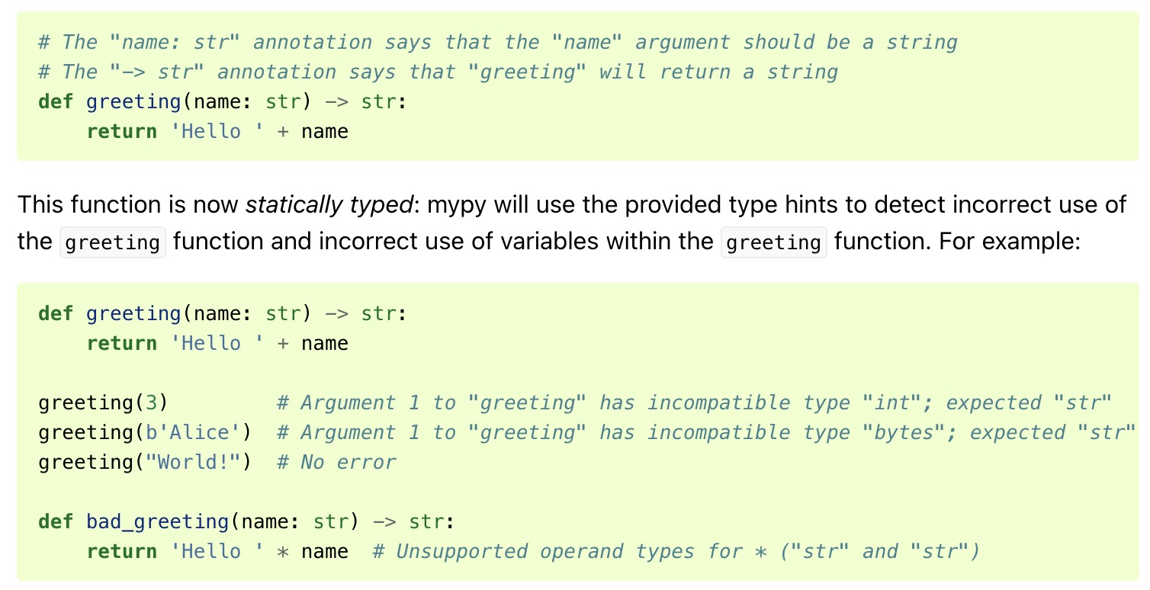
Static type declarations for Python: my[py]
https://mypy.readthedocs.io/en/stable/getting_started.html illustrates the key concept:

Slide 97
"So How About Just Defensively Escaping Any HTML Input?"
If HTML input must be allowed, one (not recommended) approach is to escape the input: import html input = '<LI><B><A HREF="https://www.stsauver.com/joe/">Joe''s Site</A></B>' sanitized = html.escape(input) print(sanitized) &lt;LI&gt;&lt;B&gt;&lt;A HREF=&quot;https://www.stsauver.com/joe/&quot;&gt;Joes Site&lt;/A&gt;&lt;/B&gt;
BUT note that https://cheatsheetseries.owasp.org/cheatsheets/ SQL_Injection_Prevention_Cheat_Sheet.html explicitly says:
"Defense Option 4: STRONGLY DISCOURAGED: Escaping All User-Supplied Input In this approach, the developer will escape all user input before putting it in a query. It is very database specific in its implementation. This methodology is frail compared to other defenses and we CANNOT guarantee that this option will prevent all SQL injections in all situations."

Slide 98
Email address validation: https://pypi.org/project/email-validator/
The M3AAWG audience may be particularly interested in validating email addresses. This is a nice example where a special validating library may be a convenient option:
from email_validator import validate_email, EmailNotValidError
test_addresses = ['root@co.uk', 'jane@@blah']
for addr in test_addresses:
try:
emailinfo = validate_email(addr, check_deliverability=True)
norm_email = emailinfo.normalized
print("superficially valid: ", norm_email)
except EmailNotValidError as e:
print(str(e))
The domain name co.uk does not accept email.
The email address is not valid. It must have exactly one @-sign.

Slide 99
Confident You're Set? Fuzz It! (Test Your Code With Random Input)
See https://www.fuzzingbook.org/ This is a freely available and wonderful online book that has been written by Andreas Zeller, Rahul Gopinath, Marcel Böhme, Gordon Fraser, and Christian Holler. They say: "You can use this book in four ways: [...] You can read chapters in your browser. Check out the list of chapters in the menu above, or start right away with the introduction to testing or the introduction to fuzzing. All code is available for download. [continues]" "This work is designed as a textbook for a course in software testing or security testing; as supplementary material in a software testing, security testing, or software engineering course; and as a resource for software developers. We cover random fuzzing, mutation-based fuzzing, grammar-based test generation, symbolic testing, and much more, illustrating all techniques with code examples that you can try out yourself." "When formatted as a PDF, @TheFuzzingBook now has 1,477 pages"

Slide 100
13. Other Python3 Testing
https://pixabay.com/photos/microscope-slide-research-close-up-275984/

Slide 101
Output Testing: Let's Look At A Python Uniform Random Number Generator – Does It Seem to Produce Uniformly Distributed Values?
$ cat ran0.py #!/usr/local/bin/python3
""" from Numerical Recipes Ch7 """
def ran0(idum):
IA = int(16807)
IM = int(2147483647)
IQ = int(127773)
IR = int(2836)
MASK = int(123459876)
AM = float(1./IM)
idum=idum^MASK
k = int(idum/IQ)
idum=int(IA*(idum-k*IQ)-IR*k)
if idum < 0:
idum=int(idum+IM)
rand0=float(AM*idum)
idum=int(idum^MASK)
return (rand0, idum)
(rand0, newseed)=ran0(int(77717))
for x in range(1,10000000):
(rand0,newseed)=ran0(newseed)
print(rand0)
$ python3 ran0.py > unif-dev.txt
$ cat test_unif-dev.py
#!/usr/local/bin/python3
import seaborn as sns
import pandas as pd
import matplotlib.pyplot as plt
df = pd.read_csv("unif-dev.txt")
ax = sns.displot(df) plt.savefig("distro.pdf",dpi=300)

Slide 102
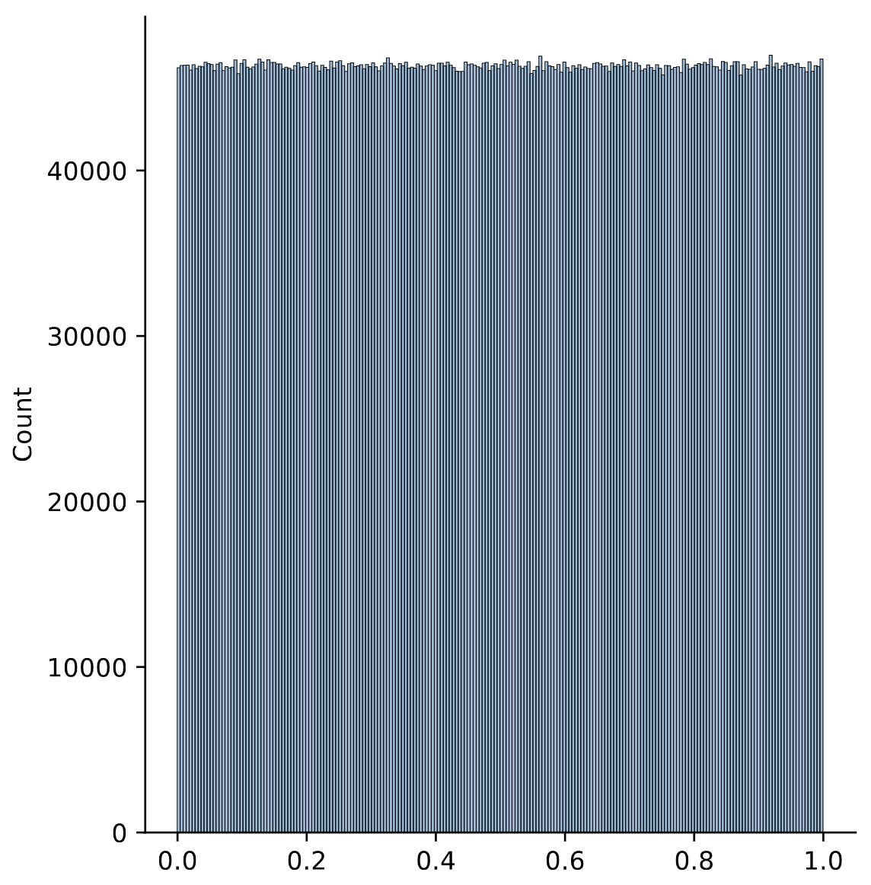
Is the output approximately uniformly distributed?
⬅ uniformly distributed (yes, with a little "random ripple") That's just "scratching the surface," however, see also https://en.wikipedia.org/wiki/Diehard_tests and https://en.wikipedia.org/wiki/TestU01

Slide 103
Unit Testing with pytest ( https://docs.pytest.org/en/8.0.x/ )
Simple rule for integrating testing into your code: anytime you write a new Python function, write one or more unit tests of that function at the same time. Trivial example:
$ cat my_fruit_pricing.py
def fruit_pricing(fruit):
fruit_prices = {"apples":1.52, "bannanas":0.52, "cherries":3.43,
"grapes":1.84, "oranges":1.21, "peaches":1.72, "pears":1.59}
if fruit in fruit_prices:
return fruit_prices[fruit]
else:
return None
def test_pricing():
assert fruit_pricing("apples") == 1.52
assert fruit_pricing("bannanas") == 0.52
assert fruit_pricing("cherries") == 3.43
assert fruit_pricing("mangoes") == None
$ pytest my_fruit_pricing.py

Slide 104
Black Box Testing with https://pypi.org/project/pbbt/
Black box testing assumes no knowledge of how a program works, it’s just treated as, well, a “black box”: inputs go into the black box, stuff happens, and outputs come out. It’s often used to ensure that:
After new code is added, the program still runs as expected
Output remains consistent: for a given set of inputs, the same results get returned
All platforms perform the same: for instance, running the program on either Linux or BSD operating systems still returns the same results.
In a nutshell, all those tests compare how things worked "before" with how things work "now," looking for changes. The assumption is that variability is generally unwanted (or at least something which should be carefully understood). This is admittedly a simplistic testing approach, but a good foundation on which more sophisticated tests can be added.
You'll sometimes hear this referred to as "regression testing."
See https://pypi.org/project/pbbt/ or I've got a full article about this at https://www.domaintools.com/resources/blog/black-box-testing-with-the-python-black-box-tool-pbbt/

Slide 105
Profiling Python3 Code
If you're trying to speed up "long-running" (slow) code, the first question is "where does the program spend most of its time?" The easiest way to answer that question is with pyinstrument (see https://pyinstrument.readthedoc3s.io/ )
$ pyinstrument --from-path ./my_python_script.py [any regular program output] _ ._ __/__ _ _ _ _ _/_ Recorded: 16:09:30 Samples: 19962 /_//_/// /_\ / //_// / //_'/ // Duration: 51.574 CPU time: 51.135 / _/ v4.6.1 Program: [program location here] 51.558 <module> <my_python_script>.py:1 └─ 51.172 open pikepdf/_methods.py:342 [2 frames hidden] pikepdf, <built-in> 51.166 PyCapsule._open <built-in> [etc]

Slide 106
14. Exercises
"U.S. Navy sailors lift a large log dubbed Old Misery during log physical training at the Naval Special Warfare Center at Naval Amphibious Base Coronado, Calif., on Feb. 3, 2009. The sailors are undergoing basic underwater demolition/SEAL training." [emphasis added] https://commons.wikimedia.org/wiki/File:Defense.gov_News_Photo_090203-N-7303M-011.jpg

Slide 107
Why Exercises?
You can read about/hear someone talk about a programming language, but you really won't understand that language until you actually struggle with it and try to use it to do something.
Working on code will help improve your skills and make you a stronger coder.
Some people find it hard to come up with sample programming projects. If you CAN come up with your own projects, that's great, work on those. If not, you can at least try some of these.
Looking for sample solutions for these? See https://www.stsauver.com/joe/solutions/

Slide 108
#1: Tic Tac Toe
Human is X, computer is O.
Show a basic tic tac toe display and request a move from the human player.
Update the "display." Now have the computer pick a move.
Loop until three the same in a column (or row, or diagonal), or no one can win (it's tie).
Notes:
Use a Python3 data structure (set, list, dictionary, tuple) as part of your code. For example, perhaps you want to have a set listing the available squares, a set listing the squares X has selected, and a set listing the squares O has selected. Or maybe you'd like to think about the board as a dictionary, and assign " " (free), "X", or "O" to each dictionary element?
The core of this exercise is the computer's "move selector." Simplest approach is to pick a random unoccupied square, but you can do better than that, right? For example, if there's a winning square, always pick that. If there's NOT a winning square, but the human has two in a row, the computer should try to keep the human from winning (if it can).
Remember, a sample solution is available at https://www.stsauver.com/joe/solutions/

Slide 109
#2: Recover Access to a PDF With A Forgotten Password
You created and saved an important PDF file. You decided it should have a password.
Unfortunately, you forgot to make a note of the precise password you used. While you don't remember the exact password, you DO remember that it used a short potentially mixed-case alphanumeric password, at most six characters long.
Write Python3 code to try opening the document with all possible short passwords.
A Few Hints:
Use a Python3 library that's able to open a password protected PDF, and which will accept a programmatically-supplied password.
ONLY try this on one of your OWN PDFs, stored LOCALLY on the system you're using. Do NOT attempt to find the password for a remote document that someone else owns. Need a passworded PDF? Download https://www.stsauver.com/joe/managers-amendment/

Slide 110
#3: Computational Linguistics: Let's Analyze Some Executive Orders!
The American Presidency Project maintains an archive of nearly a quarter million Presidential speeches and other Presidential remarks at https://www.presidency.ucsb.edu/documents Pick a category of documents (such as Executive Orders) and save at least half a dozen samples for each of at least half a dozen leaders (so 36 or more total files).
Are those speechs written for a 12th grade audience? A college-level audience? Find a Python3 library that can help you assess this. Report the Flesch-Kincaid Grade Level plus at least one other reading measure of your choice for the half dozen leaders. For example:
george_bush flesch=18.3 text_standard=17.0 doc_count=7
clinton flesch=18.4 text_standard=17.0 doc_count=21
trump flesch=21.0 text_standard=18.6 doc_count=21
obama flesch=21.3 text_standard=28.0 doc_count=21
george_w_bush flesch=24.1 text_standard=15.0 doc_count=22
biden flesch=24.3 text_standard=17.0 doc_count=12

Slide 111
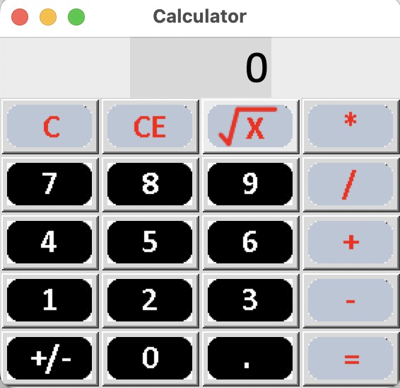
#4: Make a Basic GUI Calculator
So far we've only talked about "command line" Python3. You may be wondering if Python3 can be used to make an actual graphic application – it can!
We haven't talked AT ALL about a graphic user interface for Python3, but they DO exist. For example, check out https://docs.python.org/3/library/tkinter.html
If you're so inclined, try creating a basic graphical user interface (GUI) point-and-click calculator.
If that's too daunting, become familiar with Tkinter by extending an already functioning sample calculator – see https://www.stsauver.com/joe/solutions/exercise-four/ Maybe create and add "memory" keys M+, M-, M Recall, M Exchange (swap current value and the memory value), M Clear, in a new vertical column to the left of the current keys?

