Slide 1
Batch Versus Flow: "Real-Time" Data-Driven Network Security
NWACC Information Security Workshop
2:00-3:00 PM, Tuesday, October 18th, 2016
Courtyard by Marriott, Portland City Center
Joe St Sauver, Ph.D. (stsauver@fsi.io)
Scientist, Farsight Security, Inc.
https://www.stsauver.com/joe/batch-vs-flow/

Slide 2
I. Introduction

Slide 3
Thanks For The Chance To Talk Today!
I'd like to thank Adrian for the invitation to be with you today.
NWACC has always been a favorite organization, and not just because they created the Joanne Hugi Award for my former boss.
I recognize that it's somewhat unusual to have a now non-higher ed person at an NWACC, so let me also say that I appreciate the opportunity to see many of my old friends from higher ed again.
Disclaimer: Because I (still!) wear a lot of hats, let me be clear that today I'm here as a Scientist from Farsight Security, Inc., and I'm NOT speaking on behalf of the REN-ISAC TAG, M3AAWG, the Online Trust Alliance, Cybergreen, Global Cyber Alliance, CAUCE, Broadband Technical Advisory Group, etc.
While I appreciate feedback I've received from colleagues on this talk, I'm solely responsible for any errors or other issues.
Questions? Feel free to ask at any time...

Slide 4
Yes, My Slides Are Still In That "Weird Joe Style..."
I tend to write very detailed slides. If you're not used to my slide style, they'll look weird to you.
For those of you who may not already know, I write my slides this way so that:
I can try to stay on time while still covering a lot of material
You don't need to try to take notes (I always share my slides)
People who aren't here today and who look at these slides after-the-fact can still figure out what I was trying to tell them
This talk will be accessible to those who are deaf or hard-of-hearing (these slides == captioning for those audiences)
This talk will get well-indexed by Google, Bing, etc.
I don't end up getting misquoted (I hate to get misquoted)
I promise, I won't read these slides word-to-word for you.
You don't need to try to read them as we go along, either.

Slide 5
Those Were The Days, My Friends...
Many years ago -- before I ever did anything cyber security-related -- I was a statistical consultant at the University of Alaska-Fairbanks and then again for the University of Oregon Computing Center.
My terminal degree from the U of O Business School is actually in Production and Operations Management (e.g., "quantitative business stuff" such as linear programming, inventory management, factory layout, personnel scheduling, etc.).
With that sort of odd background, talking about batch vs flow processing and near-real-time security data analysis just seemed somehow right. :-)
Moreover, this topic also reconnected nicely with some of the work I did for Internet2, back when I was their Security Programs Manager under contract through the University of Oregon.

Slide 6
The Security Information Exchange (SIE)
When I was Internet2's Security Programs Manager, I convened two Data Driven Collaborative Security Workshops (DDCSW) (sometimes mistakenly called the "Friends of Joe meetings"): -- DDCSW, Univ. of Maryland-Baltimore County, May 21-22, 2009 -- DDCSW 2, Washington Univ. in St Louis, Aug 17-18, 2010
Andy Fried, representing ISC, talked about SIE during DDCSW I, see https://web.archive.org/web/20100626065352/http://security.internet2.edu/ddcsw/docs/fried_.pdf
Eric Ziegast, then also with ISC, talked about NMSG (the data format that is used for the majority of the data shared across SIE) at DDCSW II (working on recovering copies of those talks).
Little did I know that SIE was going to show up in my life again when I went to work as a Scientist for Farsight Security, Inc.: SIE was among the core assets that Dr. Paul Vixie purchased from ISC when he founded Farsight.

Slide 7
Why Mention SIE Here? It's FLOW Based/Continuous
Unlike many other security data distribution efforts SIE is continuous/flow-based rather than batch or sample-based.
SIE is not the ONLY continuous/flow-based model, however. For example, see also http://www.ren-isac.net/ses/ (emphasis added): Objective Improve timely local protection against cyber security threat, by sharing security event information, in near-real time, within a trusted federation, and among federations.
For an example of a data sharing effort that tends to be more batch or sample-based, see the DHS IMPACT (Information Marketplace for Policy and Analysis of Cyber-risk & Trust) Project (formerly PREDICT), https://www.impactcybertrust.org/
Another nice resource describing some ongoing and one-time data snapshots: http://www.caida.org/data/overview/

Slide 8
So What Is SIE?
The Security Information Exchange is a way to share security information in near-real time with other participants
Technically, it's a set of 10 gig Ethernet switches that support the distribution of specific near-real-time security data streams as broadcast "channels," kin to cable TV channels:
You can "listen" to a channel with raw or processed passive DNS traffic
You can "listen" to a channel with dark space telescope traffic
You can "listen" to a channel with spam samples
You can "listen" to a channel with [...]
( https://www.farsightsecurity.com/Technical/fsi-sie-channel-guide.pdf )
SIE is like being able to get your own near-real-time pre-built security sensor network for research or operational purposes
See the following slide for a conceptual overview of how one of SIE's data streams gets created and processed.

Slide 9
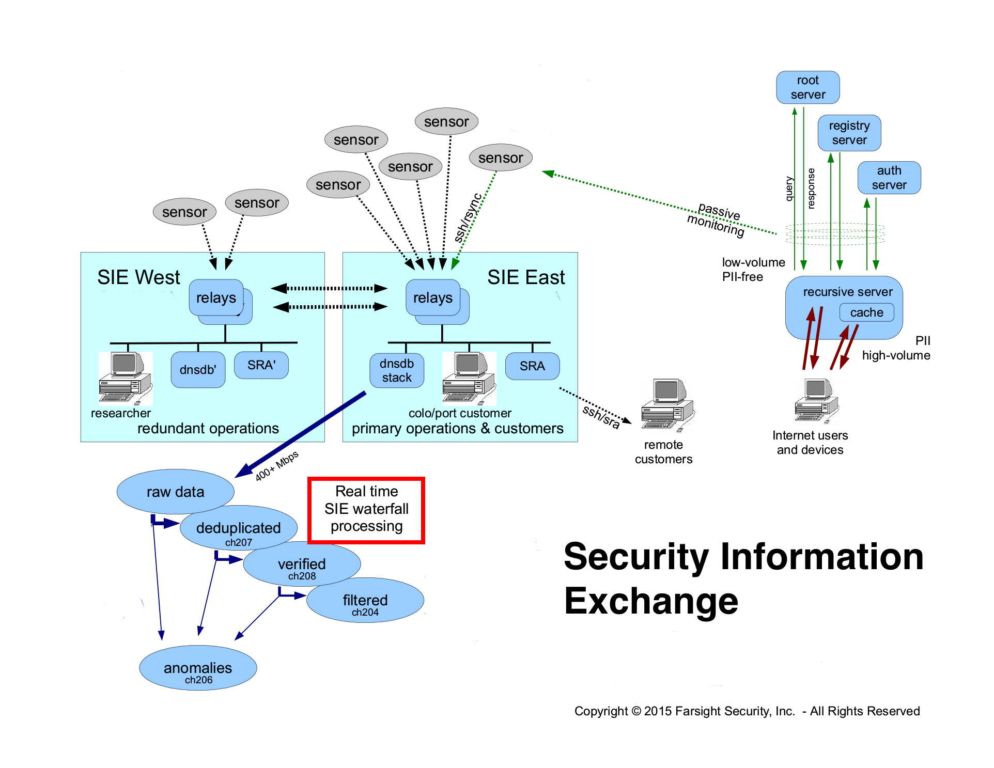

Slide 10
"Real-Time SIE Waterfall Processing"
The easy-to-miss bit from the preceding diagram (even when I've boxed it in red!) is the "real-time waterfall processing" comment...
"Real-Time?" More accurately, "NEAR-real time. (At least to me, TRUE "real-time" means millisecond time scales and a true RTOS (https://en.wikipedia.org/wiki/Real-time_operating_system )). SIE latencies are still very low, however, typically just seconds).
"Waterfall?" A very appropriate term for SIE data: -- At least some data at SIE, such as passive DNS data, gets cascaded down through successive stages of processing and refinement, like water falling through a series of cataracts -- The volume of data on some SIE channels can be somewhat overwhelming, just like the volume of water coming off a waterfall (note to self: never try standing in the water coming off an actual waterfall, F=ma applies even to water!)

Slide 11
Who Uses SIE?
Farsight itself uses SIE: we us data from SIE for DNSDB (our passive DNS product), as well as for other Farsight products
We also sell access to SIE to vetted commercial customers (but this is not a sales spiel and I'm not a sales guy).
If you are a higher education institution and potentially interested in SIE access for operational security purposes, drop me a note and I'll be happy to connect you with the right folks, particularly if you're a member of a higher education cyber security trust community or you'd like to talk about potentially trading data for discounted access.
Approved academic researchers (vetted faculty and grad student researchers) can request FREE (or, in some cases, cost-recovery-only) access to SIE for research purposes. This SIE option is, and has been, grossly underutilized IMO. I'd like to fix that.

Slide 12
Dipping A Bucket vs. Running a Hydro Plant
Let's get back to batch vs. flow...
Most statisticians are used to working with samples. Taking a sample his is analogous to dipping a bucket into a river and pulling out some water. If you like "dipping buckets," you can still do so at SIE: we make it easy to extract and save a sample of SIE data and then process it as you normally would. For example, for one paper, I took roughly 30 million observations from the SIE "DNS Changes" channel during a 24 hour period ending May 22nd, 2015. (Dividing that out, on average that's about 360 obs/second).
However, the real challenge is getting to the point where you can comfortably harness a continual stream of data at scale, much in the way that a hydroelectric plant routinely/continually uses the huge volume of water surging through its penstocks.
Today's talk is really about beginning to make that paradigm shift, going from dipping a bucket to emulating Bonneville.

Slide 13
II. Batch vs. Flow In Everyday Life, and In Data-Driven Cyber Security Operations

Slide 14
Batch vs. Flow Processes in Everyday Life
Batch Process: A dairy makes a batch of vanilla ice cream, then a batch of chocolate chip cookie dough, then a batch of chocolate, then a batch of strawberry, ...
A shoe factory makes a batch of running shoes, then a batch of loafers, then a batch of work boots, then a batch of cowboy boots
A tanker truck load of acetone gets delivered to its purchaser.
Flow ("Continuous") Process: A petroleum refinery continually produces unleaded gasoline for passenger cars, diesel fuel for home heating and diesel vehicles, asphalt for paving, etc.
A water purification plant continually processes water from a reservoir for distribution to homes and businesses.
A pipeline delivers natural gas for use in industrial processes and use in home gas appliances (water heaters, furnaces, ranges, etc.)

Slide 15
Why Choose Flow? Why Choose Batch?
Flow
Batch
(Usually) dedicated facilities
Long planning horizon with readily predictable demand
Broad user base
High volume, low margin
Few (regulated?) producers
High change costs (e.g., "build a new petroleum fractioning plant")
Produce for immediate-use (typically little inventory)
Monitored in real-time
General purpose facilities
Uncertain demand/ad hoc market ("this year's style...")
Diverse user requirements
Low volume, high(er) margin
Many potential competitors
Low change costs (e.g., "hose out the mixer, then start up a batch of chocolate")
Produce for inventory
Quality control stats may be run on a per-batch basis

Slide 16
Objective of Monitoring/Quality Control In Real Life
Whether you're doing continuous monitoring of a flow process, or computing per-batch stats for a batch processes, the objective in real life is typically the same: you want to quickly catch anything that's anomalous or "out-of-spec."
Parts that are dimensionally incorrect due to operator error or tool wear, for example, may end up having to be scrapped. Obviously you want to minimize the number of parts you need to rework or junk.
Processes that are not running as expected may need to be quickly corrected to prevent production of defective products or damage to the production facility itself. For example, it's really bad if water flows through a water treatment plant without the right levels of purifying chemicals.
That's thinking about "real life" processes. What about the data-driven cyber security case?

Slide 17
Batch vs. Flow WRT Collecting Cyber Security Data
Batch Process: A campus does a one-time scan of its network to identify vulnerable CCTV cameras exploitable by the Mirai botnet (https://www.incapsula.com/blog/malware-analysis-mirai-ddos-botnet.html )
A daily cron job runs to summarize syslog files for distribution to relevant system administrators and the IT security department.
A forensic review is performed on suspected compromised hosts.
An Sflow probe is installed to diagnose a new tricky network issue.
Flow ("Continuous") Process: An IDS passively monitors border traffic for anomalous traffic, generating alerts if a hit occurs.
SNMP counters on network devices are continually polled to ensure that network traffic levels (packets/sec, octets/sec, etc.) are nominal, often updating RRDtool graphs with the results.
Netflow data gets collected at the border and routinely archived.

Slide 18
Why Monitor Cyber Security Data?
In the cyber security world, we want to detect anomalies (anything that's "out-of-spec") when it comes to network traffic or the operations of systems.
We want to discover security anomalies as soon as they occur to limit the damage that may occur or the magnitude of the remediation efforts we may need to undertake.
Other times, you may only be able to effectively collect crucial intelligence in real time: if you're experiencing a DDoS, you want to detect it while you can still potentially work with other operators to volumetrically trace spoofed traffic to its source.
That's one reason why it's so important that we move from a batch mode of operation to a continuous flow process for cyber security data-driven operations.
Let's focus for a minute about some of the issues with a batch-oriented mode of security data collection.

Slide 19
III. Why Using Traditional Batches Can Be A Challenging Choice

Slide 20
Some Batch-Related Issues
Latency may cause decision making to be "deferred"
Non-representative samples may mislead the decision maker
Averaging effects may mask critical phenomena
Batch size vs. power: we can minimize some batch-related effects by reducing the size of batches, but then we may lose statistical power, and become unable to detect genuine differences
Data collected as batches can quickly become historical, and a historical focus limits our ability to evolve what's collected

Slide 21
1) Latency
Collecting batches of data takes time. During that time, decision making may be "deferred." This can potentially cause "issues."
"Hypothetical" example: assume a plane's altitude (as reported by its altimeter) lags the true altitude of the airplane. Obvious issue? You'd like the altimeter to accurately report the plane's ACTUAL altitude NOW so you don't accidentally "fly too low."
Bad news: a lag in reporting changes in altitude is actually a real phenomena, normally referred to as "altimeter hysteresis."
"Good" news: "This error has been significantly reduced in modern altimeters and is considered negligible at normal rates of descent for jet aircraft." [see http://www.pilotfriend.com/training/flight_training/fxd_wing/alt.htm] (emphasis added)
Note to already-nervous fliers: traditional altimeters now get augmented with other instruments (such as radar altimeters) to minimize or eliminate this sort of issue in practice.

Slide 22
Latency And Cyber Security Data
Latency can be a problem for cyber security data-driven operations, too.
As a simple example, imagine a signature based antivirus program that only updates its antivirus definitions once a week... During much of the week, newly-released malware would be able to run wild (well, it may be able to do that normally, but I digress).
Or think about data-exfiltration: if you only review outbound flows for suspicious activity once a day, an intruder might be able to fully transfer any/all files of interest before that intrusion was detected. Blocking exfiltration attempts would become impossible
Or as a third example, imagine if a spammer can freely use a spamvertised domain for days before the domain is blocked, seized or otherwise handled, that's the definition of "works!"
We need an approach that's lower latency and closer to "real-time" for most cyber security work.

Slide 23
2) Non-Representative Samples
A fundamental assumption behind statistical approaches is that samples can be drawn which are representative of the underlying population. Representative samples allow us to measure our sample, and then extrapolate from the sample to the population. Done right, we'll get good population estimates.
But consider things like national presidential polls: if we have a sample of 3,000 Americans, that's only 60 people per state.
Will you allocate that sample "evenly" to each state? If so, the preferences of people in sparsely populated states (such as Wyoming or South Dakota) will be disproportionately influential relative to highly populated states such as California or New York.
And if you just take a simple random sample, will you be able to accurately estimate the true sense of small (but potentially highly influential subgroups) based on a tiny number of participants? More complex weighting schemes typically have a lot of value.

Slide 24
Non-Representative Samples In Cyber Security Data
Let's think about Netflow data a little. Sometimes Netflow is collected as "every Nth flow" in order to get "1-in-N Sampled Netflow."
Unfortunately, that's NOT a random sample (defined to be "every observation has an equal probability of being selected"). There is 0% chance that if you selected observation foo, you'd also select observation foo+1. You'd only ever get foo, foo+N, foo+2N, etc.
This means that if you're collecting 1-in-100 Netflow, and an attacker is squirting a fifty packet burst of random UDP traffic at you as an attack, on a lightly loaded circuit you'd never see that entire fifty packet burst – at best, you might only see one packet from that burst.
How could you select a truly random 1% Netflow sample? Draw a uniform random number from [0,1] for each flow. If the random number is <= 0.01, then select that flow as part of your sample.

Slide 25
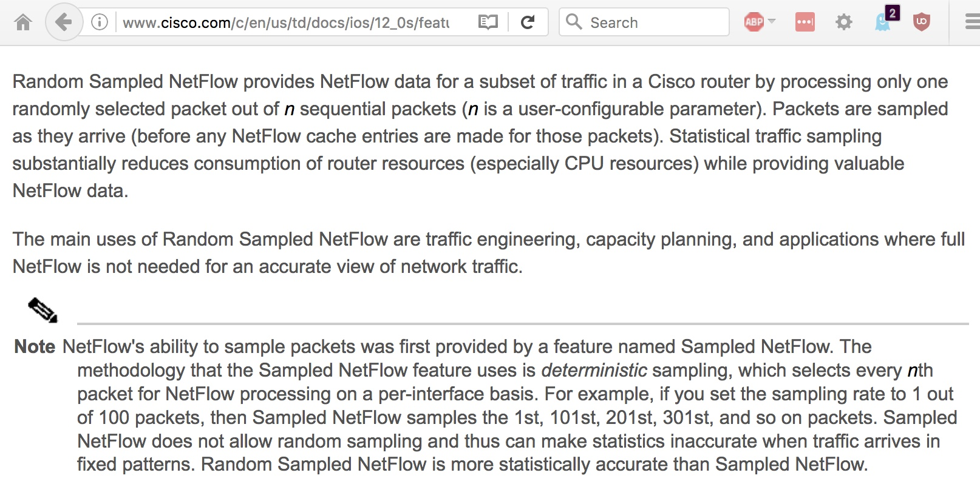
Sampled Netflow vs RANDOM Sampled Netflow
Source: http://www.cisco.com/c/en/us/td/docs/ios/12_0s/feature/guide/nfstatsa.html

Slide 26
More Non-Representativeness
Data collected from "eyeball network" contributors (such as ISPs or Universities) will inherently vary – potentially dramatically – over the course of the day due to time zone differences.
This can particularly be a consideration if you have a global sensor footprint.
If you're taking samples (batches) with less than daily duration (such as samples that are just a few hours long), you run the risk of getting samples that may be influenced (dominated?) by just one geographic region or another.
This may skew your conclusions (hypothetically, news.sky.com and dw.com are the "most popular online news sites"?)

Slide 27
The Impact of Opaque Sensor Distributions
Security data sharing collectives need to protect the identity of their sensor operators for many reasons, including a desire to avoid tipping off the bad guys about what is/isn't instrumented. (We don't want the bad guys to get "camera shy" and we don't want the sensor operators to end up taking any extra packet love as a result of being public spirited and sharing data)
As a result, privacy assurances made to sensor operators often prohibit disclosure of sensor operator identities or locations. For example, Farsight does not confirm or deny who may be contributing data, or where sensor nodes are located.
Terms of service will typically prohibit attempts at back engineering that information through traffic analysis as well.
Why do you care? Opaque sensor distributions make it harder to try to explicitly weight samples to account for sensor distributions.

Slide 28
3) Averaging Effects
In any given sample, there will be high values and lower values. By pooling those values and then computing a mean value, one can smooth the data over that interval and remove "noise."
However, often it may be the peaks or troughs that matter, not the averages. By only reporting the average for a batch, critical information may be overlooked.
Contrived example: -- Inbound network traffic flattops for five minutes due to a packet flood -- That same network then has a five minute total outage. -- Averaged over that ten minute period, how do things look? Pretty good, right? No problems noted? That's a problem.

Slide 29
4) Batch Size vs. Power
In statistical hypothesis testing, the question asked is, "Is there a meaningful difference between two or more groups (batches)?"
Being able to find that difference may be a function of the size of the samples (batches) collected for the different treatments.
Small samples may be easy and cheap to gather, and have low latency, but lack statistical power: that is, differences may actually exist, but the samples may be too small for that difference to be detected as "statistically significant."
Larger samples have more statistical power, but may take longer to collect, or cost more to collect, or collecting large samples may mean that fewer experimental conditions can be tested.
If you're drawing samples (batches), even if you're not empirically doing hypothesis testing, the size of your sample will still impact the width of the confidence intervals around your estimates.

Slide 30
Just Scan/Crawl The Whole Thing?
Strangely enough, any discussion of sampling Internet phenomena needs to recognize that you potentially have an alternative available to you that most investigators don't: you can potentially conduct a census rather than just drawing a sample.
"Here’s what you find when you scan the entire Internet in an hour," https://www.washingtonpost.com/news/the-switch/wp/2013/08/18/heres-what-you-find-when-you-scan-the-entire-internet-in-an-hour/
BTW, if that's still "too slow" for you, check out https://github.com/robertdavidgraham/masscan ("TCP port scanner [...] scanning entire Internet in under 5 minutes.")
Of course, you may not NEED to scan/crawl the whole thing – there are projects out there where people are voluntarily sharing the data they've already crawled. An example? https://github.com/trivio/common_crawl_index ("The Common Crawl data is composed of billions of pages randomly crawled from the internet...")

Slide 31
5) Batched Data: Data Quickly Becomes Historical
Data people are often data "packrats"/ data "hoarders" and may keep "inventory" (batches of data) long past the point where that data is operationally relevant
Don't get me wrong: historical data may be of immense research value, particularly for things like estimating long term trends, and definitely should be preserved, it just often isn't of particular operational value as it gets old(er).
By default, one to three months to a year is probably the relevant operational horizon for most data sets. Carrying too much data increases your storage costs, may increase processing time, may swamp more recent/relevant data, and may invite 3rd party data safaris (you should be thinking "records management").
Now is generally much more important than "way back when."

Slide 32
What /How We Collect Can Become "Cast In Stone"
A historical data focus often puts a premium on comparability: we want to be able to look backwards, and compare what we see today with what we saw "way back when."
Maintaining comparability means that we basically can't change the questions we ask or the answers we accept – if we do, we'll "lose comparability."
Hence, what we collect often tends to get "cast in stone" even if conditions change.
One easily identified exception: decomposing an aggregate measure into its component elements

Slide 33
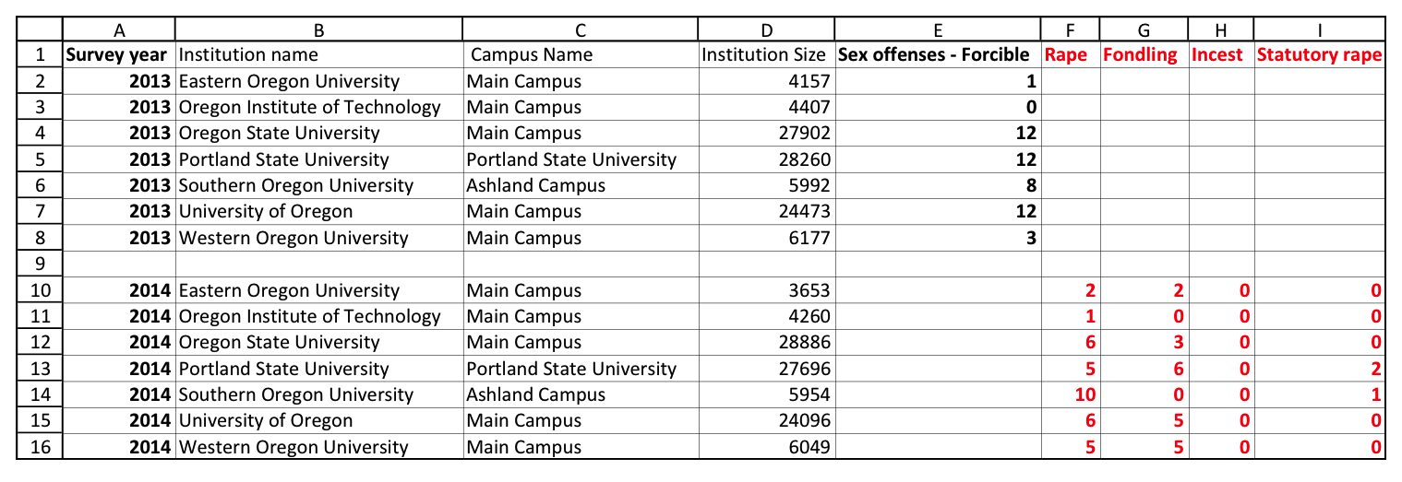
Decomposing An Aggregate Measure
In 2014, the Department of Education changed how sex offenses were reported in annual Campus Safety and Security data. Offenses
that were formerly lumped into just one or two categories were now broken out more granularly. See http://ope.ed.gov/campussafety/#/
The historical aggregate measures could still be replicated, however, by adding up now-broken-out component offenses.

Slide 34
III. So Is Continuous Flow Process Monitoring Really Just The Best Thing Since Sliced Bread?

Slide 35
Continuous Flow Approaches Have Drawbacks, Too
I do NOT want you to come away from this talk with the simplistic impression, -- "Batch: Bad," -- "Continuous Flow: Good."
The reality is a little more nuanced. Just as working with batches has limitations, working with continuous flow data can have its drawbacks, too.

Slide 36
Some Flow/Continuous Monitoring-Related Issues
You need to learn to throw stuff away...
You also need to remember what you've seen
Continuous monitoring never sleeps – will you?
Data collected as batches can quickly become historical, and a historical focus limits our ability to evolve what's collected

Slide 37
1) You Need To Learn To Throw Stuff Away...
For example, even just keeping the fully qualified domain names seen in an SIE channel, you may still find real time unfiltered data flows a bit much to just visually scan as they flow by... $ nmsgtool -C ch202 -c 100000 -o - | grep "qname:" | awk '{print $2}' Which means: -- Collect 100,000 observations from SIE Channel 202 -- Keep just the qname records -- Keep just the 2nd column from the qname records

Slide 38
/* this slide intentionally blank */

Slide 39
Finding What To Filter Using Effective 2nd Level Domains
If you are working with FQDNs, you may be able to identify a few effective 2nd-level domains that you can safely exclude...
$ nmsgtool -C ch202 -c 100000 -o - | grep "qname:" | awk '{print $2}' > temp.txt $ 2nd-level-dom < temp.txt > temp2.txt $ sort temp2.txt | uniq -c | sort -nr > temp3.txt
If you see common-but-unlikely-to-be interesting domains in the resulting list, you may want to "skim off"/"filter out" all the routine stuff that simply isn't relevant... grep -f is your friend: $ [whatever] | grep -F -v -f killfile.txt

Slide 40
the little 2nd-level-dom script
#!/usr/bin/perl
use strict;
use warnings;
use IO::Socket::SSL::PublicSuffix;
my $pslfile = 'public_suffix_list.dat';
my $ps = IO::Socket::SSL::PublicSuffix->from_file($pslfile);
my $line;
foreach $line (<>) {
chomp($line);
my $root_domain = $ps->public_suffix($line,1);
printf( "%s\n", $root_domain );
}
Note: To get a copy of public_suffix_list.dat, see https://publicsuffix.org/list/

Slide 41
2) You Also Need to Remember What You've Seen
Assume we're monitoring continuous flow data, and something "blips on the radar." Will you be able to "rewind the tape" and retrospectively dig into what you saw, if you need to do so?
Sometimes, however, there may be a tendency to just save the "interesting bits," with the result that some of the "boring bits" (that may actually turn out to be interesting bits, once we have a little more insight) may end up lost to history.
Example: we just looked at domain names in that lightning-fast tour of ~100,000 domains. If we wanted to go back and see the full records from that sample, we couldn't.
Netflow is normally excellent about this sort of thing – regardless of what else happens, most sites that deploy Netflow dump a copy of what gets captured to disk, and save that data at least for a while. (Of course, Netflow is already pretty heavily summarized)

Slide 42
3) Continuous Monitoring Never Sleeps – Will You?
Continuous flow monitoring is normally either attended, or set to generate alerts when an anomalous condition is automatically flagged, just like a good burglar alarm.
There should be a "security guard"/"responsible adult" to respond when a problem does get noticed – everybody's got a 24x7-staffed Security Operations Center, right? Nobody's running on "autopilot" overnight or on weekends because there's "nothing going on" (or because there was a need to cut payroll...)... right?

Slide 43
Setting Proper Threshold Values Is Key To Your Sanity
Continuous monitoring forces you to think explicitly about operationalizing your threshold values.
What's bad enough to justify waking you up in the middle of the night?
Put another way, how often would you like to be woken up, on average? Once a night? Once a week? Once a month? Once a quarter? Once a year? Never?
Don't just pay attention to peaks, either – a sustained traffic pattern JUST UNDER your threshold value may (in aggregate) be more worthy of attention than a brief-if-extreme spike.

Slide 44
Being Responsive To Real Changes, Not Noise
There will always be some normal variation (or "noise") in any continually monitored process. Analysts normally attempt to reduce that "noise" when doing process monitoring by using a moving average or exponential smoothing (the two are equivalent techniques)
If you average only a few values, the resulting values will be very "responsive" (readily reflect changes) – but may be TOO noisy.
If you average many values, the resulting value will tend to smooth out nicely, but it may take multiple time steps before a genuine change occurs before a genuine change is manifested in the results.
There's no magic "right" answer when it comes to questions about "how much" to smooth. But, if you get it wrong, you'll be waking up when you don't really need to, or sleeping through bad stuff until it may be too late...

Slide 45
Events Per Unit Time vs. Time Between Events?
Let's pretend that we're interested in a simple measure such as the number of failed ssh logins per hour. That feels very "batch-like:" collect ssh failures for an hour on the clock, then report.
If the rate of failed ssh logins suddenly skyrockets, alert us so we can see who's trying to brute force us (assuming we haven't just auto-banned those attack sources with a tool such as fail2ban)
Moving from a batch mentality (events per unit time, where the unit time effectively determines the size of a "batch") requires us to re-conceptualize our measurements, perhaps so that we can begin thinking about time-between-failed logins (perhaps with some sort of smoothing over multiple failures).
But what if we were to simply use a sliding window for our login failures per sixty minute measurement, rather than measuring from top of the hour to top of the hour? Perhaps the difference between batch and flow is not so great after all?

Slide 46
IV. A Concrete Example of Moving Forward Toward Continuous Flow Monitoring

Slide 47
Let's Consider An Example...
Channel 204 at the Security Information Exchange consists of "de-duplicated/filtered/verified" passive DNS data.
A sample observation from Channel 204 can be seen on the following slide...

Slide 48
Sample Full Observation From Channel 204
$ nmsgtool -C ch204 -o - -c 1 [Channel 204 header omitted here] type: INSERTION count: 1 time_first: 2016-09-12 09:48:26 time_last: 2016-09-12 09:48:26 response_ip: [omitted] bailiwick: cto39.ru. rrname: cto39.ru. rrclass: IN (1) rrtype: A (1) rrttl: 3600 rdata: 88.198.154.20 Assume we're particularly interested in rdata values (as bolded)

Slide 49
An Aside: "What's RData Again?"
$ dig cto39.ru
[...]
cto39.ru. 3600 IN A 88.198.154.20
In this example:
cto39.ru is the Resource Record Name (the "left side" of that record)
88.198.154.20 is the Resource Record Data (the "right side" of that record)

Slide 50
Our Research Interest
Assume we're particularly interested in the Rdata values (shown bolded above).
If we were to bin the observed Rdata values by their first octet over a period of time, what might that distribution look like?
Are there some /8's that are particularly busy?
Are there other /8's that basically see little or nothing?
As a first pass, let's do this the "batch way," and collect a million observations with the command shown on the next slide...

Slide 51
Collecting A Batch of A Million Observations
We can collect some data from an SIE blade server by saying:
$ nmsgtool -C ch204 -c 1000000 -o - |
grep rdata | sed 's/^rdata: //' | awk -F. '{print $1}' | grep -o '[0-9]*' | sed '/.\{4\}/d' > a-million-first-octets.txt
We can then post-process that data by saying:
$ cat a-million-first-octets.txt | awk '($1 < 256)' | sed "s/^0*\([1-9]\)/\1/;s/^0*$/0/" |
sort -n | uniq -c > a-million-first-octets-uniqed.txt

Slide 52
What The Batch of Data Looks Like
The start of the a-million-first-octets-uniqued.txt looks like the following, where the first column is the number of obs in that /8, and the second column is the /8 (e.g., 0/8, 1/8, etc.):
$ head -10 a-million-first-octets-uniqed.txt
71243 0
342094 1
278596 2
148476 3
76369 4
[etc]

Slide 53
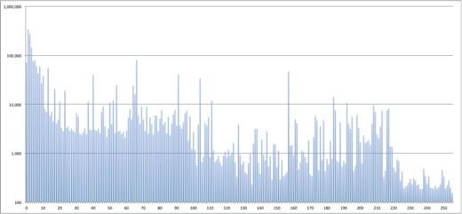
Graphing That Data In Excel
The first octet runs along the X axis from 0 to 255, and the Y axis shows the number of hits for each octet. Graph uses log-linear axes.

Slide 54
What Would The NEXT Batch of Obs Look Like?
If we were to draw another batch of observations, what would that set look like?
Presumably it would not be exactly the same as our initial sample
What if we were to look at one sample after another?
Would there be some "first octets" that are consistently "hot"?
Or will the rdata "first octet" counts jump around "all over the place?"

Slide 55
Visualizing That Data
To find out, let's create a graphic that shows a "row of pixels" for each time slice of data.
There will be 256 pixels in each row, each pixel representing one of our first octet counts. The first pixel will represent the count for 0/8, the second pixel will represent the count for 1/8, the third pixel will represent the count for 2/8, and so on, with the last pixel representing the count for 255/8.
Low activity pixels will be dim, while high activity pixels will be bright, drawing attention to the hot /8's.
While this graphic is just meant to be an exploratory tool to help us gain insight into the Channel 204 rdata, and most of the insight will come from just looking at the graph, we also want to be able to roll the cursor over the graph to see the value associated with any given pixel of interest.

Slide 56
Choice of Graphic Toolkits
There are many different graphical toolkits one could use to generate a visualization of the sort we want.
For this project, we arbitrarily selected SFML, the "Simple and Fast Multimedia Library," see http://www.sfml-dev.org/
For the purpose of this project, we'll also assume that we're using SFML on a Mac with the normal free Apple Developer Tools (including the Developer Command Line Tools) and that we have HomeBrew (see http://brew.sh/ ) installed. With Home Brew installed, installation of SFML 2.4 is easy, simply say: $ brew install sfml

Slide 57
Collecting Ch204 Data To Visualize
Now we need some data.
While there are many ways we could grab that data, this time let's use SIE Remote Access to collect 120 chunks of data with 2,500 records/chunk (300,000 total observations).
Q. "But Joe! You're still talking about collecting batches, granted, smaller batches (2,500 obs/batch vs a million obs), but still batches!" A. Stipulated. This is a gradual evolutionary process... baby steps. ("I'm doing the work, I'm baby-stepping, I'm not a slacker! Just look, I'm in really bad shape!", Bill Murray as "Bob Wiley," the movie What About Bob, circa 1990)

Slide 58
Collecting Ch204 Data To Visualize
We create an encrypted tunnel to SIE for an authorized user from an authorized host by saying:
$ sratunnel -s 'tls:srausername@sraserver,1021' -c 204 -w ch=204 -o nmsg:udp:127.0.0.1,8000 & That command means: -- Create an SIE remote access encrypted tunnel to SIE -- Watch SIE channel 204 -- Output traffic locally in nmsg format as UDP traffic on localhost port 8000

Slide 59
Data Collection Script
We then create a little bash script that picks up traffic from that tunnel...
$ cat collect-data.sh
#!/bin/sh
n=0
max=120
while [ $n -lt $max ]
do
nmsgtool -l 127.0.0.1/8000 -c 2500 | grep "rdata: " | \
awk '{print $2}' | grep -v '["a-zA-Z:\]' | grep "\." | \
awk -F. '{print $1}' | sort | uniq -c | \
awk '{print $2 " " $1}' | sort -n | \
awk '($1 >= 0) && ($1 <= 255) && ($2 >= 0) && ($2 <= 2500)'
true $(( n=n+1 ))
done
More information:
https://www.farsightsecurity.com/Blog/20150204-mschiffm-nmsg-nmsgtool/https://github.com/farsightsec/nmsg

Slide 60
Running The Data Collection Script
We run the data collection script by saying:
$ sh collect-data.sh > ch204-data.txt
That job takes only a minute or two to run, leaving us with the data file we wanted...
$ wc -l ch204-data.txt 16161 ch204-data.txt
Q. But Joe! 120*256 should equal 30720, while you've only got 16161! What went "wrong?" A. That difference is because some of the /8's didn't have any observations during a particular sampling interval. In that case, those /8's were simply omitted.

Slide 61
Checking Our Data and Then Killing The Tunnel
The records in that file look like:
$ more ch204-data.txt
5 9
8 26
10 1
12 1
14 1
[etc]
Since we're done with our SIE remote accss encrypted tunnel, we can bring it to the foreground and kill it with a ctrl-C:
$ fg
ctrl-C

Slide 62
Visualization Scheme
Ultimately we want a graphical window with 256 columns and 100 rows.
To avoid ending up with a too-tiny graphic, we'll make each of the "pixels" in that matrix actually 8x8 pixels (the screen => 2048x800)
While SFML includes classes for drawing simple shapes, including rectangles, because we're making a LOT of rectangles, we're going to create a vertex array of quads instead (see the performance discussion at http://www.sfml-dev.org/tutorials/2.4/graphics-vertex-array.php).
We'll shade each of those rectangles according to that pixel's associated count. Grey scale would work for that purpose, going from white to black, but let's be a little more colorful and adjust the saturation in a Hue/Saturation/Value (HSV) color model to represent our counts instead.

Slide 63
Actual Code
The actual code for this example can be seen in Appendix 1 to this talk. Obviously this is not polished elegant code written by a professional programmer, but maybe my ugly code will encourage someone in the audience to rewrite this more beautifully :-)
A Makefile for building the code is also convenient. One is included as Appendix 2. (Your local configuration may potentially require changes to that skeleton)
Building the code (once SFML has been installed with Brew) should just be a matter of saying
$ make

Slide 64
Running The Sample Program
With the code built you can actually run the sample code, by simply saying:
$ ./sfml-test-4 Note the dot and slash in front of sfml-test-4
A window will then appear on your screen, perhaps looking something like the one on the next slide...

Slide 65
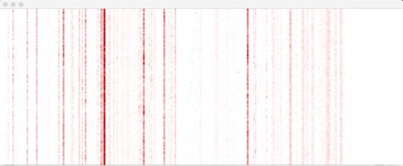
Sample Output

Slide 66
Investigating The Values Seen In The Output
If you mouse over the graph, you'll see the value under your mouse pointer reported in the window from which you launched the application.
For example, if we mouse over the hot red line that we saw: Time slice 6: Netblock 66/8 --> Count=188 Time slice 7: Netblock 66/8 --> Count=282 Time slice 8: Netblock 66/8 --> Count=221
Wonder who controls each of the /8's from that visualization? See http://www.iana.org/assignments/ipv4-address-space/ipv4-address-space.xhtml
To kill the window, click the "red X" in the upper left hand corner, or hit ctrl-C in the window from which you launched the app.

Slide 67
Improving That Visualization
This has just been a very simple proof of concept visualization. There's obviously a lot more that could be done to enhance this simple proof of concept, including:
Rather than using a shell script to capture static data from an SRA tunnel, plumb the program directly into the SIE encrypted tunnel's data stream
Instead of simply displaying a fixed number of rows, create a near-real-time scrolling display
Allow specification of the batch size to use (rather than just having a fixed value of 2,500 obs/batch)
Allow selection of a subset of columns (rather than showing all 256 by default), and allow the window size to be scaled up or down
Offer the ability to tailor the color model employed
Automatically look up the network blocks in whois
etc

Slide 68
V. Do We Really Need All Those Junky Unix Commands (awk, grep, sed, etc.)? And How Do I Actually BLOCK *BAD* Stuff?

Slide 69
We Do Live In The Modern Era
As a result, you can get SIE output in JSON format (and binary format), not just some junky ASCII presentation format.
This is literally just a matter of changing one argument: $ nmsgtool -C ch204 -o - vs $ nmsgtool -C ch204 -J -
"The resulting output, however, is now in an equally junky format, overloaded with braces and quotes and it's all run together in one long record..."

Slide 70
https://stedolan.github.io/jq/
$ nmsgtool -C ch204 -J - -c 1 | jq '.'
{
"time": "2016-10-18 19:[partially redacted]",
"vname": "SIE",
"mname": "dnsdedupe",
"source": "[redacted]",
"message": {
"type": "EXPIRATION",
"count": 9,
"time_first": "2016-10-18 03:29:32",
"time_last": "2016-10-18 13:49:58",
"bailiwick": "cinepolis.com.sv.",
"rrname": "www.cinepolis.com.sv.",
"rrclass": "IN",
"rrtype": "A",
"rrttl": 300,
"rdata": [
"146.20.1.5"
]
}
}

Slide 71
You Can Do A Lot More With jq
jq is a helpful tool if you're going to be processing large data sets and need to do things like select records based on one value while printing other values
$ nmsgtool -C ch204 -J - | jq -r --unbuffered 'select(.message.rrtype == "A") | .message.rrname, .message.rdata '
card.utsz.edu.cn.
[
"219.223.212.140"
]
www.mk882.com.
[
"121.42.139.85"
]
www.delovie.ru.
[
"91.217.9.160"
]

Slide 72
So How Do I Actually Block Bad Stuff?
At least in Farsight's case, we provide data that consists of objective facts, not opinions.
As a result, we don't claim to be able to tell you if an IP address or domain name is "good" or "bad."
In that respect, we're like a GeoIP provider: GeoIP providers just give you a city name or (latitude, longitude), they don't say "this is a good city name or this is a bad (latitude, longitude)"
You, however, are free to apply rules of your own-choosing to the data you get form any provider.

Slide 73
Implementing Your Own Determinations
Once you have determined that there may be domains you'd like your users not to visit (for whatever reason), you need a mechanism to actually block that access.
We suggest you consider using RPZ, "Response Policy Zones," see https://dnsrpz.info/
Basically, RPZ let's you locally override the way a domain name normally resolves. For example, you could use RPZ to make known phishing domains not resolve (you could make them return NXDOMAIN or some other non-zero RCode)

Slide 74
VI. Conclusion

Slide 75
Take Aways
You've now had a quick introduction to thinking about "batch vs. flow" approaches to analyzing security data, and the challenges each approach can have.
You've learned a bit about data available to researchers from the Security Information Exchange (SIE)
You've seen an example of how you can practically visualize flow data
Interested in potentially contributing data to SIE, or getting data from SIE for academic research use? Drop me a note at stsauver@fsi.io
Thanks for the chance to talk! Are there any questions?

Slide 76
Appendix 1. Source code for sfml-test-4.cpp

Slide 77
#include <cmath>
#include <SFML/Graphics.hpp>
/* ---------------------------------------------------------
following hsv_to_rsb code adapted from a comment near the bottom of
http://stackoverflow.com/questions/3018313/algorithm-to-convert-rgb-to-hsv-and-hsv-to-rgb-in-range-0-255-for-both */
float clip(float n, float lower, float upper) {
return std::max(lower, std::min(n, upper));
}
void hsv_to_rgb (float h, float s, float v, int *r_r, int *r_g, int *r_b) {
if (h > 360)
h -= 360;
if (h < 0)
h += 360;
h = clip(h, 0, 360);
s = clip(s, 0, 1);
v = clip(v, 0, 1);
float c = v * s;
float x = c * (1 - std::abs (fmod ((h / 60.0), 2) - 1));
float m = v - c;
float rp, gp, bp;
int a = h / 60;
switch (a) {
case 0:
rp = c;
gp = x;
bp = 0;
break;
case 1:
rp = x;
gp = c;
bp = 0;
break;
case 2:
rp = 0;
gp = c;
bp = x;
break;

Slide 78
case 3:
rp = 0;
gp = x;
bp = c;
break;
case 4:
rp = x;
gp = 0;
bp = c;
break;
default: // case 5:
rp = c;
gp = 0;
bp = x;
break;
}
*r_r = (rp + m) * 255;
*r_g = (gp + m) * 255;
*r_b = (bp + m) * 255;
}

Slide 79
/* ------------------------------------------------------------------ */
using namespace sf;
int main()
{
int x, y;
int val;
int i, j, ii, jj;
int thedisplayrow, thedisplaycol, lastcol;
int cell, thecell;
float myhsv_h, myhsv_s, myhsv_v;
int myrgb_r, myrgb_g, myrgb_b;
FILE * myfile;
// size of displayed "blobs" - 8x8 (still looks tiny at higher resolution)
const int delta_x=8;
const int delta_y=delta_x;
// size of working "screen" in "blobs"
// cols must stay at 256 givein the range of first octet values in IPv4 addrs
// rows can be set to suit the available screen real estate
const int cols=256;
const int rows=100;
// first blob loc (zero origin values); Cartesian coords with flipped Y axis
// so that the max (x,y) value is in the bottom right corner of the screen
x=0;
y=0;
// width of each row in actual pixels
// each row will have col cells, each delta_x wide
const int row_width=cols*delta_x;
// height of window in actual pixels
// the display will "rows" number of rows, each delta_y tall
const int number_of_rows=rows*delta_y;
// our main window
RenderWindow window(VideoMode(row_width,number_of_rows,32)," ");

Slide 80
// vectors of actual values
int actual_values[row_width*number_of_rows];
// our main data structure, holds the verticies of the cells to be displayed
// the 4 represents the number of verticies per quad
// NOTE: this is not the full width of the rows or the actual number of rows!
VertexArray quad(Quads, (rows*cols*4));
// ensure starting lastcol value will be less than initial i
lastcol=-1;
i=0; // x "coordinate" as read from the data file
// need not be sequential, e.g., may have "gaps"
j=0; // y "coordinate," incremented when i <= previous i
cell=0; // incremented, by 4's, through the array of verticies
myfile = fopen ("ch204-data.txt","r");
if (myfile == NULL) { perror("Failed: "); return 1; }
for (ii=0; ii<=(row_width*number_of_rows); ii++){
actual_values[ii]=0;
}
while ((fscanf (myfile, "%d %d", &i, &val) != EOF) && (j<rows))
{
x=i*delta_x;
y=j*delta_y;
// set the coordinates of the rectangle
// lower left hand corner
quad[cell].position = Vector2f(x,y);
// upper left hand corner
quad[cell+1].position = Vector2f(x,y+delta_y);
// upper right hand corner
quad[cell+2].position = Vector2f(x+delta_x, y+delta_y);
// lower right hand corner
quad[cell+3].position = Vector2f(x+delta_x, y);

Slide 81
// Hue, Saturation, Value Color Model (see
// https://en.wikipedia.org/wiki/HSL_and_HSV )
// www.rapidtables.com/convert/color/hsv-to-rgb.htm for color value tests
myhsv_h=((float) 360.0);
myhsv_s=(float) val/256.0;
myhsv_v=((float) 1.0);
// convert hsv to RGB since that's what SFML needs
hsv_to_rgb (myhsv_h, myhsv_s, myhsv_v, &myrgb_r, &myrgb_g, &myrgb_b);
// need to set the color of *all four* vertices to set the cell's color
quad[cell].color = Color::Color((uint8_t) myrgb_r, (uint8_t) myrgb_g,
(uint8_t) myrgb_b, (uint8_t) 255);
quad[cell+1].color = quad[cell].color;
quad[cell+2].color = quad[cell].color;
quad[cell+3].color = quad[cell].color;
// save the value for later retrieval
for (jj=y; jj<(y+delta_y); jj++) {
for (ii=x; ii<(x+delta_x); ii++) {
actual_values[ii+(jj*row_width)]=val; } }
// move forward 4 to be set for the next set of verticies
cell=cell+4;
if (i <= lastcol) {
// if the index has a lower value (*or* the same value)
// we're starting a new row
j=j+1;
if (j > rows) { /* full display */
goto display_the_data; }
}
lastcol=i;
}
display_the_data:; // *******************************************
window.clear(Color::White);
window.draw(quad);
window.display();

Slide 82
while (window.isOpen())
{
Event event;
int mouse_position_x;
int mouse_position_y;
while (window.pollEvent(event))
{
switch (event.type)
{
case Event::Closed:
window.close();
break;
case Event::MouseMoved:
mouse_position_x=event.mouseMove.x;
mouse_position_y=event.mouseMove.y;
// map screen coordinates to a cell's address
thedisplayrow=(int)(mouse_position_y / delta_y);
thedisplaycol=(int)(mouse_position_x / delta_x);
fprintf(stderr, "Time slice %d: Netblock %d/8 --> ",
thedisplayrow, thedisplaycol);
thecell=mouse_position_x+(mouse_position_y*row_width);
fprintf(stderr,"Count=%d\n\n", actual_values[thecell]);
break;
default:
break;
}
}
}
return 0;
}

Slide 83
Appendix 2. Makefile

Slide 84
Makefile
$ cat Makefile
CPPFLAGS = -g -Wall -Wunused
INCLUDES = -I/usr/local/Cellar/sfml/2.4.0/include
LDFLAGS = -L/usr/local/Cellar/sfml/2.4.0/lib \
-lsfml-system -lsfml-graphics -lsfml-window
all:
$ g++ $(CPPFLAGS) -o sfml-test-4 sfml-test-4.cpp $(INCLUDES) $(LDFLAGS)
clean:
rm -f sfml-test-4

