Slide 1
OMG: They're Inside the Walls
Joe St Sauver, Ph.D. (joe@oregon.uoregon.edu)
Association for Computing Professionals in Education (ACPE) Ashland, Oregon 2:05-3:05 December 5th, 2013
http://pages.uoregon.edu/joe/acpe/ Disclaimer: all opinions expressed are strictly my own and do not necessarily represent the opinion of any other entity.

Slide 2
Introduction
I'd like to thank ACPE and particularly my colleague Mark Johnson of Apple for the chance to speak with you today.
Given that our session today is fairly late in the day and caffeination levels may be low, I'd like to have this be an interactive discussion not just "me talking," "you listening. ''
In fact, I'd much rather just ask lots of questions, and let YOU talk. I always assume that I've got a lot to learn, and that every environment will be a little different, so I hope that you'll tell me about yours...

Slide 3
Why THIS Topic?
Why do you think this topic get chosen for this year's meeting? Is the security of personal devices connecting to school networks something that people have been worried about? If so, any particular reason WHY?
Have there been security challenges? Have their been security disasters in this community? Or are we worrying about non-issues? Are there security success stories when it comes to connecting your teachers and your students and their devices?
Is a desire for security (or a propensity toward risk aversion) getting in the way of why you have the network? Is this really a wireless network "usability" session?

Slide 4
This Meeting: A Living WiFi Laboratory
WiFi at meetings may matter more than anything but coffee.
The meeting hotel was the Ashland Springs Hotel, a beautiful and terrific historic hotel. When I checked into the hotel, I was given a password for the hotel's wireless network. I easily connected with the supplied password, clicked through a network policy statement (that I must confess I really didn't read). I then had the ability to use the web, and to ssh back to the other systems I routinely use in Eugene. This was terrific (and typical for hotels)
At the conference venue at SOU, there was also wireless access. However, guest access required me to download and install a "PolicyKey" (requiring privileged access to my Mac). Once I got that PolicyKey installed, I was able to get on the network, but my access was limited to just the web. Why? Don't get me wrong – I was happy to have had free guest wireless access (thank you!), but there's a lot more to the Internet than just the web.

Slide 5
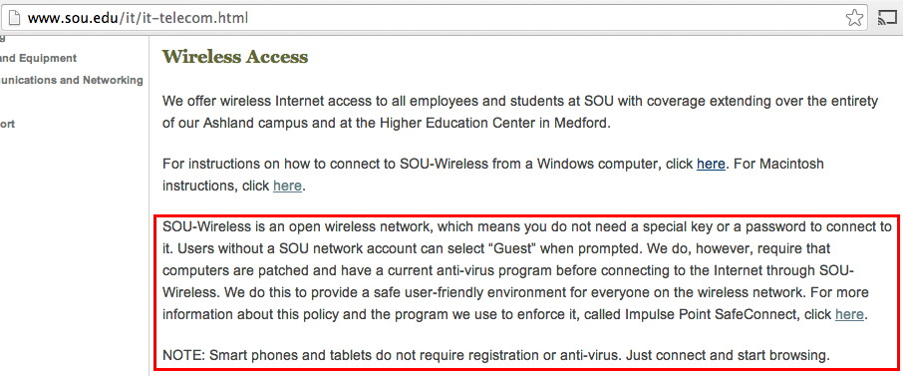
Local Policy
Questions (if you know me, you know I always have questions): -- Do users get what's implied to be on a non-encrypted network? -- Are you sure that the tool as deployed works as advertised? (For example: what A/V did I have installed on my Mac?) -- Why don't smart phones and tablets also require A/V here?

Slide 6
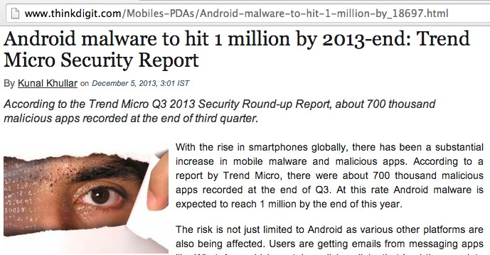
"Smart Phones and Tablets Don't Require A/V"

Slide 7
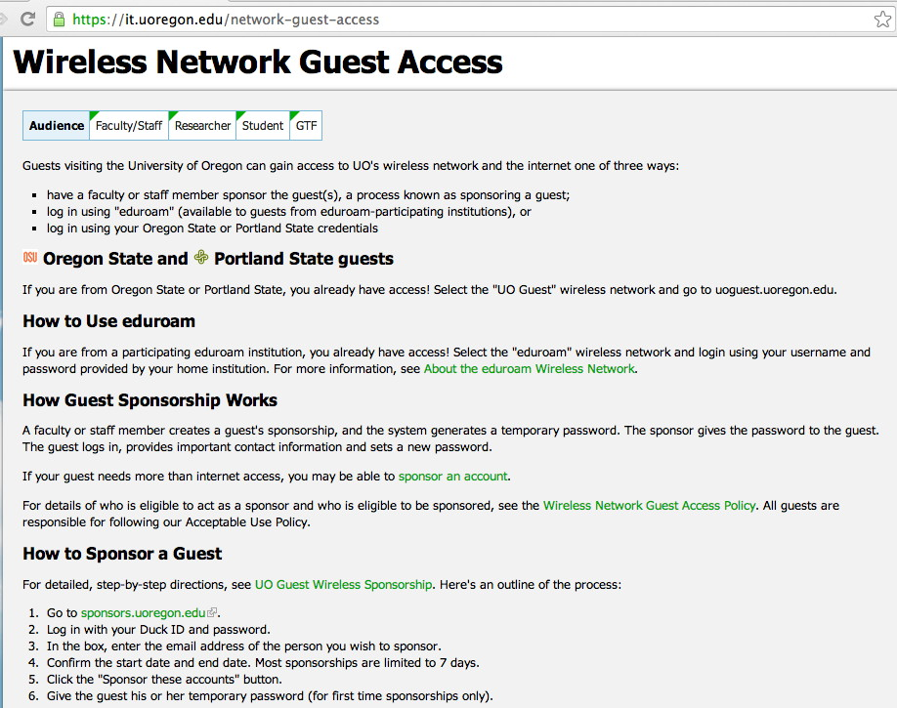
UO's Current Approach for Guest Wireless

Slide 8
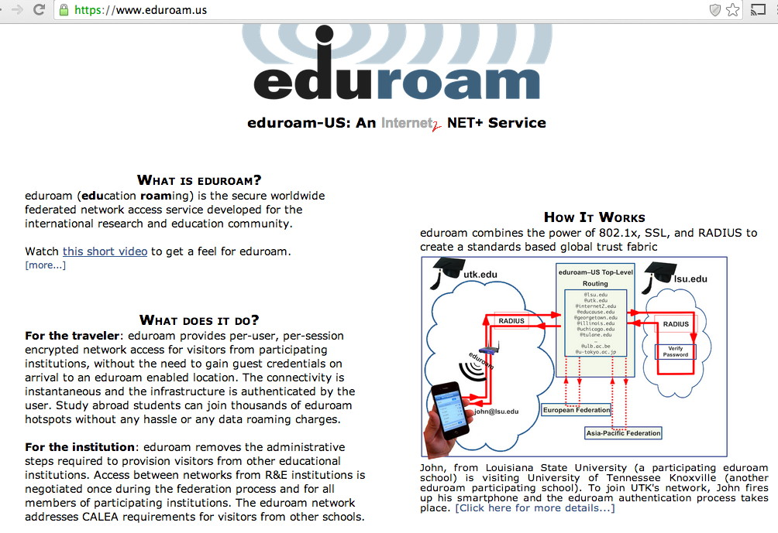
Eduroam (As Mentioned on the Previous Page)

Slide 9
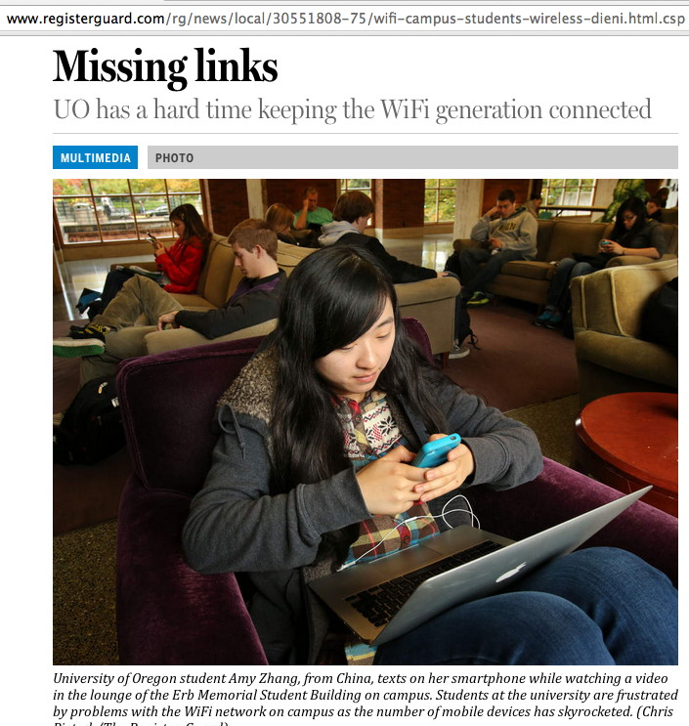
BTW, I DO Get It That WiFi is Hard/Expensive

Slide 10
Should I Just Stand Up My Own WiFi Network?
That's $72 (one time) plus $25/month for 1.5GB of data/month. Nice option -- as long as "everyone" doesn't do it, all competing for a limited number of channels.

Slide 11
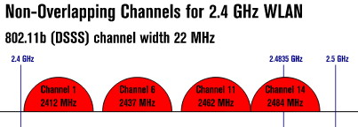
Only 4 Real 802.11b Channels
http://en.wikipedia.org/wiki/File:NonOverlappingChannels2.4GHz802.11-en.svg
If you only have four real channels, you need to use them
with care. Random users standing up their own wireless
access points are unlikely to choose their channels otimally. Even the IETF has had to struggle to get meeting wireless work the way it should...

Slide 12
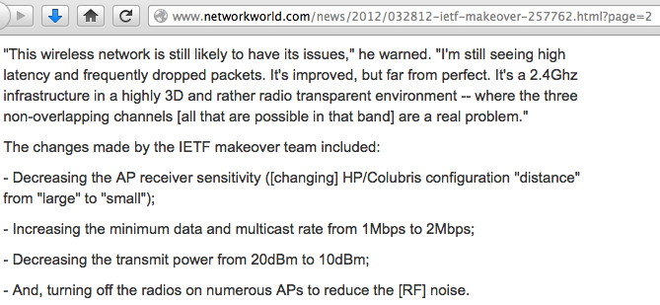
IETF Fixes For High Density WiFi Environment
"IETF attendees re-engineer their hotel's Wi-Fi network Extreme network makeover at Paris hotel boosts performance," http://www.networkworld.com/news/2012/032812-ietf-makeover-257762.html?page=2

Slide 13
Let's Talk About YOUR Normal Situation...
> [session reset] <
I know that K12 isn't the same as higher ed wireless (or hotel wireless or IETF wireless)
Let's talk about YOUR world...

Slide 14
Are You Worried About Who's On Your Network?
Who connects to the network at your site? Is everyone eligible for network access? Do they need to complete training or agree to an acceptable use policy (AUP) before they can get online? Does anyone actually read your AUP? If so, what gets covered in the training or in the policy? Are they learning they right things? When users connect, are they accountable for what they do online? For example, do they need to authenticate with a unique per-user username and password? Or does a shared password get used? Do you think that there's any unauthorized access going on?

Slide 15
Or Are We Worried About Their Systems?
What sort of systems are your users using? PC laptops running Windows? Macs? iPads/iPods/iPhones? Android smart phones or tablets? Chromebooks? Is malware a problem on those systems?
Are those systems provided by your school, or do users buy their own devices? Do you give users on what to buy, and why? (And what's the worst/weirdest thing you've seen?)
Who maintains those systems? You? The user? No one?
Upon connecting, do their systems get scanned with a network access control (NAC)-type system? Does a user have to download and install something? What if the user doesn't have administrative access as a matter of policy?
Do you monitor what users do online? Do your users know this? What if the user wants to use encryption (as I do with ssh, or as someone else might do with SSL/TLS secured web connections)? Could a student even run Tor?

Slide 16
What If It's BYOD (Bring Your Own Device) on a TPN (Third Party Network) and There's NOYSDI (None of Your School's Data Involved): DYECWH (Do You Even Care What Happens)?
If so, why? Its no longer about bandwidth consumption, right?
Is it because it is disruptive and it distracts from teaching and learning?
Do you have in-loco-parentis responsibilities?
Or is the issue access to school PII by employees, no matter what they've promised?

Slide 17
Mobile Devices: Impossible to Resist Distraction or Mere Evil Incarnate Source of Non-Learning
In classrooms lead by gifted teachers, mobile devices may be welcomed as an enabling tool, bringing the world to the classroom and enriching the student's learning experience.
In other classrooms, with less dynamic teachers, mobile devices may be less welcome.
Mobile device distraction may be a real instructional issue, but it isn't a cyber security issue, it's a teaching effectiveness/classroom management issue.

Slide 18
Students and In-Loco-Parentis Responsibilities
In a K12 environment, a school may potentially have certain formal or implicit "in-loco-parentis" responsibilities related to student behavior online, just as they may in a face-to-face context.
As a parent, I expect you to keep my kids safe from dangerous characters online, just as I do in the classroom or on the playground.
But what if students end up in jeopardy while using their own mobile device, via their own telecom provider? Short of running cellular jamming equipment (illegal in the US), or banning all mobile devices from campus (and how would you enforce THAT?), can you, or should you even try to prevent users from doing what they will on their own devices on their own network?

Slide 19
Institutional Work on Personal Devices?
Or is the issue really with administrators, teachers and staff, not students? Even if folks swear that they won't do sensitive work on their own devices (such as entering payroll information, or putting in student grades, or discussing student health conditions), will it still happen?
If it does happen, what's the risk? Potentially, I suppose: -- a mobile device might get lost or stolen, and then, if it's not encrypted, you might have a PII spill to manage... -- un-backed-up mobile device data might get lost (are people paying attention to things like CryptoLocker?) -- after use of the mobile device becomes routine, and critical processes can't continue w/o using them, the institution ends up "having" to find $ to purchase/subsidize their continued use?
How hard would you be willing to hammer someone who uses a personal device for work purposes when they shouldn't be?

Slide 20
Backups and WDE
If the worry is that mobile devices will be lost, stolen, or destroyed with institutional data on them, can we make that worry go away with routine backups and pervasive deployment of whole disk encryption (WDE)?
How are you handling those two issues now on your current site?
Or is the issue the network, not the information on the device?

Slide 21
Do You Have A Network Firewall?
What sort of firewall do you have, if you have one? Just router ACLs? A traditional stateful firewall? A next generation DPI box(such as a Palo Alto, etc.)? Some sort of specialized middlebox?
WHY do you have a firewall? -- To block scans/probes from outside sources? -- To enforce network policy wrt internal users (e.g., permitted applications, allowed or blocked destinations, management of bandwidth consumption, etc.)? -- To meet expectations (perhaps from the administration/school board/parents/the media)? -- For NAT/PAT due to limited IPv4 space? (ARIN's almost out!)
Has your firewall caused any problems? H.323? Does it make it hard for you to track abuse? Will your firewall "keep up" as bandwidth requirements scale up?

Slide 22
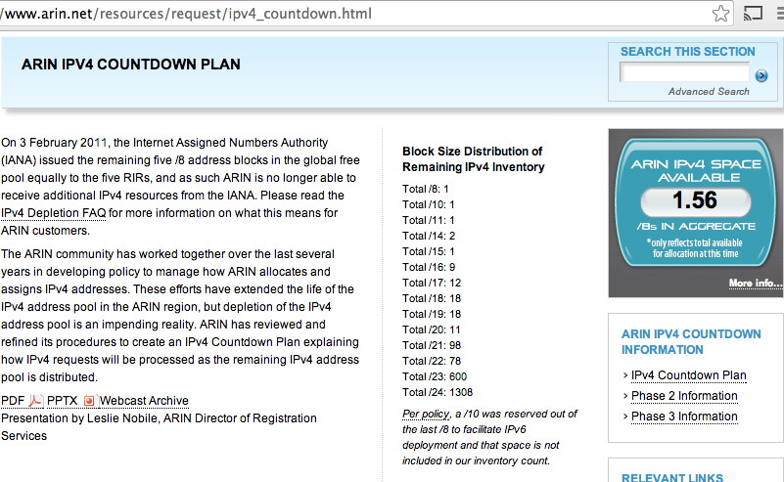
A Brief Diversion: IPv4 Address Space
Let's assume for a second that growth in devices continues to increase. Will you have enough address space? If you need more address space you better be thinking about it now because ARIN, the regional Internet registry is just about out of space:

Slide 23
Are You Thinking About IPv6?
Even though we're almost out of IPv4 space, there's plenty of IPv6 space available.
Are you even thinking about deploying IPv6?
If not, you should really should be.
But let's come back to the title of this session...

Slide 24
OMG, They're Inside The Walls! And/or OMG, They're NOT Inside The Walls!
Which do you really want?
One of the funny aspects about running any fortification (whether we're talking about a medieval castle, the Maginot Line in WW II, or a modern perimeter firewall) is that you're basically trying to balance two mutually conflicting objectives: -- the more people you've got "inside", the greater the chance that some of them may be untrustworthy, or infected and potentially contagious, or simply a drain on your limited support resources -- at the same time, you want to protect as much of your population as you can; if you leave them outside, they may get hammered.
Will one enclave be able to balance both those factors?

Slide 25
Multiple Enclaves?
Another possibility, if you wanted both the benefits of a firewalled environment yet you don't want to allow a large number of the "unwashed" "inside the walls" might be to use multiple enclaves -- one for high security assets, and another for routine user access.
These might be adjacent/peer enclaves, or nested enclaves, with the high security enclave contained within the encompassing lower security enclave.
Routine users who need to access the high security zone would presumably cross that boundary via a VPN or comparable solution.

Slide 26
Turning the Firewall Around?
One of my colleagues from Connecticut is fairly famous for having said that if he could only afford one firewall, he'd turn it around and use it to protect the rest of his world from his users.
Is THAT how we're supposed to be deploying these things? :-;
I suppose we'd have to call that a walled garden, not a firewall. Oh wait: some sites do have those, for dealing with botted users, vulnerable systems, etc., now don't they... If you had the ability to isolate a problematic user when they connected, would it be easier to expand who/how many users you allowed to connect?

Slide 27
Firewalls Can't Fix "Everything"
While firewalls can be great when it comes to blocking old fashioned scan-and-'sploit attacks, or things like brute force login attacks, they can't protect you and your users from everything. A perimeter firewall can't protect your network from a user who: -- plugs in an infected thumb drive or touches a tainted web site -- opens an infected attachment that his or her A/V product missed
Firewalls also can't protect your network if: -- the firewall is SUPPOSED to pass the traffic (e.g., web traffic to a web server, email traffic to an SMTP server, etc.), and you're not doing DPI -- the attack is a DDoS, particularly if the DDoS attack is actually trying to do state exhaustion on the firewall itself -- the traffic doesn't go near your firewall (example: 4G traffic) -- the traffic is encrypted -- your users take steps to intentionally circumvent the firewall

Slide 28
What About Running Without A Firewall?
Another alternative is to have no perimeter firewall at all. I know that this seems like running with scissors, but many universities with large networks do precisely this. Potential mitigating factors: -- Encourage use of non-MS Windows solutions since most malware targets MS Windows (or Android in the mobile world) -- Run a firewall on the device itself -- Make sure systems are patched up-to-date, including any/all browser helper applications (Secunia is terrific) -- Anti-virus isn't perfect, but can still help, so run it, too -- Don't install and run any publicly exposed network services -- Consider mitigating threats via DNS (example: OpenDNS.com) -- Instrument your network with an IDS (Snort, Bro, etc.) -- Make sure you have good abuse reporting contacts for your domain, netblocks, and autonomous system number -- Other things?

Slide 29
While We're Talking About Security...
Are there other security things you should be worried about instead of firewalls?
For example, given the increasing importance of the cloud, how are you doing identity management? And are you thinking about using something better than just plain old passwords? (e.g., multifactor authentication?)
Or, since so many people are doing so many things in the cloud that really require uninterruptable network access, is your connectivity fully redundant at every level? What's your target SLA for network availability?
Or how about IPv6? Is "security" holding up deploying that, too?

Slide 30
What Else Should We Have Talked About Today?
What did we miss? What questions do you still have?
Will you be more relaxed about this issue when you go back home, or are you leaving with more questions than you started with? I'd be happy either way!

